Slide 1
What is DevOps?

Slide 2
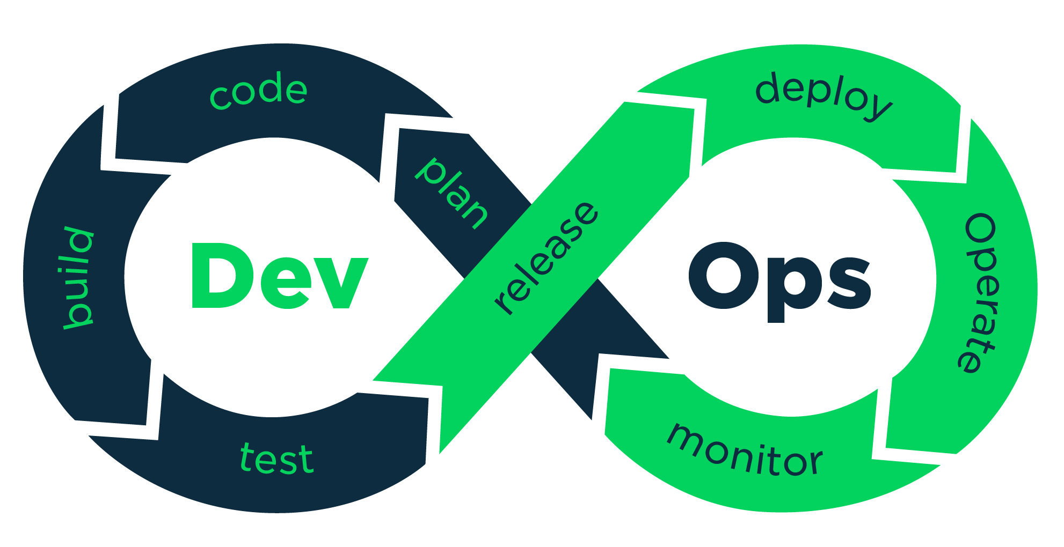
Devops is a software development methodology which improves the collaboration between developers and operations team using various automation tools. These automation tools are implemented using various stages which are a part of the Devops Lifecycle.

Slide 3
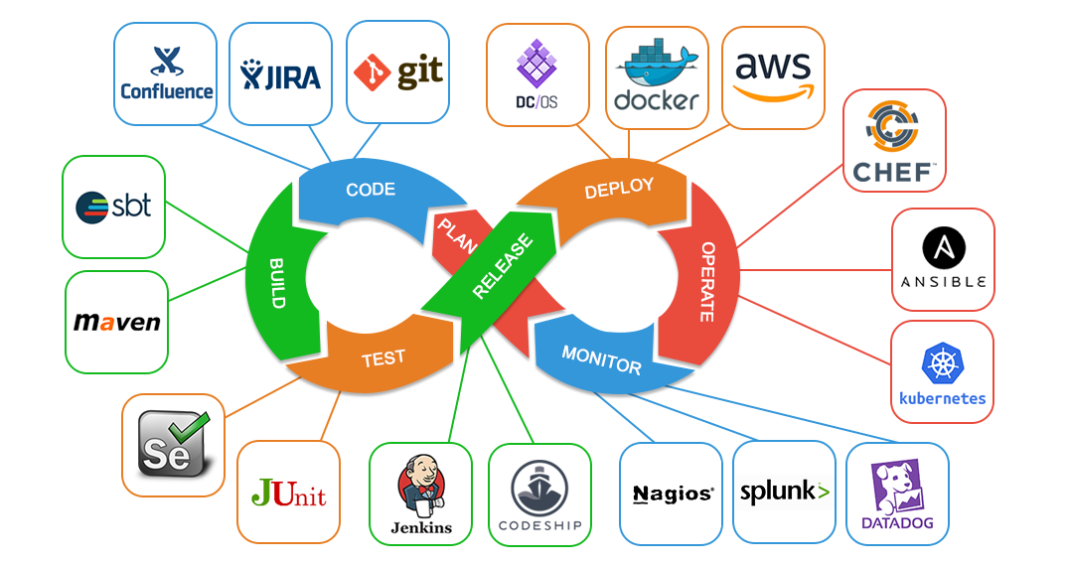
List of DevOps Practices

Slide 4
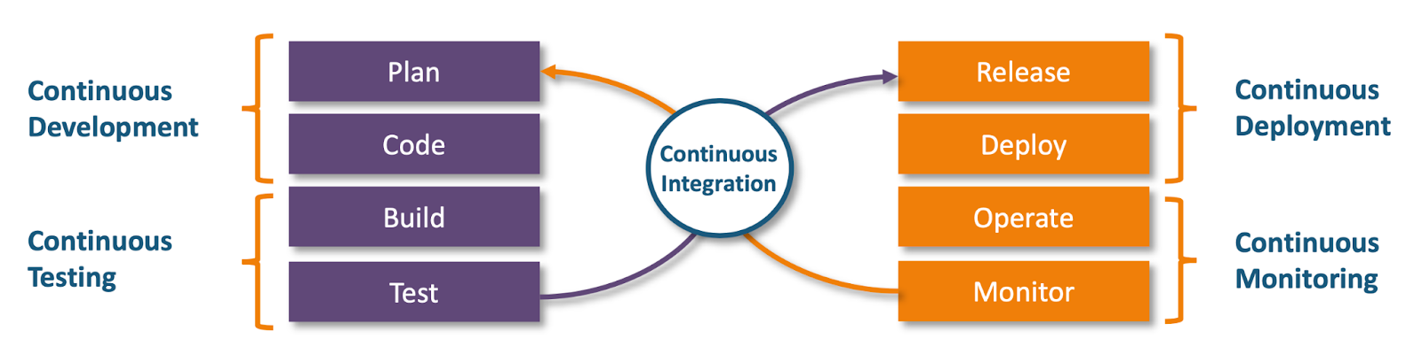
How DevOps Works?

Slide 5

How DevOps Works?
Continuous Development
This stage involves committing code to version control tools such as Git or SVN for maintaining the different versions of the code, and tools like Ant, Maven, Gradle for building/ packaging the code into an executable file that can be forwarded to the QAs for testing.
Continuous Integration
Continuous Deployment
Continuous Testing
Continuous Monitoring

Slide 6

How DevOps Works?
Continuous Development
The stage is a critical point in the whole Devops Lifecycle. It deals with integrating the different stages of the devops lifecycle, and is therefore the key in automating the whole Devops Process.
Continuous Integration
Continuous Deployment
Continuous Testing
Continuous Monitoring

Slide 7

How DevOps Works?
Continuous Development
In this stage the code is built, the environment or the application is containerized and is pushed on to the desired server. The key processes in this stage are Configuration Management, Virtualization and Containerization.
Continuous Integration
Continuous Deployment
Continuous Testing
Continuous Monitoring

Slide 8

How DevOps Works?
The stage deals with automated testing of the application pushed by the developer. If there is an error, the message is sent back to the integration tool, this tool in turn notifies the developer of the error. If the test was a success, the message is sent to Integration tool which pushes the build on the production server.
Continuous Development
Continuous Integration
Continuous Deployment
Continuous Testing
Continuous Monitoring

Slide 9

How DevOps Works?
Continuous Development
The stage continuously monitors the deployed application for bugs or crashes. It can also be setup to collect user feedback. The collected data is then sent to the developers to improve the application.
Continuous Integration
Continuous Deployment
Continuous Testing
Continuous Monitoring

Slide 10
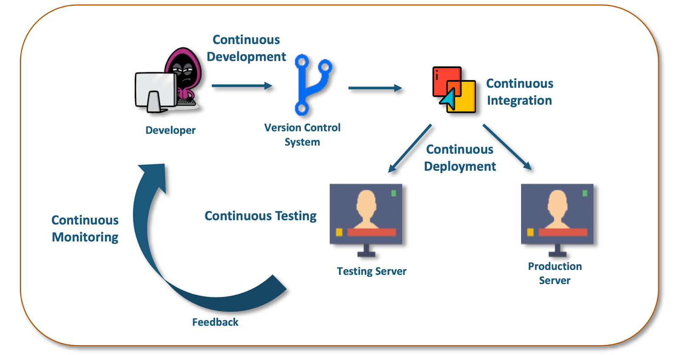
Automated CI/CD pipeline

Slide 11

DevOps Tools
Git is a distributed version-control system for tracking changes in computer files and coordinating work on those files among multiple people. It is primarily used for source-code management in software development, but it can be used to keep track of changes in any set of files.
Continuous Development
Continuous Integration
Continuous Deployment
Continuous Testing
Continuous Monitoring

Slide 12

DevOps Tools
Continuous Development
Jenkins is an open source automation server written in Java. Jenkins helps to automate the non-human part of the software development process, with continuous integration and facilitating technical aspects of continuous delivery
Continuous Integration
Continuous Deployment
Continuous Testing
Continuous Monitoring

Slide 13
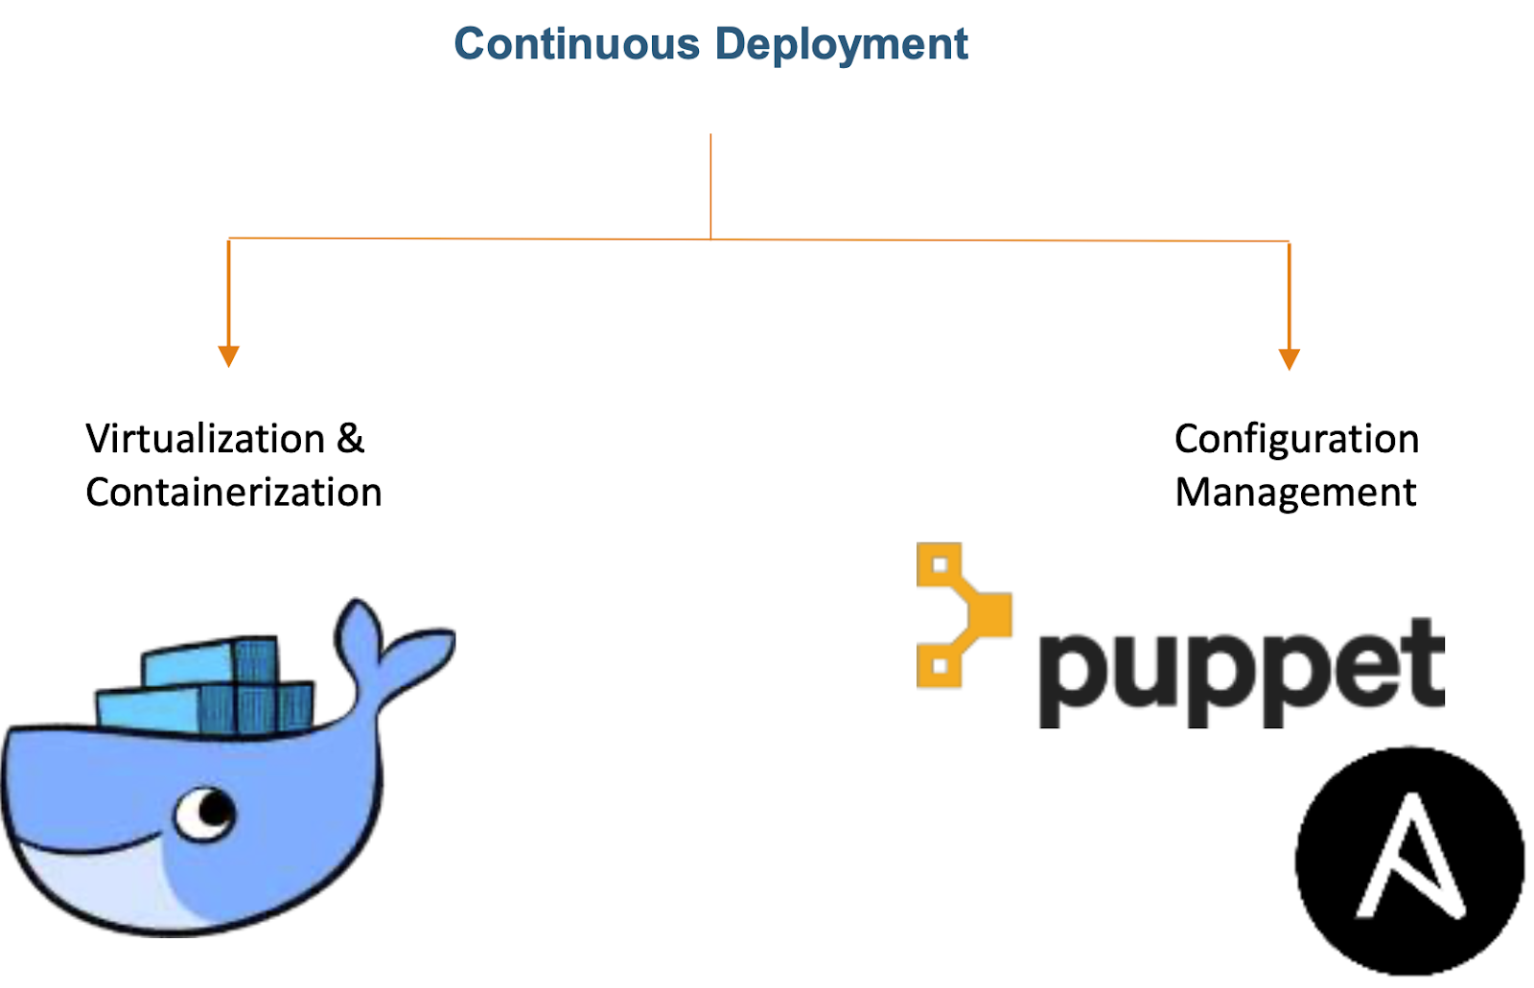
DevOps Tools
Continuous Development
Continuous Integration
Continuous Deployment
Continuous Testing
Continuous Monitoring

Slide 14

DevOps Tools
Selenium is a portable software-testing framework used for web applications. It is an open source tool which is used for automating the tests carried out on web browsers (Web applications are tested using any web browser).
Continuous Development
Continuous Integration
Continuous Deployment
Continuous Testing
Continuous Monitoring

Slide 15

DevOps Tools
Continuous Development
Nagios is an open-source devops tool which is used for monitoring systems, networks and infrastructure. It also offers monitoring and alerting services for any configurable event.
Continuous Integration
Continuous Deployment
Continuous Testing
Continuous Monitoring

Slide 16
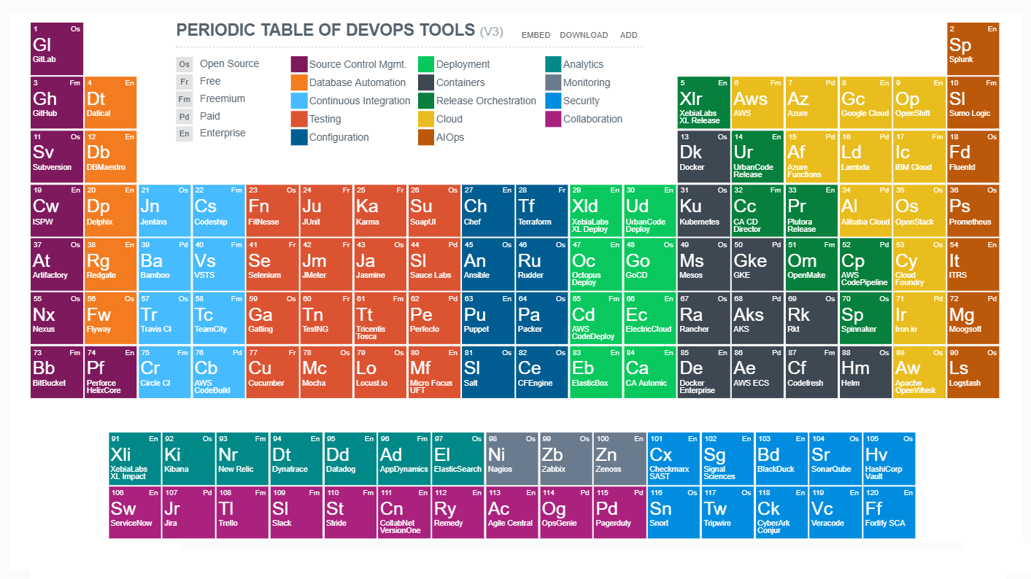

Slide 17
Who can be to DevOps engineer
System Administrators - who started to write scripts to automate the simple things
Technical Support - Engineers on technical support, who started to write scripts to automate simple things
From zero
To Hero

Slide 18
What knowledge to must-have
Understanding TCP/IP CIDR, Networking
Linux fundamentals (BASH, installing WebServers )
Windows (PowerShell, IIS, Domain)
Ansible
Git
Github, bitbucket or Gitlab
Jenkins
English
Cloud Platform (AWS, GCP, Azure)
IaC-Infrastructure as code (Terraform, CloudFormation)
Scripts on Python, Bash
Monitoring systems, logging, analyzing
Kubernetes, HELM
To be able to learn fast

Slide 19
DevOps is a good career of the future in IT Good Luck

