Slide 1

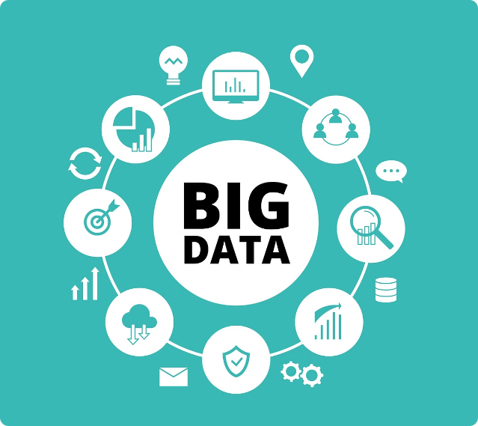
Big Data: Concepts and Technologies
In today's digital age, organizations are generating unprecedented volumes of data. This massive influx of information, known as Big Data, presents both opportunities and challenges. Understanding Big Data concepts and technologies is crucial for businesses looking to leverage this valuable asset and gain a competitive edge.

Slide 2

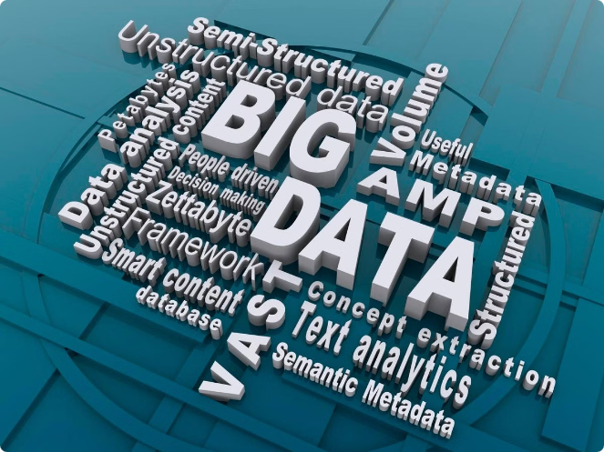
Introduction to Big Data
Big Data encompasses vast amounts of structured and unstructured data that are too large and complex for traditional data processing methods. It's characterized by the 5Vs: Volume, Velocity, Variety, Veracity, and Value. Volume refers to the sheer size of the data, Velocity denotes its speed of generation, and Variety encompasses its diverse formats. Veracity signifies the reliability and accuracy of the data, while Value highlights its potential to generate insights and create business value.
1
Data Lakes
A central repository for storing raw data in its native format, without pre-defined schemas. Data lakes facilitate data exploration and analysis without the need for upfront data transformations.
2
Data Warehousing
A structured data storage system designed for analytical processing. Data warehouses typically use relational databases (RDBMS) and focus on providing comprehensive, integrated, and historical data for decision-making.
3
ETL
Extract, Transform, and Load. An essential process for data integration, where data is extracted from source systems, transformed into a standardized format, and loaded into a target system, such as a data warehouse.
4
Data Streams
Continuously flowing data generated in real-time from various sources, such as sensor networks, social media platforms, and financial transactions.

Slide 3
Big Data Challenges
Managing and processing Big Data comes with unique challenges, including scalability, data quality, storage, and retrieval, data processing, security and privacy, and cost and infrastructure. Scalability refers to the ability of systems to handle increasing data volumes and processing demands. Ensuring data quality involves addressing issues like data inconsistencies, errors, and incompleteness.
Data Management
Data Processing
Security and Privacy
Storing and managing large volumes of data efficiently while maintaining data integrity and availability is a major challenge.
Big Data demands specialized processing techniques for real-time analysis and batch processing to handle the complexity and volume of data.
Protecting sensitive data from unauthorized access, breaches, and misuse is critical in Big Data environments.

Slide 4


Timeline of Big Data Technologies
The evolution of Big Data technologies can be traced back to the early days of data warehousing and relational databases. Over the past few decades, significant advancements have led to the development of powerful and scalable solutions for handling Big Data.
1
Early Developments (1990s)
The emergence of data warehousing and relational database management systems (RDBMS) laid the groundwork for managing large volumes of data. Techniques for scaling RDBMS were introduced to handle the growing data needs.
2
2000s
The introduction of Hadoop, a distributed file system and processing framework, revolutionized Big Data processing. MapReduce, a programming model for processing large datasets across clusters of computers, gained popularity.
3
2010s to Present
The rise of cloud computing and the emergence of technologies like Apache Spark, Apache Kafka, and NoSQL databases have transformed Big Data landscape. Cloud-based Big Data solutions have gained prominence, offering scalability, flexibility, and cost-effectiveness.

Slide 5

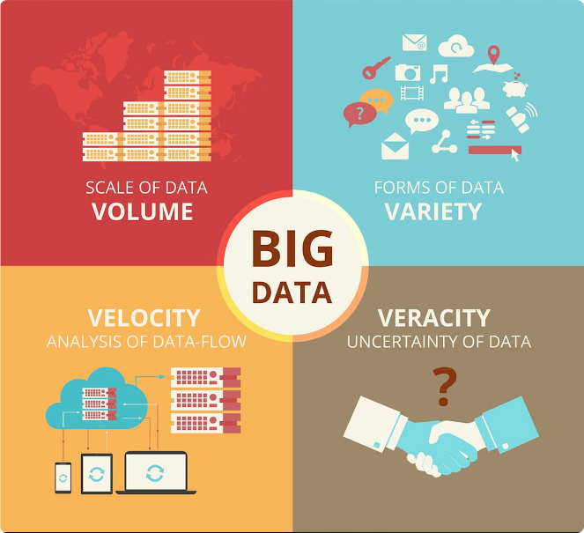
When to Use Big Data Technologies
Big Data technologies are valuable in situations involving high-volume data, complex data types, and the need for real-time analysis. However, it's important to consider factors such as cost, performance, ease of use, and ecosystem compatibility before adopting these technologies.
High Volume Data
Big Data technologies excel in handling massive datasets that exceed the capabilities of traditional data processing tools.
Complex Data Types
They are well-suited for processing diverse data formats, including structured, semi-structured, and unstructured data.
Real-time Analysis
Real-time processing frameworks enable organizations to gain insights from streaming data, enabling faster decision-making and action.

Slide 6

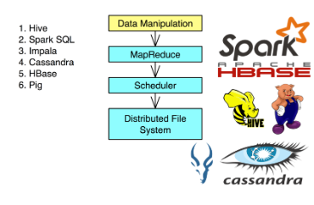
Overview of Big Data Tools and Technologies
Big Data technologies encompass a wide range of tools and frameworks designed for different purposes, such as data storage, processing, querying, streaming, and coordination. Choosing the right tools depends on specific requirements and use cases.
Data Storage
HDFS
Cassandra
HBase
Data Processing
MapReduce
Spark
Flink
Storm
Data Querying
Hive
Impala
Pig
Data Streaming
Kafka
Flink
Storm
Coordination & Management
Zookeeper
Oozie

Slide 7


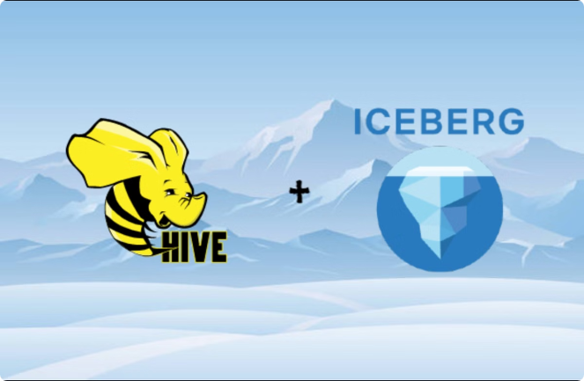



Detailed Tool Overview
Here's a detailed look at some key Big Data tools and their problem-solving capabilities. Each tool provides specific functionalities for addressing challenges in Big Data environments.
Hive
Simplified data querying for large datasets. Hive provides a SQL-like language for querying data stored in Hadoop. It simplifies complex queries and makes data analysis more accessible to users with SQL knowledge.
Zookeeper
Distributed coordination. Zookeeper serves as a central coordinator for distributed systems, ensuring consistency and synchronization across multiple nodes. It's crucial for managing distributed applications and handling complex interactions.
Kafka
High-throughput data streaming. Kafka is a distributed streaming platform designed for handling real-time data streams from various sources. It's used for building real-time data pipelines, event streaming, and message queuing systems.
MapReduce
Distributed batch processing. MapReduce is a programming model for processing large datasets across clusters of computers. It's well-suited for batch-oriented tasks, such as data analysis, reporting, and ETL processes.

Slide 8

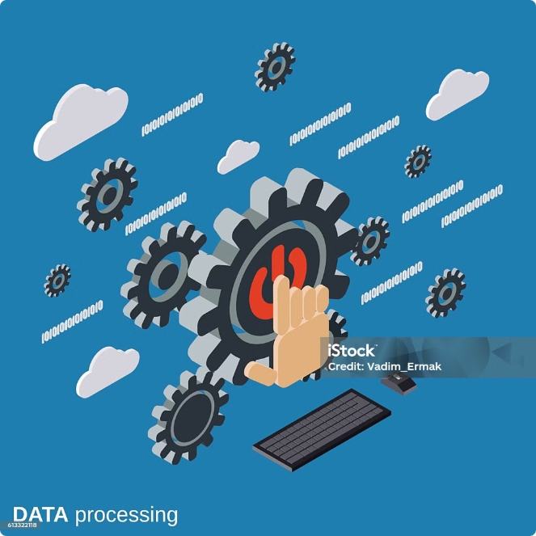




Alternate Technologies
Big Data technology landscapes are constantly evolving, with new solutions and advancements emerging frequently. Comparing and contrasting different technologies helps in making informed decisions for specific needs and use cases.
Kafka vs. RabbitMQ
Kafka and RabbitMQ are both message queueing systems, but Kafka is designed for high-throughput data streaming and real-time use cases, while RabbitMQ is more suitable for general-purpose messaging and asynchronous communication.
HDFS vs. S3
HDFS is a distributed file system for storing large datasets, while S3 is a cloud-based object storage service. Both provide scalability and high availability, but S3 offers broader integration with cloud services and greater flexibility.
Spark vs. Flink
Spark and Flink are both powerful data processing engines, but Spark is more versatile, supporting batch, streaming, and machine learning workloads, while Flink focuses primarily on streaming and real-time data processing.

