Slide 1

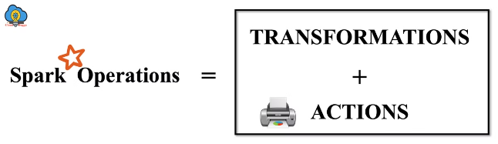
Introduction to RDDs
RDDs are the core of Spark, providing distributed, fault-tolerant, and immutable datasets. They can be created from external data sources or by transforming existing RDDs.

Slide 2
When to Use RDDs
Data Transformations
Custom Data Structures
Legacy Code
RDDs are ideal for performing transformations on large datasets, especially when dealing with complex operations.
If you need to work with data structures not natively supported by DataFrames, RDDs offer greater flexibility.
If you're working with existing code that relies on RDDs, there's no need to rewrite everything.

Slide 3

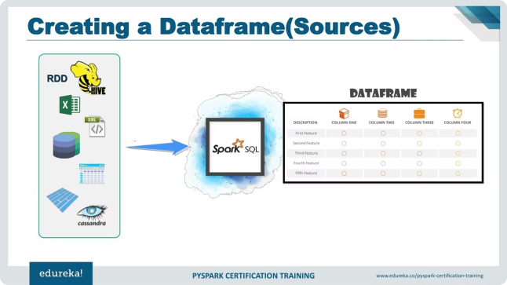
Pyspark DataFrames
DataFrames offer a more structured approach to working with data in Spark. They provide a columnar representation of data, making it easier to perform queries and analysis.
1
Columnar Data
2
SQL Integration
DataFrames store data in a columnar format, making it efficient for querying and analysis.
DataFrames support SQL-like queries, allowing you to leverage familiar SQL syntax for data manipulation.
3
High-Level APIs
Pyspark provides high-level APIs for interacting with DataFrames, simplifying data manipulation tasks.

Slide 4
Pyspark MLlib
MLlib is a machine learning library built on top of Spark. It provides a wide range of algorithms and tools for building machine learning models.
Classification
Regression
Clustering
Algorithms like Logistic Regression, Decision Trees, and Support Vector Machines.
Algorithms like Linear Regression, Decision Trees, and Random Forests.
Algorithms like K-Means, Gaussian Mixture Models, and LDA.

Slide 5
Spark Stack
The Spark stack consists of various components that work together to provide a comprehensive platform for data processing and analysis.
Spark Core
1
The foundation of Spark, providing the core functionalities for distributed computation.
2
Spark SQL
Extends Spark Core to support SQL queries and structured data processing.
Spark Streaming
3
Allows for real-time processing of streaming data, enabling near-instant analysis.
4
MLlib
Provides a machine learning library for building and deploying machine learning models.
GraphX
5
Enables efficient analysis and manipulation of graph-structured data.

Slide 6



Spark Components
Spark components can be categorized based on their roles and functionalities, making it easier to understand the overall architecture.
Category
Examples
Programming Languages
Scala, Java, Python, R
Libraries
Spark SQL, MLlib, GraphX, Spark Streaming
Engine
Spark Core
Cluster Management
YARN, Mesos, Standalone
Storage
HDFS, S3, Local Disk

Slide 7


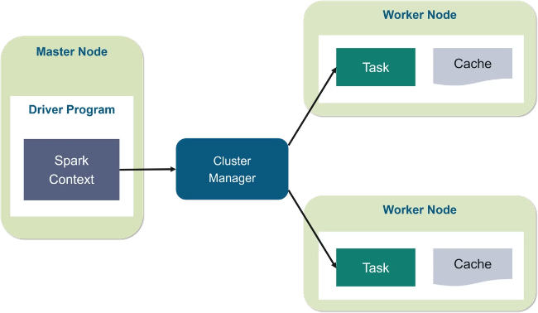
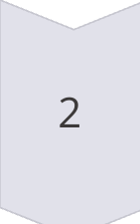
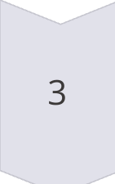
Spark Architecture
Spark architecture consists of key components that work together to distribute and execute applications across a cluster of machines.
Driver
Manages the application execution, sends tasks to executors, and collects results.
Cluster Manager
Responsible for allocating resources and launching executors on worker nodes.
Executor
Runs tasks assigned by the driver and communicates with the driver to send results.

Slide 8





Spark Deployment Modes
Spark offers various deployment modes to fit different cluster management and resource allocation needs.
Spark Standalone
Spark on Apache Mesos
Spark on Hadoop YARN
Spark on Amazon EC2
A simple deployment mode where Spark manages its own cluster resources.
Uses the Mesos cluster manager for resource allocation and scheduling.
Leverages YARN (Yet Another Resource Negotiator) for resource management in a Hadoop environment.
Deploys Spark applications on Amazon Elastic Compute Cloud (EC2) for scalable cloud computing.
Spark on Kubernetes
Utilizes Kubernetes for containerized deployment and resource management.

Slide 9
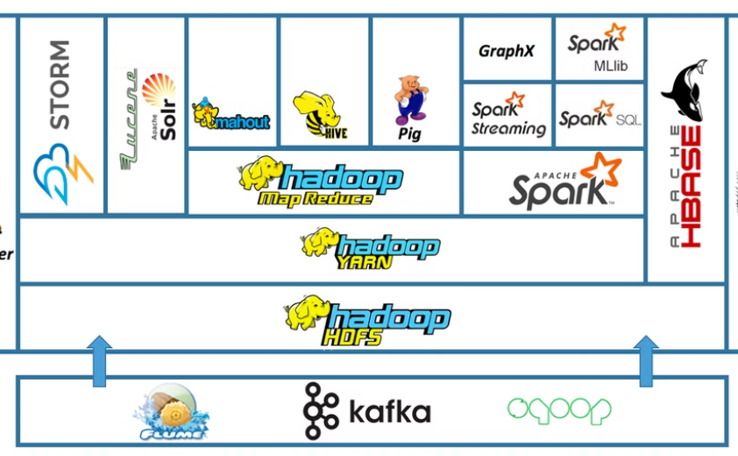
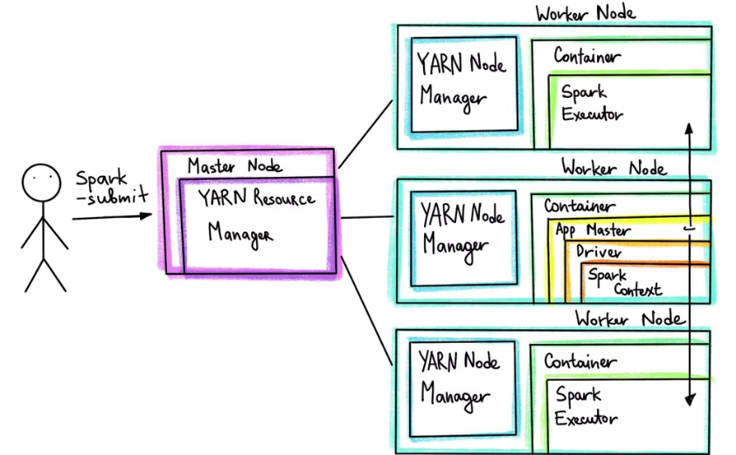
Running Spark Applications on YARN
YARN provides a resource management framework, enabling Spark applications to leverage resources within a Hadoop ecosystem.
YARN Architecture
Spark on YARN
YARN manages the resources and scheduling of applications running on a Hadoop cluster.
Spark utilizes YARN for resource management and scheduling, integrating seamlessly with the Hadoop environment.

