Slide 1


PySpark DataFrames: Introduction
PySpark DataFrames offer a powerful way to manipulate and analyze large datasets.

Slide 2

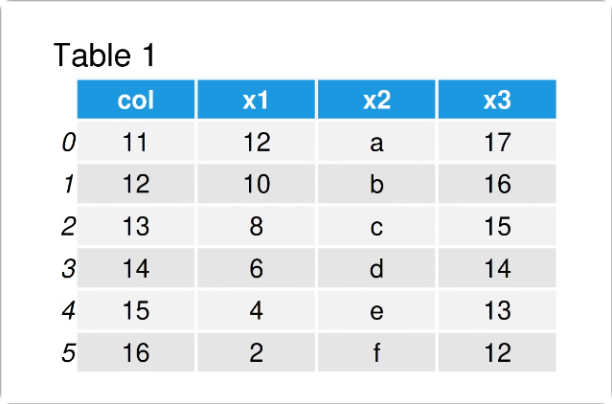
DataFrames: Powerful Collections
1
Organized Structure
Named columns for data organization
2
Similar to Tables
Relational database-like structure
3
Distributed Processing
Efficiently handle large datasets

Slide 3
Creating DataFrames
Existing RDDs
External Sources
List or Dictionary
Transform Resilient Distributed Datasets into DataFrames
Read data from files like CSV, JSON, Parquet, etc.
Create DataFrames directly from Python objects
spark.createDataFrame(rdd)
spark.read.csv("file.csv")
spark.createDataFrame(data)

Slide 4

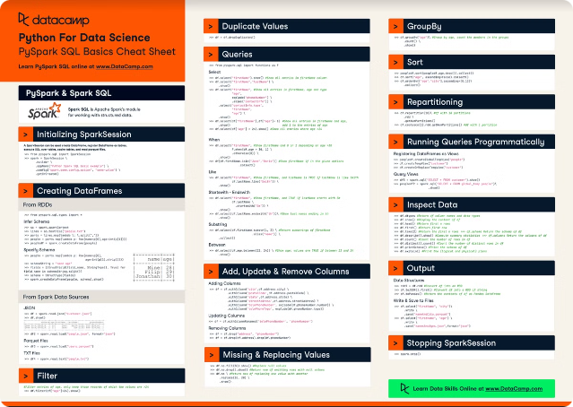
Basic Operations
Show
View the first 20 rows of your DataFrame
Describe
Generate summary statistics for each column
Schema
Display the data types and structure of your DataFrame

Slide 5





Filtering and Conditional Operations
Filter
Select rows based on specific conditions
Where
Similar to filter but offers enhanced readability
Conditional Statements
Create new columns based on complex conditions

Slide 6

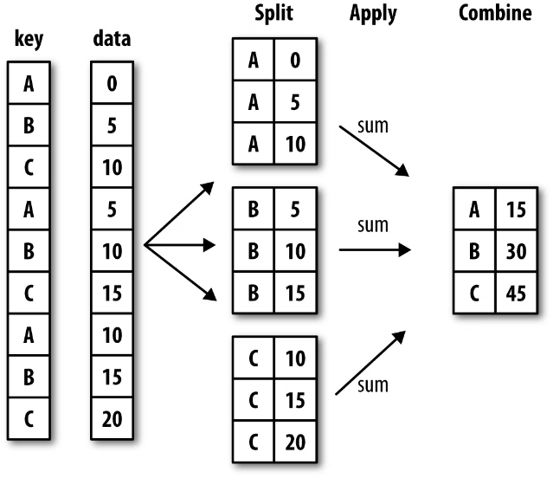
Aggregation and Grouping
GroupBy
Group rows based on a column
Aggregation
Apply functions like sum, average, or count
Multiple Aggregations
Perform multiple aggregation functions simultaneously

Slide 7

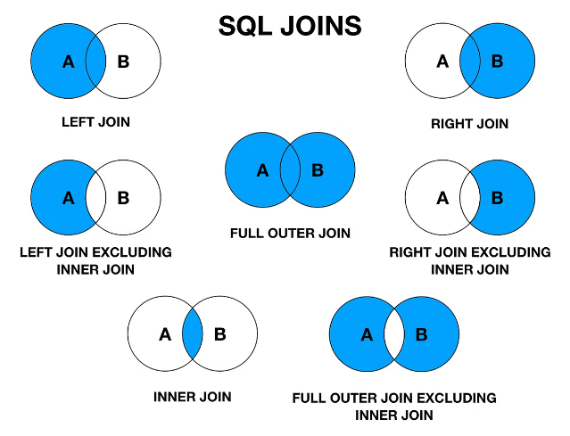


Joins and Merging
Join Types
Inner, Left, Right, Full Outer joins
Merging
Combine two DataFrames with the same schema

Slide 8


Performance Optimization
1
Caching
Store DataFrames in memory for faster access
2
Repartitioning
Distribute data across partitions for optimal performance
3
Broadcast Joins
Optimize joins by broadcasting a small DataFrame

