Slide 1
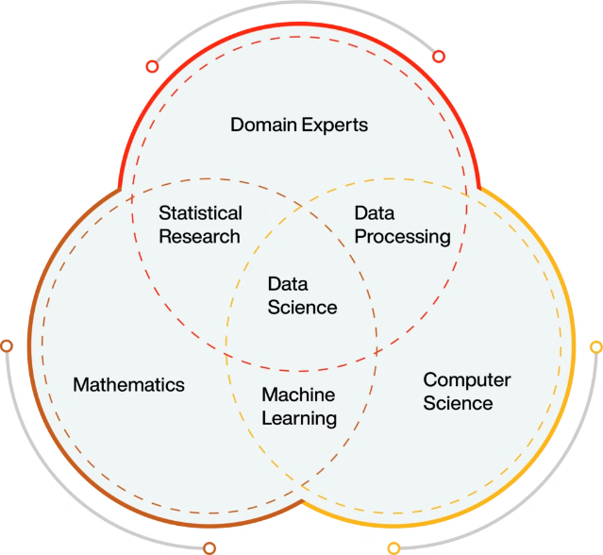
PySpark MLlib: Scalable Machine Learning
Discover the power of PySpark MLlib, a scalable machine learning library that enables high-performance data processing and advanced analytics on big data.

Slide 2
MLlib Algorithms
Classification
Regression
Clustering
Logistic regression, decision trees, and more.
Linear regression, random forests, and more.
K-means, Gaussian mixture models, and more.

Slide 3

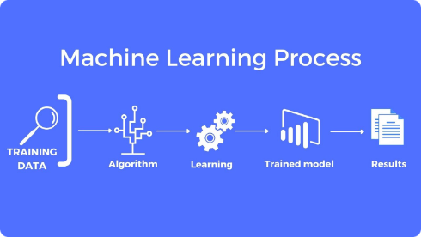
MLlib Estimators
Create
Evaluate
Define machine learning estimators.
Assess model performance.
1
2
3
Train
Fit estimators to your data.

Slide 4

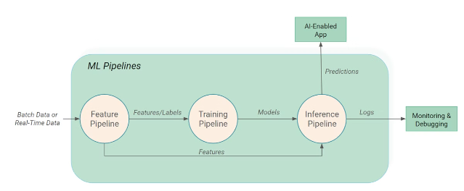
MLlib Pipelines
Chaining Estimators
Build complex workflows by connecting multiple estimators.
Optimization
Tune and refine your pipeline for optimal performance.
Scalability
Leverage Spark's distributed processing power.

Slide 5

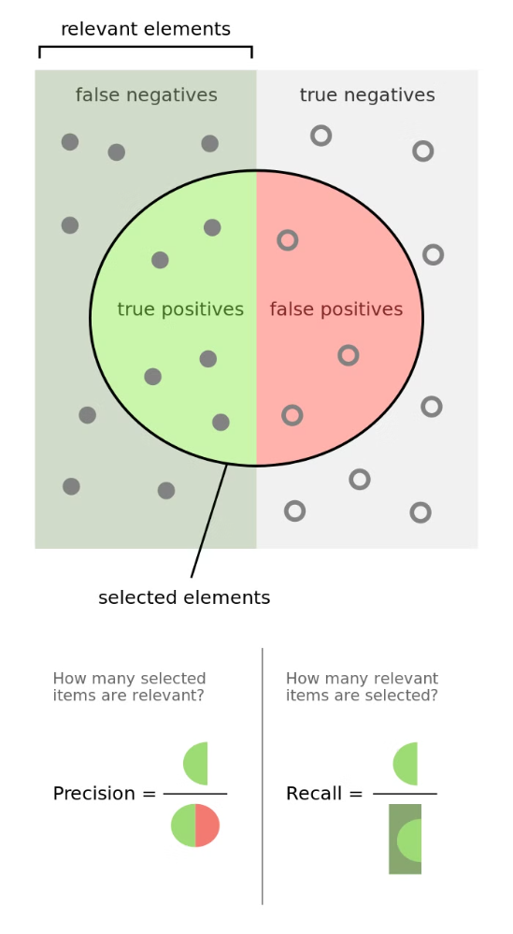
MLlib Model Evaluation
1
Accuracy
Measure how well your model predicts the target.
2
Precision
Assess the reliability of your model's positive predictions.
3
Recall
Determine how many positive instances your model identifies.

Slide 6


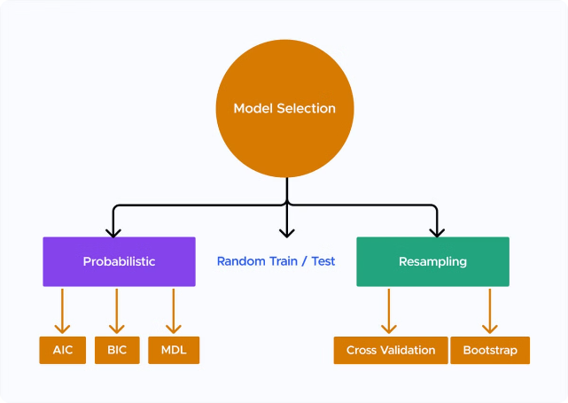


MLlib Model Selection
Hyperparameter Tuning
Optimize model parameters for best performance.
Model Comparison
Evaluate and select the most suitable model.
Cross-Validation
Ensure robust and unbiased model evaluation.

Slide 7

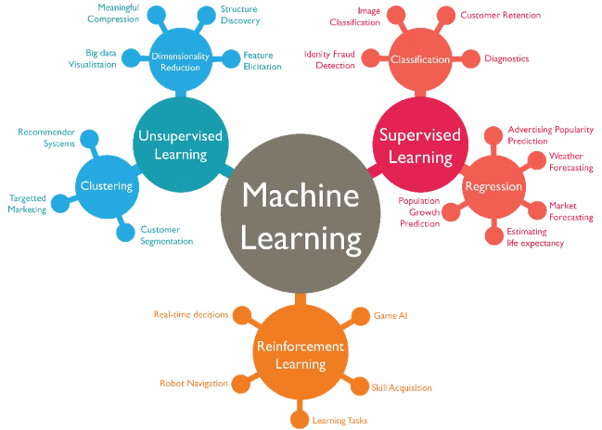


MLlib Advanced Topics
Deep Learning
Leverage powerful neural network models.
NLP
Analyze and process textual data.
Time Series
Model and forecast temporal data.

Slide 8

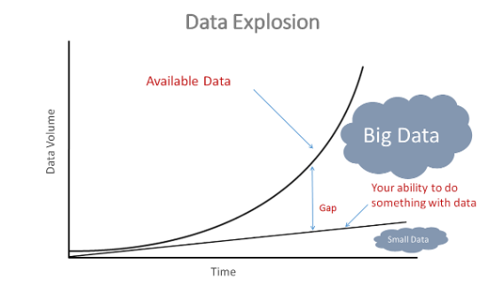
Mastering PySpark MLlib
Unlock the full potential of big data machine learning with PySpark MLlib. Explore advanced techniques and stay at the forefront of the rapidly evolving field of data science.

