Slide 1

SIGN LANGUAGE DEPLOYMENT ON VERSAL VCK190
By Sasya Merugu

Slide 2

OBJECTIVE
Deploy an Indian Sign Language (ISL) alphabet recognition model on the AMD Versal VCK190 platform using the Vitis AI workflow
Input: Hand sign image
Output: Predicted ISL alphabet (A–Z)
Target Hardware: AMD Versal VCK190
Dataset: https://github.com/ayeshatasnim-h/Indian-Sign-Language-dataset

Slide 3
TRAINING STAGE: TRANSFER LEARNING & FINE-TUNING
Model Architecture & Layer Freezing
Pretrained Backbone: A ResNet18 model was loaded using models.ResNet18_Weights.DEFAULT. The pretrained weights were obtained from ImageNet and already contained robust, learned visual features.
Layer Freezing Strategy: To retain fundamental low-level visual features while reducing training time, layers 1 through 3 were frozen (requires_grad = False). Only the weights in layer4 and the final classification layer were left trainable (requires_grad = True).
Custom Classifier: The original ResNet18 classifier produces outputs for 1000 ImageNet classes. The final fully connected layer (model.fc) was replaced with a new linear layer dynamically mapped to the number of classes in the Indian Sign Language (ISL) dataset (26 classes):

Slide 4
Optimization & Learning Rate Scheduling
Loss Function: The model was fine-tuned on the ISL dataset using Cross-Entropy Loss (nn.CrossEntropyLoss()).
Optimizer: The Adam optimizer was utilized with an initial learning rate of 0.001. It was explicitly filtered to optimize only the parameters with tracking gradients enabled:
Learning Rate Scheduler: To prevent convergence plateaus, a ReduceLROnPlateau scheduler monitored the validation accuracy. If validation accuracy stalled for 3 consecutive epochs (patience=3), the scheduler automatically reduced the learning rate by half (factor=0.5).

Slide 5
Training Execution & Checkpoint Saving
Training Loop: The model was trained on the CPU over 30 epochs using a batch size of 32.
Validation & Saving: At the end of each epoch, validation accuracy was computed. The model configuration with the highest validation accuracy was progressively tracked and saved to the designated file path:
Final Evaluation: After completing all epochs, the best performing checkpoint (isl_resnet18.pth) was reloaded and evaluated on the held-out test dataset, ultimately achieving a test accuracy of approximately 99.69%

Slide 6
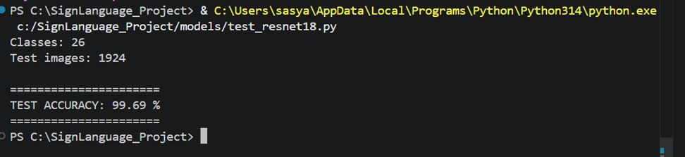
OUTPUT

Slide 7
WORKFLOW
ISL Dataset
↓
Train ResNet18 (FP32)
↓
FP32 Model (.pth)
↓
Vitis AI Quantization (INT8)
↓
Quantized Model
↓
Vitis AI Compiler (VCK190 DPU)
↓
resnet18_isl.xmodel
↓
Deployment on VCK190
↓
Real-time Sign Language Inference

Slide 8
Quantization
The VCK190 DPU is optimized for INT8 inference. Quantization converts the trained FP32 ResNet18 model into an INT8 model for efficient execution on the AMD VCK190 DPU.
A representative calibration dataset was used to determine the activation ranges and compute scaling factors, enabling the conversion of FP32 weights and activations to INT8 with minimal accuracy loss.
The resulting INT8 model was then compiled using Vitis-AI compiler for execution on the VCK190 DPU.

Slide 9
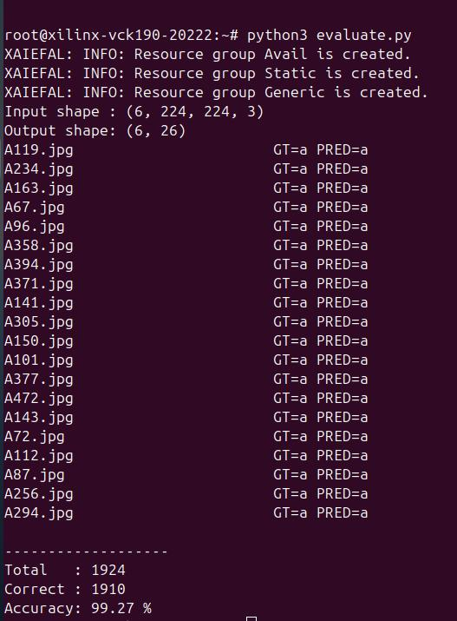
RESULT

Slide 10
CONCLUSION
The trained FP32 ResNet18 model achieved 99.69% accuracy. After INT8 quantization and deployment on the AMD VCK190, the model achieved 99.27% accuracy, resulting in only a 0.42% accuracy drop.
This demonstrates that INT8 quantization preserved model accuracy while enabling efficient execution on the VCK190 DPU.

Slide 11
THANK YOU

