Slide 1
USFDA 483 records observation analysis
-Satyadev Subudhi

Slide 2
CONTENTS
Introduction
Problems Solved
Benefits
Methodology
Top Summaries from each Cluster
Future Work

Slide 3
Introduction
In India there are 3000+ pharma companies & USA is the biggest consumer of Indian pharmaceuticals companies. The USFDA conducts regular audits of global companies to ensure compliance with safety and quality standards. When violations are found, they issue Form 483 to prompt corrective actions, maintain public safety, and ensure adherence to regulations.
Notes:
India has 3000+ pharmaceutical companies, with the USA being the biggest consumer.The USFDA conducts regular audits to ensure compliance with safety and quality standards.when violations are found Form 483 is issued to maintain public safety and adherence to regulations. SO our main focus will be on summarizing the observations into different categories.

Slide 4
What problems are we solving?
Automating data processing: Eliminate the need for manual searching and downloading by automating the process
Leveraging Machine Learning: Extract insights from the data using ML for a more comprehensive understanding.
Centralized and categorized view: Provide a summarized and categorized view of observations by company, offering a clear picture of inspection findings.
Notes:
Automating Data Processing: Eliminate manual searching and downloading by automating the process.Leveraging Machine Learning: Extract insights from data using ML for a comprehensive understanding.Centralized and Categorized View: Summarized and categorized observations by company.

Slide 5
Benefits
Save time and effort: Free up valuable resources by automating manual tasks.
Improved data quality: Ensure consistent and accurate data collection and categorization.
Enhanced insights: Gain valuable insights from USFDA inspections for better decision-making.
Digitized format: Facilitate further training and improve quality compliance across different areas.
Notes:
Save time and effort by automating manual tasks.Ensure consistent and accurate data collection and categorization.Gain valuable insights for better decision-making.Digitized format for further training and quality compliance improvement.

Slide 6
Two Observations FOR REFERENCE
The automatic visual inspection machine was used to usually inspect commercial patches for the of market for clear and amber vilas my to my in size for particles glass fragments fibres low high volume discoloured and empty vital s . Is part of a response to the May 2022 483 particles of known size were acquired to appropriately qualify the machine . During evaluation of the newly acquired known defect vilas on the automatic visual inspection machine the machine failed to reject all defective vilas using the existing commercial machine recipe . The existing machine recipe were found to be inadequate for further qualification work . There was no non investigation opened to evaluate the impact of this failure on previously released product within expire that used the deficient visual inspection process evaluate whether a field alert was necessary or evaluate the impact for the continuing use of the visual inspection equipment . Despite the failure of the existing recipe during challenge tests the same instrument recipe were used in continuing visual inspection until October 13 2022 for patches released to the of market . a . After the my amber vilas failed the challenge test using the commercial machine recipe rejecting and of the defective vilas on July 6 2022 the same deficient machine recipe continued to be used for visual inspection of Injection my patches that were shipped to the of market . b . After the my amber vilas failed the challenge test using the commercial machine recipe rejecting and of the defective vilas on July 12 2022 the same deficient machine recipe continued to be used for visual inspection of Injection my patches that were shipped to the of market . c . After the my clear vilas failed the challenge test using the commercial machine recipe rejecting and of the defective vilas on September 11 2022 the same deficient machine recipe continued to be used for vise al inspection of Injection my patches that were shipped to the of market . d . To challenge tests using the existing machine recipe were initiated for other vital configuration for of market products inspected with the including my fill in my clear vilas used for Injection my fill in my clear vilas for Injection and my fill in my clear vilas for Injection .
Equipment and utensils are not cleaned and maintained at appropriate intervals to prevent contamination that would alter the safety identity strength quality or purity of the drug product . 1 . He observed change parts for the filling and tapping lines were damaged in ways that may generate articulate or make them difficult to clean . Change parts were observed entrusted with black brown and color materials . The details are included as follows a . on Filling Machine His change part is installed on filling line . It was observed entrusted in parts with brown and black color spots cracked whipped scratch marks and rough surface due to damage to the on many areas while it was ragged in CLEANED status . Upon wiping areas of this change part using clean white color wiped we observed stains of black and color materials on the wiped . b . Filling machine These change parts are installed on filling line . These were observed entrusted in parts with brown and black color spots cracked whipped scratch marks and rough surface due to damage on the on many areas while it was ragged in CLEANED status . Upon wiping areas of this change parts using clean white color wiped we observed stains of black and colors materials on the wiped . c . Filling machine His change part is installed on filling line and used for carrying vilas town rd It was observed cracked whipped and entrusted in parts with brown and black color stains on many areas while ragged in CLEANED status . d . Tapping machine along with guide These change parts are installed on filling line . These were observed entrusted in parts with brown and black color spots scratch marks and rough surface due to damage of the on many areas while these were ragged in CLEANED status . e . towards tapping machine His change part is installed on filling line . It was observed entrusted in parts with brown and black color spots cracked whipped scratch marks and rough surface due to damage to the on many areas while it was ragged in CLEANED status . f . Filling machine and guide my These change parts are installed on filling line . These were observed entrusted in parts with brown and black color spots cracked whipped scar th marks and rough surface due to damage to the on many areas while these were ragged in CLEANED status . g . Filling machine His change part is installed on filling line . It was observed entrusted in parts i th brown and black color spots cracked whipped scratch marks and rough surface due to damage to the on many areas while it was ragged in CLEANED status . h . Filling machine His change part is installed on filling line . It was observed cracked whipped scratch marks and rough surface on many areas while it was ragged in CLEANED status . i . Filling machine His change part is installed on the filling line . It was observed to have chips and a rough surface . Areas on the had an unknown sticky substance . 2 . He observed defects on your line filling machine EQP 57 while it was ragged in CLEANED status on January 26 2023
Original Content Length : 8209 Words or two Pages
Original Content Length : 5027 Words or one & half pages
Notes:
So to show you how time consuming the data processing part can be here are 2 examples of 483 observation. It would take a lot of time and effort for a human to manually go through them.
So here are Examples of 2 observs in 483 records to illustrate how big they are and how much time and effort it would take for a human to review them

Slide 7
How did I achieve this?
Data Collection
Data Cleaning
Generating summaries
Converting It to Vector
Feeding it to ML Model
Data is gathered from the official website of FDA which includes links to Form 483 inspection records for various companies.
Extracted data is processed to enhance its quality for analysis which includes removal of irrelevant characters and text.
Reducing the length of observations by removing redundant data and extracting phrases that highlight major issues.
Summarized text is transformed into a numerical representation suitable for machine learning models.
The vector is fed into a k-means clustering model. This model groups similar summaries together based on their content.
Notes:
The data is collected from the official website of FDA which has links to form 483 of companies all across the world. The data is then filtered for Indian companies and the observations are extracted. The observations from these records is extracted using pypdf. The extracted data is cleaned to improve qualitt that is removal of irrelevant characters. The next step involves generating summaries out of these observations to extract important phrases. The sum
If we have a better source definitely the outputs would be better. Not everything can be solved by machines, human interventions at some places is not a bad idea.

Slide 8
Summarization method
The summarization method using the facebook/bart-large-cnn model works as follows:
Input: You provide a long piece of text that you want to summarize.
Processing: The BART model, which is a type of neural network, processes this text. It uses patterns it learned during training to understand the important parts of the text.
Output Summary: The model then generates a shorter version of the text, capturing the main points and key information.
This method helps in quickly understanding the gist of long texts without reading everything in detail.
Notes:
Bidirectional autoregressive transformer is a type of neural network architechture developed by facebook which has been trained on huge data like wikipidea, books, journals etc. for performing various nlp task like translation, comprehension,removing noise in sequence translation. For our project it is used for summarization task.

Slide 9
Clustering
Clustering is grouping of data points that are similar to each other based on their relation to surrounding data points. Clustering is especially useful for exploring data you know nothing about.
There are various types of it. For our project, I have used K-Means Algorithm which separates data based on multiple centroids and is the most commonly used algorithm for small data.
Notes:
Clustering is a way to group similar data together and there are various methods to achieve this. I have implemented K-Means model which is most commonly used unsupervised algo for small data. How it works? First k centroids are assigned randomly. The Euclidian distance of each data point is calculated from each of these centroids. For a particular data point, the cluster group is decided by the centroid closest to it. After all points have been assigned to a cluster, the centroids of each cluster is recalculated with the points in that group. The process repeats until there is no change in the cluster group points.

Slide 10
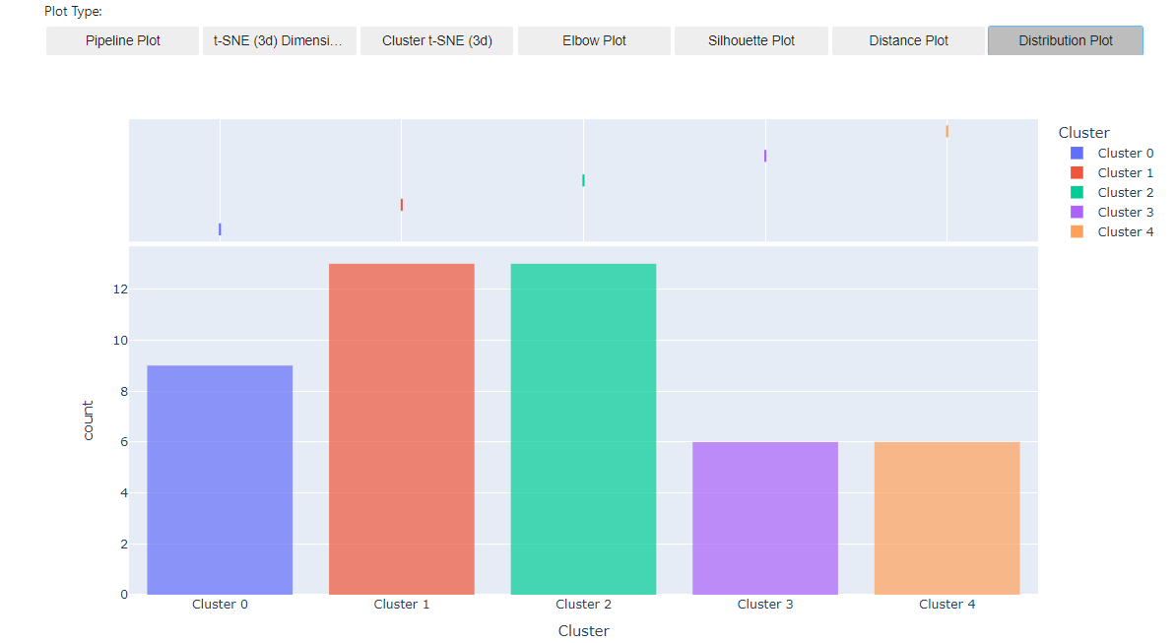
Notes:
This distribution plot shows frequency of summaries in each cluster. We can see that summaries in cluster 0,1,2 are important as they have high occurrence.
We can see that a large number of summaries are in cluster numb 0,1,2 denoting that those clusters are important.

Slide 11
Cluster 0
Summary | Company_name | Cluster
The inflow study conducted on In Protocol Document 00315 00 effective June 05 2021 under dynamic conditions did not demonstrate inflow during I b C intervention. Procedures designed to prevent contamination of mug products importing to be sterile did not include adequate variation of the aseptic process. | Zydus Lifesciences Limited | Cluster 0
Each lot of Controlled Reserve Retain samples of dig products is not examined at least once a year for the evidence of and physical defects. The limited number selected for the annual purification are the only ones that are verified throughout the products shelf life. | Sun Pharmaceutical Industries Limited | Cluster 0
Procedures designed to prevent contamination of mug products importing to be sterile are not established and followed. Effectiveness of disinfectant solutions was also not evacuated on material noted as all which is the . Of h b ll h old . 1 h by 4 eaten. | Eugia Steriles Private Limited | Cluster 0
During set up and aseptic filling of Injection batch of market on January 20 2024 the following was observed. Procedures designed to prevent contamination of mug products importing to be sterile are not established and followed. The operator did not first their hands before entering the filling barrier. | Eugia Pharma Specialities Limited | Cluster 0
Procedures designed to prevent contamination of drug products supporting to be sterile are not established. For example during batch the time between smiling and the end of was approximately 11 hour ere is no smiling data from the holding tank. | Baxter Pharmaceuticals India Pvt Ltd | Cluster 0
Notes:
We can see that the summaries the model grouped into a cluster are actually similar. For cluster 0, the summaries have words like contamination, sterile etc. mainly focusing on contamination in drugs.
Lets look at summaries the model grouped together in cluster 0. We can see these are inspections related to contaminamination in products.
The model is doing a pretty good job in groupin the summaries together.

Slide 12
Cluster 1
Summary | Company_name | Cluster
The responsibilities and procedures applicable to the quality control unit are not fully followed. Your firm failed to follow document control procedures. For example during the walk through of the stability chambers drug substances located in the by l the warehouse Knit e observed an uncontrolled SAMPLE LOCATION CHART. | Cipla, Ltd. | Cluster 1
The responsibilities and procedures applicable to the quality control unit are not in writing and fully followed. The Quality Knit has given an access to employees across the site to all documents on which allows employees of other departments to print controlled documents unrelated to their respective departure it. The lack of an issued violates the film s of 018075 for form issuance. | Sun Pharmaceutical Industries Limited | Cluster 1
The Quality Knit has failed to investigate Product Quality Complaints thoroughly. Procedures describing the handling of written and oral complaints related to drug products are efficiently written or followed. For example t user Of . Your nm restricted s trend evaluation for a period of b only while you marked drug products into the of. | Sun Pharmaceutical Industries Limited | Cluster 1
Your firm failed to establish adequate written or procedures for production and process controls. Review of completed visual inspection records found more units were inspected in the document time periods than would have been reasonably possible if the procedure had been followed. The acceptance criterion for light intensity during visual inspection was changed from to not less than klux for all products. | Baxter Pharmaceuticals India Pvt Ltd | Cluster 1
The responsibilities and procedures applicable to the quality control unit are not in writing and fully followed. One or more of your laboratory instruments do not have adequate control. For example your analytical balances neither have audit trail capabilities nor measured weights 4 . ted. | Jubilant Generics Limited | Cluster 1
Notes:
Similarly in cluster 1 focuses on quality control procedures
Simi the summms in clust 1 highlight that there are flaws in quality and document control procedures.

Slide 13
Cluster 2
Summary | Company_name | Cluster
Clean room and aseptic behaviour not followed to ensure sterilised components are only contracted with sterile forceps. Aseptic manipulations are performed from the side so as not to dismay the lamina air flow. | Zydus Lifesciences Limited | Cluster 2
equipment and utensils are not cleaned and maintained at appropriate intervals to prevent contamination n that would alter the safety identity strength or purity of the drug product. 1 by ill on line observed to have scratches rough surfaces and small pieces that were not fully attached during aseptic filling of cry j late lb April 19 2024. | Zydus Lifesciences Limited | Cluster 2
Equipment and utensils are not cleaned and maintained at appropriate intervals to prevent contamination that would alter the safety identity strength quality or purity of the dog product. The accumulation of stagnant liquid may have occurred after the last preventive maintenance of 13 Act 4 42023 due to leakage of water. | Sun Pharmaceutical Industries Limited | Cluster 2
Equipment and utensils are not cleaned and maintained at appropriate intervals to prevent contains ton that would alter the safety identity strength quality or purity the drug product. The li is white in color . Add Continuation Age | Cipla Limited | Cluster 2
Equipment used in the manufacture processing packing or holding of drug products is not of appropriate design to facilitate operations for its intended use and cleaning and maintenance. Filling rooms and tapping rooms for both the and filling lines used for of market product are not designed to permit operator s to move freely to required areas. | Baxter Pharmaceuticals India Pvt Ltd | Cluster 2
Notes:
Cluster 2 summaries focuses on protocols of maintenance and cleaning of equipments.

Slide 14
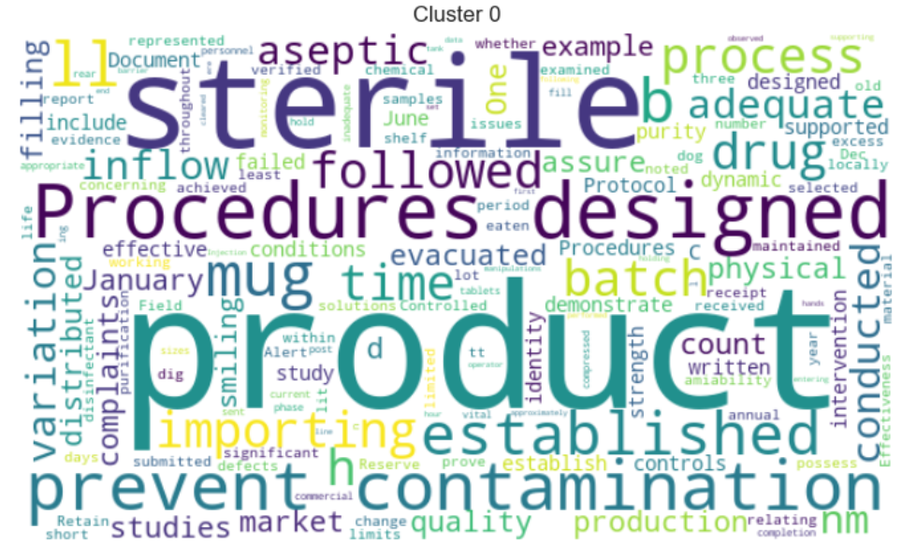
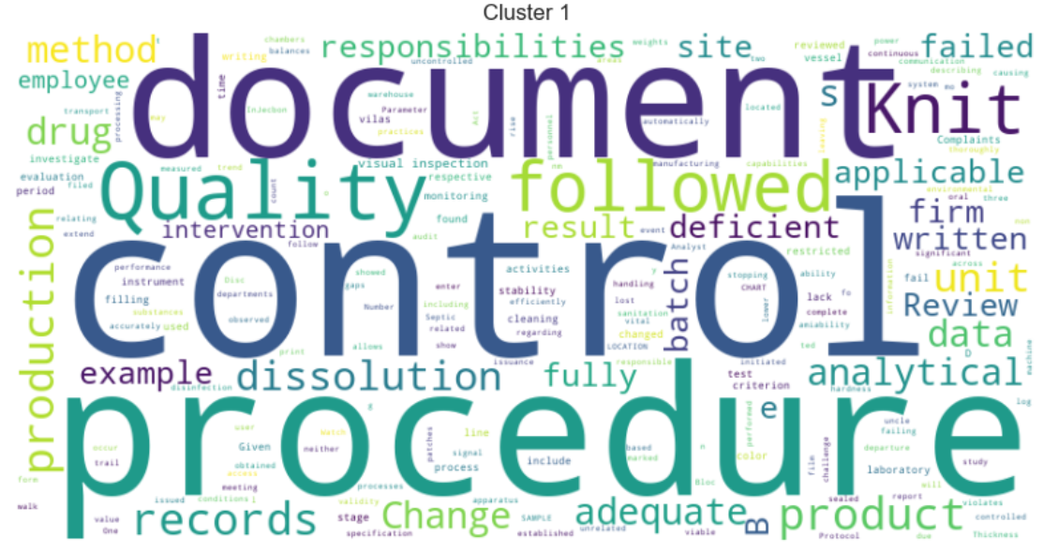
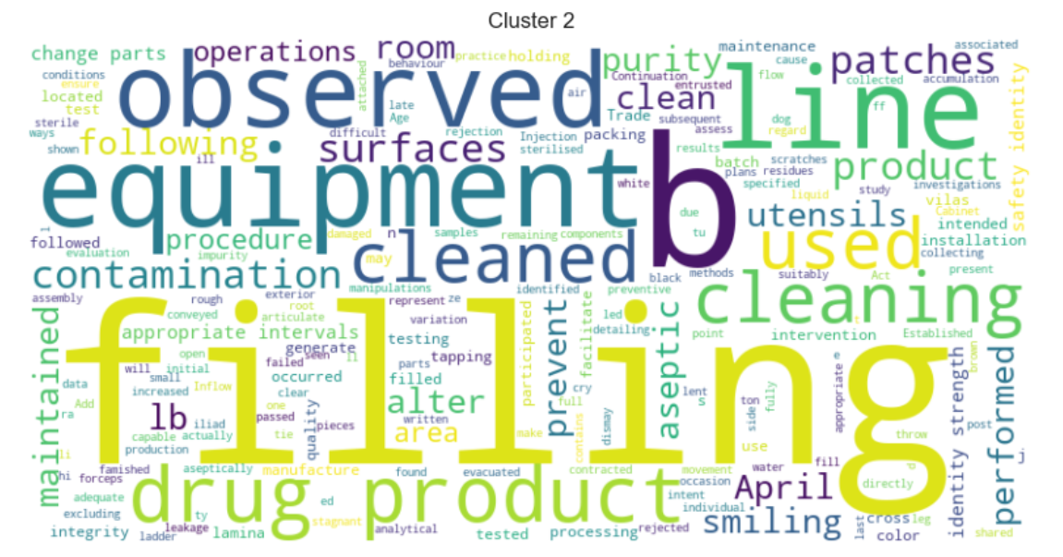
Word cloud of various clusters
Notes:
These images represent what is known as word cloud. The bigger the font size of certain word the more frequent it has occurred in the cluster.
These images show what words have occurred more frequently in the sample of input.
So we can see the summaries in cluster 0 focuses mostly on aspects like contamination and sterile products. Cluster 1 focuses on quality Unit details, and document control procedure. Cluster 2 focuses on cleaning equipments and maintenance.

Slide 15
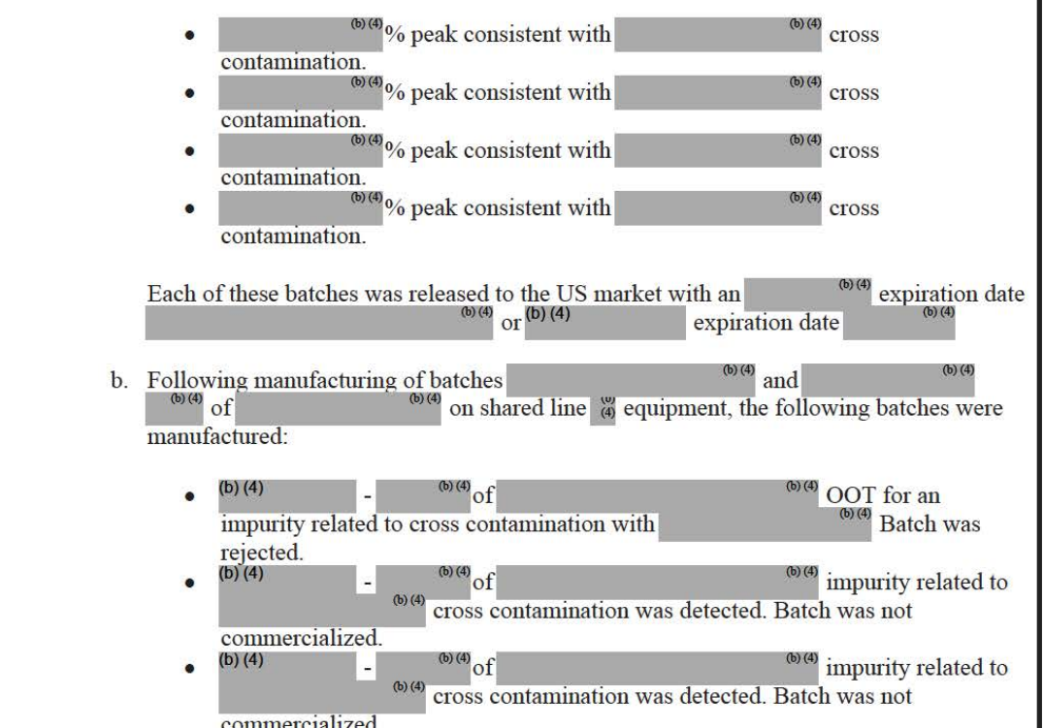
Challenges that I faced
As u can see there are some highlighted areas in the observation records which causes text extraction using PyPDF to convert text inaccurately. We need a better way to completely eliminate this text as this will have its own different spacing.
Notes:
The source of data is not good for text extraction. As we can see there are shaded regions which causes improper text extractions from these records.
This affects the quality of data to be processed impacting the overall result. If we get a better source of data, the outputs will surely be better. A human review of these extracted text is needed for getting good output

Slide 16
What are the next steps
True potential can be delivered by developing an application around this data, where users can easily identify and compare categories or clusters as determined by both the system and human/SME input.
Use of different Un-supervised algorithms to group & summarize actual content for better accuracy & performance.
Use of multiple supervised clustering algorithm with labelled data will make prediction accurate. The same data can be used again for training/testing & validating that clustering is working as per the human level.

Slide 17
conclusion
The project not only optimizes the process of handling USFDA observations but also empowers the company with actionable insights, leading to improved quality management and regulatory compliance.
Notes:
The project optimizes the task of handling USFDA obs and also gives better insights on quality management and regulatory compliance

Slide 18
THANK YOU

