Slide 1
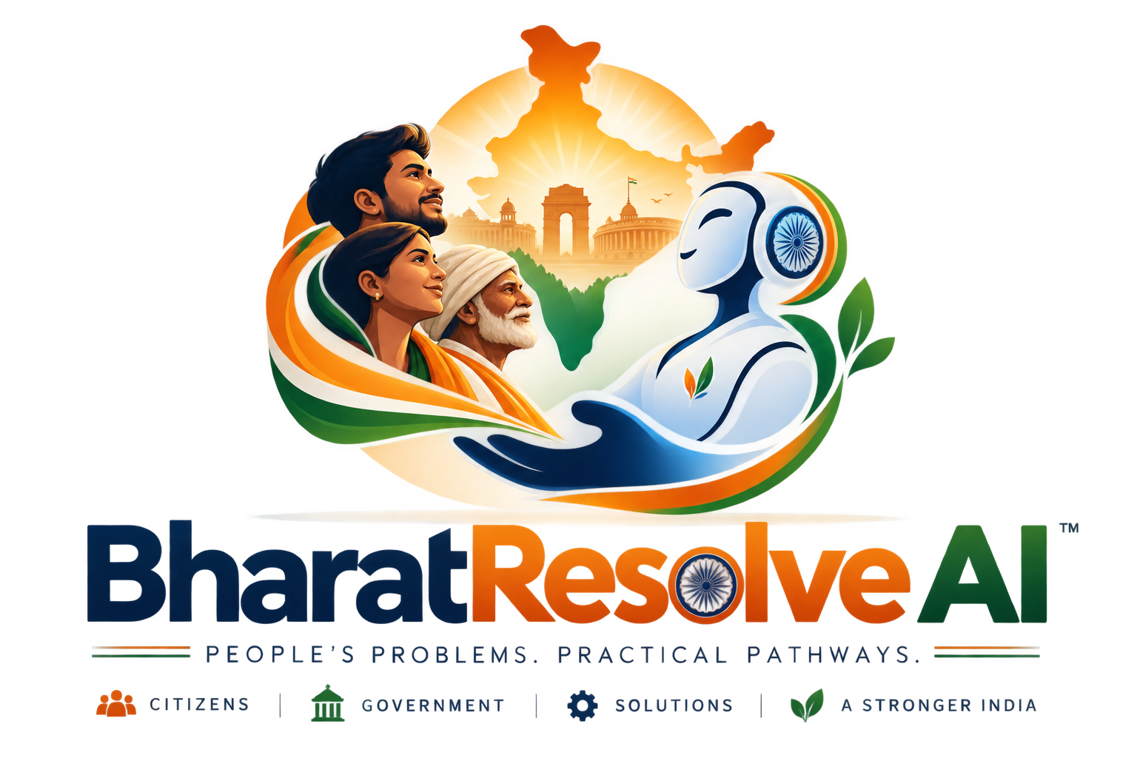
BHARATAGENTIC | CITIZEN & GOVTECH
BharatResolve AI
From a citizen's problem
to a verified path to resolution.
An agentic AI that investigates, gathers evidence, plans safe actions,
and verifies outcomes — instead of merely answering questions.
BUILT FOR REAL CITIZEN PROBLEMS
BHARATRESOLVE AI
01 / 05

Slide 2
01 | THE PROBLEM
When something goes wrong, the citizen becomes the case manager.
A broken drain. A missing service. A delayed grievance. A public issue. The problem may be simple — the resolution journey often isn't.
“I know what is wrong. I just don't know WHO can solve it, WHAT evidence I need, or WHAT happens next.”
01
FIND THE RIGHT DOOR
02
BUILD THE CASE
Departments, portals, schemes and grievance channels can be fragmented.
Citizens must assemble documents, dates, photos, location and supporting facts.
03
NAVIGATE THE PROCESS
04
FOLLOW THROUGH
Knowing information is different from knowing the correct next action.
A submitted complaint is not a solved complaint. Outcomes need verification.
THE REAL GAP
Not access to information — access to a guided, evidence-backed resolution path.
BHARATRESOLVE AI
02 / 05

Slide 3
02 | THE SOLUTION
BharatResolve AI turns a messy complaint into an executable case.
One agent. Real tools. Evidence-backed reasoning. Human approval where risk matters.
01
02
03
04
05
UNDERSTAND
INVESTIGATE
REASON
PLAN
VERIFY
Citizen problem
+ documents
Live sources
+ tools
Facts • support
• contradictions
Next safe
action
Outcome or
escalation
AGENTIC
Research → reason → plan → pause for approval → act → verify
Not just an answer.
It moves the case forward.
BHARATRESOLVE AI
03 / 05

Slide 4
03 | TRUST BY DESIGN
Built for the moment AI has to do more than talk.
BharatResolve AI constrains action with evidence, risk controls and verification.
1
EVIDENCE FIRST
2
HUMAN CONTROL
3
CLOSED-LOOP
Claims carry provenance.
Zero evidence cannot become
a confident resolution.
Medium / high / critical-risk actions
pause for approval before execution.
The workflow does not stop at submission
— it verifies the resulting state.
BHARATRESOLVE AI
04 / 05

Slide 5
04 | THE IMPACT
Make government problem-solving feel less like a maze.
The goal is simple: reduce the citizen's coordination burden while keeping decisions auditable and humans in control.
01
LESS SEARCH
Find relevant services, sources and next steps faster.
FROM
PROBLEM
02
BETTER EVIDENCE
Turn documents + live information into a traceable case.
↓
EVIDENCE
03
SAFER ACTION
Route higher-risk actions through human approval.
↓
ACTION
04
VERIFIED OUTCOMES
Close the loop with verification — or escalate.
↓
VERIFIED OUTCOME
BHARATRESOLVE AI
AI that doesn't just answer citizens — it helps resolve cases.
BHARATRESOLVE AI
05 / 05

