Slide 1

Customer Attrition Forecasting in Banking
Data-driven insights to retain customers and improve loyalty
Satelite Alison Ndayikunda

Slide 2


Problem Statement
Lison Bank faces customer churn in its credit card services, with approximately 16% of customers leaving. Understanding which customers are likely to churn and which are most loyal is critical for designing effective retention strategies and maximizing revenue. The challenge is compounded by class imbalance and limited context on certain customer behaviors.
Presentation Objectives
  Show analysis of customer churn patterns at Lison Bank
  Highlight key factors driving churn using feature importance
  Present predictive models to identify high-risk and loyal customers
  Recommend data-driven strategies to improve retention and engagement

Slide 3
Dataset Overview
Records: 10,127 customers with demographics, credit card usage, and transaction history
Target Variable: Attrition_Flag – whether a customer churned or stayed (~16% churn)
Feature Groups:
  Demographics: Customer_Age, Gender, Dependent_count, Education_Level, Marital_Status, Income_Category
  Product & Relationship: Months_on_book, Total_Relationship_Count, Card_Category
  Engagement: Months_Inactive_12_mon, Contacts_Count_12_mon
  Financial Metrics: Credit_Limit, Total_Revolving_Bal, Avg_Open_To_Buy, Avg_Utilization_Ratio
  Transaction Behavior: Total_Trans_Amt, Total_Trans_Ct, Total_Ct_Chng_Q4_Q1, Total_Amt_Chng_Q4_Q1

Slide 4
Data Insights & Visualizations

Slide 5

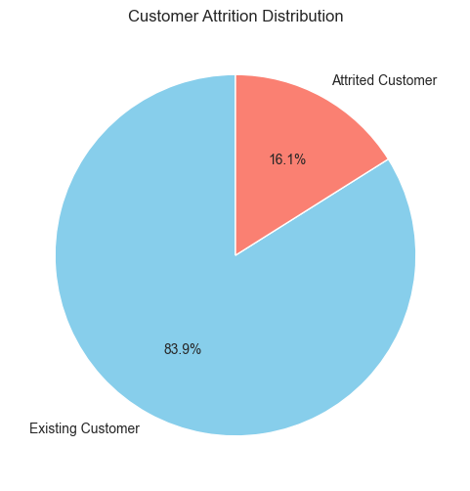
Target Variable
  The dataset is imbalanced: 84% existing customers vs 16% churned customers.
  Without addressing this, models tend to favor the majority class, reducing prediction accuracy for churners.
  Solution: SMOTE used to create synthetic churn examples for better model learning.

Slide 6
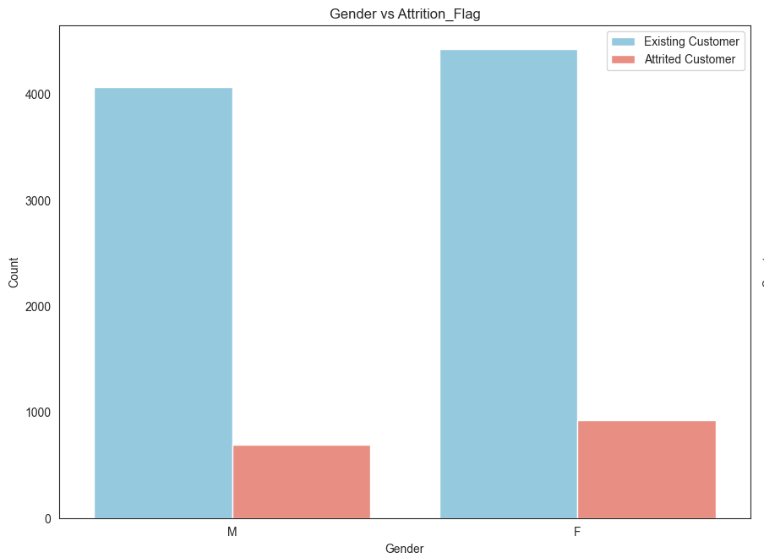
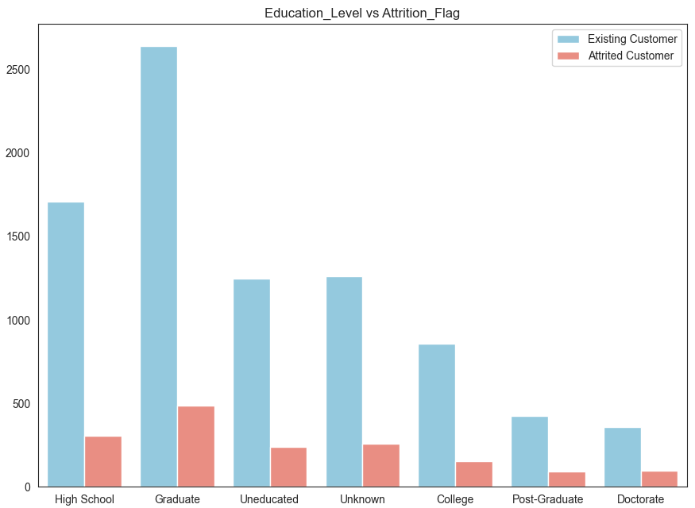
Gender & Education Level vs Churn
Gender
- More women are customers overall.
- Women churn slightly more than men.
Education Level
-Most customers are graduates — and they also have the highest number of people leaving.
- However, within smaller groups, the Uneducated segment may have the highest percentage of churn.
- This indicates a bigger churn issue relative to the size of that group.

Slide 7
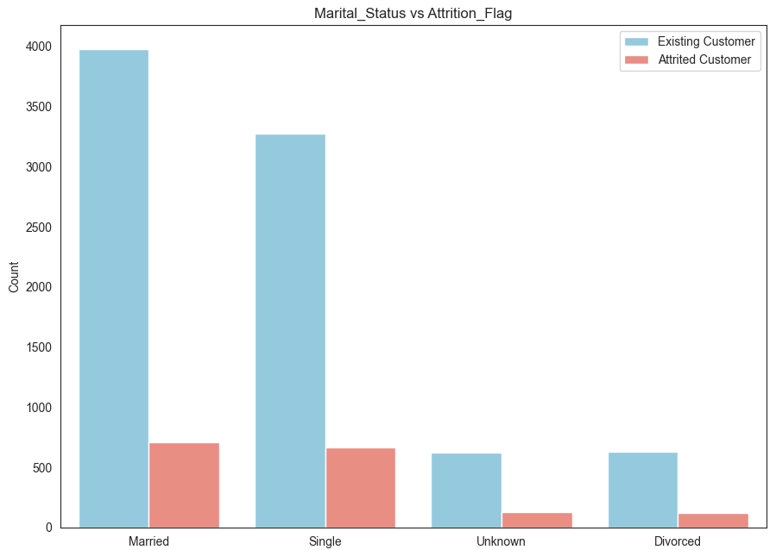
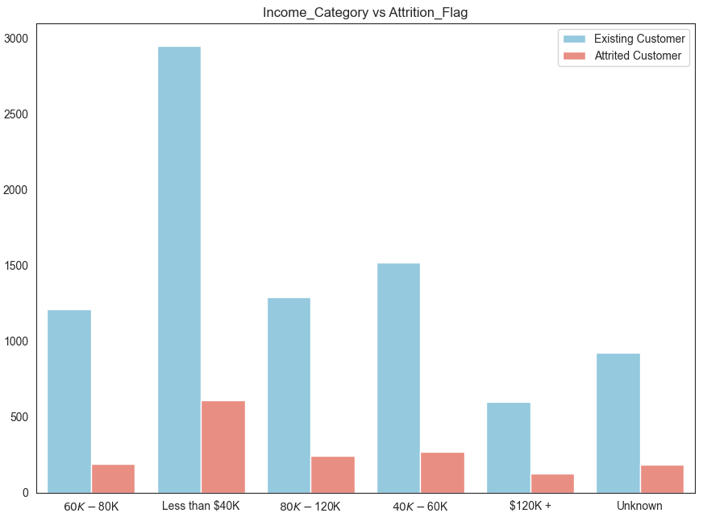
Marital Status & Income Range vs Churn
Marital Status
- Married customers churn less.
- Single customers churn the most compared to their group size.
Divorced and Unknown groups are small, so churn impact there is minimal.
Income Category
- Customers earning less than $40K churn the most.
- High-income customers ($120K+) rarely churn.
This suggests that financial pressure may be a factor in why they leave

Slide 8
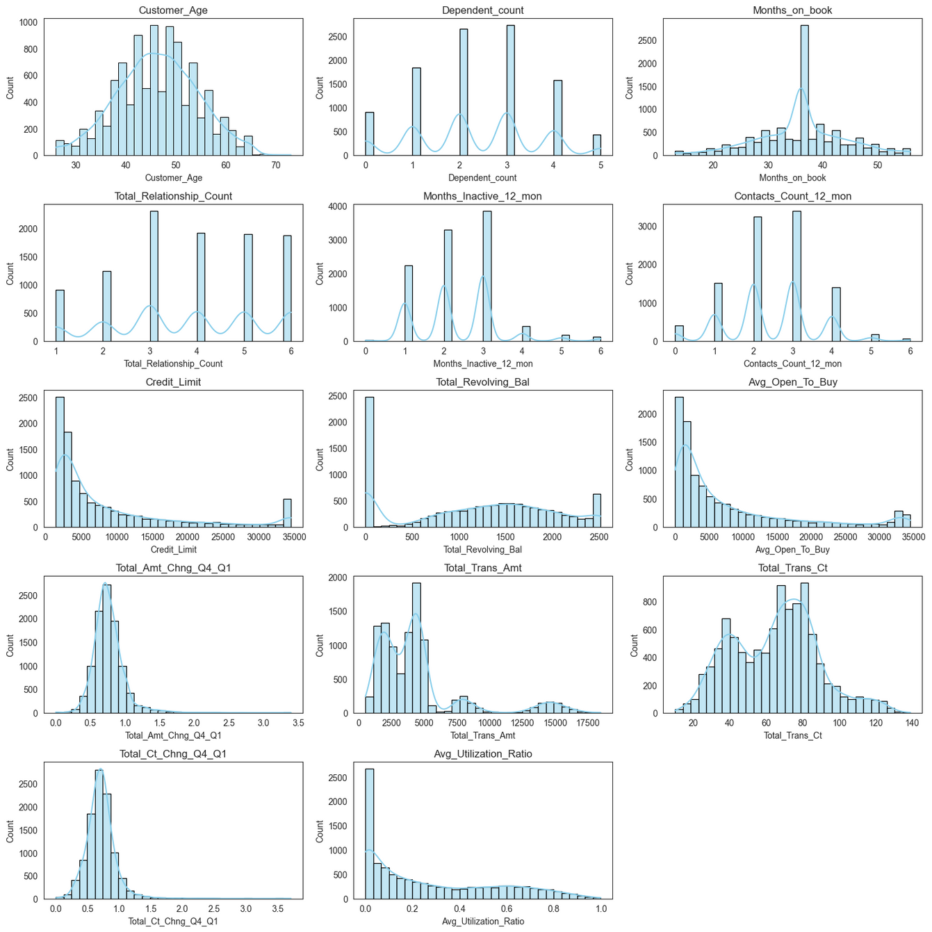
Numerical Feature Distribution
Age & Transaction Count
- Balanced, nearly normal features.
- These work well with most models without transformation.
Credit Limit, Utilization & Transaction Amount
- They are right-skewed with a small high-value group.
- Log transform is recommended for modeling with linear models
Dependents, Contacts & Months Inactive
- Discrete features with clear peaks forming natural segments.
- These are treated as categorical/ordinal.
Months_on_book (Tenure)
- Most customers are mid-tenure (36–40 months).
- Indicates early churn or slow acquisition.
Quarterly Change Metrics
- Most customers are stable; the sharp drops signal churn risk.
Hidden Segments
- The multi-modal patterns reveal distinct customer groups.
- These are useful for feature engineering or clustering.

Slide 9
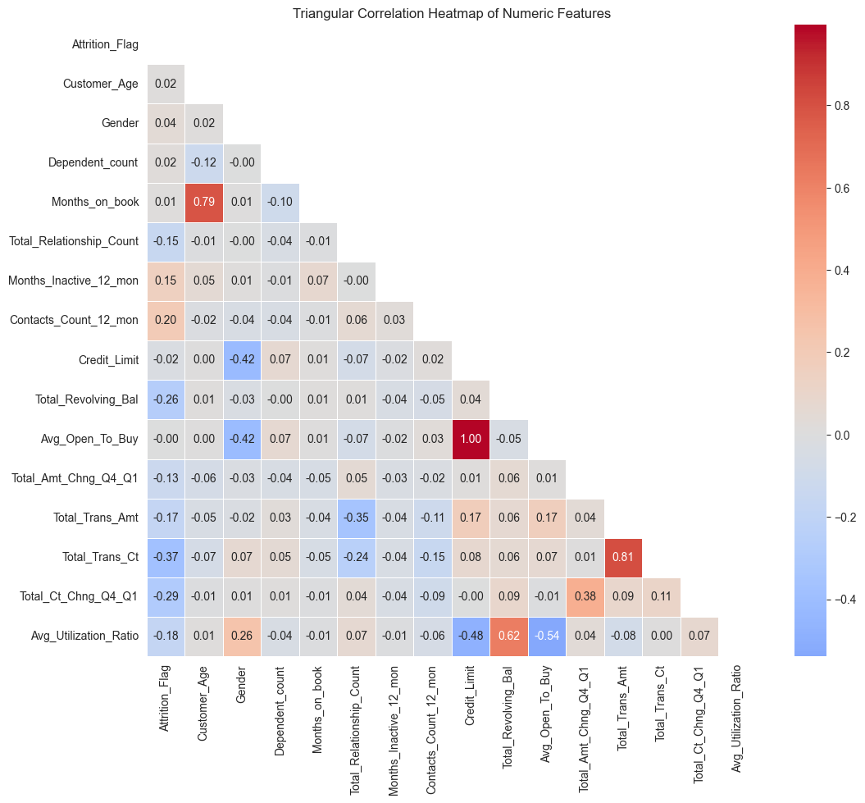
Correlations
Correlations show how features move together. Strong correlations highlight key predictors, while weak correlations indicate features with little predictive value.
Key Positive Correlations
Customers who make more transactions also spend more. Higher credit utilization is associated with higher revolving balances. Credit_Limit and Avg_Open_To_Buy are perfectly correlated, so one was removed.
Key Negative & Weak Correlations
Inactive customers make fewer transactions. High utilization corresponds to low available credit, signaling credit stress. Features like Customer_Age and Gender show very weak correlation and are not strong predictors alone.

Slide 10
Data Preprocessing

Slide 11
Preprocessing Process
01
02
03
04
01
Encoding Categorical Variables
  Ordinal Encoding: Education Level, Income Category, Card Category
  One-Hot Encoding: Marital Status
Feature Scaling
  Applied StandardScaler to all numerical columns to ensures fair contribution of each feature during modeling.
Handling Class Imbalance
Dataset was 84% existing vs 16% churned
Used SMOTE to oversample minority class
Improved model’s ability to learn churn patterns
Data Cleaning
  Deleted unnecessary columns
  Standardized categorical labels
  Verified missing values (none required imputation)

Slide 12
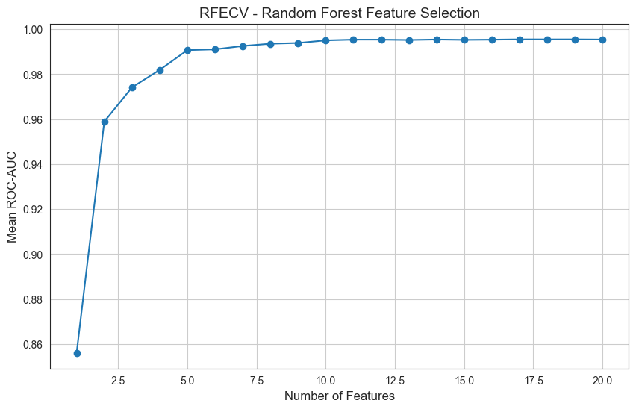
Feature Selection
The rfecv graph shows how well our model performs as we remove features one by one using Random Forest and cross-validated AUC (area under the curve) as the score.
The model gave 17 Optimal Features
- The model’s performance peaks at 17 features adding more doesn’t help, removing more hurts.
- Even with just 2–3 features, the model is already decent (about 0.96 AUC), but it gets better and stabilizes at 17.

Slide 13
Model Selection

Slide 14
Report after Hyper Parameter tuning
Models Evaluated
Precision = 0.90
Recall = 0.90,
F1-Score = 0.90
Precision = 0.81
Recall = 0.91
F1-Score = 0.86
XGBoost Model
Random Forest Model
Why these models were chosen:
  Strong performance on tabular, structured data
  Ability to capture both linear (Logistic Regression) and nonlinear (RF, GB, XGBoost) relationships
  Built-in feature importance for interpretability
  Complementary strengths → allows selecting the best performer
Evaluation Strategy:
  Train/test split with stratification
  Metrics: ROC-AUC, Precision, Recall, F1-score, Confusion Matrix
  Classification threshold adjusted to 0.40 to capture more at-risk churners
Precision = 0.91
Recall = 0.89
F1-Score = 0.90
Precision = 0.49
Recall = 0.83
F1-Score = 0.62
Gradient Boosting Model
Logistic regression Model (Before hyperparameter tuning)

Slide 15
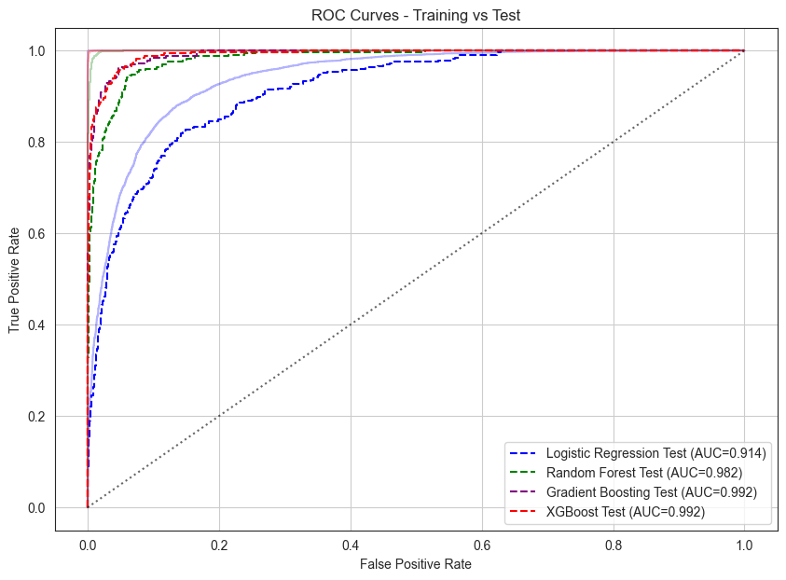
Evaluating Model Performance
Looking at the ROC curves
All four models are working really well. None of them are overfitting they all do just as well on new data as they did on the training data.
That’s a big win!
XGBoost and Gradient Boosting are the top performers, but even the simpler Logistic Regression is doing great.

Slide 16
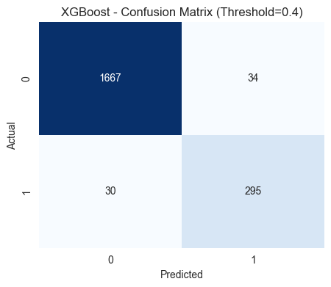
Winning Model
Final Model Choice: Gradient Boosting vs. XGBoost
Before tuning, Gradient Boosting gave strong results.
But once we applied hyperparameter tuning, XGBoost consistently outperformed it offering better control, stronger regularization, and higher recall for catching churners.
Final Decision
I'll go with XGBoost (after tuning) as the primary model.
It’s more robust, more accurate, and better suited for churn prediction.
TN = 1667 → Correctly predicted NON-churn
FP = 34 → Predicted churn but customer stayed
FN = 30 → Missed churners (Critical!)
TP = 295 → Correctly predicted churners
Precision = 0.90, Recall = 0.91, F1-Score = 0.90,
ROC—AUC =0.99

Slide 17
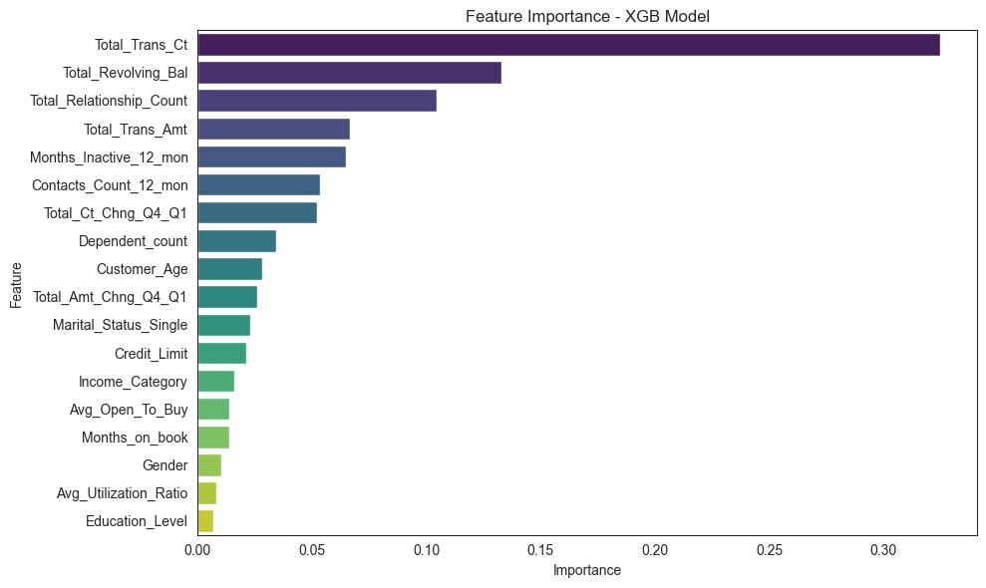
XGBoost Feature Importance
Other features like contacts, account changes, marital status, age, and credit limit have smaller impact.
Implications for the bank:
- Focus retention efforts on customers with low transactions, few products, or long inactivity.
- Encourage engagement through offers or personalized services.
- Monitor revolving balances and transaction patterns to proactively identify at-risk customers.
From the XGBoost model, the top features influencing churn are:
1. Total Transaction count (0.33) – Customers with fewer transactions are more likely to churn.
2. Total Revolving Balance (0.13) – Higher revolving balances may indicate engagement or risk; impacts churn likelihood.
3. Total Relationship Count (0.10) – Customers with more relationships (products) are less likely to leave.

Slide 18
Next Steps & Strategic Direction

Slide 19
Business Recommendations
Monitor Low-Engagement Customers
Customers with low transaction counts or low activity levels are more likely to leave. The bank should identify these customers early and re-engage them through personalized offers or reminders.
03
Increase Relationship Depth
Customers with fewer banking products (e.g., only one account) churn more easily. Encouraging them to add savings accounts, credit cards, or other services helps increase loyalty.
Support Customers With High Complaint Frequency
Customers who contact the bank many times are usually frustrated. The bank should investigate common issues, improve service quality, and provide quicker support to prevent them from leaving.
01
04
Track and React to Inactive Customers
A long period of inactivity is a strong churn signal. Sending reactivation messages, offering incentives, or having relationship managers reach out can help reduce this risk.
Use the Churn Prediction Model Proactively
The XGBoost model can be used to assign a monthly churn score to each customer. High-risk customers should receive immediate attention, while medium-risk customers can be targeted with engagement strategies.
02
05

Slide 20
Model Regularization
Regular Model Monitoring & Retraining
The model should be checked frequently to detect performance drift. As new customer data becomes available, retraining and hyperparameter tuning will help keep predictions accurate and reliable.
01
This model gives a strong foundation for predicting customer attrition, but maintaining its value requires ongoing attention.
Customer behavior evolves over time, so the model should evolve with it.
Here are the key next steps to ensure longterm effectiveness and business impact.
Integrate Live Customer Data
Connecting the model to real-time transaction behavior, complaints, or engagement data will allow the bank to identify at-risk customers earlier and intervene before churn happens.
02
Build an Internal Churn Insights Dashboard
A dashboard can help teams track churn patterns, risk levels, feature importance, and emerging behavioral trends. This supports faster decision-making and makes the model more actionable for business teams.
03

Slide 21
Conclusion
This project has shown that customer churn isn’t random, it follows patterns we can identify, understand, and act on. By uncovering the key factors driving customers away, we’ve built a foundation for smarter decisions and stronger retention strategies.
But this is only the beginning. A model is not a one-time creation, it must grow, adapt, and evolve as customers do. With continuous monitoring and improvement, this work can become a powerful tool that keeps the business ahead of churn and closer to its customers.

Slide 22


Thank you very much!
Satelite Alison Ndayikunda
satalisonn@gmail.com

