Slide 1
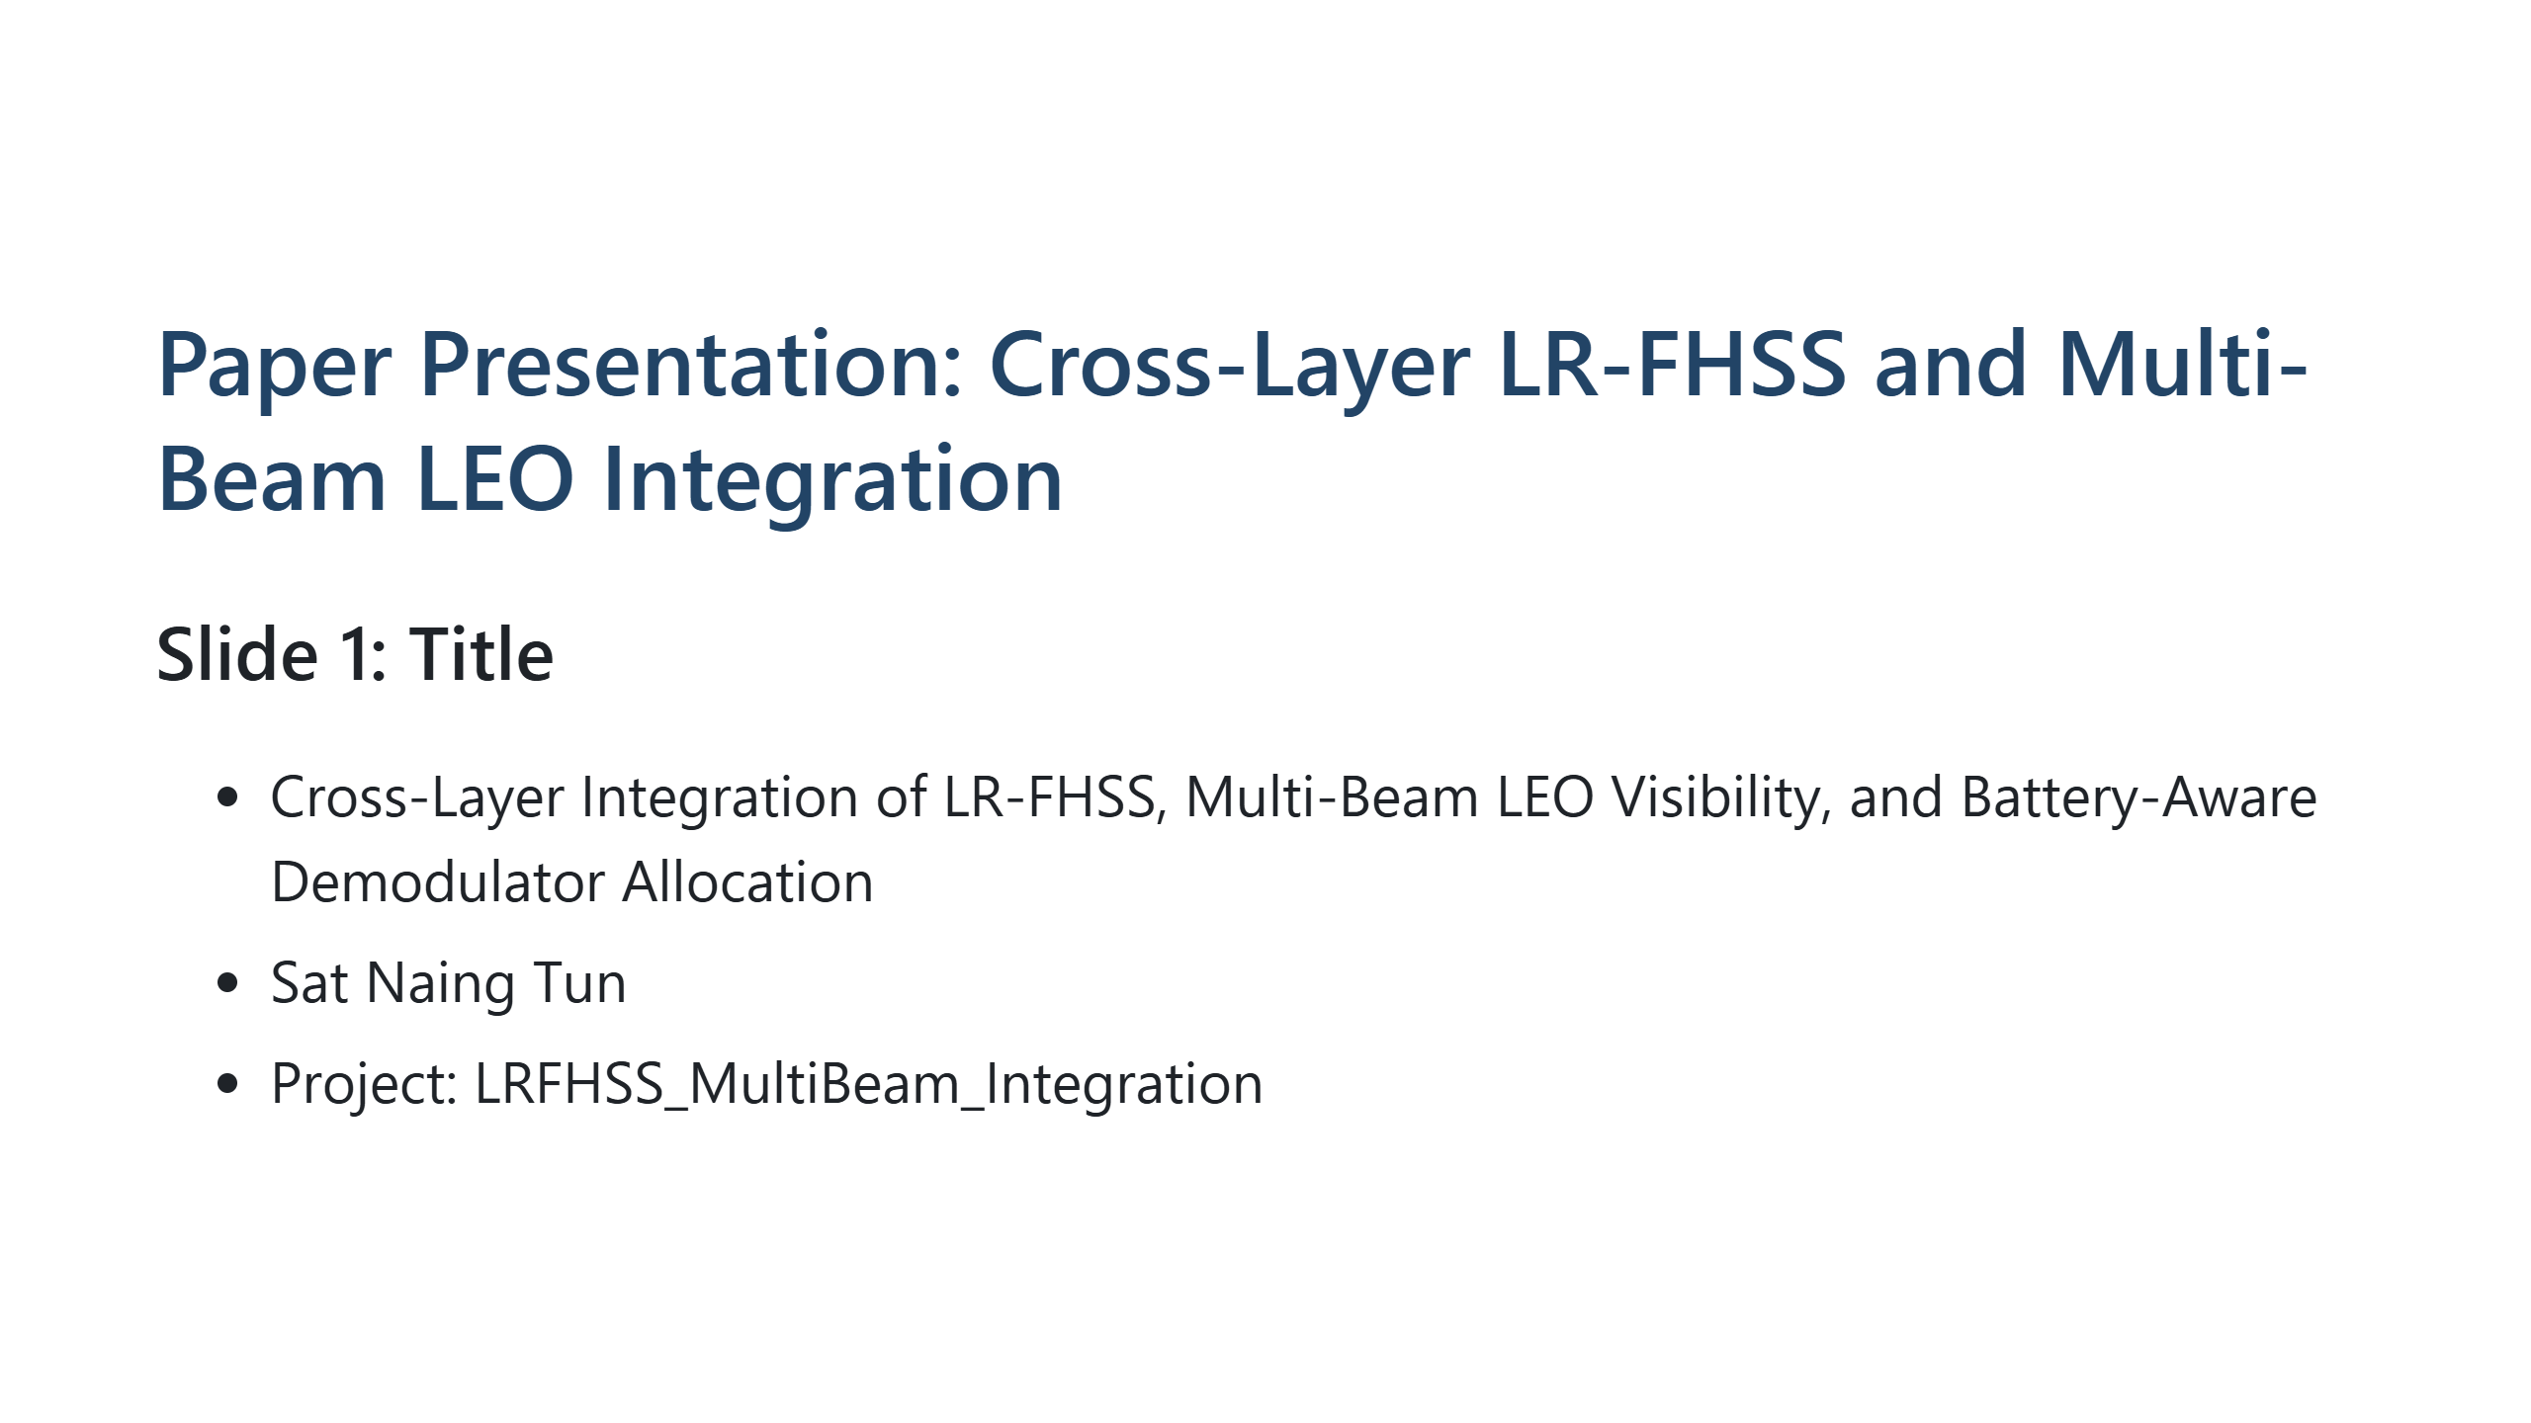
Notes:
**Speaking script** Good [morning/afternoon]. This presentation summarizes our cross-layer study that integrates LR-FHSS decoding, multi-beam LEO visibility, and battery-aware demodulator control in one simulation framework.

Slide 2
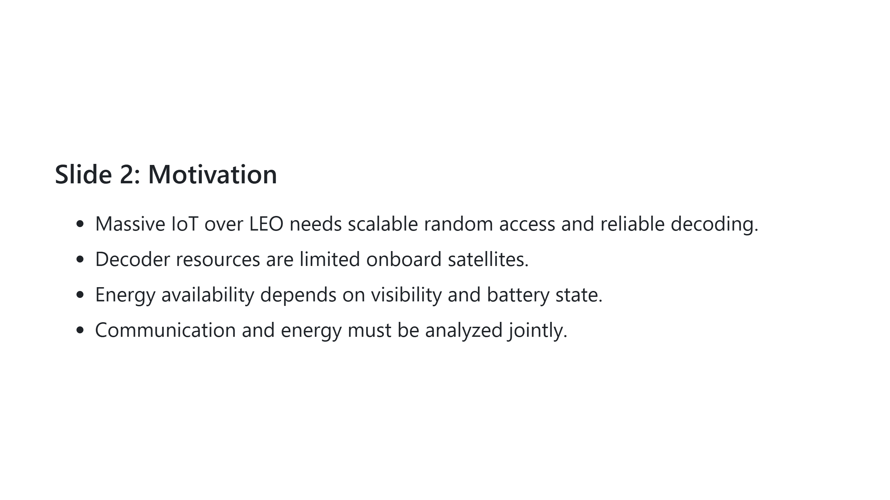
Notes:
**Speaking script** Most studies optimize only one layer, but in satellites, communication performance and onboard energy are tightly coupled. This motivates a joint model instead of isolated analyses.

Slide 3
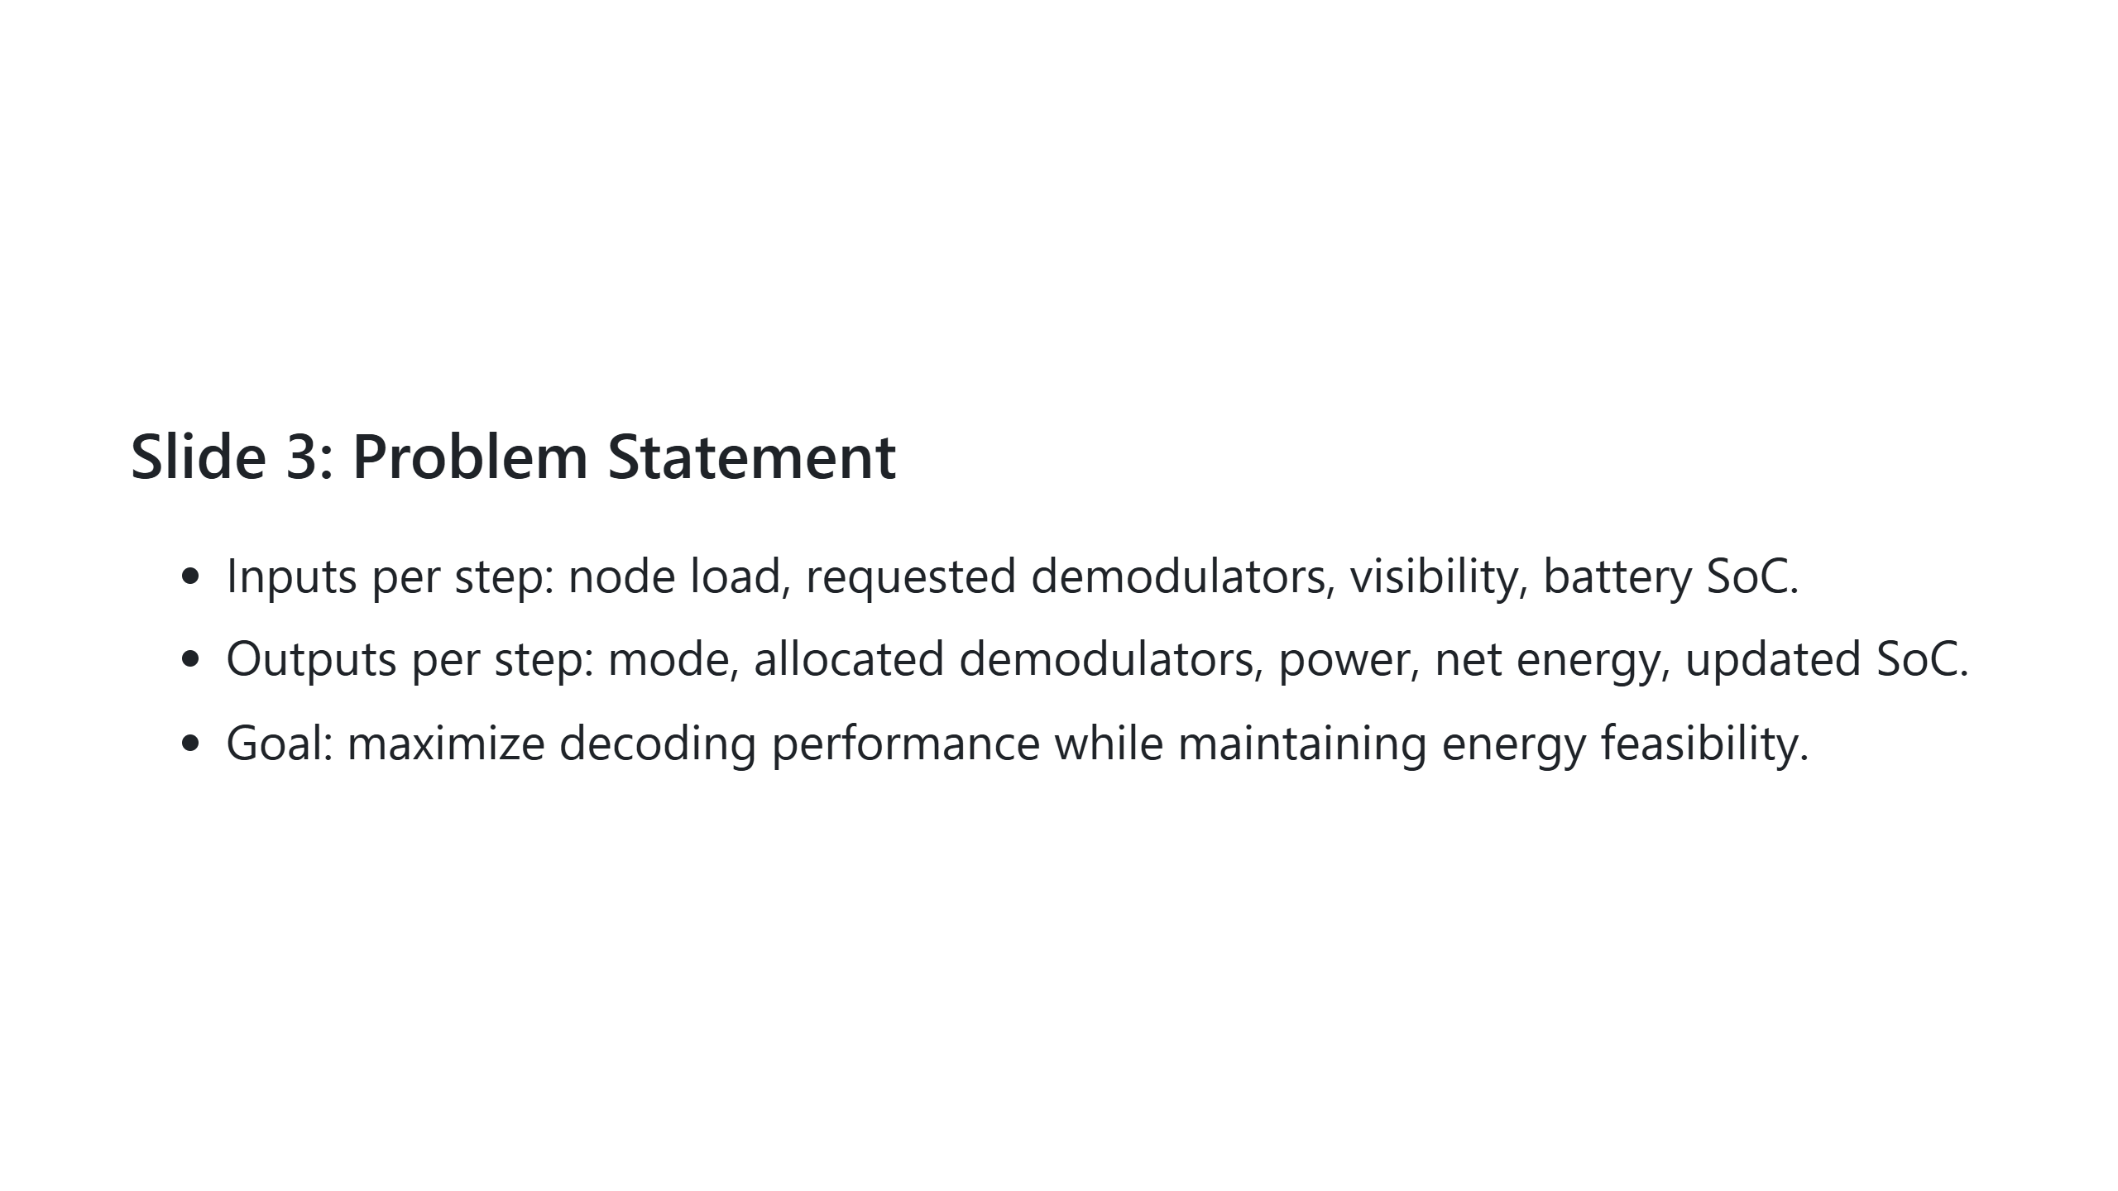
Notes:
**Speaking script** At each simulation step, we decide operation mode and demodulator allocation using load, visibility, and battery state, then evaluate both decoding success and energy impact.

Slide 4
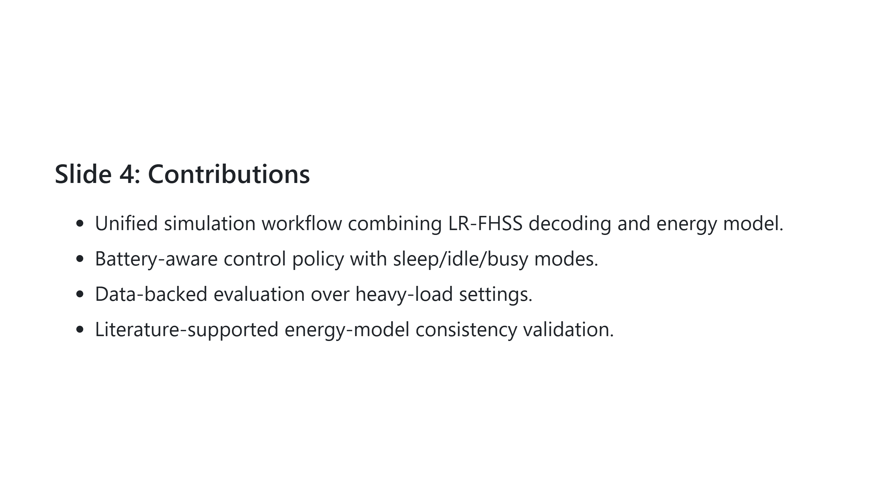
Notes:
**Speaking script** The key novelty is not only the workflow integration but also a formal consistency check showing why the energy model is scientifically reasonable with respect to prior work.

Slide 5
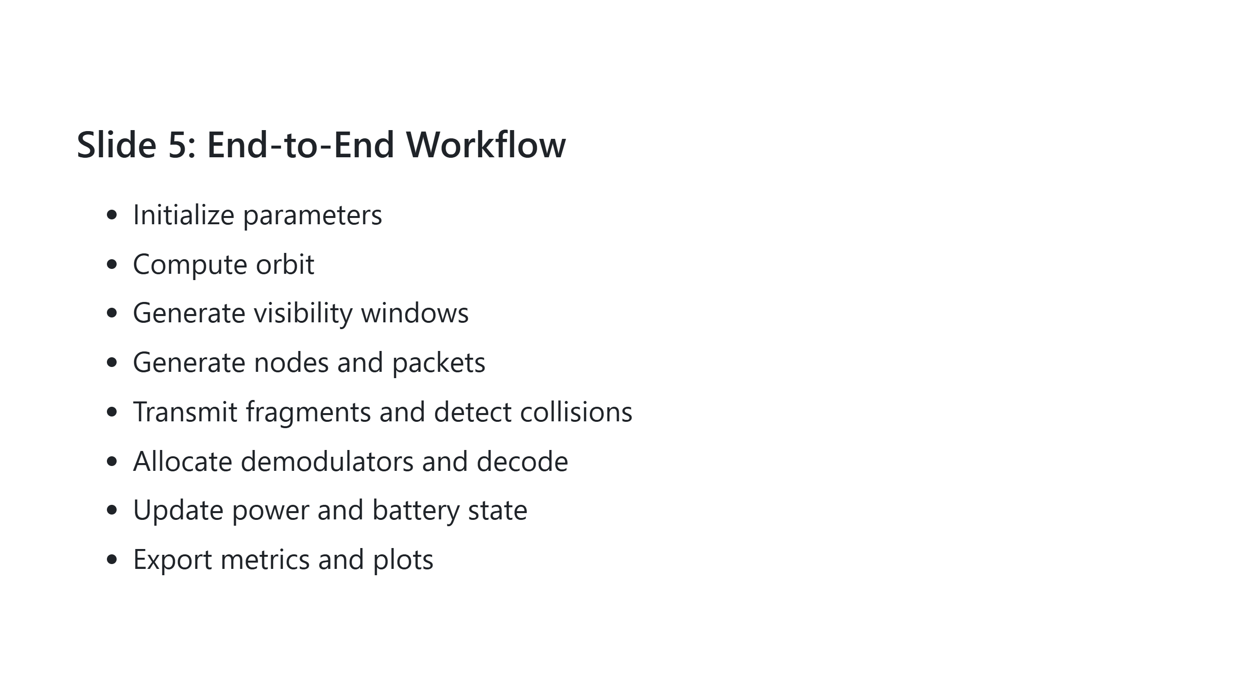
Notes:
**Speaking script** This is the full loop we execute for each operating point. The important part is the feedback: allocation affects power, and power affects future allocation through battery SoC.

Slide 6
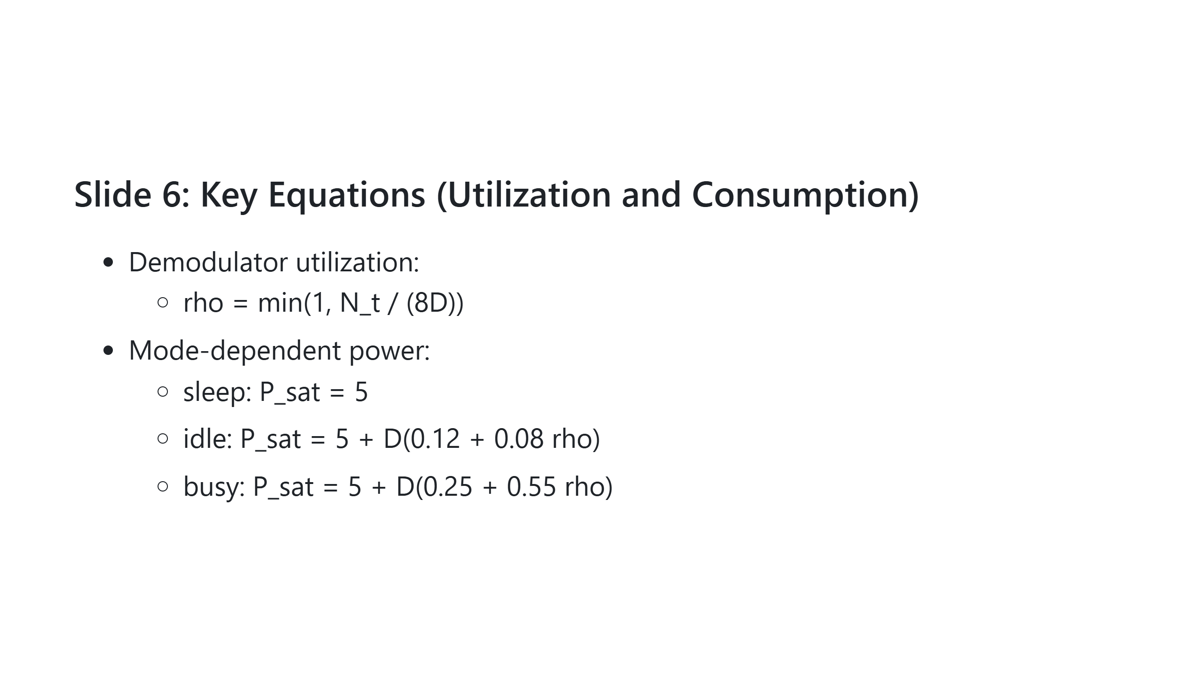
Notes:
**Speaking script** We use a bounded utilization model and an affine, mode-dependent power law. This captures low-to-high activity transitions while keeping the model simple and controllable. Details: - rho is utilization ratio; N_t/(8D) is demand/capacity. - min(1, .) caps utilization at 100%, with rho < 1 underutilized and rho = 1 saturated. - Queue-free approximation: no buffering modeled. - Equivalent compact form: P_total = P_base + P_RF + D * P_demod(rho). - Power scales linearly with D; per-demod power is bounded from idle to peak. - Assumes independent demodulator scaling (no shared bottleneck).

Slide 7
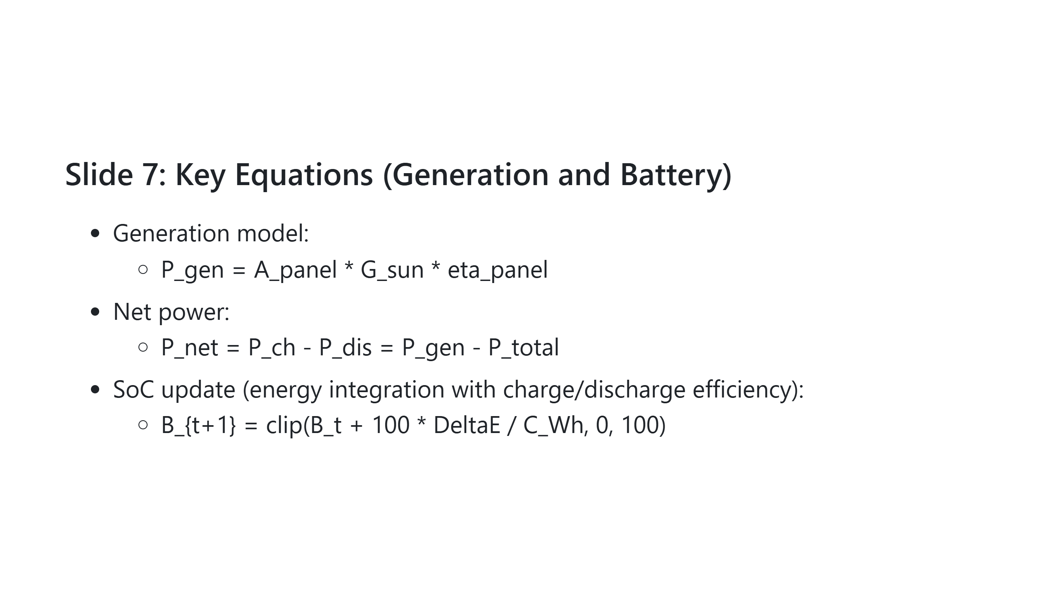
Notes:
**Speaking script** Visibility gates generation, and the battery evolves from net power after efficiency losses. The clip operation enforces physical SoC bounds between 0 and 100 percent. Apanel is panel area (m2), Gsun is solar irradiance (W/m2), and ηpanel is dimensionless efficiency Details: - G_sun is approximately 1361 W/m^2 in space. - During eclipse, P_gen = 0. - No incidence-angle loss is modeled. - P_net > 0 means charging, P_net < 0 means discharging. - DeltaE uses eta_ch * max(P_net,0) * Delta t - (1/eta_dis) * max(-P_net,0) * Delta t. - Delta t must be in hours for Wh consistency. - SoC update is linearized and ignores nonlinear battery-voltage behavior.

Slide 8
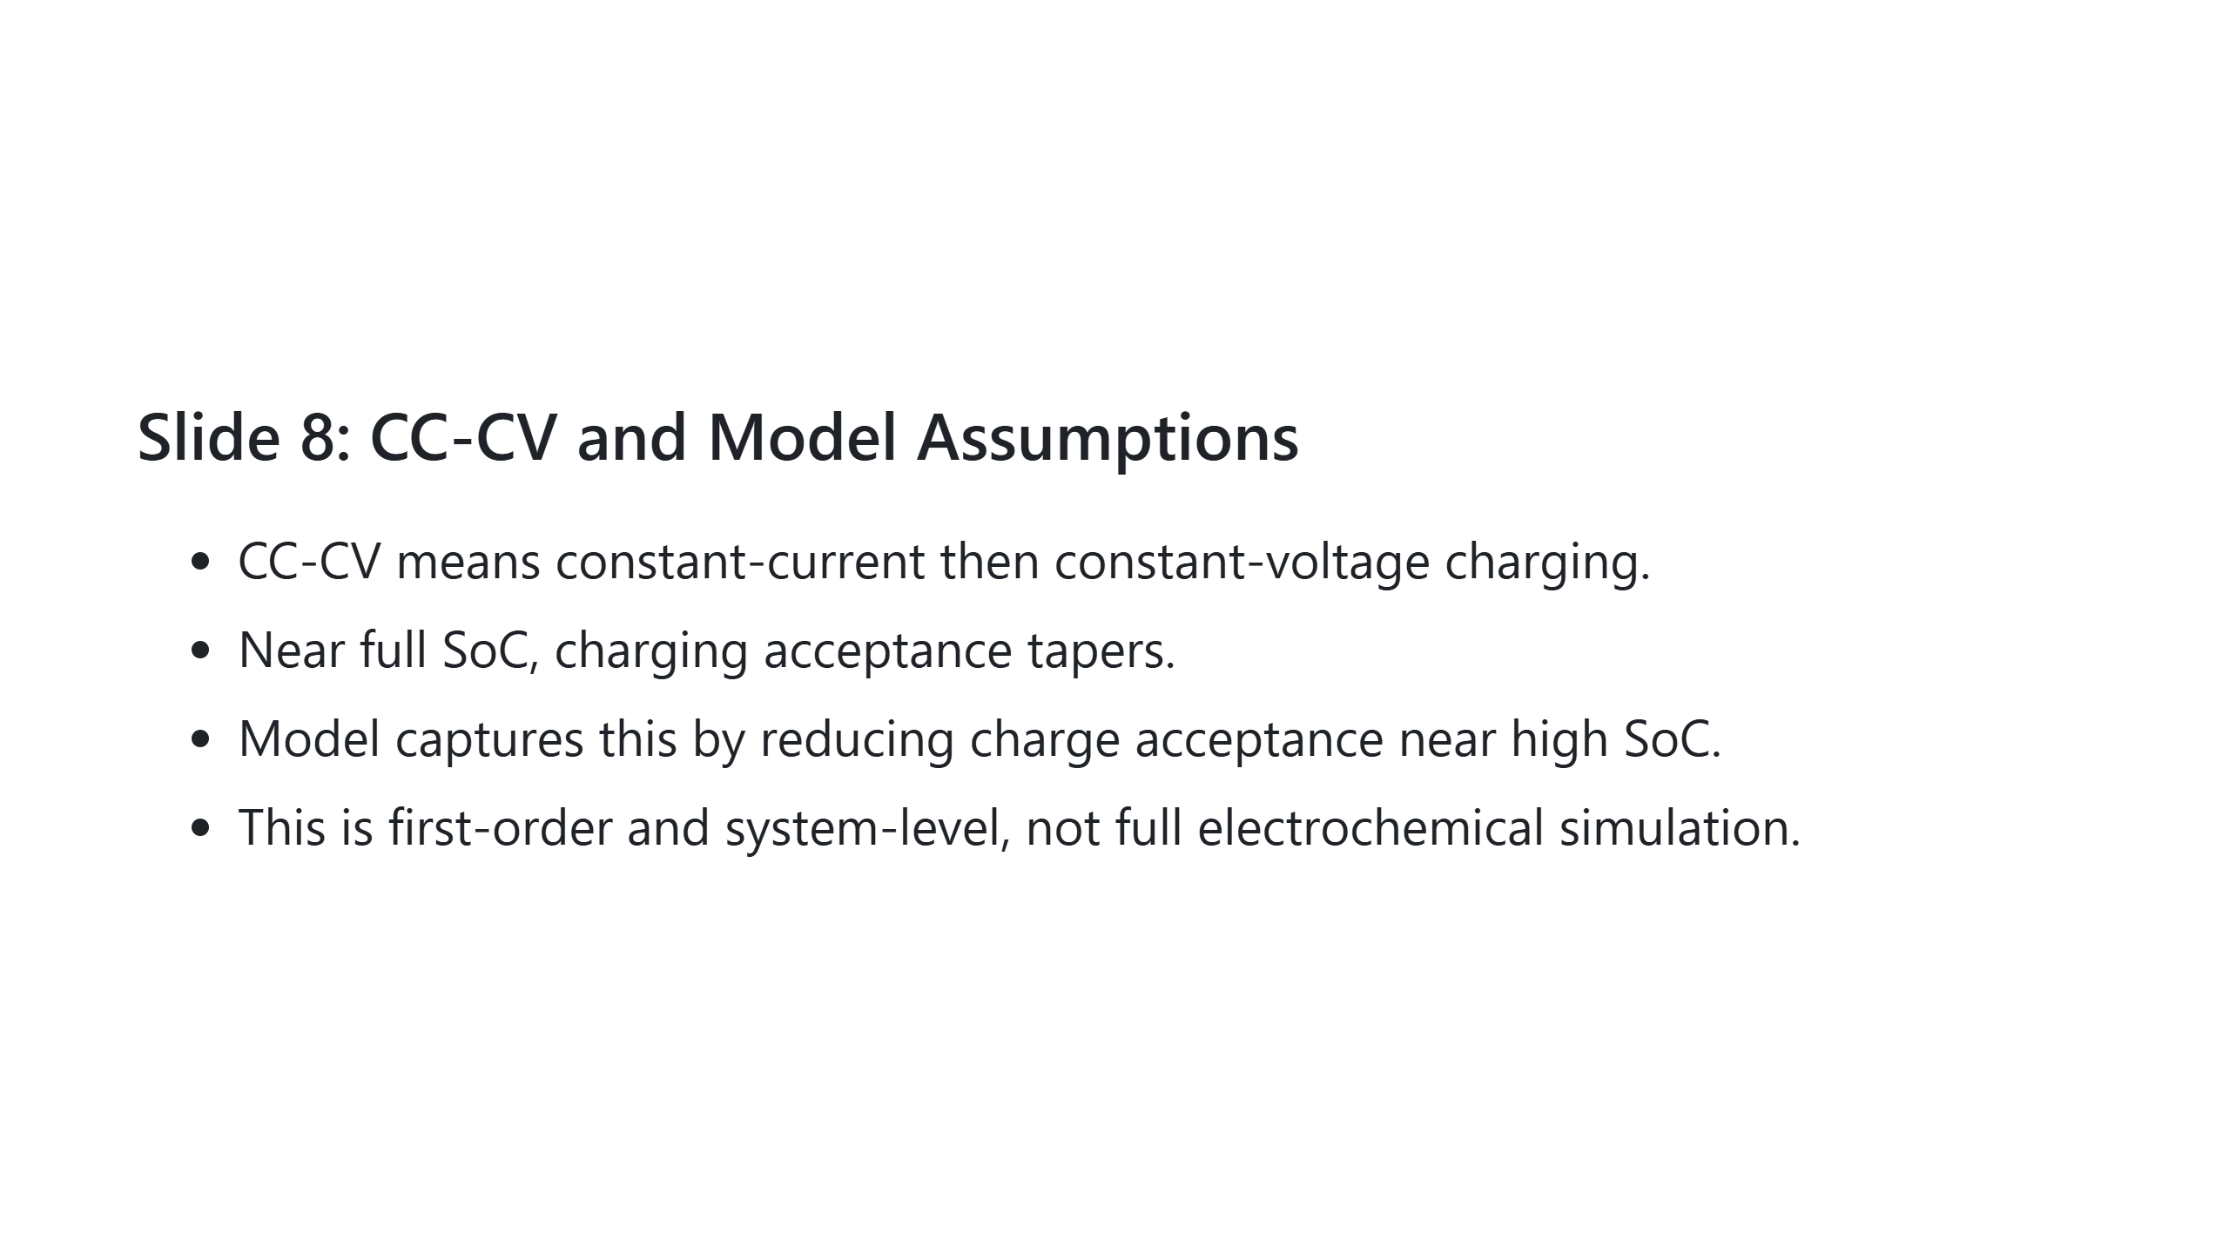

Slide 9
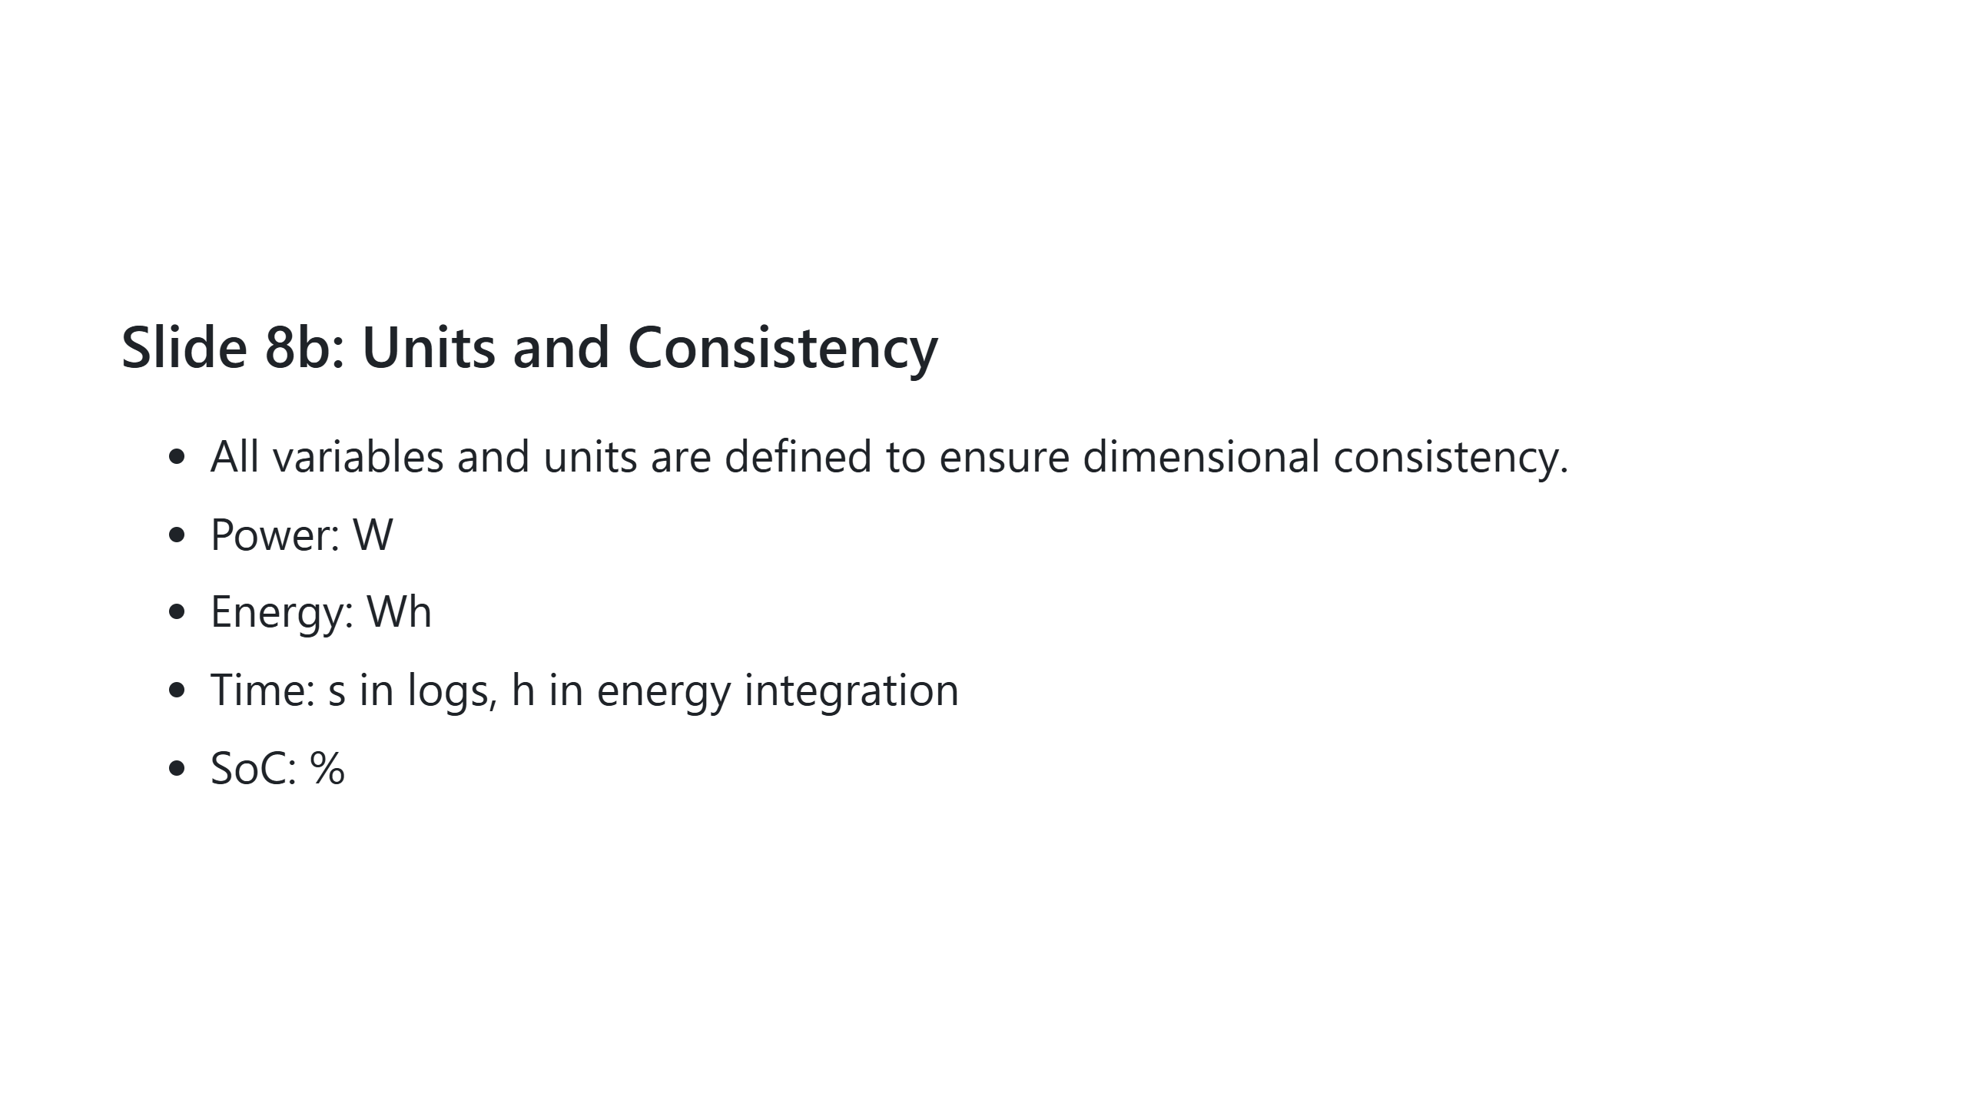
Notes:
**Speaking script** We intentionally use a first-order CC-CV-inspired taper to represent practical charge saturation behavior, without adding heavy electrochemical complexity. Assumptions: - ideal battery model - no thermal effects - linear/affine power scaling - no degradation/aging dynamics

Slide 10
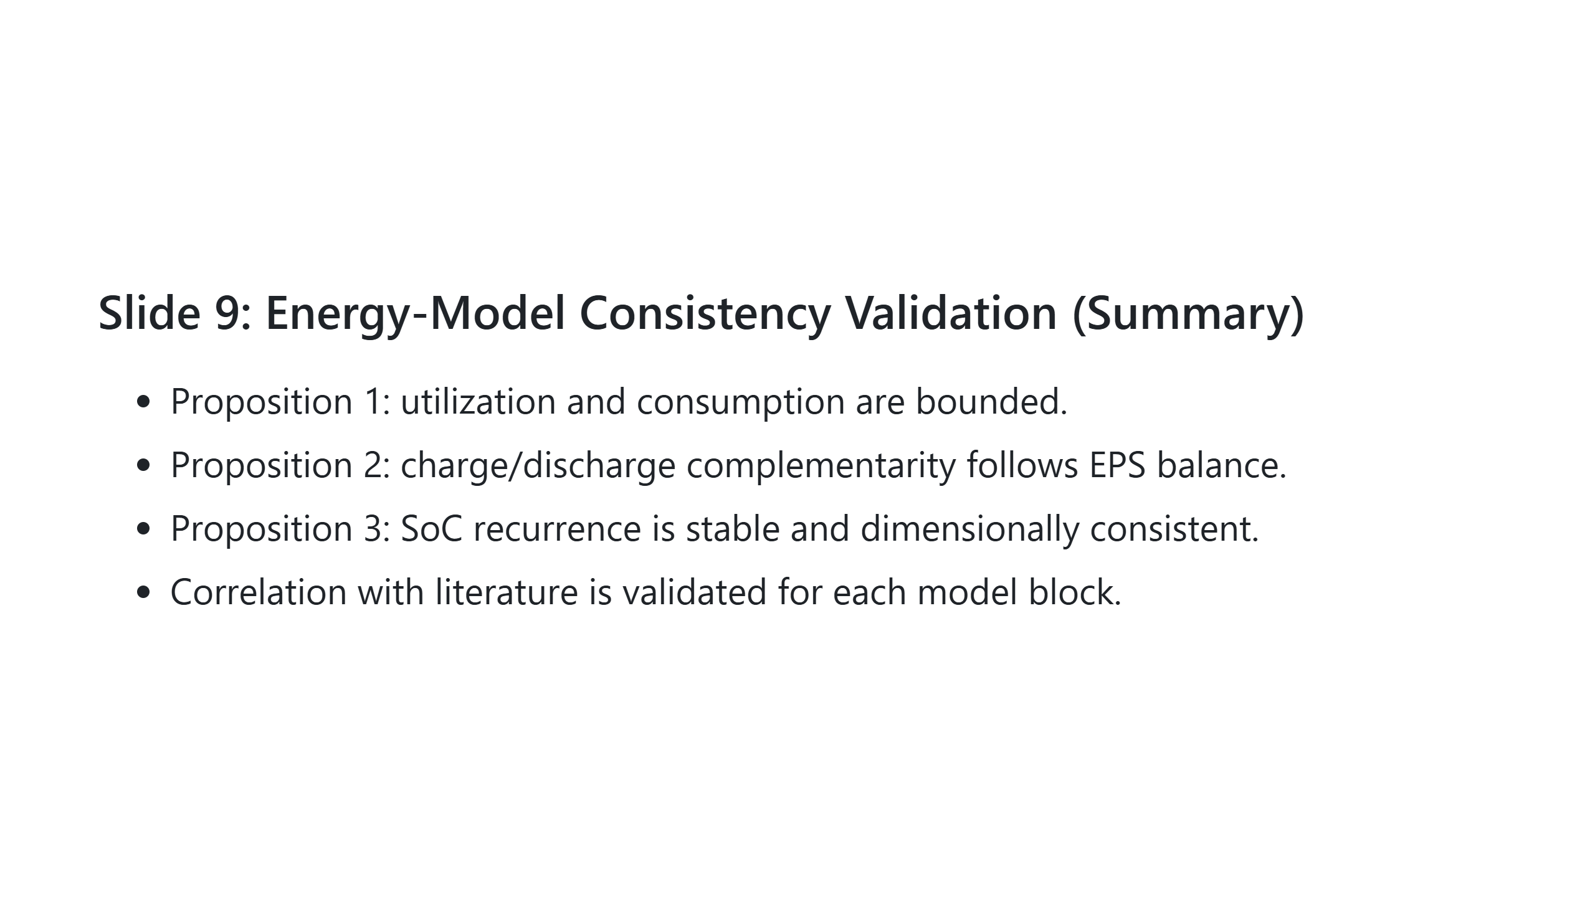
Notes:
**Speaking script** These propositions justify that the model is physically coherent and mathematically stable. They are the bridge between implementation convenience and scientific defensibility. Validation note: this model is first-order and not hardware-calibrated.

Slide 11
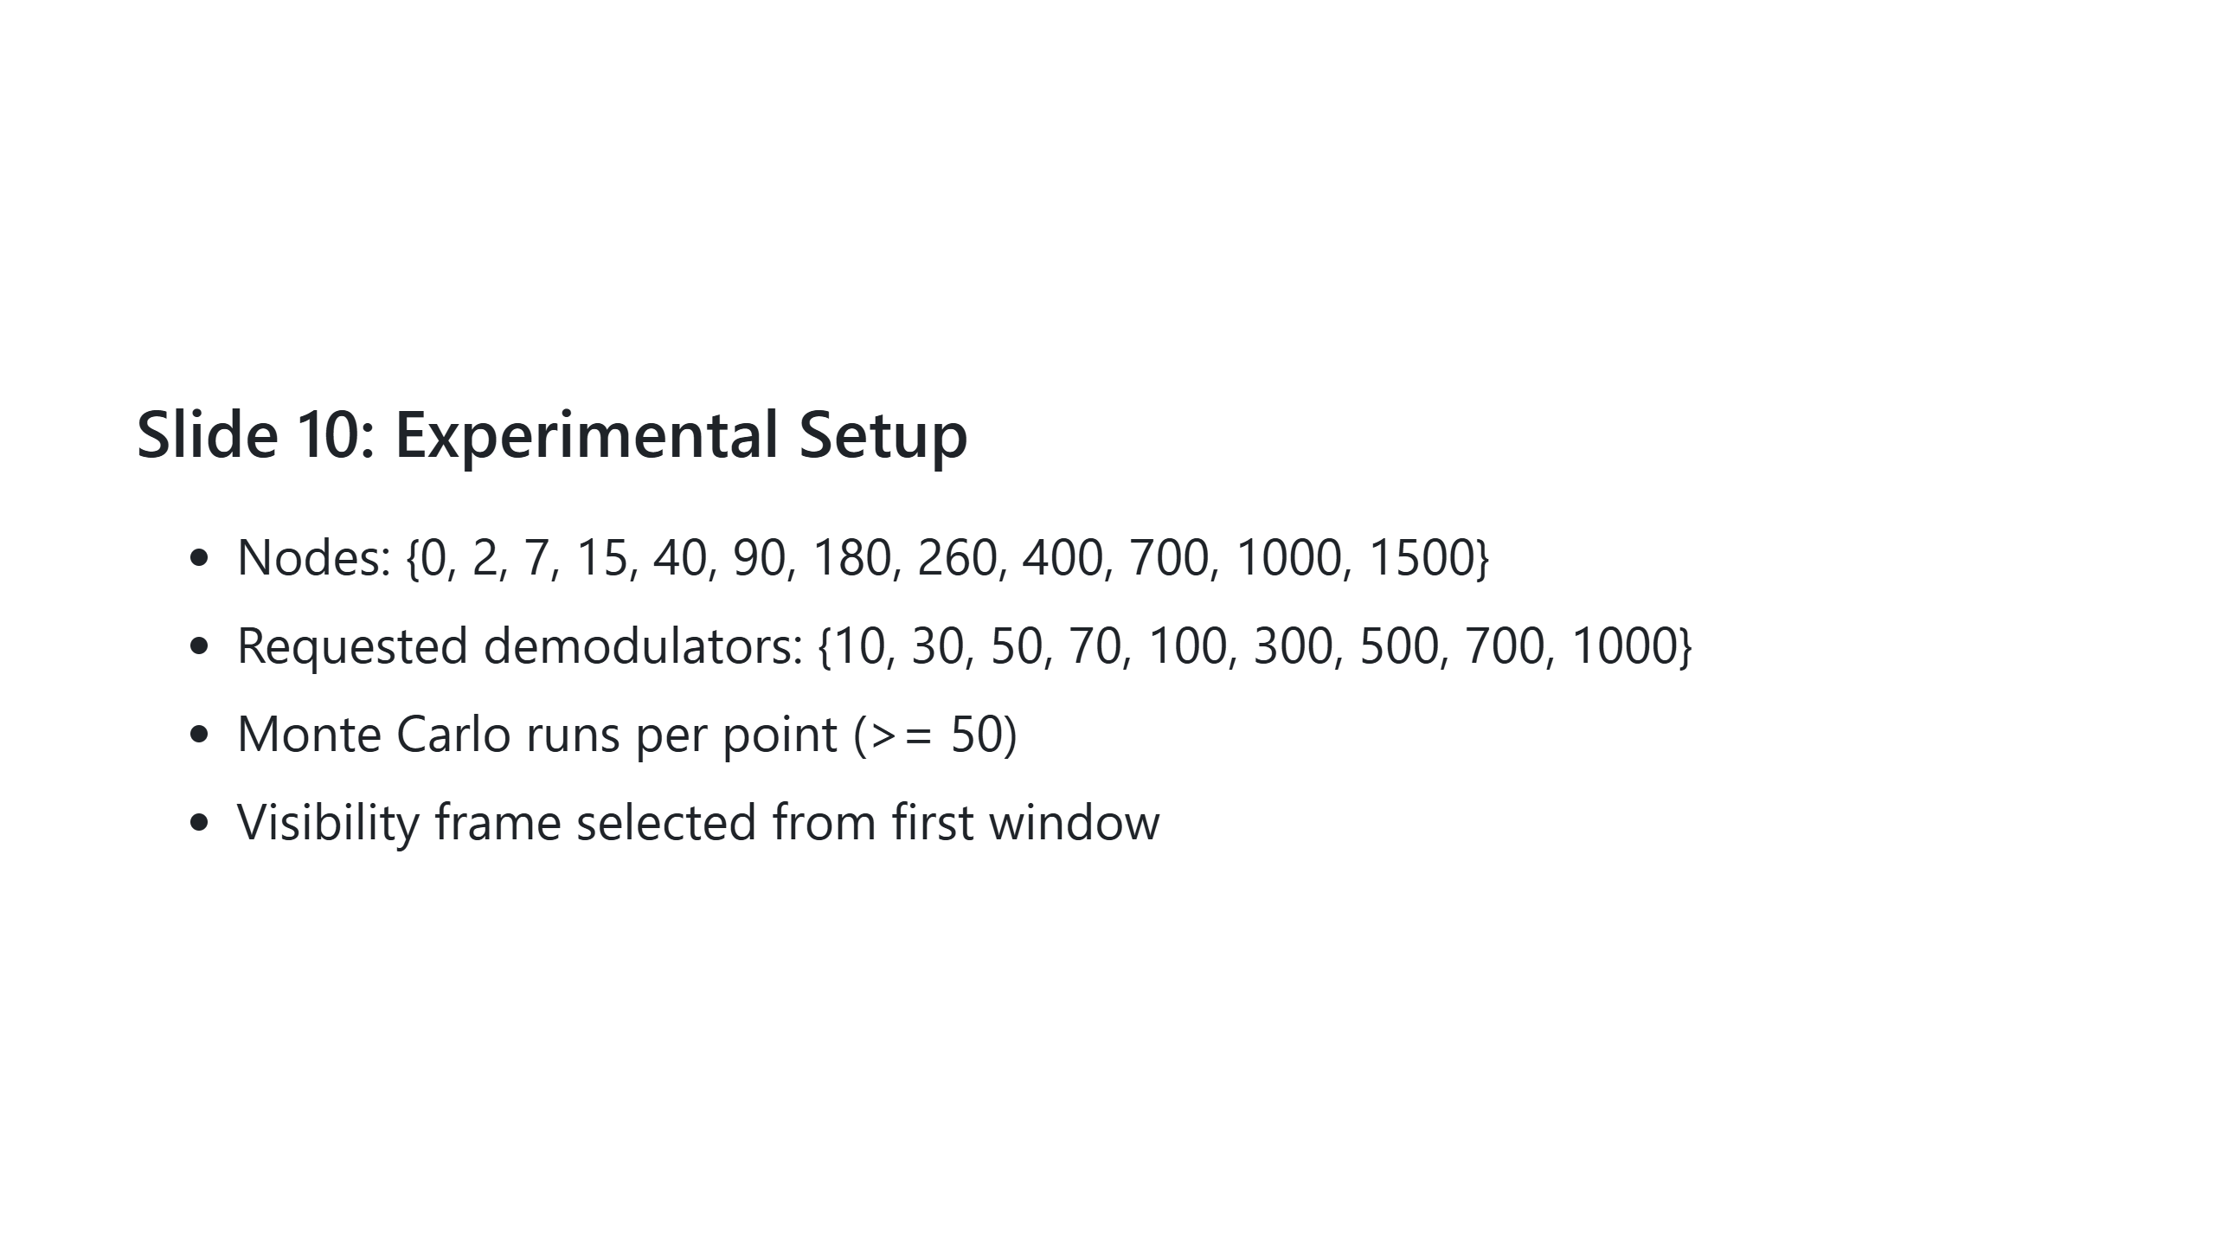
Notes:
**Speaking script** This heavy-load grid is designed to expose bottlenecks and tradeoffs. It spans very low to very high traffic, with conservative to aggressive demodulator budgets.

Slide 12
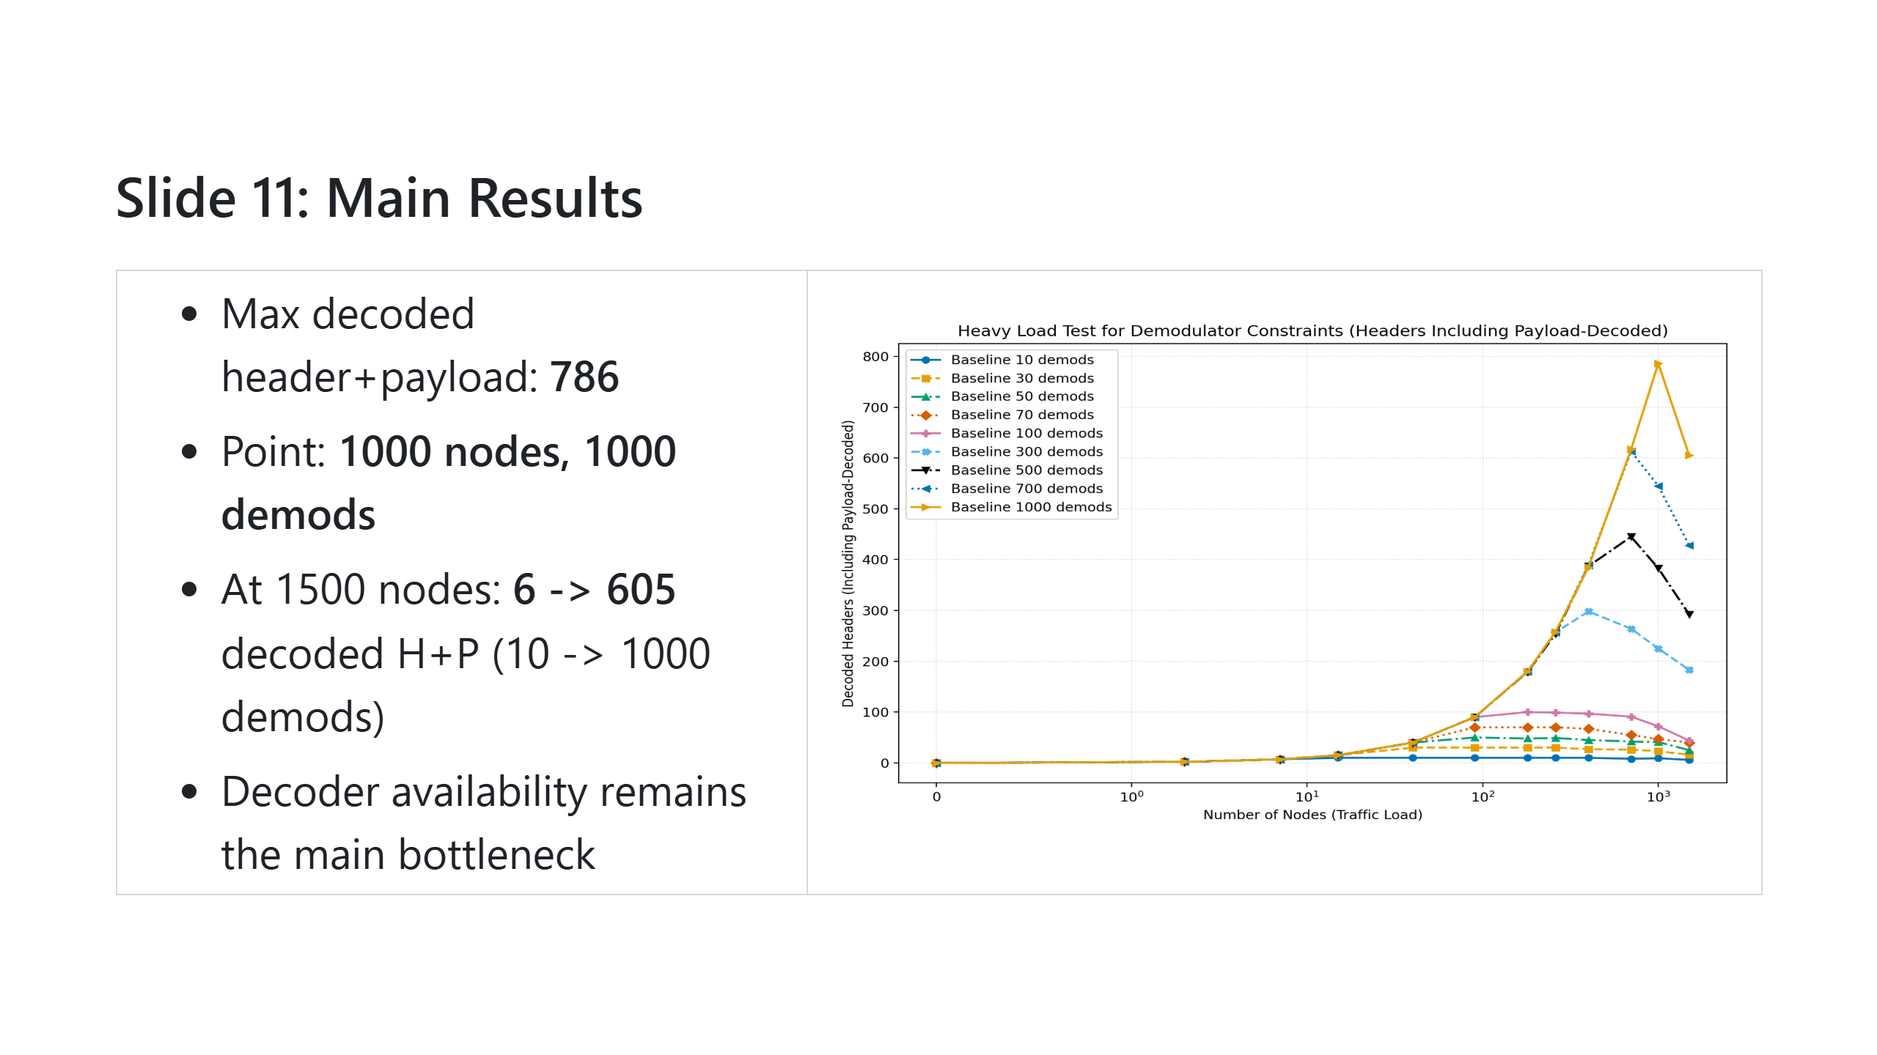
Notes:
**Speaking script** Decoding improves with more demodulators, but scaling is sublinear under congestion. This confirms demodulator constraints as a dominant bottleneck at high load.

Slide 13
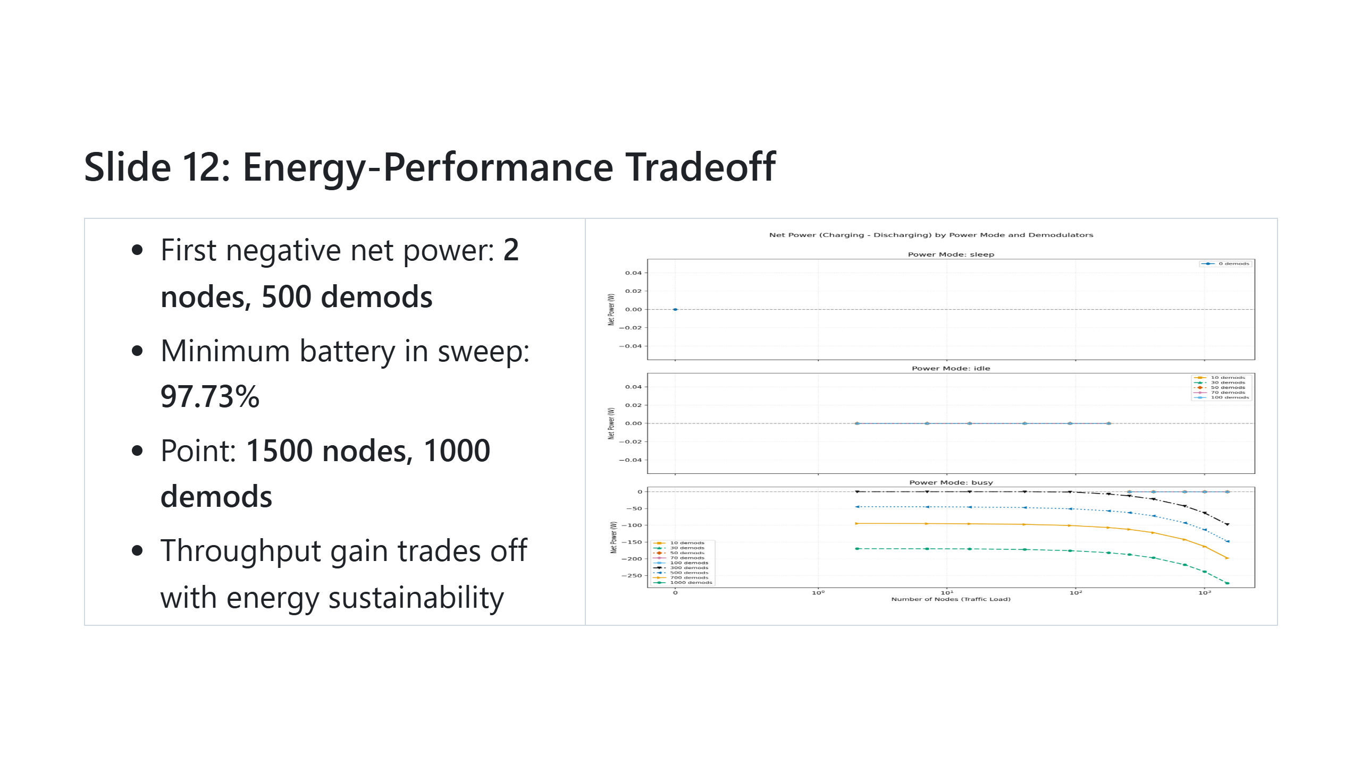
Notes:
**Speaking script** This is the central tradeoff: adding demodulators helps throughput but can move the platform into energy deficit, which is risky for longer mission operation.

Slide 14
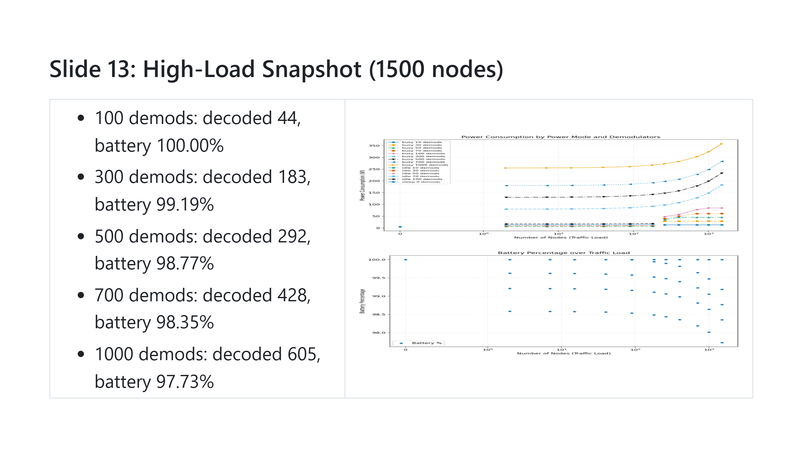
Notes:
**Speaking script** At the highest load, increasing demodulators gives clear decoding gains, but collision counts remain high and battery drops more as power demand increases.

Slide 15
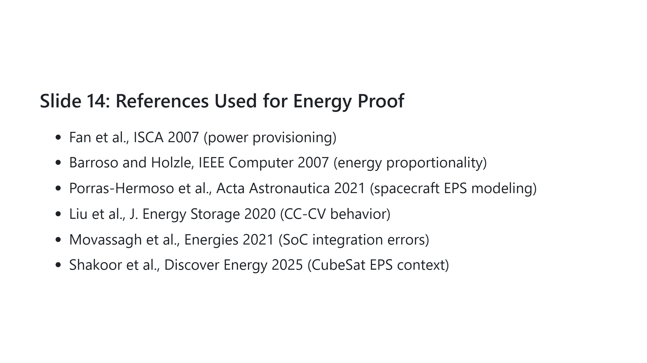
Notes:
**Speaking script** These references are cited only where model assumptions directly correlate with established methods, ensuring citation accuracy and scientific integrity.

Slide 16
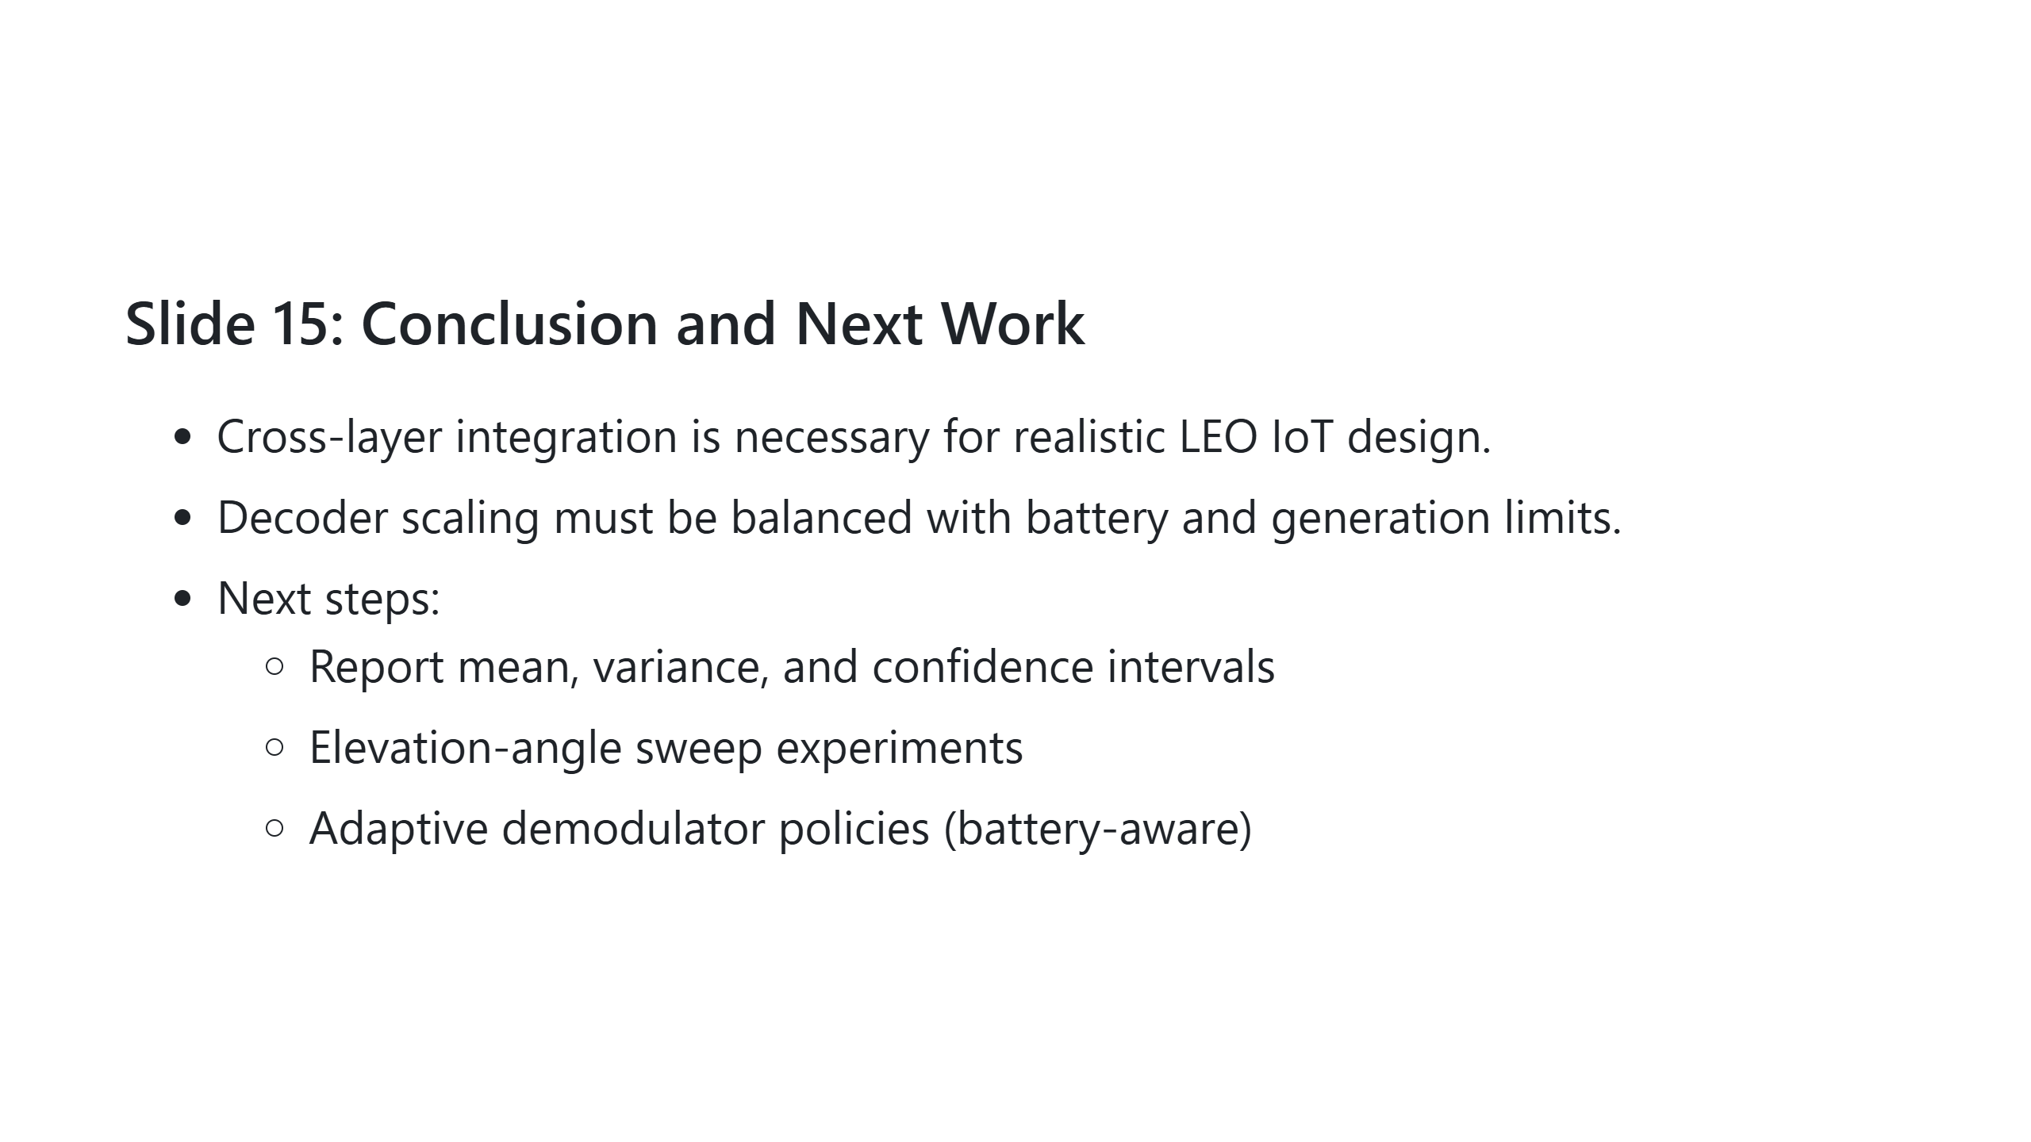
Notes:
**Speaking script** In summary, the framework demonstrates a practical path for jointly optimizing communication capacity and energy sustainability. Next, we will add statistical robustness and adaptive control policies.

