Slide 1
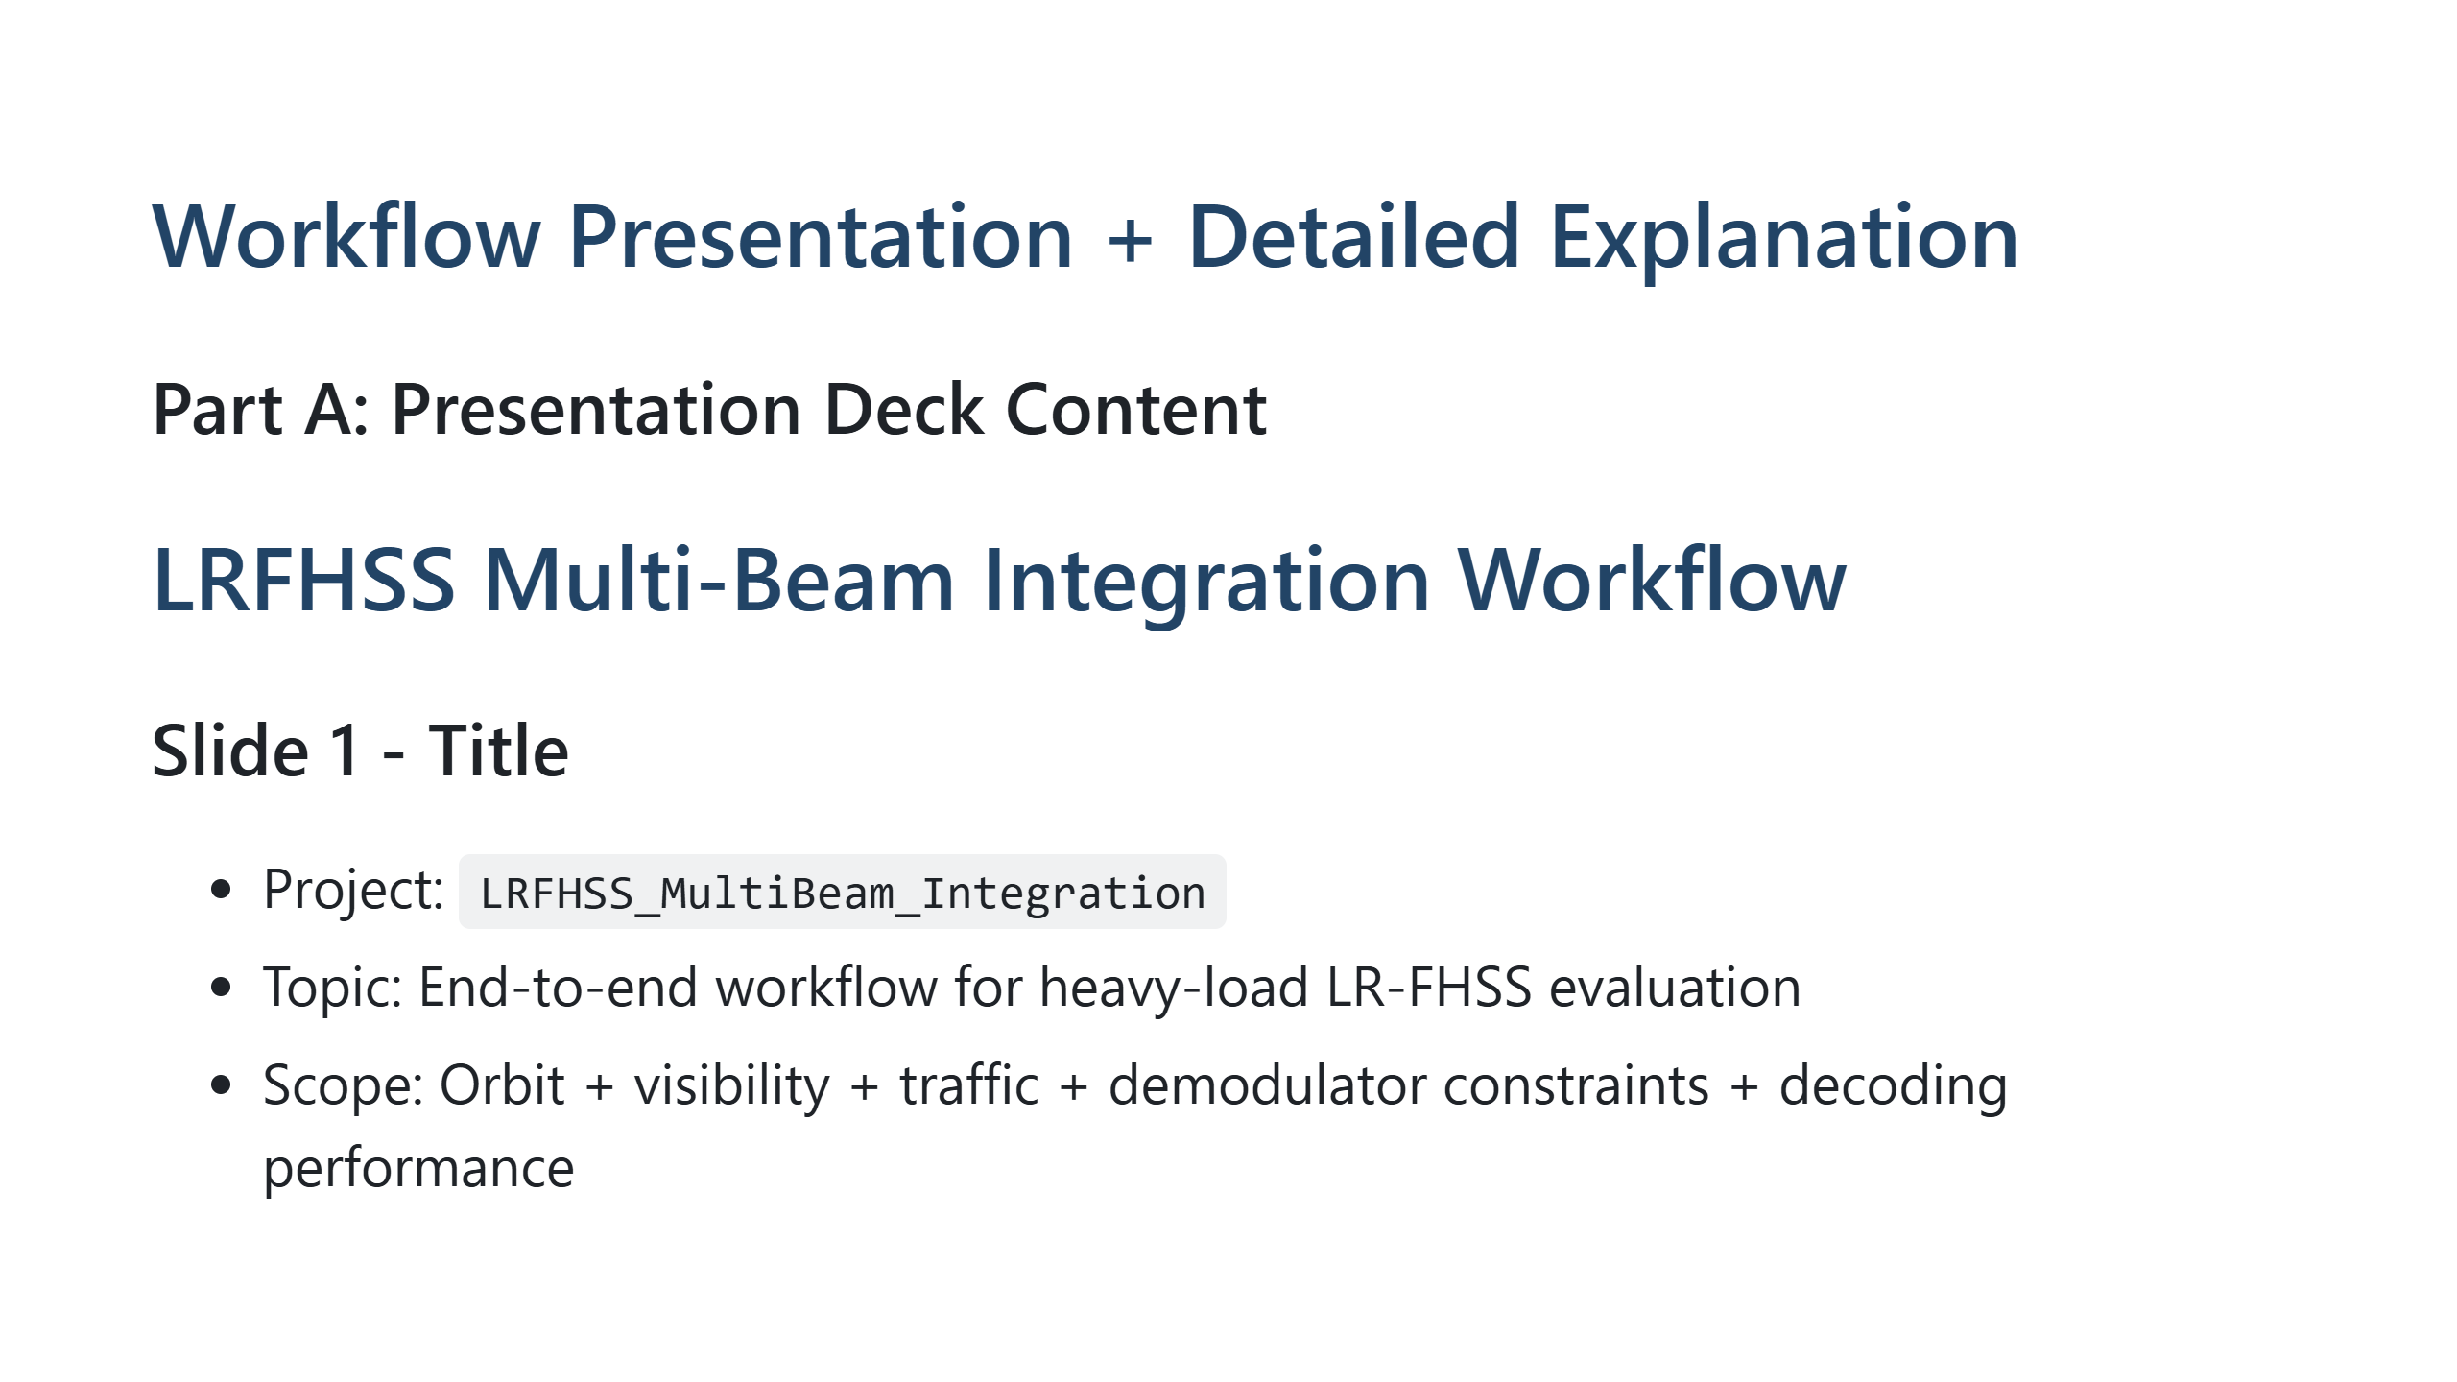
Notes:
Presenter note: Introduce the scope and emphasize this is a full pipeline from satellite geometry to decoding KPIs.

Slide 2
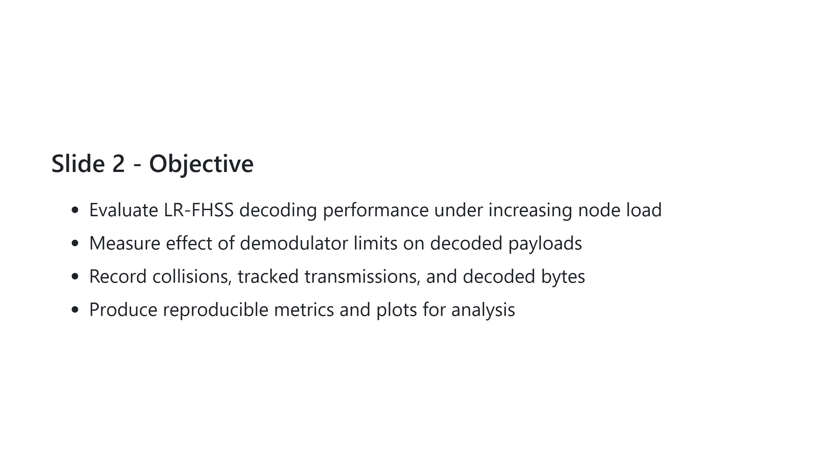
Notes:
Presenter note: State that the main question is where performance breaks first under heavy load.

Slide 3
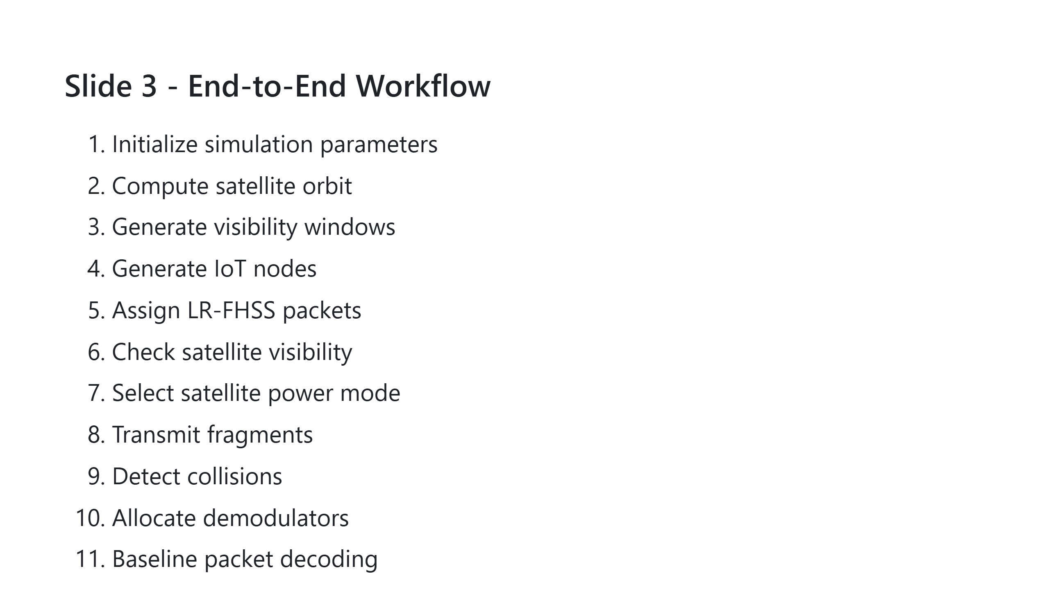
Notes:
Presenter note: Walk through quickly and mention modularity for future extensions.

Slide 4
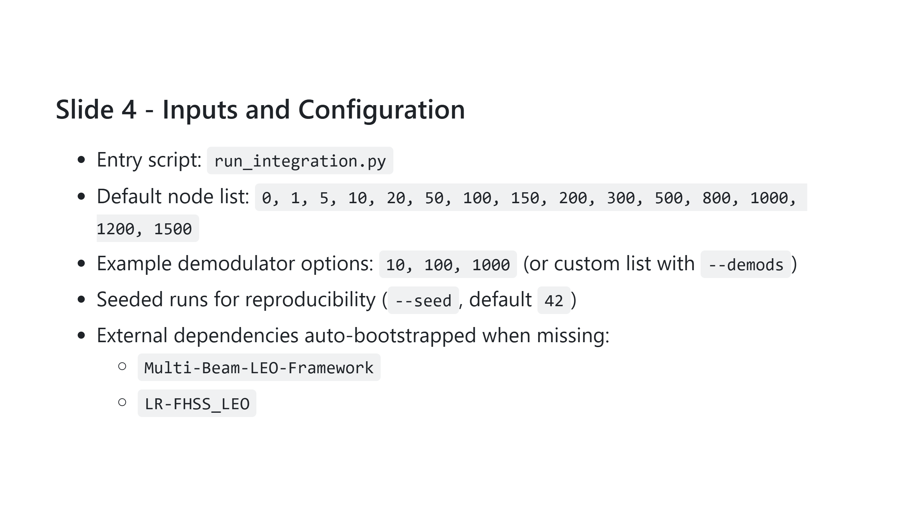
Notes:
Presenter note: Highlight reproducibility and zero-manual setup from dependency bootstrap.

Slide 5
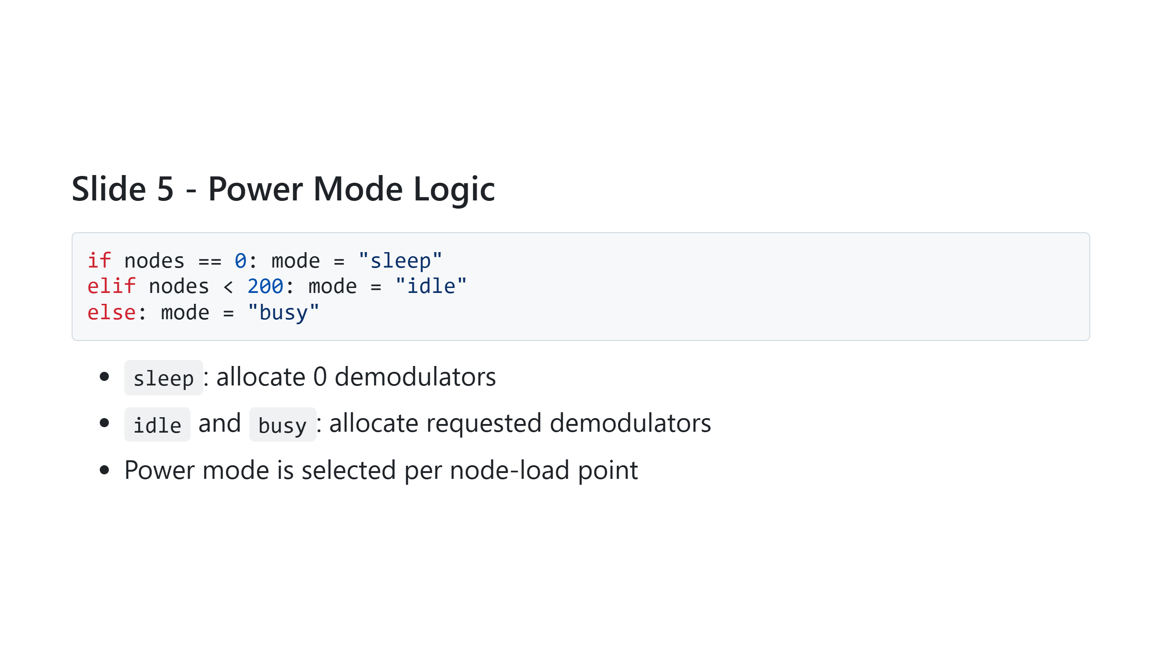
Notes:
Presenter note: Explain that this is a simple policy baseline and can be replaced by smarter adaptive policies.

Slide 6
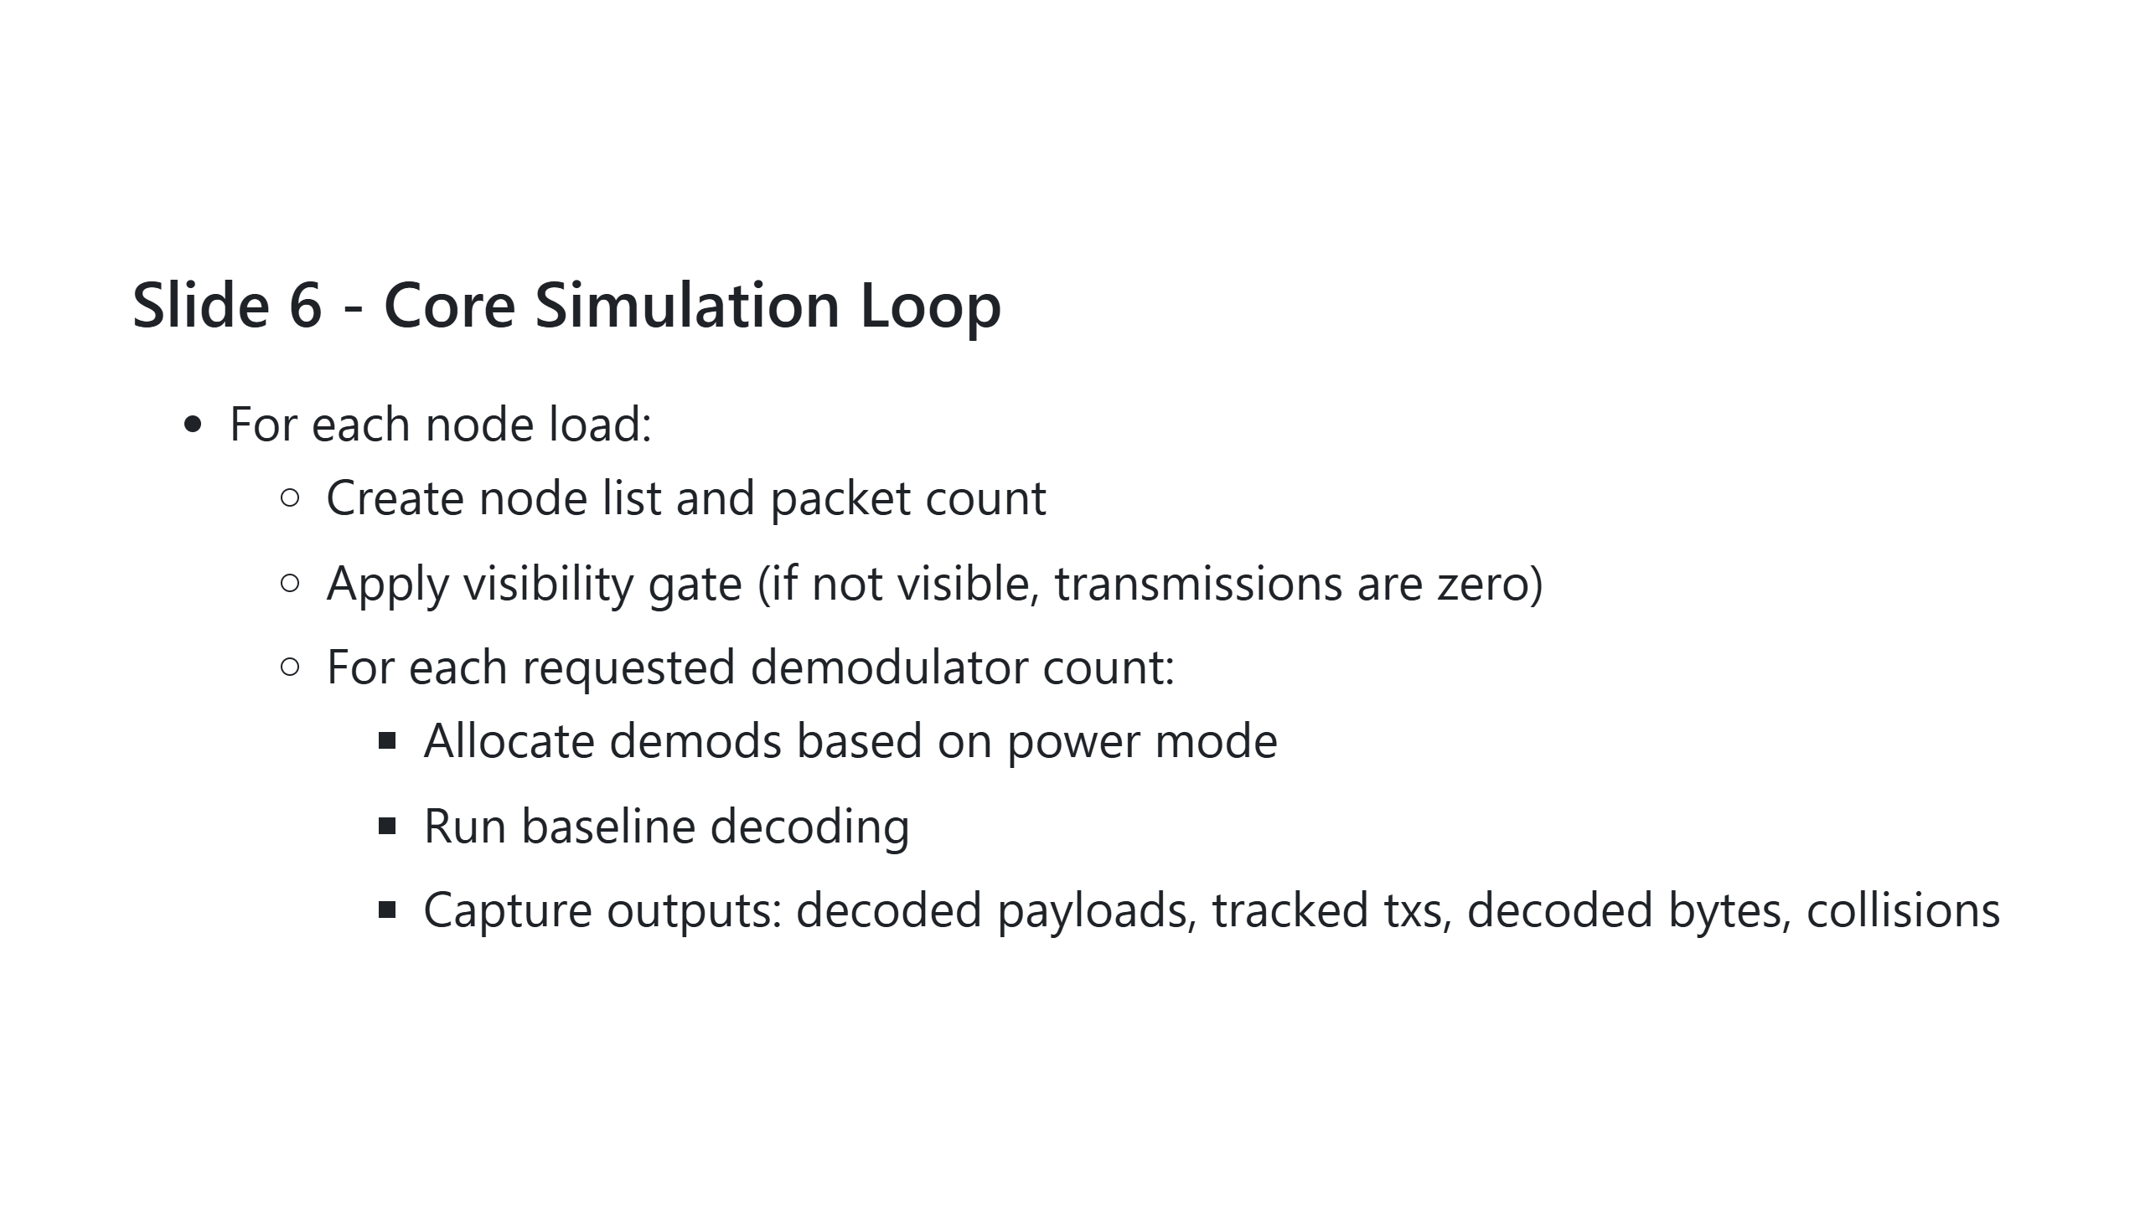
Notes:
Presenter note: Emphasize this loop is the experiment matrix: nodes x demods.

Slide 7
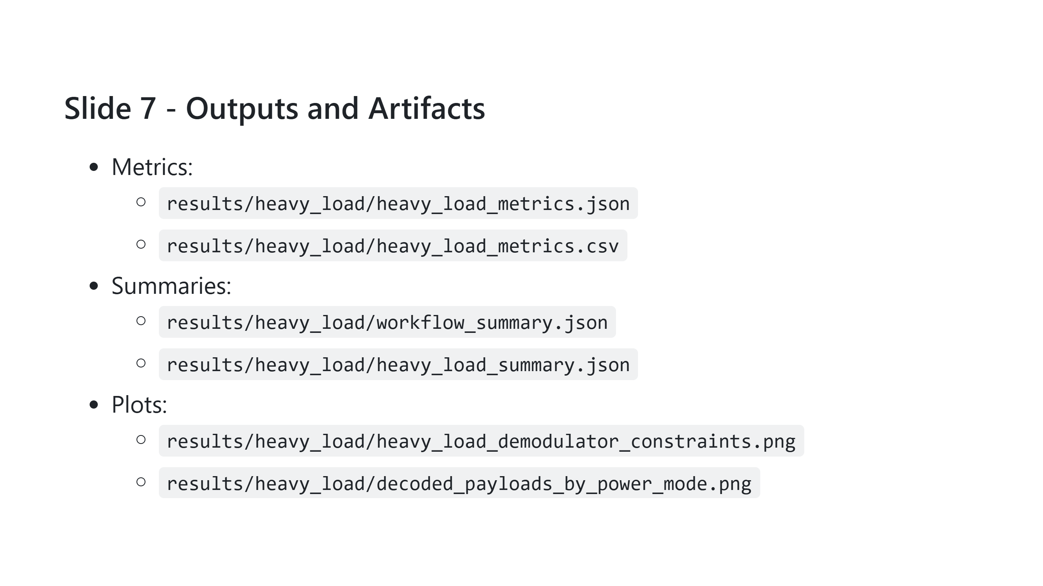
Notes:
Presenter note: Mention that CSV supports post-analysis while PNG enables immediate reporting.

Slide 8
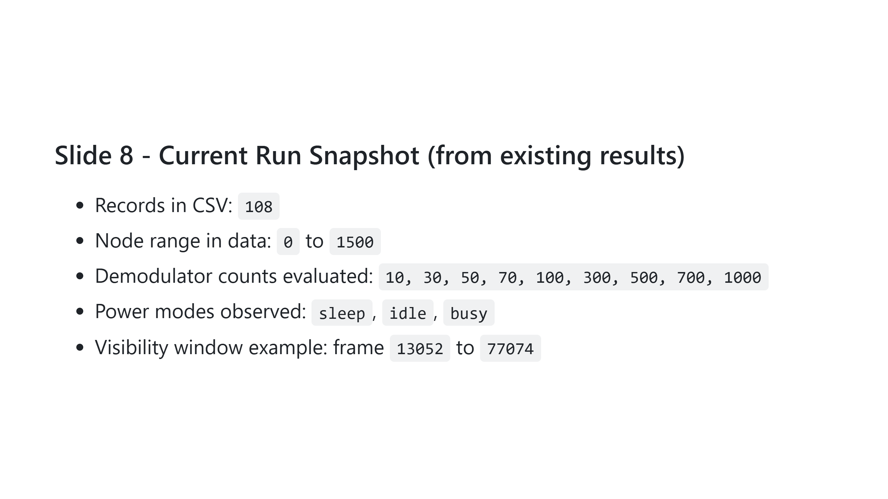
Notes:
Presenter note: Use this slide to confirm coverage and reassure audience the sweep is broad.

Slide 9
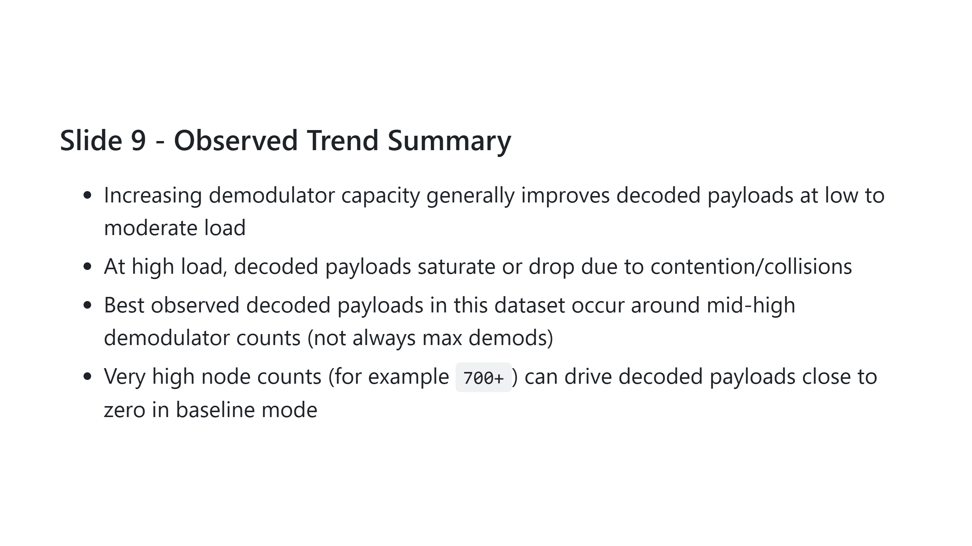
Notes:
Presenter note: Stress that collision behavior, not only demod budget, dominates in heavy-load regimes.

Slide 10
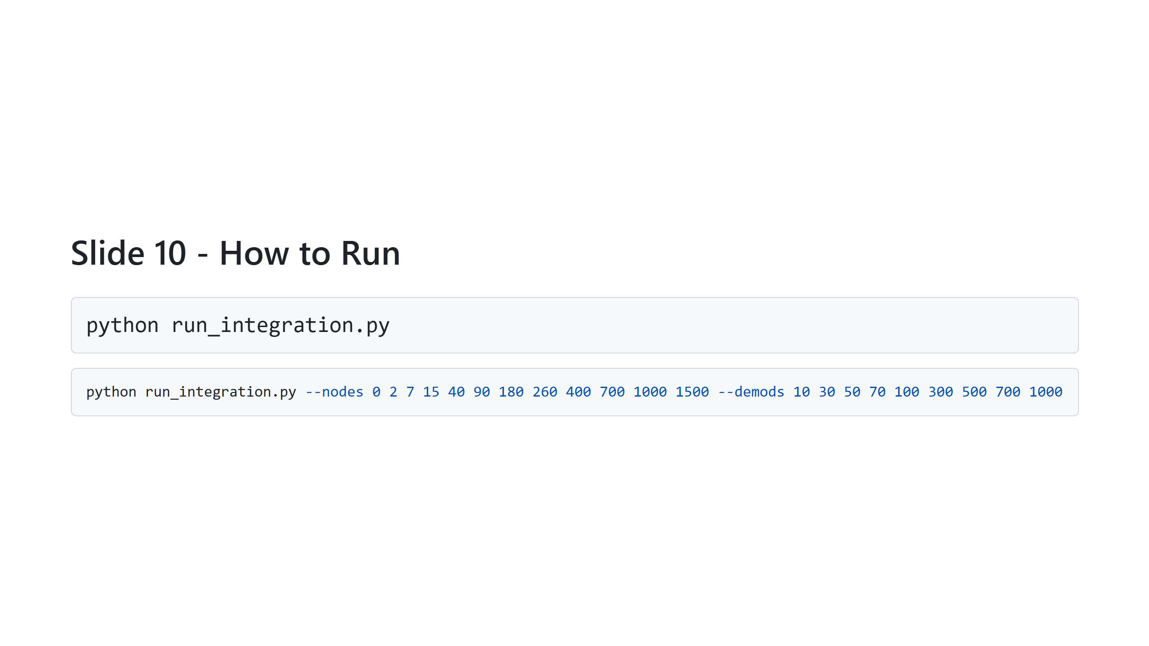
Notes:
Presenter note: Mention first command for default execution and second for custom sweeps.

Slide 11
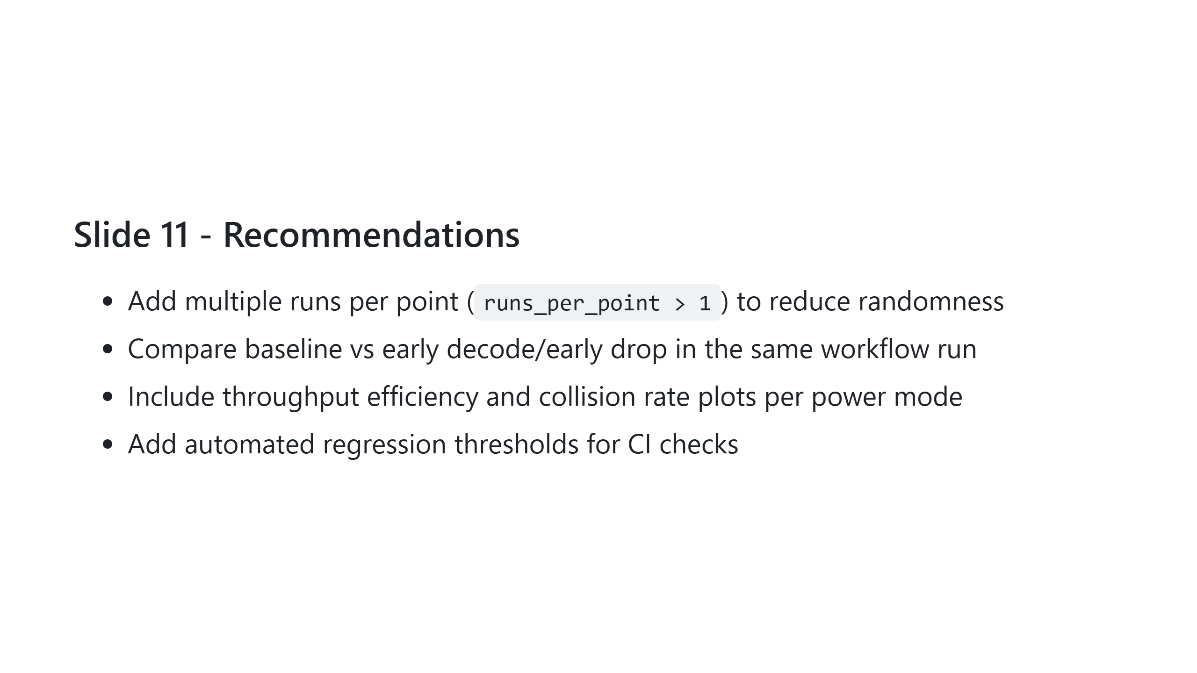
Notes:
Presenter note: Position these as actionable next steps for stronger experimental confidence.

Slide 12
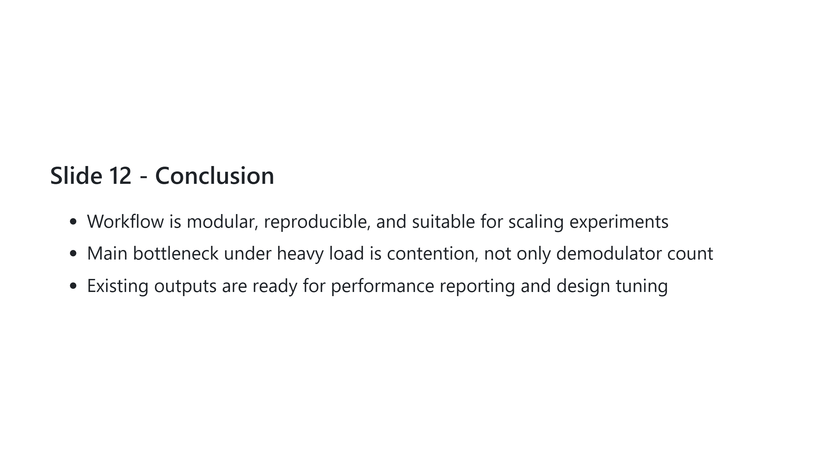
Notes:
Presenter note: End by tying technical findings to practical optimization direction.

Slide 13
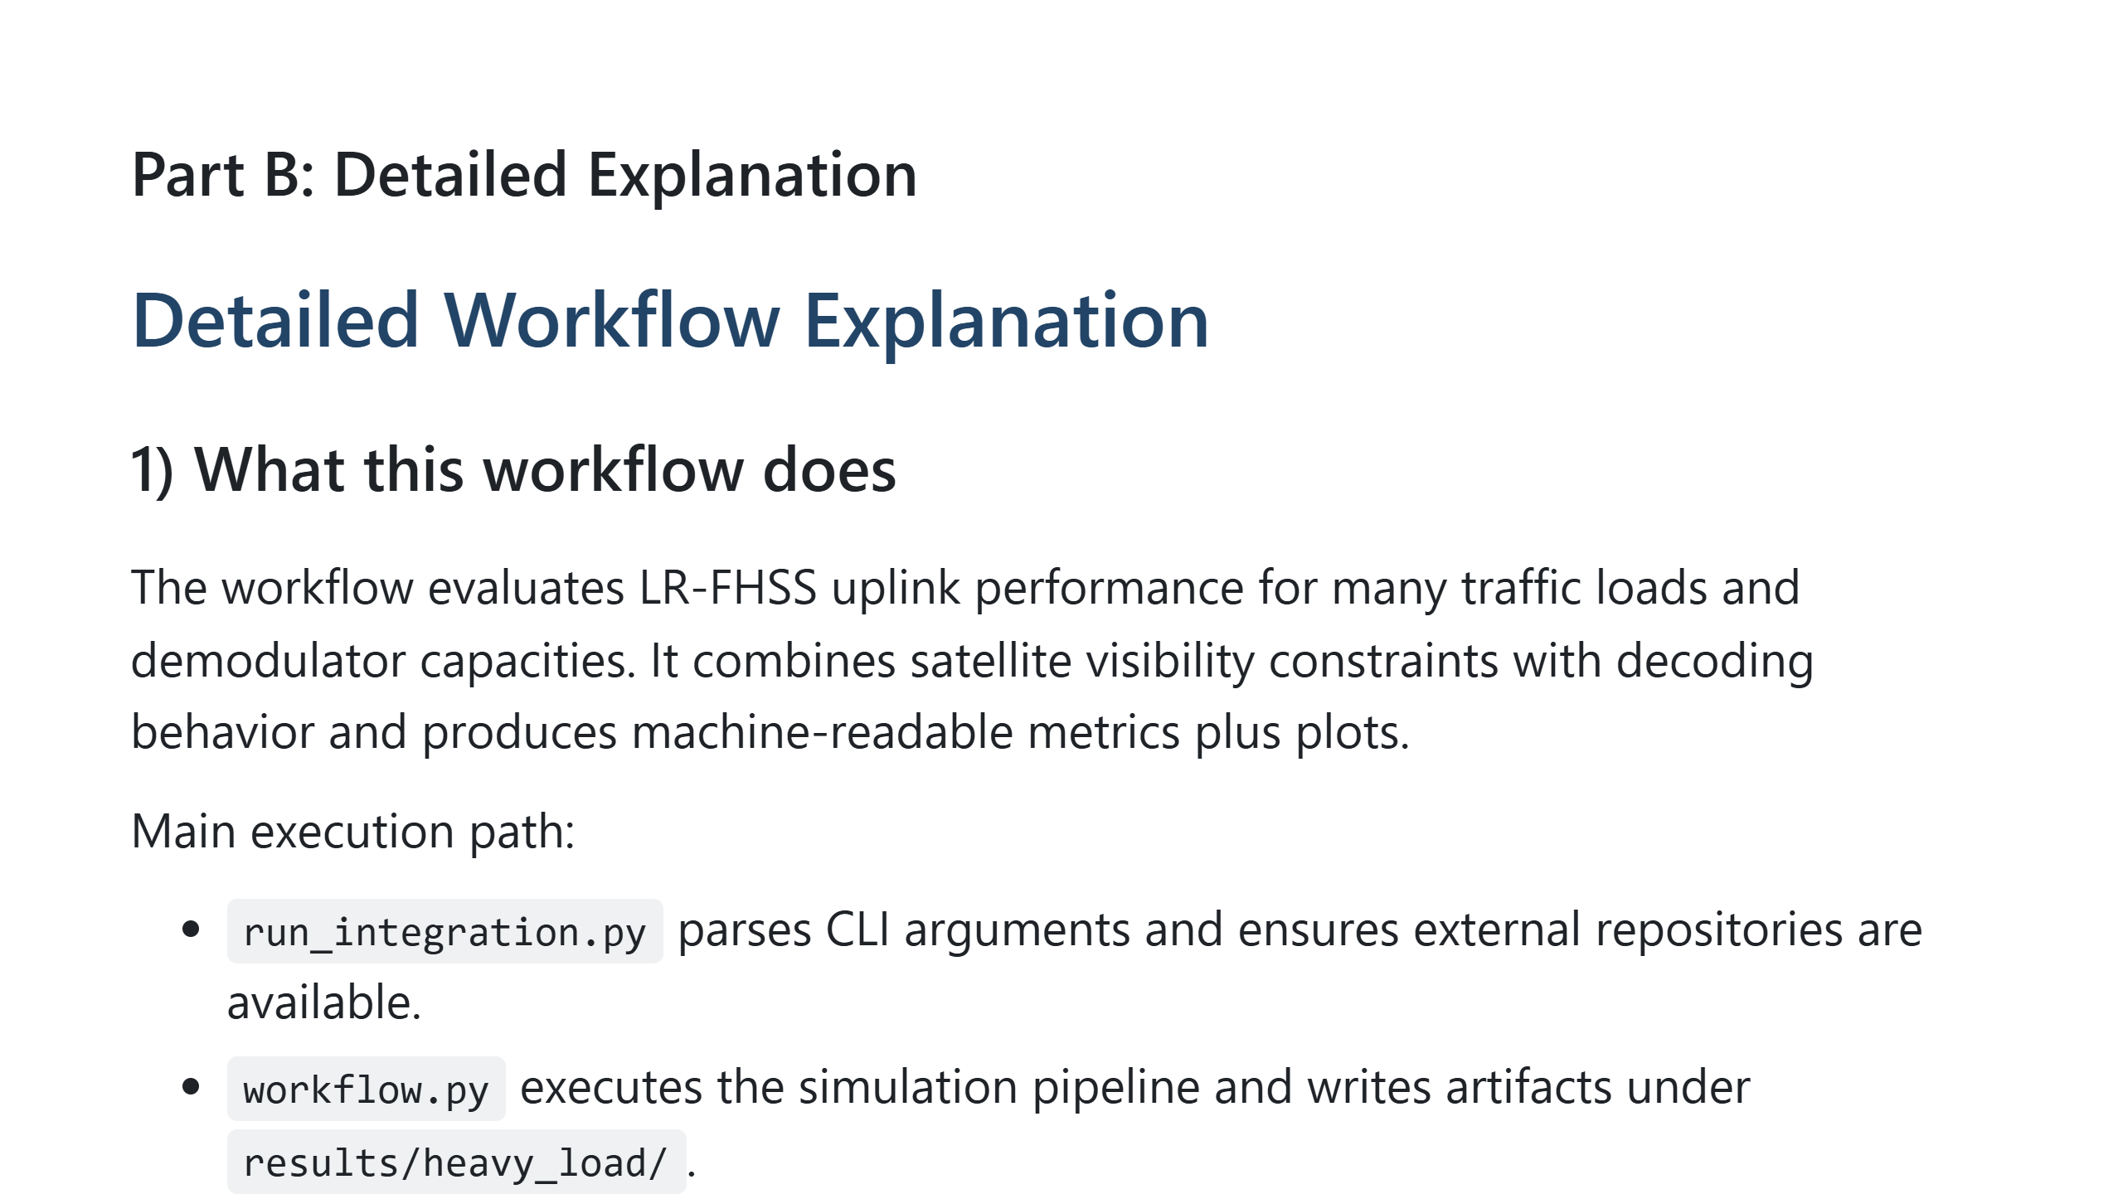

Slide 14
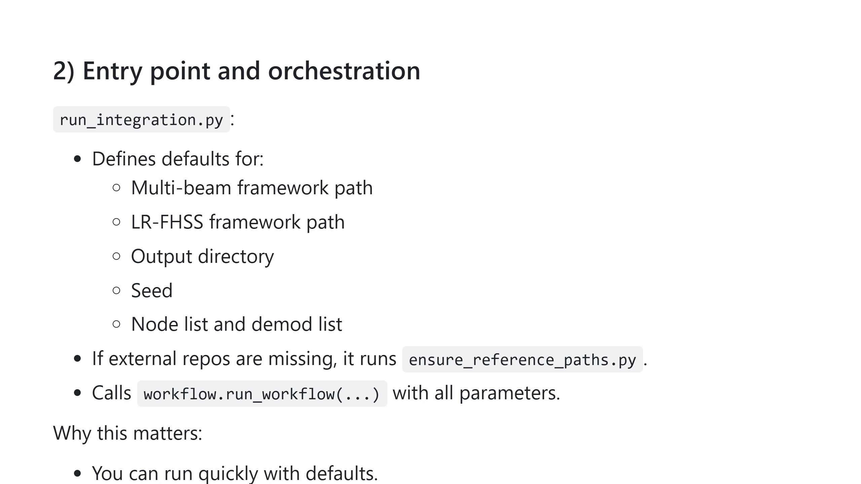

Slide 15
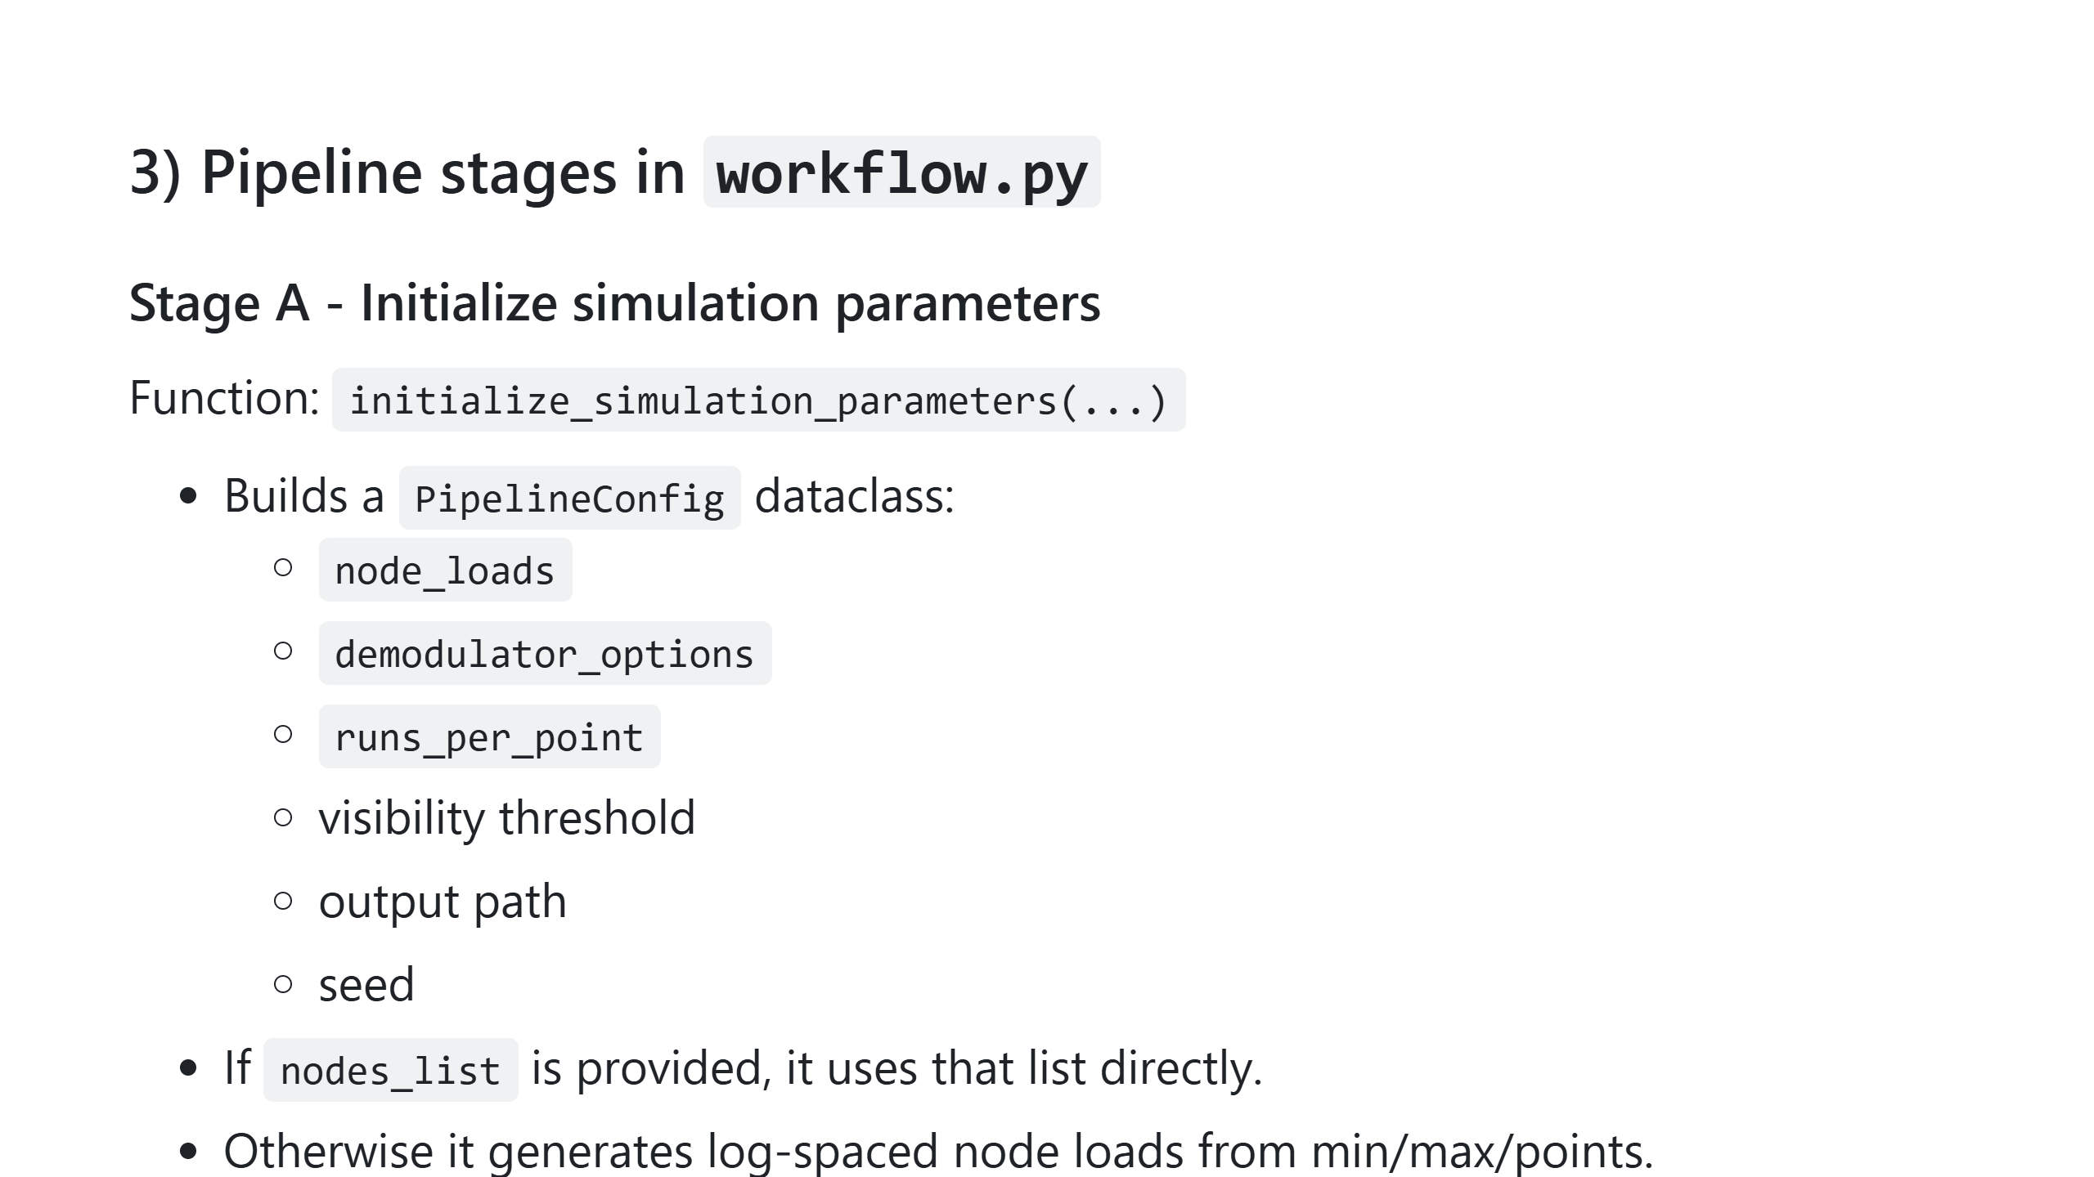

Slide 16
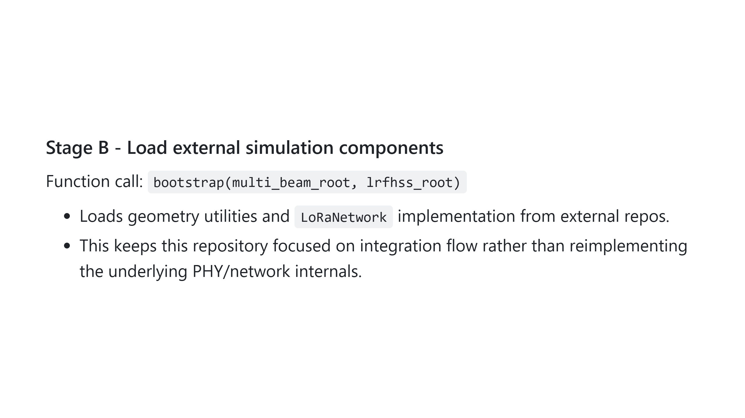

Slide 17
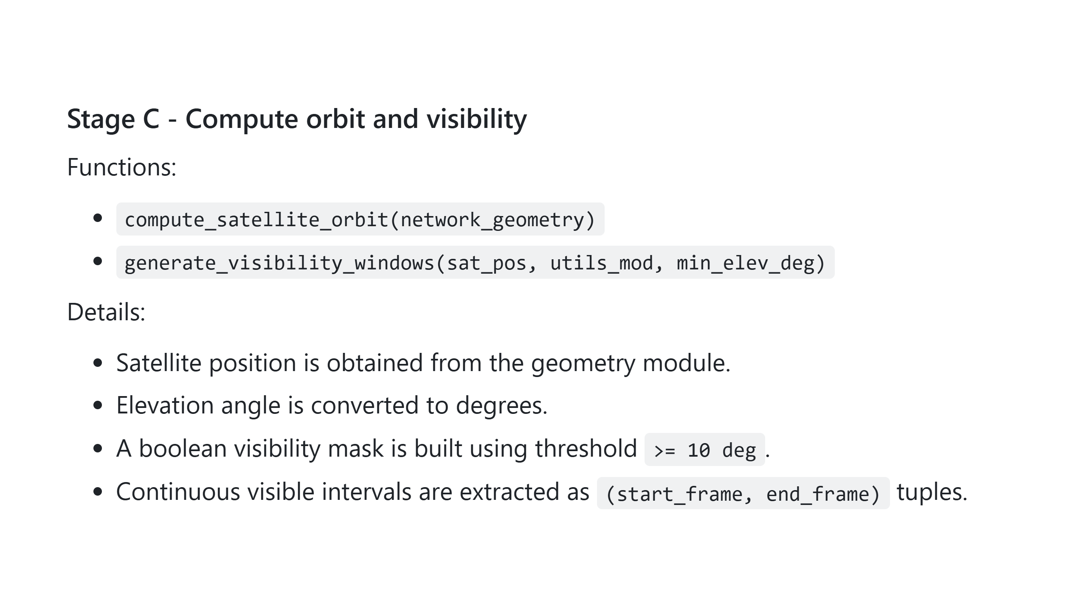

Slide 18
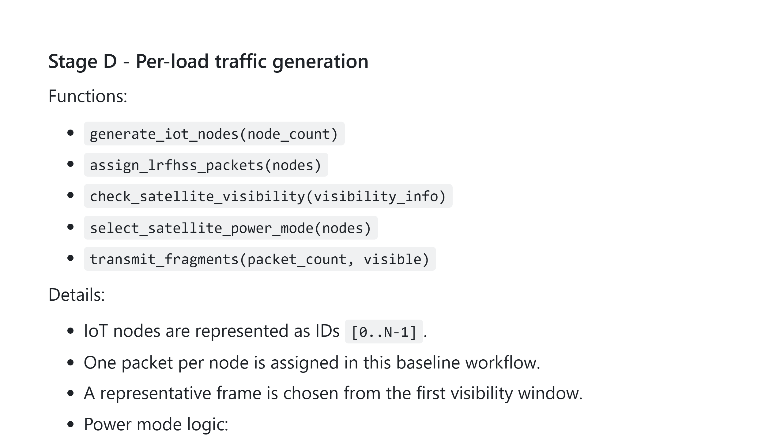

Slide 19
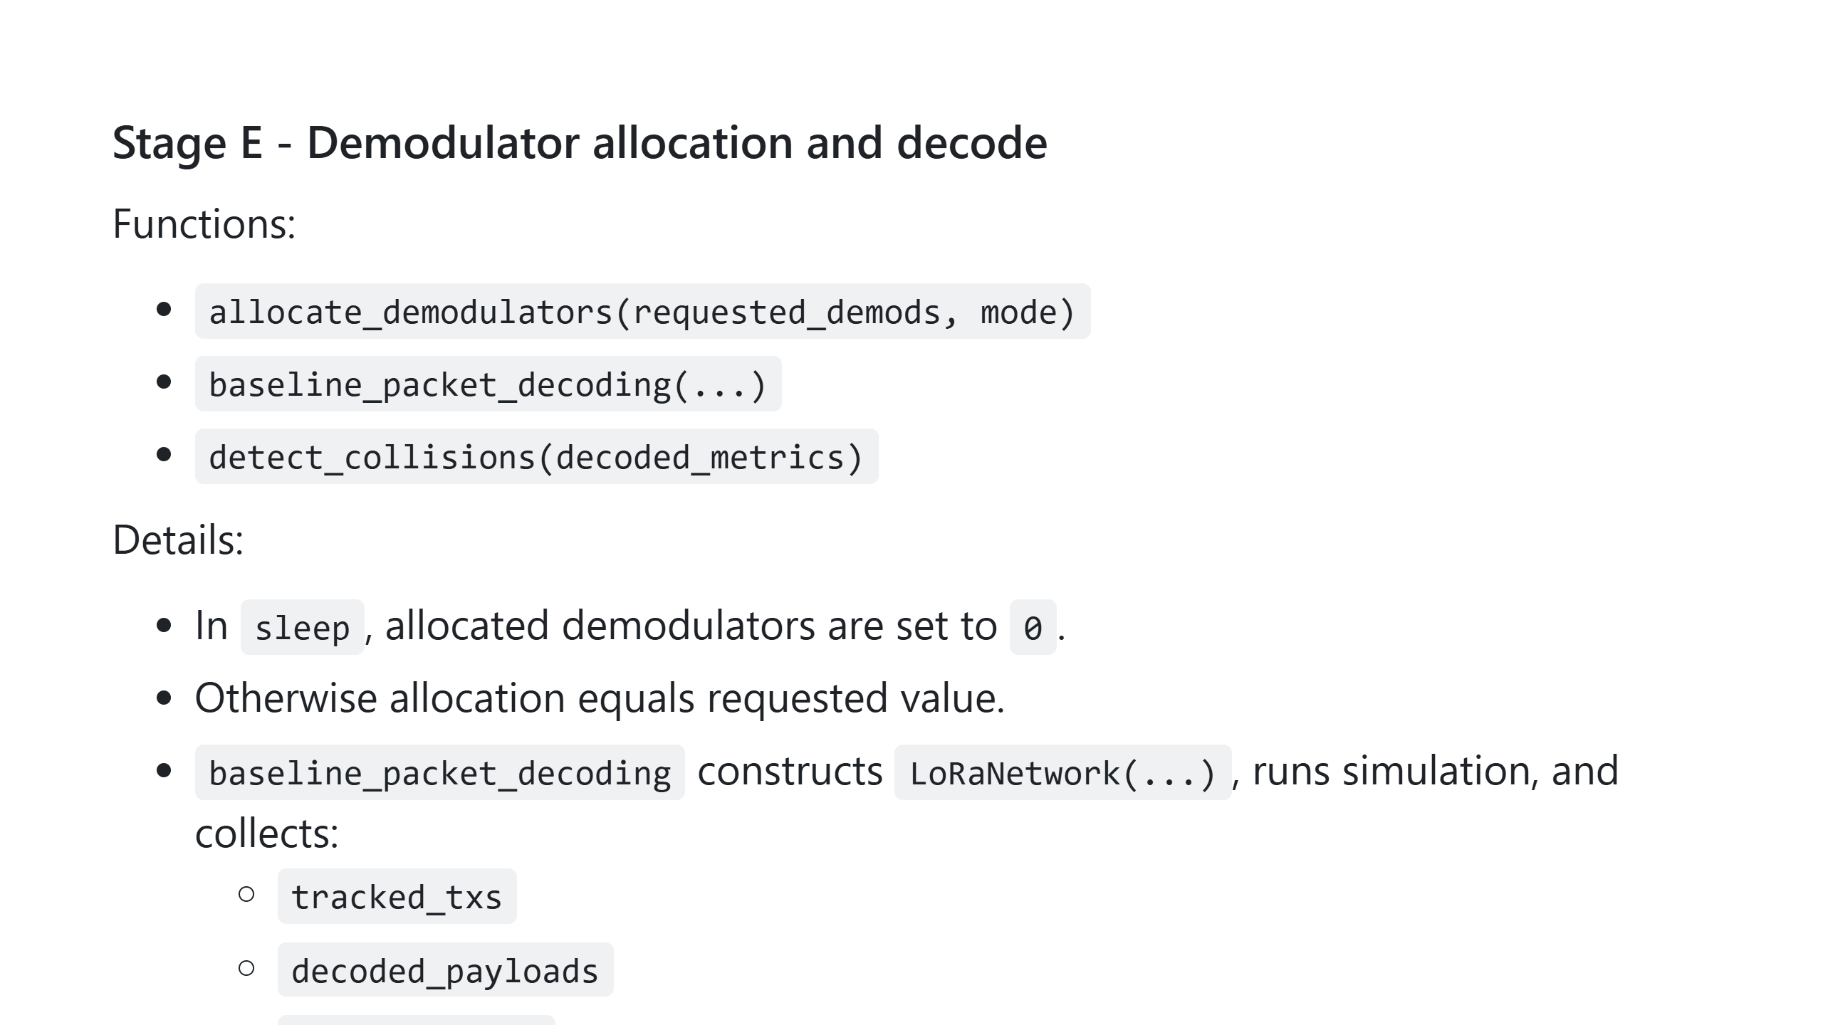

Slide 20
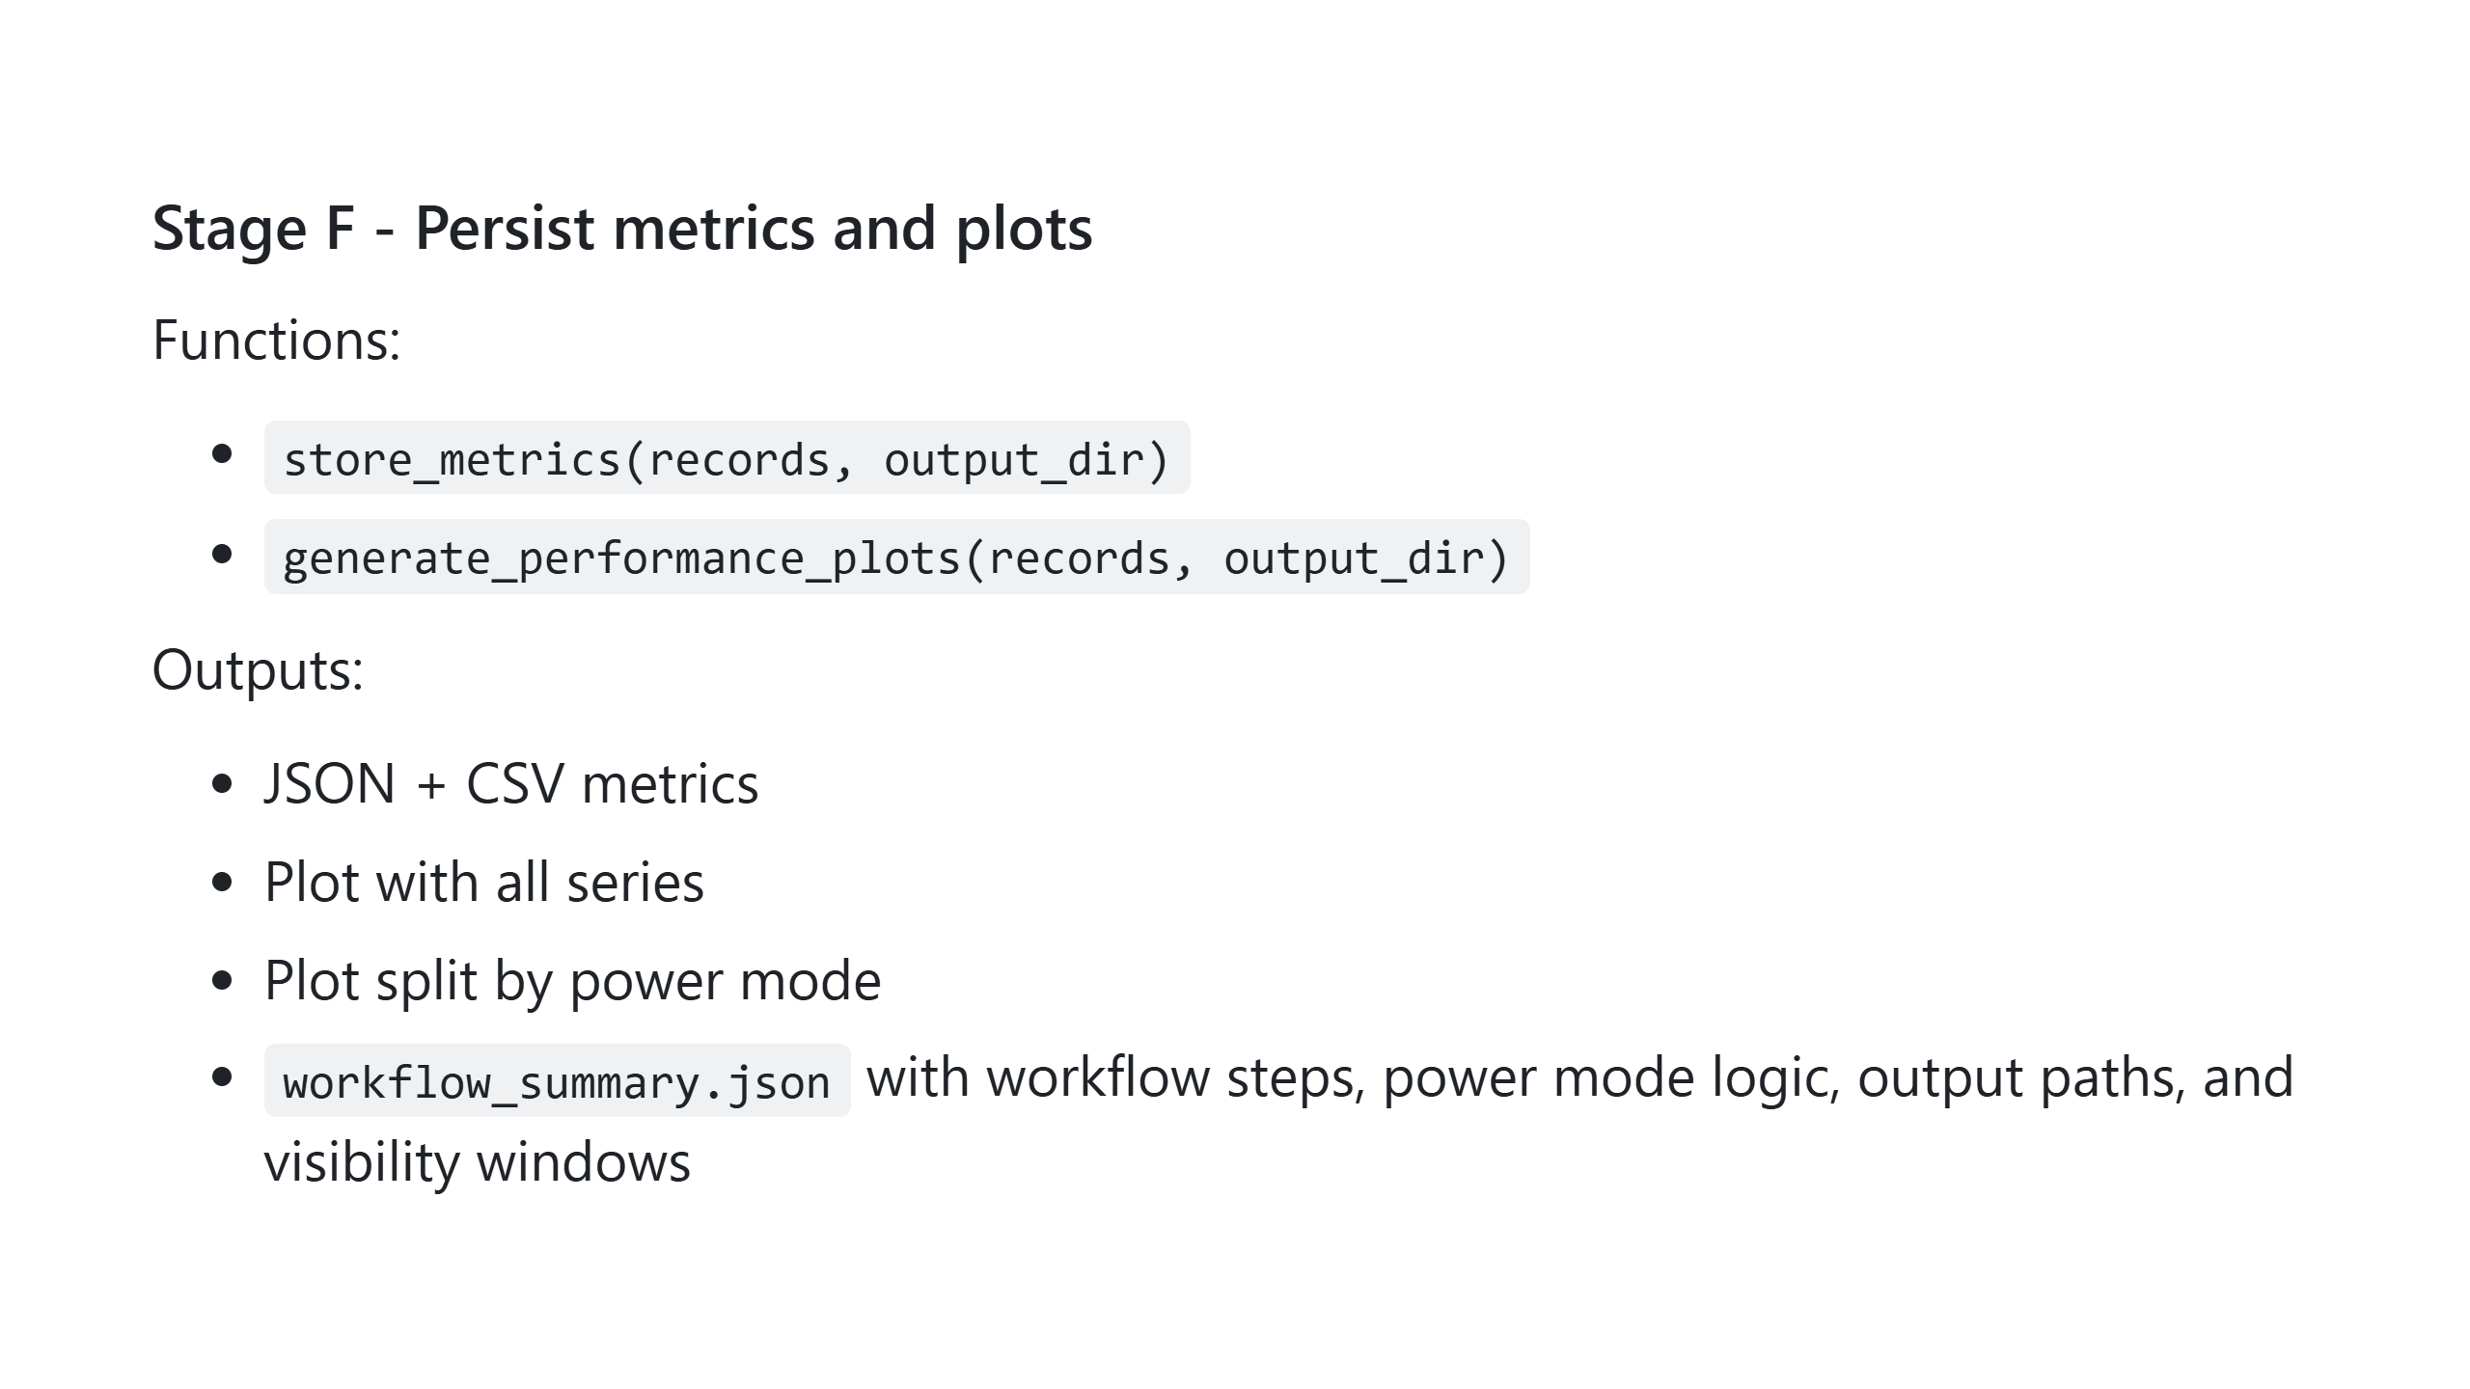

Slide 21
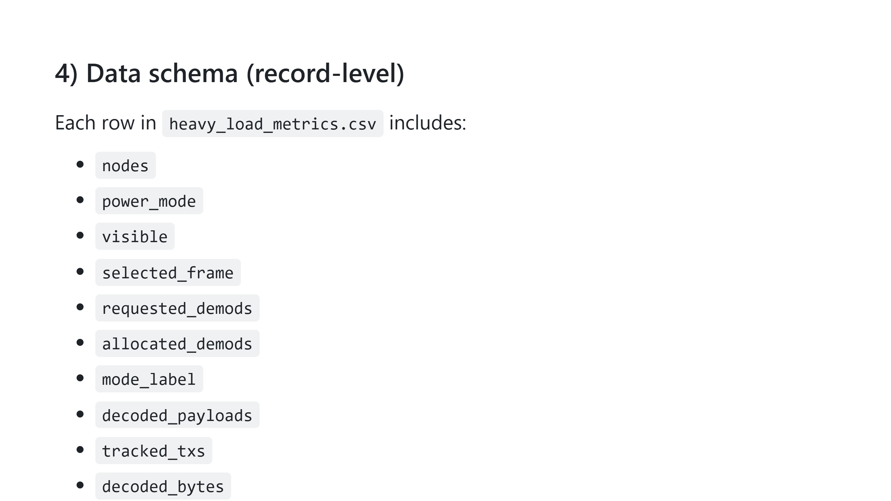

Slide 22
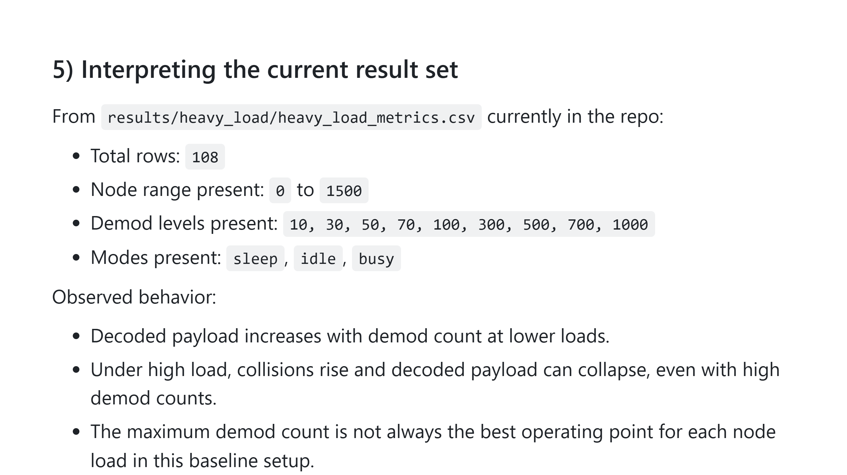

Slide 23
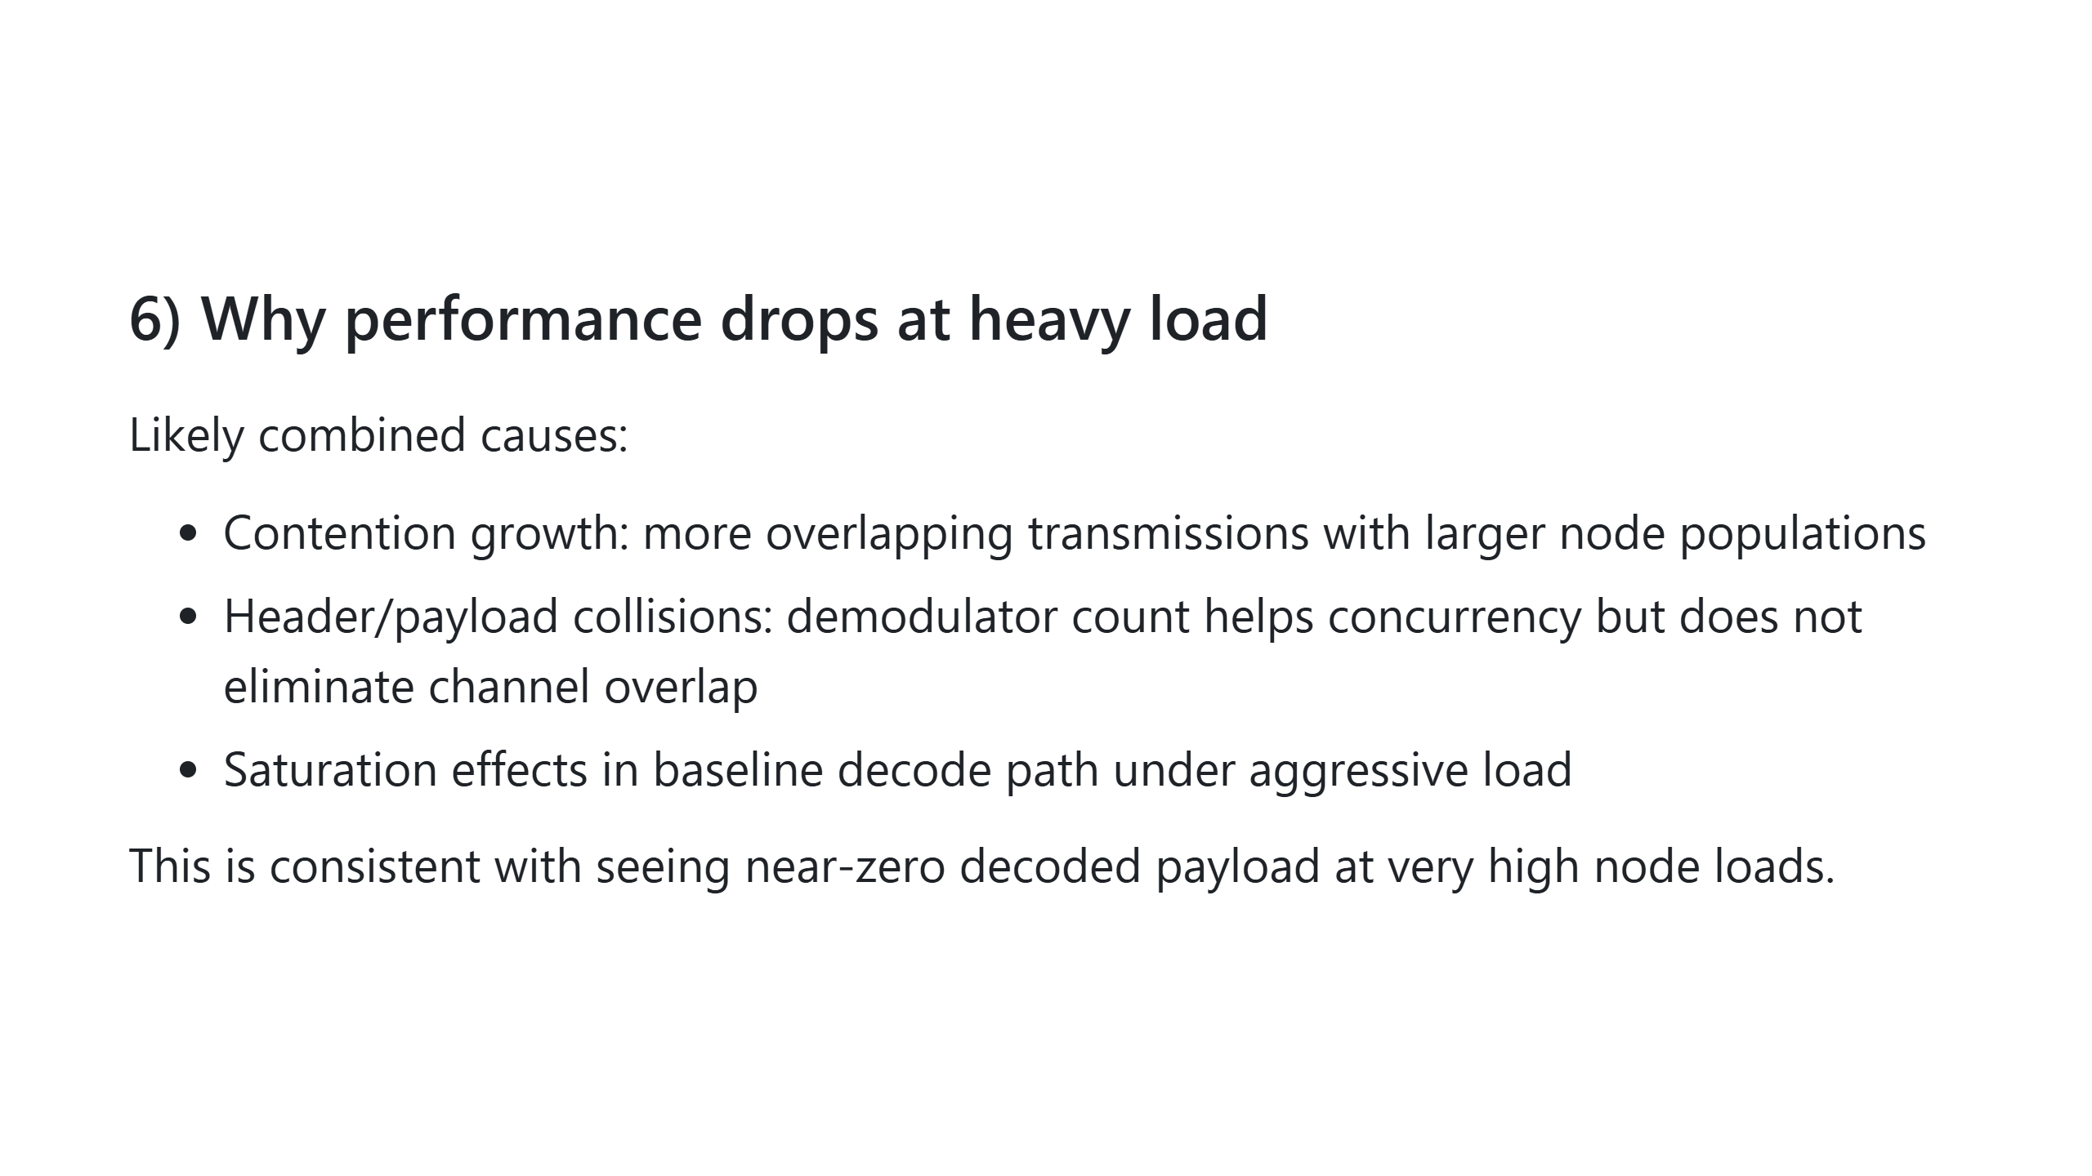

Slide 24
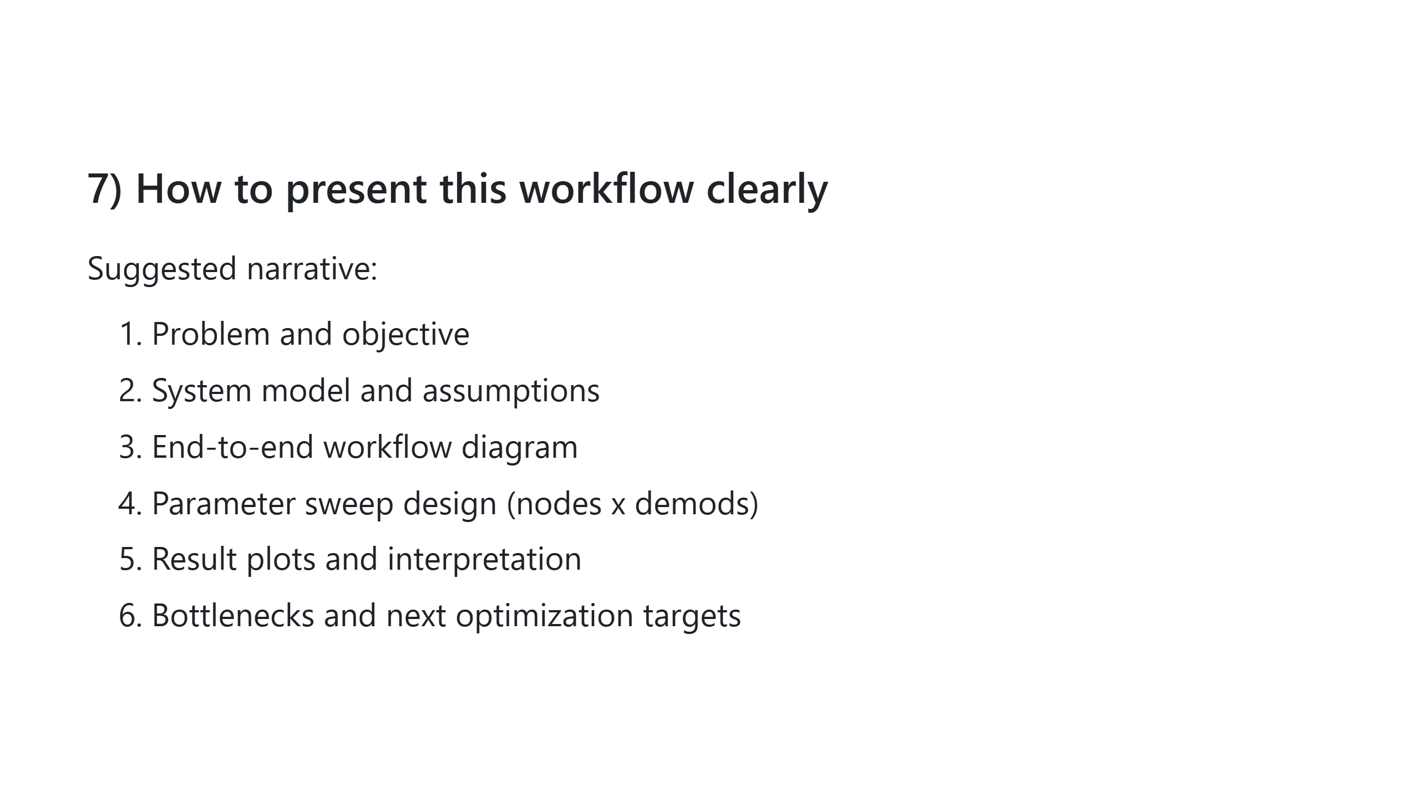

Slide 25
