Slide 1
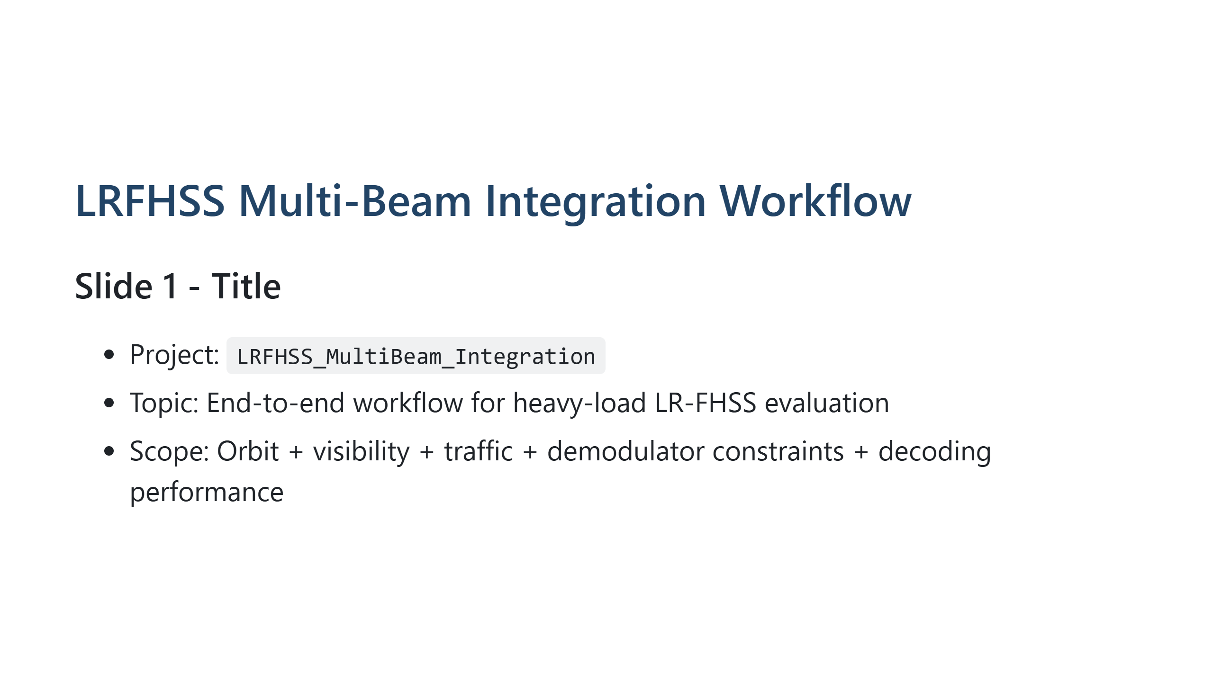
Notes:
Presenter note: Introduce the scope and emphasize this is a full pipeline from satellite geometry to decoding KPIs.

Slide 2
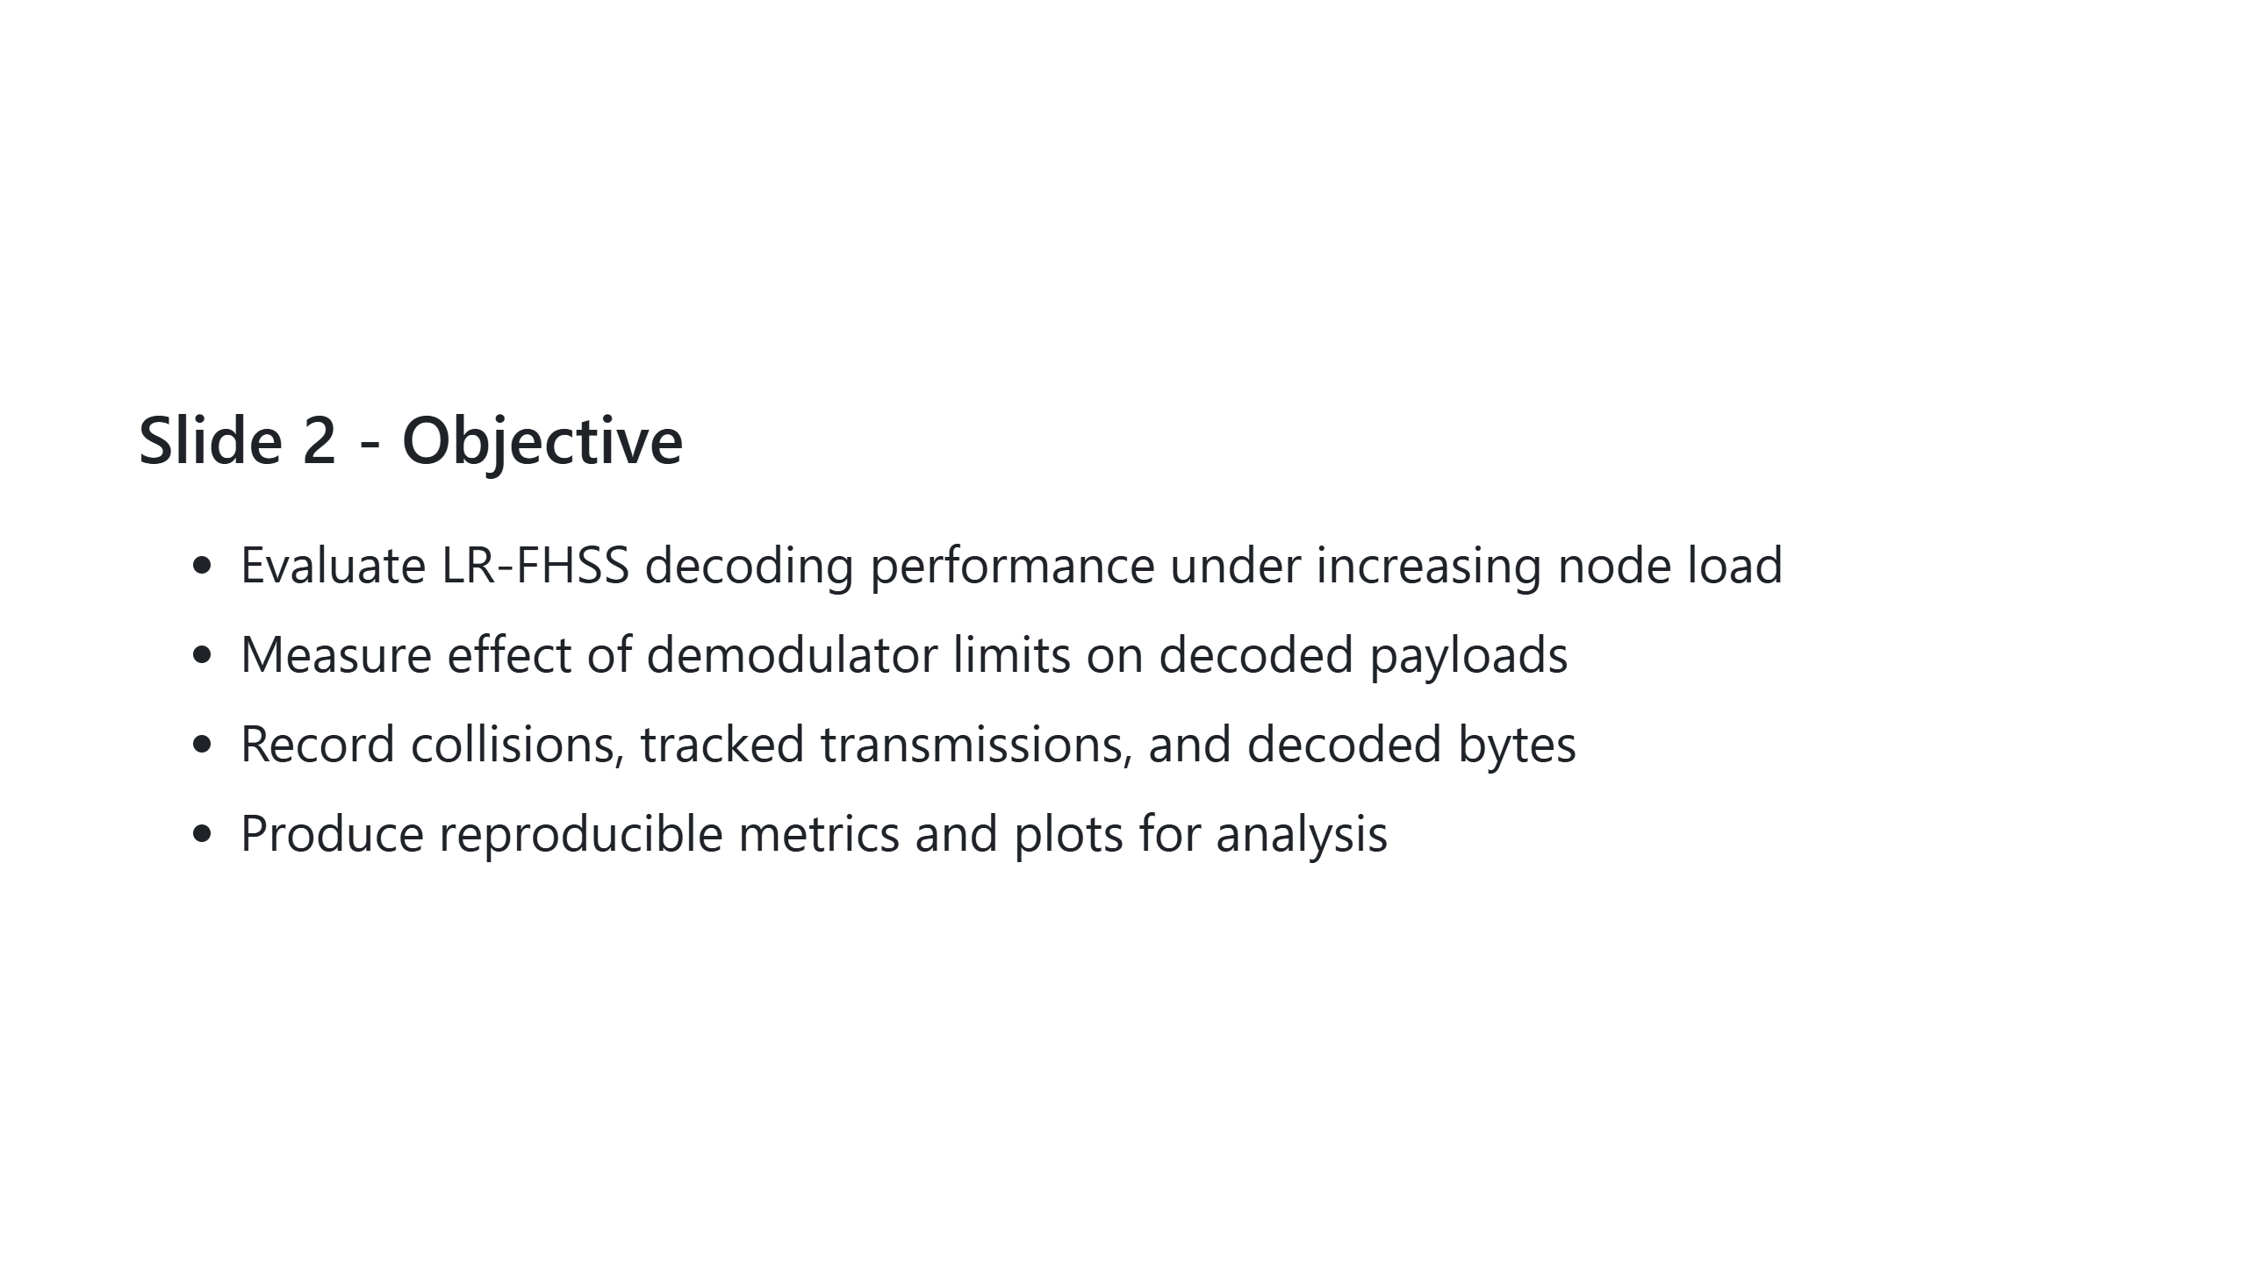
Notes:
Presenter note: State that the main question is where performance breaks first under heavy load.

Slide 3
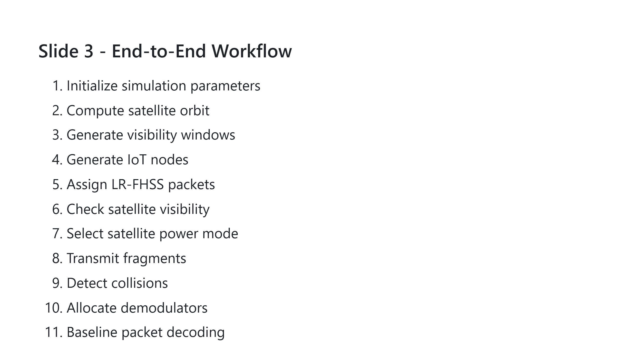
Notes:
Presenter note: Walk through quickly and mention modularity for future extensions.

Slide 4
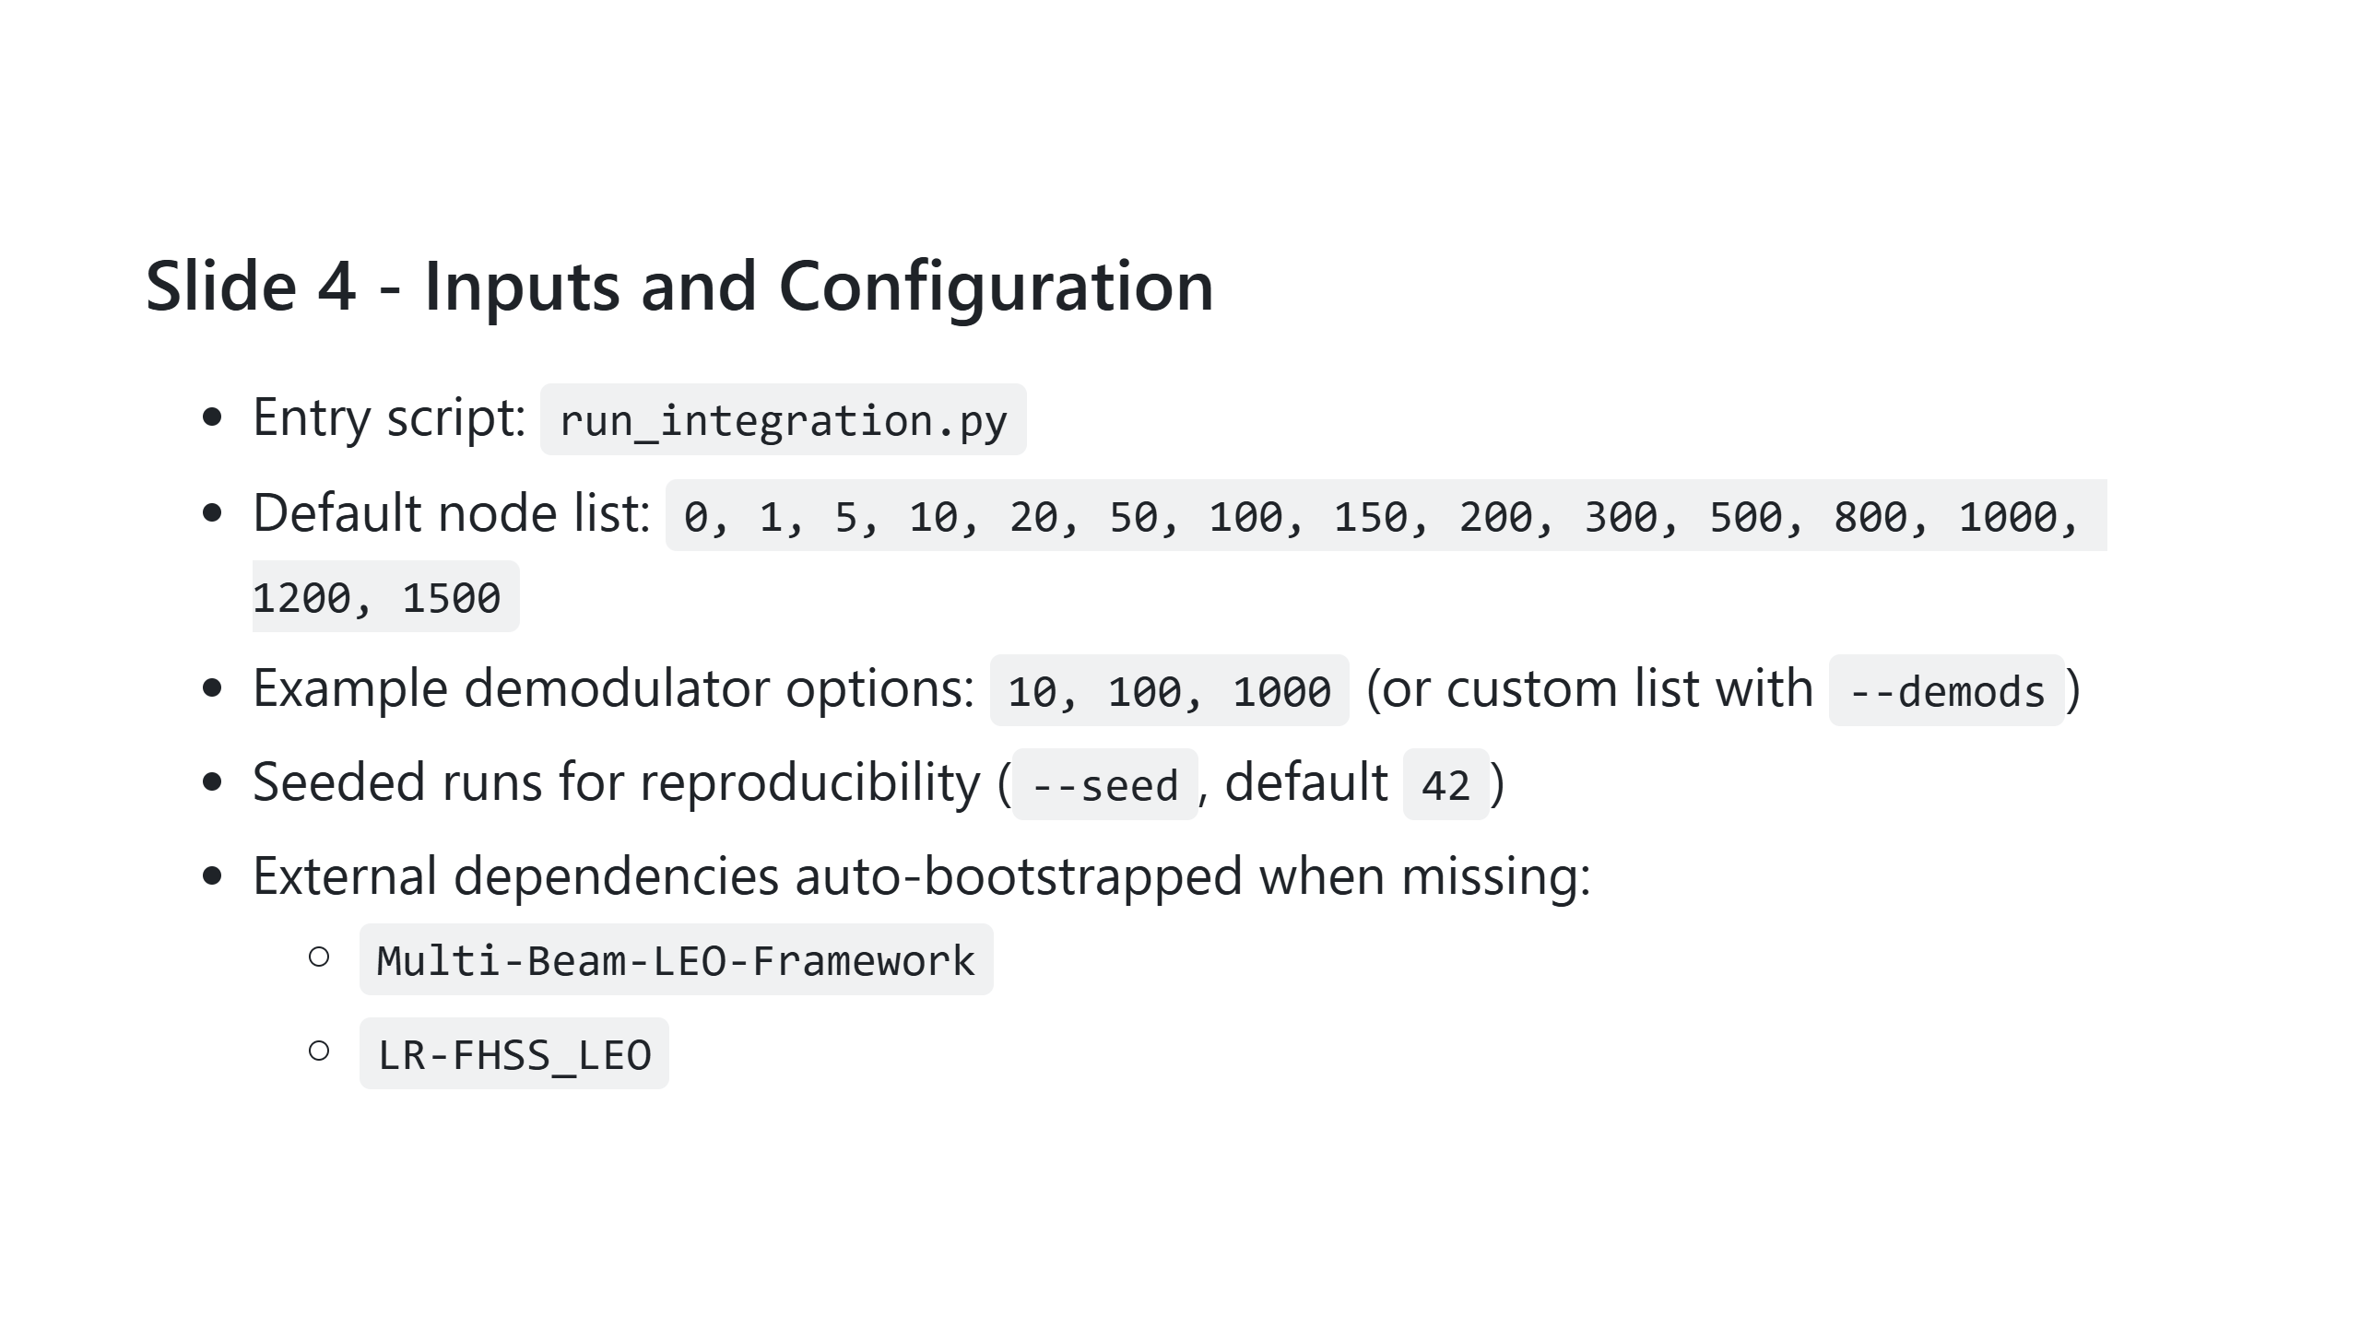
Notes:
Presenter note: Highlight reproducibility and zero-manual setup from dependency bootstrap.

Slide 5
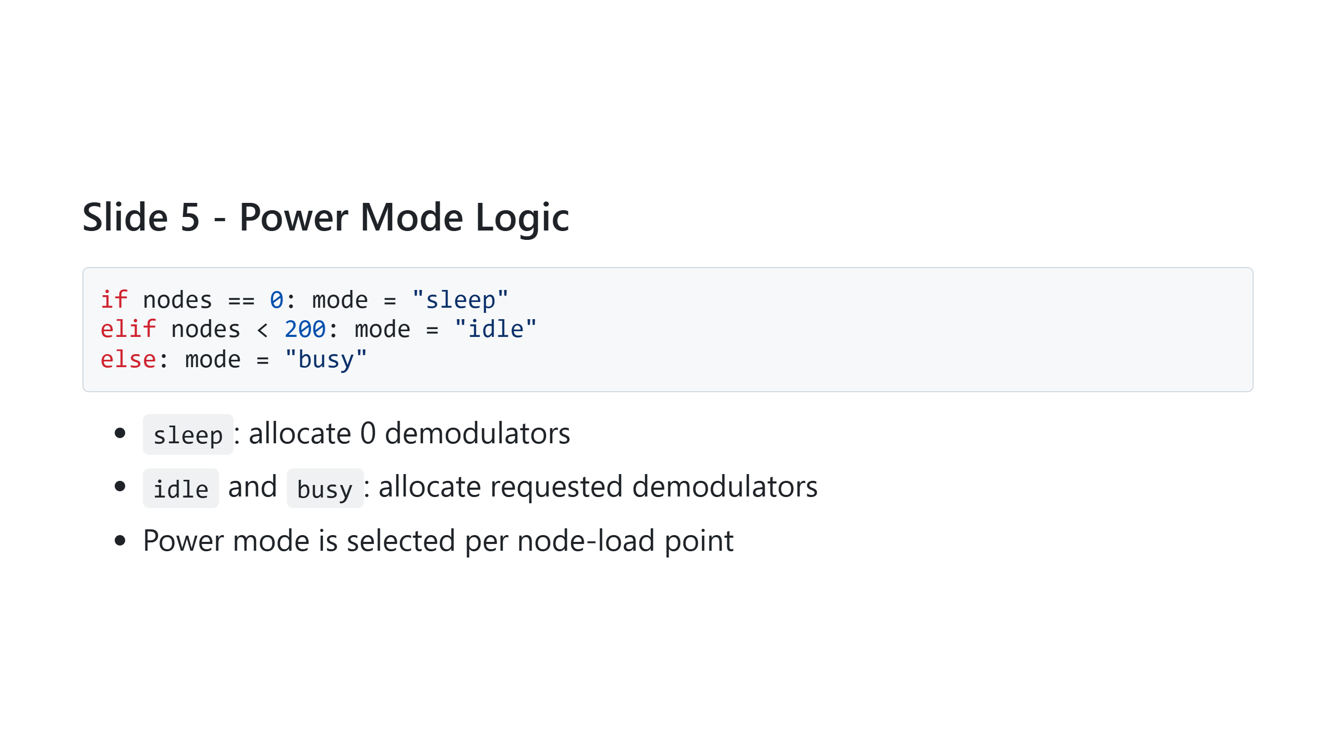
Notes:
Presenter note: Explain that this is a simple policy baseline and can be replaced by smarter adaptive policies.

Slide 6
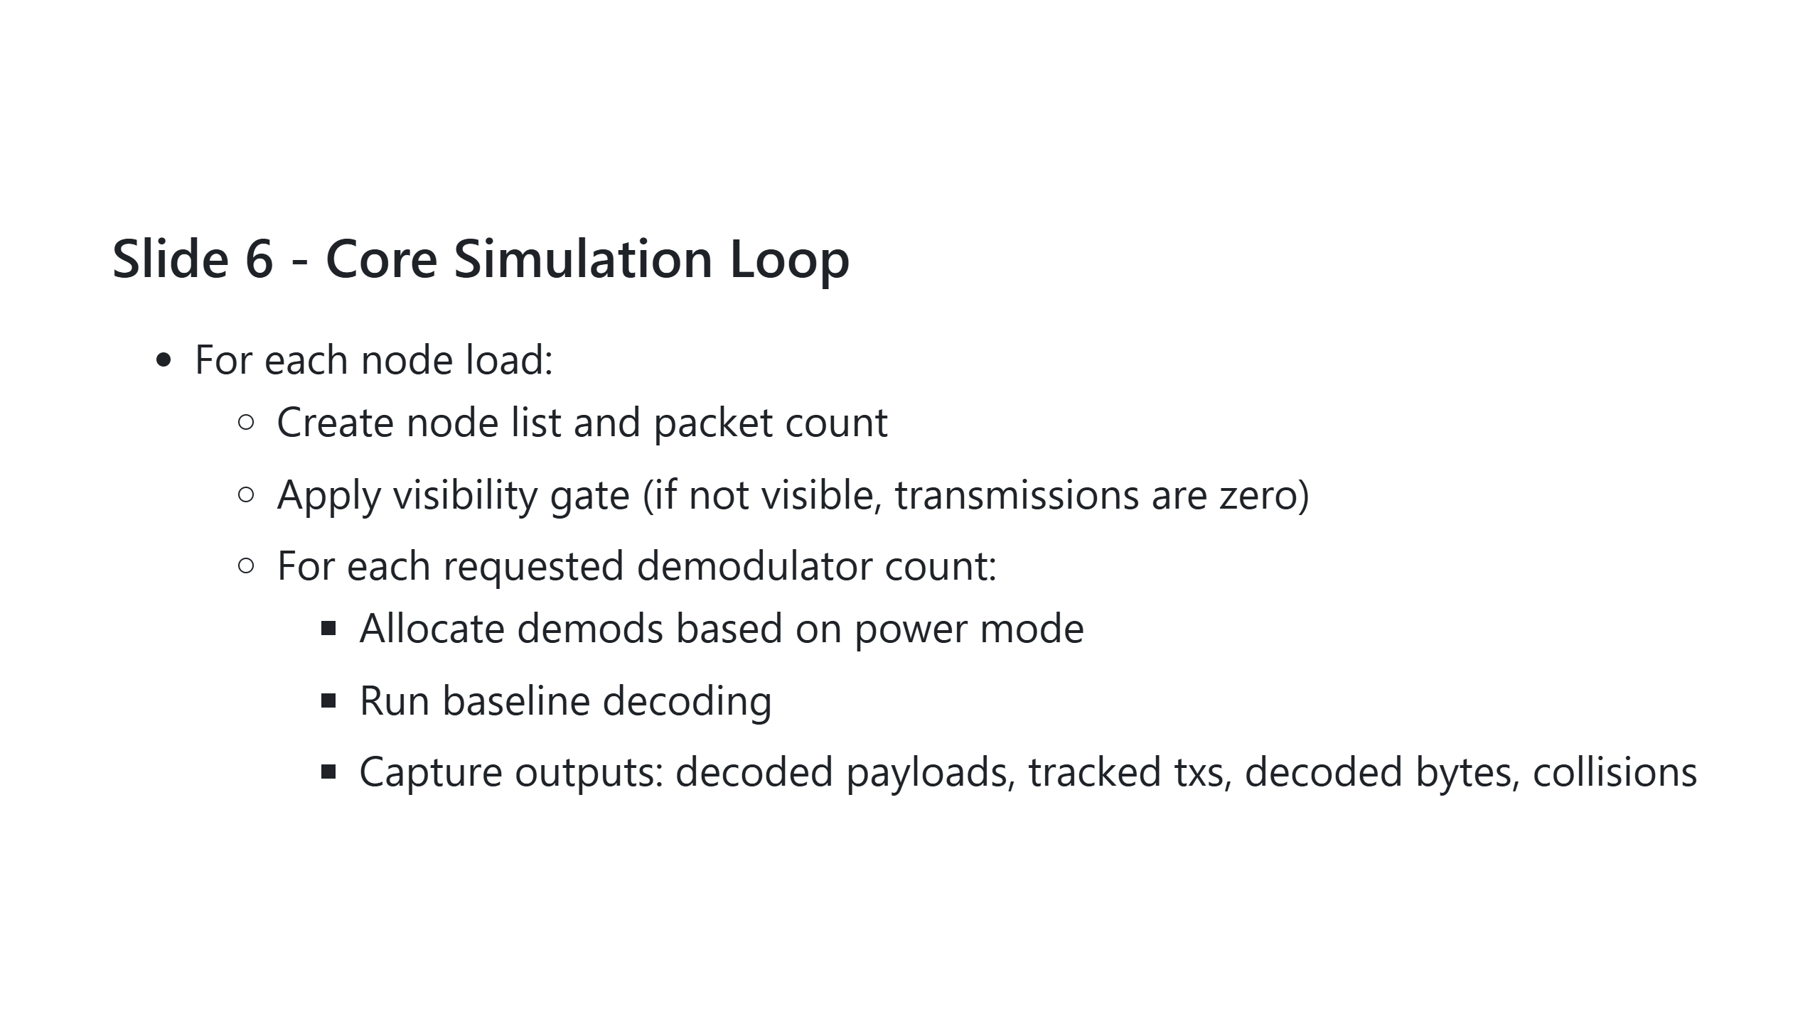
Notes:
Presenter note: Emphasize this loop is the experiment matrix: nodes x demods.

Slide 7
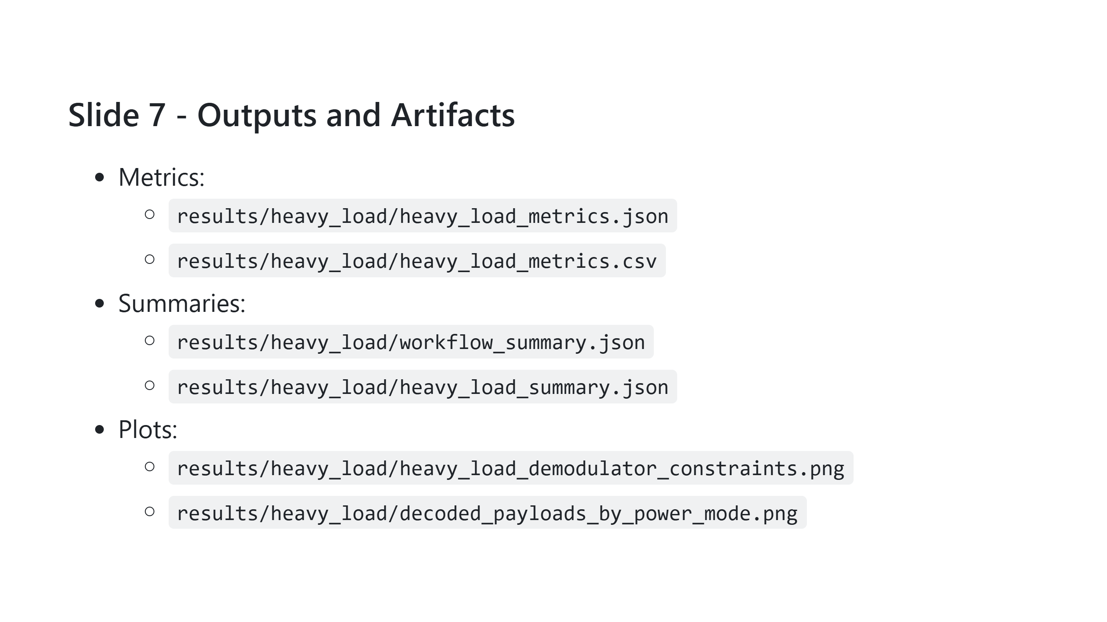
Notes:
Presenter note: Mention that CSV supports post-analysis while PNG enables immediate reporting.

Slide 8
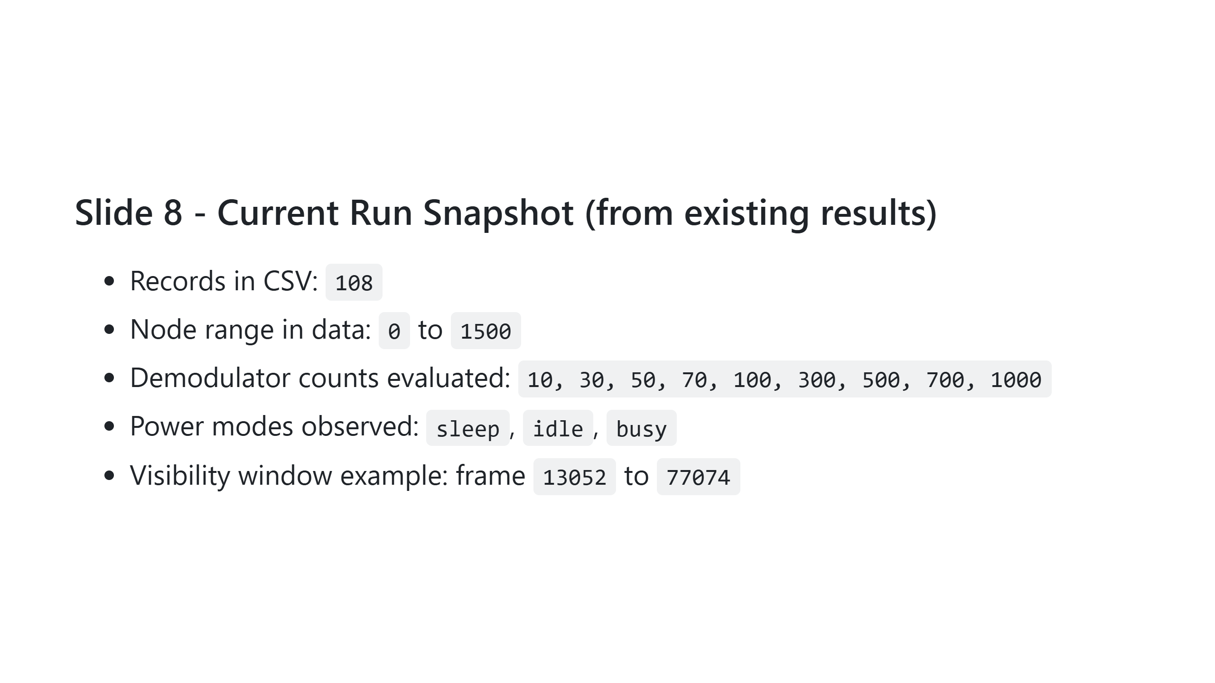
Notes:
Presenter note: Use this slide to confirm coverage and reassure audience the sweep is broad.

Slide 9
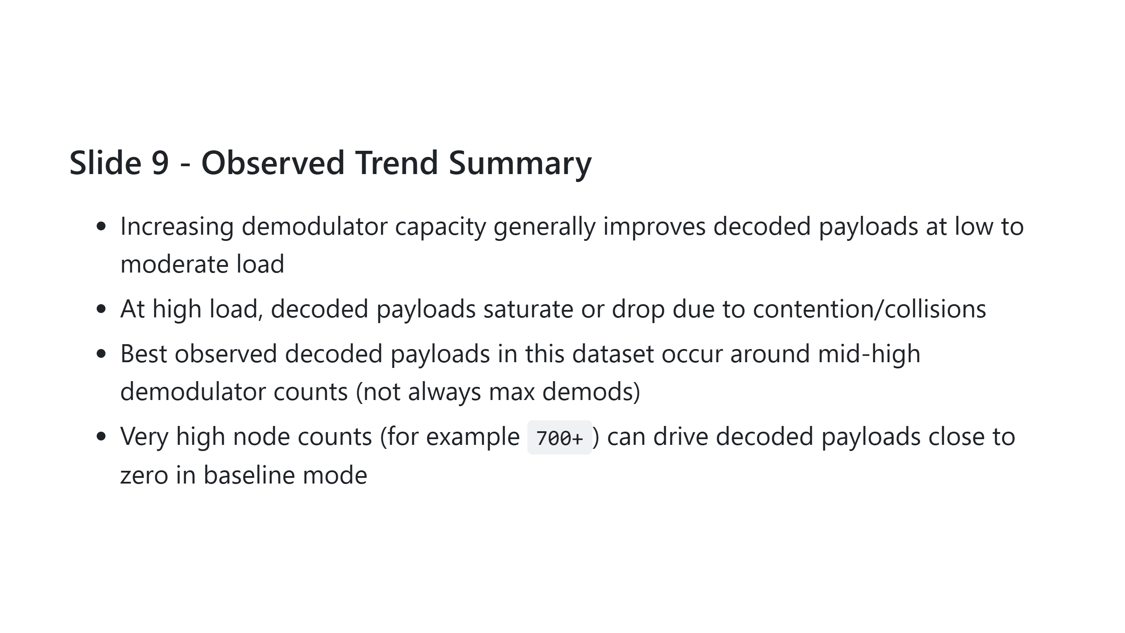
Notes:
Presenter note: Stress that collision behavior, not only demod budget, dominates in heavy-load regimes.

Slide 10
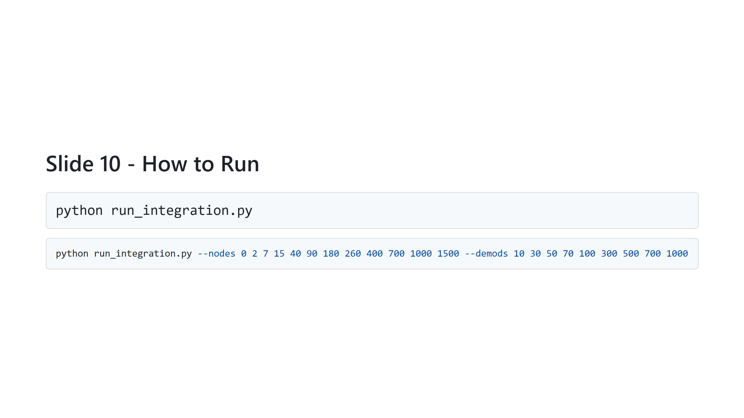
Notes:
Presenter note: Mention first command for default execution and second for custom sweeps.

Slide 11
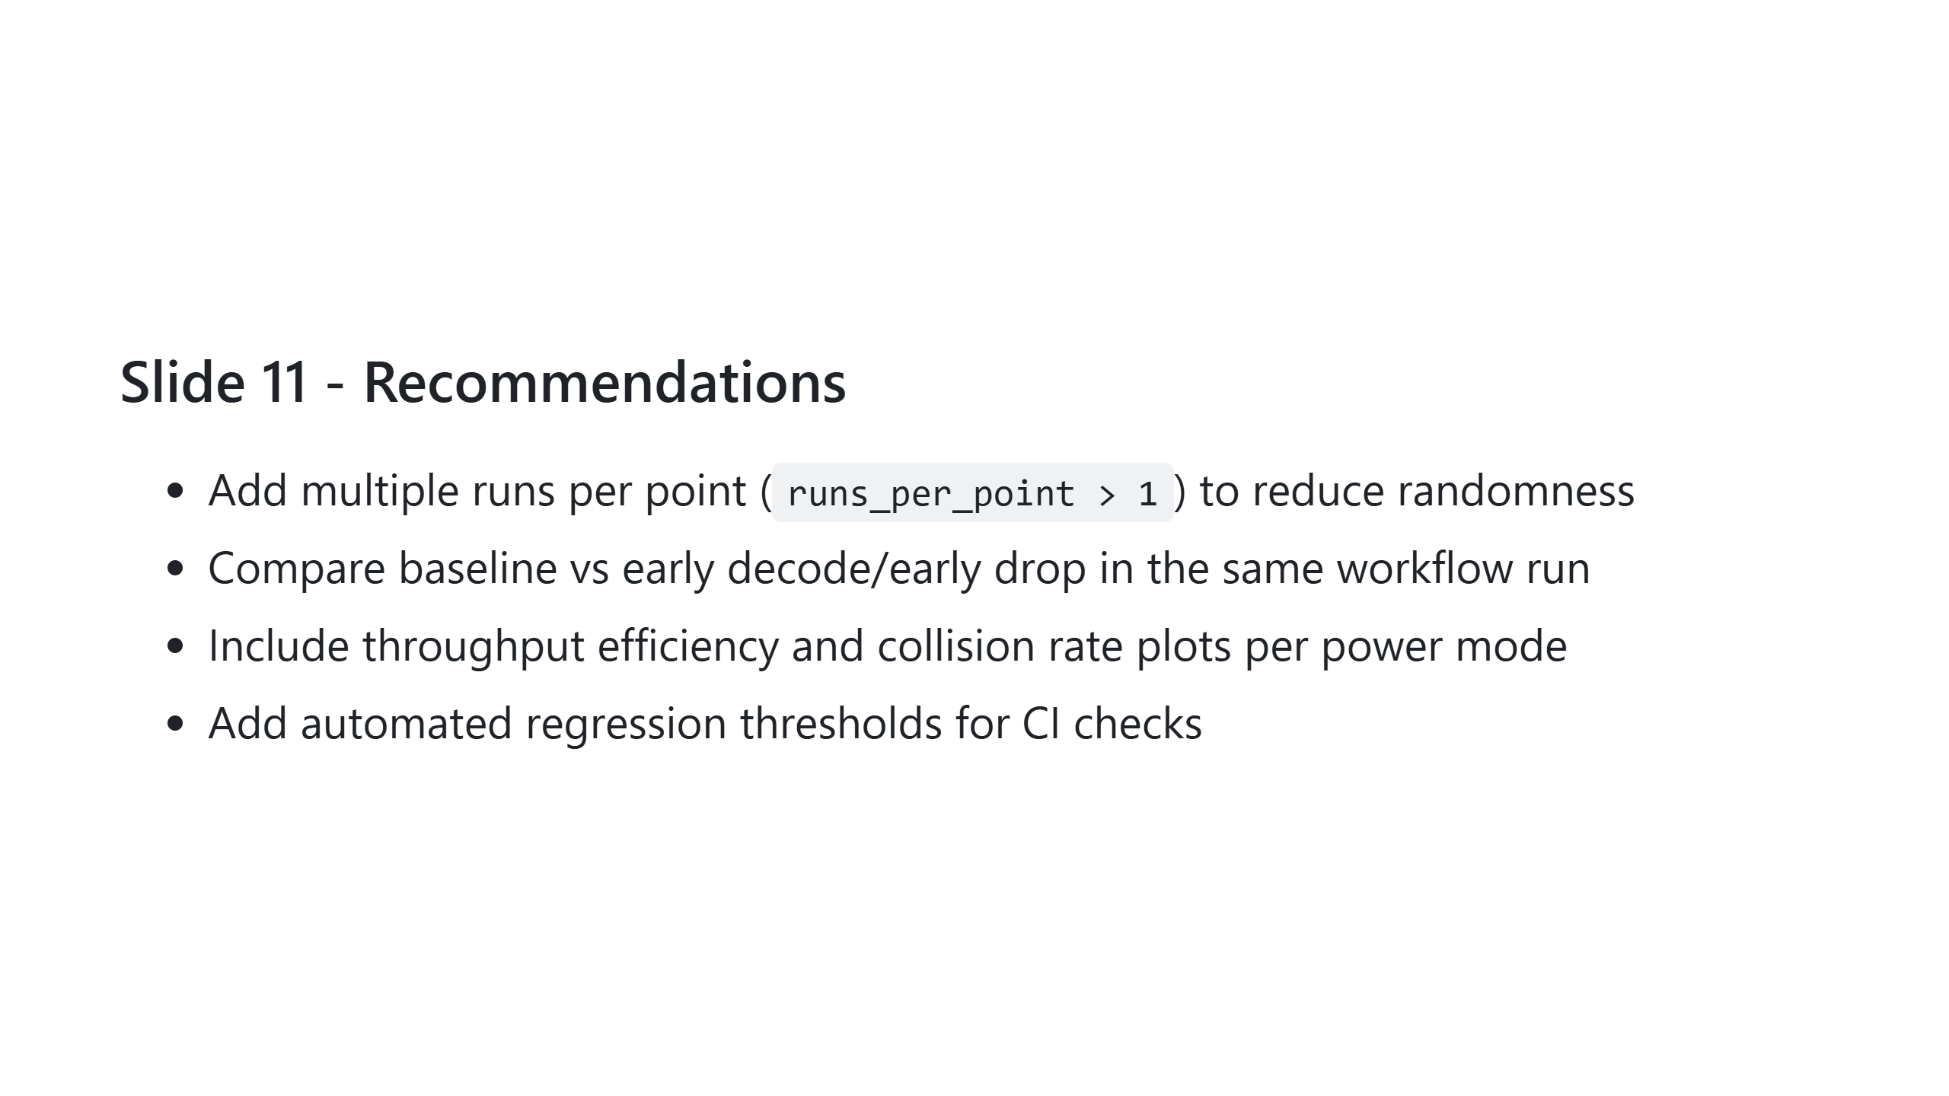
Notes:
Presenter note: Position these as actionable next steps for stronger experimental confidence.

Slide 12
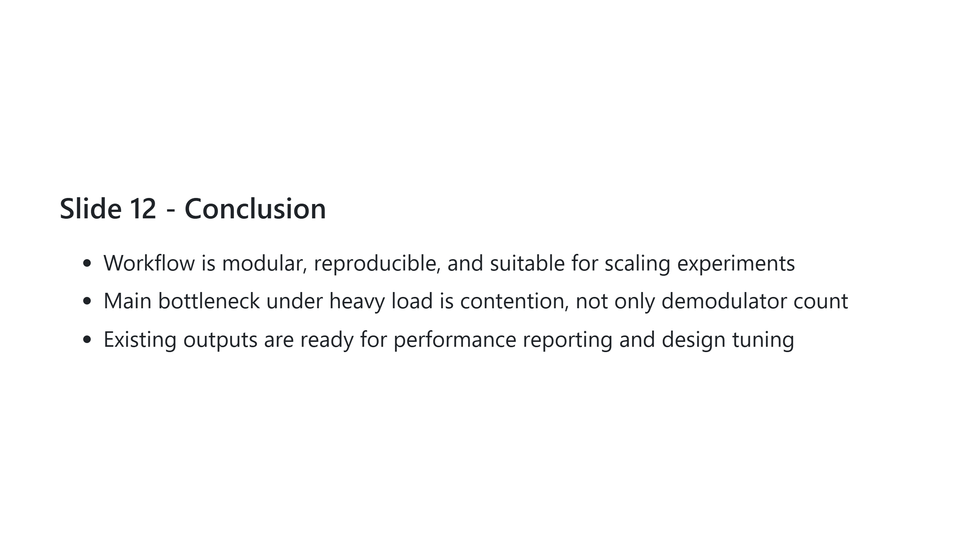
Notes:
Presenter note: End by tying technical findings to practical optimization direction.

