Slide 1
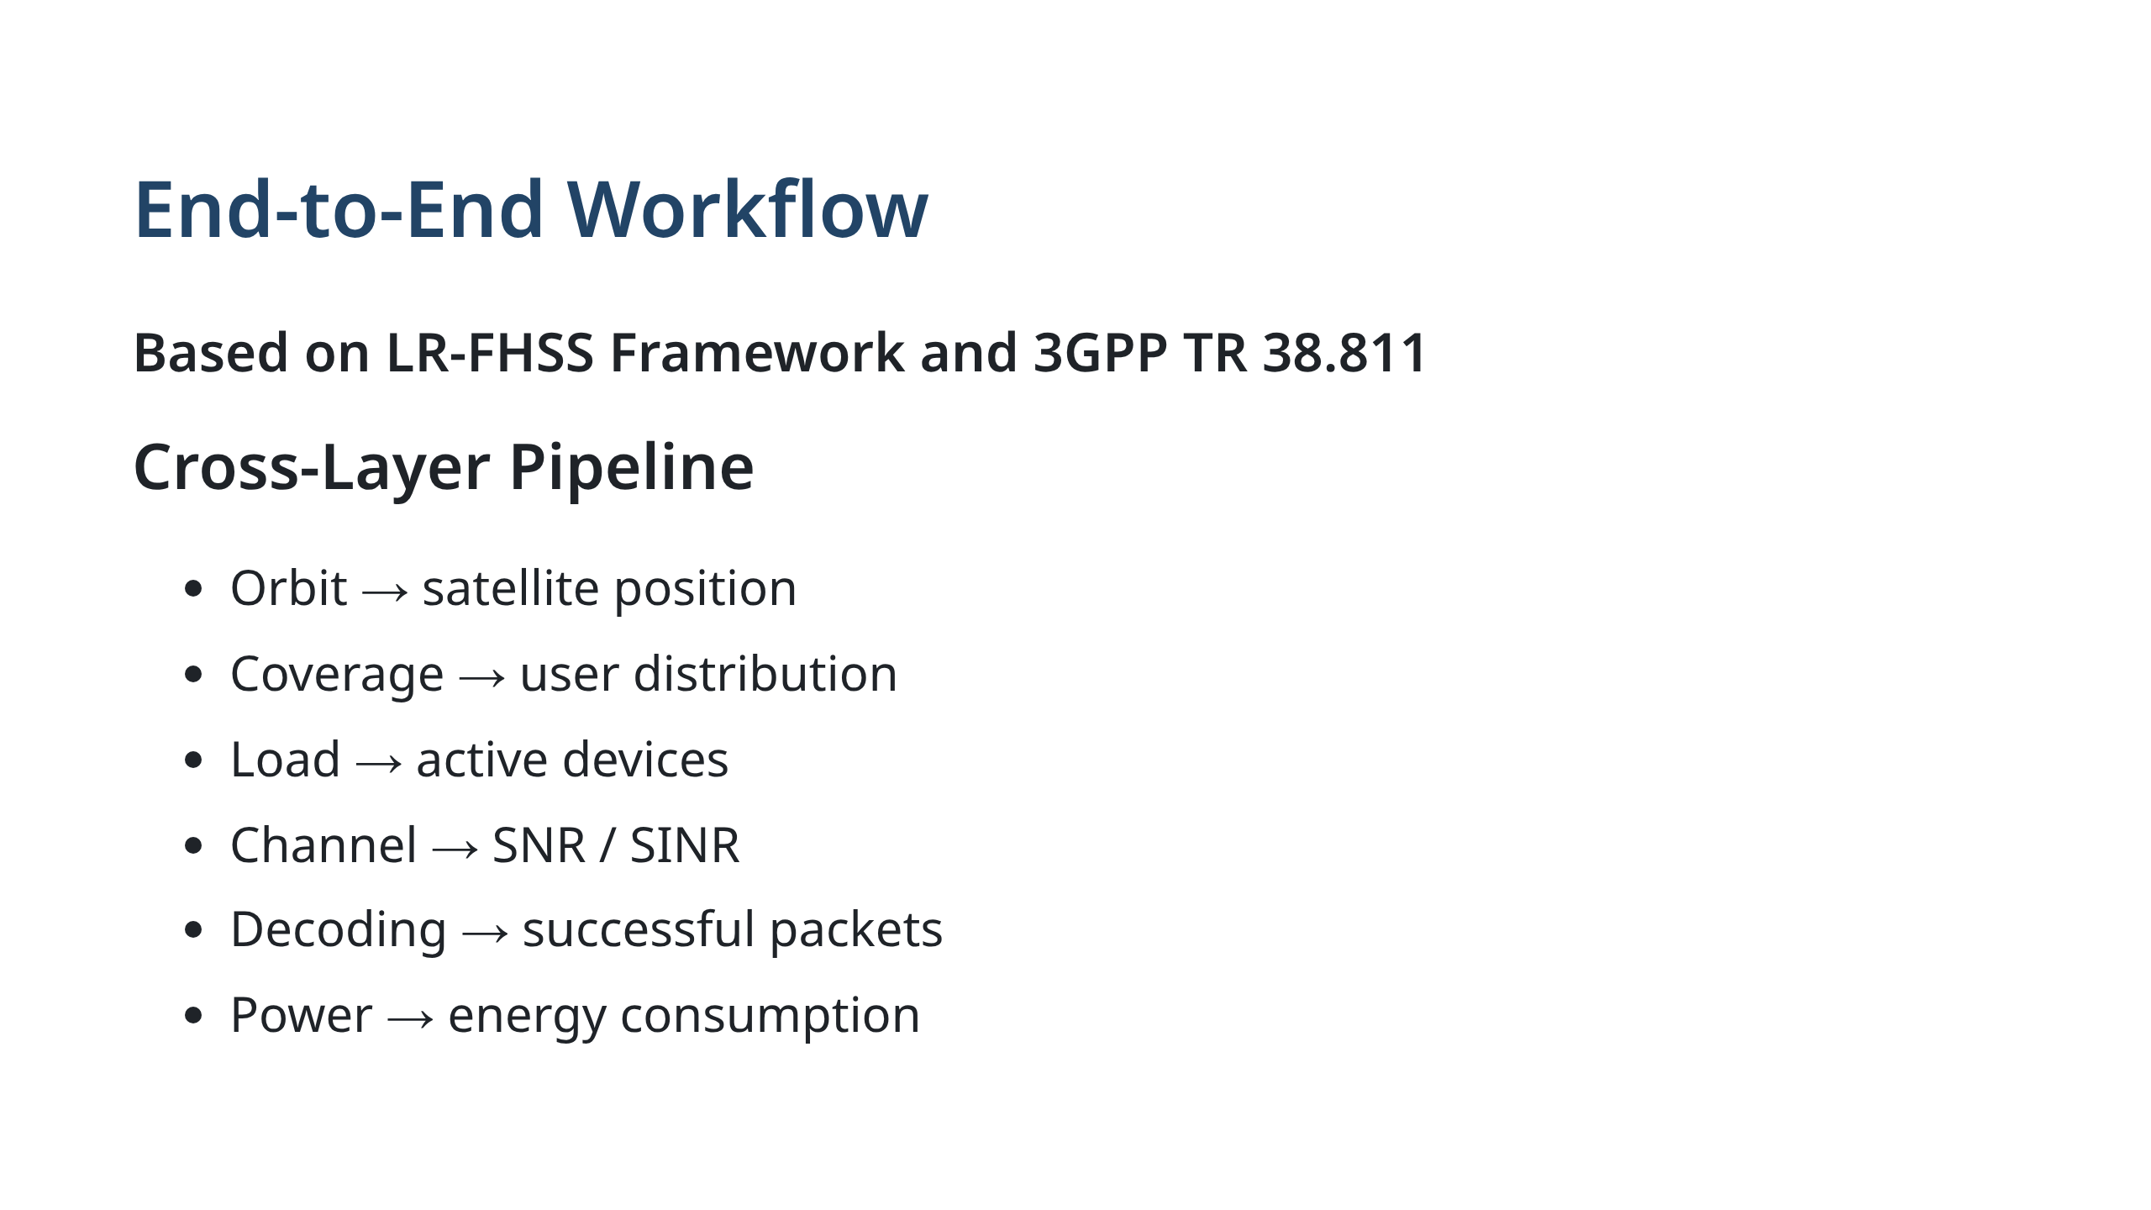
Notes:
This slide explains the full workflow. Each stage depends on the previous one.

Slide 2
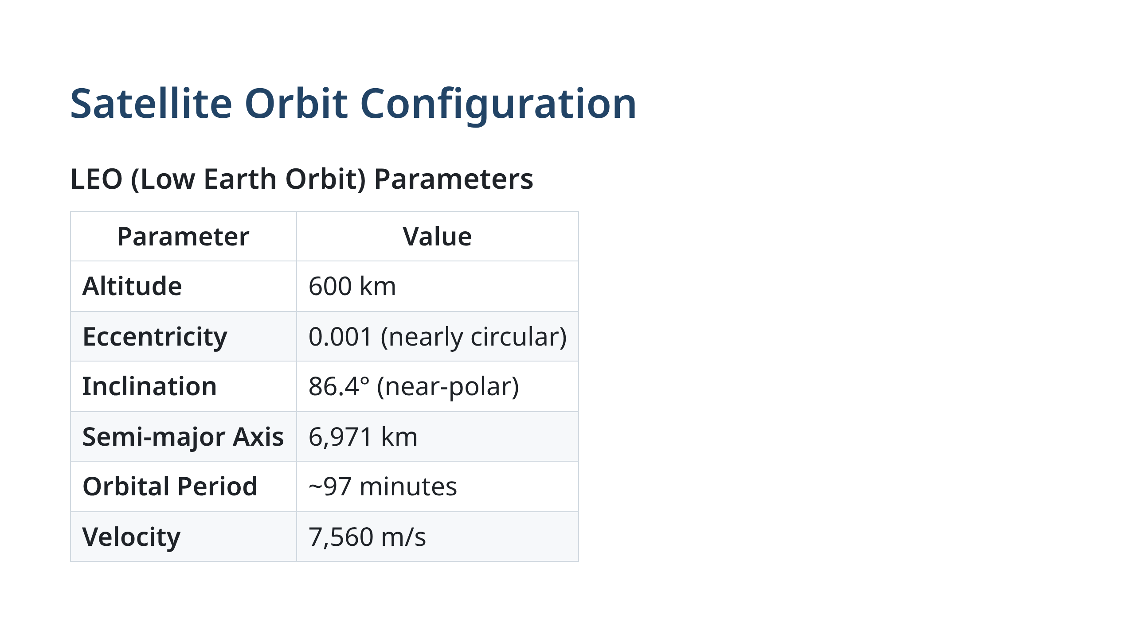
Notes:
Our satellite operates in a Low Earth Orbit at 600 km altitude. The nearly circular orbit (e=0.001) with near-polar inclination (86.4°) provides global coverage, which is ideal for LEO IoT networks like LoRaWAN. With an orbital period of ~97 minutes, the satellite completes roughly 15 passes per day. The velocity of 7,560 m/s is typical for LEO constellations. This configuration is based on Keplerian propagation with two-body dynamics.

Slide 3
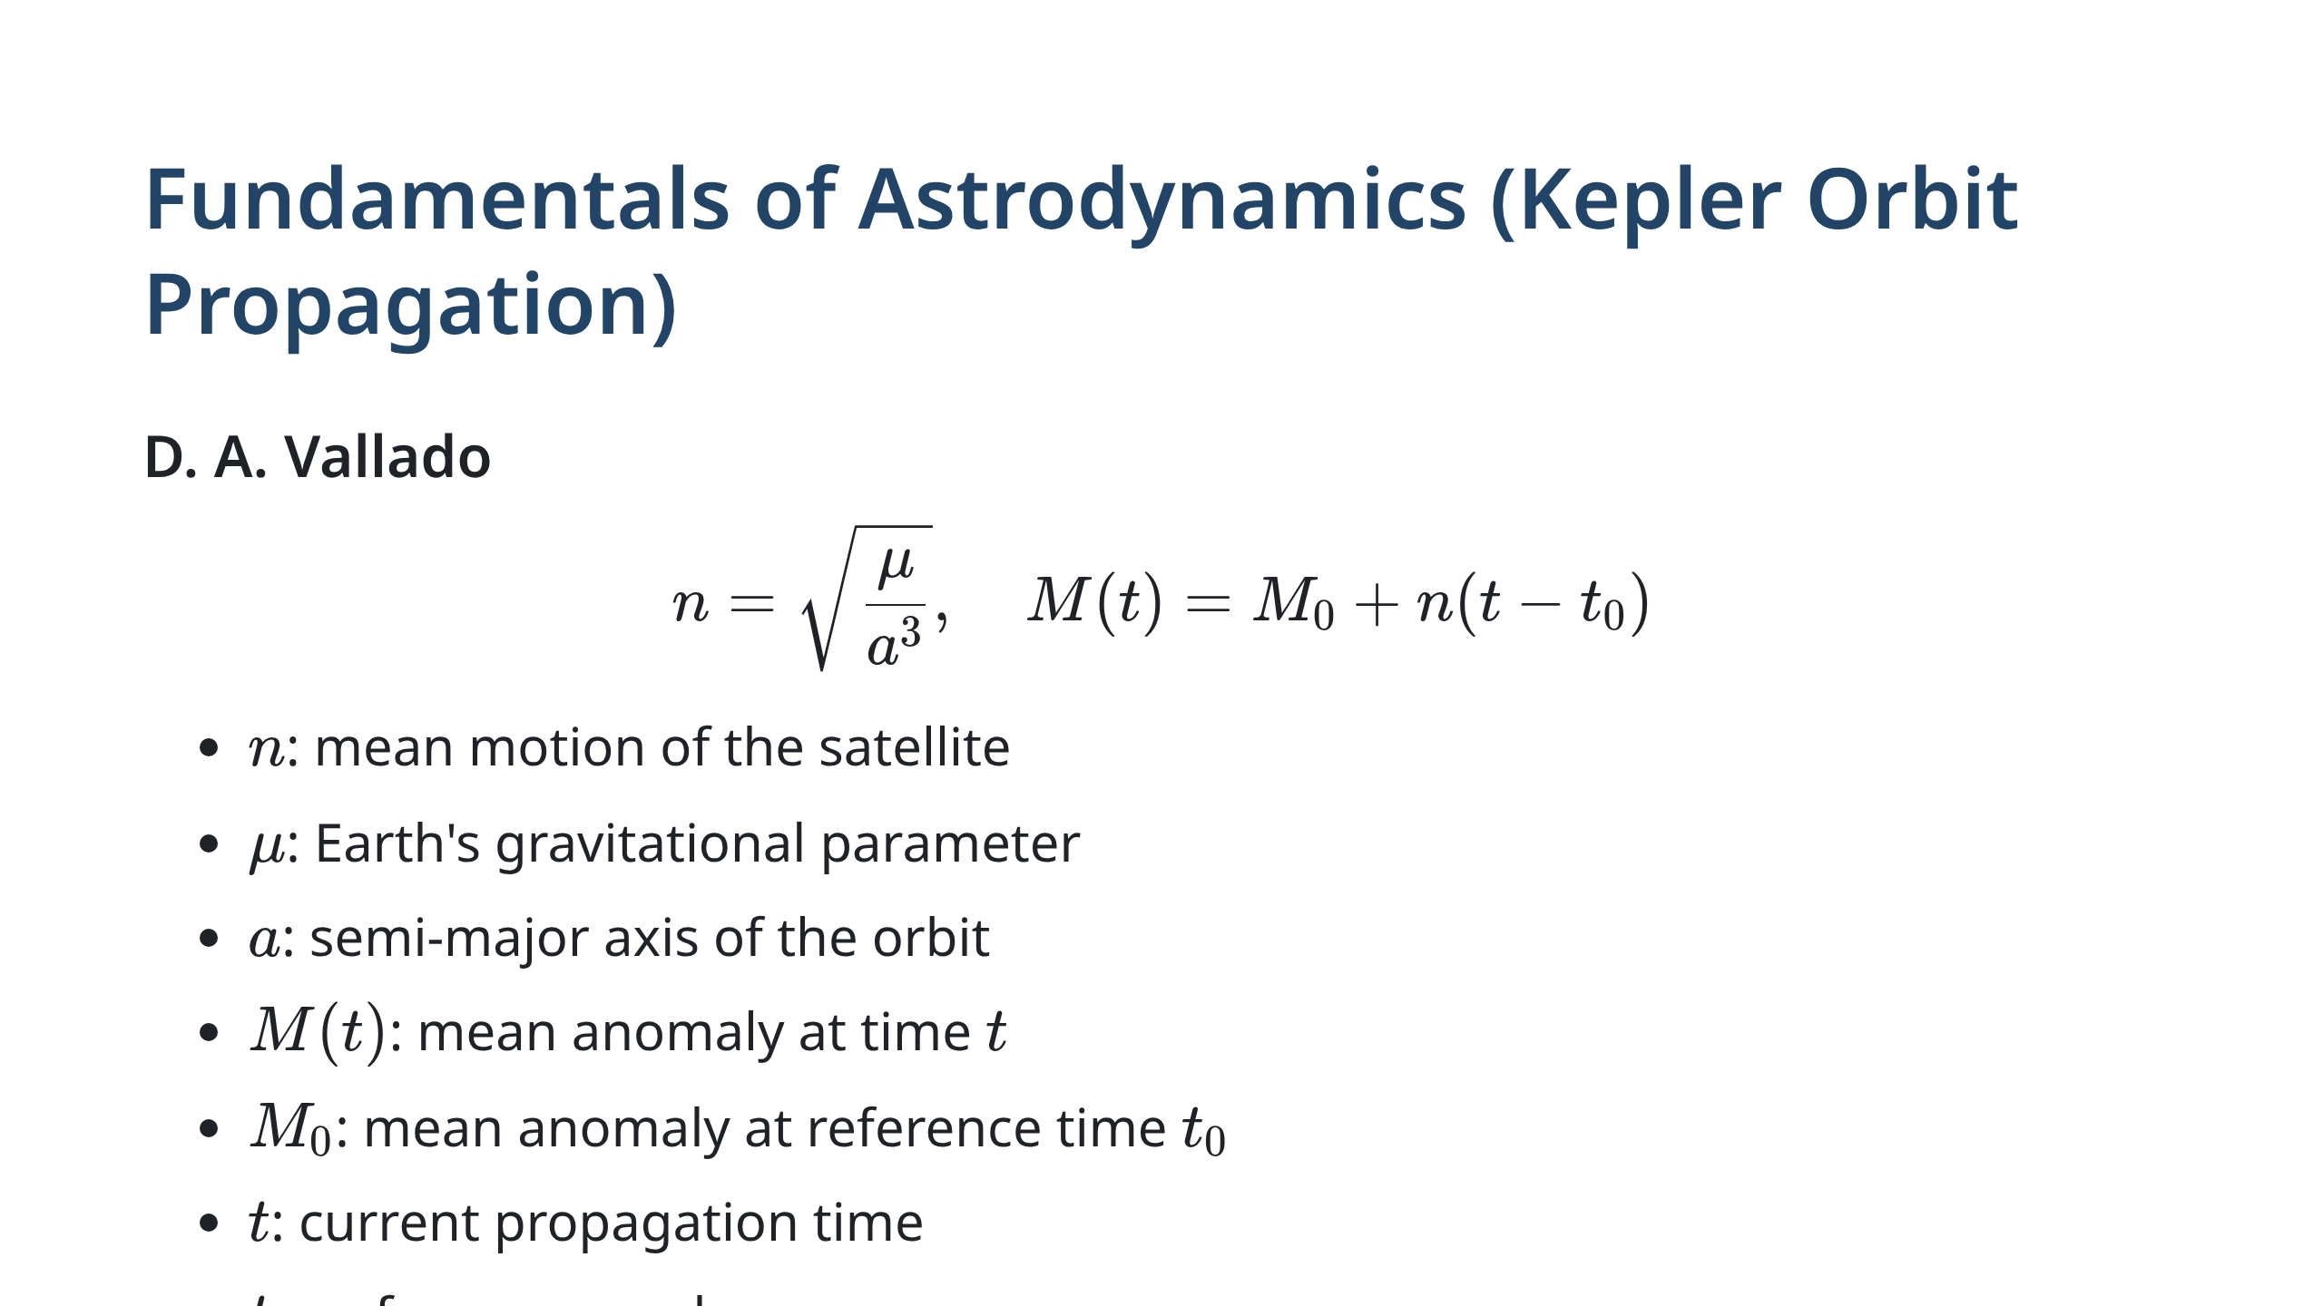
Notes:
Keplerian orbit propagation defines satellite motion. The mean motion $n$ depends on the semi-major axis. We solve Kepler's equation using Newton-Raphson iteration to find the eccentric anomaly, then compute satellite position in inertial coordinates. This propagation is deterministic and highly accurate for our 600 km LEO orbit.

Slide 4
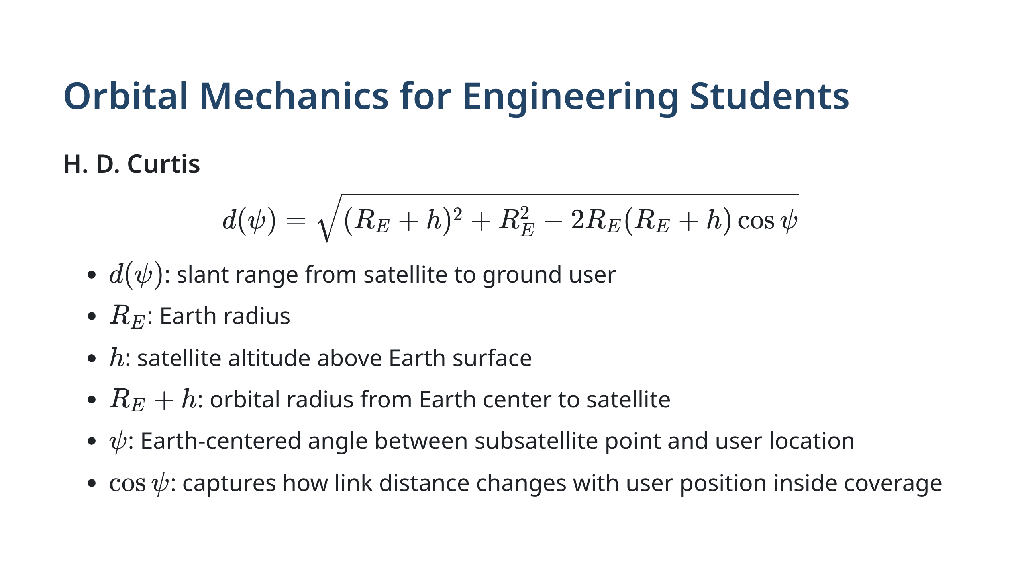
Notes:
Distance varies with geometry and affects signal strength.

Slide 5
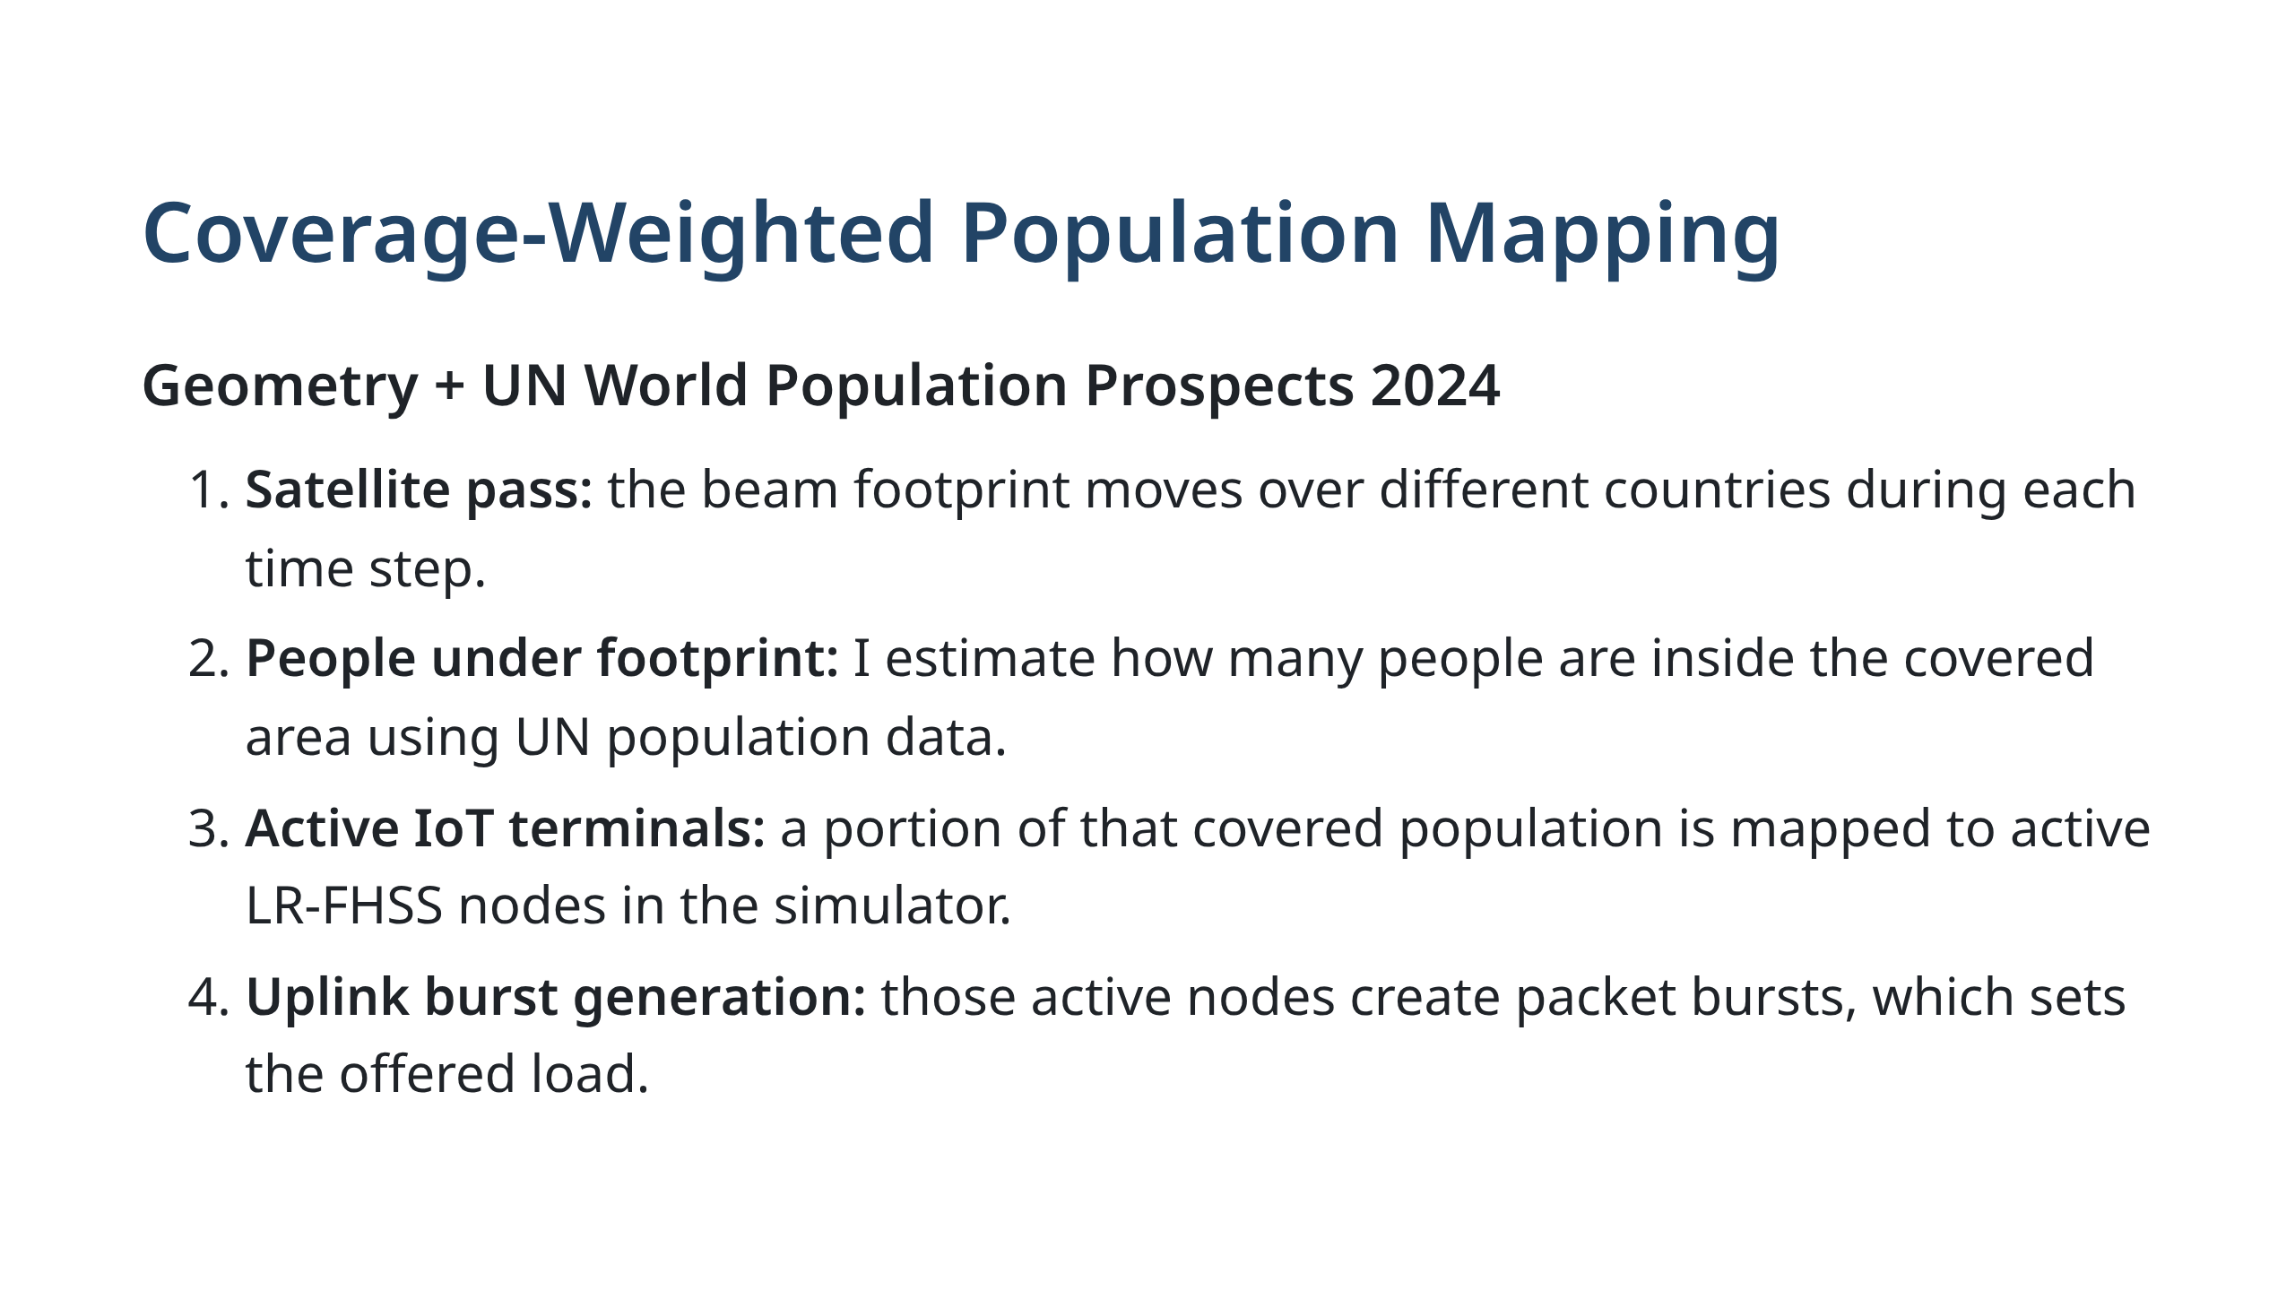

Slide 6
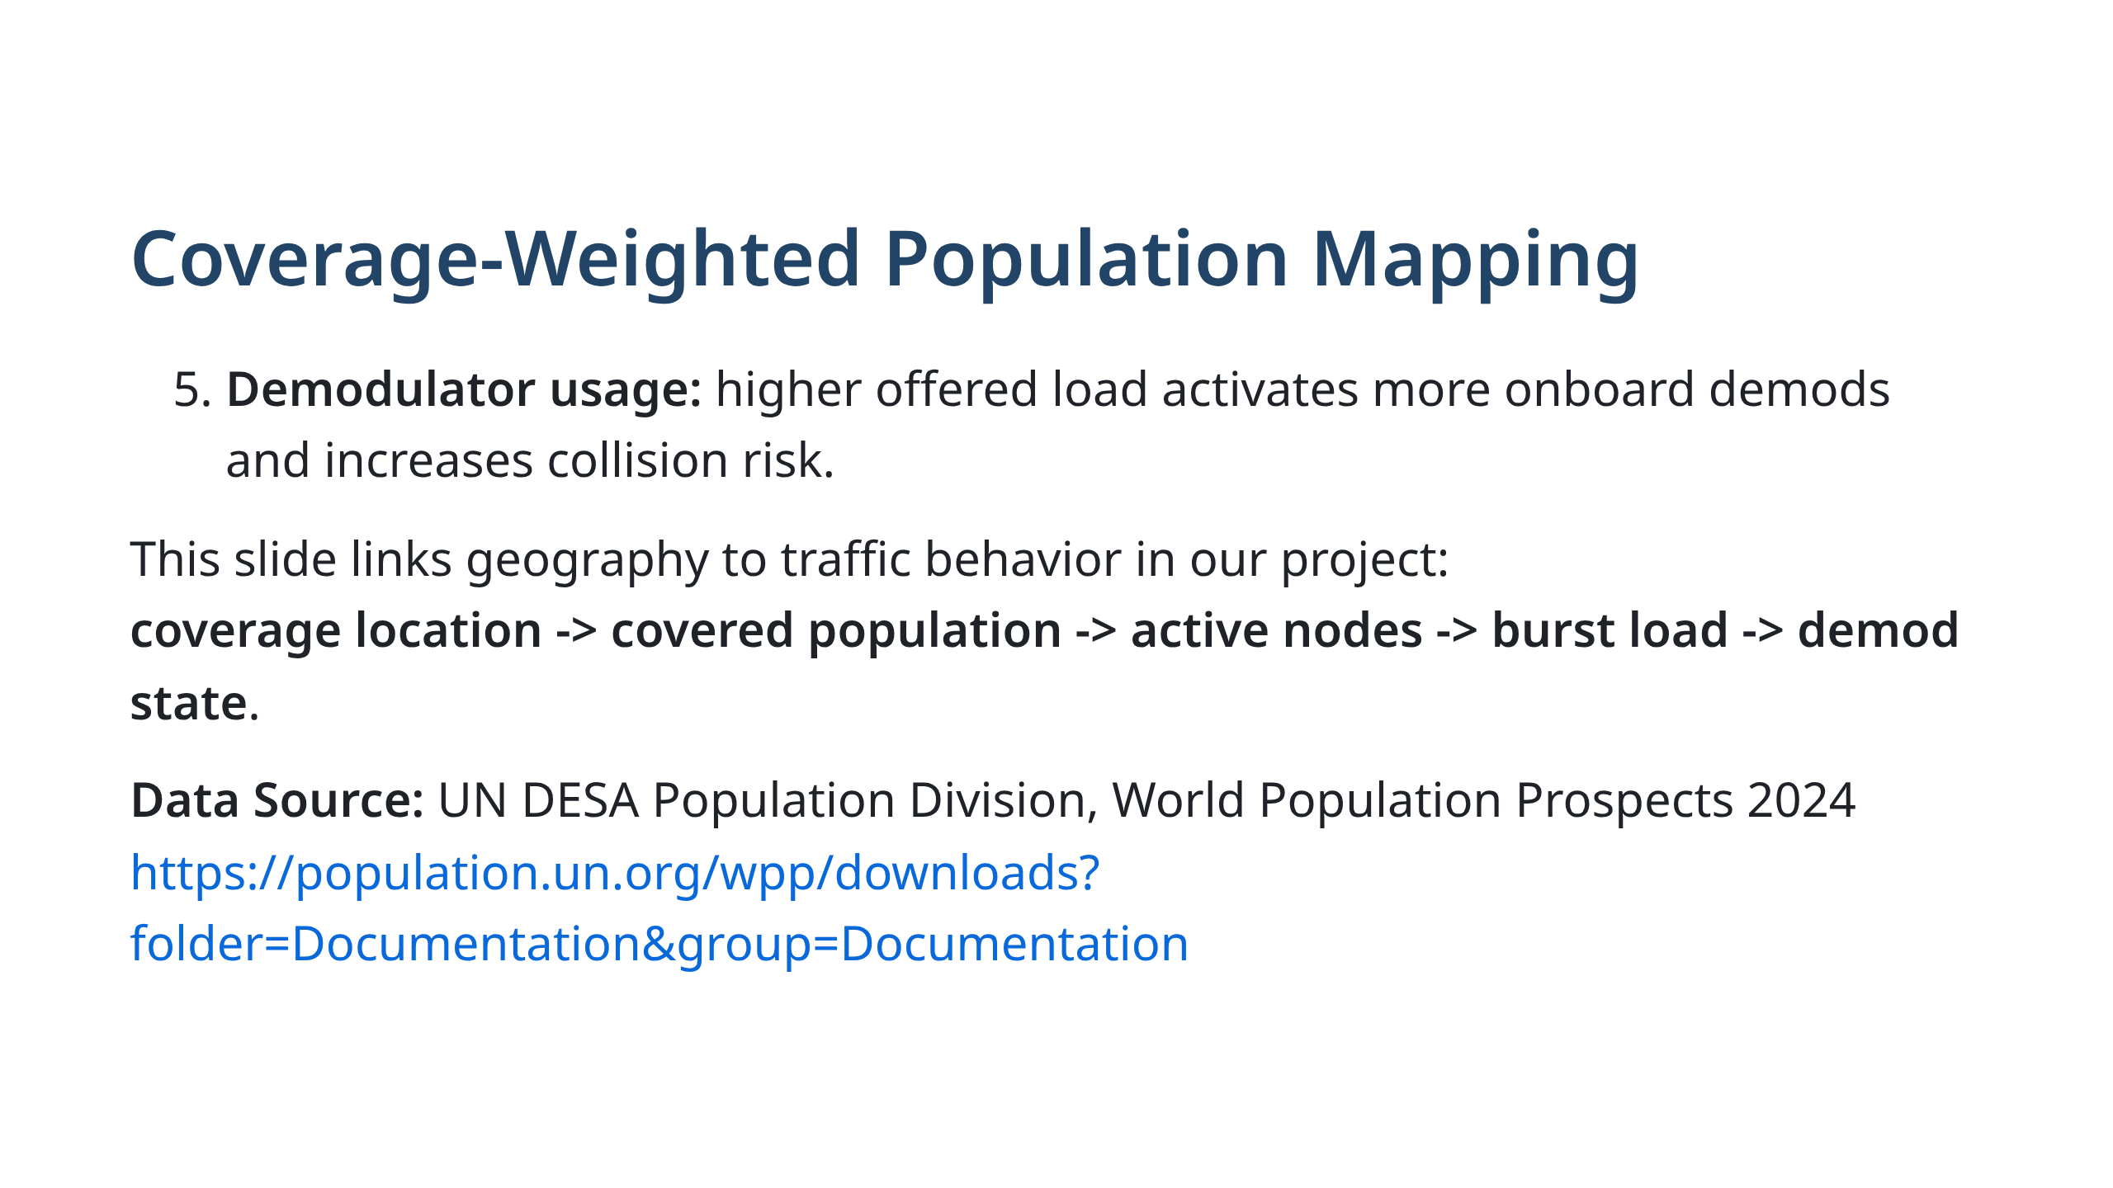
Notes:
## Mathematical Model $$ \xi_c(t)=\frac{A_{overlap,c}}{A_c}, \quad P_{eff}(t)=\sum_c P_c \, \xi_c(t) $$ **Key Variables:** - $A_{overlap,c}$: area where satellite footprint intersects country $c$ - $A_c$: total area of country $c$ - $P_c$: population living in country $c$ (from UN data) - $P_{eff}(t)$: effective covered population — the number of people who *can be reached* at time $t$ - $\xi_c(t)$: coverage factor (0 to 1) — fraction of country $c$ under the satellite at time $t$ This slide maps geometric overlap into covered population. We multiply the coverage fraction by total population to get reachable users. The sum over all countries gives the instantaneous effective coverage.

Slide 7
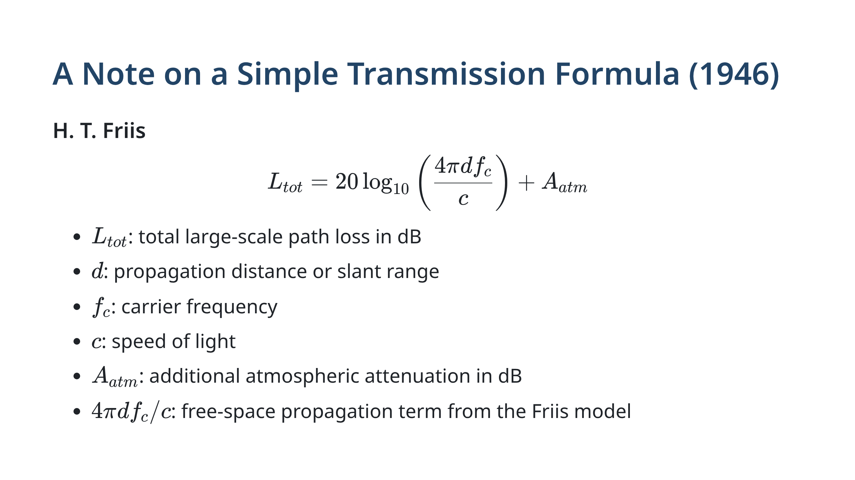
Notes:
Channel loss depends on distance and environment.

Slide 8
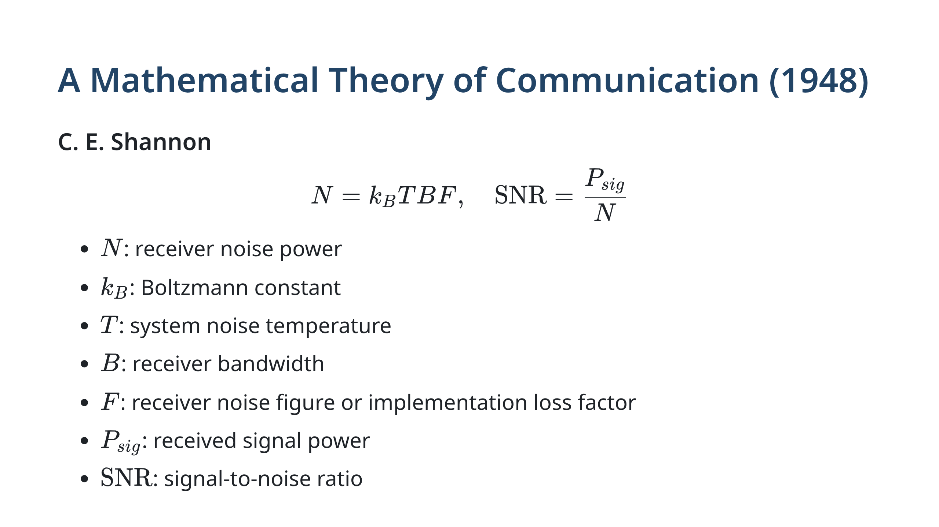
Notes:
SNR defines signal quality baseline.

Slide 9
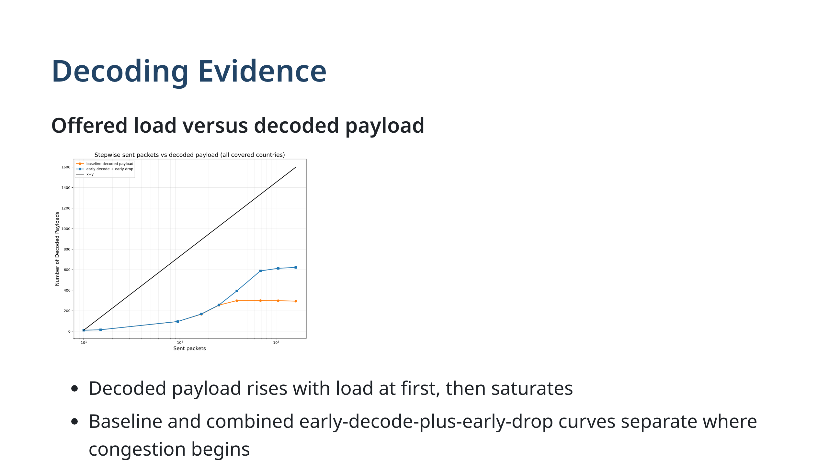
Notes:
This figure shows how successful payload delivery diverges from offered traffic.

Slide 10
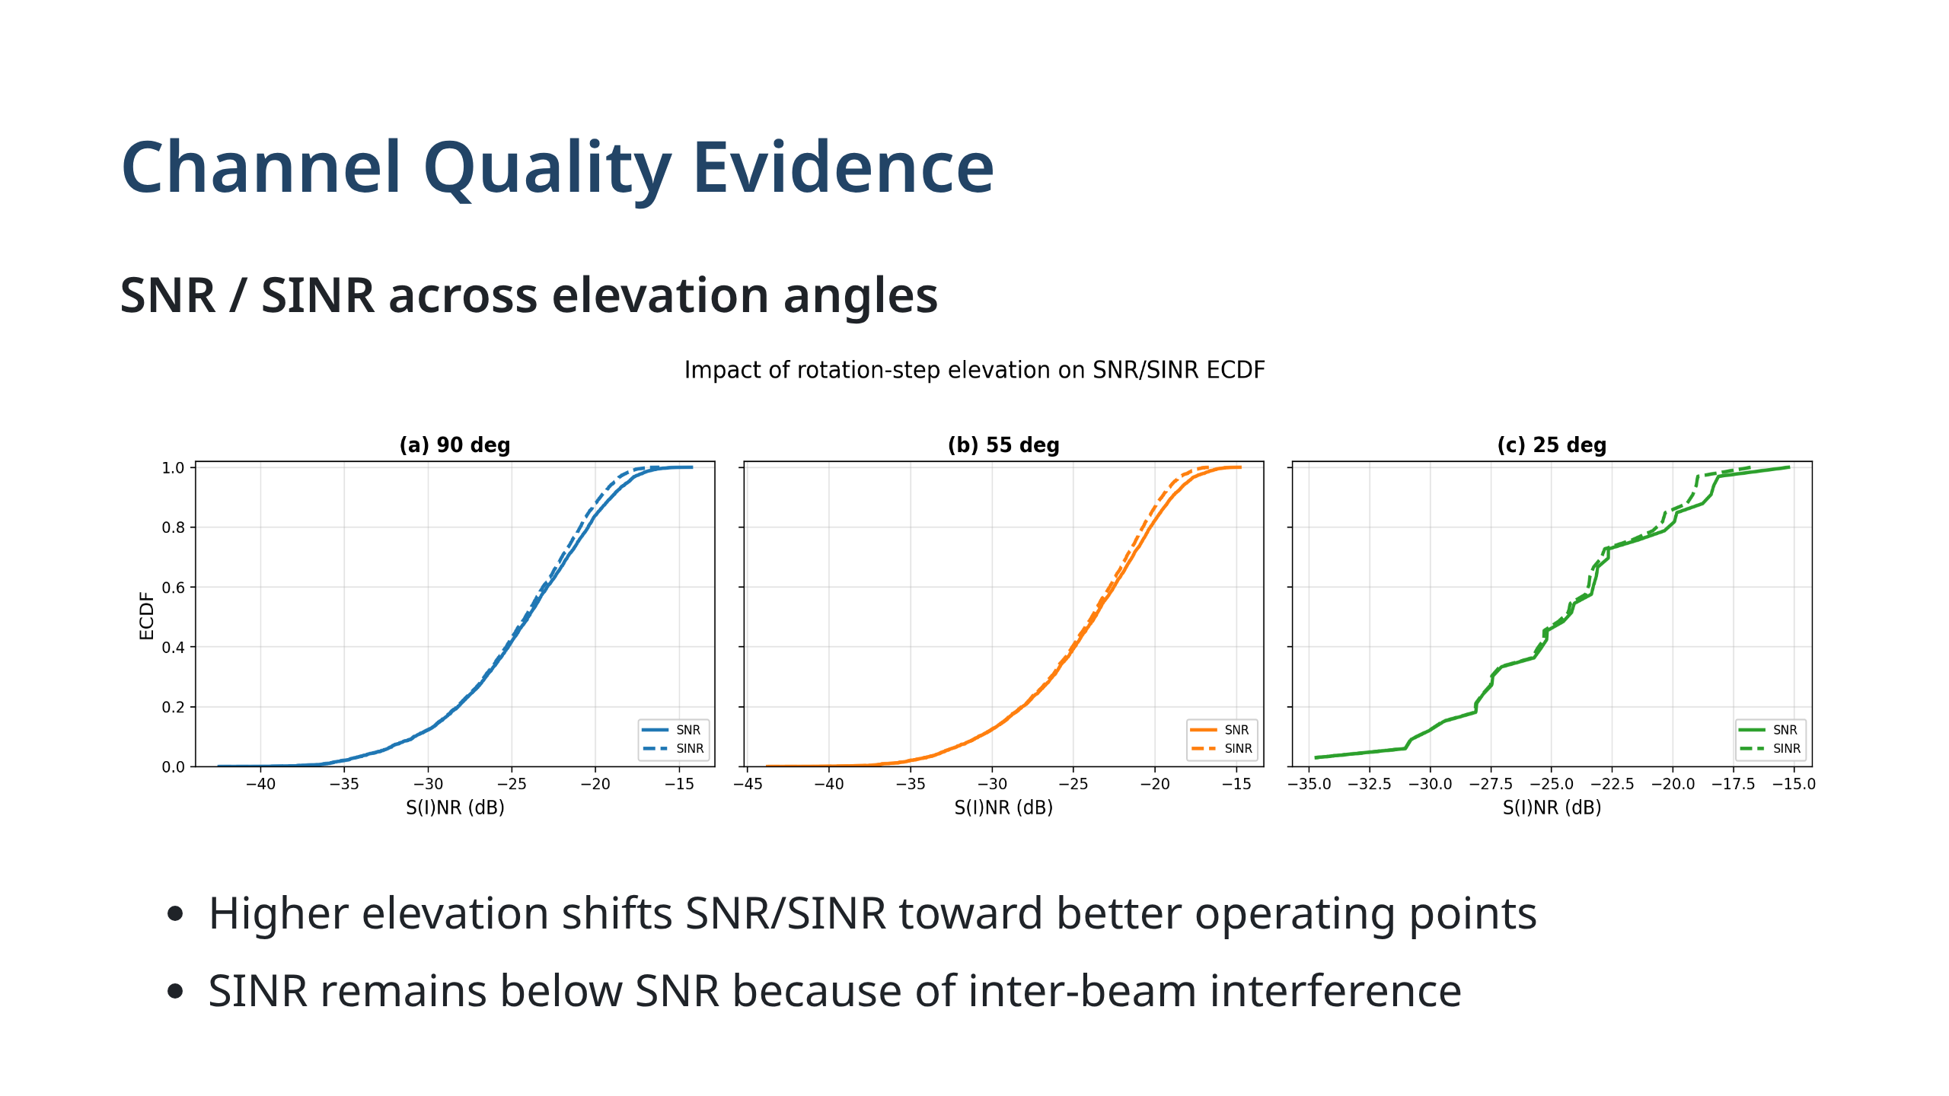
Notes:
This plot supports the channel-quality discussion with measured ECDFs.

Slide 11
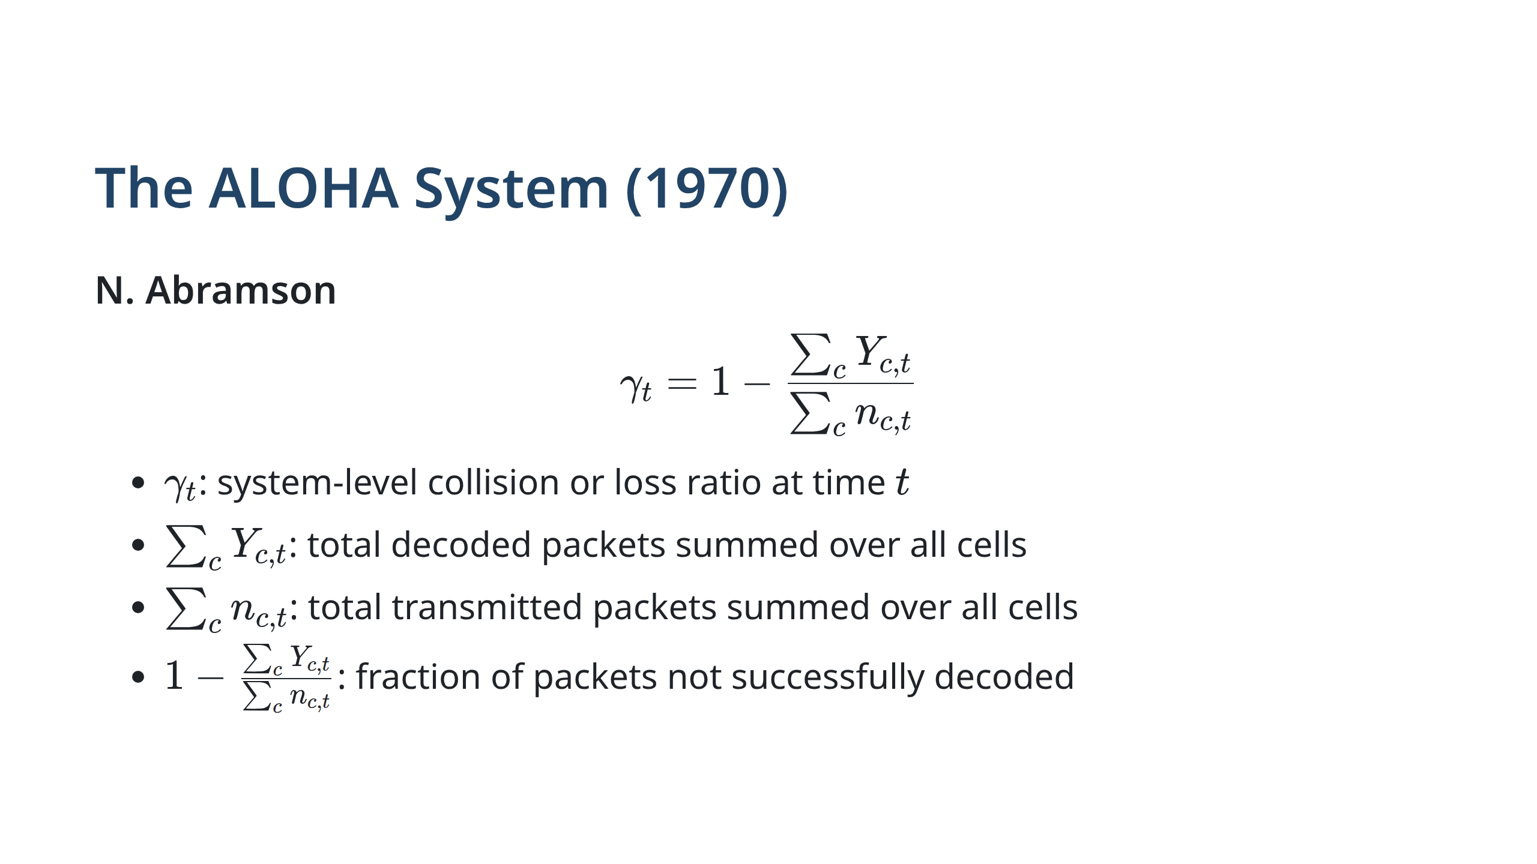
Notes:
Collision aggregated across all users.

Slide 12
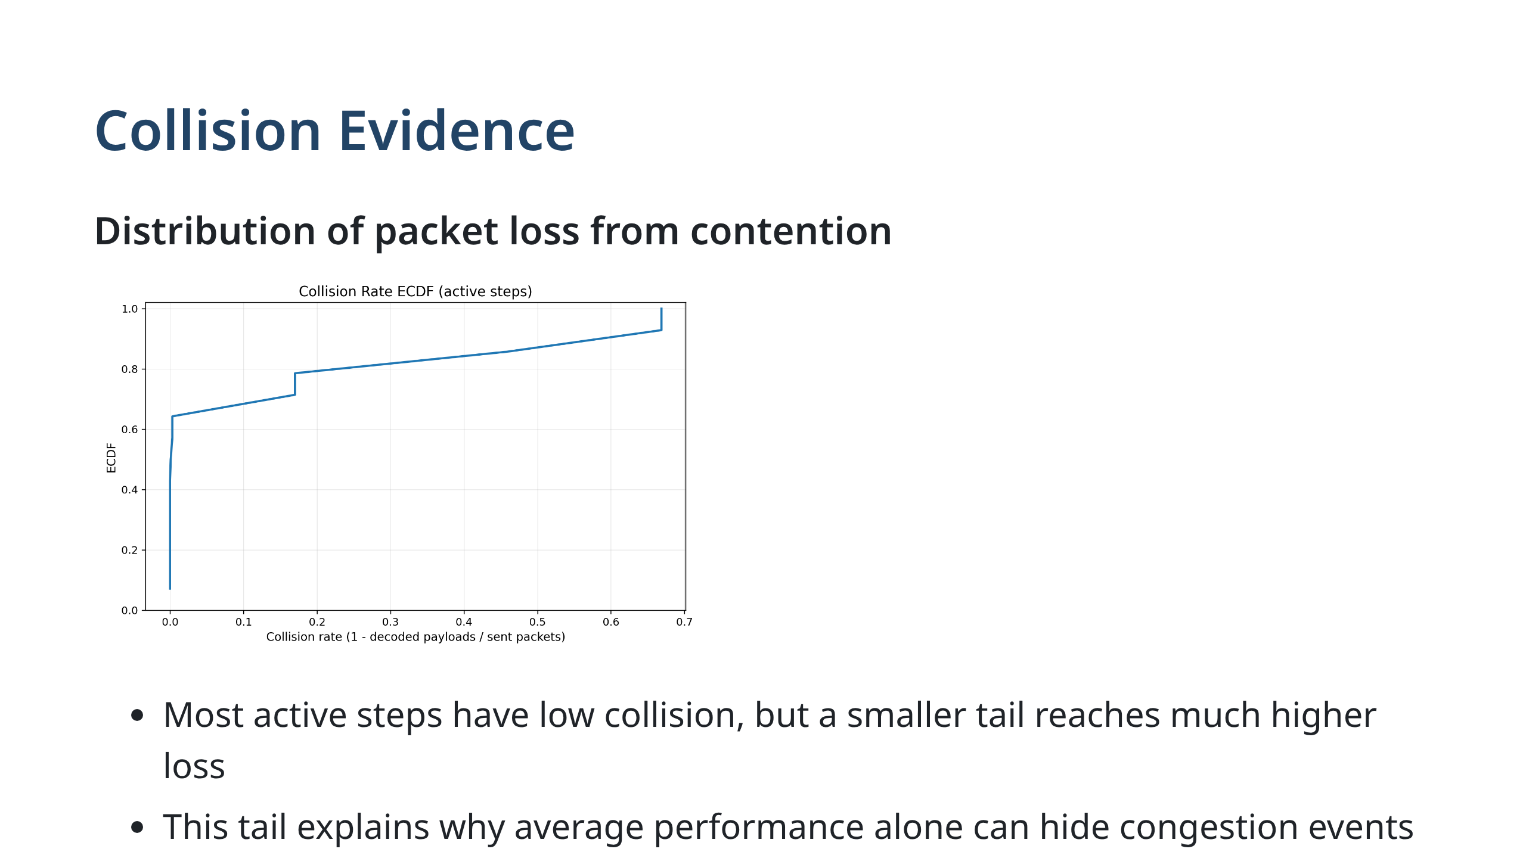
Notes:
This plot supports the system-level collision discussion.

Slide 13
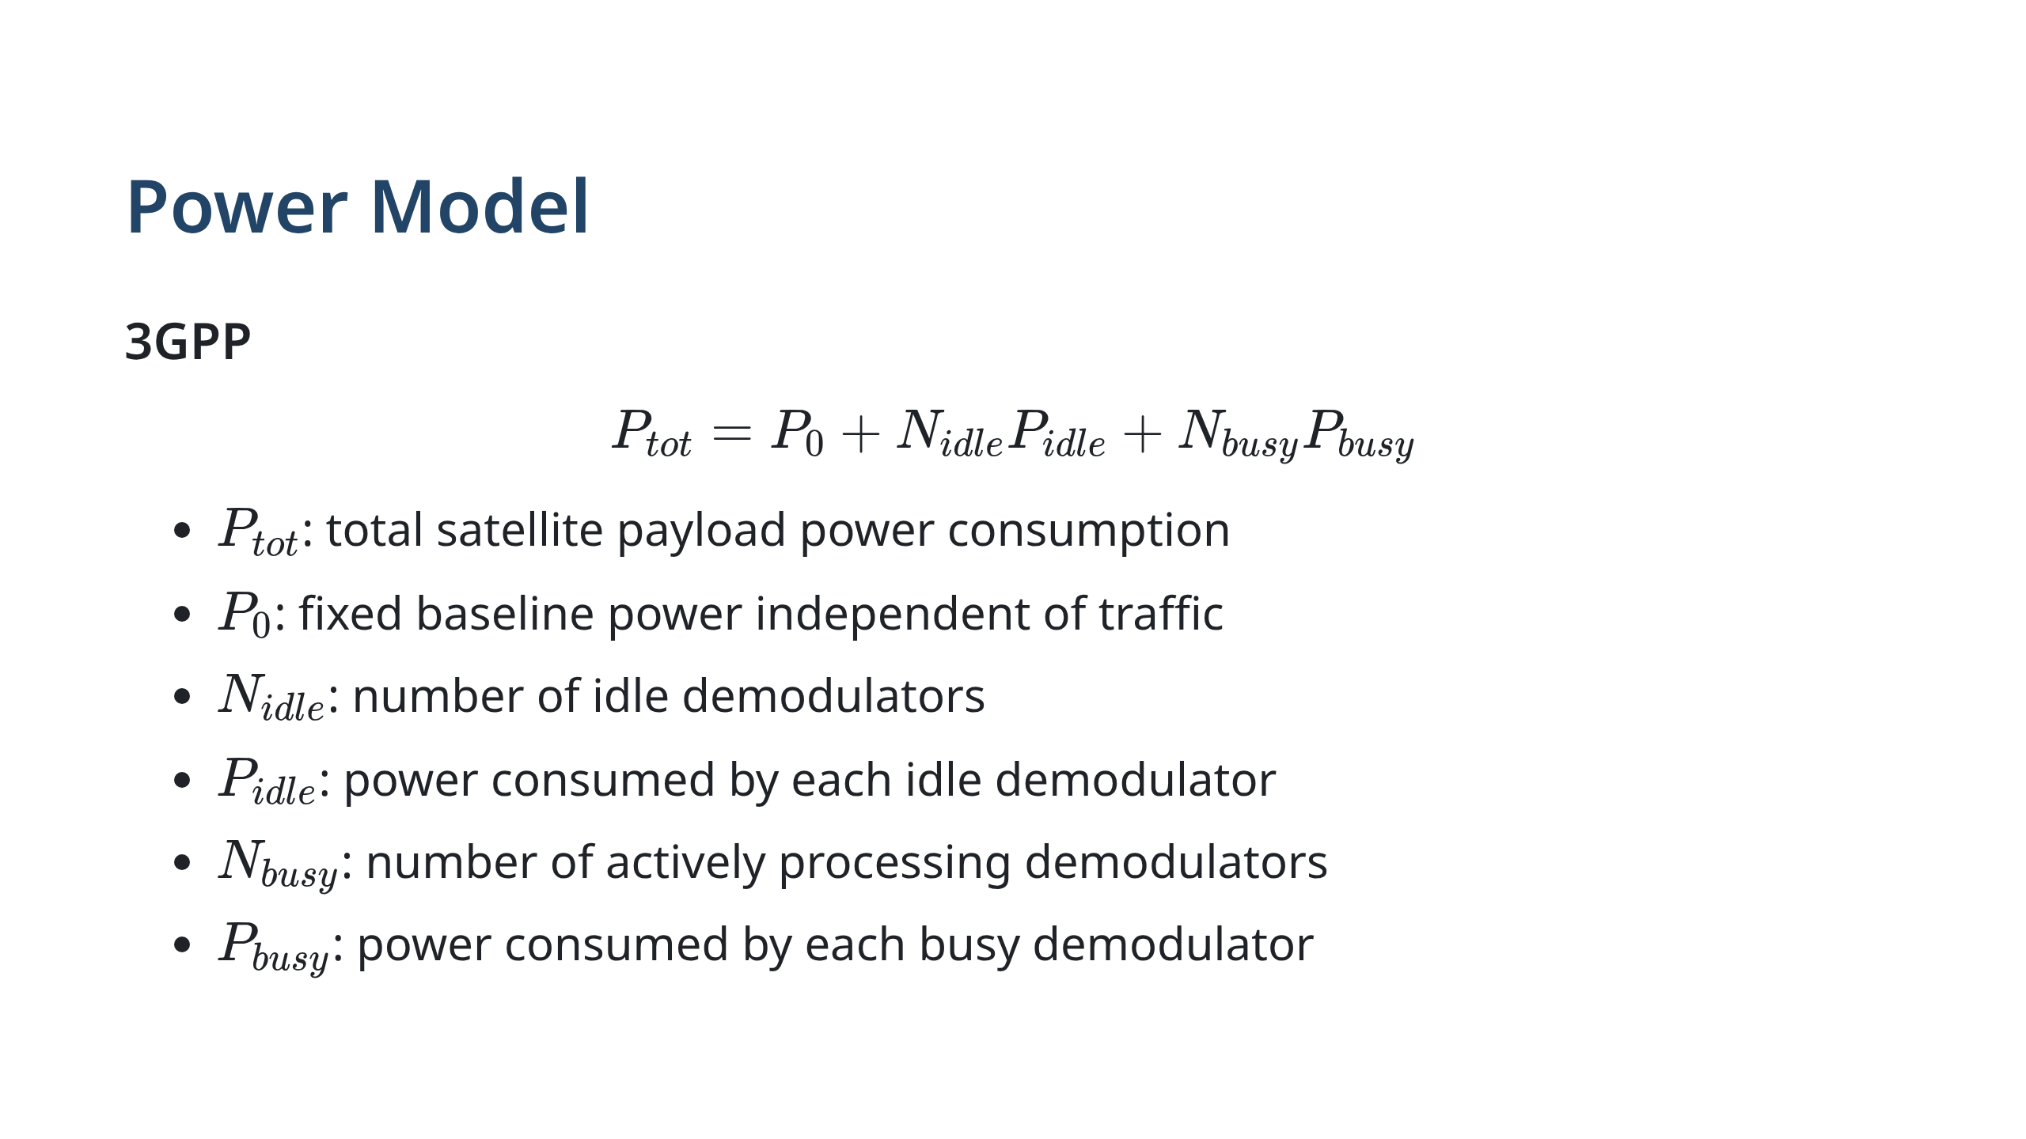
Notes:
Power depends on system load.

Slide 14
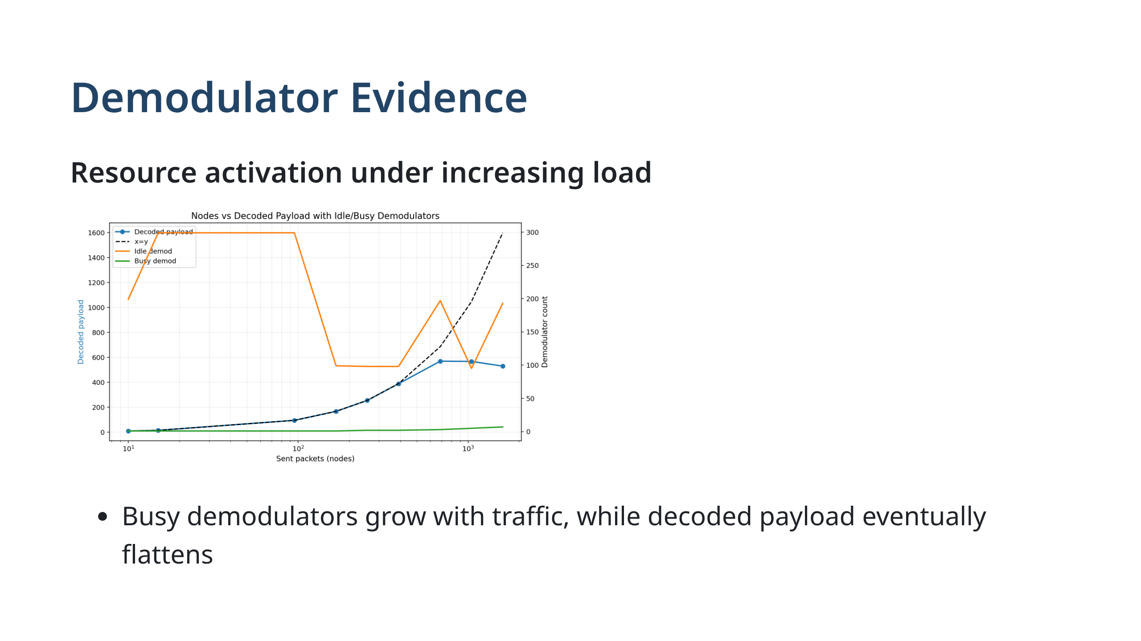
Notes:
This plot links decoding saturation to demodulator allocation.

Slide 15
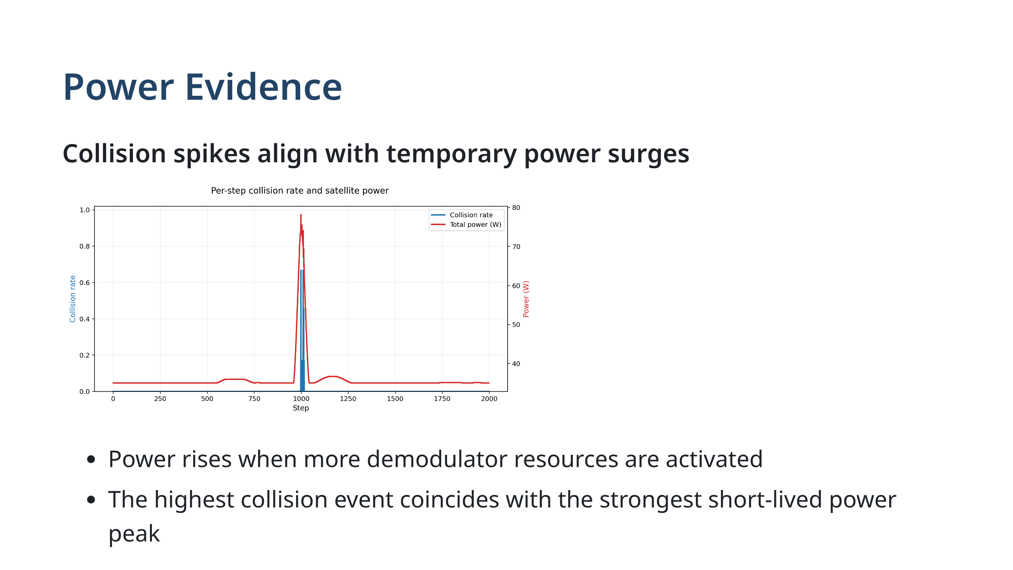
Notes:
This plot links congestion events to power draw.

Slide 16
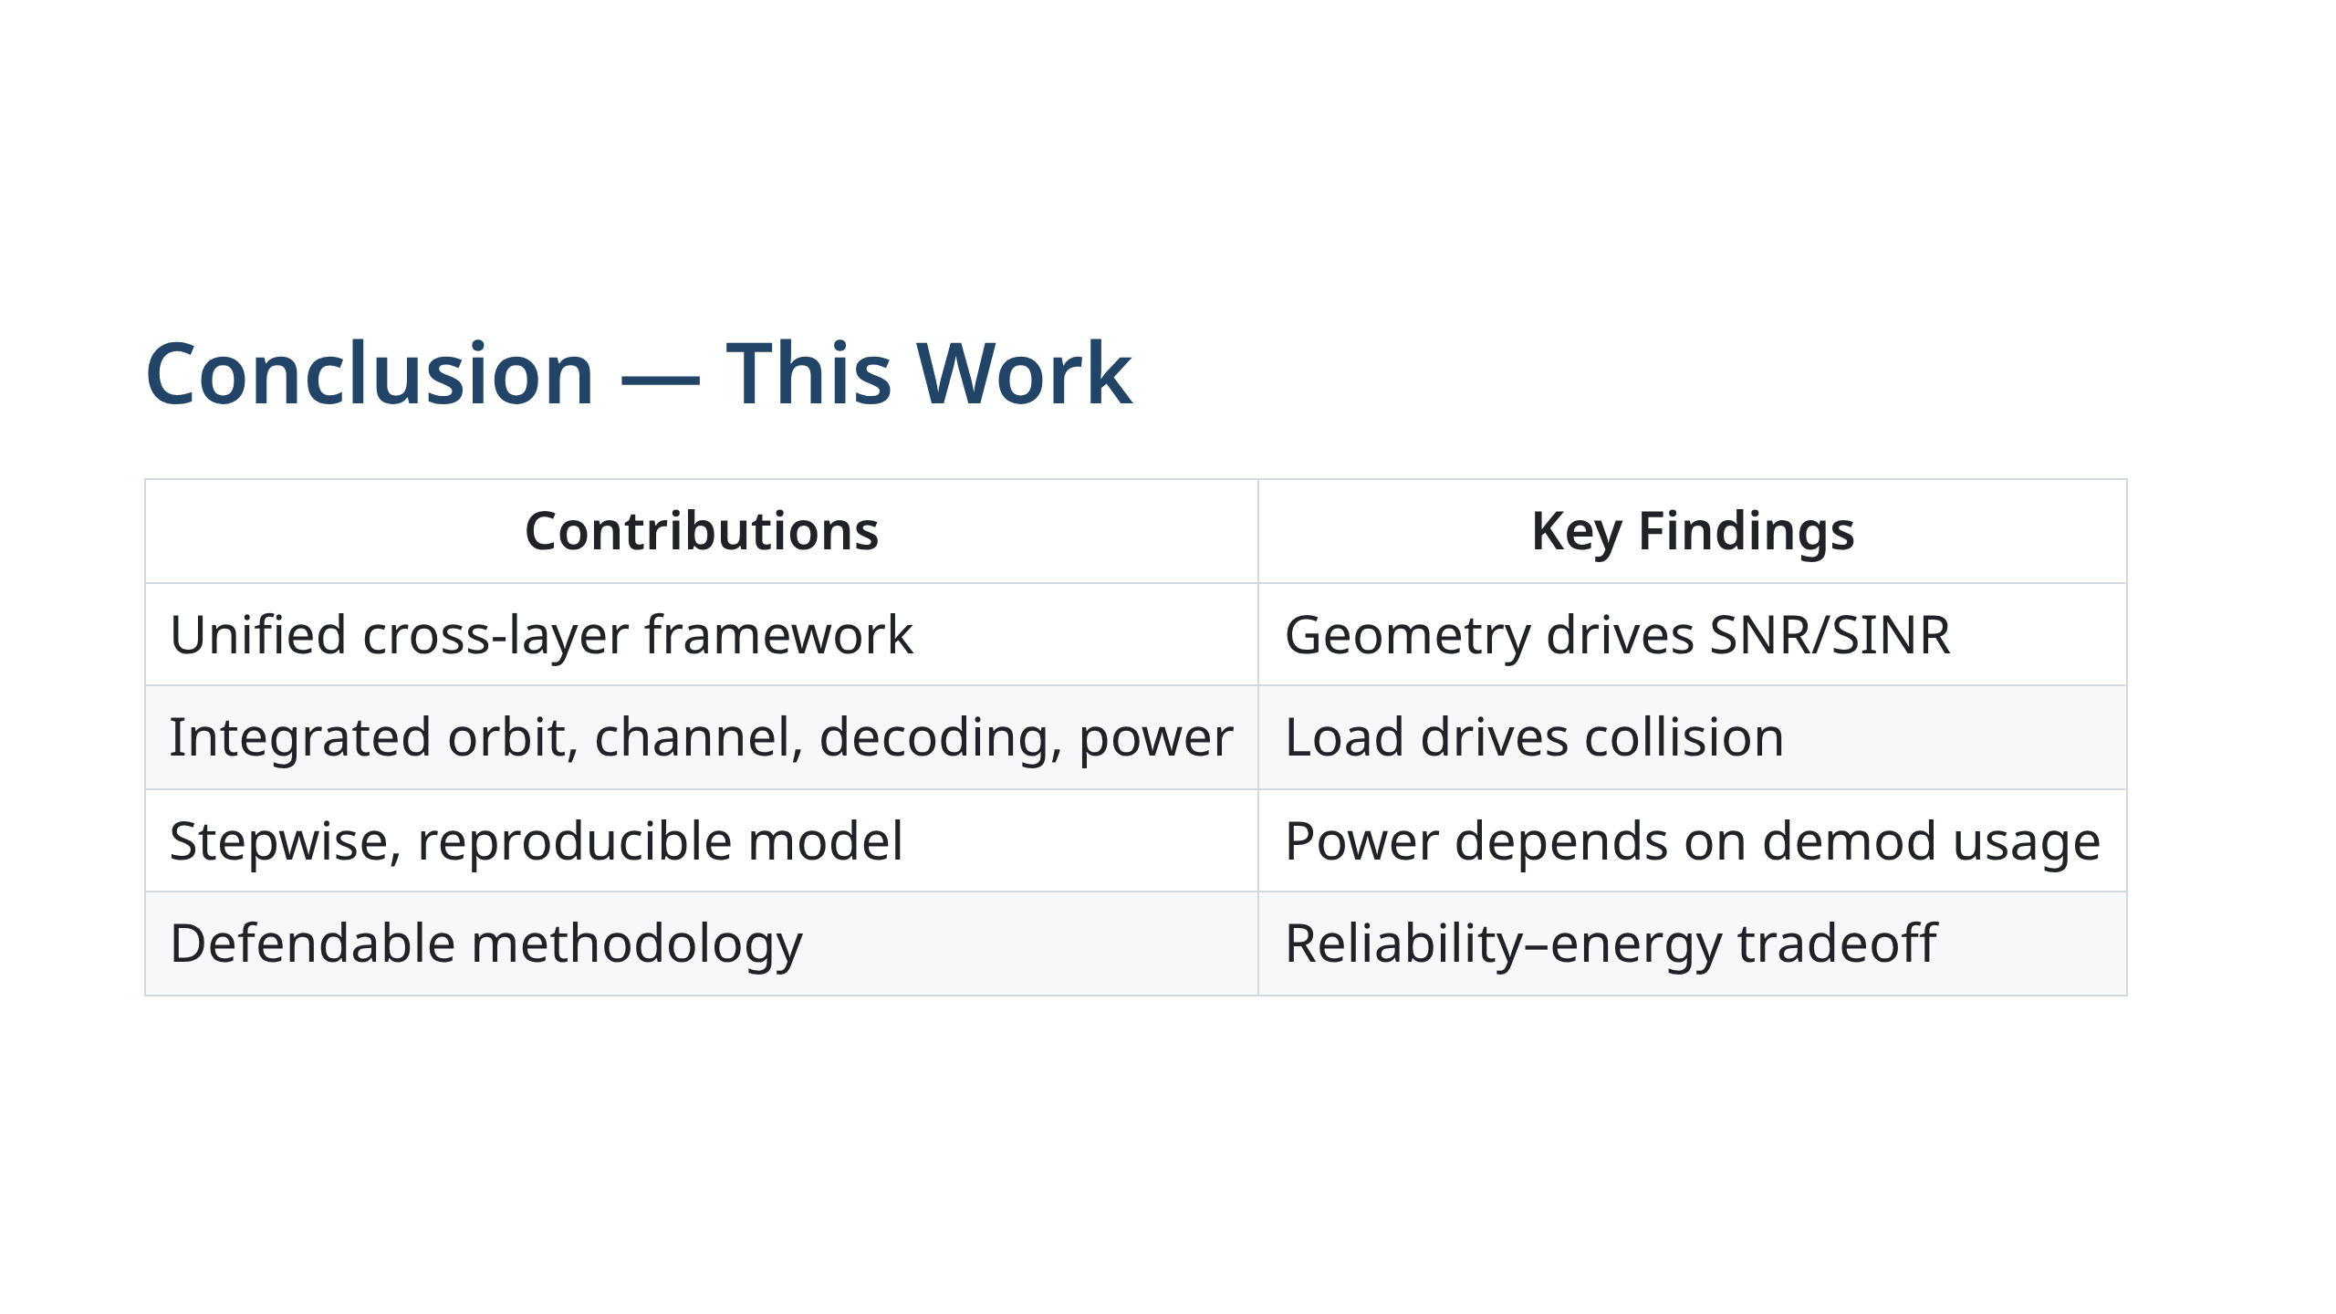

Slide 17
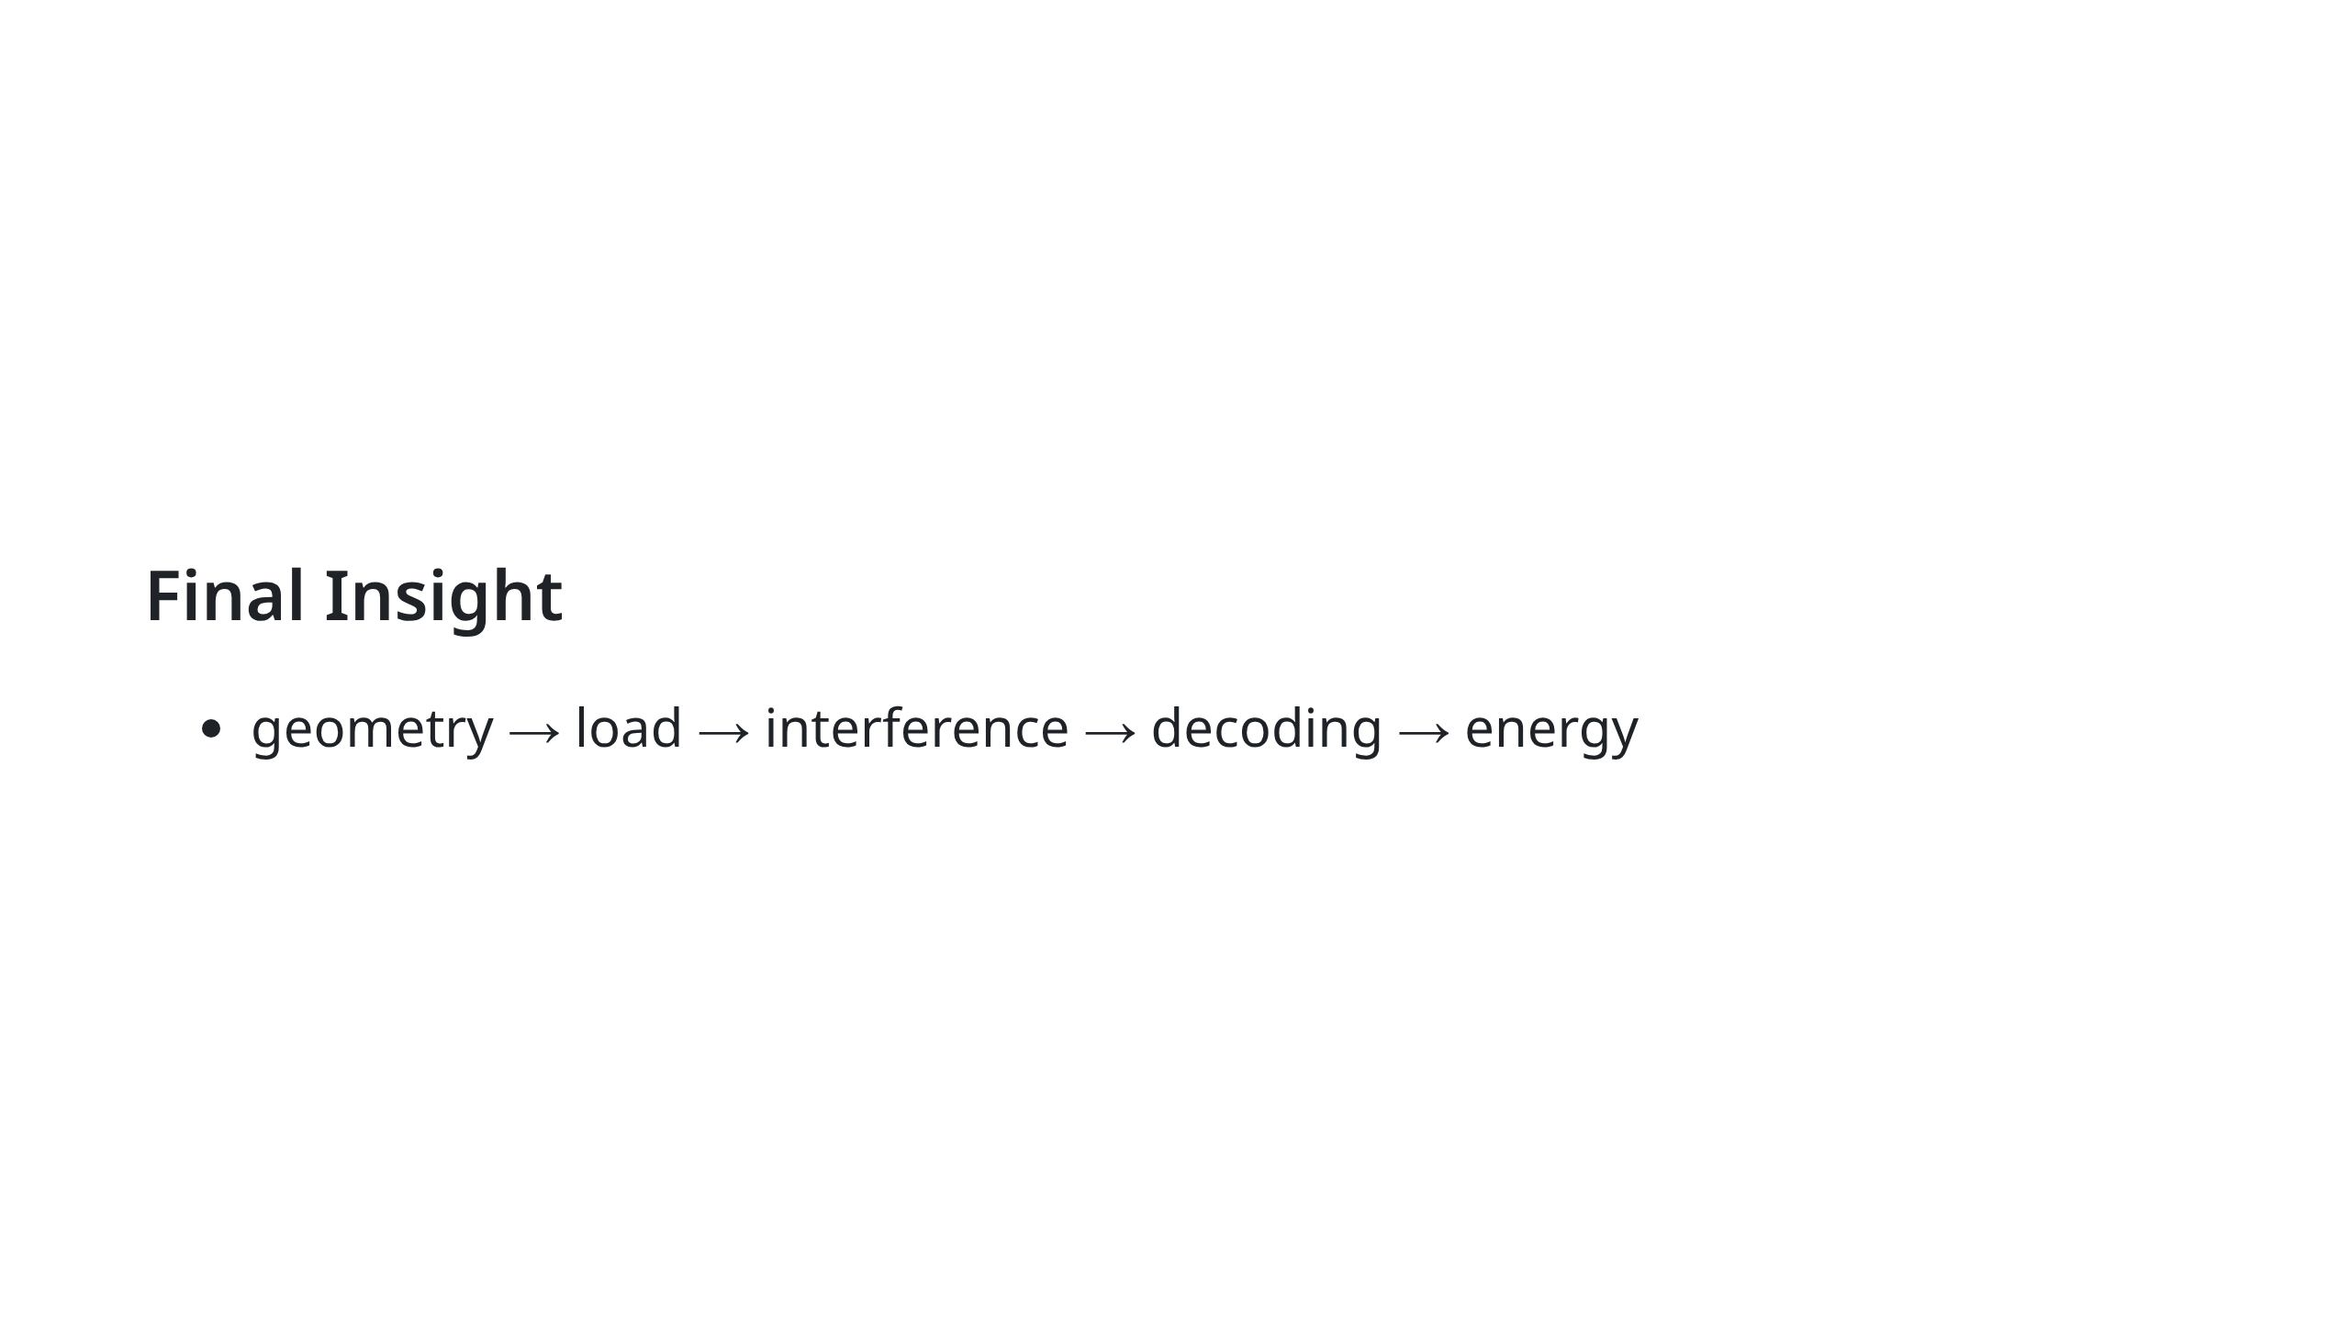
Notes:
Left shows contributions, right shows observations.

