Slide 1
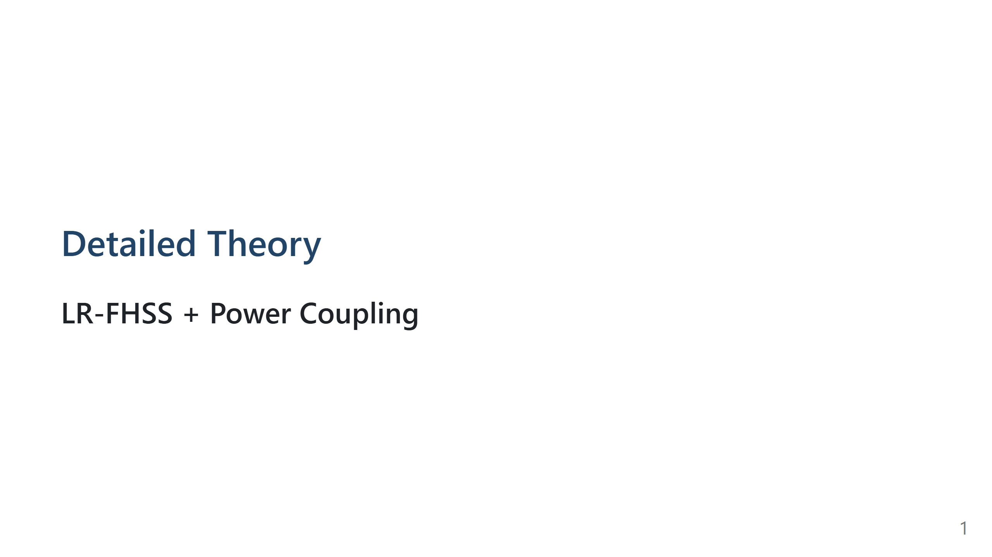
Notes:
Speech script: This detailed deck is equation-first. I will define symbols, derive each block, and then combine the blocks into a final recurrence.

Slide 2
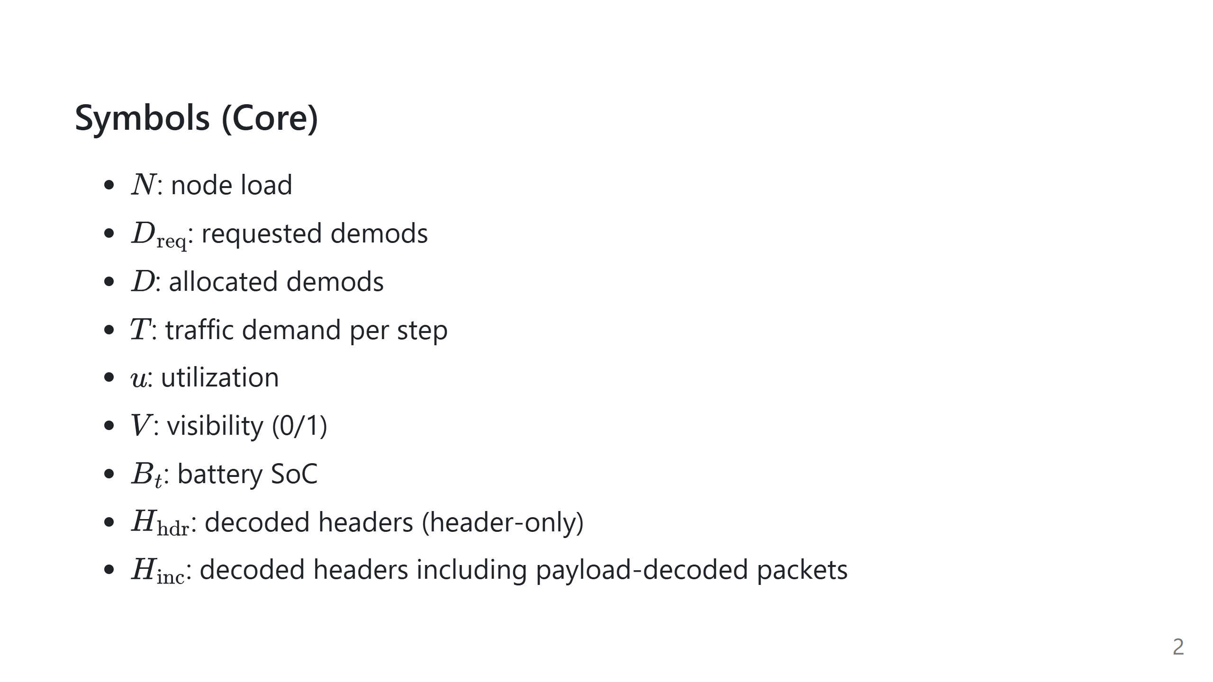
Notes:
Speech script: These are the communication and state variables. They form the input to each simulation step.

Slide 3
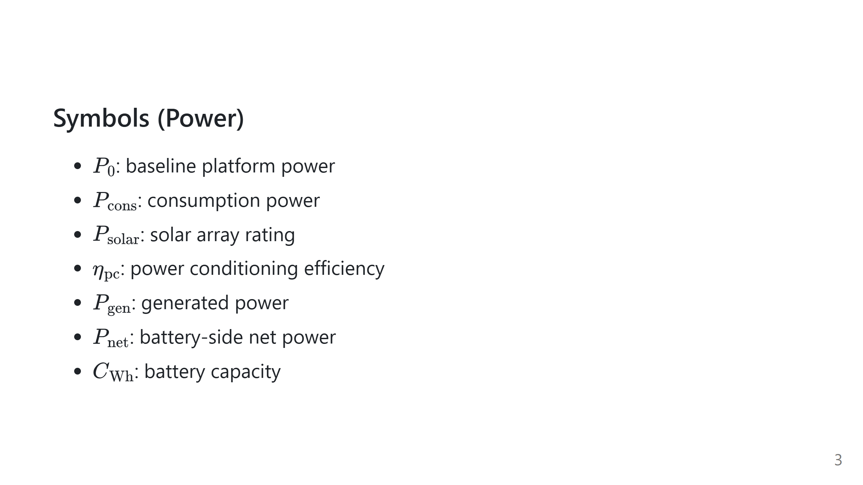
Notes:
Speech script: These are the power-system parameters and outputs. Keep this slide as reference for the remaining equations.

Slide 4
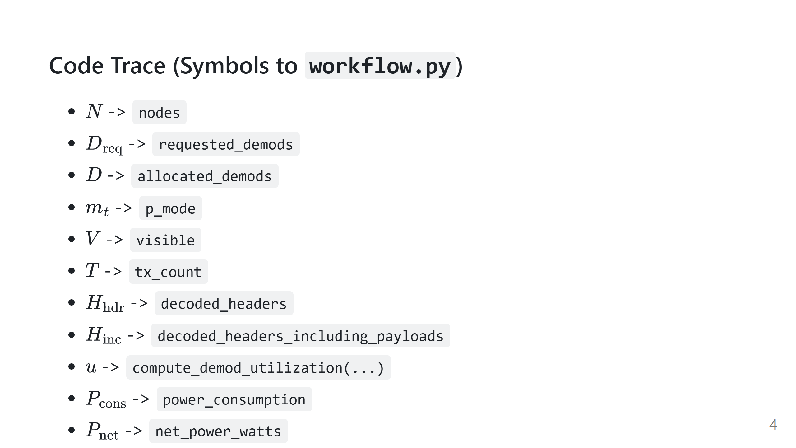
Notes:
Speech script: This slide maps each equation symbol to the exact implementation variable. It helps reviewers verify that the math and code are consistent.

Slide 5
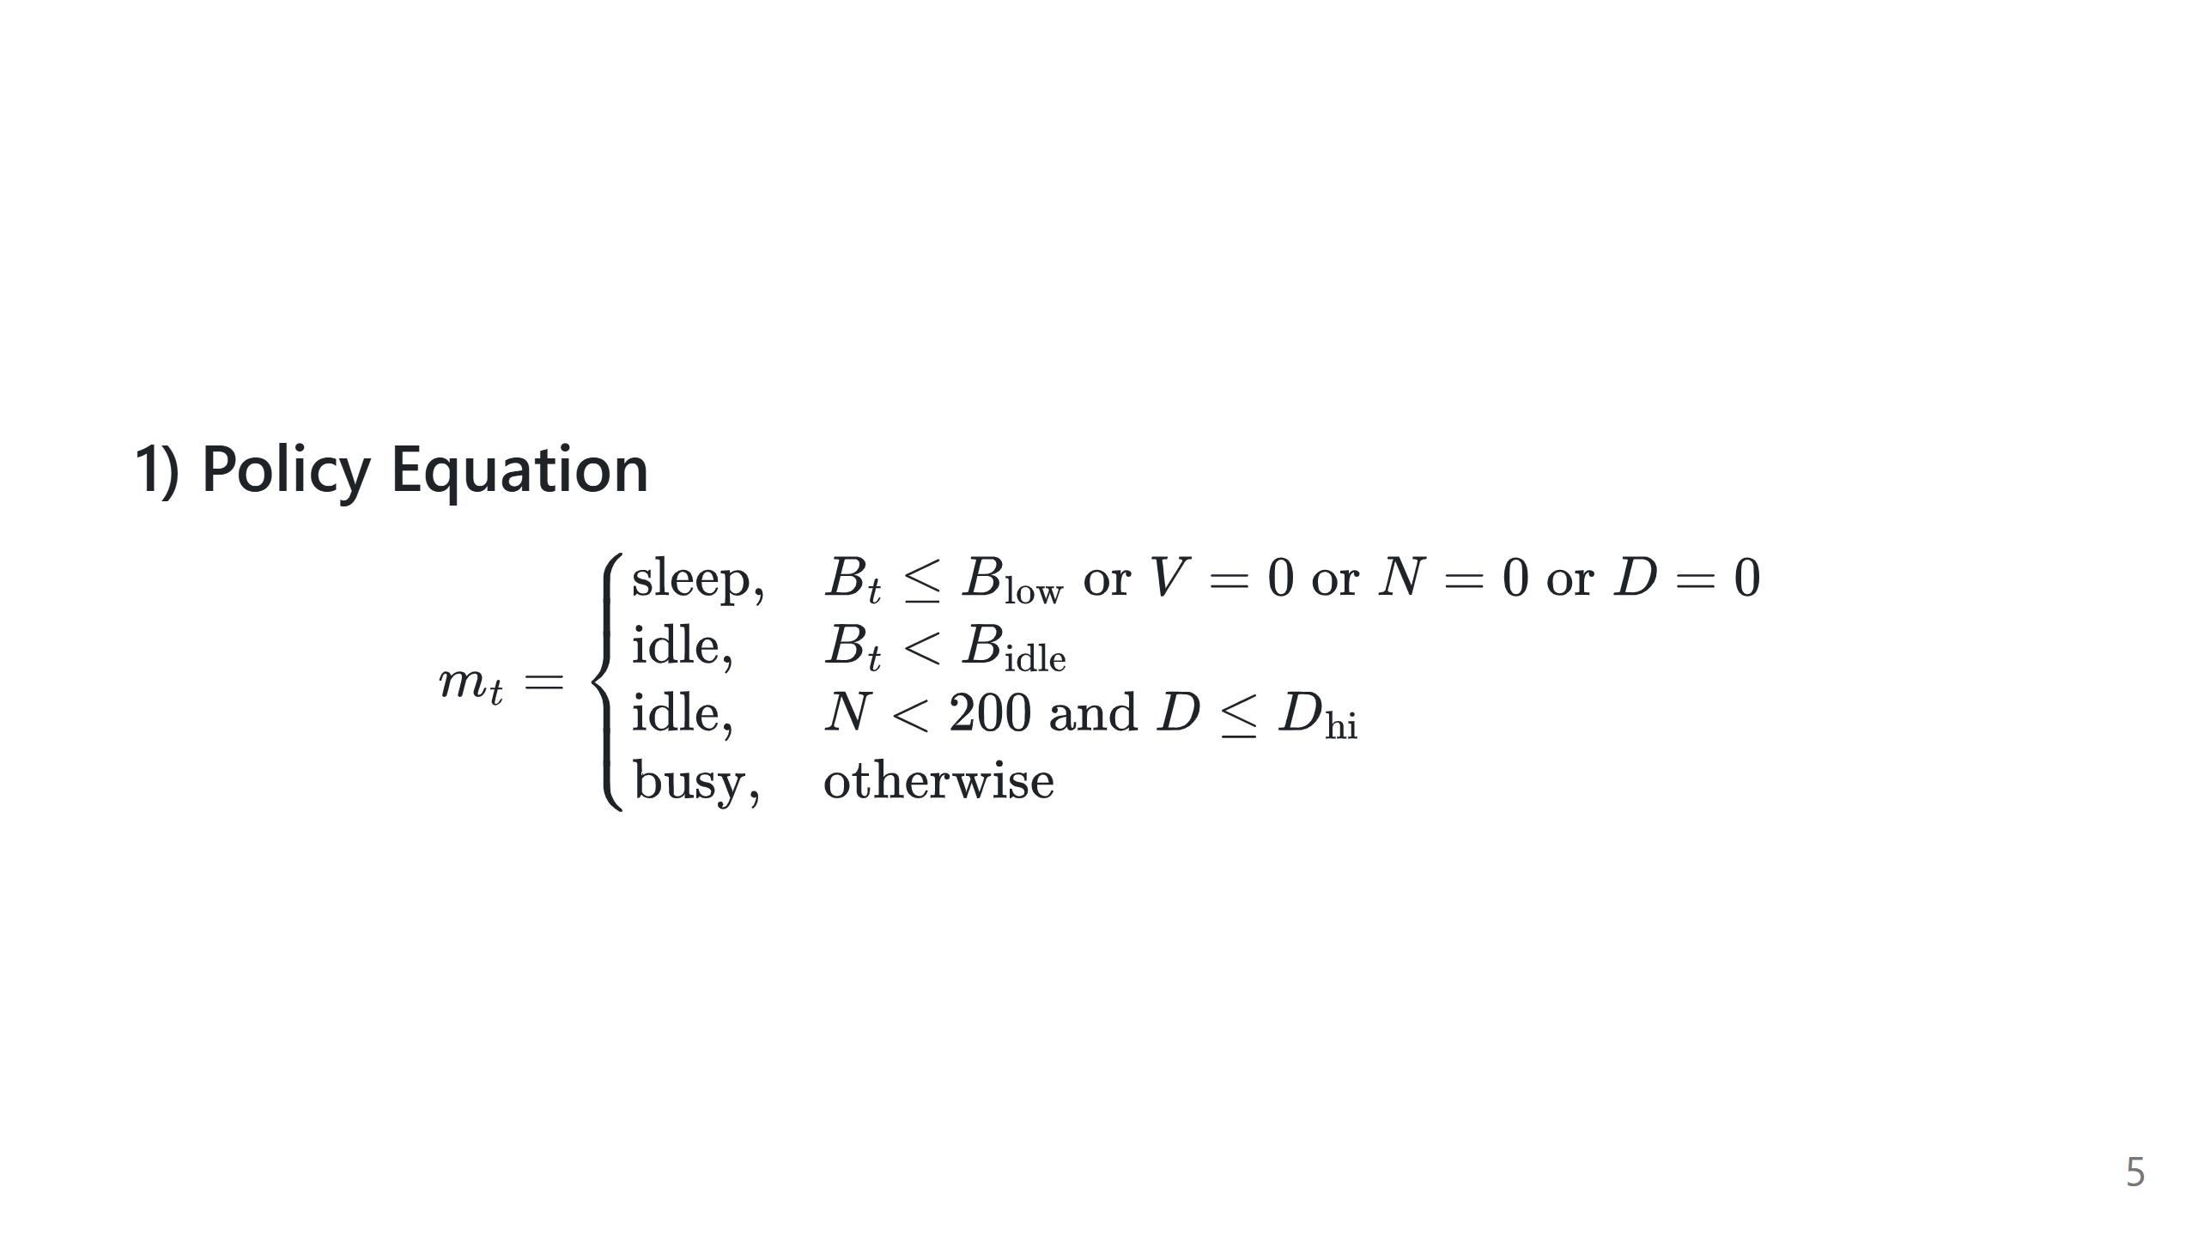
Notes:
Speech script: Mode is decided first. Battery safety, visibility, no traffic, or no allocated demods can force sleep. Otherwise, threshold logic separates idle and busy operation, including low-load idle.

Slide 6
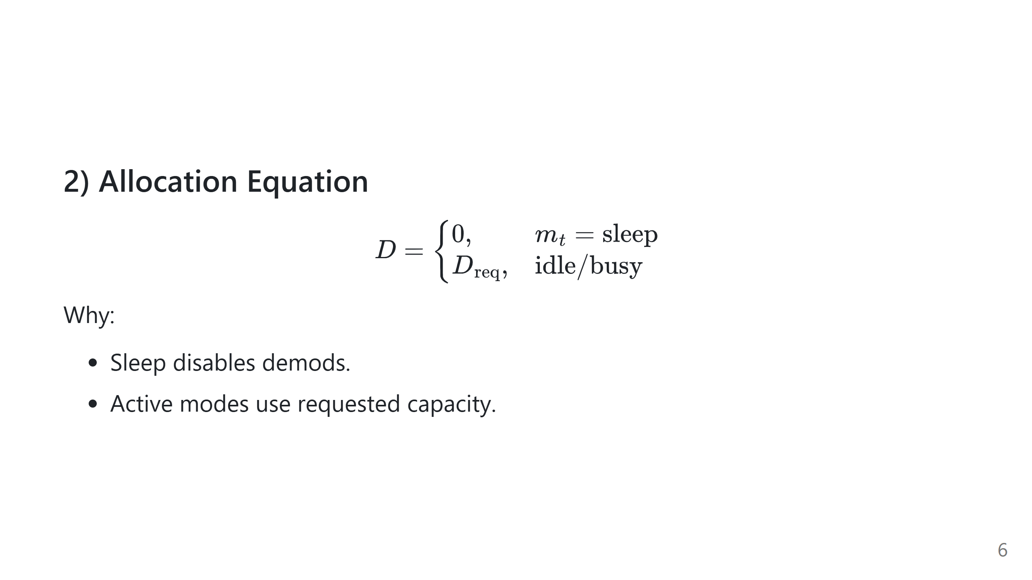
Notes:
Speech script: Mode becomes hardware allocation here. This is the bridge from policy to decoding capability.

Slide 7
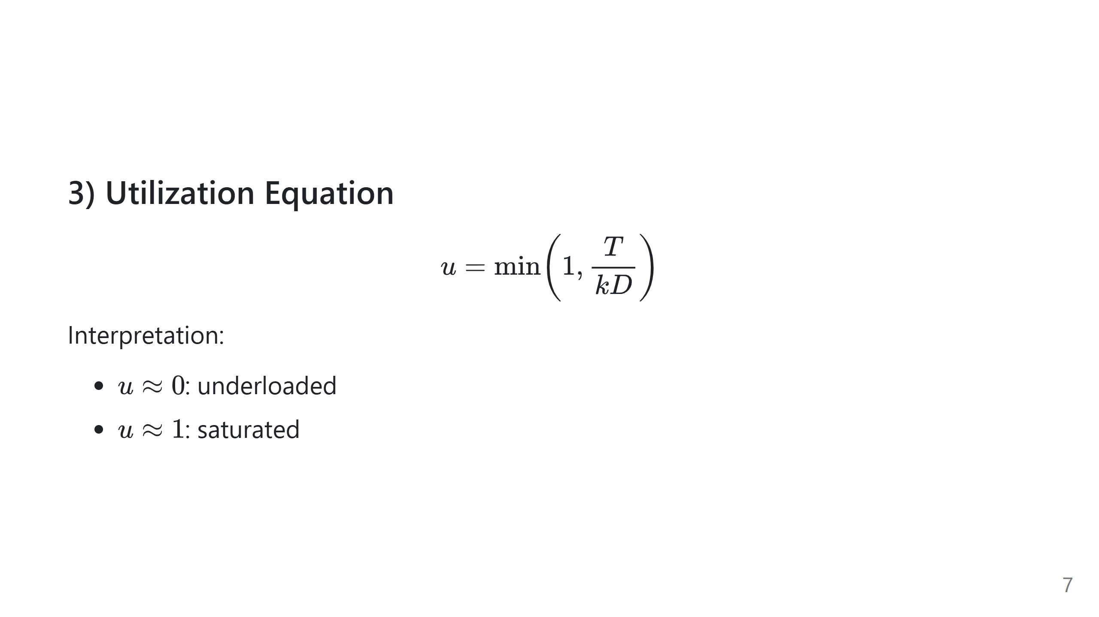
Notes:
Speech script: Utilization compares demand to demod capacity. This gives a normalized stress variable between zero and one.

Slide 8
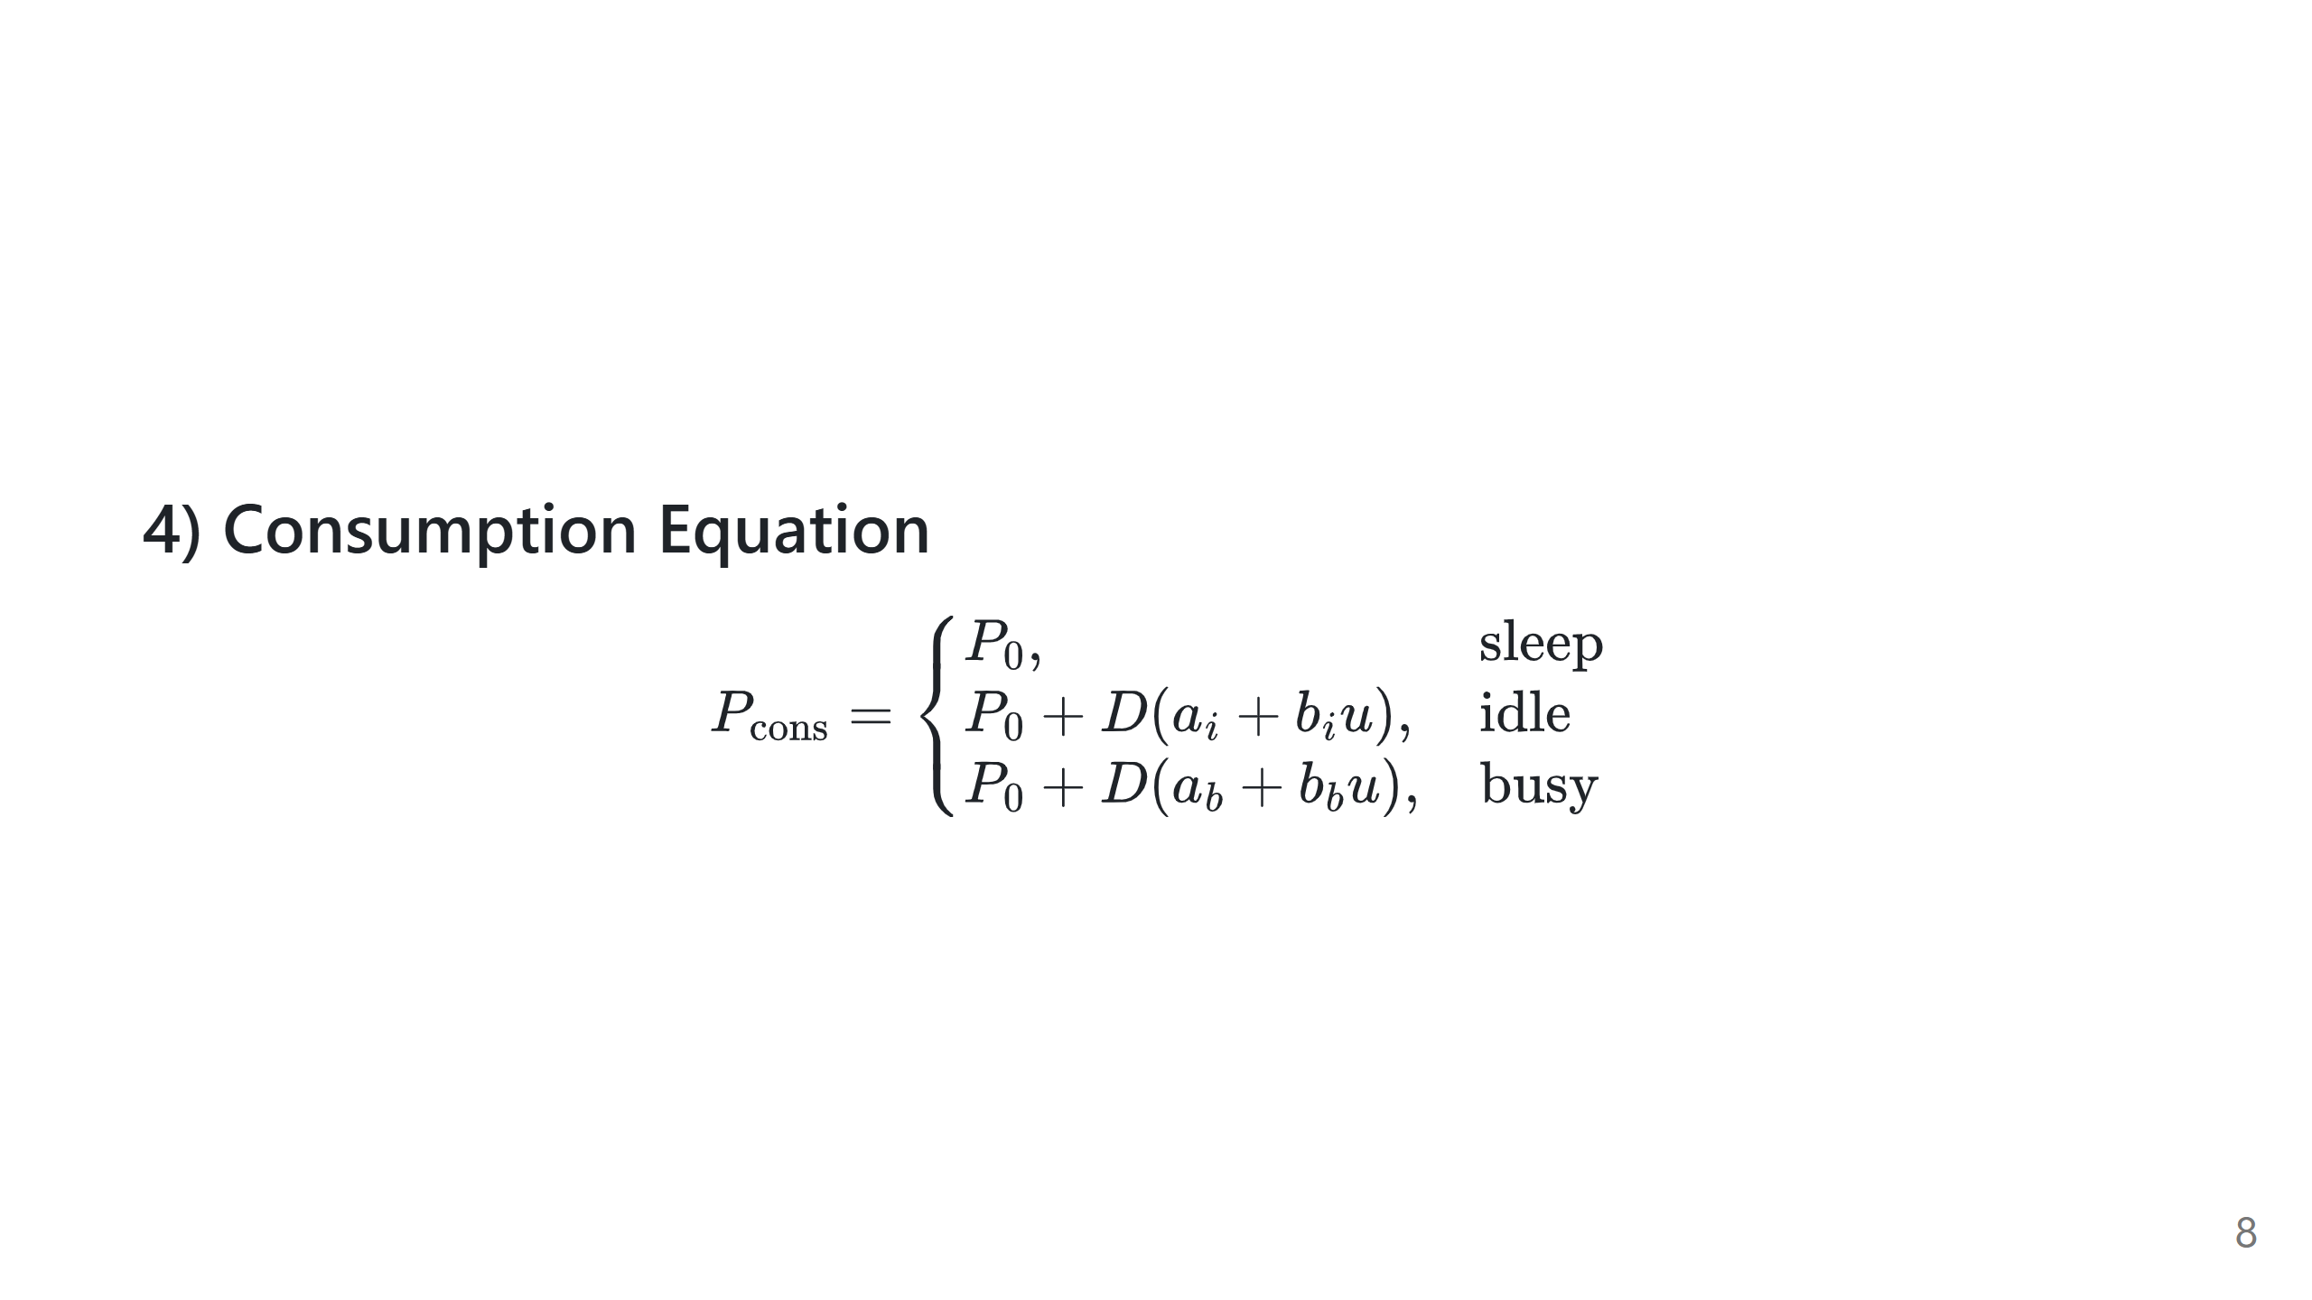
Notes:
Speech script: Sleep is baseline-only power. Idle and busy add demod power, scaled by utilization. Busy coefficients are larger than idle by design.

Slide 9
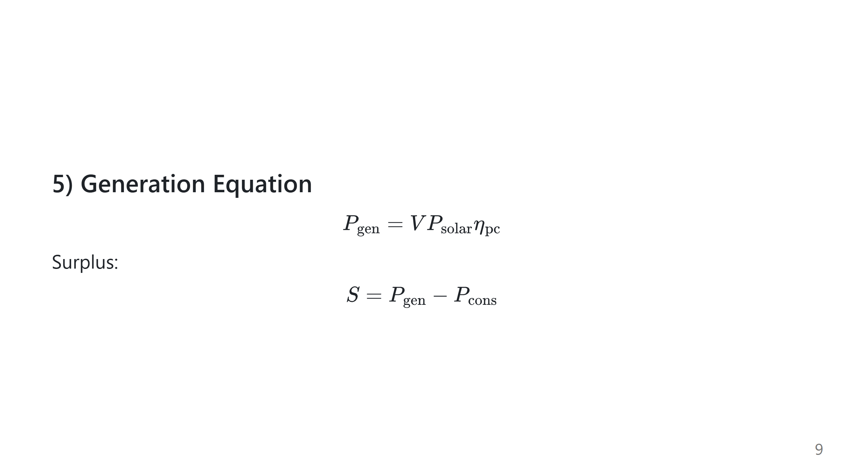
Notes:
Speech script: Visibility gates generation. Surplus is the key sign variable: positive means potential charging, negative means required discharging.

Slide 10
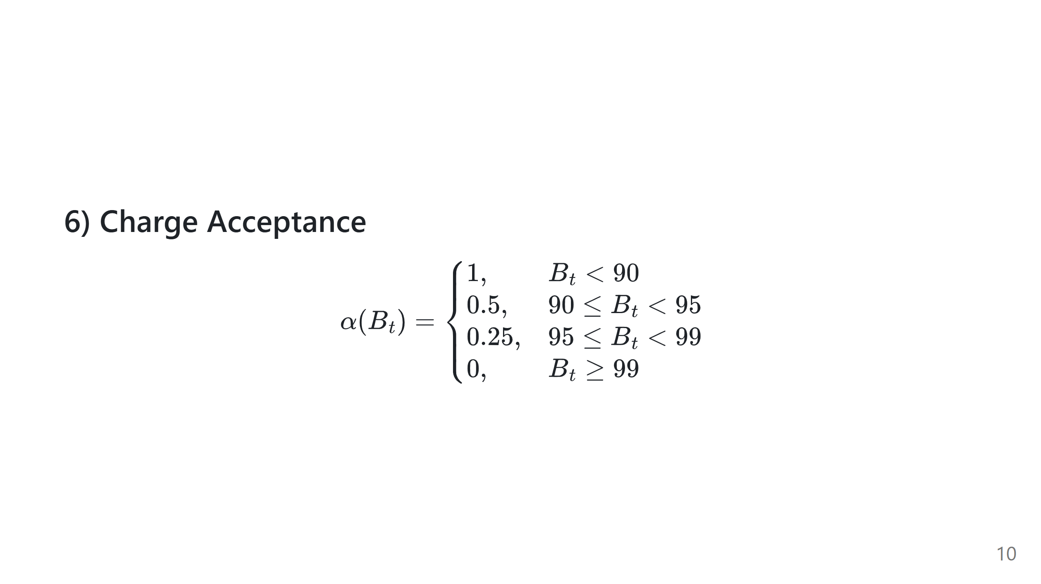
Notes:
Speech script: This captures CV-like taper near full battery. It limits accepted charging power as SoC approaches 100 percent.

Slide 11
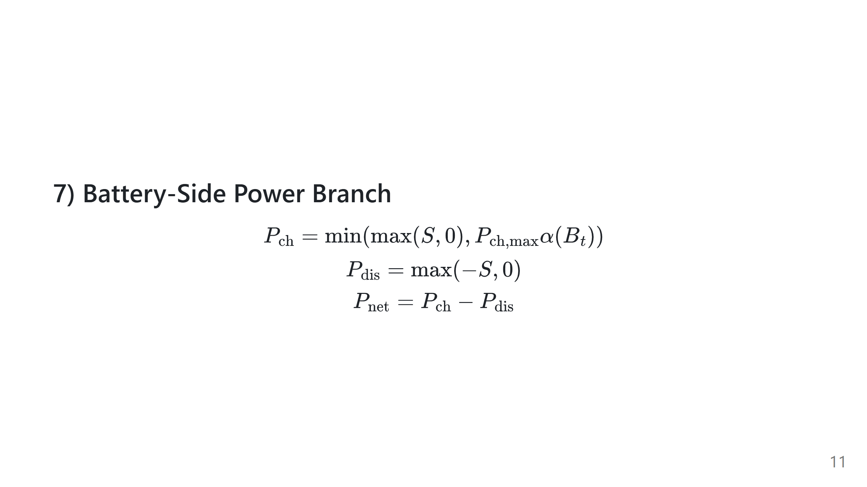
Notes:
Speech script: This is a piecewise branch written compactly. Only one branch is active at a time: charging branch for positive surplus, discharging branch for negative surplus.

Slide 12
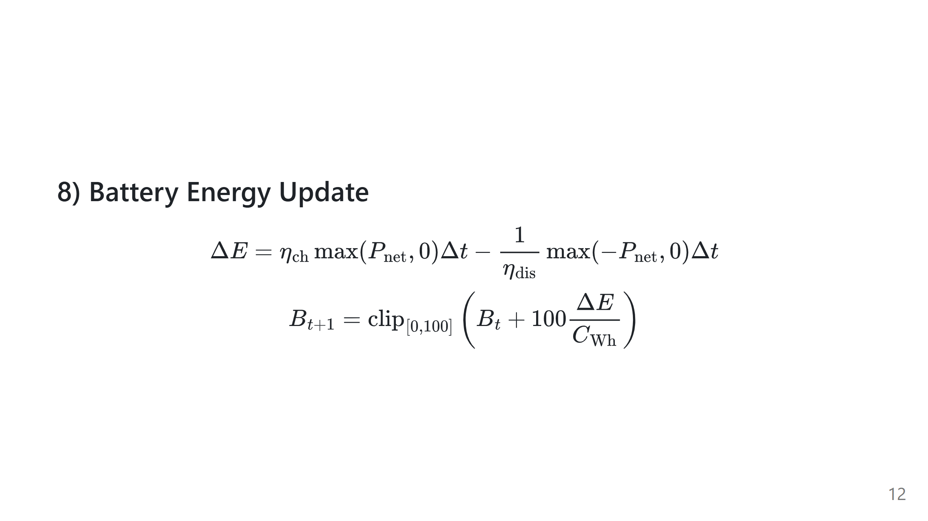
Notes:
Speech script: We integrate power over step duration to get energy change. Then convert energy to SoC percentage. Clip ensures physically valid SoC bounds.

Slide 13
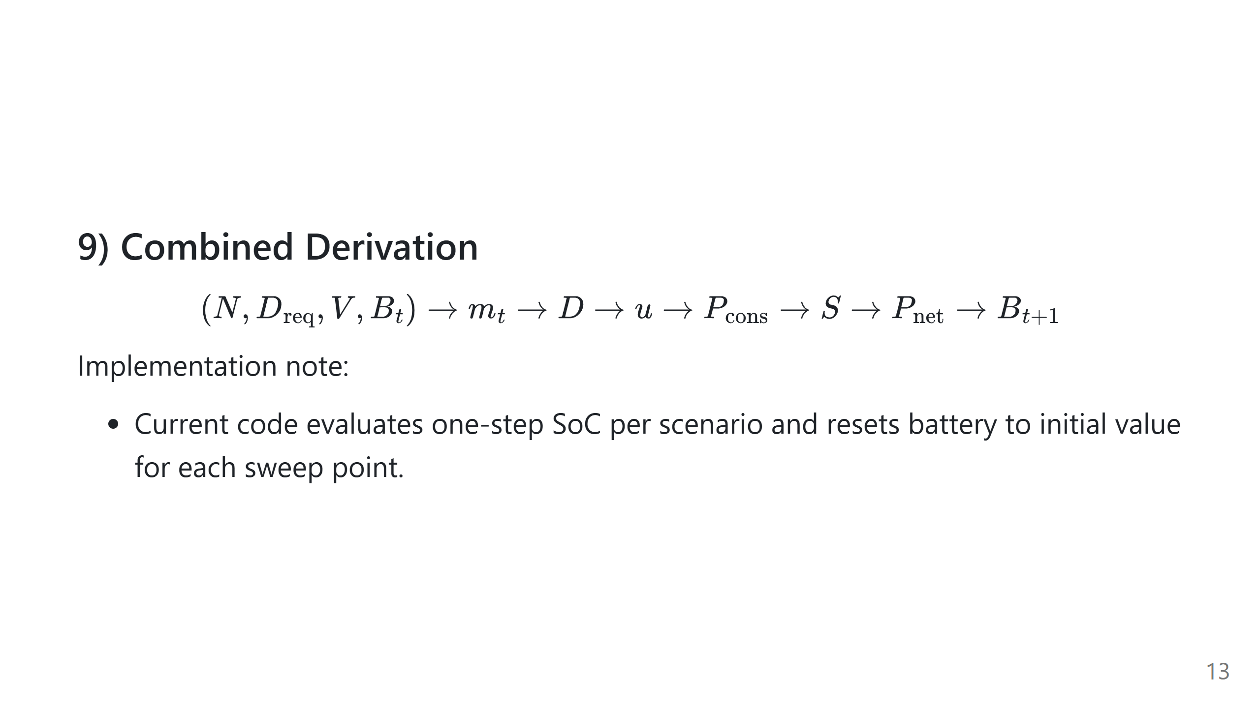
Notes:
Speech script: This one-line chain is the full algorithm. Every block is deterministic once parameters are set. In code, this chain is applied as a one-step scenario update rather than a multi-step temporal rollout across scenarios.

Slide 14
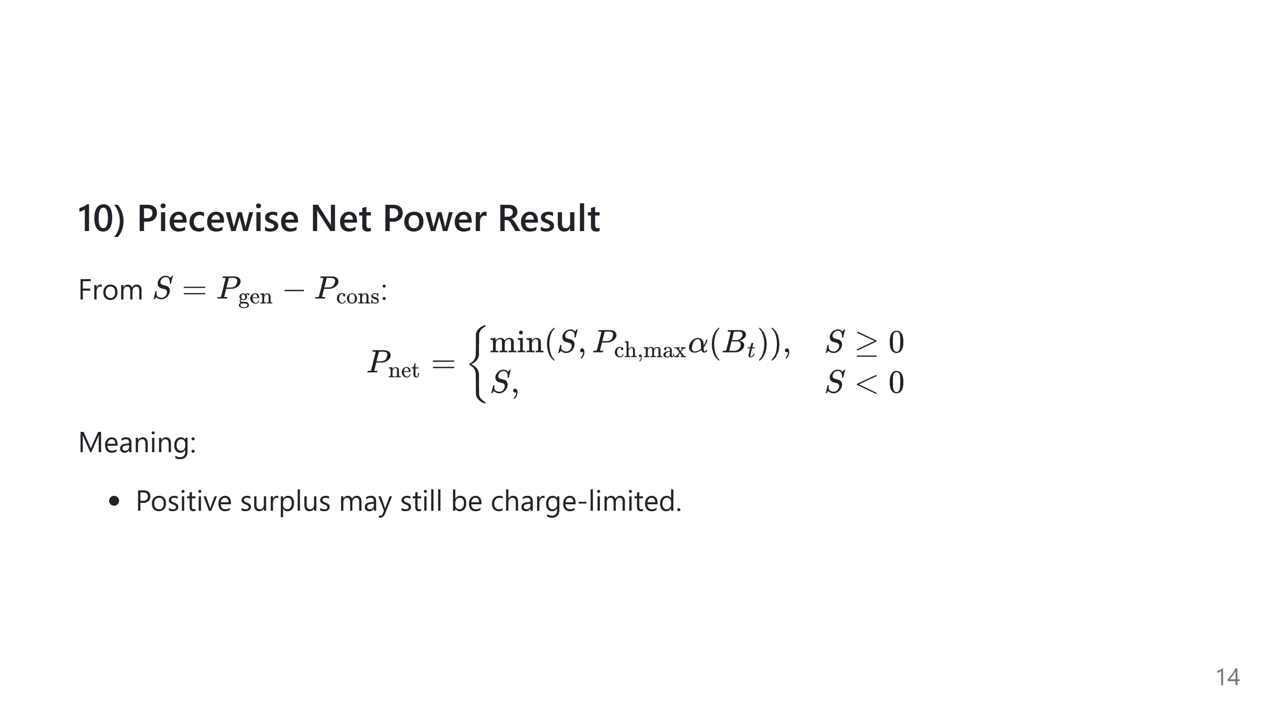
Notes:
Speech script: This is the most important derived simplification. When surplus is positive, charging can still be capped by acceptance. When surplus is negative, net power simply follows deficit.

Slide 15
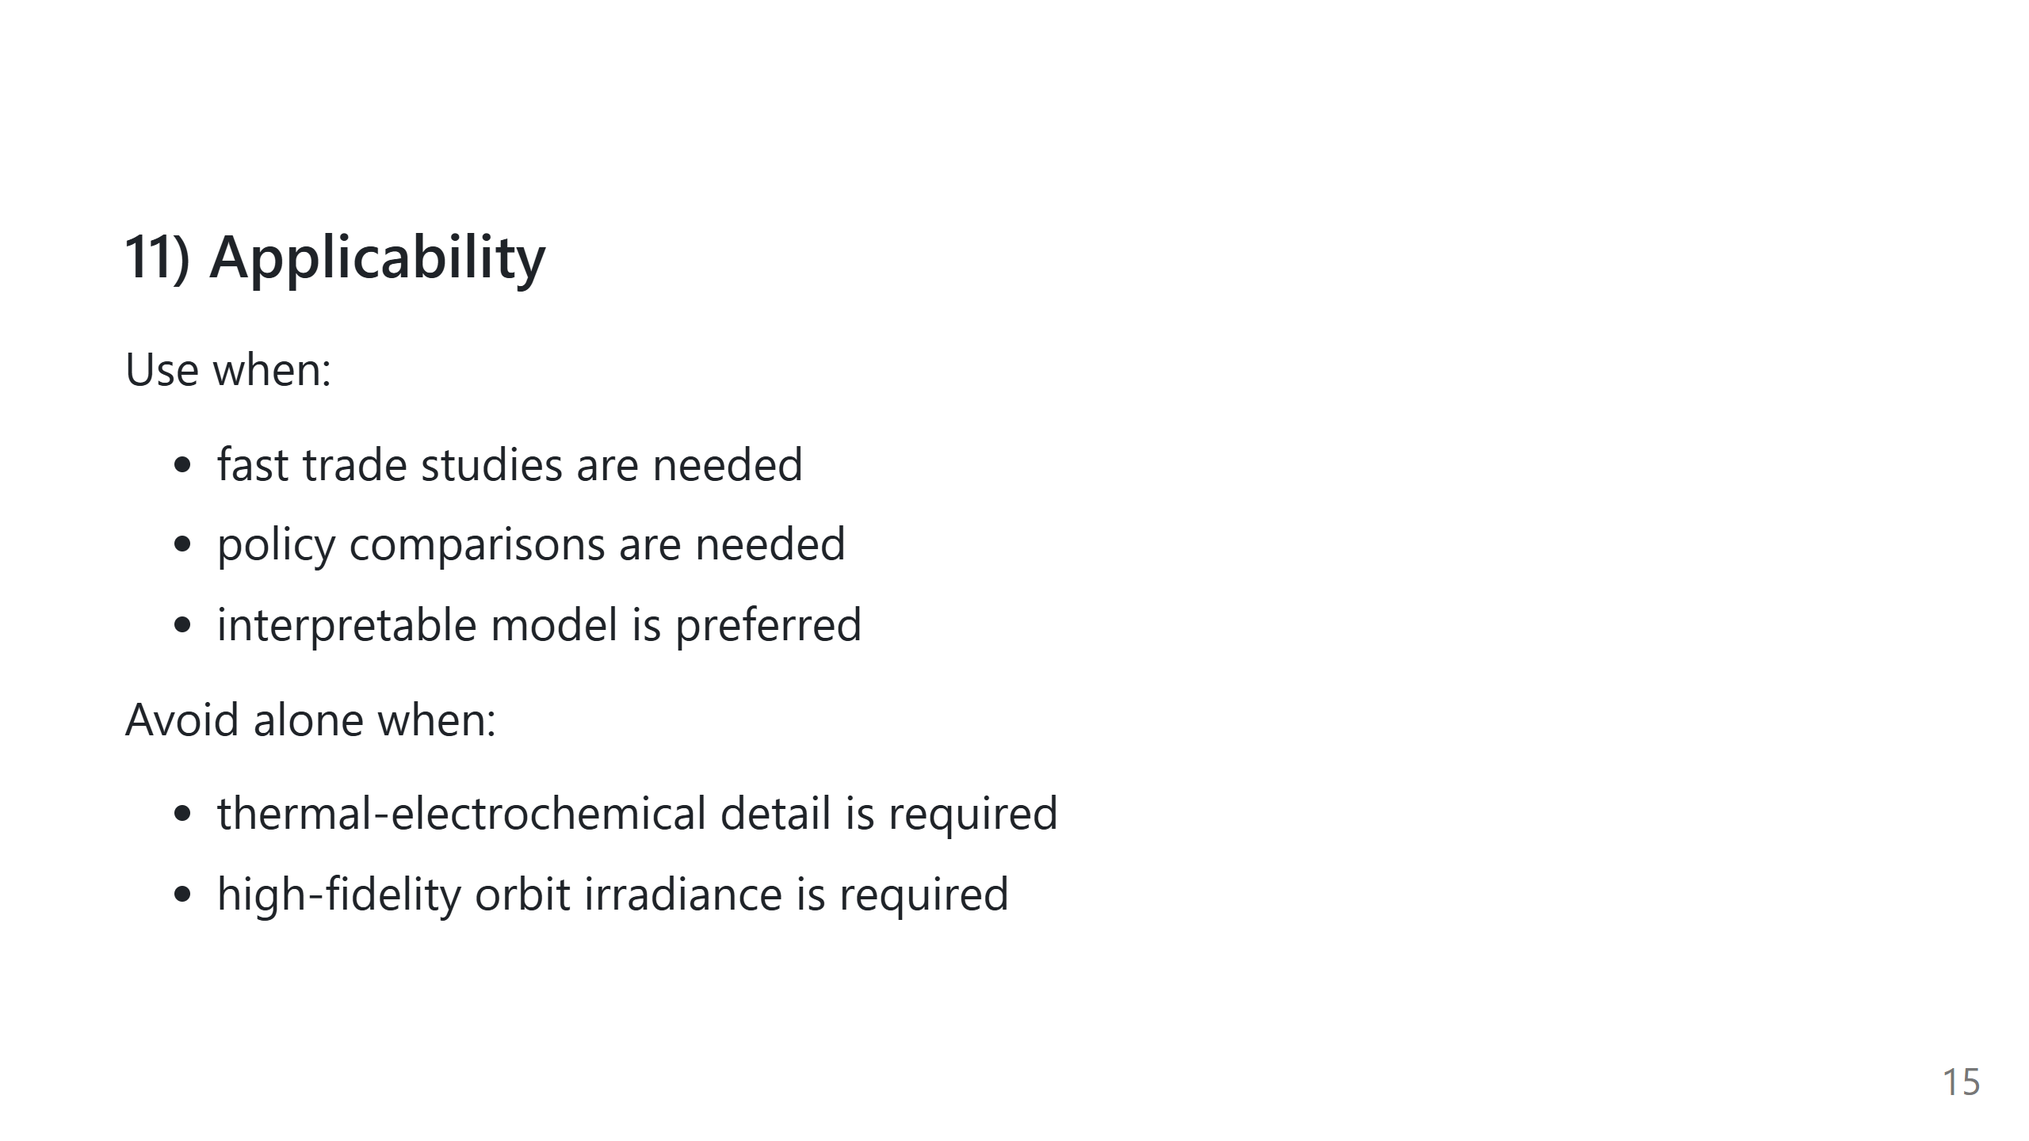
Notes:
Speech script: This model is intentionally lightweight. It is great for control and system-level trade space analysis. It should be complemented by high-fidelity models for final verification.

Slide 16
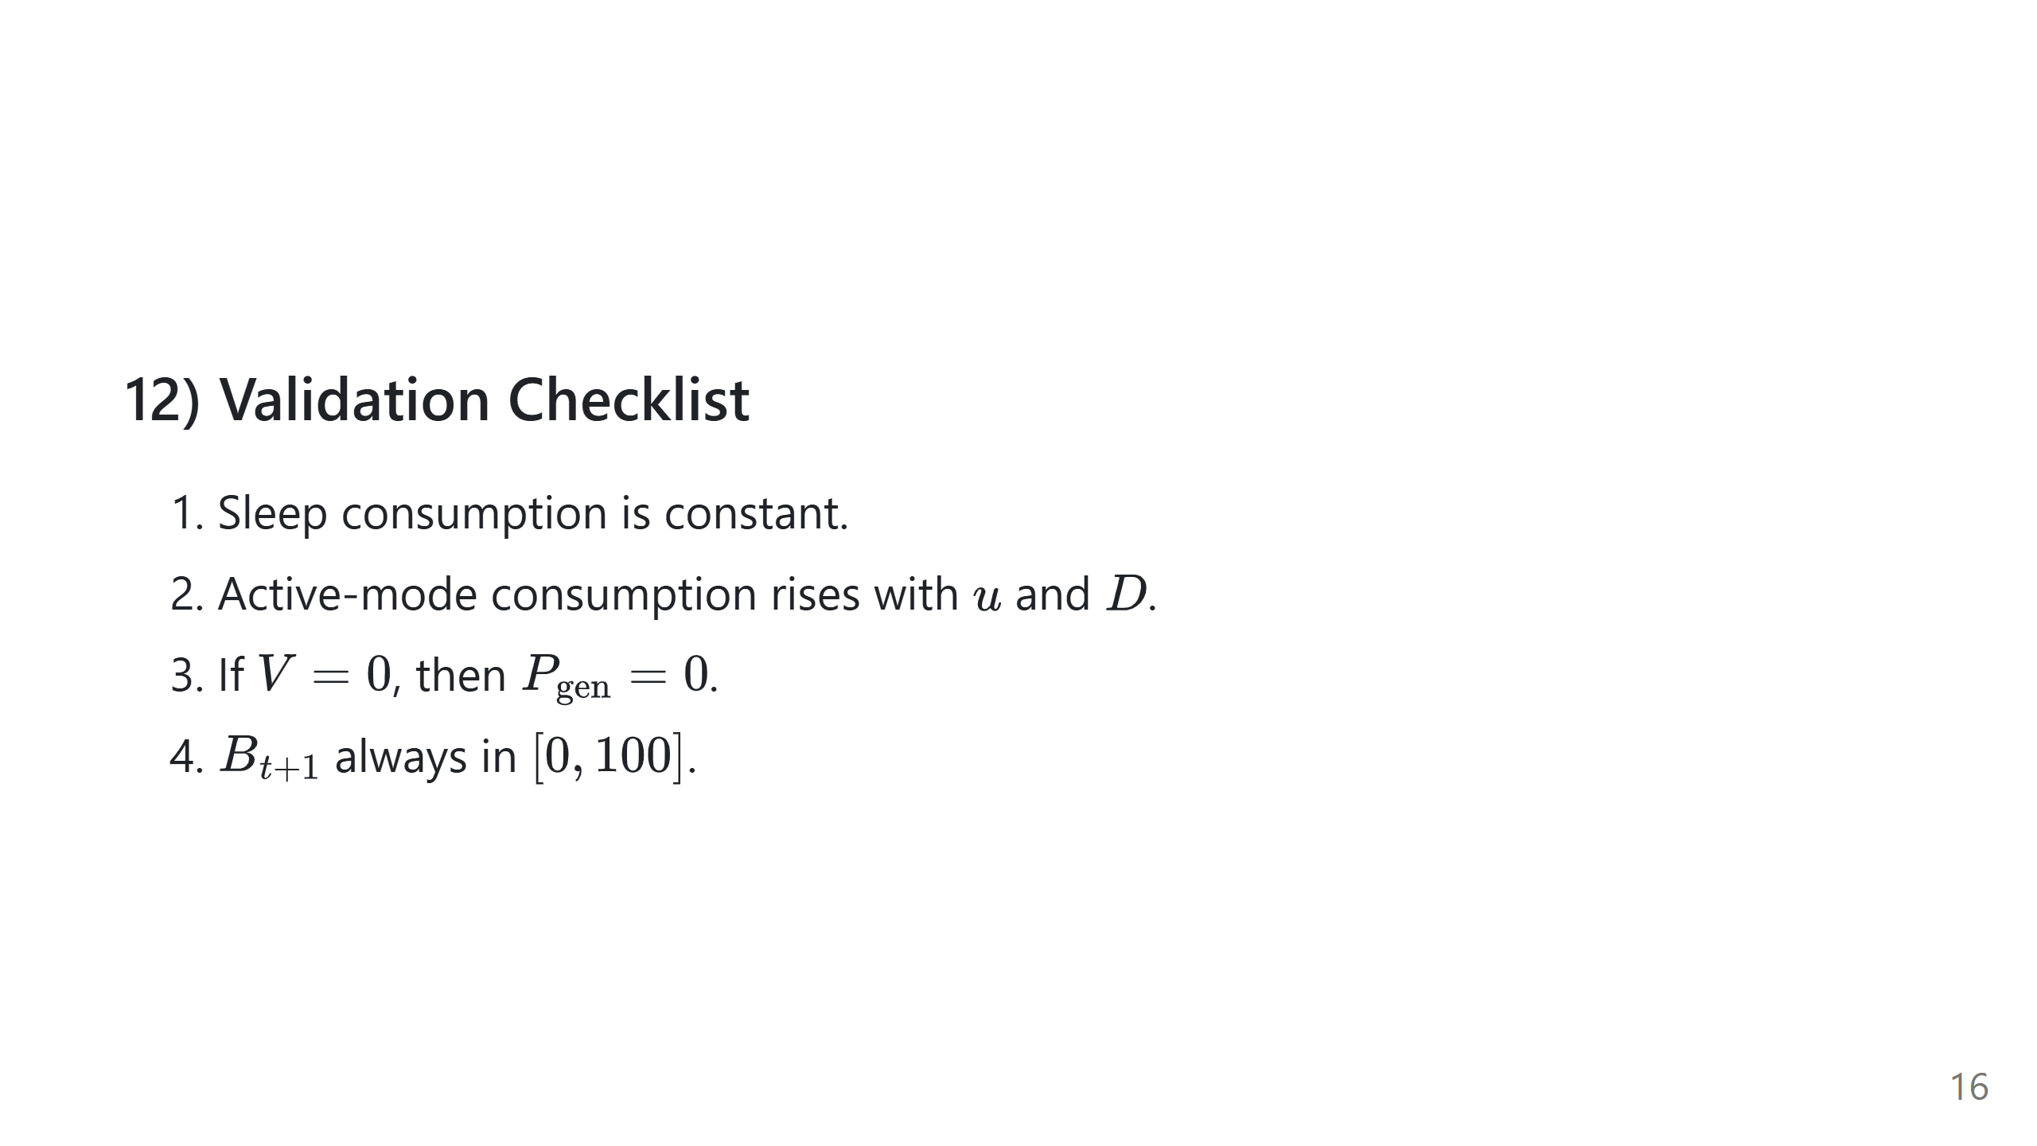
Notes:
Speech script: These checks are quick sanity tests for implementation correctness. If any fail, either parameters or code logic should be reviewed.

Slide 17
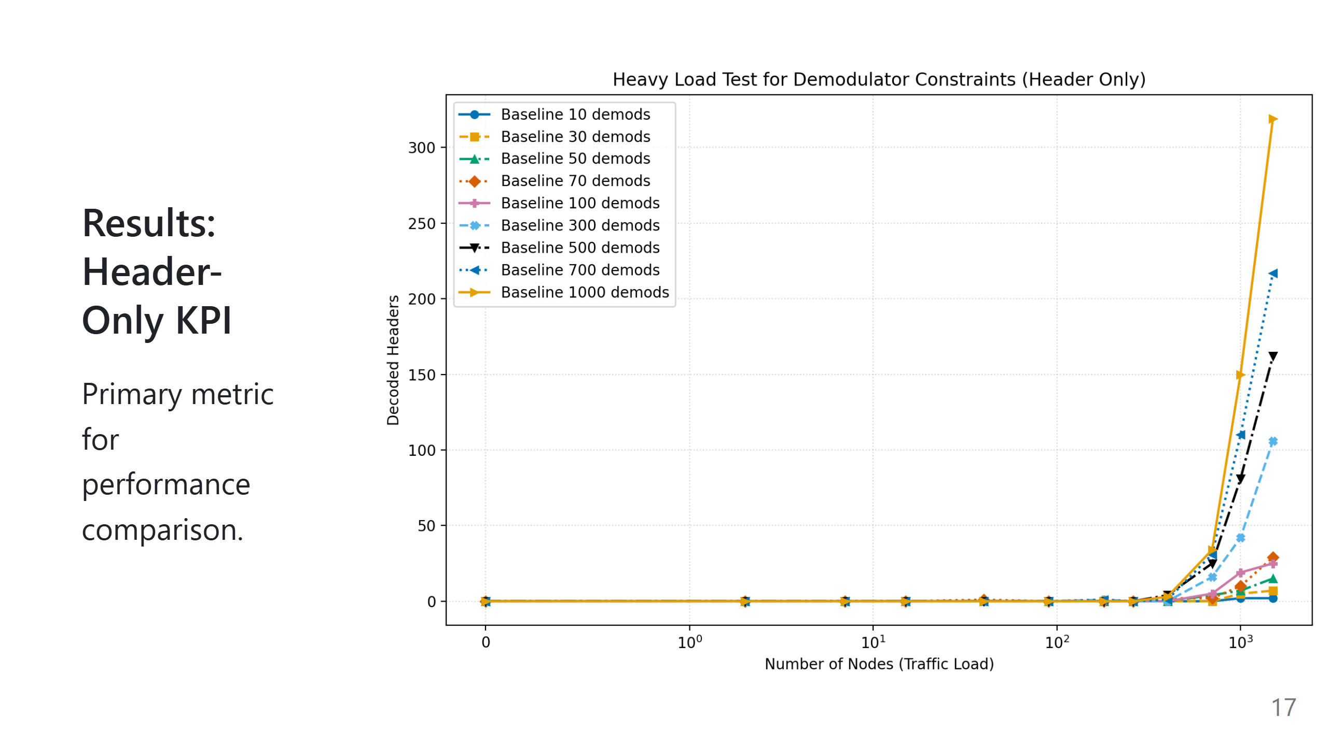

Slide 18
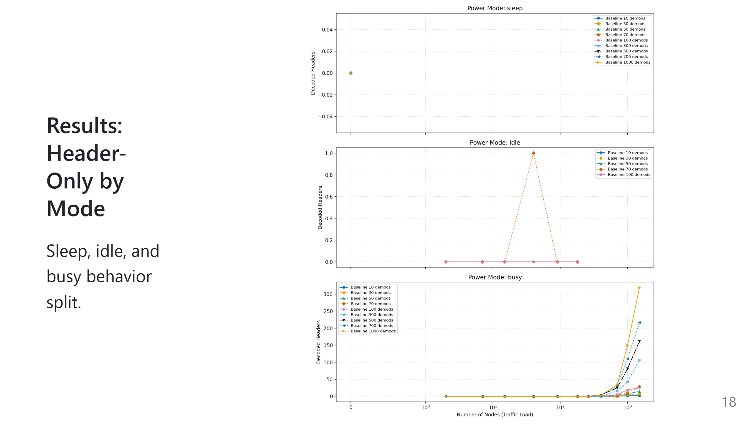

Slide 19
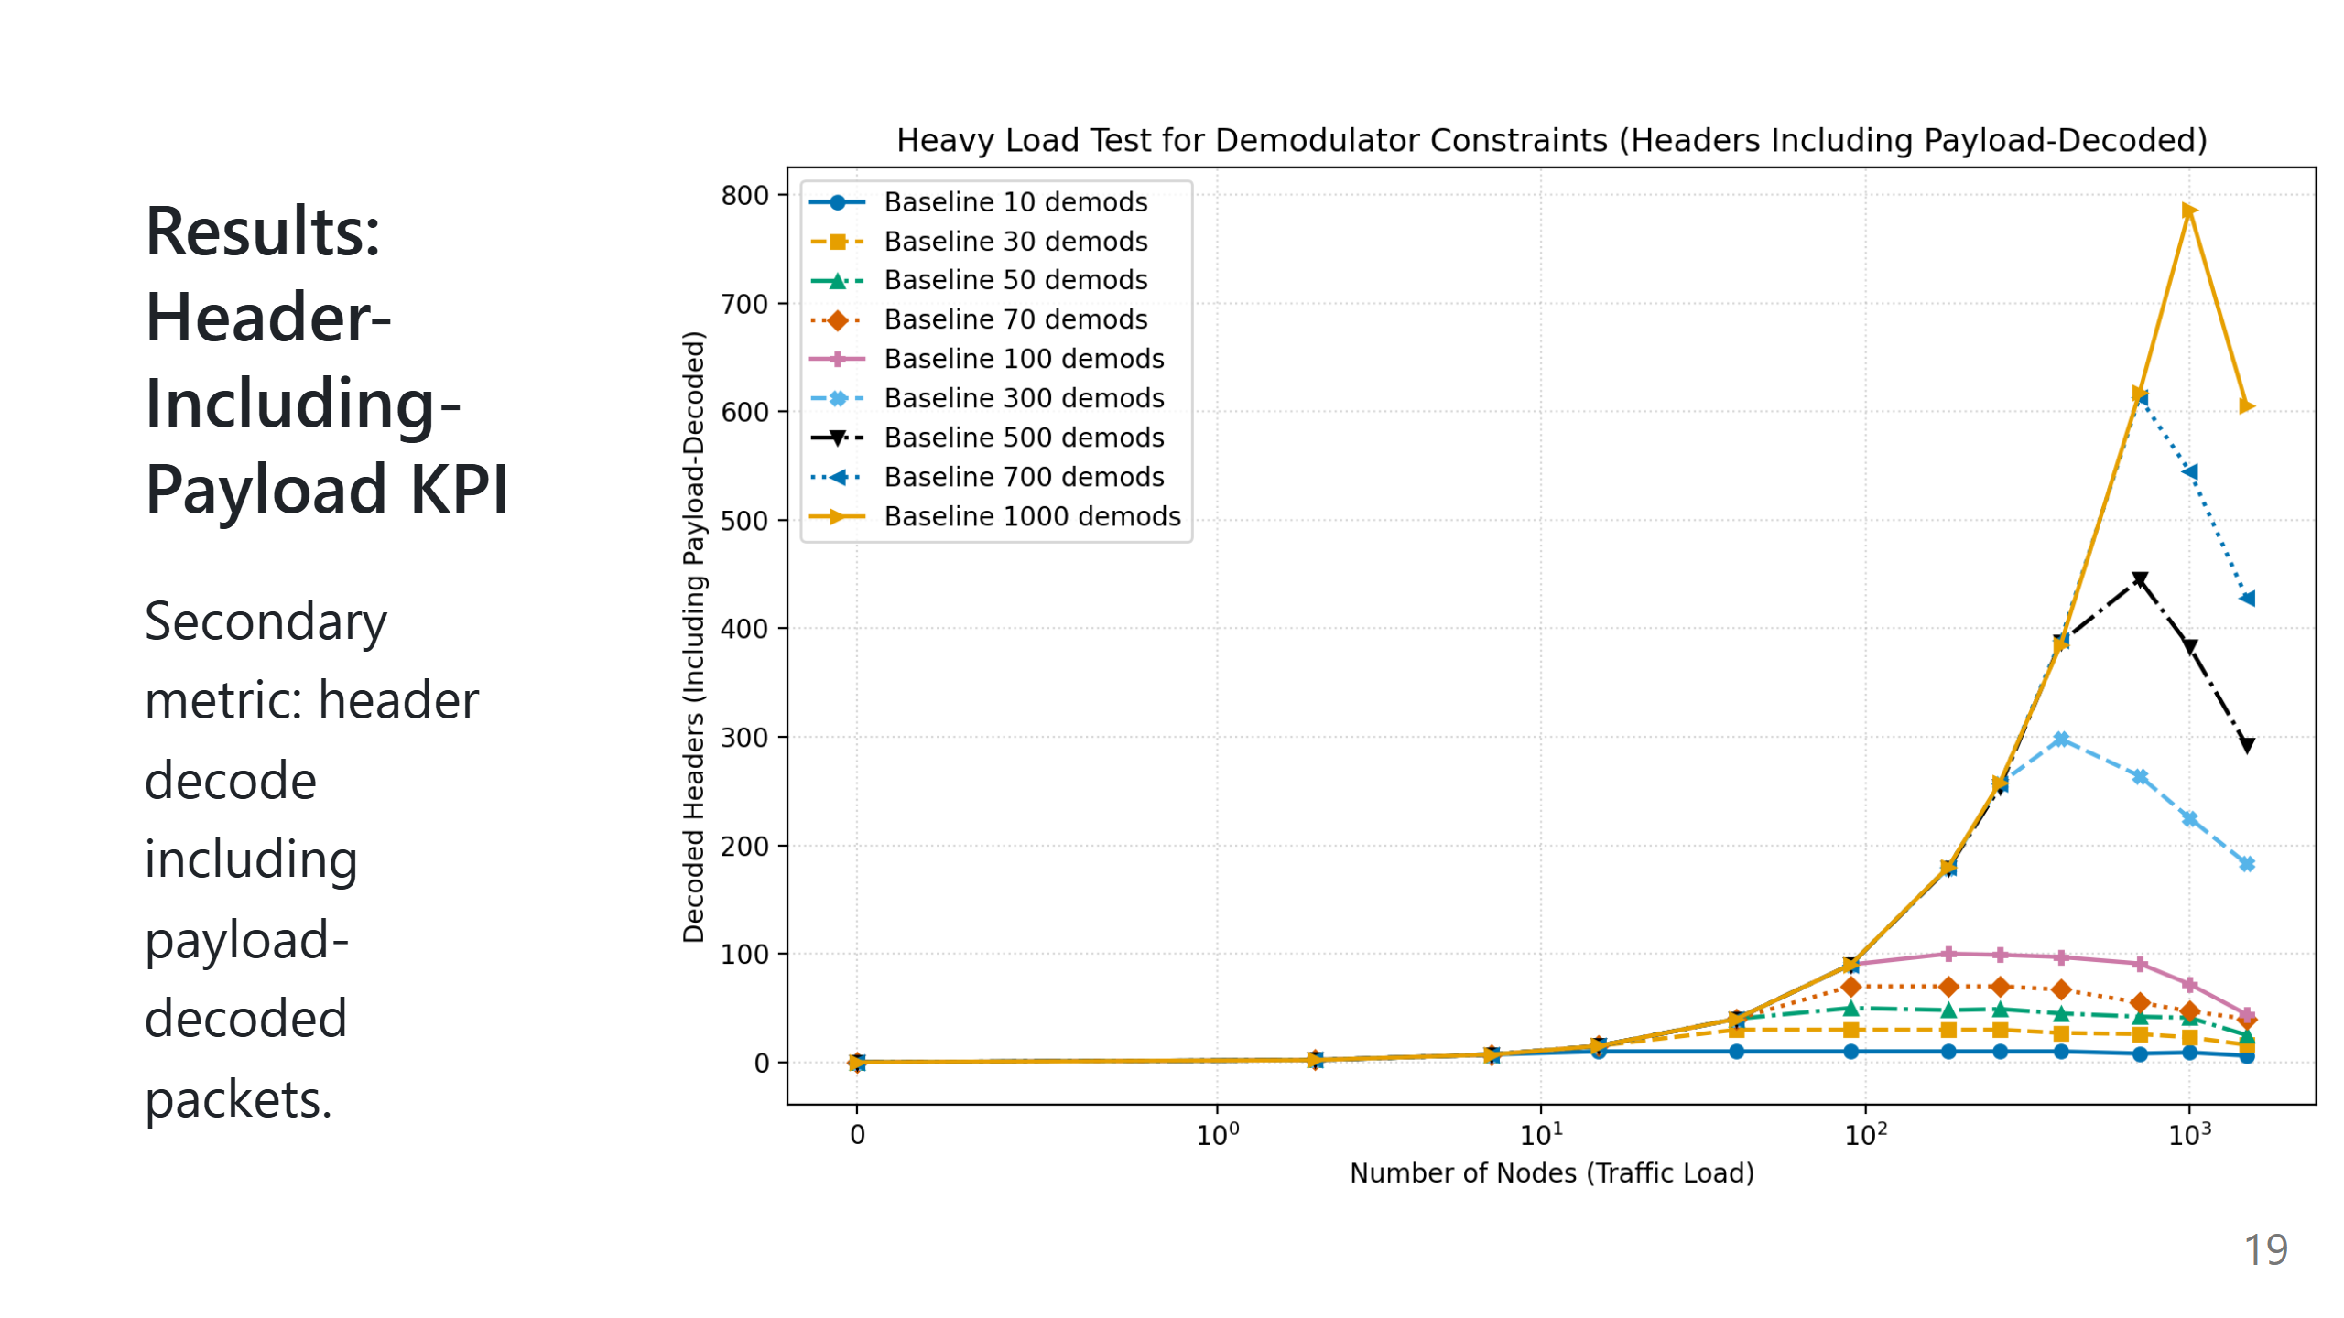

Slide 20
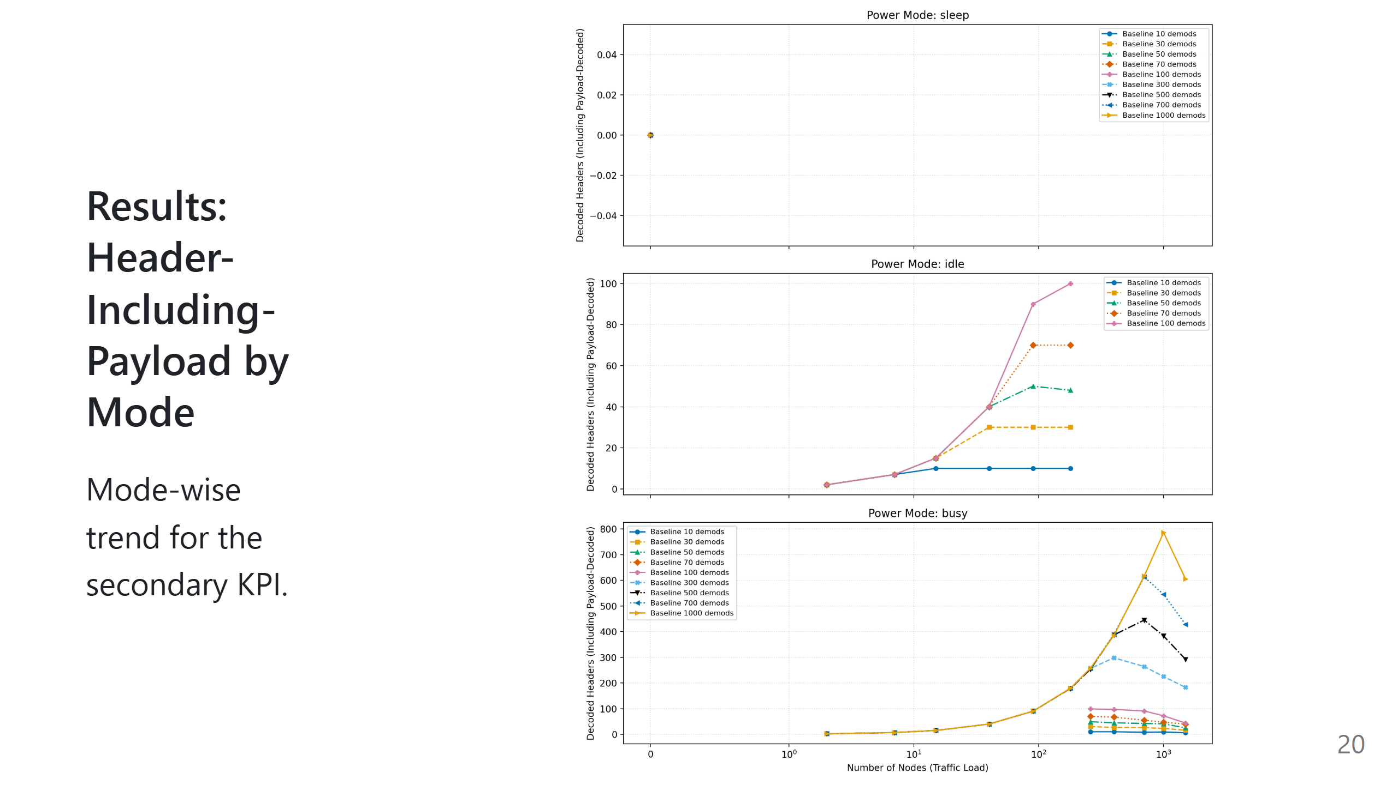

Slide 21
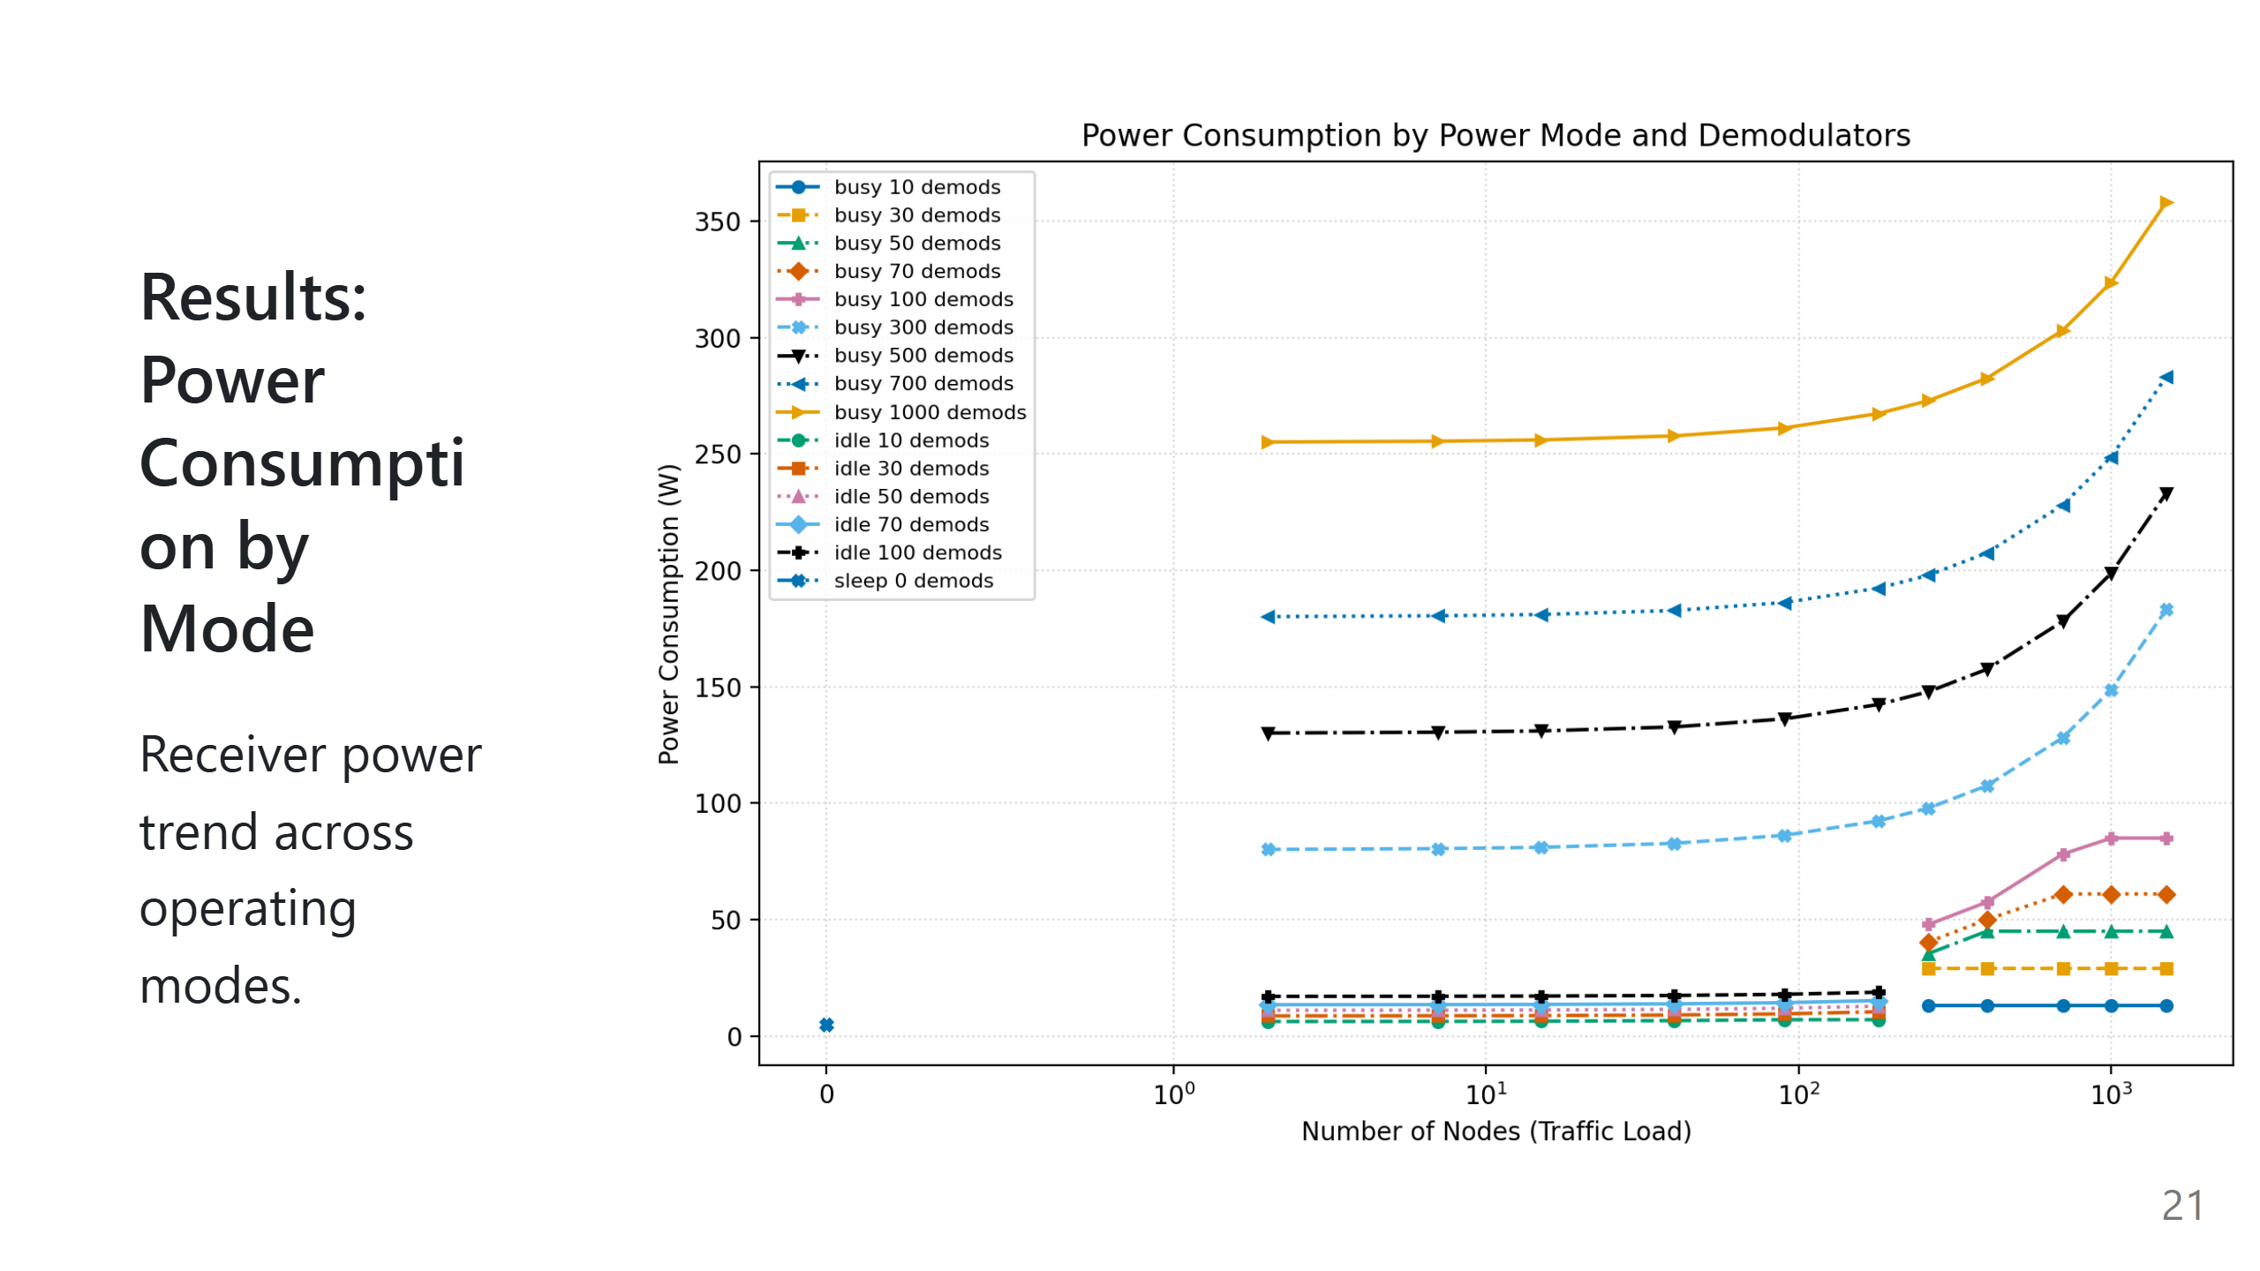

Slide 22
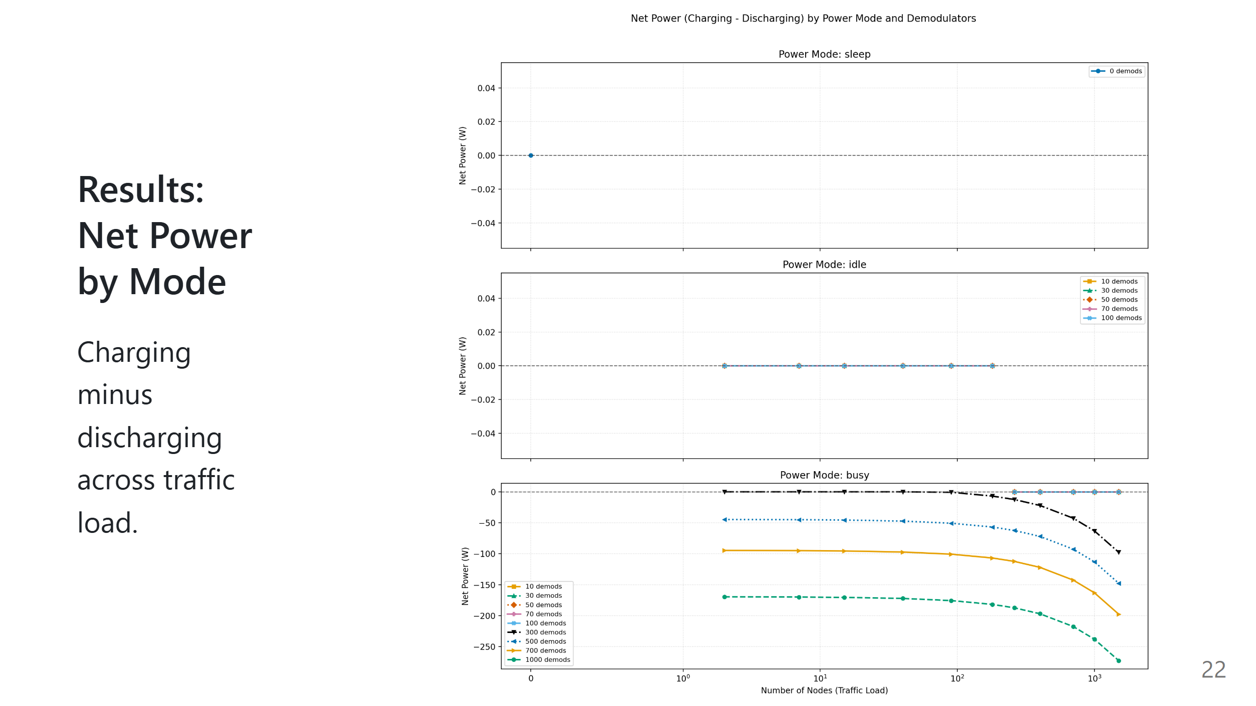

Slide 23
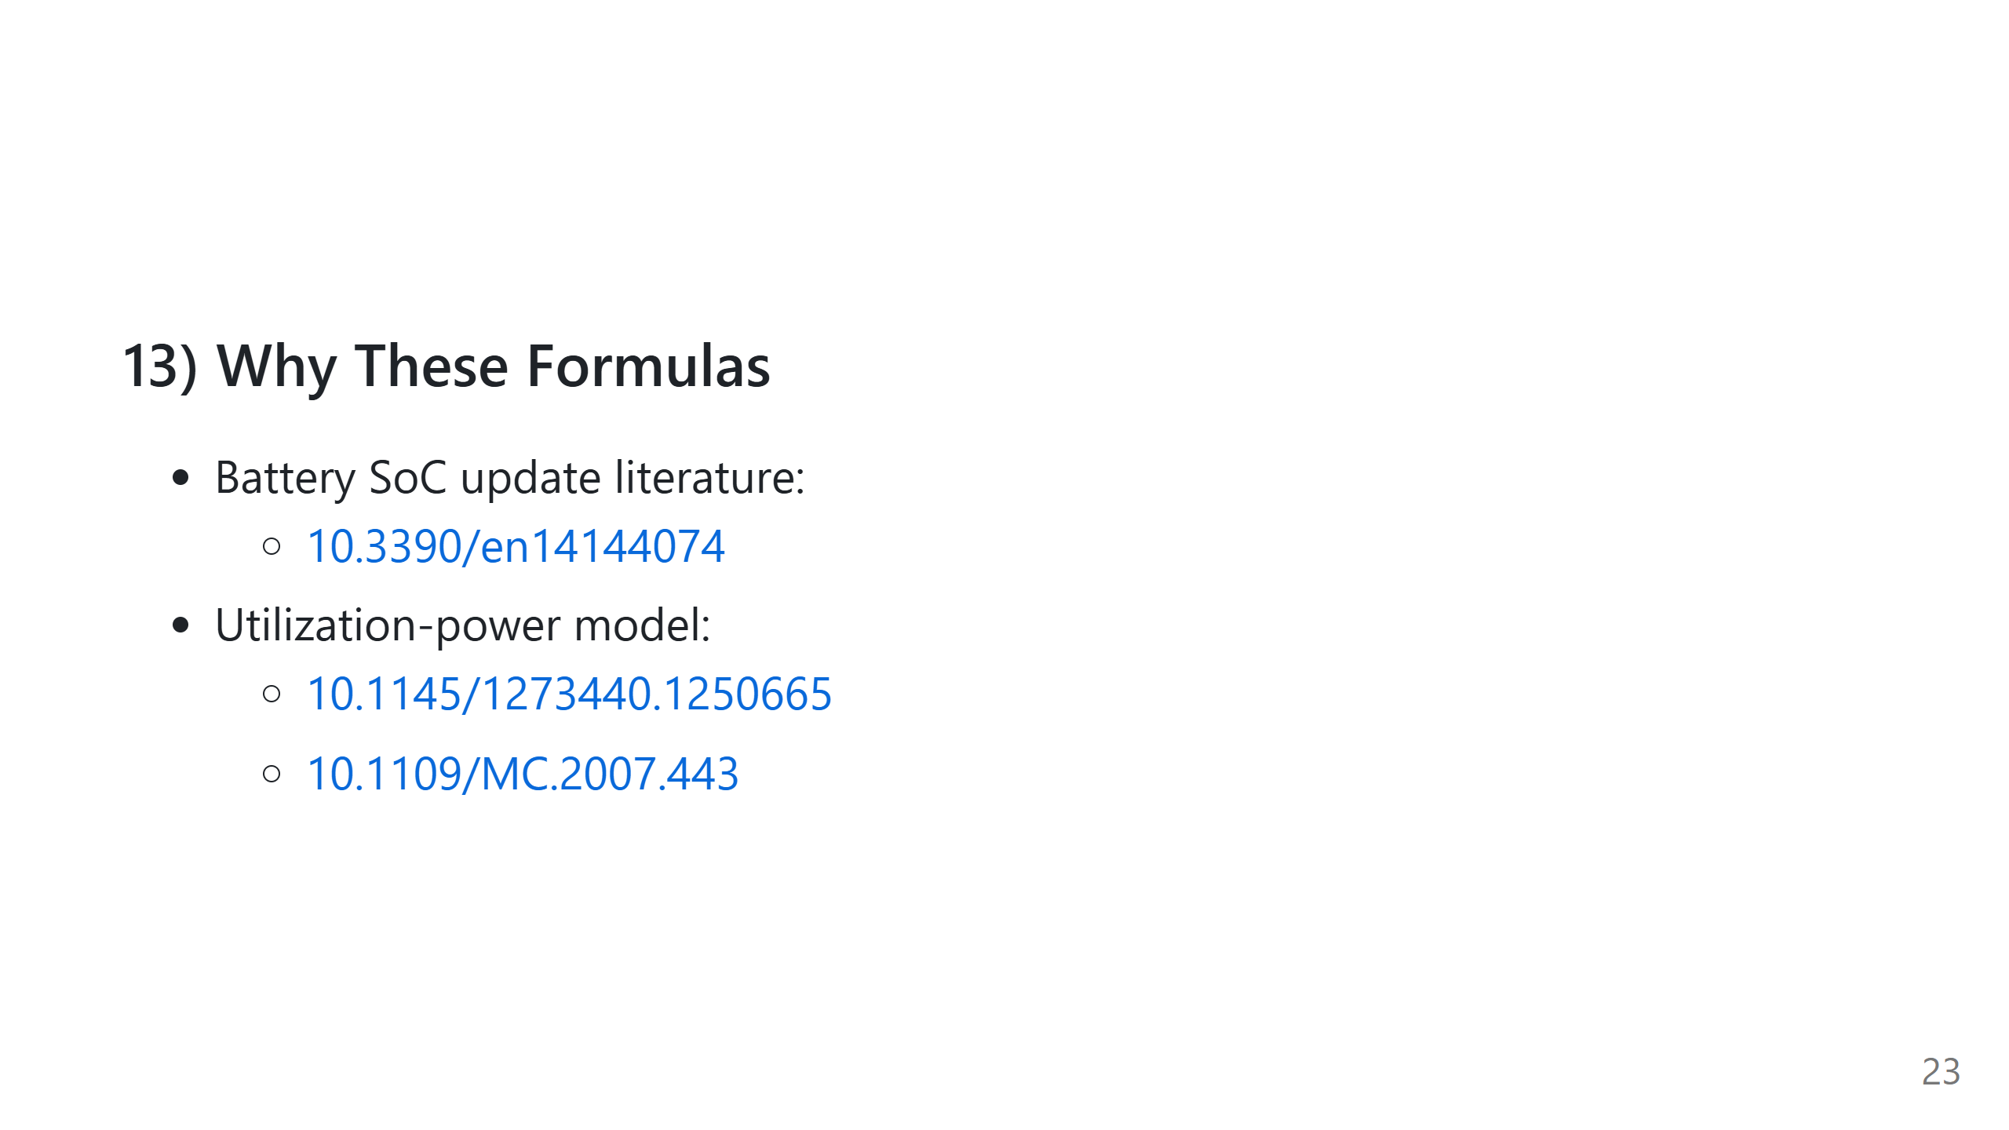
Notes:
Speech script: These references justify the foundational equations. Our contribution is how we combine and adapt them for LR-FHSS demodulator-constrained operation; some blocks are inspired approximations.

Slide 24
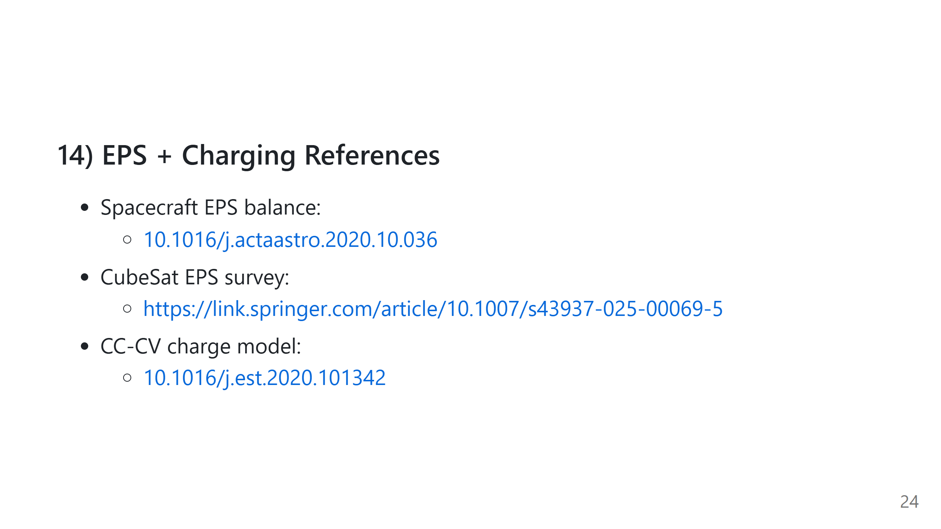
Notes:
Speech script: These references support the EPS generation-load balance and the charge taper concept near full SoC. They underpin the power and battery blocks of our recurrence.

