Slide 1

TY ECE AIML A
SMART CINEMA MANAGEMENT,
DYNAMIC PRICING & MOVIE RECOMMENDATION SYSTEM
Course: Database Management System
Presented by
Satakshi Krishna | Rutu Vaghaisya
Division: ____ Roll Nos.: ____ / ____ Batch: ____ PRNs: ____ / ____
MIT World Peace University • TY ECE AIML • Academic Year 2025–26
Notes:
SLIDE 1: Project Introduction
SPEAKER: Satakshi Krishna
SUGGESTED TIME: 10 seconds
WHAT TO SAY:
Good morning respected teachers. We are Satakshi Krishna and Rutu Vaghaisya. Our DBMS project is Smart Cinema Management, Dynamic Pricing and Movie Recommendation System.

Slide 2
Presentation Flow
Problem & Objectives
Architecture & Database
01
02
Why the system is needed
Flask, MySQL, ER diagram
Core Workflows
Testing & Outcomes
03
04
Booking, pricing, recommendations
Postman, SQL results, future scope
2
Department of Electrical and Electronics Engineering
12/10/2026
Notes:
SLIDE 2: Presentation Flow
SPEAKER: Satakshi Krishna
SUGGESTED TIME: 7 seconds
WHAT TO SAY:
We will cover the problem, objectives, technologies, database design, booking process, pricing and recommendations, followed by implementation, testing and future scope.

Slide 3
Introduction & Problem Statement
PROJECT OVERVIEW
A single platform for cinema booking, smart pricing and movie discovery.
Booking accuracy
Connected records
Better user experience
Seat availability must be current.
Shows, users and payments must stay linked.
Customers need clear choices and suggestions.
Our solution: a Flask + MySQL system with customer and admin modules.
3
Department of Electrical and Electronics Engineering
12/10/2026
Notes:
SLIDE 3: Introduction & Problem Statement
SPEAKER: Satakshi Krishna
SUGGESTED TIME: 18 seconds
WHAT TO SAY:
Cinema booking needs accurate handling of show schedules, seats and payments. Separate or manual records can lead to duplicated information and booking errors. Our project brings these tasks into one database-driven application.

Slide 4
Project Aims & Objectives
KEY GOALS
01
Reliable bookings
Validate seat availability and prevent duplicate reservations.
02
Structured data
Use a normalized relational schema with keys and constraints.
03
Demand-based prices
Calculate ticket price from actual show occupancy.
04
Recommendations
Suggest similar and personalized movies.
05
Admin operations
Manage movies, shows, bookings and analytics.
4
Department of Electrical and Electronics Engineering
12/10/2026
Notes:
SLIDE 4: Project Aims & Objectives
SPEAKER: Satakshi Krishna
SUGGESTED TIME: 18 seconds
WHAT TO SAY:
Our aim is to build a cinema booking system using a normalized MySQL database. We focus on accurate seat reservations, rule-based dynamic pricing, customer recommendations, and a separate admin dashboard.

Slide 5
Background & Proposed System
Existing / fragmented approach
Our proposed system
Manual or separate booking records
One connected MySQL database
Limited visibility of seat availability
Server-side seat validation
Pricing may remain fixed
Occupancy-based dynamic pricing
Difficult to track refunds and reports
Customer reviews + admin analytics
5
Department of Electrical and Electronics Engineering
12/10/2026
Notes:
SLIDE 5: Background & Proposed System
SPEAKER: Satakshi Krishna
SUGGESTED TIME: 18 seconds
WHAT TO SAY:
Traditional or disconnected systems may make availability checking, cancellation and reporting difficult. Our proposed system links customer booking, payments, refunds, movie reviews and administration through one Flask application and database.

Slide 6
Software Requirements & Tools
DEVELOPMENT STACK
FRONTEND
HTML • CSS • JavaScript • Bootstrap • Jinja
BACKEND
Python • Flask • mysql-connector-python
DATABASE
MySQL Server • MySQL Workbench
SMART FEATURES
Pandas • scikit-learn • Chart.js
TOOLS
VS Code • Figma • Postman • Git/GitHub
6
Department of Electrical and Electronics Engineering
12/10/2026
Notes:
SLIDE 6: Software Requirements & Tools
SPEAKER: Satakshi Krishna
SUGGESTED TIME: 18 seconds
WHAT TO SAY:
We used HTML, CSS, JavaScript and Bootstrap for the pages, Python Flask for the backend, and MySQL for data storage. Pandas and scikit-learn support recommendations, while Figma, Postman and GitHub support design, testing and version control.

Slide 7
System Design & Architecture
REQUEST / RESPONSE FLOW
Frontend
HTML • CSS • Bootstrap • JS
Customer & Admin
Flask Backend
ML Recommender
Browse, book, manage shows and analytics
Routes • Sessions • Validation
TF-IDF • cosine similarity • user history
MySQL Database
13 tables • queries • transactions
Flask exchanges SQL queries/results with MySQL and displays the returned data through Jinja templates.
7
Department of Electrical and Electronics Engineering
12/10/2026
Notes:
SLIDE 7: System Design & Architecture
SPEAKER: Satakshi Krishna
SUGGESTED TIME: 20 seconds
WHAT TO SAY:
The browser sends requests to Flask. Flask validates data and executes SQL using the MySQL connector. The recommendation module reads movie and user information, calculates similarity, and returns suggestions that Flask displays on the website.

Slide 8
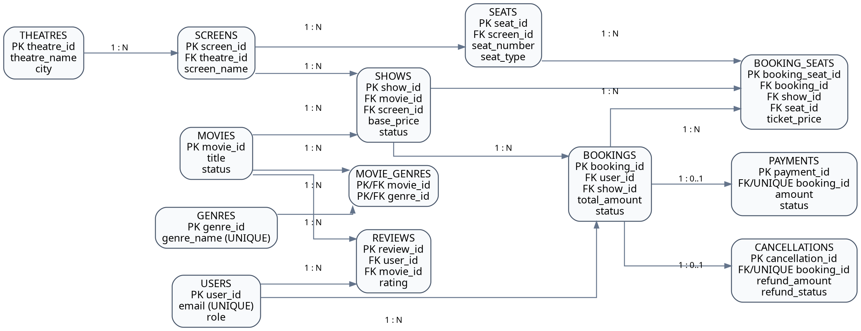
System Design — ER Diagram
RELATIONAL MODEL
13 tables • 1:N relationships • M:N via movie_genres • Primary and Foreign Keys
8
Department of Electrical and Electronics Engineering
12/10/2026
Notes:
SLIDE 8: ER Diagram — 13 Tables
SPEAKER: Satakshi Krishna
SUGGESTED TIME: 24 seconds
WHAT TO SAY:
Our ER diagram contains thirteen main tables. A user can make many bookings; a movie can have many shows; and a theatre can have many screens. The movie_genres table handles the many-to-many relation between movies and genres.

Slide 9
Database Schema & DBMS Features
NORMALIZATION
1NF → 2NF → 3NF
Structured tables, reduced duplication
CONSTRAINTS
Prevents duplicate seat reservation
PK, FK and UNIQUE(show_id, seat_id)
TRANSACTIONS
Booking and cancellation integrity
COMMIT and ROLLBACK
SQL OBJECTS
create_booking • calculate_ticket_price • trg_payment_success • movie_ratings_view
Procedure, function, trigger and view
9
Department of Electrical and Electronics Engineering
12/10/2026
Notes:
SLIDE 9: Schema Design & DBMS Features
SPEAKER: Satakshi Krishna
SUGGESTED TIME: 25 seconds
WHAT TO SAY:
We used primary and foreign keys to link tables and normalization to avoid duplication. Transactions and a unique constraint on show ID and seat ID prevent incomplete or duplicate bookings. We also created a pricing function, payment trigger, stored procedure and ratings view.

Slide 10
System Implementation — Booking Flow
CUSTOMER WORKFLOW
1
2
3
4
5
6
›
›
›
›
›
Login
Select movie
Choose show
Pick seats
Pending booking
Pay → Confirm
Server-side checks
Safe database booking
Validate screen, show and seat availability.
Unique seat constraint + transaction rollback.
Payment is simulated; a successful payment insert triggers booking confirmation.
10
Department of Electrical and Electronics Engineering
12/10/2026
Notes:
SLIDE 10: System Implementation — Booking
SPEAKER: Rutu Vaghaisya
SUGGESTED TIME: 22 seconds
WHAT TO SAY:
Now I will explain the main workflow. A customer logs in, chooses a movie and show, and selects available seats. Flask checks the seats again, creates a pending booking, and after a successful simulated payment the trigger changes its status to confirmed.

Slide 11
Dynamic Ticket Pricing
MYSQL CALCULATE_TICKET_PRICE(SHOW_ID)
Occupancy = booked seats ÷ actual seats × 100
4 booked
6 available
40% occupancy
₹200 base + 10% = ₹220 / ticket
Rule bands: 0–30%: base | >30–60%: +10% | >60–80%: +20% | >80%: +30%
11
Department of Electrical and Electronics Engineering
12/10/2026
Notes:
SLIDE 11: Dynamic Ticket Pricing
SPEAKER: Rutu Vaghaisya
SUGGESTED TIME: 23 seconds
WHAT TO SAY:
Our pricing function uses actual booked seats divided by total physical seats. In our tested example, four of ten seats were booked, giving forty percent occupancy. So a two-hundred-rupee base ticket increases by ten percent to two hundred and twenty rupees.

Slide 12
Movie Recommendation System
CONTENT-BASED RECOMMENDATION
Movie features
TF-IDF vectors
Cosine similarity
Top suggestions
Genre, description, language
Text converted into numbers
Rank movies by resemblance
Relevant movies for the user
→
→
→
Personalization adds user booking history and ratings to the recommendation scores.
Python libraries: Pandas + scikit-learn
12
Department of Electrical and Electronics Engineering
12/10/2026
Notes:
SLIDE 12: Movie Recommendation System
SPEAKER: Rutu Vaghaisya
SUGGESTED TIME: 24 seconds
WHAT TO SAY:
Our recommendations use content-based filtering. TF-IDF converts movie text such as description and genre into numerical features, and cosine similarity compares them. Confirmed bookings and ratings are also weighted to produce more personalized movie suggestions.

Slide 13
Frontend & Admin Dashboard
Customer Interface
Admin Interface
Movie browsing and search
Movie and theatre CRUD
Showtime and seat selection
Screen and show scheduling
Booking, payment and cancellation
Customer booking records
Reviews and recommendations
Chart.js analytics and reports
Figma prototype → HTML / CSS / Bootstrap / JavaScript → Flask routes
13
Department of Electrical and Electronics Engineering
12/10/2026
Notes:
SLIDE 13: Frontend & Admin Dashboard
SPEAKER: Rutu Vaghaisya
SUGGESTED TIME: 20 seconds
WHAT TO SAY:
We designed the screens in Figma and implemented the actual frontend with HTML, CSS, Bootstrap and JavaScript. Customers can book, cancel and review movies. The admin can manage movies and shows, and view revenue and booking analytics using Chart.js.

Slide 14
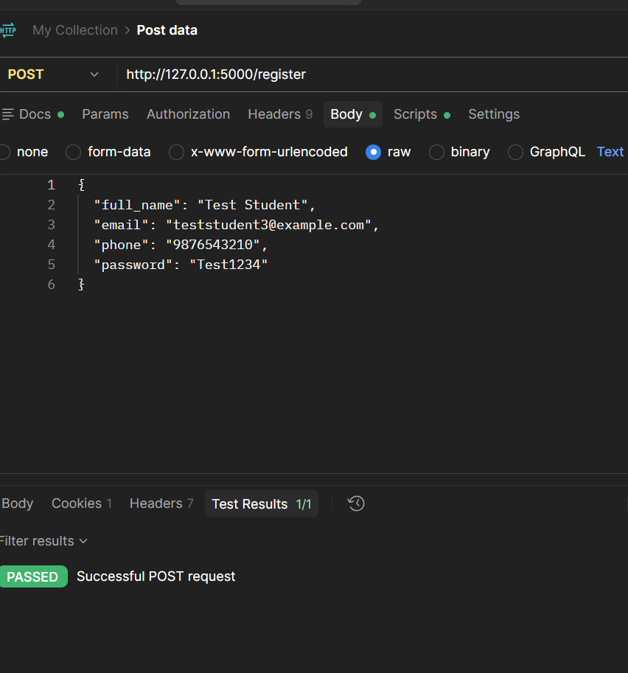
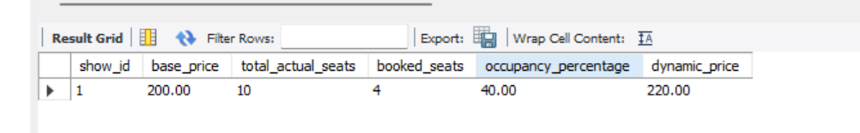
Testing & Results
Postman — Registration POST
SQL — Dynamic Price Check
10 actual seats, 4 booked → ₹220
1/1 test passed
Additional manual checks
Login • seat reservation • mock payment • cancellation • admin operations
14
Department of Electrical and Electronics Engineering
12/10/2026
Notes:
SLIDE 14: Testing & Results
SPEAKER: Rutu Vaghaisya
SUGGESTED TIME: 23 seconds
WHAT TO SAY:
We tested registration, booking, pricing, payments and cancellation. Postman was used to send a JSON POST request to the registration route, and the test passed. In MySQL Workbench we verified the forty-percent occupancy and two-hundred-and-twenty-rupee ticket price.

Slide 15
Applications, Limitations & Future Scope
Applications
Current limitations
Future scope
Small cinemas, campus screenings and seat-based reservation systems.
Simulated payments and refunds; limited movie data; no automatic expiry of unpaid seat holds.
Real payment gateway, reservation timeout, richer recommendation data and online deployment.
15
Department of Electrical and Electronics Engineering
12/10/2026
Notes:
SLIDE 15: Applications, Limitations & Future Scope
SPEAKER: Rutu Vaghaisya
SUGGESTED TIME: 19 seconds
WHAT TO SAY:
This can be adapted for small cinemas or college screening events. Currently payments and refunds are simulated, and recommendations depend on available data. Future improvements include real payment integration, expiring unpaid seat holds, better recommendations and online deployment.

Slide 16
Conclusion & References
A database-first cinema system combining booking safety, rule-based pricing, movie recommendations and admin management.
Key references
MySQL 8.0 Reference Manual and Flask Documentation
scikit-learn User Guide; Pandas Documentation
Bootstrap / Chart.js Documentation; project testing evidence
GitHub repository: [Insert repository URL]
Thank you!
16
Department of Electrical and Electronics Engineering
12/10/2026
Notes:
SLIDE 16: Conclusion & References
SPEAKER: Rutu Vaghaisya
SUGGESTED TIME: 11 seconds
WHAT TO SAY:
To conclude, our system combines normalized database design with booking, dynamic pricing, recommendations and administration. It helped us apply real DBMS concepts using Flask and MySQL. Thank you; we are ready for your questions.

