Slide 1
Android Application Development
By Rajbir Singh

Slide 2
Contents
What is Android?
History of Android
Architecture of Android
Components of Android Application
Requirements for Android Application development
Example App

Slide 3

What is Android?
Android is a software package and linux based multitasking operating system for mobile devices such as tablets and smartphones.
Android is the most widely used mobile operating system.
The goal of android project is to create a successful real-world product that improves the mobile experience for end users.
Android provides a flexible and customizable platform for developing applications, enabling developers to create a wide range of mobile experiences.

Slide 4
History of Android
Android Inc. started the development with initial goal to create an advanced operating system for cameras.
In 2005, Google acquired Android Inc., and it was announced that Android would be developed as an open-source platform for mobile devices.
The Open Handset Alliance, a consortium of several hardware, software, and telecommunications companies, was formed to collaborate on the development of Android.
Thereafter, there have been different versions like Cupcake, Donut, Gingerbread, Ice Cream Sandwich, Oreo, Nougat etc.

Slide 5
Android Platform Architecture
System Applications
(Dialer, Email, Contacts etc.)
Java API Framework
(Content Providers and Managers)
Android Runtime(ART) and Core libraries
Hardware Abstraction Layer(HAL)
Linux Kernel

Slide 6
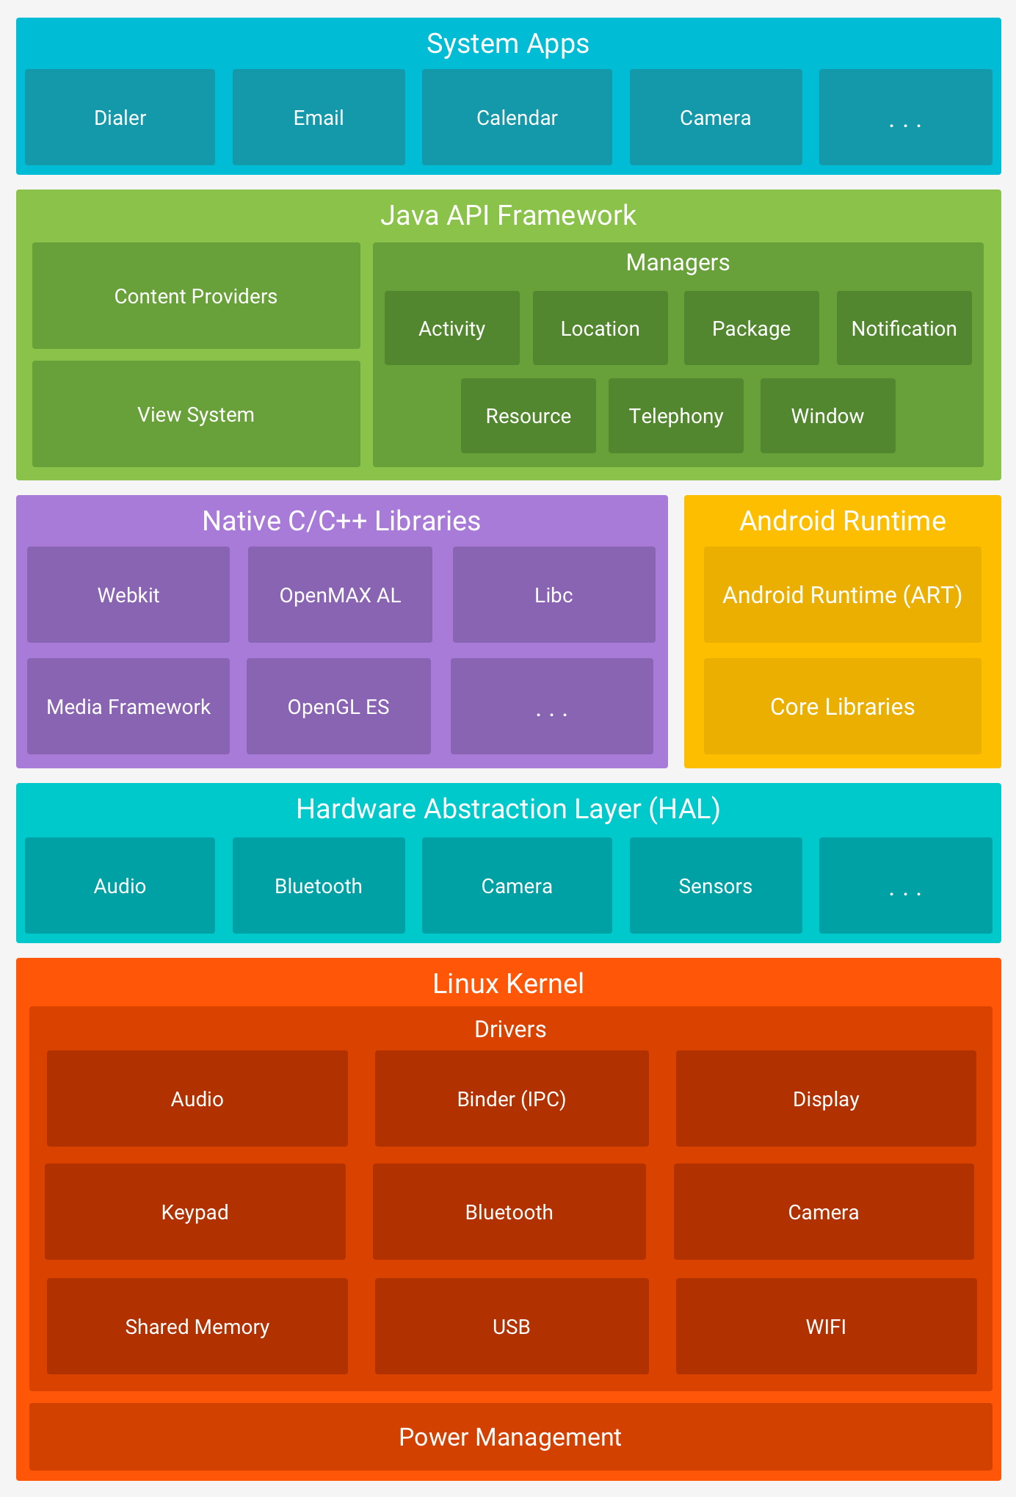

Slide 7
Components of Android Application
Following are the main components of an Android application:
Activities
Views
Intents
Services
Content Providers
Fragments
AndroidManifest.xml

Slide 8
Requirements for Application Development
Some key requirements for Android application development:
Java Development Kit (JDK)
Android Studio
Programming language like Java, Kotlin, JS (React) etc.
Android SDK
Emulator or Phone

Slide 9
Applications Developed
DuBooks
Language used : Java
Database : SQLite
Number of Activities: 4
Content is read from Github and then is parsed as JSON.

Slide 10
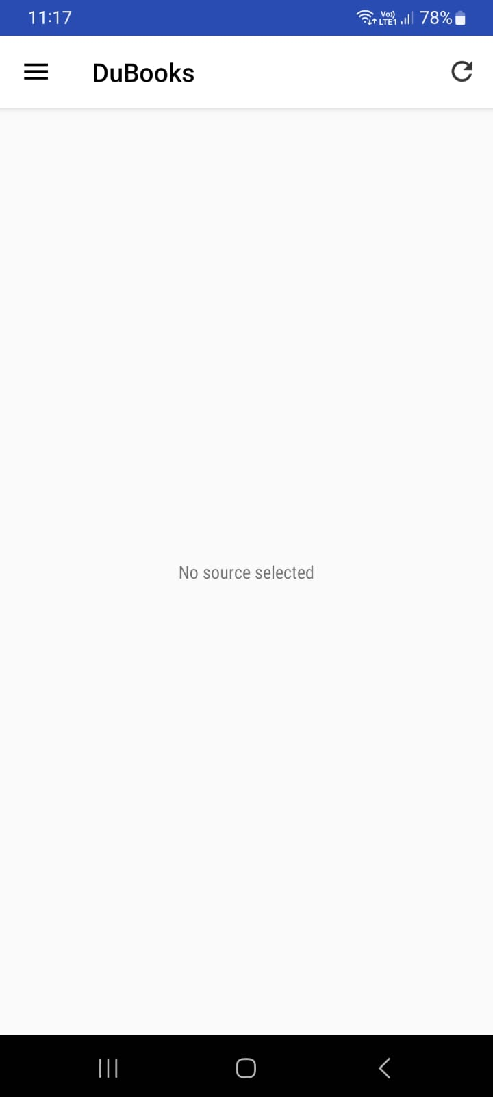
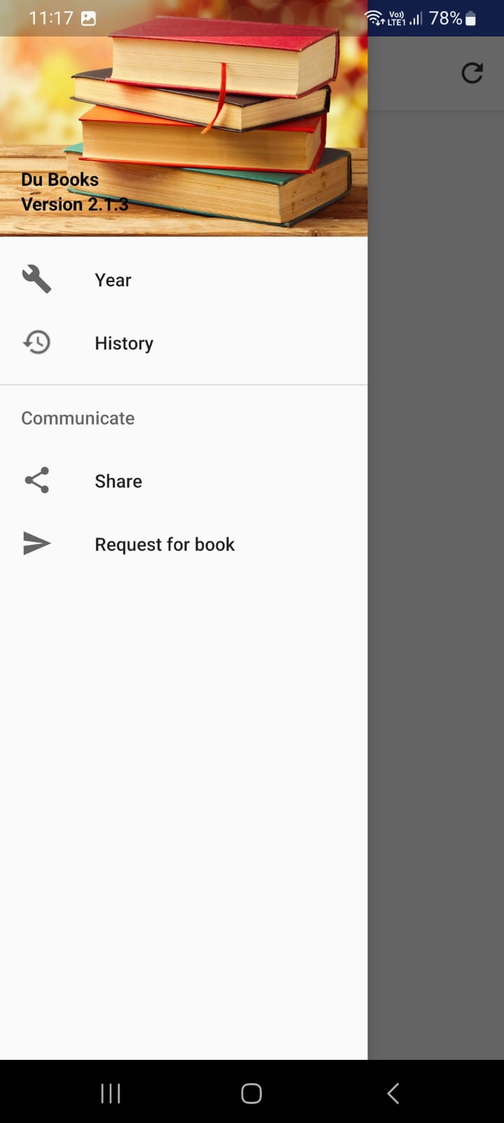
DuBooks

Slide 11
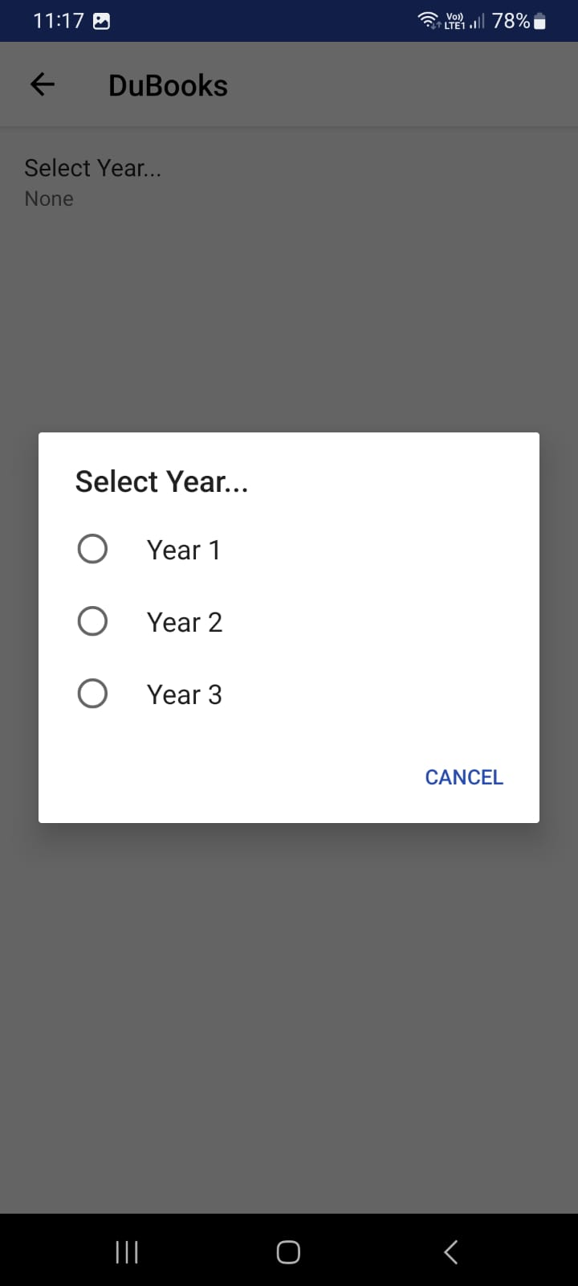
Setting Year Preference
Preferences refer to a way of storing and retrieving user settings or configuration options within an application.

Slide 12
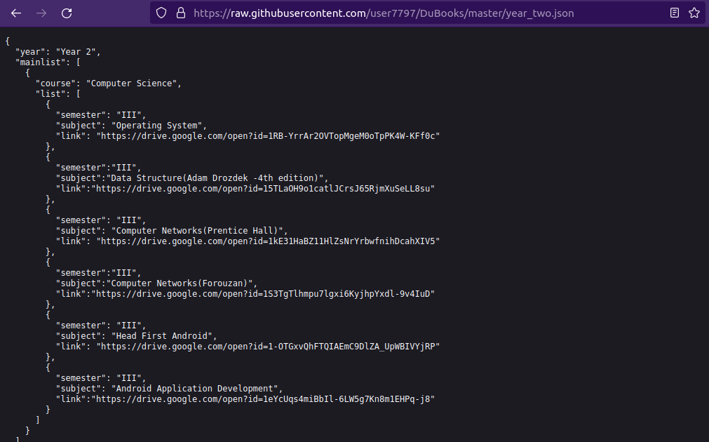
Once the user select Year preference and goes back to Main Activity it will read the JSON object from Github

Slide 13
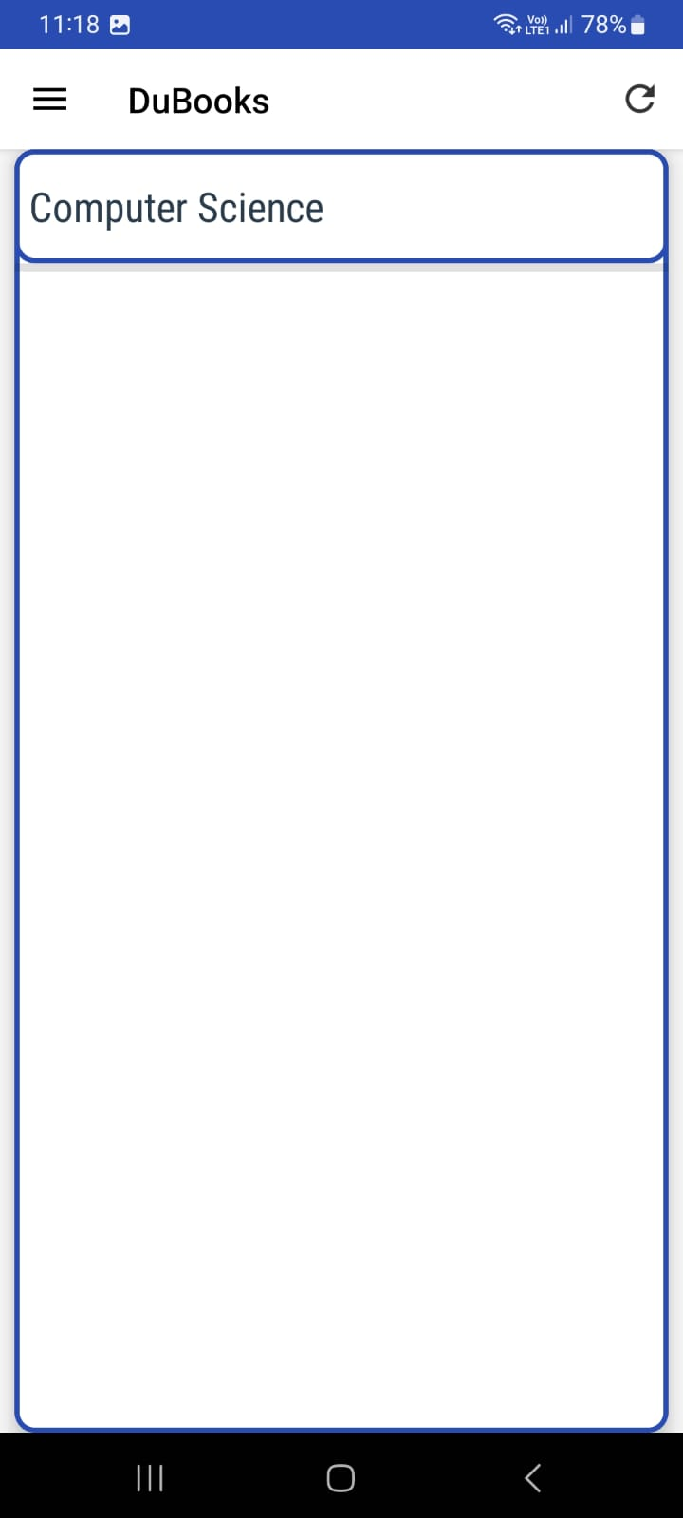
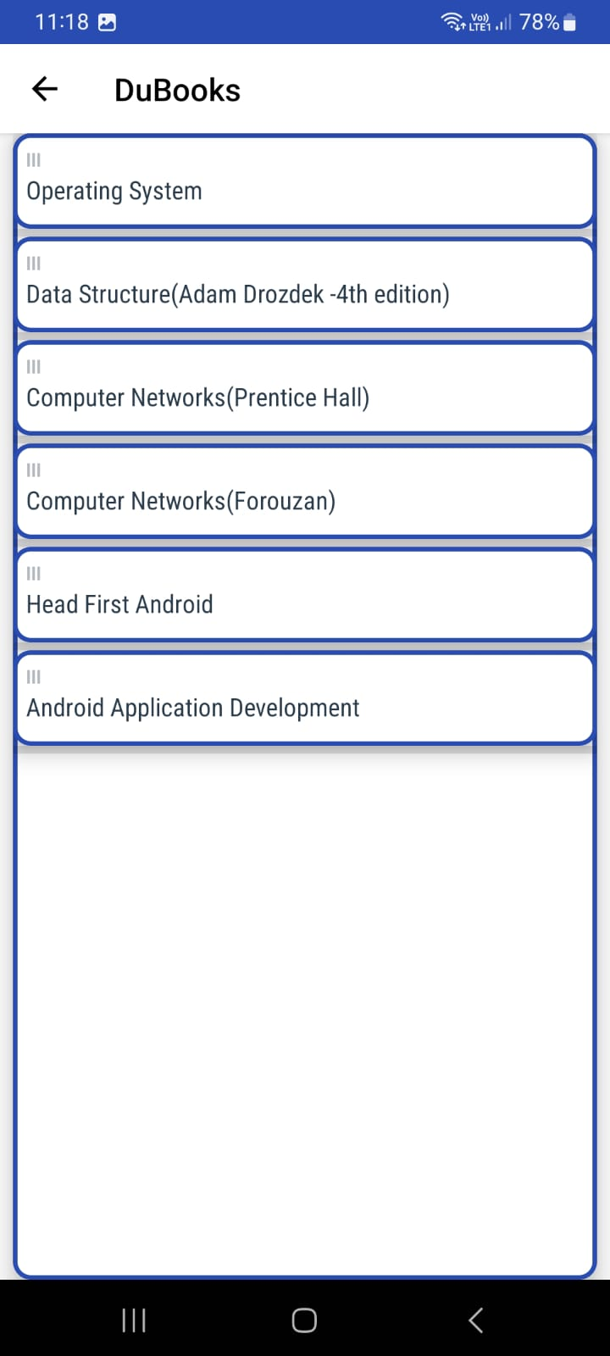
Once user clicks on any book it will be added to history database.
This will use Content Provider and SQLite database.

Slide 14
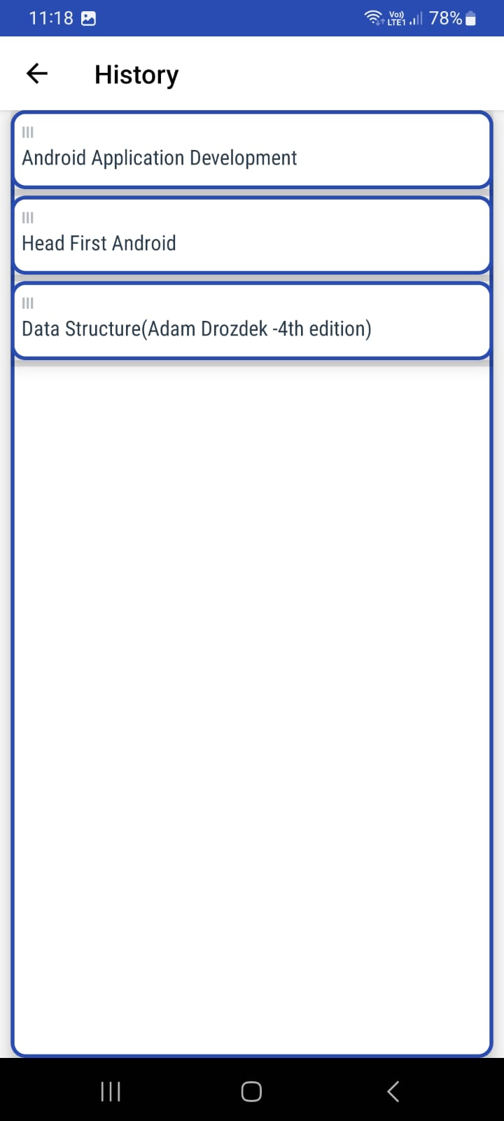

Slide 15
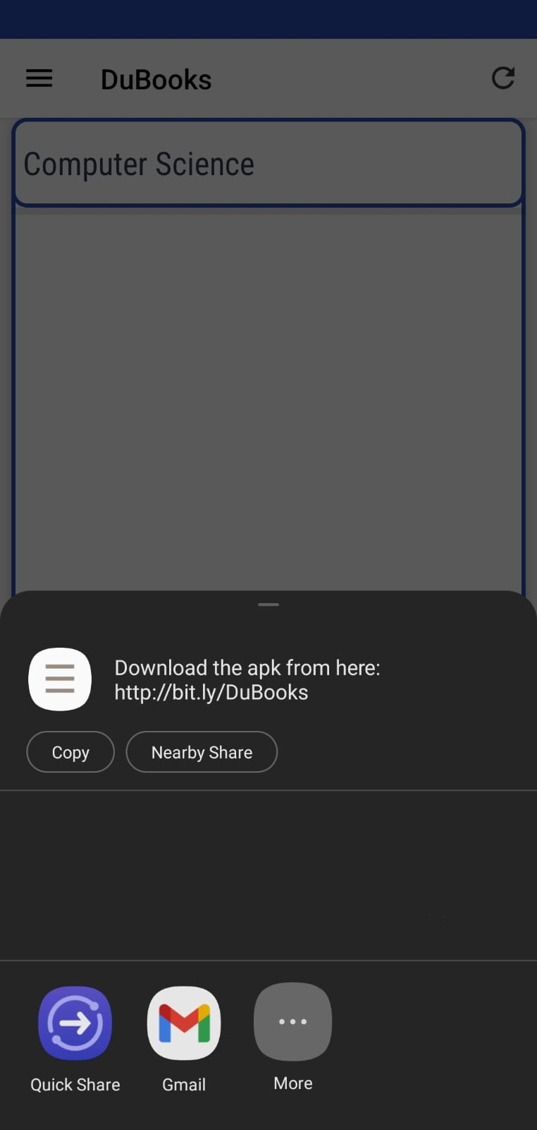

Slide 16
2. DuNation
Language used : Java
Database : Firebase
Number of Activities: 1
Content is read from Firebase Real Time Database.

Slide 17

Firebase
Comprehensive mobile and web application development platform provided by Google.
It is a BaaS (Backend as a Service).
Offers Real-time Database using NoSQL.

Slide 18
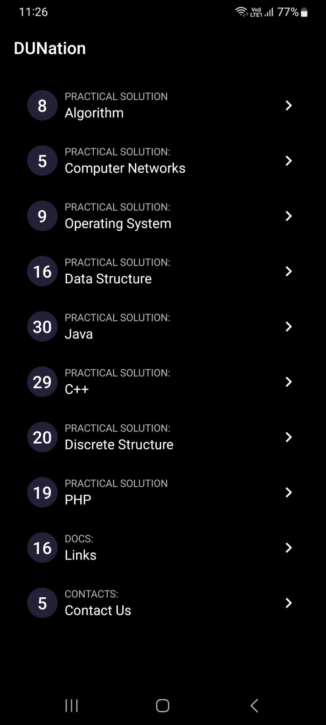
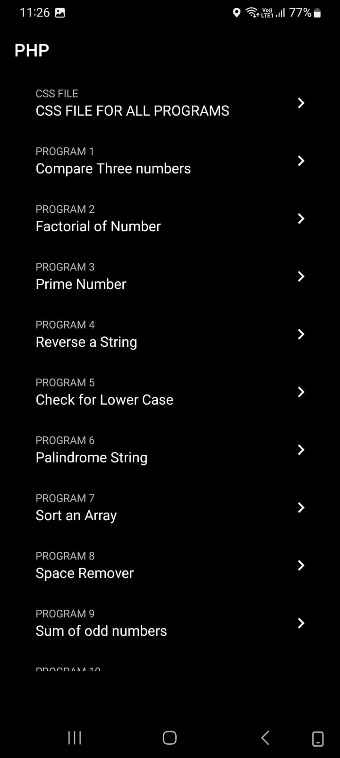
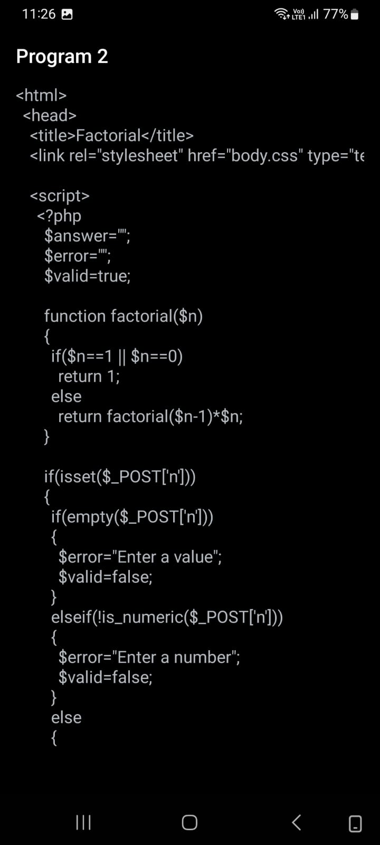
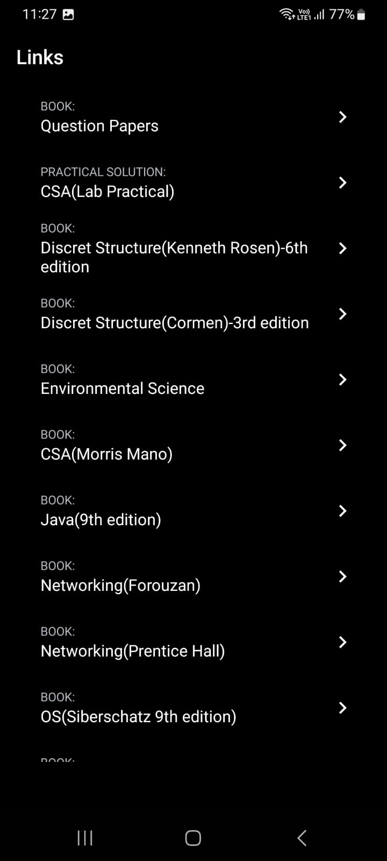

Slide 19
THANK YOU

