Slide 1



Student Management Portal
“Organizing Students, Optimizing Success”

Slide 2
Name :- Satasiya Daksh M.
Roll No. :- 22
Enrollment :- 23002170110165
No.
Division :- A1
Branch :- C.E.
Sem :- 4th
Student Management Portal
“Organizing Students, Optimizing Success”

Slide 3

AGENDA
Name :- Satasiya Daksh M.
Roll No. :- 22
Enrollment :- 23002170110165
No.
Division :- A1
Branch :- C.E.
Sem :- 4th
Introduction
Functionalities
Merits
Demerits
Future Scope

Slide 4

INTRODUCTION
AGENDA
A Student Management Portal (SMP) is a digital platform designed to automate various administrative tasks related to student data, branch, grades and performance.
This Portal can manage student’s details like grades, performance, and can help to do any operation related to this.
It is used for making it easier to handle student records although student can also see their records.
Introduction
Functionalities
Merits
Demerits
Future Scope
Name :- Satasiya Daksh M.
Roll No. :- 22
Enrollment :- 23002170110165
No.
Division :- A1
Branch :- C.E.
Sem :- 4th

Slide 5

FUNCTIONALITIES
INTRODUCTION
A Student Management Portal (SMP) is a digital platform designed to automate various administrative tasks related to student data, branch, grades and performance.
This Portal can manage student’s details like grades, performance, and can help to do any operation related to this.
It is used for making it easier to handle student records although student can also see their records.
Student and admin can login.
Admin can do CRUD operations on students.
Stores students data using Django.
Student can see his individual records (ex :- grades , graphs).
counting operations using numpy.
Graphs like area plot for Grades, Performance, Branch using matplotlib to visualize data.
Alert students who got low grades.
Export and import data (csv) using pandas.
Predict performance based on machine learning (knn model).

Slide 6

MERITS
FUNCTIONALITIES
Student and admin can login.
Admin can do CRUD operations on students.
Stores students data using Django.
Student can see his individual records (ex :- grades , graphs).
counting operations using numpy.
Graphs like area plot for Grades, Performance, Branch using matplotlib to visualize data.
Alert students who got low grades.
Export and import data (csv) using pandas.
Predict performance based on machine learning (knn model).
Stores and organizes student records (username, password , grades etc.).
Reduces paperwork and manual errors.
Identifies students with less grades using graph visualization and also alert them.
It is used to view/improve overall institutional performance of student.
Easy access by student of their individual data by quick touch.

Slide 7
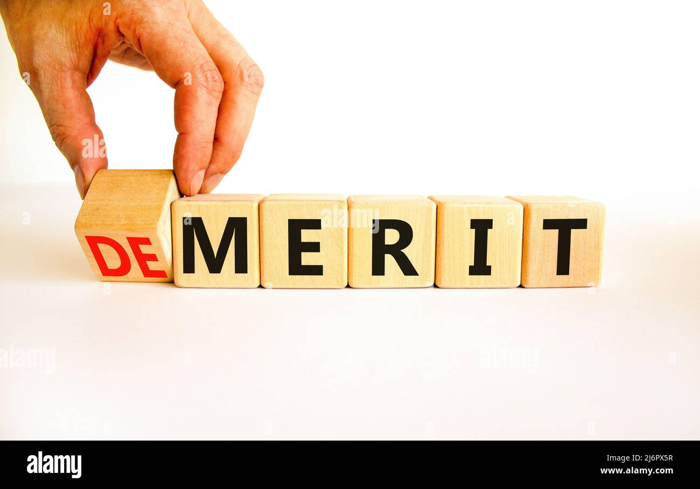
DEMERITS
MERITS
Stores and organizes student records (username, password , grades etc.).
Reduces paperwork and manual errors.
Identifies students with less grades using graph visualization and also alert them.
It is used to view/improve overall institutional performance of student.
Easy access by student of their individual data by quick touch.
This software need regular bug fixes and regular storing information of data of student like grades and CRUD operation.
Data Entry Errors.

Slide 8

FUTURE SCOPE
DEMERITS
This software need regular bug fixes and regular storing information of data of student like grades and CRUD operation.
Data Entry Errors.
Make this portal on global level to store all university / school data.
Identifies students with poor grades using graph visualization and interact with student and parents manually.
Integrate with E-learning platform for digital classroom and complete academic ecosystem.

Slide 9
FUTURE SCOPE
Make this portal on global level to store all university / school data.
Identifies students with poor grades using graph visualization and interact with student and parents manually.
Integrate with E-learning platform for digital classroom and complete academic ecosystem.
THANK YOU

Slide 10
THANK YOU

