Slide 1

PADAMU SATEESH KUMAR

Slide 2

ABSTRACT
Quizzik – An Online Quiz Platform is a web-based application designed to create, manage, and participate in quizzes. The platform provides administrators with tools to create quizzes comprising various question types. Participants can attempt quizzes with automatic scoring and real-time timers. Additionally, a leaderboard and performance analytics offer insights into user achievements and quiz trends. This project aims to modernize the traditional assessment methods by integrating technology for a seamless and efficient quiz experience.

Slide 3
Software Requirements
Operating system : Windows 10/11
Coding Language : C#.net
Frontend : ASP.Net Core, WEB API, HTML, CSS, JavaScript, JQuery, Angular 17
IDE Tool : Visual Studio code ,Visual Studio .Net, PostMan/ Webstorm
Database : SQL SERVER 2019.

Slide 4
Quiz Creation
This module empowers administrators, such as teachers or quiz creators, to design quizzes tailored to their needs. Users can create quizzes with diverse question types, such as multiple-choice, true/false, fill-in-the-blank, and short answers. Additionally, quizzes can be categorized by topic or difficulty level, and settings like time limits and pass criteria can be defined to align with specific requirements.

Slide 5
Quiz Attempt and Scoring
This module provides users with an intuitive interface to browse and attempt available quizzes. Participants can answer questions in real-time, with timers ensuring adherence to time limits. The platform automatically evaluates answers upon quiz submission, providing immediate scores based on predefined rules. This module eliminates the need for manual grading and ensures consistent, unbiased evaluation for all participants.

Slide 6
Leaderboard and Analytics
The third module focuses on providing actionable insights and fostering healthy competition among users. A dynamic leaderboard ranks participants based on their scores, accuracy, and completion time. Advanced analytics allow quiz creators to review question-wise performance, identify trends, and measure participant engagement. This module ensures transparency and motivates users to perform better in future attempts.

Slide 7
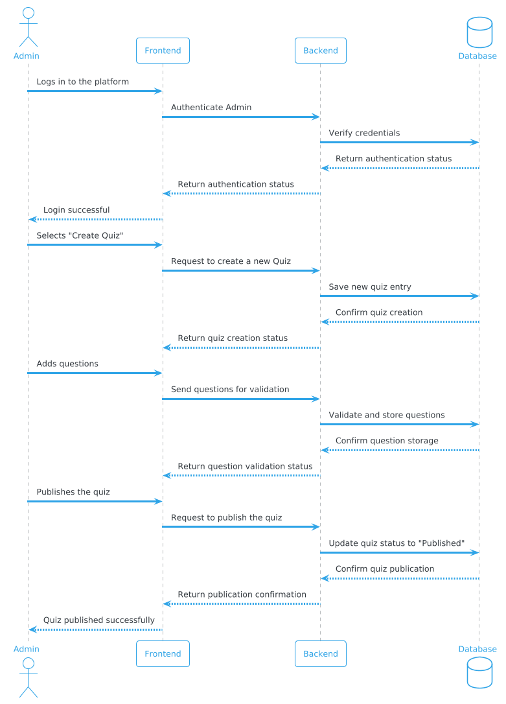
Quiz Creation
Sequence Diagram

Slide 8
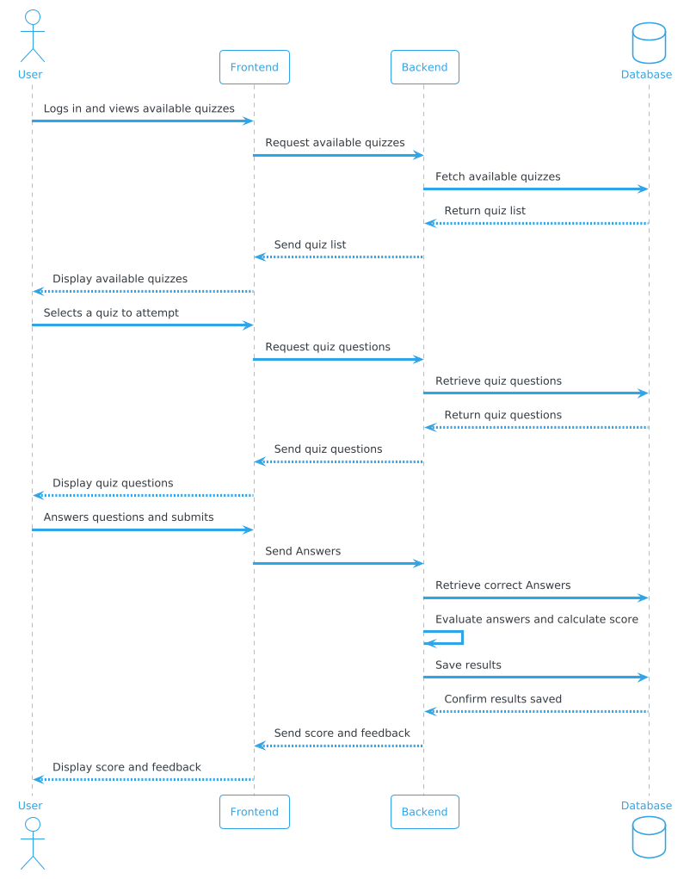
Quiz Attempt and Scoring
Sequence Diagram

Slide 9
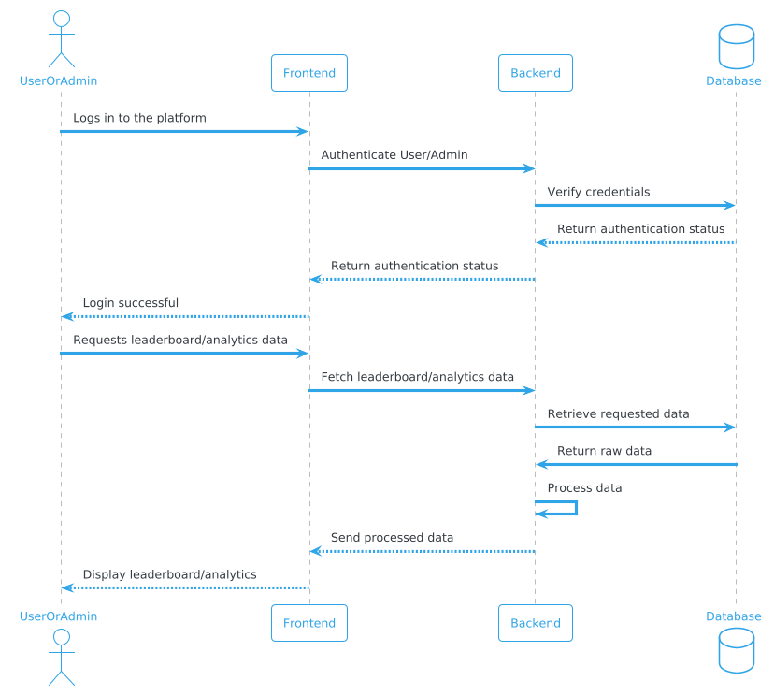
Leaderboard and Analytics
Sequence Diagram

Slide 10
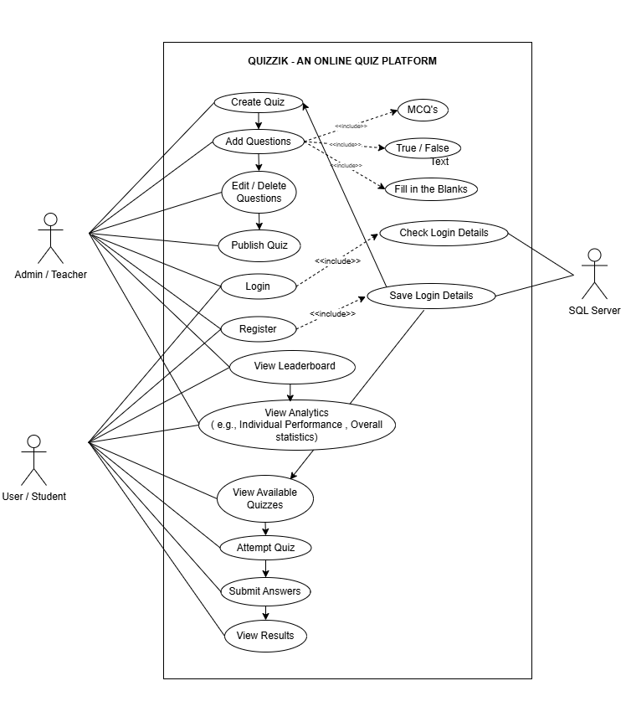
Online Quiz Platform
UseCase Diagram

Slide 11
Functionalities
Design quizzes with different question types, set categories, time limits, and pass criteria.
Users can take quizzes, submit answers in real-time, and receive immediate, automated scores.
Shows participant rankings, provides performance insights, and encourages competition.

Slide 12
THANK YOU

