Slide 1
Power BI Dashboard – Sales Analysis
Task 4: Dashboard Design
Date: 19/11/2025

Slide 2
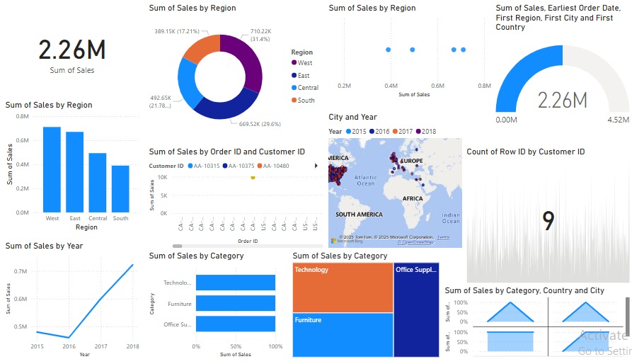
DASHBOARD

Slide 3
Project Overview
Objective
Design an interactive Power BI dashboard for business stakeholders.
Dataset: Superstore Sales dataset (Kaggle source)
Tools Used: Power BI

Slide 4
Key Metrics and KPIs
Total Sales: 2.26M
Count of Customers: 9
KPIs Visualized:
Total Sales by Region
Total Sales by Year
Total Sales by Category
City and Year-wise Sales Mapping

Slide 5
Dashboard Features
Visuals Used: Bar Charts, Line Charts, Donut Chart, Gauge Chart
Interactive Elements: Filters/Slicers for Region, Customer ID, City
Geographic Analysis: Map showing sales distribution across continents
Time Series Analysis: Sales trend analysis over multiple years

Slide 6
Business Insights
Regions show varied sales performance.
Steady growth observed in yearly sales.
Certain product categories dominate total sales.
Opportunities identified based on customer distribution and city-level analysis.

Slide 7
Thank You
Samruddhi Shinde

