Slide 1
resources for the competition

Slide 2
No DNNs
The starting point we give you is for XGBoost, not for DNNs.
Why?
Training a CNN takes hours, training XGBoost: minutes.
Training CNN effectively requires GPU, a very limited resource on Datahub / Vocareum.
People can download and use own GPU: unfair to students w.o. private resources.
The submission zode should fit in a 10MB zip file.

Slide 3
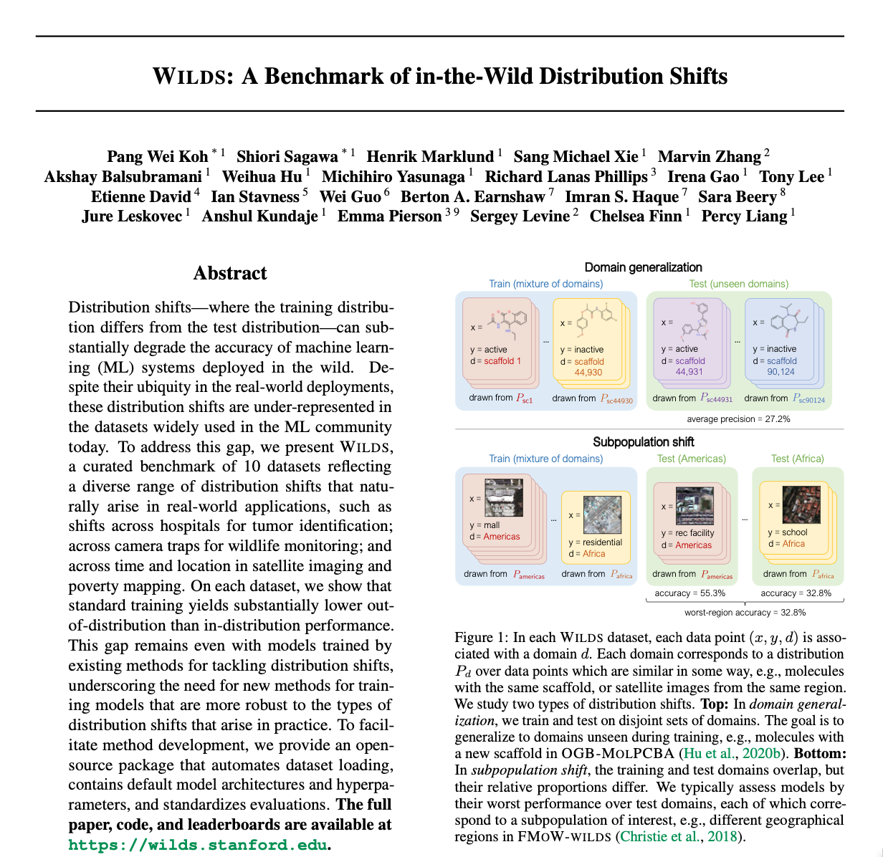
Background:
https://wilds.stanford.edu/datasets/#povertymap
Paper on using CNN:
Using publicly available satellite imagery and deep learning to understand economic well-being in Africa
Yeh, Christopher and Perez, Anthony and Driscoll, Anne and Azzari, George and Tang, Zhongyi and Lobell, David and Ermon, Stefano and Burke, Marshall
Nature Communications 2020

Slide 4
Digging Further
A Modified Bare Soil Index to Identify Bare Land Features during Agricultural Fallow-Period in Southeast Asia Using Landsat 8: https://www.mdpi.com/2073-445X/10/3/231
Classification of Urban Area Using Multispectral Indices for Urban Planning: https://www.mdpi.com/2072-4292/12/15/2503

Slide 5
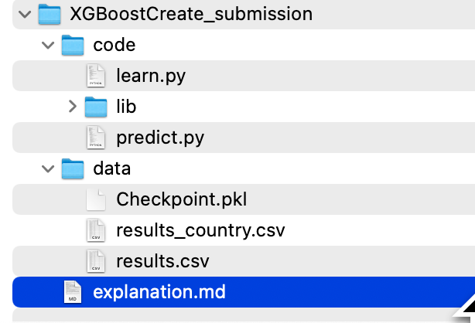
Submission Format:

Slide 6
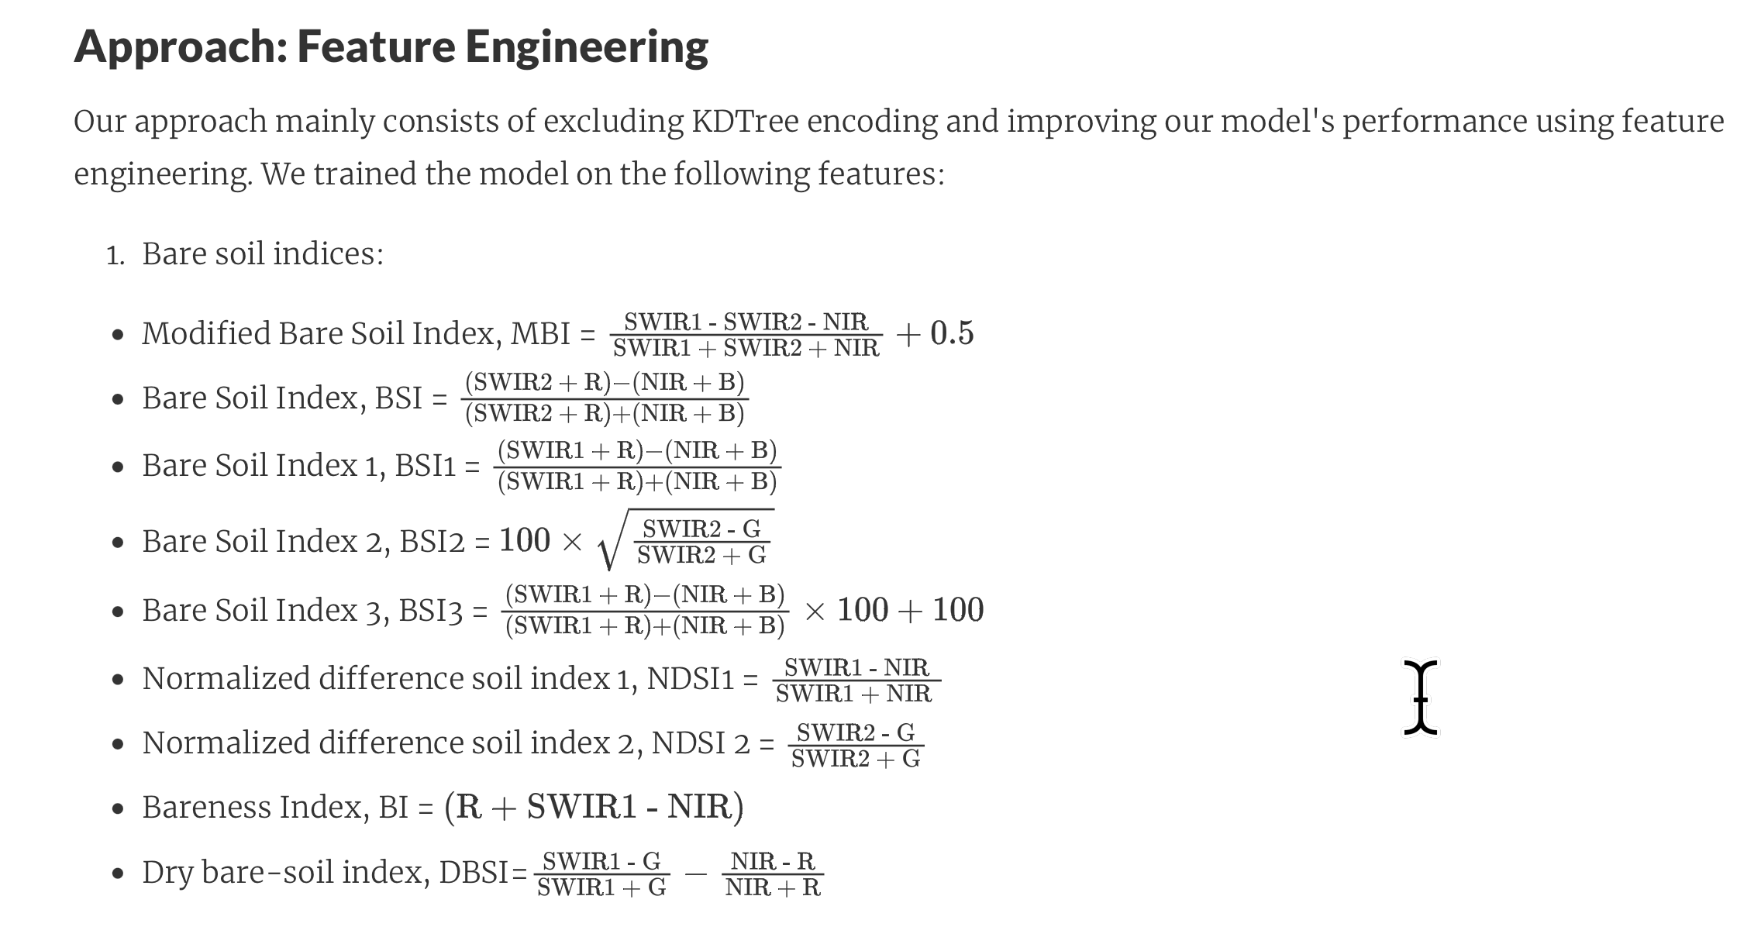
A good explanation.md

Slide 7
Meta-information
Files:
5124 country_test_reduct.csv
3637 random_test_reduct.csv
10911 train.csv
19672 TOTAL
Columns:
filename,country,wealthpooled,urban,label,nl_mean
image7716.npz,21,-1.0900524854660034,False,0,-0.097

Slide 8
How to estimate the error on the test sets?
Partition train into train2 and validation.
Train on train2, evaluate on validation
If by country: split by country ID.
Repeat to get distribution of validation error.
Using variance of performance:
Give a confidence interval on test error. - use for optimization.
Identify examples on which prediction is unstable: use for IDK
Use boosting score instead of classification: more refined estimate

Slide 9
Directions for improvement
Defining new “colors”
Varying resolution – large vs. small features
Segmenting by color to identify roads, etc.
Define shape-based weak rules.
Visualizing: what are the image parts that explain the prediction: roads, pools, vegetation in urban areas.
Run many small experiments to learn before a few big experiments.

