Slide 1
Final HW

Slide 2
The problem statement
Given satellite images, predict wealth of households in area.
23 countries.
~20,000 images.

Slide 3
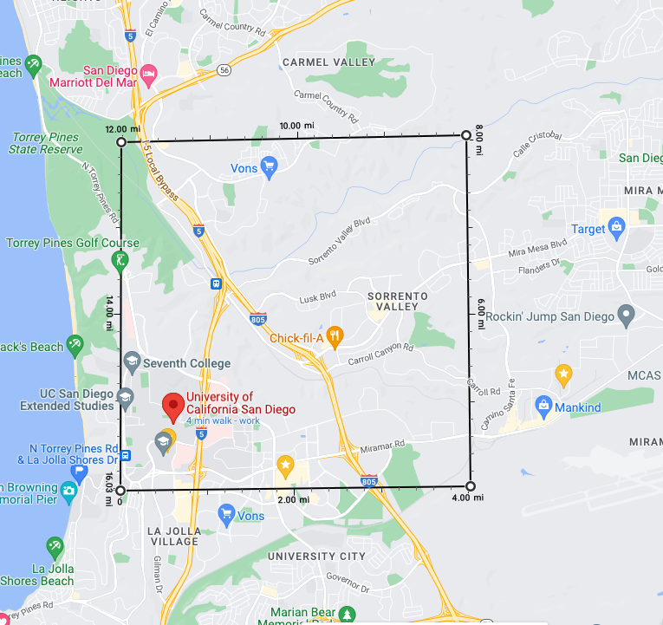
Size of each image
Each image 224x224x8, last layer is night-light.
30x30 meter per pixel.
= 6.7x6.7 KM per image.
= 4.2 X 4.2 mile per image

Slide 4
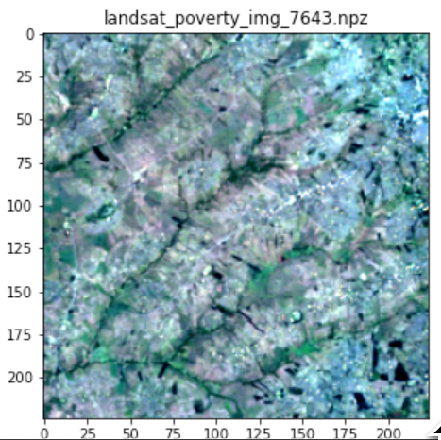
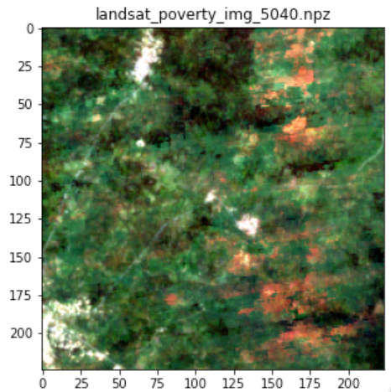
Rural areas

Slide 5
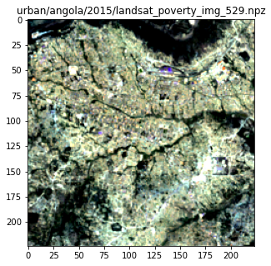
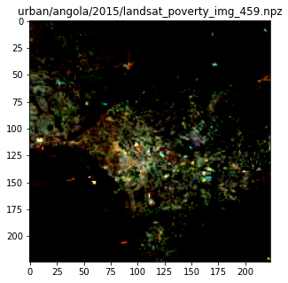
Urban areas

Slide 6
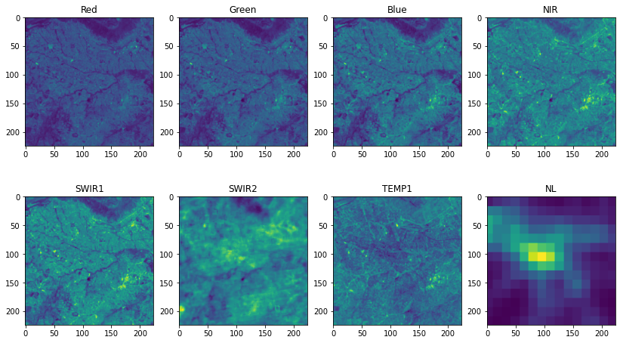
8 Channels

Slide 7
The dataset
Task: identify poor vs. rich areas from satellite images.
23 countries.
~20,000 images
Each image 224x224x8, last layer is night-light.
Urban wealth >> Rural wealth.
Binary classification “poor” vs “rich”
Threshold on wealth is -0.5 for rural , 1.2 for urban

Slide 8
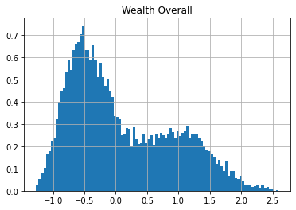
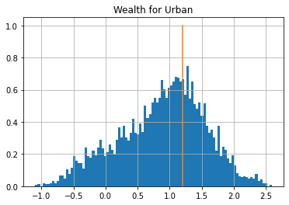
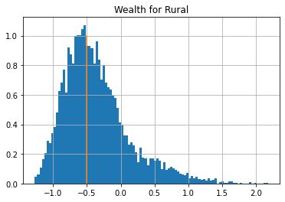
Label Definition

Slide 9
Competitions:
Random Test / symmetric loss
Country test /Assymetric loss

Slide 10
Symmetric and asymetric loss
Symmetric loss:
Asymetric loss
 | prediction: above thr | Prediction: below thr
Outcome: above thr | Loss = -1 | Loss = 1
Outcome: below thr | Loss = 1 | Loss = -1
 | prediction: above thr | Prediction: IDK | Prediction: below thr
Outcome: above thr | Loss = -1 | Loss=0 | Loss = 2
Outcome: below thr | Loss = 2 | Loss=0 | Loss = -1

Slide 11
Train-Test partition
Country test: select 25% of rows such that they contain all rows for test countries.
Random test: select 25% (out of remaining 75%) by selecting rows at random.
The rest is training data.
You have access to all images.
You don’t have access to the label / country on the test sets.

Slide 12
Hidden test data
On-going competitions your grade is determined by your last submission.
At most one submission per day per person.
Reported test error = true error + 1% label noise
Why – to discourage hyper-parameter tuning.
Competition and leaderboard is managed using gradescope
https://github.com/yoavfreund/Poverty_Analysis/blob/main/autograder/readme.md

Slide 13
Starting points
A solution based on Kdtrees and Boosting
Two solutions based on DNNs
All available from github.

Slide 14
Stability, Margins and specialization

Slide 15
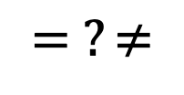
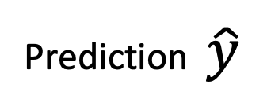
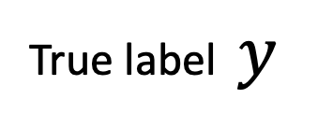
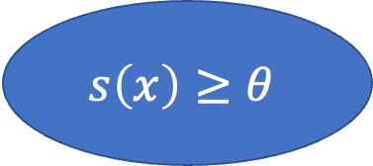
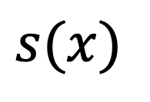
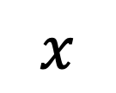
Binary classifiers based on a scoring function
$$x$$
Training Data
Learning Algorithm
Scoring Function
$$s\left(x\right)≥θ$$
True label $y$
$$= ?≠$$
Prediction $\hat{y}$
$$s(x)$$

Slide 16
Stability with respect to training set.
perturbation
$$x$$
Training Data
Learning Algorithm
Scoring Function
$$s\left(x\right)≥θ$$
True label $y$
$$= ?≠$$
Prediction $\hat{y}$
$$s(x)$$

Slide 17
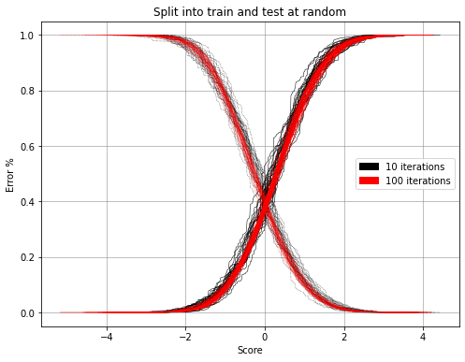
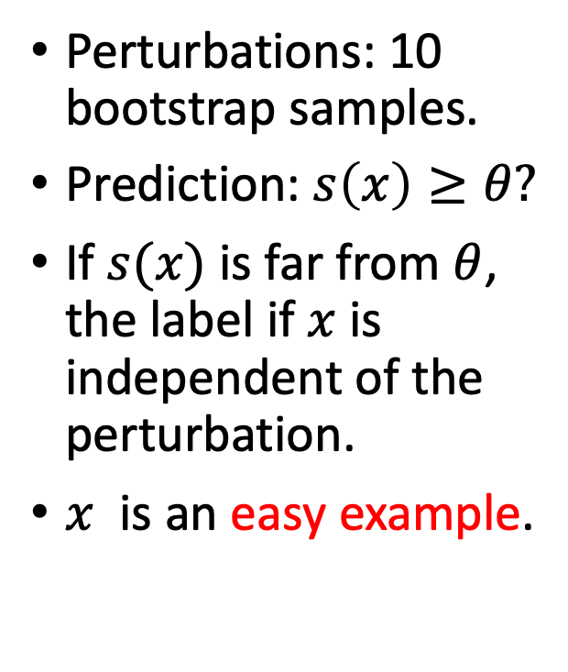


The score distribution
Perturbations: 10 bootstrap samples.
Prediction: $s\left(x\right)≥θ?$
If $s(x)$ is far from $θ$, the label if $x$ is independent of the perturbation.
$x$ is an easy example.
$$s\left(x\right)$$
$$θ$$

Slide 18
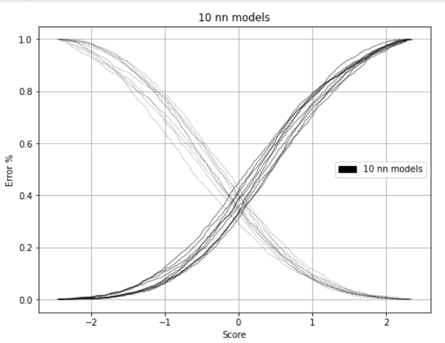
Score distribution for boosting vs. NN

Slide 19
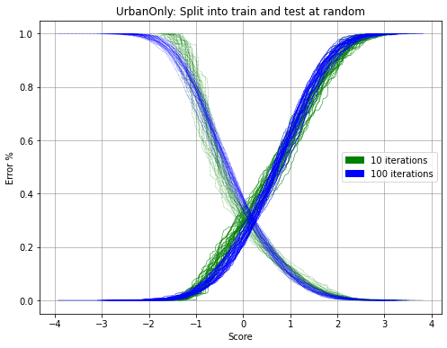
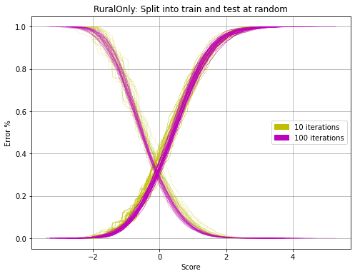
Comparing training on urban only to training on all.
Urban only
Rural only

Slide 21
Perturbing examples vs unstable classifiers
Adversarial examples : a small change to the example changes the label.
Unstable classifiers: A small perturbation of the training set changes the classification of many examples.

Slide 22
Most classification algorithms generate a scoring function
Unstable
Stable
Decision trees
Deep Neural Networks
Logistic Regression
Bagging
Random Forests
Boosting
SVM
K Nearest Neighbors (for large k)

Slide 23
Model robustness
Perturbation: the same task with unimportant (nuisance) variables changed.
Splitting dataset randomly into train and test.
Bootstrap on training data
Augmentation
Splitting dataset by domains (countries)
Using different sensors (calibration is used to counteract)

Slide 24
Ensembles
Train several models under perturbations
Easy examples: all classifiers in the ensemble agree.

