Slide 1
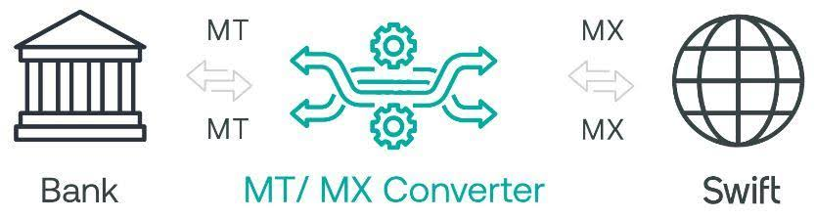
Project’s Title : MXMTConverter Client : Prudential Bank Ltd, Ghana

Slide 2
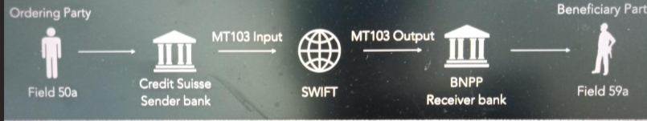
PURPOSE
The Society for Worldwide Interbank Financial Telecommunications

Slide 3
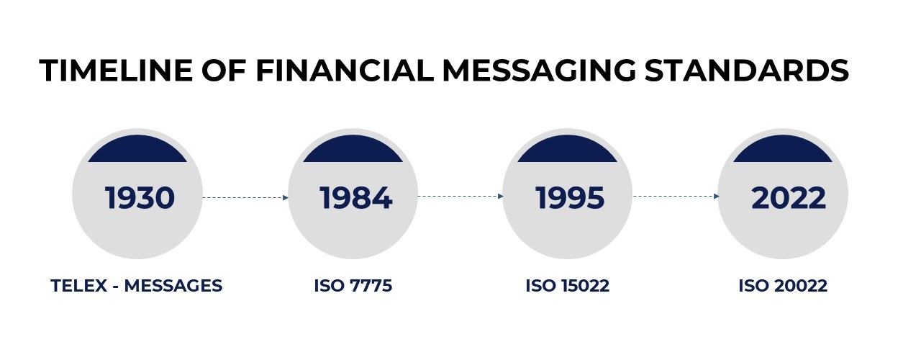
It has security concerns, slow processing speed and lacked a unified messaging system, leading to frequent human errors in transaction descriptions.
It was highly unstructured, difficult to modify and lacked the capability to provide accurate and complete settlement information.

Slide 4
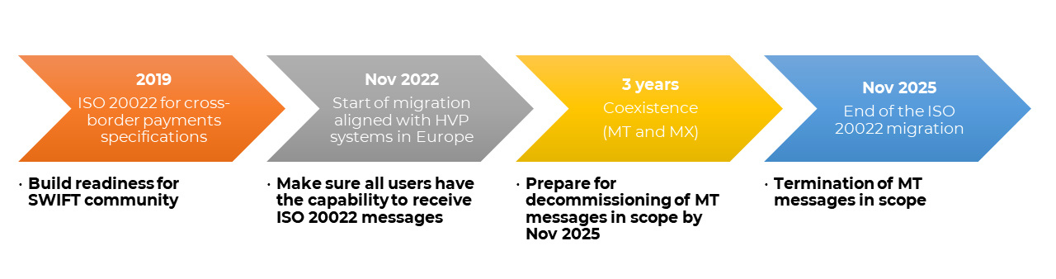
In the migration timeline created by SWIFT, there is a coexistence period of MT and MX messages which is expected to continue for 3 years from November 2022 until November 2025. The coexistence period of MT and MX messages will end after November 2025 and only MX standard messages will be used and supported for the financial message categories.

Slide 5
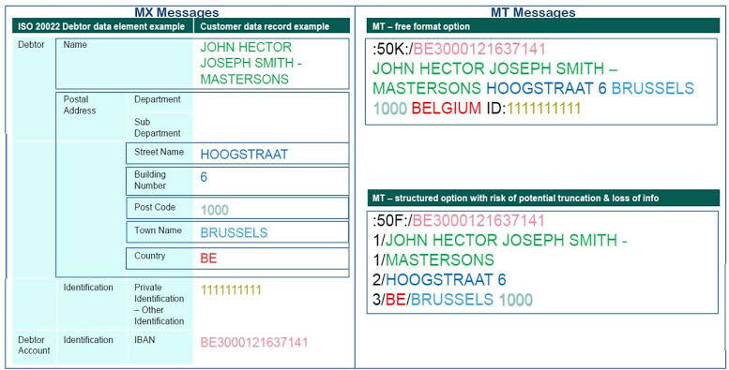

Slide 6
MT MESSAGE
:50F:/123456789 Bank of America P.O. BOX 12345 340 NORTH SOUTH ROAD GEORGE TOWN KY1-111, CAYMAN ISLANDS
<Dbtr> <Nm> Bank of America </Nm> <PstlAdr> <AdrLine>P.O. BOX 12345</AdrLine> <AdrLine>340 NORTH SOUTH ROAD</AdrLine> <AdrLine>GEORGE TOWN KY1-111, CAYMAN ISLANDS</AdrLine> </PstlAdr> <CtryOfRes>KY</CtryOfRes> </Dbtr> <DbtrAcct> <Id>123456789</Id> </Other> </DbtrAcct>
MX MESSAGE

Slide 7
Disadvantages of MT messages:
Limited Data: MT messages can carry less information compared to MX messages which can lead to incomplete data.
Less Structured: The format is less structured, making it harder to automate and process efficiently.
Higher Error Rates: Due to less structure, there’s a higher chance of errors in data entry and processing.
Compliance Challenges: Meeting regulatory requirements can be more difficult with the limited data in MT messages.
Global Compatibility: MT messages are not as widely accepted as the ISO 20022 standard, which can complicate international transactions.

Slide 8
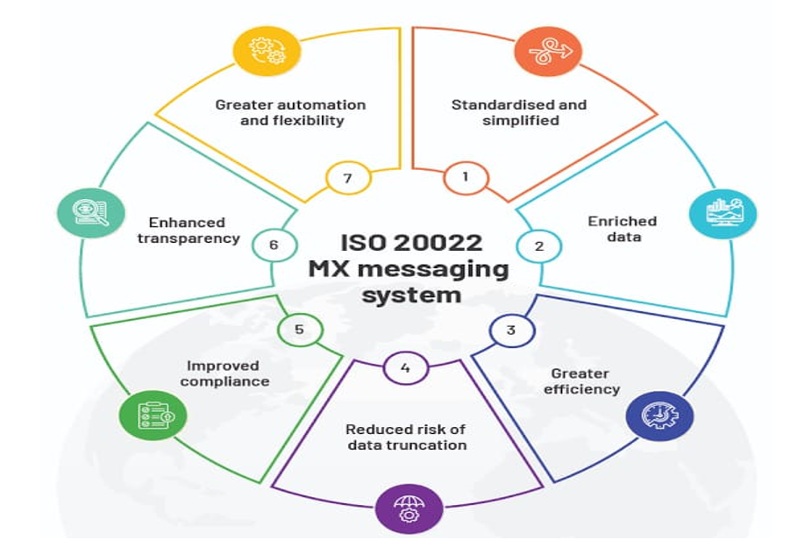
Advantages of MX messages:
More Information: MX messages can carry more detailed data compared to MT messages.
Better Efficiency: The structured format makes processing faster and reduces errors.
Improved Transparency: More detailed data helps in better tracking and reduces fraud.
Global Standard: ISO 20022 is used worldwide, making international transactions easier.
Enhanced Compliance: Easier to meet regulatory requirements with detailed data.
Better Customer Service: Richer data helps in providing better service to customers.
Support for Multiple Languages: MX messages can support multiple languages, including Chinese, Japanese, Arabic, etc., making them more versatile

Slide 9
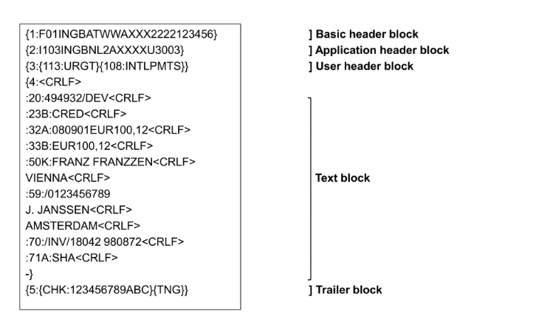
MT Message Format

Slide 10
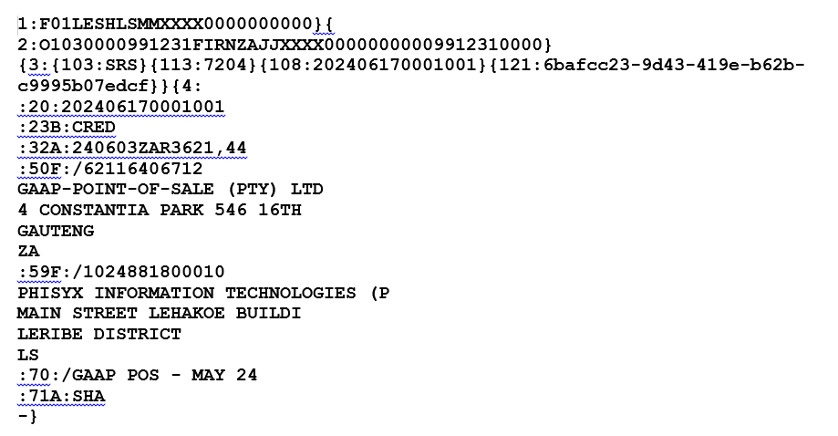
MT Message Format (MT103)

Slide 11
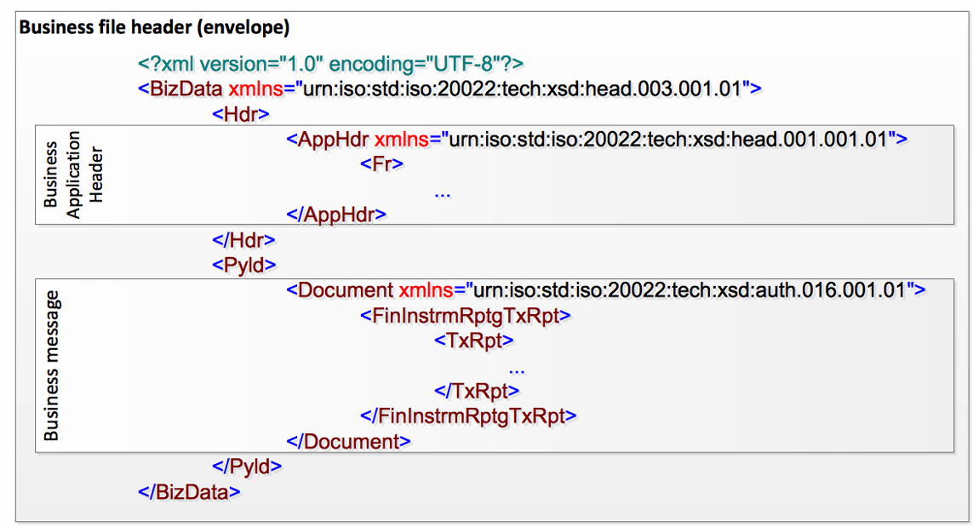
MX Message Format

Slide 12
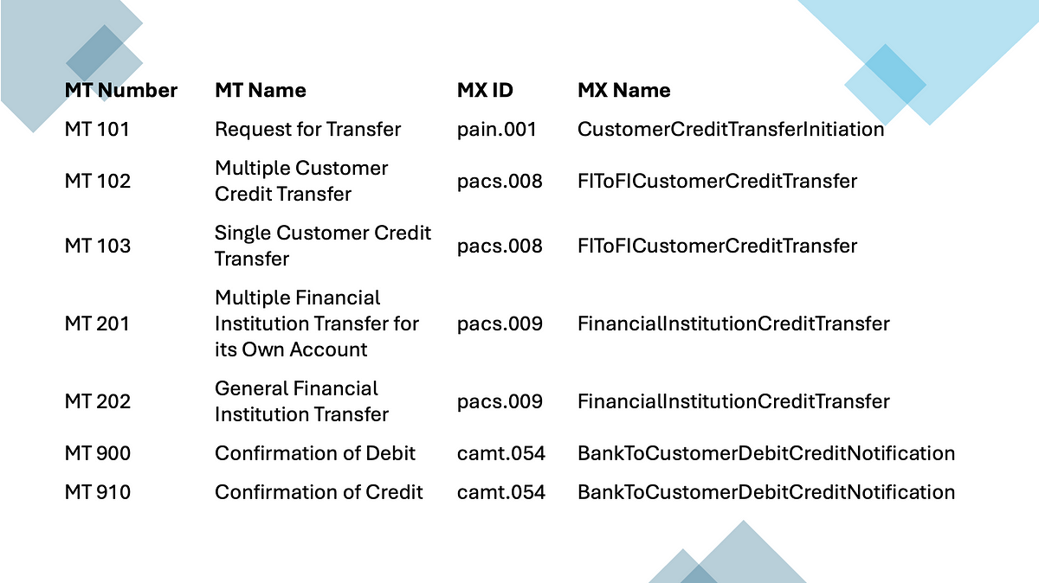
pain : Payment Initiation refers to a message used when a customer initiates a payment to their bank,
pacs : Payment Clearing and Settlement, is used for interbank clearing and settlement of that payment
camt: cash management is used for sending payment status updates or notifications to the customer once the transaction is complete.

Slide 13
Introduction
The MXMTConverter is a software tool designed to facilitate the conversion of financial messages between the MT format based on the ISO 15022 standard and the MX format based on the ISO 20022 standard and vice versa.
Key Features:
Bidirectional Conversion: It supports both MT to MX and MX to MT conversions allowing flexibility in handling different types of financial messages.
High Accuracy: The converter is designed to accurately map the fields and data elements between the two formats, minimizing the risk of data loss or misinterpretation.
Scalability: The MXMT Converter can handle a high volume of messages making it suitable for large financial institutions with extensive transaction processing requirements.
Compliance: The tool ensures compliance with regulatory requirements by accurately converting and preserving the necessary data elements in the target format.

Slide 14
Main Goal of the MXMT Converter Project:
Streamlined Conversion: The primary goal of the MXMT Converter project is to streamline the conversion process between MT and MX messages, allowing financial institutions to efficiently transition to the newer ISO 20022 standard while maintaining compatibility with the older ISO 15022 standard.
Enhanced Data Quality: By enabling the conversion to MX messages, the project aims to improve the quality and richness of data exchanged in financial transactions, leading to better transparency and accuracy.
Regulatory Compliance: The project ensures that financial institutions remain compliant with evolving regulatory standards by facilitating the adoption of ISO 20022, which is increasingly becoming the global standard for financial messaging.
Operational Efficiency: The MXMT Converter project aims to reduce operational costs and enhance efficiency by automating the conversion process and minimizing the need for manual intervention.
Future-Proofing: The project prepares financial institutions for future changes in the financial messaging landscape by providing a flexible and adaptable conversion tool that can accommodate updates to the ISO 20022 standard.

Slide 15
Tool & Technology
Java 8 version , PlSql
Weblogic server
GIT for version control

Slide 16
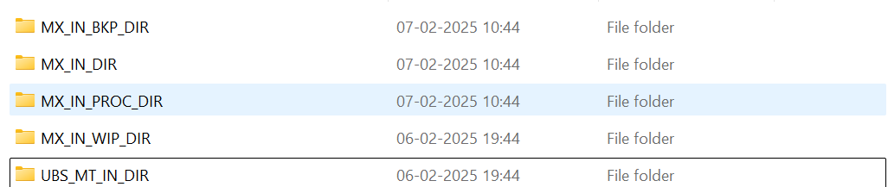
MX to MT Conversion (Incoming message)
Business Logic in Java
Process Steps:
Read the incoming message, operations on relevant message, check the message is within scope or not and store the data in the database.
Retrieve data from the database and process the necessary conversions for in-scope messages.
Save the converted message to the designated folder and update the database with the output message.

Slide 17
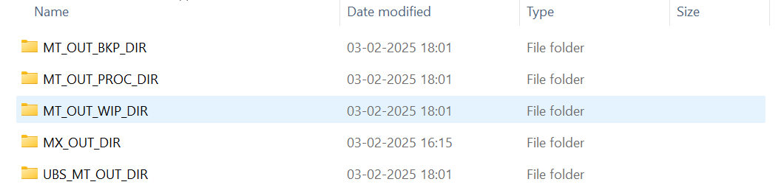
MT to MX Conversion (Outgoing Message)
Business Logic in Java + PL/SQL
Process Steps:
Read the incoming message, operations on relevant message, check the message is within scope or not and store the data in the database.
Retrieve and transform the in-scope message using PL/SQL for data conversion.
Save the converted message to the target folder and update the database with the output message.

Slide 18
Thank you

Slide 21
MT to MX: Steps Involved in Converting MT Messages to MX Messages (Using PL/SQL)
Extract Data from MT Messages:
Parse MT Message: Use PL/SQL procedures to read and parse the MT message.
Identify Key Fields: Extract relevant fields from the MT message based on the message type (e.g., MT103, MT940).
Map MT Fields to MX Structure:
Field Mapping: Map the extracted MT fields to the corresponding fields in the MX message structure (e.g., pacs.008, camt.053).
Data Transformation: Apply necessary data transformations to align with the MX format.
Generate MX XML:
Construct XML: Use PL/SQL to generate the XML structure for the MX message.
Populate XML Fields: Populate the XML fields with the transformed data from the MT message.
Validate MX Message:
XML Validation: Validate the generated MX XML against the ISO 20022 schema to ensure compliance.
Error Handling: Implement error handling mechanisms to capture and resolve validation errors.
Store or Transmit MX Message:
Database Storage: Store the validated MX message in the database, if required.
Transmission: Transmit the MX message to the intended recipient over the SWIFT network.

Slide 22
MX to MT: Steps Involved in Converting MX Messages to MT Messages (Using Java 8 on WebLogic Server)
Extract Data from MX Messages:
Parse MX XML: Use Java libraries (e.g., JAXB) to parse the MX XML message.
Identify Key Fields: Extract relevant fields from the MX message based on the message type (e.g., pacs.008, camt.053).
Map MX Fields to MT Structure:
Field Mapping: Map the extracted MX fields to the corresponding fields in the MT message structure (e.g., MT103, MT940).
Data Transformation: Apply necessary data transformations to align with the MT format.
Generate MT Message:
Construct MT Message: Use Java to construct the MT message structure.
Populate MT Fields: Populate the MT message fields with the transformed data from the MX message.
Validate MT Message:
Message Validation: Validate the constructed MT message to ensure it meets the MT message format specifications.
Error Handling: Implement error handling mechanisms to capture and resolve validation errors.
Store or Transmit MT Message:
Database Storage: Store the validated MT message in the database, if required.
Transmission: Transmit the MT message to the intended recipient over the SWIFT network.

