Slide 1
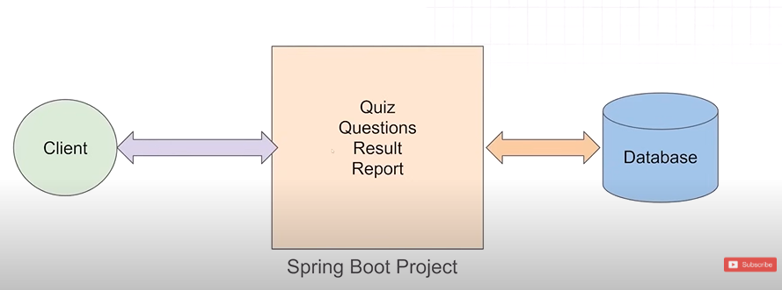
Monolithic Architecture
The entire application is built as a single, unified unit, where all the components are tightly integrated. The entire application is in one codebase.
Imagine a monolithic exam application where all functionalities such as quiz, questions, result and report are bundled together in a single Java application

Slide 2
Disadvantage
Tight coupling of services
If one service is down, other service also got affected.
If one service is planned to redeploy, other also got affected.
Scaling problem
Technology locking
Codebase become complex as project scale

Slide 3
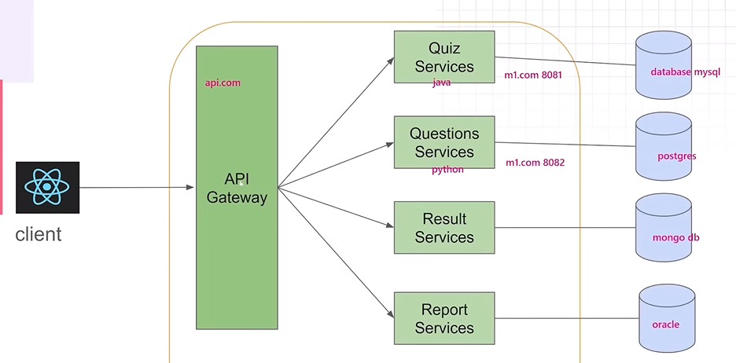
Microservices Architecture
It is a collection of small, independent and loosely coupled services. Each service corresponds to a specific business functionality and can be developed, deployed, and scaled independently.

Slide 4
Advantages
Independence
Single Responsibility Principle
Loose Coupling
Decentralized Data Management
Technology Diversity
Continuous Deployment and Scaling

Slide 5
There are two main types of communication: 1. Synchronous Communication (Direct Request-Response) One service sends a request, and another service responds immediately. Example: Service A asks Service B for customer details and Service B responds with the data. Common Methods: REST API using RestTemplate (Manual HTTP calls) Feign Client (Simpler way to call other microservices) 2. Asynchronous Communication (Event-Driven Messaging) Services don’t wait for an immediate response. Instead, they send a message and continue working. Example: When an order is placed, a message is sent to a queue, and another service (like Payment Service) picks it up when it's ready. Common Methods: Kafka / RabbitMQ (Messaging Queue)

Slide 6
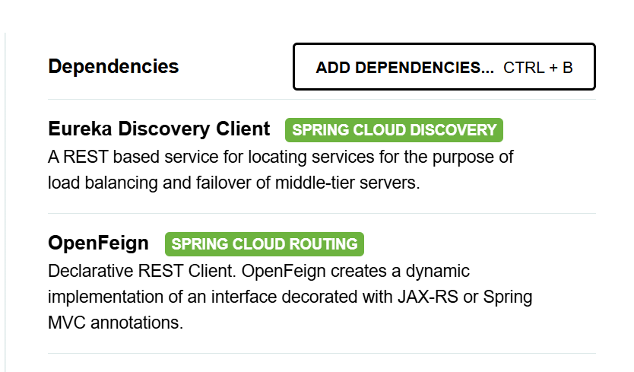
Following dependency is added in every microservices project

Slide 7
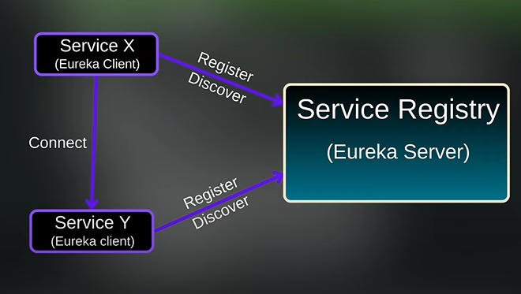
Creating a service registry:
Think of Eureka Server as a phone directory for microservices. Instead of hardcoding service addresses, Eureka dynamically manages them.
How Eureka Works: 1. Each microservice registers itself with Eureka. 2. When one service needs another, it asks Eureka instead of using a fixed URL.

Slide 8
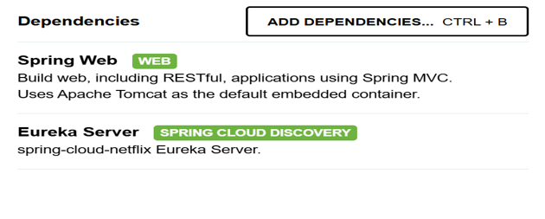
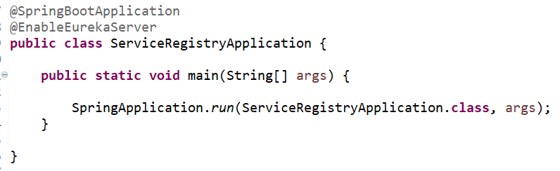
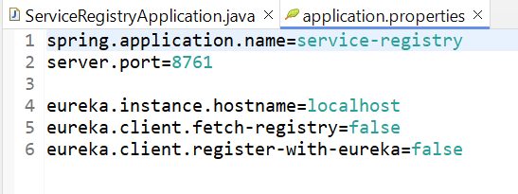

Slide 9
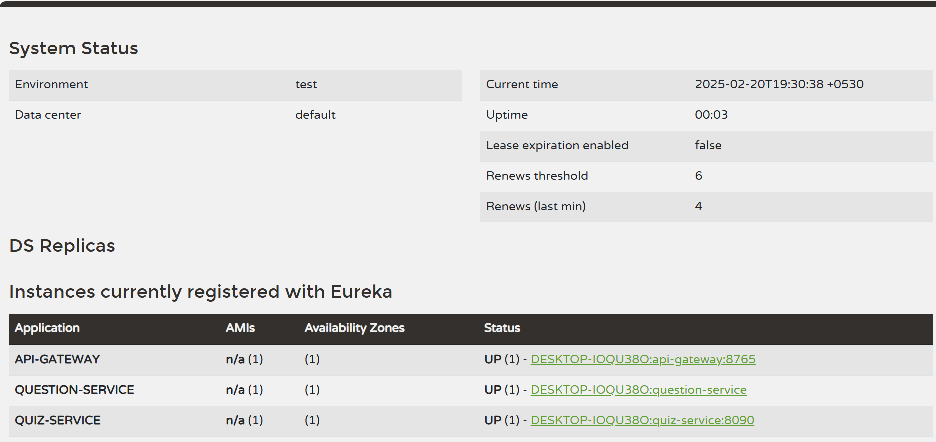

Slide 10
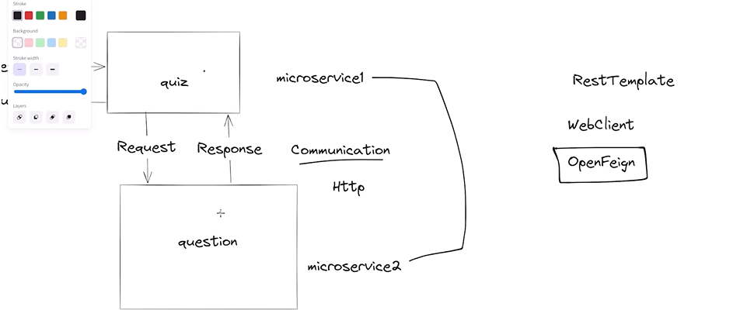
Without Feign, calling another service requires writing manual REST API calls. With Feign, it’s as simple as defining an interface!
Feign Client

Slide 11
Using RestTemplate:
RestTemplate restTemplate = new RestTemplate();
ResponseEntity<User> response = restTemplate.getForEntity("http://USER-SERVICE/users/1", User.class);
User user = response.getBody();
With Feign Client -> Feign automatically finds `QUESTION-SERVICE` and calls the correct API.
@FeignClient("QUESTION-SERVICE")
public interface QuizInterface {
@GetMapping("question/generate")
public ResponseEntity<List<Integer>> getQuestionsForQuiz
(@RequestParam String categoryName, @RequestParam Integer numQuestions );

Slide 12
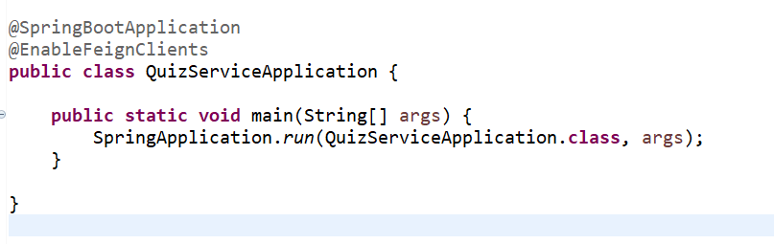
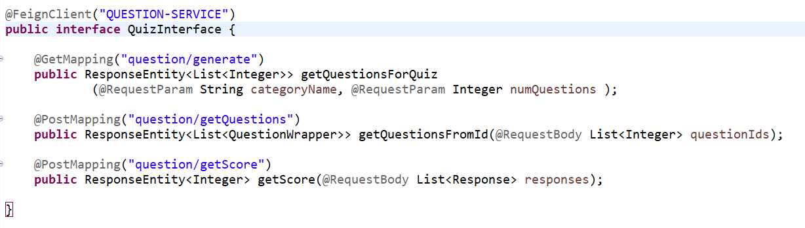

Slide 13
API Gateway
It act as a single entry point for client requests and managing communication between clients and multiple microservices. Why API Gateway? ✔ Centralized authentication & security (JWT, OAuth2) ✔ Load balancing & request routing ✔ Single entry point for all microservices
🔹 Without API Gateway: Clients must call services directly (e.g. `http://user-service:8081/users`) This exposes internal service details. 🔹 With API Gateway: Clients only call one URL (`http://api-gateway/users`). The API Gateway forwards the request to the right microservice.

Slide 14
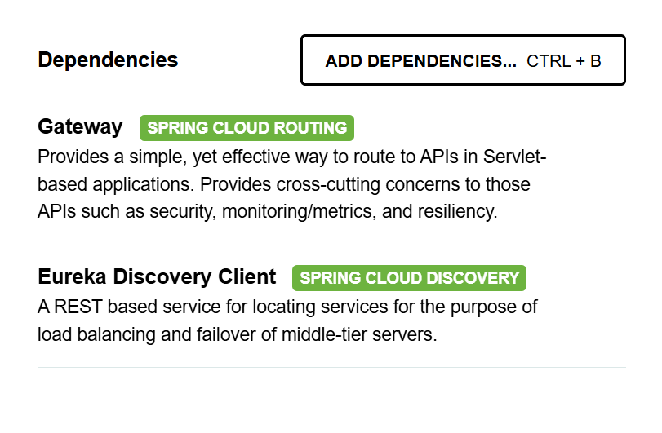
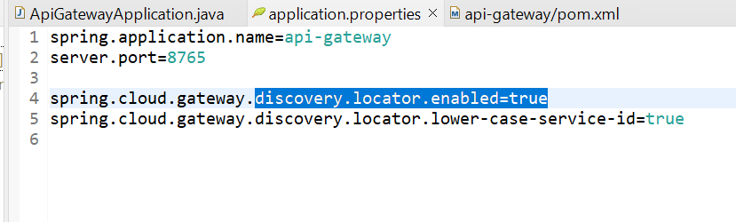

Slide 15
✔ Microservices are a set of small and independent services. ✔ Eureka Server registers all microservices. ✔ Feign Client calls microservices dynamically via Eureka. ✔ API Gateway handles all client requests and forwards them to the correct microservice.
How Everything Works Together:

Slide 16
THANK YOU

