Slide 1

Movie Ratings: Exploration through Visualizations
By Satendra Nath
Roll: A19027

Slide 2
Problem Statement
Movies, we all love or hate with or without knowing the factors that made us to reject or accept that piece of work. But the same factors can be really crucial for a movie maker, like which star to cast in movie, which genre to chose for the next venture, what location to shoot in, and what attracts the public more and more.
The better the movie the more it will make at the box office and hence more profit will be earned. Even the factors can be really important to make a economical yet large profitable movie.
Here we will try to visualize the different factors that can be really crucial for a movie to be a successful.

Slide 3

Which genres are most prevalent?

Slide 4
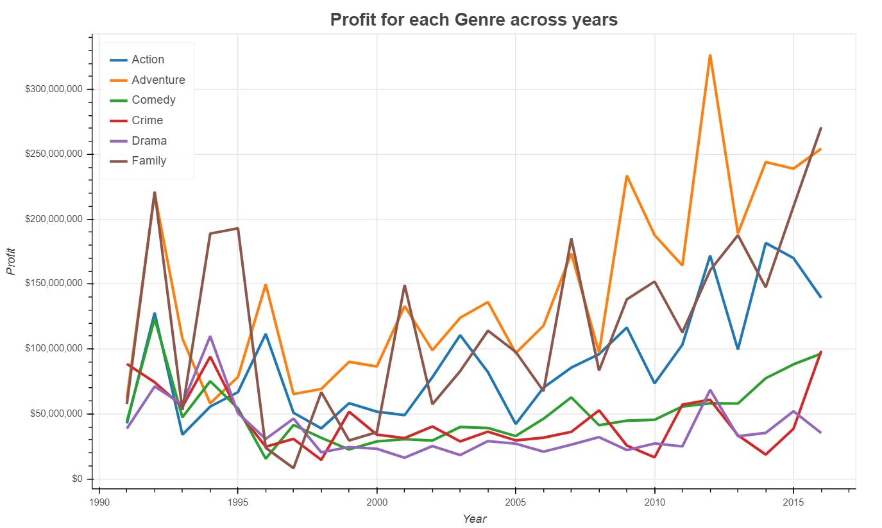
Which genres are most profitable?
“Family” and “Adventure” movies tend to be most profitable of late, while “Comedy”, “ Thriller” and “Drama” are the most prevalent genres

Slide 5
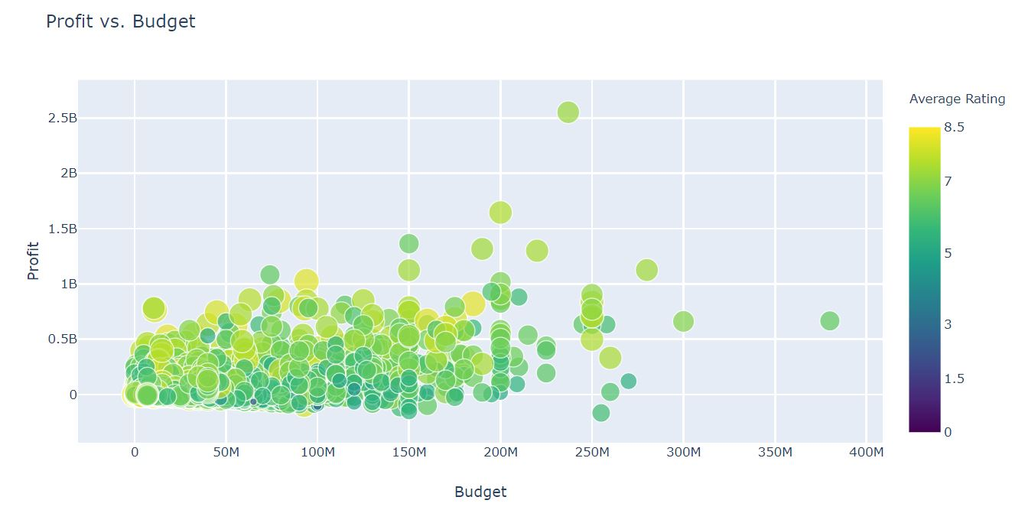
How has movie budget affected profit?
There is not much correlation between budget and profit achieved

Slide 6
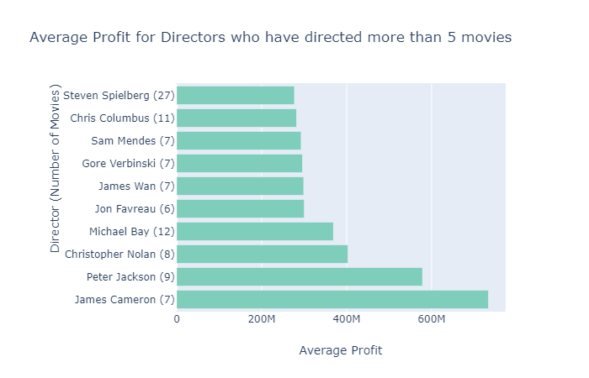
Which director brings in the most profit?
James Cameron makes movies with the most average profit.
Christopher Nolan’s movies get the highest average rating.

Slide 7

How many leading actors have worked together?
Robert De Niro is a leading actor who has worked with 24 other leading actors as of the data used.

Slide 8
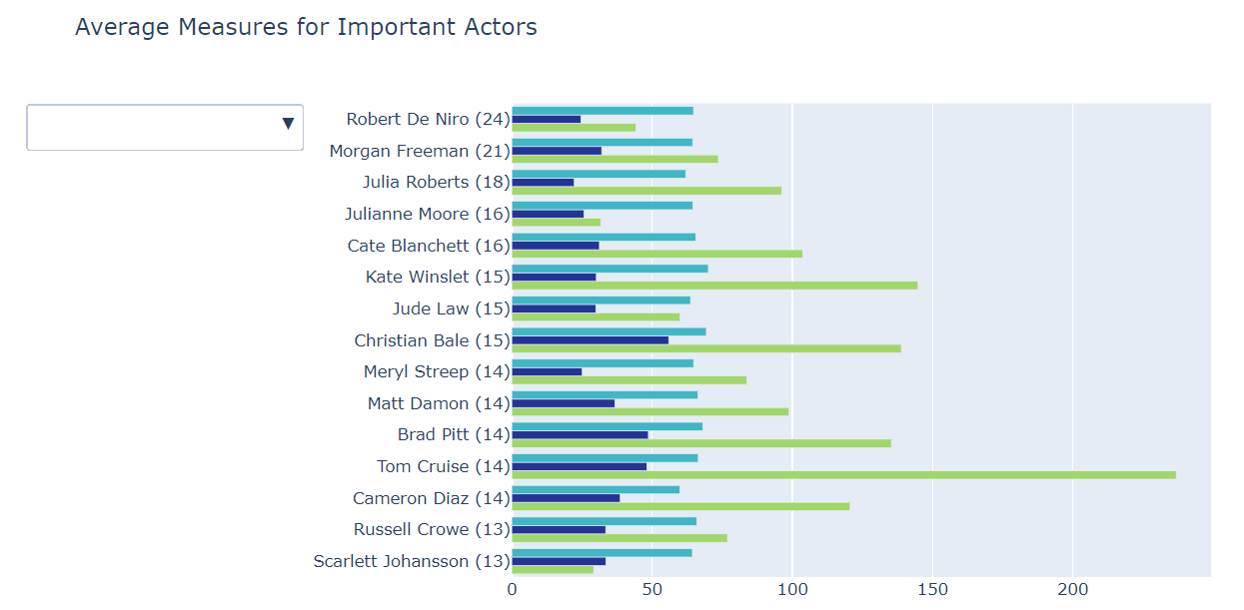
Can top actors be compared?
Tom Cruise’s movies make the most average profit, Kate Winslet’s movies get the highest average vote, and Christian Bale’s movies are the most popular.

Slide 9

Trivia! This actor…
Has appeared in the Marvel Cinematic Universe
Is not Natalie Portman
Has appeared in the Star Wars prequels
Is the highest all time box-office grossing actor

Slide 10
References
Data Reference : - https://github.com/Satendra101995/Data-Viz.git
The Movie Database (TMDB): https://www.themoviedb.org/?language=en

