Slide 1
Satheeshkumar L
Final Project
3/21/2024 Annual Review

Slide 2
PROJECT TITLE
Dominant color in an image
3/21/2024 Annual Review

Slide 3


AGENDA
Problem Statement
Project Overview
Who are the end users?
Your solution and its value proposition
The wow in your solution
Modelling
Results
3/21/2024 Annual Review

Slide 4

PROBLEM STATEMENT
The objective of this project is to create a Python class, `DominantColorDetector`, that can automatically identify and visualize the dominant colors present in an image using the K-means clustering algorithm. The class includes methods to preprocess the input image, train a K-means clustering model with a specified number of color clusters (`n_colors`), and extract the dominant colors from the trained model. Additionally, it provides a method to visualize the identified dominant colors in a palette format. The problem involves implementing these functionalities to enable efficient and accurate detection of dominant colors in images, which can have applications in areas such as image analysis, content summarization, and graphic design. The ultimate goal is to develop a robust tool capable of analyzing and representing the primary color palette of any given image.
3/21/2024 Annual Review

Slide 5

PROJECT OVERVIEW
This project focuses on creating a Python tool to automatically detect and display the main colors in an image. Using the K-means clustering algorithm with libraries like OpenCV, NumPy, sklearn, and matplotlib, the tool processes image data. The `DominantColorDetector` class handles image preprocessing, model training with K-means clustering, extraction of dominant colors, and visualization of these colors in a palette. This tool helps users understand the primary color composition of images, useful for tasks like image analysis, content summarization, and graphic design. The project's simplicity lies in offering a straightforward way to analyze and visualize dominant colors using a user-friendly Python class.
3/21/2024 Annual Review

Slide 6

WHO ARE THE END USERS?
The end users of a machine learning system for finding the dominant color in images can include graphic designers, photographers, e-commerce platforms, fashion industry professionals, marketers, web developers, app developers, content moderators, and researchers in artificial intelligence and computer vision. Graphic designers and artists can use it to incorporate colors into their designs, while photographers might apply it to enhance photo editing. E-commerce platforms benefit by tagging products accurately by color, and the fashion industry can track color trends. Marketing and advertising professionals can analyze color impact in campaigns, and web/app developers can automate color theme generation. Content moderation and medical imaging applications can use it for categorization purposes. Overall, a range of creative, commercial, and technical users can benefit from this technology.
3/21/2024 Annual Review

Slide 7

YOUR SOLUTION AND ITS VALUE PROPOSITION
Using machine learning to find the dominant color in images is a valuable solution with broad applications. This technology can accurately identify the main colors in an image, helping graphic designers create color themes, assisting photographers with color correction, and aiding e-commerce platforms in organizing products by color. It also supports trend tracking in the fashion industry, optimizes visual impact in marketing, and streamlines color scheme generation for web and app development. Overall, this ML-based solution offers a time-saving and efficient way to analyze colors in images, benefiting users across various industries.
3/21/2024 Annual Review

Slide 8

THE WOW IN YOUR SOLUTION
The "wow" factor of using machine learning to find the dominant color in images is how effortlessly and accurately it can identify main colors. It makes life easier for designers, helping them create stunning color schemes with ease, and for photographers, simplifying precise color adjustments. It's a game-changer for online shopping, making it easier to find products by color. Marketers also benefit, making smarter decisions about impactful color choices in ads. Overall, it's a simple yet powerful tool that brings efficiency and creativity to various industries.
3/21/2024 Annual Review

Slide 9
MODELLING
In this code, the main model used is K-means clustering from the `sklearn.cluster` library. This model is applied to identify the dominant colors in an image. First, the image is loaded and converted into RGB format using OpenCV (`cv2`). Then, the image pixels are reshaped to prepare them for clustering. The K-means algorithm is used to group similar colors into clusters based on pixel values. The number of clusters (`n_colors`) determines how many dominant colors will be identified. After fitting the K-means model to the image data, the cluster centers, representing the dominant colors, are obtained. Finally, these dominant colors are visualized as a color palette using `matplotlib`, providing a clear representation of the main colors in the image. This method of using unsupervised learning (K-means) is effective for automatically detecting and displaying dominant colors in images, which can be useful in various applications such as graphic design, photography, and color analysis.
3/21/2024 Annual Review

Slide 10
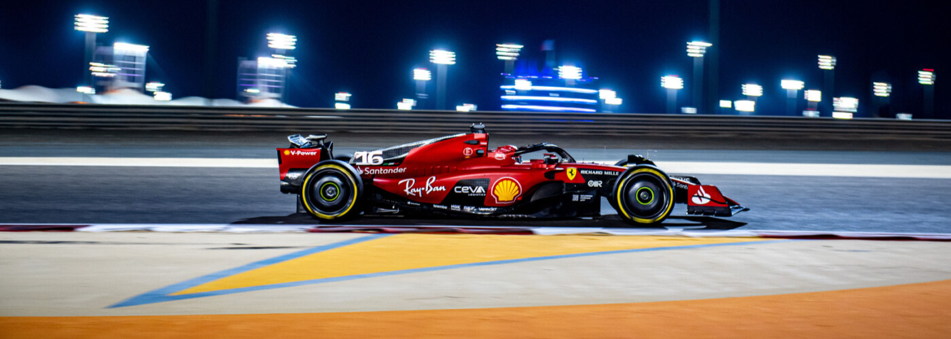
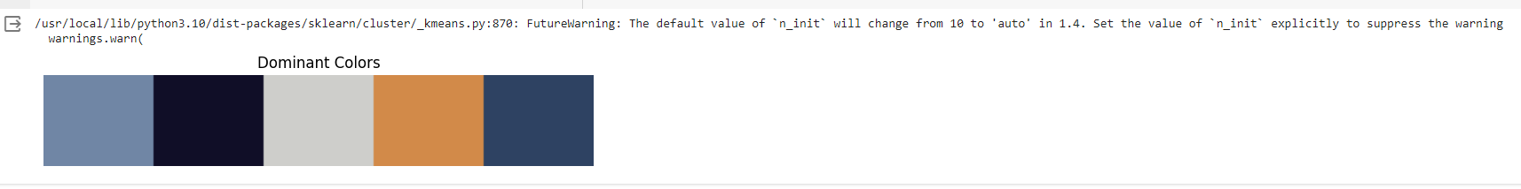
RESULTS
https://github.com/Satheeshkumar-L/Naan_mudhalvan_AIML
3/21/2024 Annual Review

