Slide 1


Analysis Update -31/10/2024

Slide 2
P&L - Overall Performance

Slide 3
P&L - Revenue and Profit

Slide 4
P&L - Revenue Performance
Description | Sep | Oct
 | % of Revenue | Growth%(Sep-Oct) | % of Revenue
Revenue | 183.1%
Sales | 99.60% |  | 99.80%
SERVICE INCOME A/C | 0.40% |  | 0.20%

Slide 5
P&L - COGS Performance
Description | Sep | % Of Revenue | Oct | % of Revenue
Cost Of Sales | 17,061,127.66 | 68.86% | 49,961,836.14 | 71.23%
Cost Of Sales - General | 16,853,963.49 | 68.02% | 49,940,336.14 | 71.20%
Event Expenses | - |  | 21,500.00 | 0.03%
Cost of Service Income | 106,884.17 | 0.43% | -
Cost of Service - Specific | 100,280.00 | 0.40% | -

Slide 6
P&L - KPIs (OPEX)
Description | Sep |  | Oct
Administrative Expenses (% of Revenue) | 3,914,920.90 | 15.801% | 3,877,645.22 | 5.529%
1.Other Administrative Expenses | 2,232,340.95 | 9.010% | 2,109,716.65 | 3.008%
2.Staff Salary | 1,287,289.51 | 5.195% | 1,234,687.60 | 1.760%
3.Utility | 29,044.84 | 0.117% | 85,644.57 | 0.122%
4.Rent Expenses | 355,000.00 | 1.433% | 385,000.00 | 0.549%
5.Insurance | 11,245.60 | 0.045% | 62,596.40 | 0.089%
Selling & Distribution Cost (% of Revenue) | 65,635.50 | 0.265% | 78,210.75 | 0.112%

Slide 7
P&L - OPEX (Administration Expenses)
Other Administrative Exp | September | 9.010% | October | 3.008%

Slide 8
P&L - OPEX (Administration Expenses)
Staff Salary | September | 5.195% | October | 1.760%

Slide 9
P&L - OPEX (Administration Expenses)
Utility | September | 0.117% | October | 0.122%

Slide 10
P&L - OPEX (Administration Expenses)
Rent & Insurance | September | 1.48% | October | 0.64%

Slide 11
P&L - OPEX (Selling and Distributions Expenses)
Selling and Distributions Expenses | September | 9.010% | October | 3.008%

Slide 12
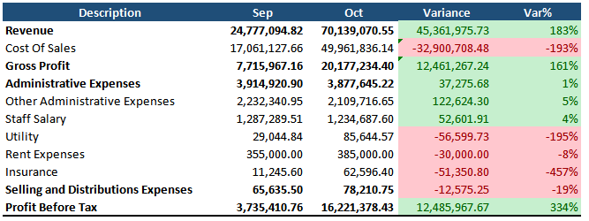
P&L - Overall Variation (Sep-Oct)

Slide 13
P&L - Summary
Description | Sep |  | Oct
Revenue | 24,777,094.82 | Revenue Growth | 183.08% | 70,139,070.55
Cost of Sale | 17,061,127.66 | 68.858% | 49,961,836.14 | 71.233%
Gross Profit | 7,715,967.16 | 31.142% | 20,177,234.40 | 28.767%
Administrative Expenses | 3,914,920.90 | 15.801% | 3,877,645.22 | 5.529%
1.Other Administrative Exp | 2,232,340.95 | 9.010% | 2,109,716.65 | 3.008%
2. Staff Salary | 1,287,289.51 | 5.195% | 1,234,687.60 | 1.760%
3.Utility | 29,044.84 | 0.117% | 85,644.57 | 0.122%
4.Rent Expenses | 355,000.00 | 1.433% | 385,000.00 | 0.549%
5.Insurance | 11,245.60 | 0.045% | 62,596.40 | 0.089%
Selling and Distributions Expenses | 65,635.50 | 0.265% | 78,210.75 | 0.112%
Profit Before Tax | 3,735,410.76 | 15.076% | 16,221,378.43 | 23.127%

Slide 14

THANK YOU!
Analysis Update -31/10/2024

