Slide 1


Analysis Update -31/10/2024

Slide 2
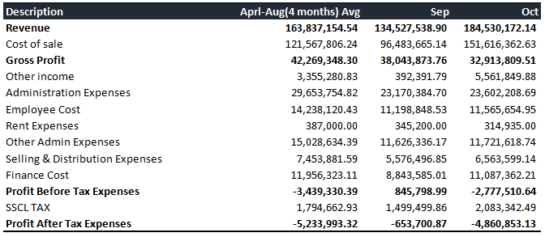
P&L - Overall Performance

Slide 3
P&L - Revenue and Profit

Slide 4
P&L - Revenue Performance

Slide 5
P&L - Revenue KPIs
Description | Sep |  | Oct |  | Aprl-Aug(4 months) avg
 | MOM%(Last month AVg)-Sep | % of Revenue | MOM%(Sep-Oct) | % of Revenue | % of Revenue
Revenue | -17.9% | 100% | 37.2% | 100.0% | 100.0%
[4-11003] Project Income | -95.6% | 0.03% | 1114.3% | 0.2% | 0.5%
[4-11004] Inter SBU Sales | -36.5% | 10.31% | -4.3% | 7.2% | 13.3%
[4-11101] Trade Sales - General | -12.3% | 73.62% | 48.9% | 79.9% | 69.0%
[4-12001] Eng - Service Income | 7.5% | 10.82% | -48.2% | 4.1% | 8.3%
[4-12003] Service Contract Income | 19.0% | 7.94% | 6.4% | 6.2% | 5.5%
[4-12004] Service Return | -76.7% | -0.10% | 4.1% | -0.1% | -0.3%
[4-12005] Service Income | 129.1% | 0.25% | -100.0% | 0.00% | 0.1%
[4-12006] MIS Service Revenue | 12.6% | 0.01% | -100.0% | 0.00% | 0.0%
[4-20007] Deferred Project Income | -61.2% | 1.89% | -12.4% | 1.2% | 4.0%
[4-20008] Defered Service Income | -1422.5% | -4.76% | -136.5% | 1.3% | -0.3%
No Revenue
No Revenue
Note: In October , deferred service income negative growth decreased due to Increase in deferred service income.

Slide 6
P&L - Revenue (Tabular Form)
Description | Sep | Oct | Aprl-Aug(4 months) Avg
Revenue | 134,527,538.90 | 184,530,172.14 | 163,837,154.54
Project Income | 35,000.00 | 425,000.00 | 787,669.49
Inter SBU Sales | 13,866,461.00 | 13,274,047.76 | 21,851,990.97
Inter SBU Sales (Service Journey) | - | - | -
Trade Sales - General | 99,041,838.09 | 147,506,955.45 | 112,984,613.47
Eng - Service Income | 14,556,277.18 | 7,538,108.43 | 13,534,453.50
Service Contract Income | 10,677,410.62 | 11,360,632.38 | 8,969,992.94
Service Return | -130,732.00 | -136,031.26 | -561,386.17
Service Income | 342,777.95 | - | 149,650.00
MIS Service Revenue | 8,915.00 | - | 7,916.67
Discount | - | - | -5,496.50
Deferred Project Income | 2,538,056.00 | 2,223,000.00 | 6,538,655.20
Defered Service Income | -6,408,464.94 | 2,338,459.38 | -420,905.04
Defered MIS Service Income | - | - | -

Slide 7
P&L - COGS Performance

Slide 8
P&L - COGS KPIs
Description | Sep | Oct | Aprl-Aug(4 months) Avg
 | % of Revenue | % of Revenue | % of Revenue
Cost of Sale(% of Revenue) | 71.72% | 82.16% | 74.20%
Cost of Sales - General | 65.48% | 78.98% | 69.06%
Cost of Project Income | 0.04% | 0.74% | 0.32%
Cost of Service Income | 6.18% | 3.10% | 4.43%
Inventory Consumption - General | 0.12% | 0.26% | 0.15%
Cost of Warranty Replacement | 0.05% | 0.00% | 0.18%
Import & Other Charges (Not added with Costing) | 0.00% | 0.11% | -0.01%
OB Stock Adjustment | -0.15% | -1.03% | 0.07%

Slide 9
P&L - COGS (Tabular Form)
Description | Sep | Oct | Aprl-Aug(4 months) AVg
Cost of Sale | 96,483,665.14 | 151,616,362.63 | 121,567,806.24
Cost of Sales - General | 88,093,428.33 | 145,744,553.64 | 113,152,921.69
Cost of Project Income | 56,580.16 | 1,373,832.11 | 531,016.75
Cost of Service Income | 8,314,284.61 | 5,720,422.43 | 7,249,841.54
General Expense- Services | - | - | -
General Expense- Projects | - | - | -
Inventory Consumption - General | 158,039.97 | 472,953.41 | 244,080.58
Sales & Procurement Return Charges | - | - | -
Cost of Warranty Replacement | 63,187.86 | 5,128.18 | 292,425.73
Local Handling Charges | - | - | 2,302.50
Import & Other Charges (Not added with Costing) |  | 195,358.86 | -15,065.95
OB Stock Adjustment | -201,855.79 | -1,895,885.99 | 110,283.40

Slide 10
P&L - KPIs (OPEX)
Description | Sep |  | Oct |  | Aprl-Aug(4 months) AVg
Administrative Expenses (% of Revenue) | 23,170,384.70 | 17.20% | 23,602,208.688 | 12.80% | 29,653,754.822 | 18.10%
1.Employee Cost (% of Administrative cost) | 11,198,848.53 | 48.30% | 11,565,654.950 | 49% | 14,238,120.433 | 48%
2.Rent Expenses (% of Administrative cost) | 345,200.00 | 1.50% | 314,935.000 | 1.30% | 387,000.000 | 1.30%
3.Other Admin Cost (% of Administrative cost) | 11,626,336.17 | 50.20% | 11,721,618.738 | 49.70% | 15,028,634.390 | 50.70%
Selling & Distribution Cost (% of Revenue) | 5,576,496.85 | 4.10% | 6,563,599.137 | 3.60% | 7,453,881.591 | 4.50%
Finance Cost (% of Revenue) | 8,843,585.01 | 6.60% | 11,087,362.205 | 6% | 11,956,323.113 | 7.30%

Slide 11
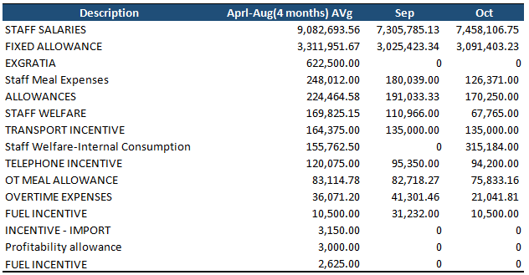
P&L - OPEX (Administration Expenses)
Employee Cost(% of AC) | Aprl-Aug(4 months) AVg | 48.0% | September | 48.3% | October | 49.0%

Slide 12
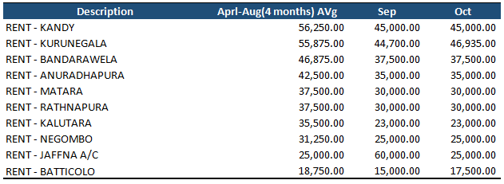
P&L - OPEX (Administration Expenses)
Rent Expenses(% of AC) | Aprl-Aug(4 months) AVg | 1.3% | September | 1.5% | October | 1.3%

Slide 13
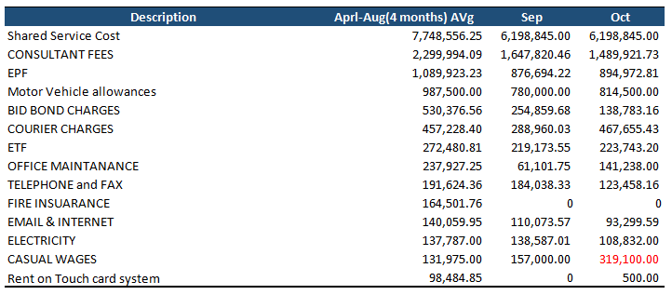
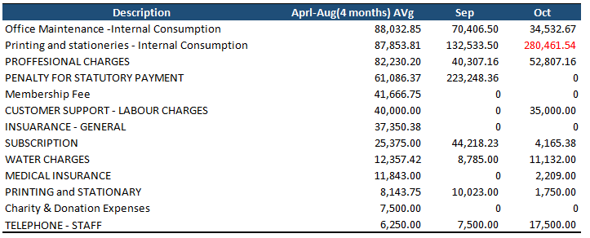
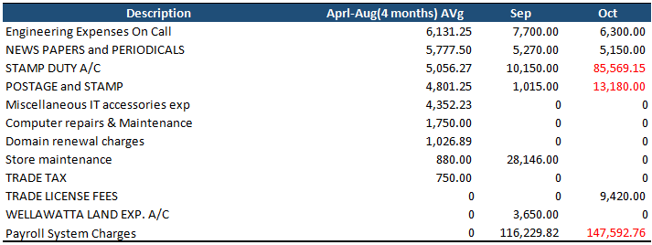
P&L - OPEX (Administration Expenses)
Other Admin Expenses(% of AC) | Aprl-Aug(4 months) AVg | 50.7% | September | 50.2% | October | 49.7%

Slide 14
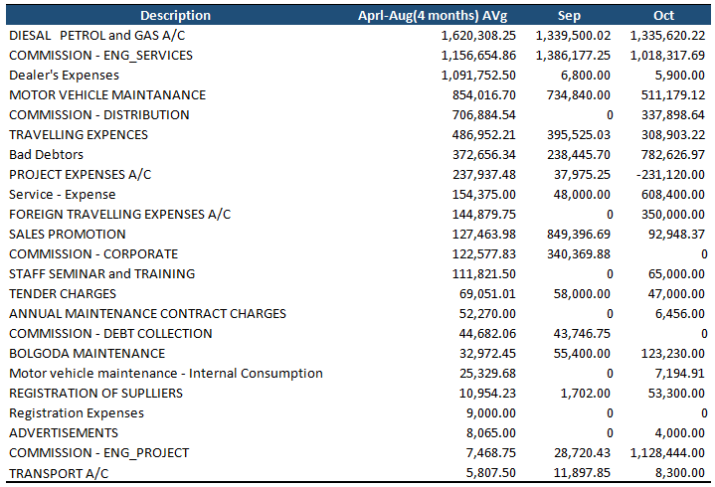
P&L - OPEX (Selling & Distribution Expenses)
Selling & Distribution Expenses(% of Revenue) | Aprl-Aug(4 months) AVg | 4.5% | September | 4.1% | October | 3.6%

Slide 15
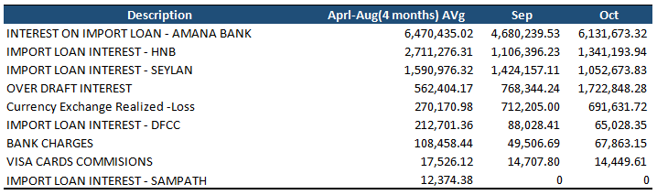
P&L - OPEX (Finance Cost)
Finance Cost (% of Revenue) | Aprl-Aug(4 months) AVg | 7.3% | September | 6.6% | October | 6.0%

Slide 16
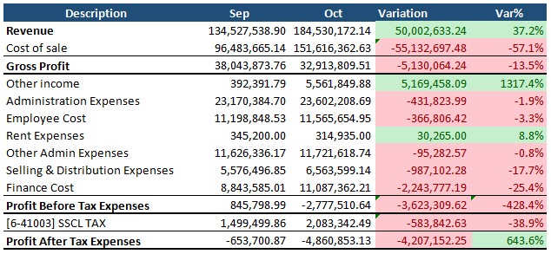
P&L - Overall Variation (Sep-Oct)

Slide 17
P&L - Summary
Description | Sep |  | Oct |  | Aprl-Aug(4 months) AVg
Revenue | 134,527,538.90 |  | 184,530,172.14 |  | 163,837,154.54
Cost of Sale | 96,483,665.14 | 71.7% | 151,616,362.63 | 82.2% | 121,567,806.24 | 74.2%
Gross Profit | 38,043,873.76 | 28.3% | 32,913,809.51 | 17.8% | 42,269,348.30 | 25.8%
Other Income | 392,391.79 | 0.3% | 5,561,849.88 | 3% | 3,355,280.83 | 2%
Administrative Expenses | 23,170,384.70 | 17.2% | 23,602,208.69 | 12.8% | 29,653,754.82 | 18.1%
% Of Administrative Expenses
Employee Cost | 11,198,848.53 | 48.3% | 11,565,654.95 | 49.0% | 14,238,120.43 | 48.0%
Rent Expenses | 345,200.00 | 1.5% | 314,935.00 | 1.3% | 387,000.00 | 1.3%
Other Admin Expenses | 11,626,336.17 | 50.2% | 11,721,618.74 | 49.7% | 15,028,634.39 | 50.7%
Selling & Distribution Cost | 5,576,496.85 | 4.1% | 6,563,599.14 | 3.6% | 7,453,881.59 | 4.5%
Finance Cost | 8,843,585.01 | 6.6% | 11,087,362.21 | 6.0% | 11,956,323.11 | 7.3%
Profit Before Tax | 845,798.99 | 0.6% | -2,777,510.64 | -1.5% | -3,439,330.39 | -2.1%
Tax Expenses(% of PBT) | 1,499,499.86 | 177.3% | 2,083,342.49 | -75.0% | 1,794,662.93 | -52.2%
Profit After Tax Expenses | -653,700.87 | -0.5% | -4,860,853.13 | -2.6% | -5,233,993.32 | -3.2%

Slide 18
THANK YOU!
Analysis Update -31/10/2024

