Slide 1


Analysis Update -31/10/2024

Slide 2
P&L - Overall Performance

Slide 3
P&L - Revenue and Profit

Slide 4
P&L - Revenue Performance
Description | Sep | Oct
 | % of Revenue | Growth%(Sep-Oct) | % of Revenue
Revenue | 104.3%
Sales Income | 97.00% |  | 98.35%
Service Income | 3.00% |  | 0.92%
Inter SBU Income | - |  | 0.74%

Slide 5
P&L - COGS Performance
Description | Sep | % Of Revenue | Oct | % of Revenue
Cost of Sales | 11,764,444.4 | 78.2% | 25,096,804.1 | 81.6%
Cost of Sale-General | 11,654,301.69 | 77.46% | 25,003,609.8 | 81.32%
Cost of Service Income | 101,624.82 | 0.68% | 93,194.21 | 0.30%
Inventory Consumption | 7,900.00 | 0.05% | -
Import Purchase | 617.92 | 0.004% | -

Slide 6
P&L - KPIs (OPEX)
Description | Sep |  | Oct
Administrative Expenses (% of Revenue) | 677,340.1 | 4.5% | 643,953.4 | 2.09%
1.Insurance Expenses | 31,340.0 | 0.21% | 17,580.6 | 0.06%
2.Other Administration Expenses | 646,000.1 | 4.29% | 625,792.8 | 2.04%
3.Depreciation | - | - | 580.0 | 0.002%
Selling & Distribution Cost (% of Revenue) | 31,115.0 | 0.21% | 21,882.3 | 0.07%
Employee Cost | 265,421.4 | 1.76% | 236,462.4 | 0.77%
Finance Cost | 163,631.6 | 1.09% | 220,719.3 | 0.72%

Slide 7
P&L - OPEX (Administration Expenses)
Administration Expenses | September | 4.5% | October | 2.09%

Slide 8
P&L - OPEX (Selling and Distributions Expenses)
Selling and Distributions Expenses | September | 0.21% | October | 0.07%

Slide 9
P&L - OPEX (Employee Cost)
Employee Cost | September | 1.76% | October | 0.77%

Slide 10
P&L - OPEX (Finance Cost)
Finance Cost | September | 1.09% | October | 0.72%

Slide 11
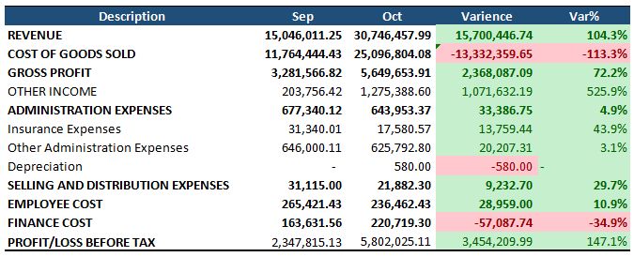
P&L - Overall Variation (Sep-Oct)

Slide 12
P&L - Summary
Description | Sep |  | Oct
Revenue | 15,046,011.25 | Revenue Growth | 104.3% | 30,746,457.99
Cost of Sale | 11,764,444.43 | 78.2% | 25,096,804.08 | 81.6%
Gross Profit | 3,281,566.82 |  | 5,649,653.91
Administrative Expenses | 677,340.12 | 4.5% | 643,953.37 | 2.09%
1.Insurance Expenses | 31,340.01 | 0.21% | 17,580.57 | 0.06%
2.Other Administration Expenses | 646,000.11 | 4.29% | 625,792.80 | 2.04%
3.Depreciation | - | 0 | 580.00 | 0.002%
Selling and Distributions Expenses | 31,115.00 | 0.21% | 21,882.30 | 0.07%
Employee Cost | 265,421.43 | 1.76% | 236,462.43 | 0.77%
Finance Cost | 163,631.56 | 1.09% | 220,719.30 | 0.72%
Profit Before Tax | 2,347,815.13 | 15.6% | 5,802,025.11 | 18.87%

Slide 13
THANK YOU!
Analysis Update -31/10/2024

