Slide 1


Analysis Update -31/10/2024

Slide 2
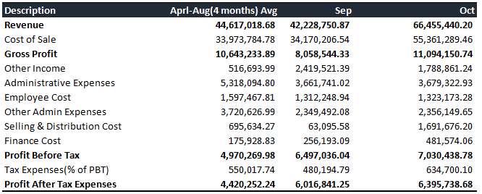
P&L - Overall Performance

Slide 3
P&L - Revenue and Profit

Slide 4
P&L - COGS Performance

Slide 5
P&L - COGS KPIs
Description | Sep | Oct | Aprl-Aug(4 months) Avg
 | % of Revenue | % of Revenue | % of Revenue
Cost of Sale(% of Revenue) | 80.92% | 83.31% | 76.15%
LOCAL PURCHASE | 0.00% | 0.00% | 0.00%
Cost of Sales General | 80.80% | 83.31% | 74.99%
Standard Cost Variance - Inbound (Temp) | 0.00% | 0.00% | 0.00%
Sales & Procurement Return Charges | 0.00% | 0.00% | 0.00%
Import & Other Charges (Not added with Costing) | 0.11% | 0.00% | 1.14%
Inventory Consumption - General | 0.00% | 0.00% | 0.01%
Service - Expense | 0.00% | 0.00% | 0.00%
Labour Expense - Service | 0.00% | 0.00% | 0.00%

Slide 6
P&L - COGS (Tabular Form)
Description | Sep | Oct | Aprl-Aug(4 months) Avg
Cost of Sale(% of Revenue) | 34,170,206.54 | 55,361,289.46 | 33,973,784.78
LOCAL PURCHASE | - | - | 280.00
Cost of Sales General | 34,122,751.81 | 55,361,289.46 | 33,458,702.38
Standard Cost Variance - Inbound (Temp) | - | - | -
Sales & Procurement Return Charges | - | - | -
Import & Other Charges (Not added with Costing) | 47,454.73 | - | 510,127.41
Inventory Consumption - General | - | - | 4,675.00
Service - Expense | - | - | -
Labour Expense - Service | - | - | -

Slide 7
P&L - KPIs (OPEX)
Description | Sep |  | Oct |  | Aprl-Aug(4 months) AVg
Administrative Expenses (% of Revenue) | 3,661,741.02 | 8.7% | 3,679,322.93 | 5.5% | 5,318,094.80 | 11.9%
1.Employee Cost (% of Administrative cost) | 1,312,248.94 | 35.8% | 1,323,173.28 | 36.0% | 1,597,467.81 | 30.0%
3.Other Admin Cost (% of Administrative cost) | 2,349,492.08 | 64.2% | 2,356,149.65 | 64.0% | 3,720,626.99 | 70.0%
Selling & Distribution Cost (% of Revenue) | 63,095.58 | 0.1% | 1,691,676.20 | 2.5% | 695,634.27 | 1.6%
Finance Cost (% of Revenue) | 256,193.09 | 0.6% | 481,574.06 | 0.7% | 175,928.83 | 0.4%

Slide 8
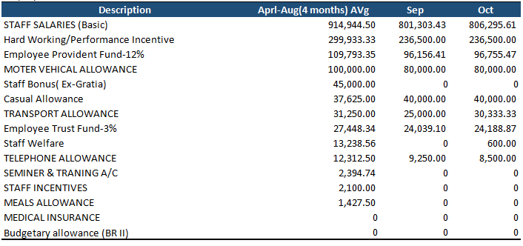
P&L - OPEX (Administration Expenses)
Employee Cost(% of AC) | Aprl-Aug(4 months) AVg | 35.8% | September | 36.0% | October | 30.0%

Slide 9
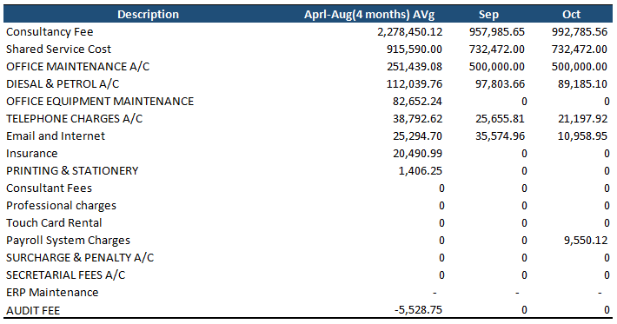
P&L - OPEX (Administration Expenses)
Other Admin Cost(% of AC) | Aprl-Aug(4 months) AVg | 64.2% | September | 64.0% | October | 70.0%

Slide 10
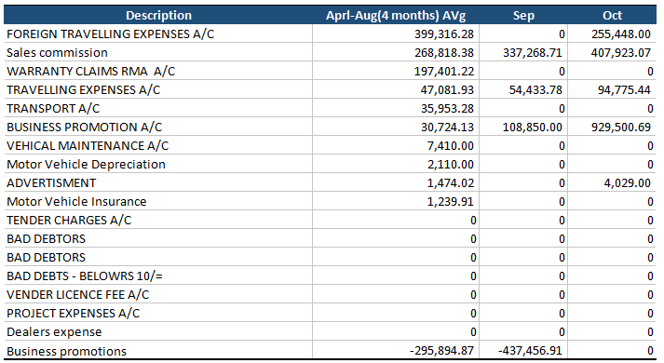
P&L - OPEX (Selling & Distribution Expenses)
Selling & Distribution Expenses(% of Revenue) | Aprl-Aug(4 months) AVg | 0.1% | September | 2.5% | October | 1.6%

Slide 11
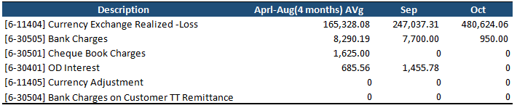
P&L - OPEX (Finance Cost)
Finance Cost (% of Revenue) | Aprl-Aug(4 months) AVg | 0.6% | September | 0.7% | October | 0.4%

Slide 12
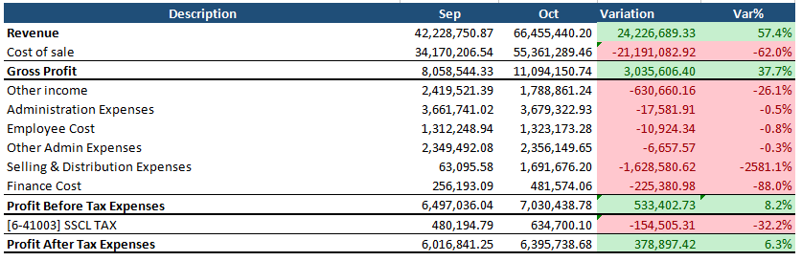
P&L - Overall Variation (Sep-Oct)

Slide 13
P&L - Summary
Description | Sep |  | Oct |  | Aprl-Aug(4 months) AVg
Revenue | 42,228,750.87 |  | 66,455,440.20 |  | 44,617,018.68
Cost of Sale(% of Revenue) | 34,170,206.54 | 80.9% | 55,361,289.46 | 83.3% | 33,973,784.78 | 76.1%
Gross Profit(% of Revenue) | 8,058,544.33 | 19.1% | 11,094,150.74 | 16.7% | 10,643,233.89 | 23.9%
Other Income(% of Revenue) | 2,419,521.39 | 5.7% | 1,788,861.24 | 2.7% | 516,693.99 | 1.2%
Administrative Expenses(% of Revenue) | 3,661,741.02 | 8.7% | 3,679,322.93 | 5.5% | 5,318,094.80 | 11.9%
% Of Administrative Expenses
Employee Cost | 1,312,248.94 | 35.8% | 1,323,173.28 | 36.0% | 1,597,467.81 | 30.0%
Other Admin Expenses | 2,349,492.08 | 64.2% | 2,356,149.65 | 64.0% | 3,720,626.99 | 70.0%
Selling & Distribution Cost(% of Revenue) | 63,095.58 | 0.1% | 1,691,676.20 | 2.5% | 695,634.27 | 1.6%
Finance Cost(% of Revenue) | 256,193.09 | 0.6% | 481,574.06 | 0.7% | 175,928.83 | 0.4%
Profit Before Tax(% of Revenue) | 6,497,036.04 | 15.4% | 7,030,438.78 | 10.6% | 4,970,269.98 | 11.1%
Tax Expenses(% of PBT) | 480,194.79 | 7.4% | 634,700.10 | 9.0% | 550,017.74 | 11.1%
Profit After Tax Expenses(% of Revenue) | 6,016,841.25 | 14.2% | 6,395,738.68 | 9.6% | 4,420,252.24 | 9.9%

Slide 14
THANK YOU!
Analysis Update -31/10/2024

