Slide 1
LDAP Basics

Slide 2
AGENDA

Slide 3
Understanding LDAP

Slide 4
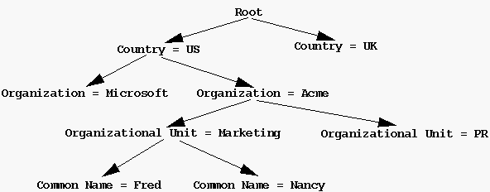
Understanding LDAP(Con..)
LDAP Structured with:
Partition
Entry
Attributes
Object Classes
Schema
DIT
DN

Slide 5
When to use LDAP?

Slide 6
LDAP Servers

Slide 7
Apache Directory Server
ApacheDS is an extensible and embeddable directory server entirely written in Java.
ApacheDS has been written in Java, which makes it easy for developers to embed in their own Java applications.
What is Apache Directory Studio?
The Eclipse based LDAP browser and directory client
Apache Directory Studio is a complete directory tooling platform intended to be used with any LDAP server however it is particularly designed for use with ApacheDS.
These plugins can even run within Eclipse itself.

Slide 8
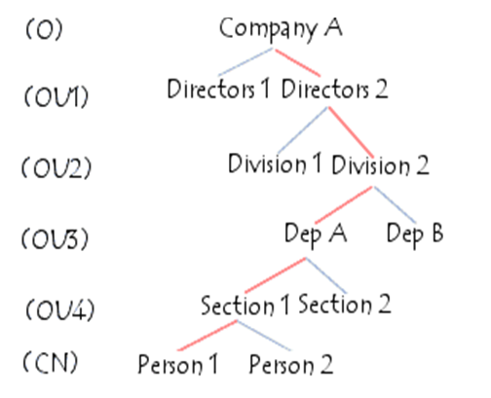
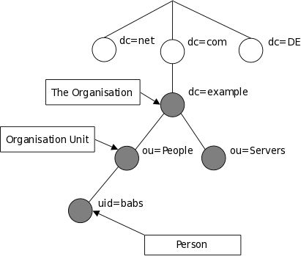
Information Structure
Presents information in the form of a hierarchical tree structure called a DIT (Directory Information Tree).

Slide 9
Information Structure (con..)

Slide 10
Information Structure (con ..)
Every entry in the directory has a distinguished name (DN).
DN is made up of attribute=value pairs, separated by commas, for example:
cn=Yokesh TTT,ou=people,dc=pdda.com,o=Honda
Some keys which are generally used:
o | Organization
ou | Organizational unit
cn | Common name
sn | Surname
givenname | First name
uid | Userid
mail | Email address

Slide 11
Information Structure (con ..)
Planista Tree (DIT).

Slide 12
LDAP Security
Simple: Authenticates fast using plain text usernames and passwords.
SSL: Authenticates with SSL encryption over the network.
SASL: Uses MD5/Kerberos mechanisms. SASL is a simple authentication and security layer-based scheme

Slide 13
LDAP Operations

Slide 14
How to use LDAP?
Can use any Java LDAP SDK, for example:
JNDI LDAP : standard .
Spring LDAP: http://www.springsource.org/ldap
(it is better to use it when using spring framework)
LDAP API: from apache
NetScape LDAP

Slide 15
Using JNDI For LDAP
Spring LDAP makes it easier to build Spring-based applications that use the Lightweight Directory Access Protocol.
Template-style and Annotation-based simplifications to LDAP programming.
Spring LDAP framework does not replace JNDI. Rather, it provides wrapper and utility classes over JNDI to simplify LDAP programming on the Java platform.
Using Spring LDAP

Slide 16
With Spring Security
userDetailsService()
authenticationProvider()
jdbcAuthentication()
ldapAuthentication()
Etc..

Slide 17

Thank You

