Slide 1
Fashion E‑Commerce Sales Analysis
Data Analyst Case Study Presentation

Slide 2
Problem Statement
Analyse 2023 fashion e‑commerce sales data
Understand sales trends across multiple platforms
Identify customer buying patterns
Provide insights to improve sales strategy for 2024

Slide 3
Dataset Overview
Dataset contains fashion product orders from multiple platforms
Platforms include Amazon, Myntra, Flipkart, Ajio, Nykaa, Meesho and others
Includes categories such as jeans, saree, kurta, sets, tops and western dresses
Contains customer demographics, order status, quantity and revenue

Slide 4
Key Dataset Columns
Customer Details: Cust ID, Gender, Age
Order Details: Order ID, Date, Status
Product Details: Category, SKU, Size, Quantity
Sales Details: Amount, Platform Channel
Location Details: City, State, Postal Code

Slide 5
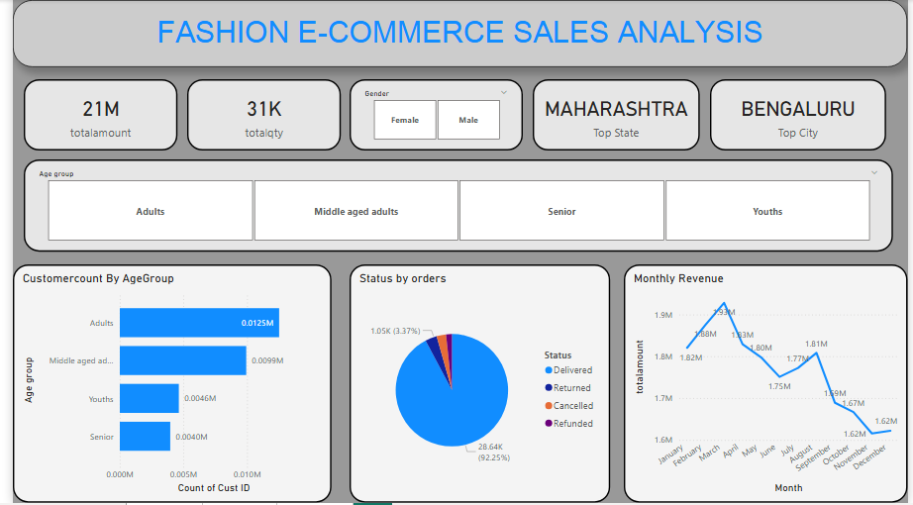
Sales Dashboard Overview

Slide 6
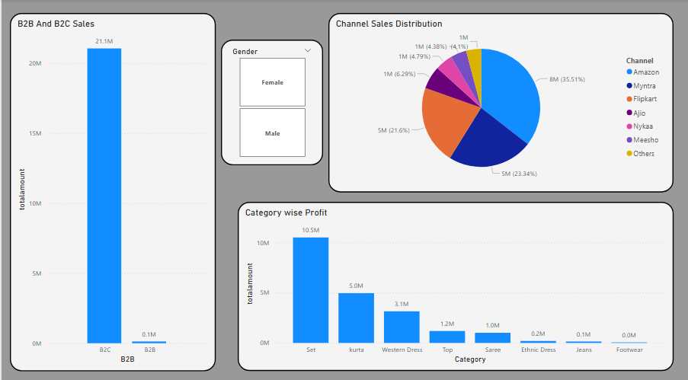
Channel & Category Analysis

Slide 7
Key Insights
Total revenue reached approximately 21M
B2C orders dominate overall sales compared to B2B
Adult and middle‑aged customers contribute most purchases
Delivered orders form the majority of order status

Slide 8
Business Insights
Amazon and Myntra contribute significant sales share
Top performing categories include Sets and Kurtas
Revenue varies across months indicating seasonal trends
Certain states and cities dominate overall sales contribution

Slide 9
Recommendations
Focus marketing campaigns on top performing platforms
Promote high demand categories such as Sets and Kurtas
Target adult and middle‑aged customer segments
Reduce return and cancellation rates through better logistics

Slide 10
Conclusion
Data analysis helps understand customer behavior and sales trends
Insights support better business decisions for 2024
Optimizing product strategy and marketing can increase revenue

