Slide 1
COVID 19 – Precautions and Venue Data Analysis of Seattle
Sathya Thiruvengadam
Jun 2020

Slide 2
Introduction
The COVID-19 Pandemic, also known as the coronavirus pandemic, is an ongoing pandemic of coronavirus disease 2019(COVID-19), caused by severe acute respiratory syndrome coronavirus 2(SARS-CoV-2). The virus that causes COVID-19 is spreading very easily and sustainably between people.
The virus is spreading between person-to-person due to close contact, tiny droplets from sneezing, coughing can spread in air and people get infected by touching the contaminated areas and touching their face.
As of today, the graph shows the consistent upward arch while in the other end thing are getting to normal called “new” normal with precautions. But still people find it difficult to get adjusted to new normal, where bringing more risk prone zones for easy contamination.

Slide 3
Problems and Interest
By analyzing the venues of high risky area(where it is highly crowded) and making a legally bonded procedures with extra precautions to handle based on the nature of the venue is an optimal way to control the contamination while we step into the stage of introducing new normal to the people. The idea behind analyzing the venues of Seattle is due to the constant increase in COVID-19 cases and a big city with large crowd, in future this model can be used in any cities for this purpose as states started slowly announcing to reverse the lock down.
Government official to consider extra measures to take precautions and monitor the process to minimize the contamination. General public knowing the high-risk prone areas to undertake extra personnel precautions or to the max avoiding the risk prone areas.

Slide 4
Data Description
Neighborhood Data :-
The data of Seattle Neighborhood is scraped from Wikipedia using BeautifulSoup- python library for web scraping.
Geocoding
Performing geocoding in python with the help of Geopy and Geopandas libraries to retrieve the geographical coordinates of an address from neighborhood data.
Venues for clustering
Using the geographical coordinates obtained, the venues are gathered using FourSquare API to perform clustering.

Slide 5
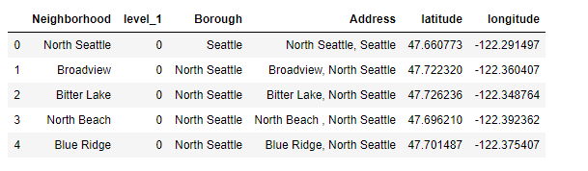
Methodology
Scraped data from Wikipedia, cleaned and used geocoder to obtain the geographical coordinates of the address listed, the data used below

Slide 6
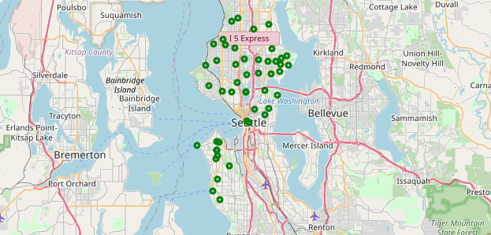
Methodology
Used python folium library to visualize geographic details of Seattle and its boroughs and I created a map of Seattle with boroughs superimposed on top.

Slide 7
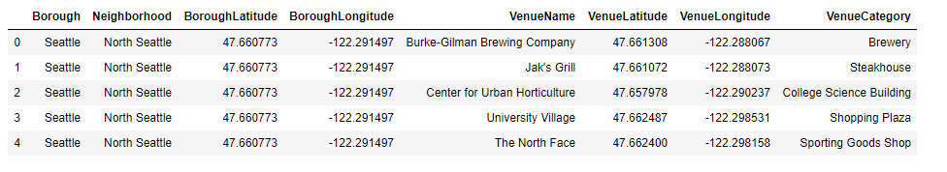
Methodology
Used the Foursquare API to explore the boroughs and segment them, set the boundaries with the radius of 1000 meters and allocated the limit as 50 venues for each borough from their geographical coordinates’ location.

Slide 8
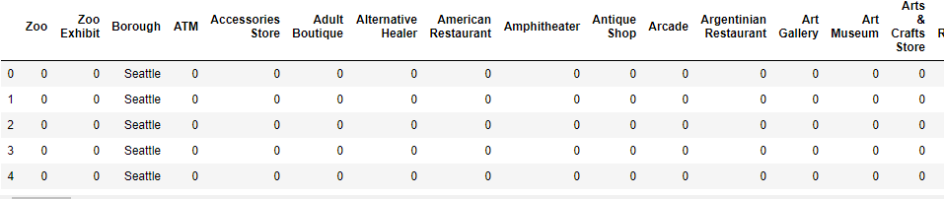
Methodology
From the detail count, it shows there are 269 unique categories listed and now each neighborhood is analyzed individually to understand the most common place tend to be crowded within 1000 meters.
The process is taken further by using “one-hot encoding” function of the python panda’s library’. One hot encoding converts the categorical variables into a form that could be help ML algorithms for better prediction accuracy.

Slide 9
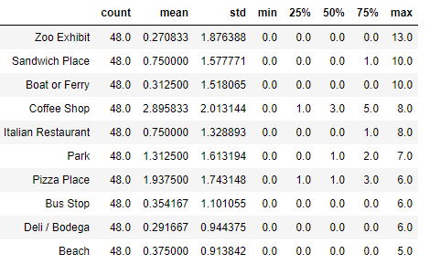
Methodology
The top 10 venue categories can be found by counting their occurrences, the top venue is listed are Zoo Exhibit, sandwich place, boat or ferry, coffee shop and Italian restaurants.

Slide 10
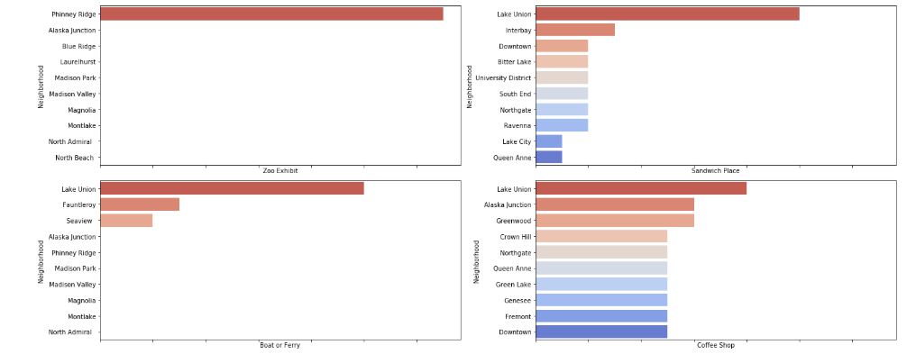
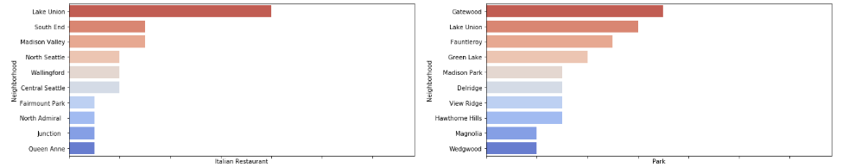
Methodology
Then the top 10 venues are plotted individually by neighborhoods using seaborn python library for easy visual reading to see possibility on where to be crowded for each neighborhood.

Slide 11
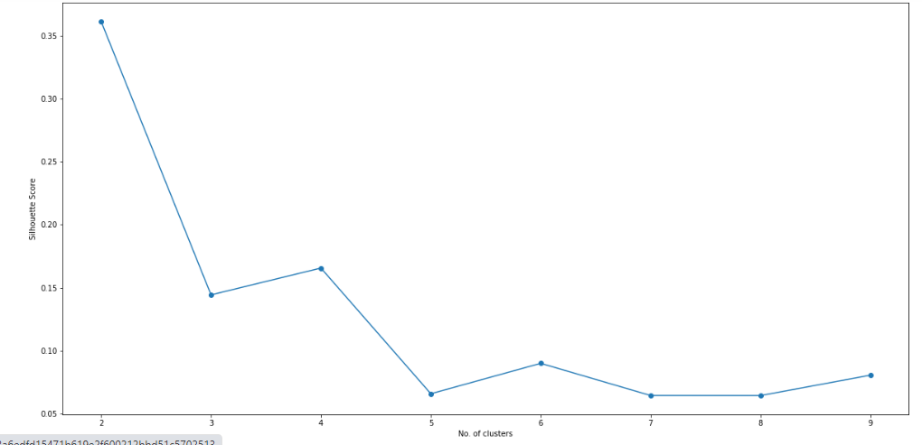
Methodology
K-Means is an unsupervised ML algorithm which creates cluster of data points based on the similarities among the data point. This algorithm will be used to count neighborhoods for each cluster for variable cluster size.
With initializing the KMeans n to 10, calculate the silhouette_score to find the optimal cluster value,

Slide 12
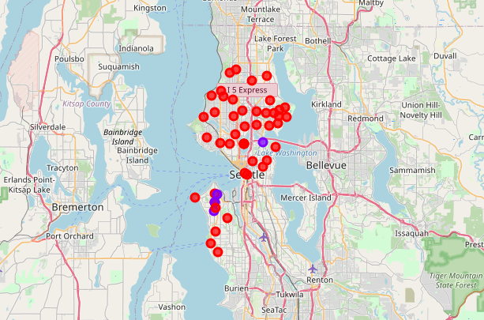
Methodology
I used folium library again to visualize the Seattle neighborhood with the cluster segmentation included on this,

Slide 13
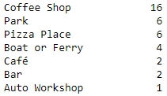
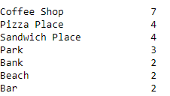
Results:
There are two clusters, Below are the cluster information on the venue that suppose to be crowded that can be monitored for extra precautions and safety,
Result from cluster analysis – 0
Most 1st common Most 2nd common

Slide 14


Results:
There are two clusters, Below are the cluster information on the venue that suppose to be crowded that can be monitored for extra precautions and safety,
Result from cluster analysis – 1
Most 1st common Most 2nd common

Slide 15
Discussions:
Performed cluster analysis with available data information and the coordinates obtain, segmented into two clusters with most common places being coffee shops, restaurants, boat ferry, park, and beach are most crowded places, Not more surprising that both cluster and the most common place look more alike.
As I mentioned in the data column, the neighborhood information did not contain postal code, assumed that each neighborhood in a borough belong to different postal code, for more detailed and accurate model, the data set can be expanded and verified by obtaining it from specific platform as most current data set.
This model can be expanded further to other states and cities, that is more for discussion in gathering more accurate data.

Slide 16
Conclusions
During this phase of time, it is crucial to act with more precautions and cautions, the graph shows the consistent upward arch while in the other end thing are getting to normal called “new” normal with precautions. But still people find it difficult to get adjusted to new normal, where bringing more risk prone zones for easy contamination.
The main goal of building this model is to obtain a most crowded places in each neighborhood/borough to set a rules based on the venue to maintain social distancing and keep away to get adjusted to new normal and is our responsibility to bend the curve of COVID-19.

Slide 17
References
https://en.wikipedia.org/wiki/List_of_neighborhoods_in_Seattle
https://developers.google.com/maps/documentation/geocoding/
https://developer.foursquare.com/
Applied data science capstone lab notebook created by the staffs.

