Slide 1

BIORIDGE PHARMA
Monthly Business
Review
August 6th 2026

Slide 2

TODAY’S DISCUSSION
Welcome and Organization Structure
Executive Summary
Performance Management Updates
Continuous Improvement Program Updates
Transportation Updates
Quality System Management Updates
Next Steps

Slide 3

ORGANIZATIONAL STRUCTURE FOR BIORIDGE
Nicole Gaudio
Vice President
Bob Anderson
Chief Financial Officer
Edwin Rodriguez
VP Trade Relations
Patrick Redmond
Logistics Operations Coordinator
Plarent Sinamati
Financial Analyst
Marlo Sanchez
Financial Analyst
Joe Collins
Small pack Lead
William Smith (Bill)
Inbound Lead
Eloisa Arciga
Order Control
Travis Cochran
Outbound Lead

Slide 4
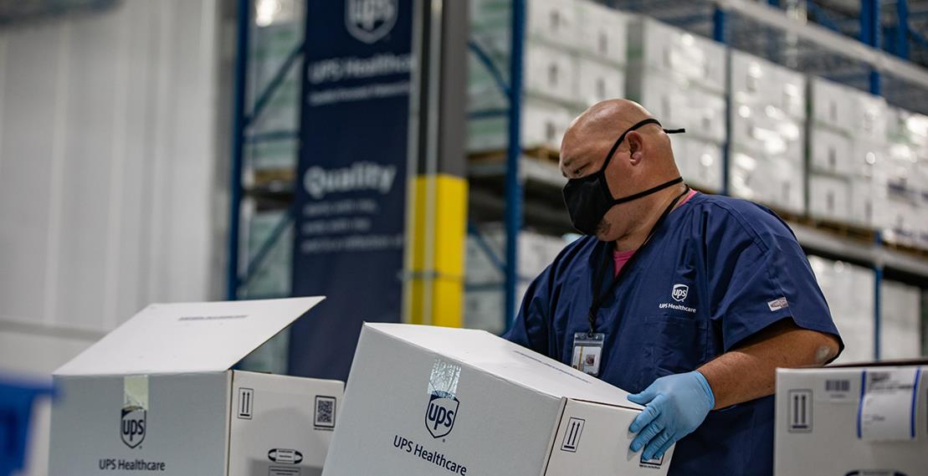

EXECUTIVE SUMMARY

Slide 5




PREVIOUS QUARTER ACHIEVEMENTS
Required slide
Example text provided
1
Transportation Amendment Signed – Reduces transportation cost
2
Successful CVS Tour
3
Transportation Management services started 1/16
4
Calgary UPS Healthcare Logistics and Distribution operations opened 1/25
5
Details
6
Details

Slide 6
[CUSTOMER NAME] PRIORITIES
Required content
Format Option 1
May include customer slides or their specific goals/challenges
  PRIORITY 1
  PRIORITY 2
  PRIORITY 3
Supporting text here
Supporting text here
Supporting text here

Slide 7

[CUSTOMER NAME] PRIORITIES
Required content
Format Option 2 – example text only
May include customer slides or their specific goals/challenges
EXPAND TO NEW MARKETS
MITIGATE RISK
ENHANCE VISIBILITY
By optimizing global supply chain to rapidly scale and adapt to increased demand
By partnering with time critical and cold chain logistics experts.
Using advanced technology platforms to provide insight across end-to-end service.

Slide 8
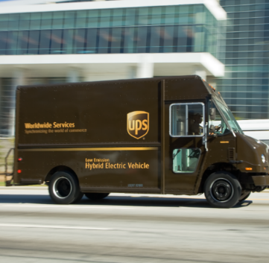

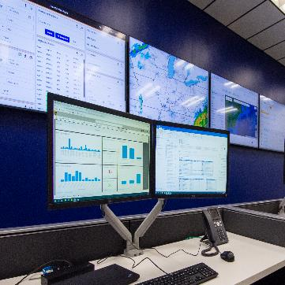
UPS HEALTHCARE™ LOGISTICS AND DISTRIBUTION PRIORITIES
Performance
Partnership
Cost
Details
Details
Details
Required content
Example Text Only
May include What’s New, Investments, Organic Growth opportunities, facility or account level priorities, etc. Link to latest QBR supplemental deck in Seismic
https://eng2e.seismic.com/i/9PrPLUSSIGNbpUo___Os1XvAIPLUSSIGN934GOLGgMC___awpoLgJoERlFGleiVJ18LmYFCV6voPLUSSIGNsJHoHXKxb1vlNTWbHHCPhrgvFb8BNMeDzqHUPuAu___2ZcgwQJMEQUALSIGN

Slide 9
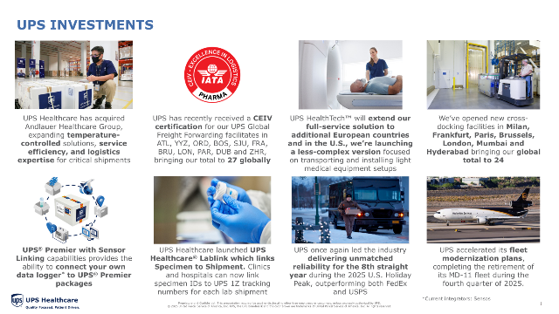
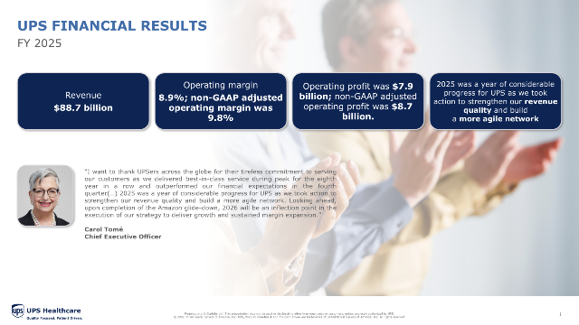
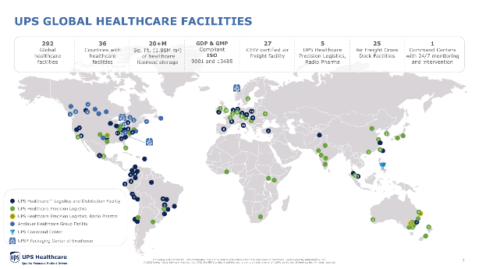
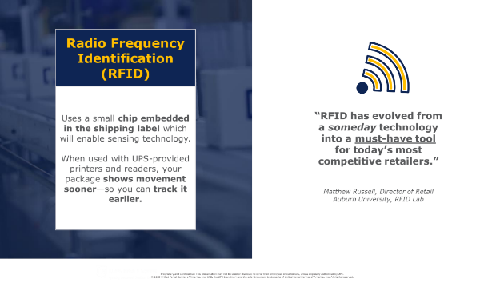
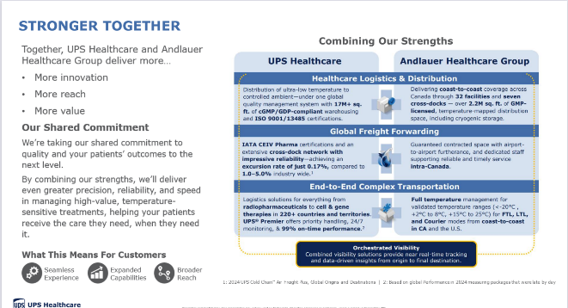
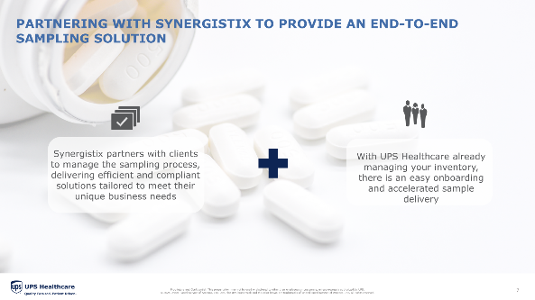
Additional slides available to use
Hyperlinks included
Should be relevant to your customer

Slide 10
ACTION ITEM TRACKER
Required content
EXAMPLE
Facility name or location
Project | Owner | Next Steps | Comment | Status
CAPA resolutions | Amy Carney | Meet with vendor
SLA review in support of 2-day | Craig Chisum | Lane analysis

Slide 11
VOICE OF THE CUSTOMER
Supporting information, charts, or graphs can go on this side.
Are there any specific quotes or callouts from the customer that we can use here?
~Customer Name, Title

Slide 12
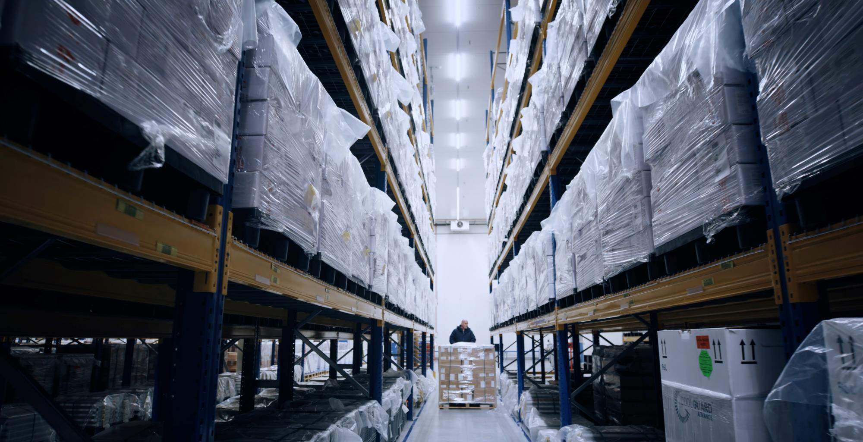
PERFORMANCE MANAGEMENT UPDATES

Slide 13
KEY PERFORMANCE INDICATOR (KPI) DASHBOARD
1860 KYVLE
Key Performance Indicators | 1st Quarter 2026 |  |  | 2nd Quarter 2026
 | Delivered | Committed | YTD | Delivered | Committed | YTD
On Time Receiving | 99% | 99.50% | 97% | 92% | 99.50% | 90%
Client Order Accuracy | 100% | 99.50% | 100% | 100% | 99.50% | 100%
On Time Shipping | 95% | 99.50% | 96.00% | 92% | 99.50% | 92%
Inventory Cycle Count | 91.75% | 99.80% | 91.88% | 94.90% | 99.80% | 94.89%
Operation highlights | 1st Quarter 2026 | 2nd Quarter 2026
Receiving
ASN's Received | 665 | 626
Lines Received | 7,137 | 7,541
Units Received | 35,082,033 | 37,588,094
Outbound
Orders Shipped | 39,045 | 40,536
Lines Shipped | 65,681 | 67,493
Outbound Units | 36,128,570 | 34,560,686
Inventory
Absolute Unit Accuracy CC | 91.75% | 94.90%
Absolute Adjusted | 4,561 | 17,819
Units Counted | 11,045,198 | 19,619,738

Slide 14

INBOUND SUMMARY
KPI summary required
EXAMPLE
Facility name or location
Q1 INSIGHTS
What changed
Why
Missed KPIs
  RCA
  CAPA
What’s next

Slide 15
OUTBOUND SUMMARY
KPI summary required
EXAMPLE
Facility name or location
Q1 INSIGHTS
Q1 INSIGHTS
What changed
Why
Missed KPIs
  RCA
  CAPA
What’s next

Slide 16
INVENTORY ACCURACY
KPI summary required
EXAMPLE
Facility name or location
Q1 INSIGHTS
Q1 INSIGHTS
What changed
Why
Missed KPIs
  RCA
  CAPA
What’s next

Slide 17
CUSTOMER FORECAST ACCURACY
Required content,
Customer provided historical or UPS plan
EXAMPLE
Facility name or location
Q1 INSIGHTS
Q1 INSIGHTS
What changed
Why
Missed KPIs
  RCA
  CAPA
What’s next

Slide 18
SPACE UTILIZATION
Can be a total, by storage condition or facility, etc. EXAMPLE
Facility name or location
Q1 INSIGHTS
Q1 INSIGHTS
What changed
Why
Missed KPIs
  RCA
  CAPA
What’s next

Slide 19
SPEND SUMMARY
Can be by quarter, business unit or facility, etc. EXAMPLE
Facility name or location
Q1 INSIGHTS
Q1 INSIGHTS
What changed
Why
Missed KPIs
  RCA
  CAPA
What’s next

Slide 20
ACCOUNTS RECEIVABLE UPDATES
Optional
EXAMPLE
Facility name or location
Q1 INSIGHTS
Q1 INSIGHTS
What changed
Why
Missed KPIs
  RCA
  CAPA
What’s next

Slide 21
MASTER DATA MANAGEMENT KPI’S AND UPDATES
Required content

Slide 22
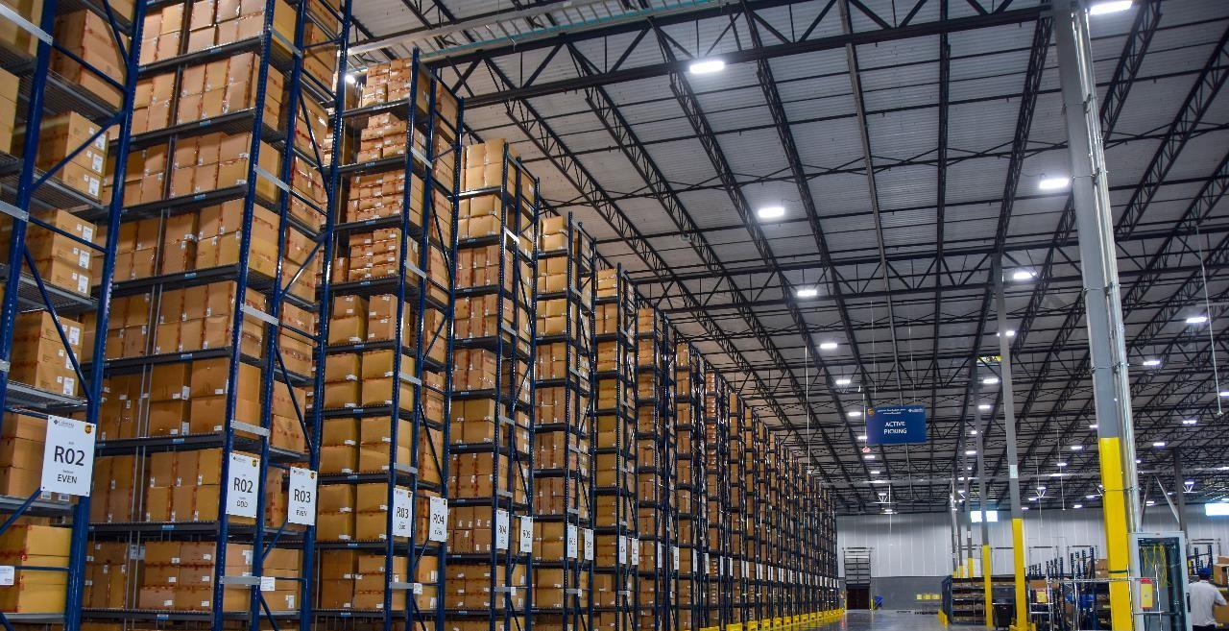
CONTINUOUS IMPROVEMENT PROGRAM UPDATES

Slide 23
GEMBA WALK SUMMARY
Required content
EXAMPLE
UPS Healthcare™ Logistics and Distribution conducts Gemba Walks to identify areas of improvement in efficiency, quality, and safety. Below is an example of items identified during Gemba Walks.
Area | Observation
General | Excess pallet repurposing – listed on the CI slide 72” pallet utilization – listed on the CI slide Productivity dashboard IE is working on dashboards to be displayed in the operation to show employee productivity, order/line count/order status
Rack Location Consolidation | Consolidation of rack locations that contain the same SKU/Batch combination so bins are not under-utilized
Small Package Floor Layout Change | Improved workflow efficiency Increased throughput Better space utilization Improved safety
Account 5s Methodology | Increased efficiency and productivity Improved organization Better safety Higher quality and fewer mistakes Better use of space

Slide 24
CONTINUOUS IMPROVEMENT ACTIVITY TRACKER
Required content
EXAMPLE
CIP Activity | Category | Status | Annual Estimated Value | Comments
SP Payment Processing Fee | Optimization |  | $2,504.20 | Effective May 2025, Vertex no longer receives 2% payment processing fee from SP
 |  |  | $2,504.20

Slide 25

QUALITY MANAGEMENT SYSTEM UPDATES

Slide 26
QUALITY ORGANIZATIONAL STRUCTURE FOR [CLIENT NAME]
Example
Timothy Bishop
Director
UPS Healthcare - Louisville, KY
Karen York
Senior Manager
UPS Healthcare - Louisville, KY
Mary Barnett
Supervisor
UPS Healthcare
Chelsie Draughon
Specialist
UPS Healthcare
Tamara Plaisance
Specialist
UPS Healthcare

Slide 27
NON-CONFORMANCE REVIEW
Required content
EXAMPLE 1
Facility name or location
Total NC Initiated 2025 | Total CAPA’s Assigned | Total CAPAS Closed to Date | Percent Complete
2 | In progress | In progress | N/A
NC-111-00071 (Critical): Missing 6 Units of Nonsaleable Product
  Investigation is still in progress
NC-111-00070 (Major): Hold Order Physically Shipped, but not systematically processed
  Investigation in still in Progress

Slide 28
NON-CONFORMANCE TRACKER
Required content
EXAMPLE 2
Facility name or location
Period | NC# | Event | Due Date | Status
Q1 2025 | 111-00071 | Missing 6 Units of Nonsaleable Product | 4/10/2025 | Complete

Slide 29

NEXT STEPS

Slide 30

NEXT STEPS
Step 1 description here | Date (Optional)
Step 2 description here | Date (Optional)
Step 3 description here | Date (Optional)
Step 4 description here | Date (Optional)

Slide 31


MOVING OUR WORLD FORWARD BY DELIVERING WHAT MATTERS™
Proprietary and Confidential: This presentation may not be used or disclosed to other than employees or customers, unless expressly authorized by UPS.
© 2026 United Parcel Service of America, Inc. UPS, the UPS brandmark and the color brown are trademarks of United Parcel Service of America, Inc. All rights reserved.

Slide 32
OPTIONAL SLIDES

Slide 33
KPI SCORECARD QUARTERLY SUMMARY
Facility name or location
Quarterly | On-Time Receiving | On-Time Shipping | Inventory Accuracy | Shipment Accuracy | Comments
Target | 99.00% | 98.00% | 99.50% | 99.50%
Q1 | 100% | 100% | 100% | 100%
Q2
Q3
Q4

Slide 34
KPI SCORECARD QUARTERLY SUMMARY
Facility name or location
KPI | Target | Q1 | Q2 | Q3 | Q4 | Comments
On-Time Receiving | 99.00% | 100%
On-Time Shipping | 99.00% | 100%
Inventory Accuracy | 98.00% | 100%
Shipment Accuracy | 99.50% | 100%
Client Specific | 100% | 100%

Slide 35
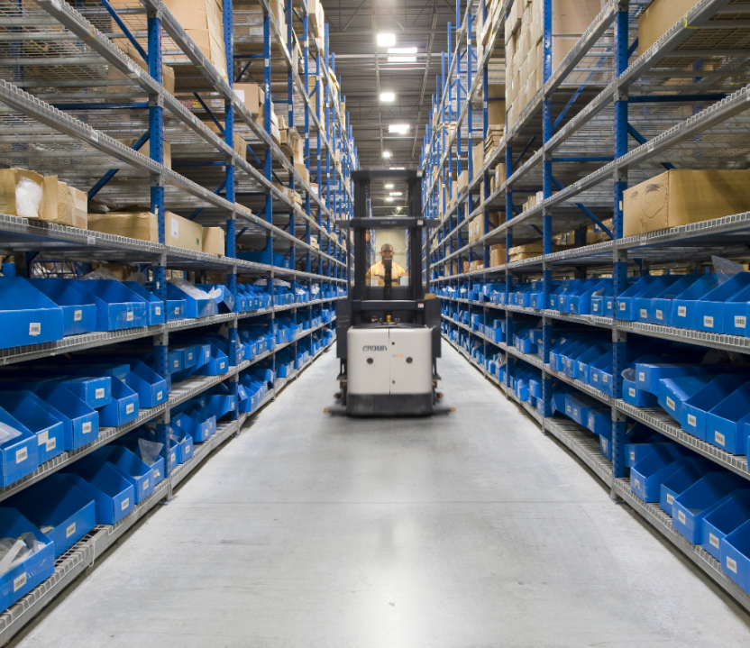

Example only –
How to summarize performance
Must be updated
PERFORMANCE SUMMARY
Facility name or location
Ship to Delivery
1.07 Avg Business Days¹*
Annual On-Time Delivery
98.7% Controllable¹
CUSTOMER NAME
Customer specific info
# of Units Distributed
3.8 Billion/Year¹
1K+ Regulatory Audits/Year
ZERO Critical Findings¹
ISO Accredited
100% of distribution facilities are ISO 9001 and 13485¹
¹Internal KPIs
*TL only, excludes LTL

Slide 36
VALUE-CENTRIC APPROACH FOR [CUSTOMER NAME]
EXAMPLE –
Formulas in Notes
KPI compliance delivers cost avoidance for [Customer Name]
Operational KPI Targets | Industry Average* | 2025 UPS Healthcare Results & Impact (based on actual [Customer Name] 2025 volumes)
On-Time Receiving Target: 99.5% | 97% | UPS Healthcare Result 100% Annual Impact $1.6K
On-Time and Complete Shipping Target: 99.5% | 95% | UPS Healthcare Result 99.63% Annual Impact $128K
Returns Processed On-Time Target: 99.5% | 92% | UPS Healthcare Result 99.59% Annual Impact $1.5K
Shipment Accuracy (WH) Target: 99.5% | 97% | UPS Healthcare Result 97.73% Annual Impact $142K
Inventory Accuracy Target: 99.8% | 98% | UPS Healthcare Result 99.2% Annual Impact $16K
Shipment Accuracy (Delivered Non-Damaged Shipments): 98.5% | 97% | 2025 Result N/A
KPI Compliance Total Annual Impact = $289K
1
2
3
4
5
6
*Source: Warehousing Education and Research Center
Notes:
Impact=Volume×(Target−Industry)×Cost per Failure\text{Impact}
Example - On-Time Receiving
Formula – Customer Volume (2153 receipts) x target (99.5% UPS) – industry (97% Avg) x cost per failure ($30 avg as defined by Copilot) = $impact
[Customer] actual YTD 2025 - 2153 x 2.5% (UPS vs industry gap) x $30 = $1615
On-Time Receiving cost per failure - $30 is defined as $10 rehandling fee + $15 inventory delay/stockout fee + $5 administrative/re-scheduling fee
Shipment Accuracy cost per failure - $45
On-Time Shipping cost per failure - $18
Inventory Accuracy cost per failure - $20
Returns On-Time cost per failure - $12
Frame it as: “Running at industry average vs our SLA would cost about $XXX annually in operational and customer-experience losses.”

Slide 37
FINANCIAL VALUE
Facility name or location
Q1 INSIGHTS
Q1 INSIGHTS
Q1 INSIGHTS
What changed
Why
Missed KPIs
  RCA
  CAPA
What’s next
What changed
Why
Missed KPIs
  RCA
  CAPA
What’s next
What changed
Why
Missed KPIs
  RCA
  CAPA
What’s next

Slide 38
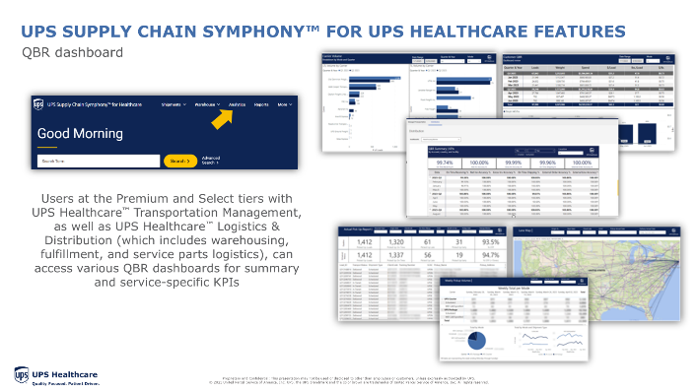
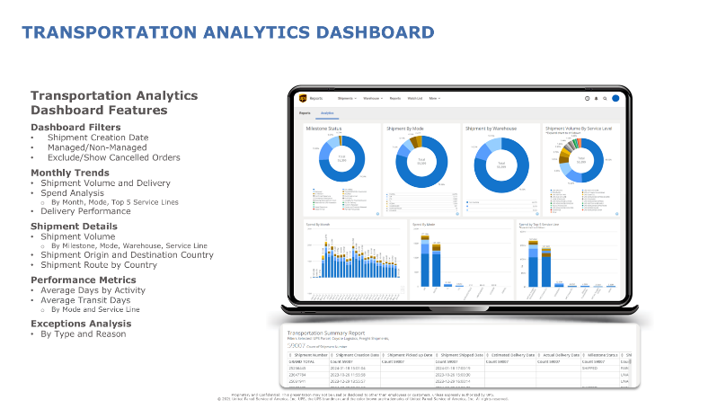
COST / DATA / TREND ANALYSIS
Facility name or location
Q1 INSIGHTS
Q1 INSIGHTS
Some text
Some text
Examples –
UPS Supply Chain Symphony for UPS Healthcare

Slide 39
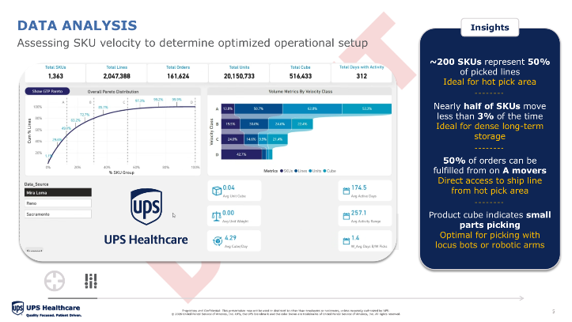
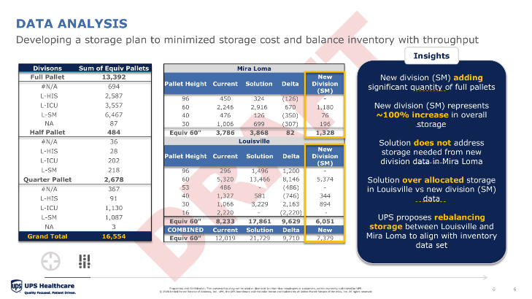
COST / DATA / TREND ANALYSIS
Facility name or location
Q1 INSIGHTS
Q1 INSIGHTS
Some text
Some text
Examples

Slide 40
FORWARD LOOKING ROADMAP
Example items for discussion
Some text
Future priorities
Some text
Some text
Some text
Project roadmap
Some text
Some text
Some text
Continuous improvement
Some text
Some text
Some text
GEMBA updates
Some text
Some text
Some text
Optional
Some text
Some text
Some test

Slide 41
TECHNOLOGY AND DIGITAL ENABLEMENT
Some text
Ideas:
Serialization
RFID
Warehouse automation

Slide 42
FORMATTING HELP

Slide 43
GUARDRAILS
Do not import any slides that are not in the current HC brand guidelines. Please insert a new slide within the existing presentation and copy only the content over
Product slide verbiage cannot be changed, header can be customized but must remain one line
Newly created product slides need to be approved by SME, product owners, or Seismic
All claims must be sourced
Per legal, we cannot use customer logos or personal data without written consent
Translation services are not available, content other than English cannot be included.
Updates need to be provided latest 48H before deadline, if the meeting/call is postponed sales needs to inform PF asap with new date (so PF can reschedule priorities)
Sales to provide PF with the final deck and indicate their changes within two business days after the meeting
43

Slide 44
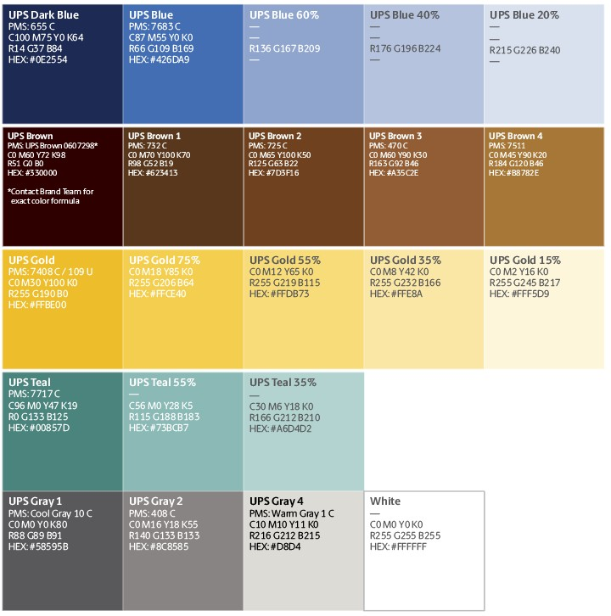
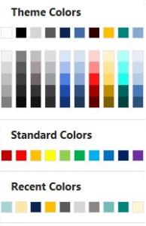

BRAND APPROVED COLORS
Sub-headline
Primary
  The default slide background is white
  Normal text is dark brown tone; UPS Blue is the default color, for emphasis and bullets but other theme colors can be used as needed
  Title and subtitle text is UPS dark brown tone
  Only use the colors set within this template
✓
Secondary
✗

Slide 45
TITLE IS 22 PT VERDANA BOLD UPPERCASE
Sub-headline text is 18 pt Verdana
Title
Choose the Title and Content layout page from the New Slide menu
First level of text is 18 pt Verdana, gray 1, but may be set to other theme color if it functions as a title
  Use the “promote and demote” buttons to adjust bullet level
  Do not use the bullet button to turn bullets on or off
    Spacing and alignment are preset within the template
  If text does not fit, reduce line and paragraph spacing
    If necessary, reduce font size down to 12 pt for normal text slides or 12 pt for 2-column slides

Slide 46
VISUALIZE YOUR DATA IN AN EASY TO READ MANNER
60%
supporting copy
51%
supporting copy
44%
supporting copy
40%
supporting copy

Slide 47
VISUALIZE YOUR DATA IN AN EASY TO READ MANNER
Sub-headline
44%
supporting copy
You can use monochromatic secondary colors for graphs, charts and tables for a more impactful look
44%
supporting copy
Source: UPS Pulse of the Online Shopper™ 2016 survey.
For the fifth year, UPS developed this study with comScore, Inc. Input was collected from 5,330 qualified comScore panelists in January and February, 2016. Shoppers had to have made at least two online purchases in a typical three-month period. To get the full white paper, go to ups.com/insideretail.

Slide 48
SAMPLE TABLES CREATED USING THE TABLE FUNCTION
Consolidated | Amount | %
Specified Committed | 12,520 | 39.8%
Specified Uncommitted | 10,325 | 37.8%
Unspecified Uncommitted | 1,262 | 5.4%
Total Revenue | 23,366 | 100.0%
New York | Amount | %
Specified Committed | 12,520 | 39.8%
Specified Uncommitted | 10,325 | 37.8%
Unspecified Uncommitted | 1,262 | 5.4%
Total Revenue | 23,366 | 100.0%
London | Amount | %
Specified Committed | 12,520 | 39.8%
Specified Uncommitted | 10,325 | 37.8%
Unspecified Uncommitted | 1,262 | 5.4%
Total Revenue | 23,366 | 100.0%
Mexico | Amount | %
Specified Committed | 12,520 | 39.8%
Specified Uncommitted | 10,325 | 37.8%
Unspecified Uncommitted | 1,262 | 5.4%
Total Revenue | 23,366 | 100.0%

Slide 49
SAMPLE TABLES CREATED USING THE TABLE FUNCTION
Row titles | Header 1 | Header 2 | Header 3 | Header 4 | Header 5 | Header 6 | Header 7
Row 1 | ✓ | ✓ | ✓ | ✓ | ✓ | ✓ | ✓
Row 2 | ✓ |  | ✓
Row 3 |  |  |  | ✓ | ✓ | ✓ | ✓
Row 4
Row 5 |  | ✓ |  | ✓ | ✓ | ✓ | ✓
Row 6 |  | ✓ | ✓ | ✓
Row 7 |  |  | ✓
Row 8 |  |  |  | ✓

Slide 50
SAMPLE TABLES CREATED USING THE TABLE FUNCTION
 | Headers are bottom aligned | Header 2 | Header 3 | Header 4
Row title | Text | Text Text Text | Text Text
Row title | Some text | Text Text | Highlight specific cells by filling with lt. green
Row title | More text which can wrap onto two or more lines | Text Text | Text

Slide 51
PROCESS FLOW COMPARISON WITH COLOR SCHEMES
    The preferred color for a process flow is UPS Gray 4, which allows you to highlight a segment with a secondary color.
    If it is necessary to use more color in the flow, follow this particular segment
Titles in segments
are initial cap
and left aligned
Header
Header
Header
Titles in segments
are initial cap
and left aligned
Header
Header
Header

Slide 52
CHART SAMPLES

Slide 53
SAMPLE GRAPHS

Slide 55
ICONS 1 – 60

Slide 56
ICONS 61 – 120

Slide 57
ICONS 121 – 183

Slide 58
HARVEY BALL ICONS

Slide 59










NEW ICONS
OUTCOMES
HOW WE WORK
EFFICIENCY

Slide 60


NEW ICONS

