Slide 1

NATIONAL ENGINEERING COLLEGE,
K.R.NAGAR, KOVILPATTI - 628 503
23CS1ME - Mini Capstone Project
Healthcare Data Analytics System
PROJECT COORDINATOR:
Ms.P.Priyadharshini, Assistant Prof/CSE
SUBMITTED BY:
SATHISH B - 2312099
DATE: 13-04-2026

Slide 2
AGENDA
Problem Statement & Project Motivation
System Architecture & Workflow Diagram
Database / Model / Pipeline Design
Algorithm / Model Selection Justification
Model Prototype Demonstration

Slide 3
PROBLEM STATEMENT
In healthcare systems, large amounts of symptom and disease data are generated from patient records, but this data is often not effectively analyzed to support clinical understanding and decision-making.
Manual analysis of symptom–disease relationships is time-consuming and prone to oversight, making it difficult to identify common disease patterns and trends. Using the Healthcare Symptoms–Disease Classification dataset, the problem is to design a Healthcare Data Analytics System that organizes, analyzes, and visualizes symptom and disease data to extract meaningful insights.
The system aims to help healthcare stakeholders better understand disease occurrences, symptom associations, and overall health trends, thereby supporting informed and data-driven healthcare decisions.

Slide 4
System Architecture and WorkFlow Diagram
System Architecture
Modular design integrating UI, backend processing, and machine learning components
Ensures smooth data flow from user input to prediction output
User Interface (Frontend)
Collects patient details such as age, gender, and symptoms
Displays disease prediction with High, Medium, and Low risk levels
Application Layer (Backend)
Receives and validates input from the frontend
Coordinates preprocessing and model prediction

Slide 5
Data Preprocessing
Cleans and standardizes symptom text data
Prepares input features for machine learning
Feature Engineering
Converts text symptoms into numerical vectors
Combines age, gender, and age group with symptom features
Machine Learning Model
Uses Naive Bayes classifier for disease prediction
Calculates probability scores for each disease
Result Processing
Ranks diseases based on prediction probabilities
Normalizes top three results into High, Medium, and Low risk

Slide 6
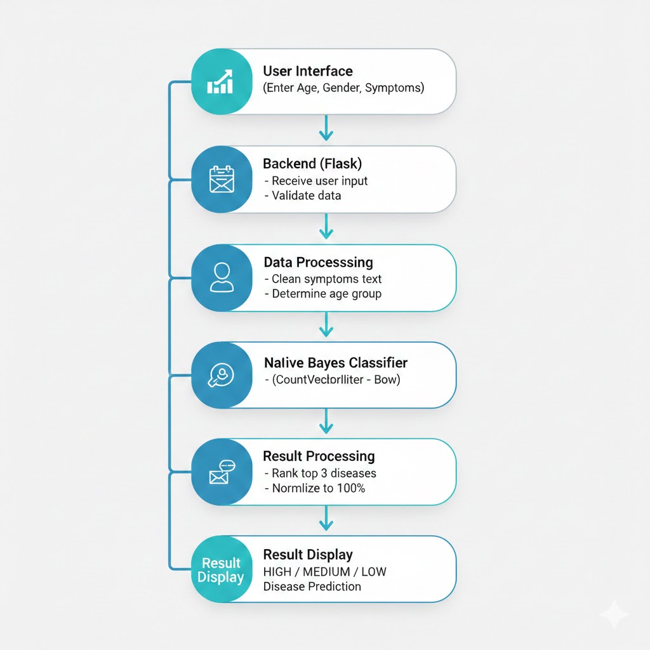
Flow Diagram

Slide 7
Algorithm - Naive Bayes Classifier
Naive Bayes is a probabilistic machine learning algorithm based on Bayes’ Theorem.
It predicts the most likely disease by calculating the probability of each disease given the observed symptoms and patient information.
Working Principle
Assumes that symptoms are conditionally independent of each other given the disease.
Computes disease probabilities using frequency of symptoms from the training dataset.
Justification Works well with text data such as medical symptoms represented using bag-of-words. Requires less computational power and provides quick predictions, suitable for real-time healthcare systems.

Slide 8
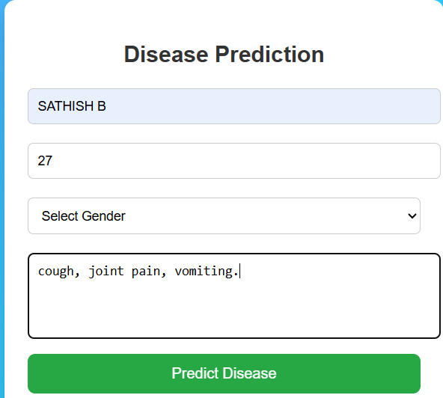
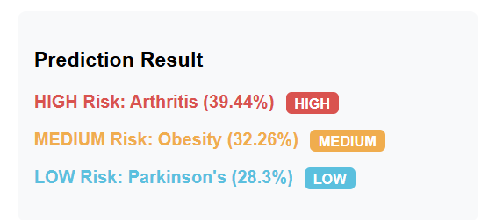
Output:

Slide 9
Project Plan and Milestones:
Phase 1: Requirement Analysis & Dataset Collection – Studied healthcare problem, collected symptoms–disease dataset, and finalized project scope.
Phase 2: Data Preprocessing & Feature Engineering – Cleaned symptom text, handled age and gender data, and prepared features for ML model.
Phase 3: Machine Learning Model Development – Implemented Naive Bayes algorithm and generated disease predictions with probabilities.
Phase 4: System Integration & UI Development – Integrated ML model with backend and developed a web-based user interface for input and output.
Phase 5: Testing, Evaluation & Finalization – Tested system accuracy, refined outputs (High/Medium/Low), and prepared documentation and presentation.

Slide 10
THANK YOU

