Slide 1

Material Balance Simulator
Presented by
Brindaa (24MT0111)
Shobhita (24MT0165)
Sathish (24MT0398)
Project Guide
Prof. Neetish Kumar Maurya

Slide 2
Objective
Develop a Material Balance Simulator
Analyze Fluid Properties
Estimate initial hydrocarbons in place (OOIP & OGIP)
Evaluate Drive Mechanisms
Estimate reservoir pressure for future prediction.
Predict reservoir performance & production forecasting
Making Web Interface for the Simulator

Slide 3
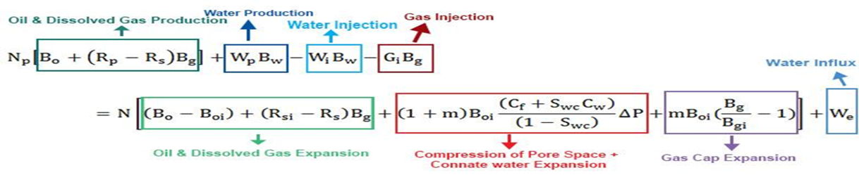

MBE Equation
Oil Reservoir MBE
Gas Reservoir MBE

Slide 4
Recap And Update
Previous Work
Developed a material balance simulator for solution gas drive in oil reservoirs.
Estimated key reservoir parameters via fluid properties and material balance calculations.
New Enhancements
Extended the simulator to handle combination drive.
Incorporated analysis for gas reservoirs with and without water influx.
Developed a web interface for interactive simulation and visualization.

Slide 5
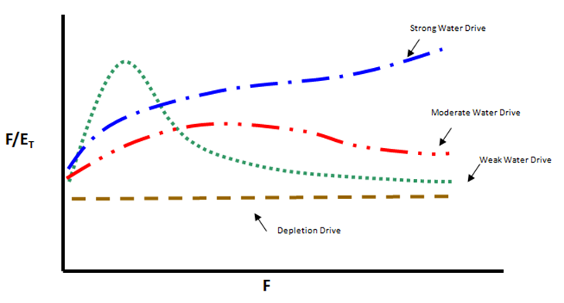
Campbell Plot

Slide 6
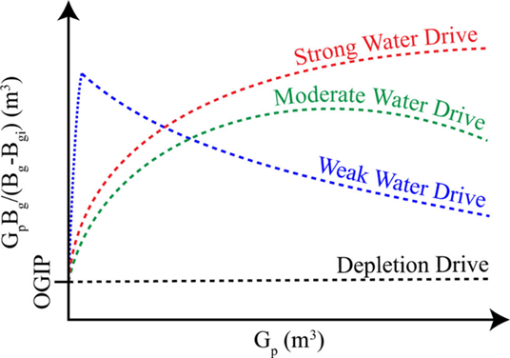
Cole Plot

Slide 7
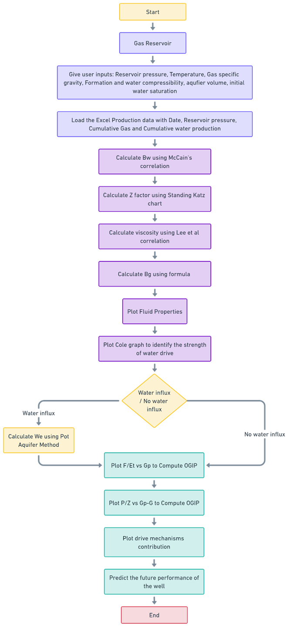
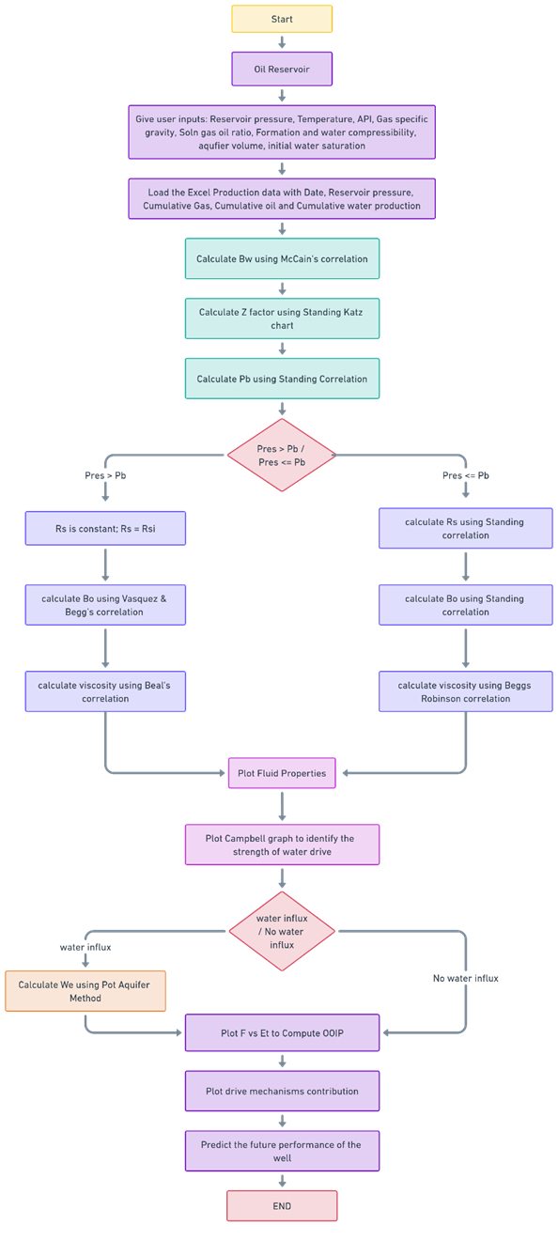
Algorithms

Slide 8
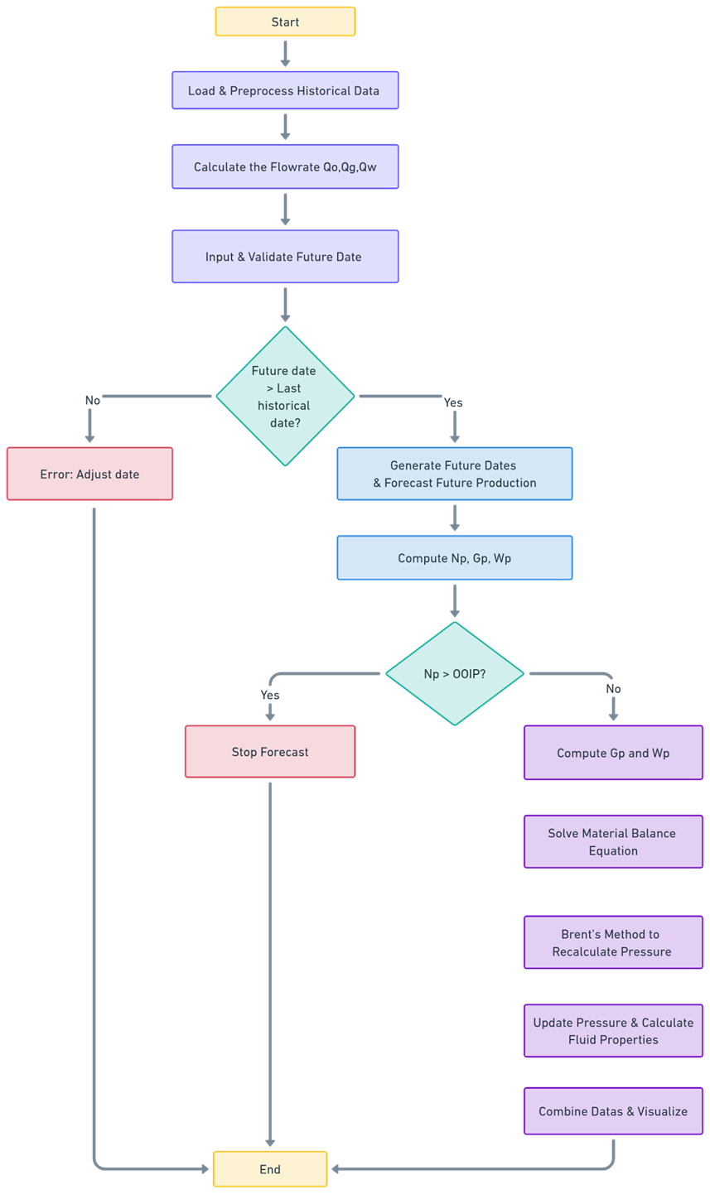
Future Prediction

Slide 9
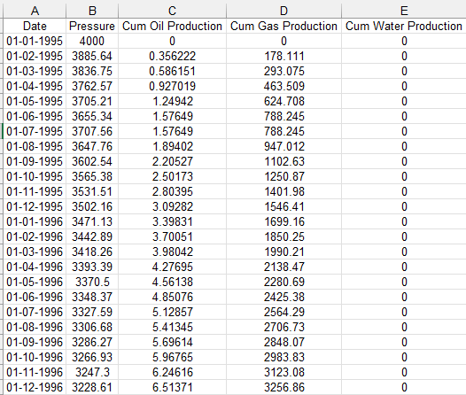
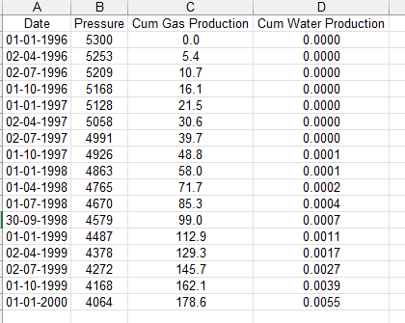
Dataset ( Open Source)
Oil Reservoir Dataset
Gas Reservoir Dataset

Slide 10
Web Interface
The excel file should a column name as similar as
Date
Pressure
Cum Oil Production
Cum Gas Production
Cum Water Production
Here the oil production unit is in MMSTB, Gas Production Unit is in MMSCF and water Production unit is in MMSTB.
Web Interface Link- App Link

Slide 11
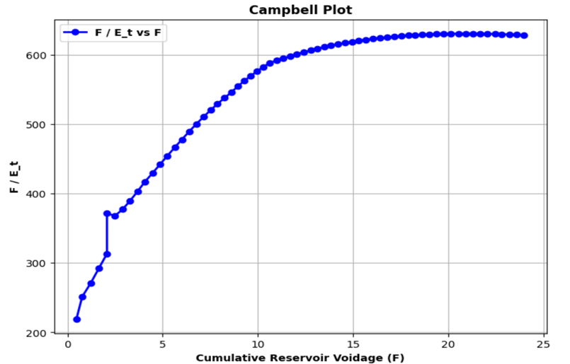
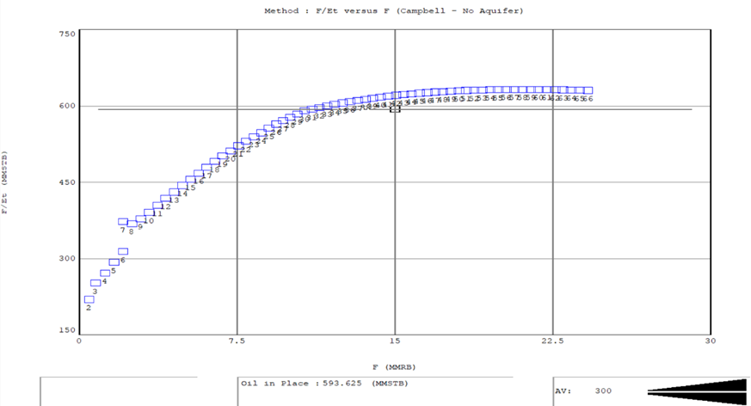
Campbell Plot Validation
Fig - Oil Reservoir

Slide 12
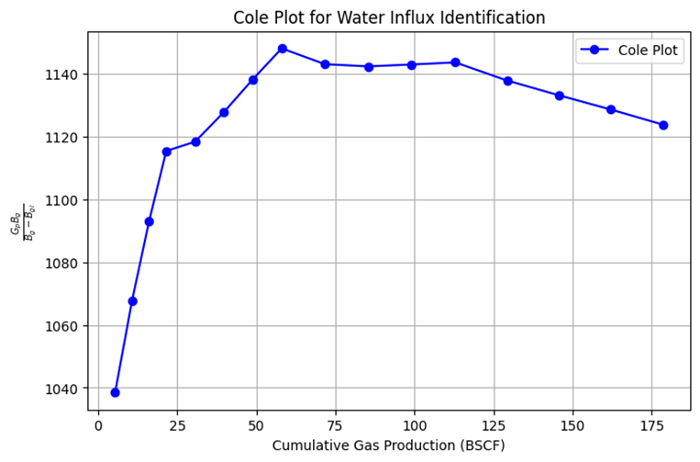
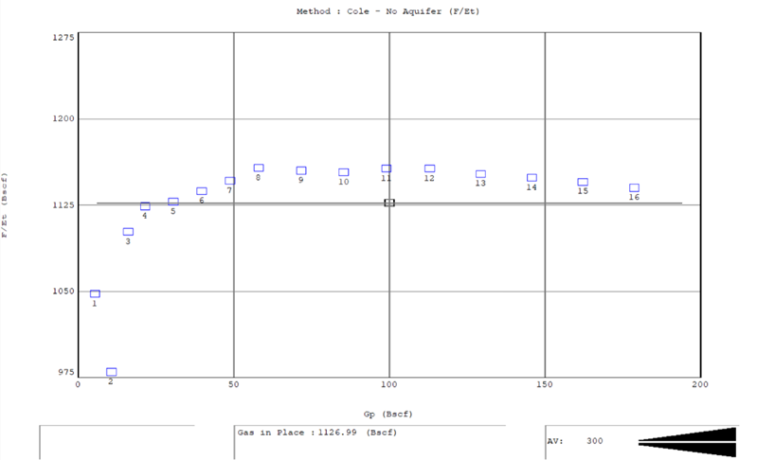
Cole Plot Validation
Fig - Gas Reservoir

Slide 13
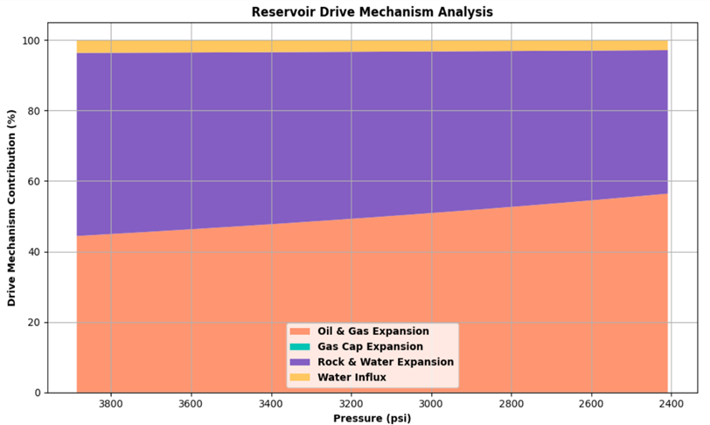
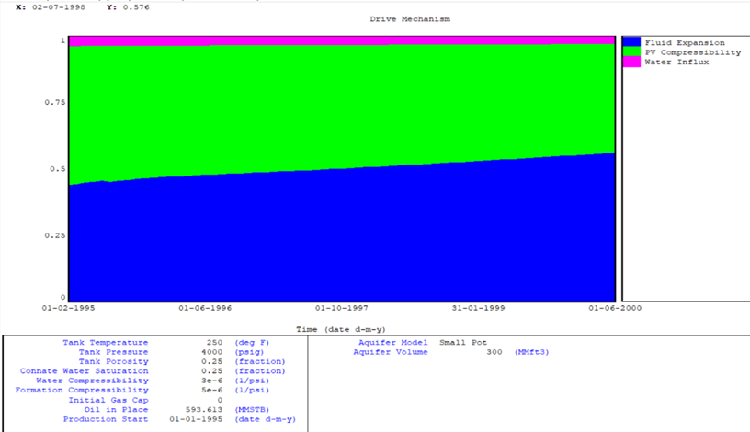
Energy Plot Validation
Fig - Oil Reservoir

Slide 14
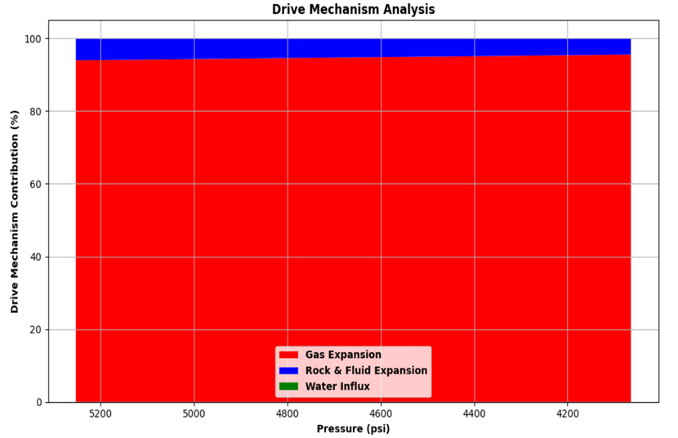
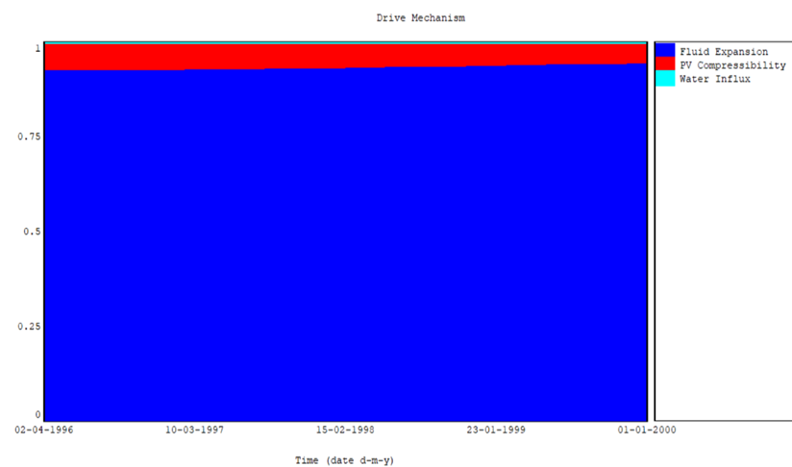
Energy Plot Validation
Fig - Gas Reservoir

Slide 15
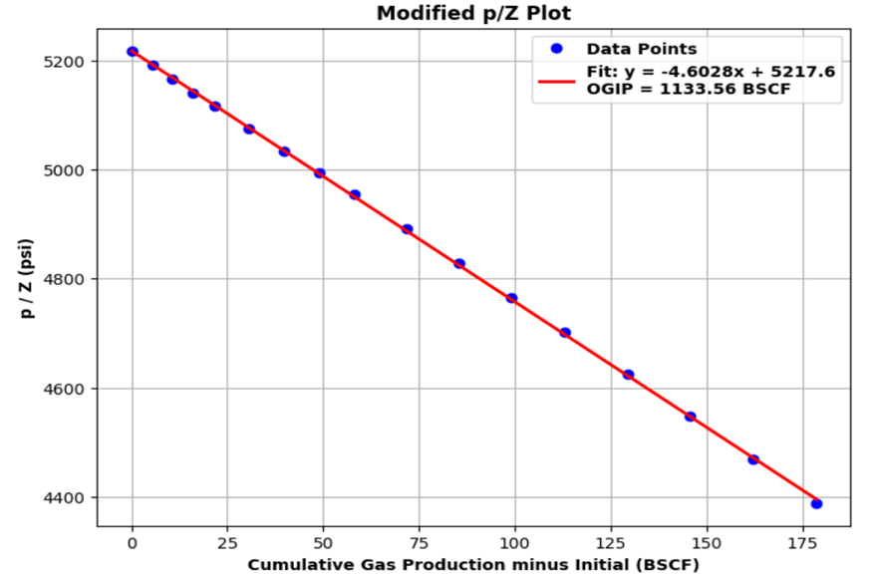
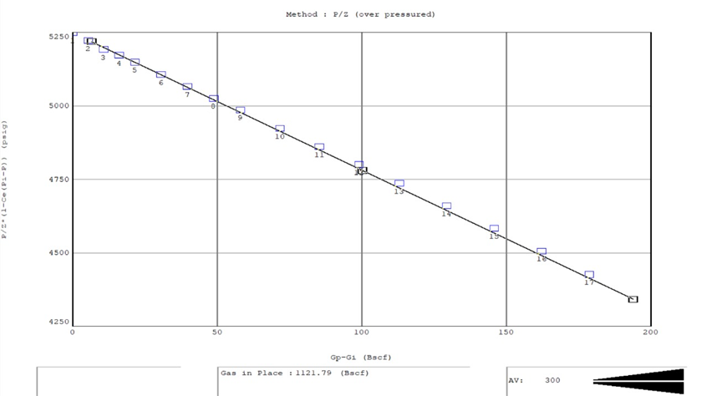
Validation (Modified P/Z Plot)
Fig - P/Z Vs Gp-Gi

Slide 16
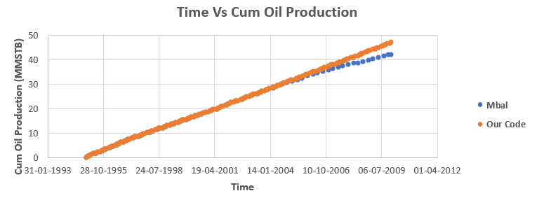
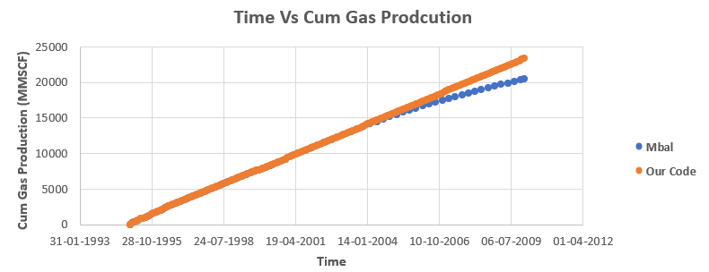
Validation (Oil Reservoir )

Slide 17
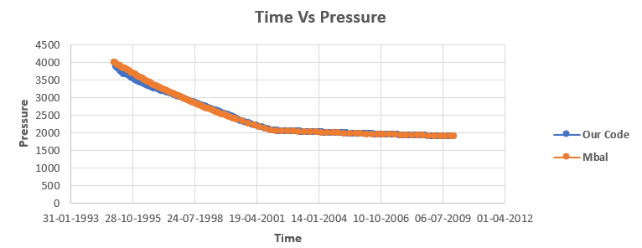
Validation (Oil Reservoir)

Slide 18
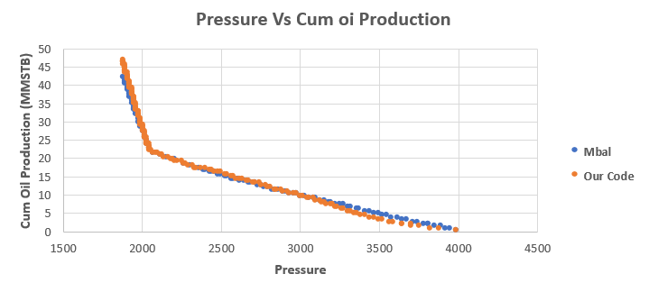
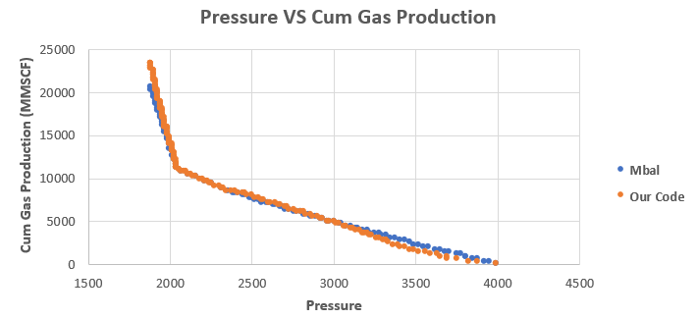
Comparison Plots (Oil Reservoir)

Slide 19
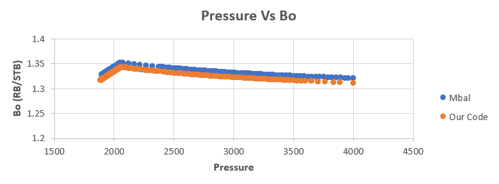
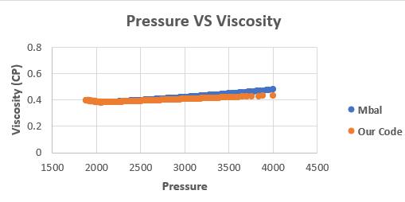
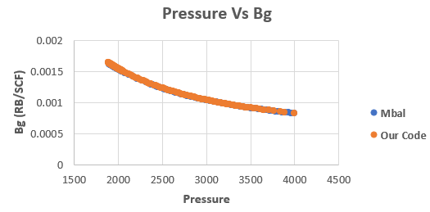
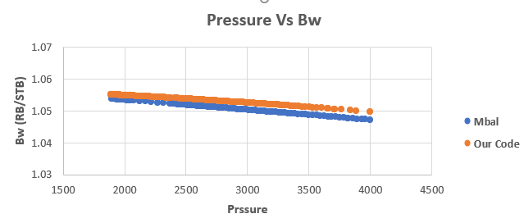
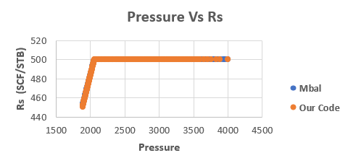
Comparison Plots (Fluid Properties)

Slide 20
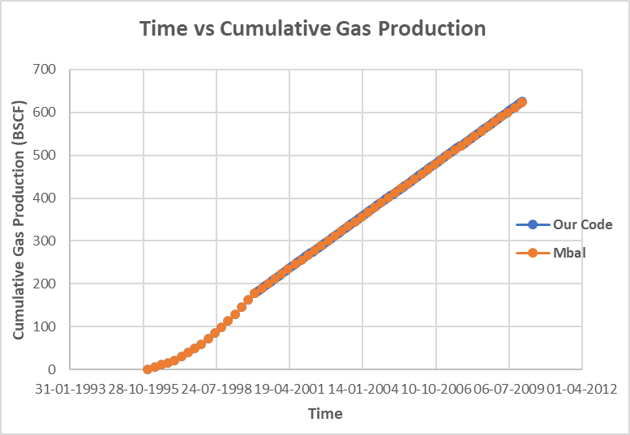
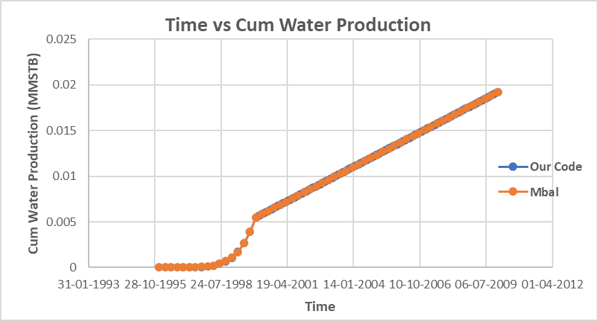
Validation ( Gas Reservoir)

Slide 21
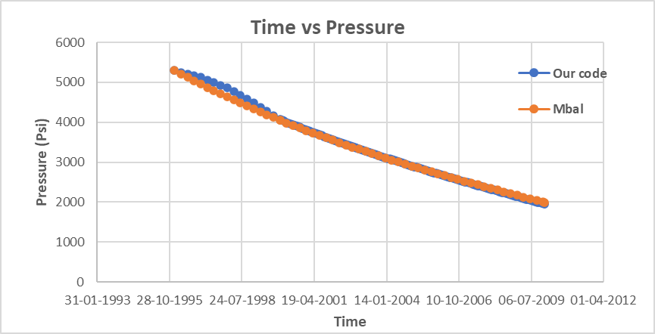
Validation (Gas Reservoir)

Slide 22
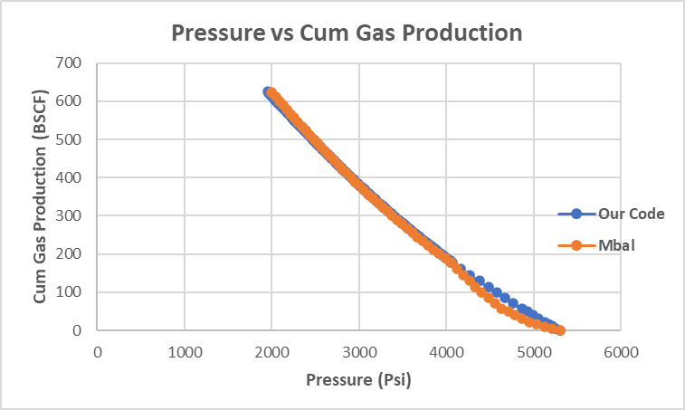
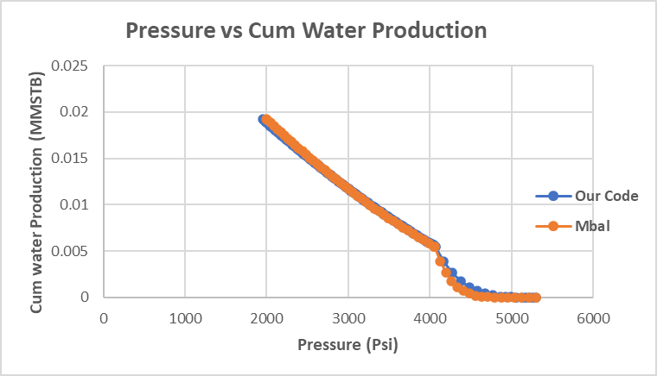
Comparison Plots (Gas Reservoir)

Slide 23
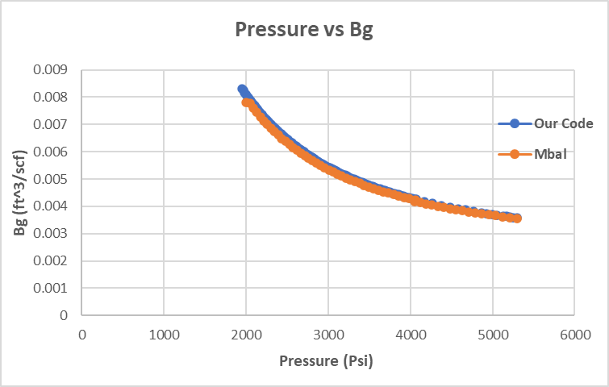
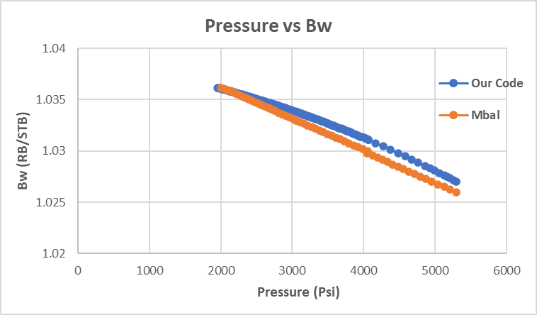
Comparison Plots (Fluid Properties)

Slide 24
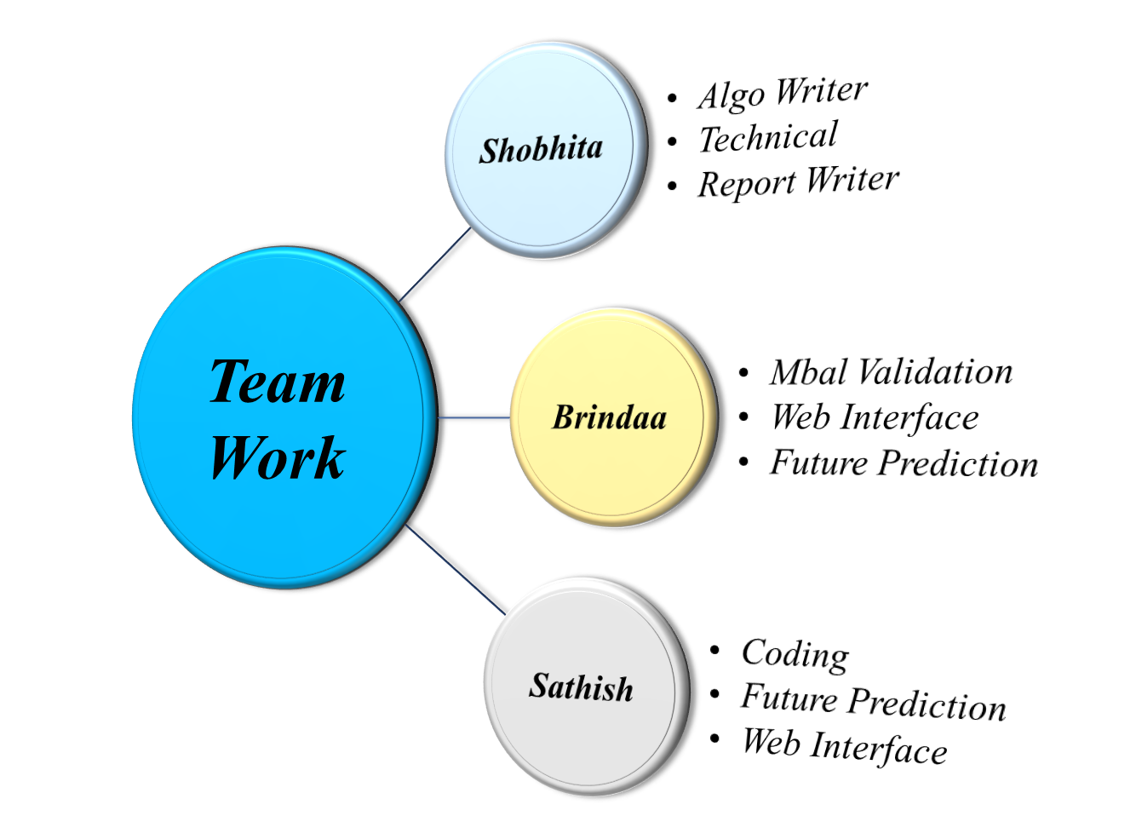
Individual Contribution for a Project
Colab- Link
Thank You

