Slide 1
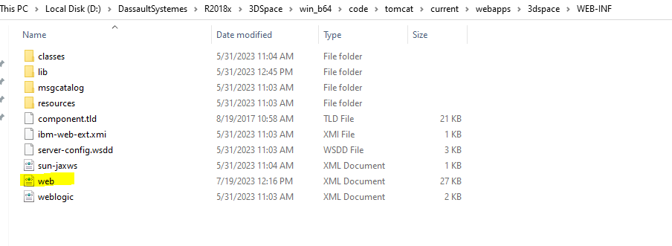
Step1: Find web.xml file in 3D Space and it is configuring file in whole 3DSpace.

Slide 2
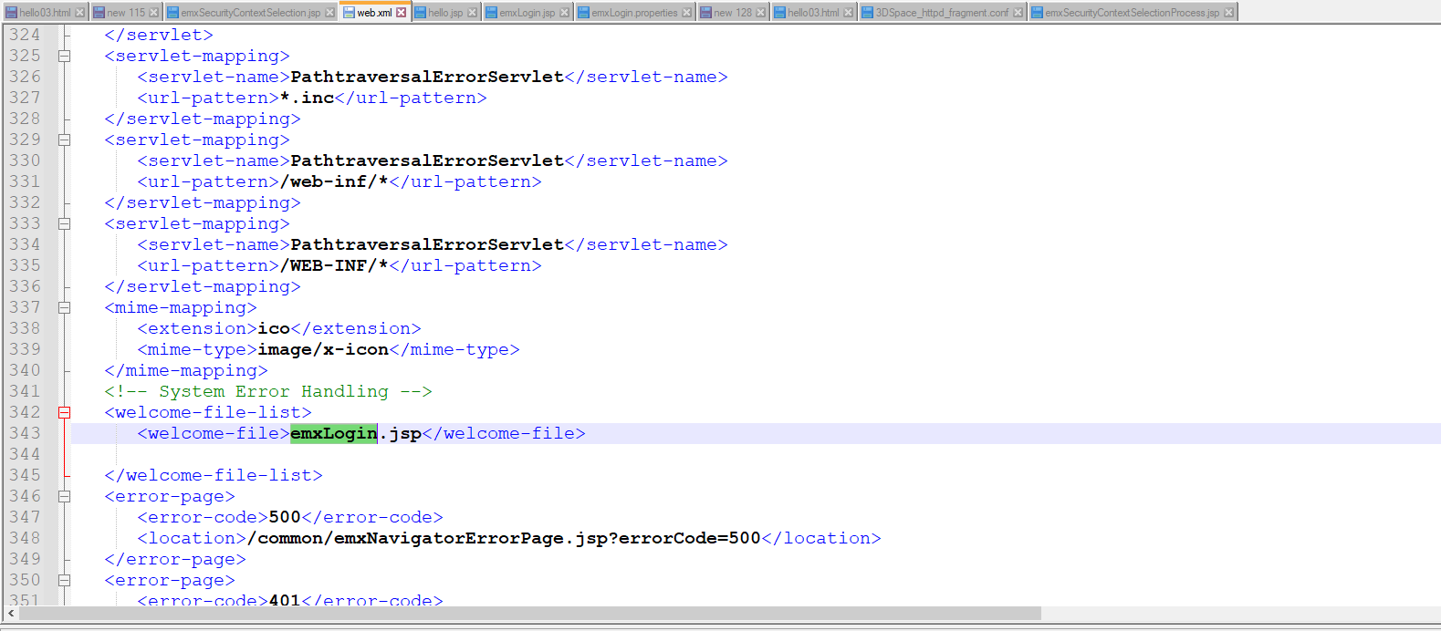
Step2: Find < welcome-file-list> in web.xml file and inside this tag emxlogin.jsp page is called.

Slide 3
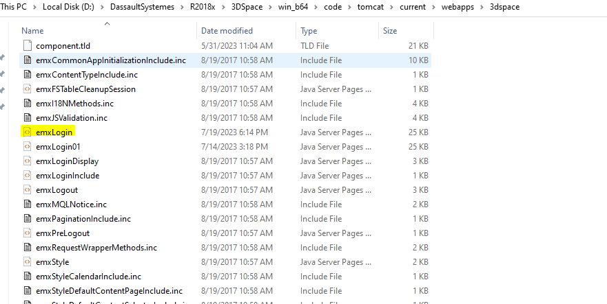
Step3: Find emxLogin.jsp file location.

Slide 4
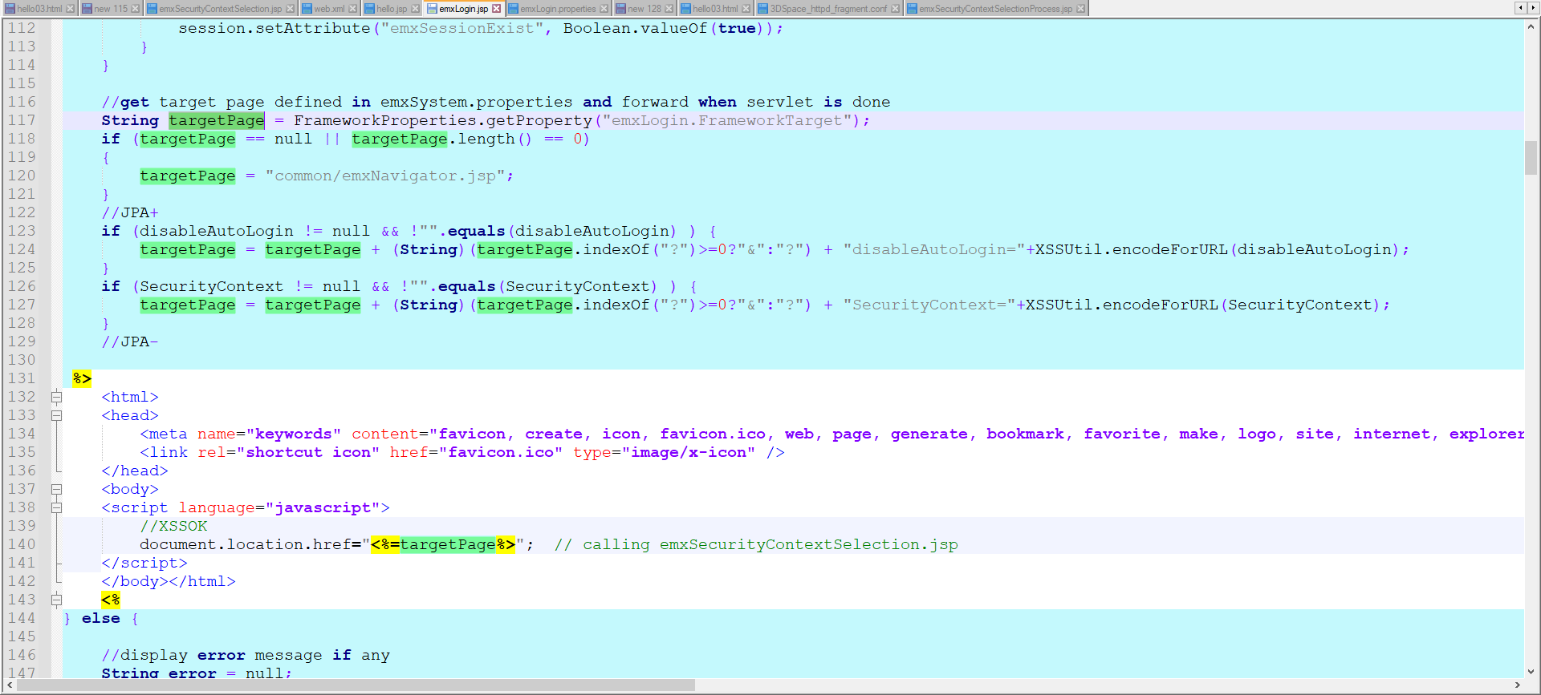

Step4: Inside emxLogin.jsp file, find getProperty which is defined in emxLogin.Properties and it is assigned to targetPage.

Slide 5
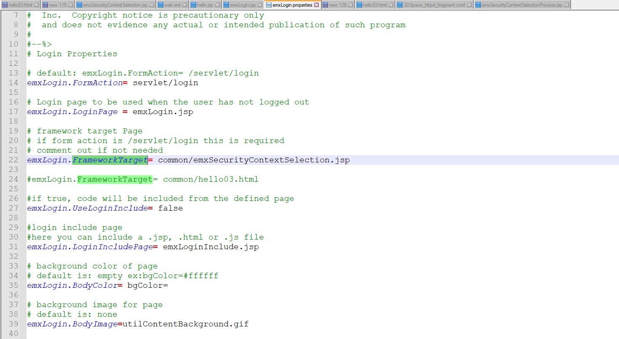
Step5: And this is property file for emxLogin.properties - ' Location: tomcat\current\webapps\3dspace\WEB-INF\classes\emxLogin.properties '

Slide 6
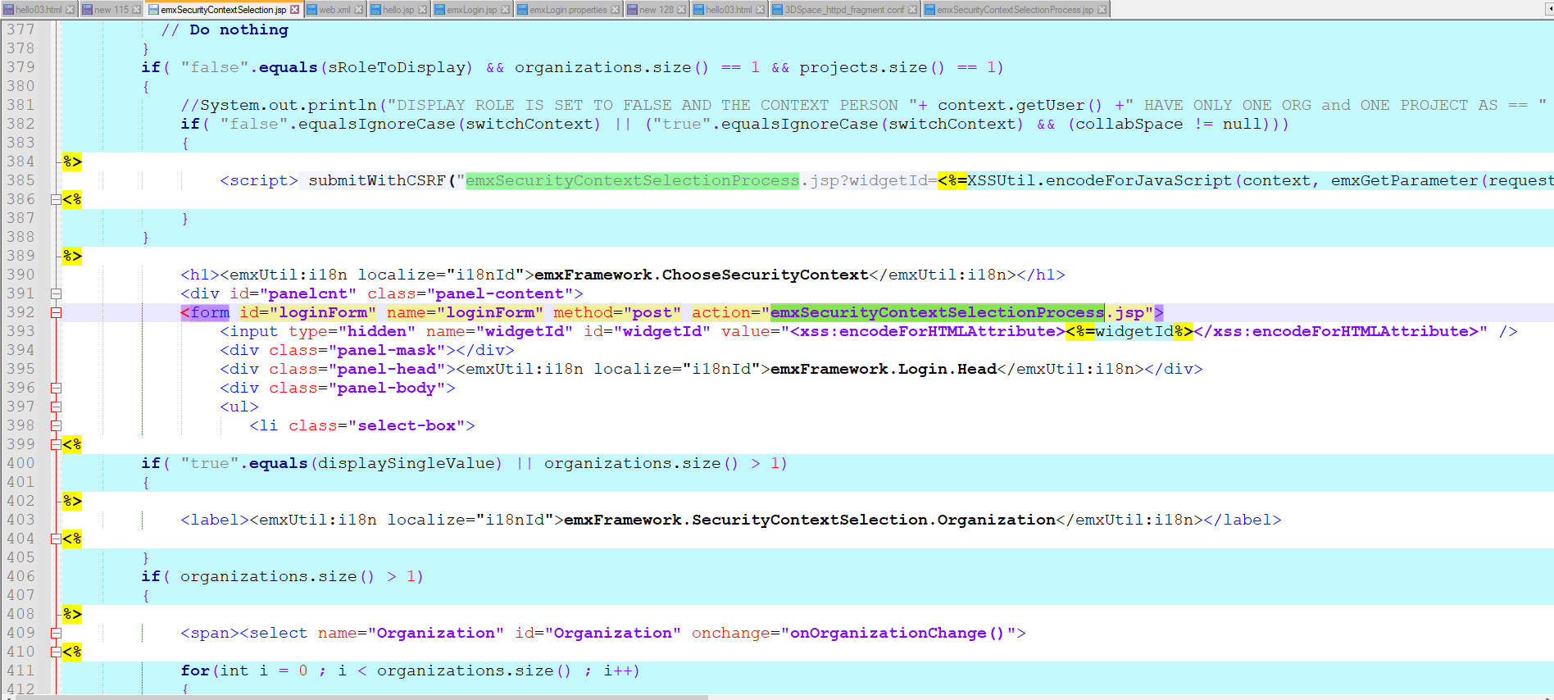
Step6: step4 jsp call is performed in here (i.e) emxSecurityContextSelection.jsp - ' Location : tomcat\current\webapps\3dspace\common '
And this jsp redirected to emxSecurityContextSelectionProcess.jsp file.

Slide 7
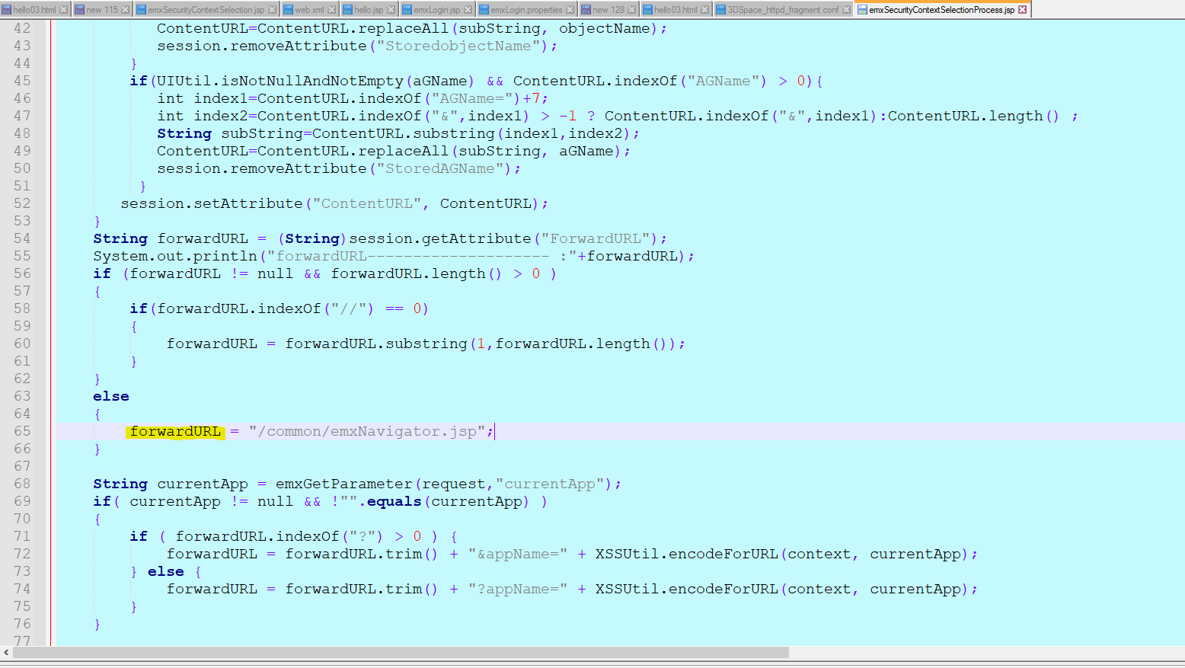
Step7: In this emxSecurityContextSelectionProcess.jsp, forwarding URL is mentioned.

Slide 8
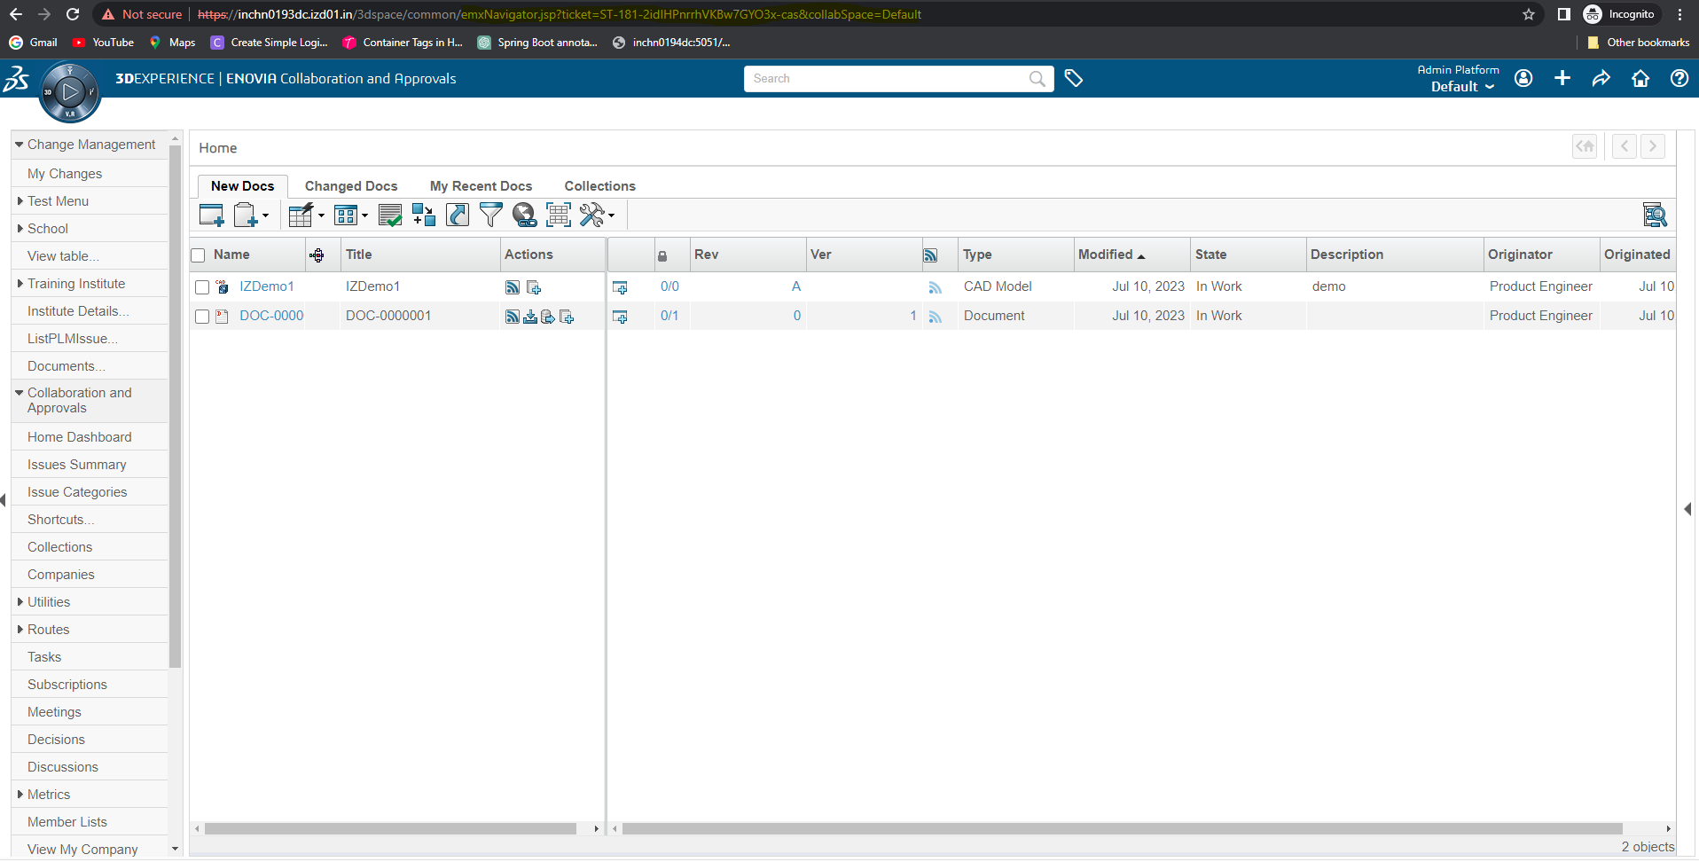
Step8: Before modifying the User Interface page.

Slide 9
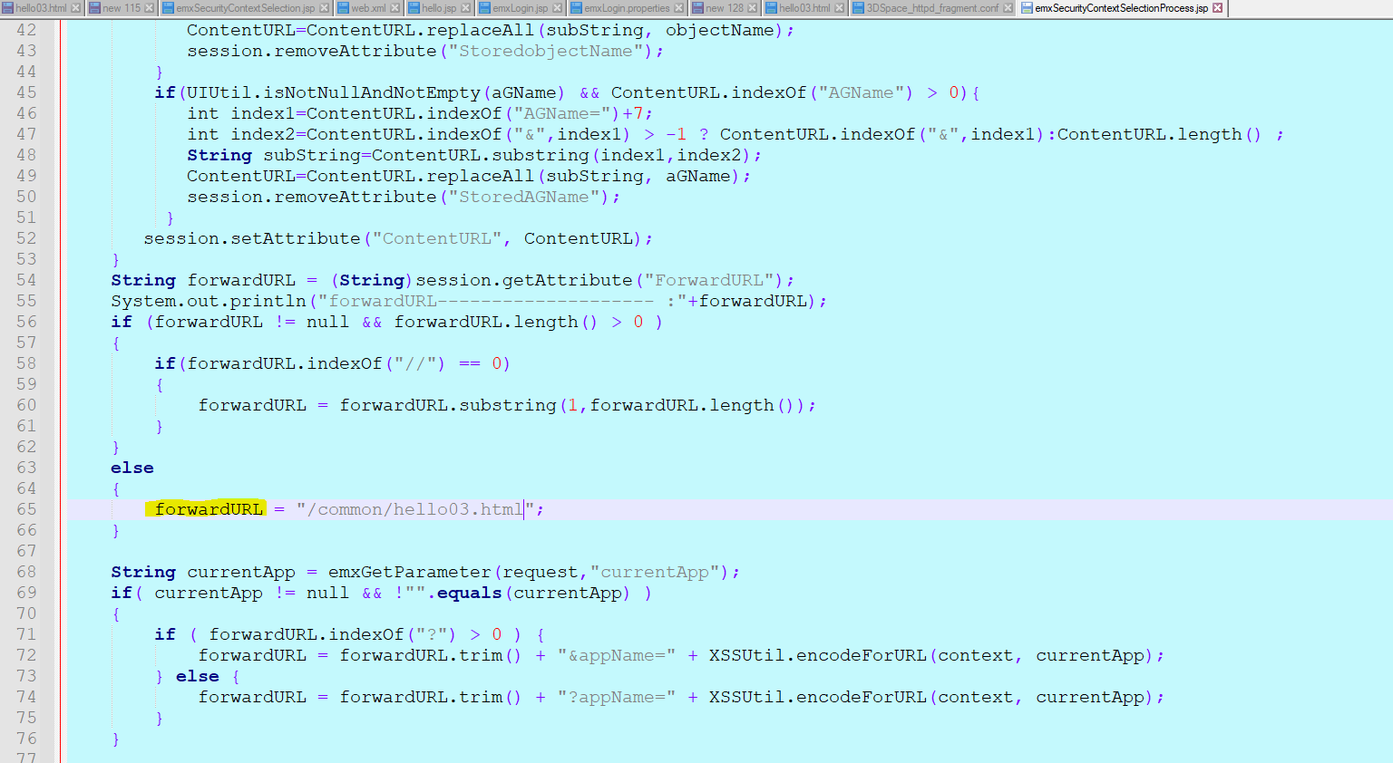
Step9: In this emxSecurityContextSelectionProcess.jsp file, we should mention our custom jsp/html file in forwardURL.

Slide 10
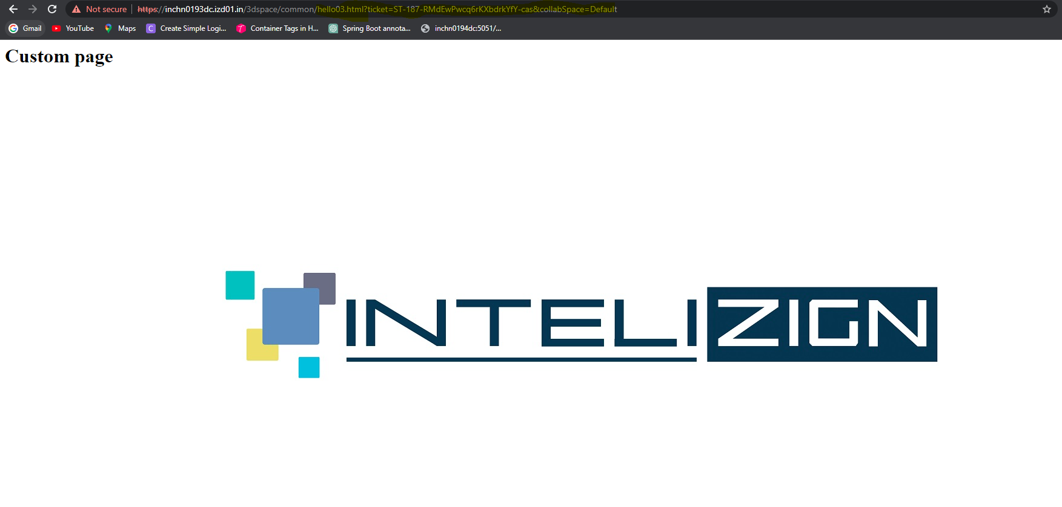
Step10: hello03.jsp file performed and the User Interface Page is modified as I expected.

