Slide 1
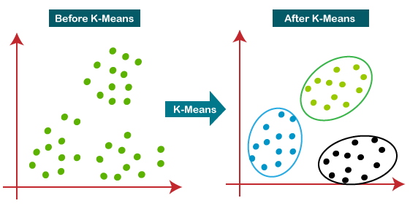
K-Means Clustering
Introduction
Unsupervised Learning Technique.
Groups similar data points into K clusters.
Identifies patterns, relationships, and structure in data.
Simple, efficient, and scalable.
Widely used in data mining, image segmentation, customer segmentation, etc.

Slide 2
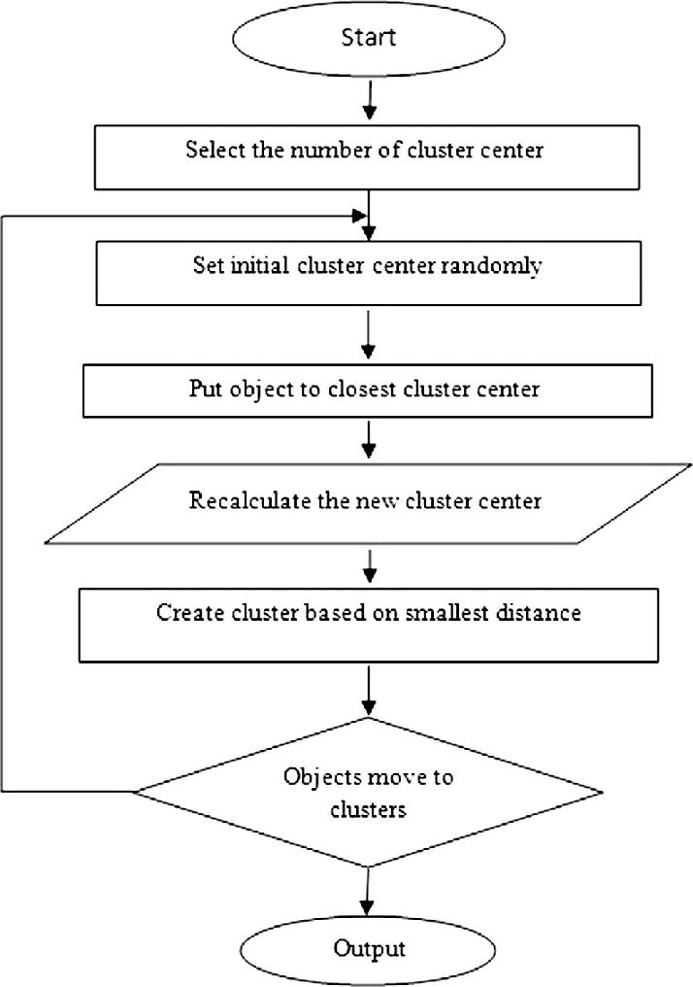
How K-Means Works & Key Concepts
Initialize K centroids randomly
Assign data points to closest centroid
Update centroids based on assigned data points
Repeat until convergence
Key Concepts:
* Centroids: Cluster centers
* Distance metric: Euclidean, Manhattan, etc.
* K: Number of clusters.
* Initialization methods: Random, K-Means++, etc.

Slide 3

Advantages, Limitations & Applications
Advantages:
Simple to implement.
Efficient computation .
Handles large datasets.
Limitations:
Sensitive to initial centroids .
Assumes spherical clusters.
Not suitable for complex relationships.
Applications:
Customer segmentation.
Image compression.
Gene expression analysis.
Recommendation systems.

Slide 4
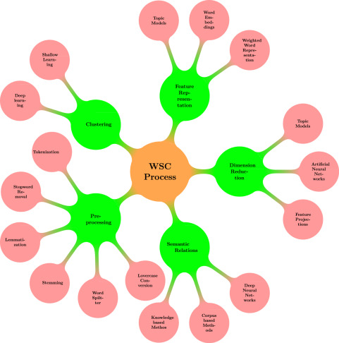
Introduction to Affinity Propagation Clustering
Identifying Exemplars and Clusters
Unsupervised clustering algorithm
Identifies exemplars (representative data points)
Clusters data points around exemplars
No predefined number of clusters needed
Handles noisy and outlier data

Slide 5
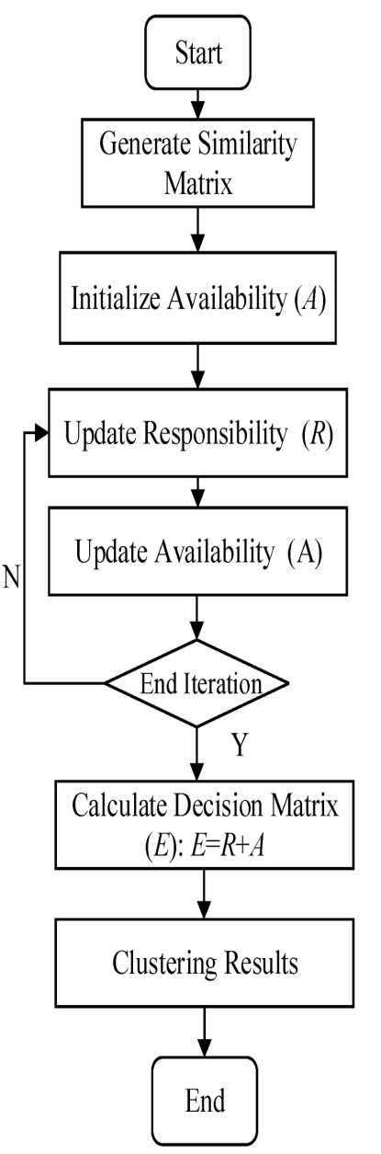
How Affinity Propagation Works & Key Concepts
Sends messages between data points to identify exemplars
Two types of messages: responsibility and availability
Iterative process until convergence
Exemplars become cluster centers
Key Concepts:
Similarity matrix: measures similarity between data points
Preference value: controls number of exemplars
Damping factor: controls convergence rate
Convergence criteria: iteration limit or change threshold

Slide 6
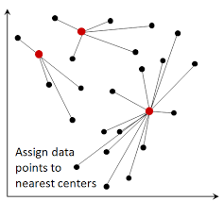
Advantages, Limitations & Applications
Advantages:
Identifies representative data points (exemplars)
Handles noisy and outlier data
Flexible clustering approach
No predefined number of clusters needed
Limitations:
Computationally expensive
Sensitive to preference value
Not suitable for very large datasets
Applications:
Image segmentation
Gene expression analysis
Customer segmentation
Recommendation systems

Slide 7
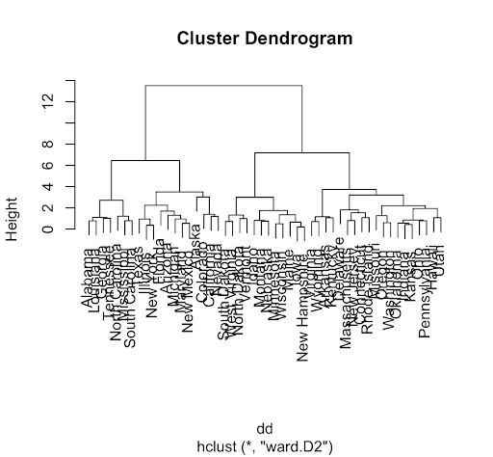
Introduction to Hierarchical Clustering
Nested Clustering Structure
Unsupervised clustering algorithm
Builds hierarchy of clusters
No predefined number of clusters needed
Suitable for exploratory data analysis
Visualizes cluster relationships

Slide 8
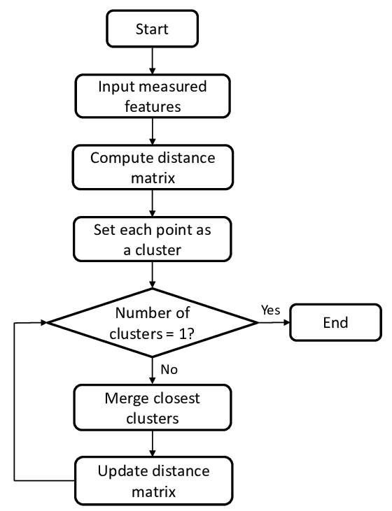
How Hierarchical Clustering Works & Key Concepts
Agglomerative (bottom-up) or Divisive (top-down)
Distance metric: Euclidean, Manhattan, etc.
Linkage criterion: Single, Complete, Average, Ward's
Merge or split clusters based on similarity
Key Concepts:
Dendrogram: visual representation of hierarchy
Cluster distance: measures similarity between clusters
Linkage: method for merging or splitting clusters
Cutoff point: determines number of clusters

Slide 9
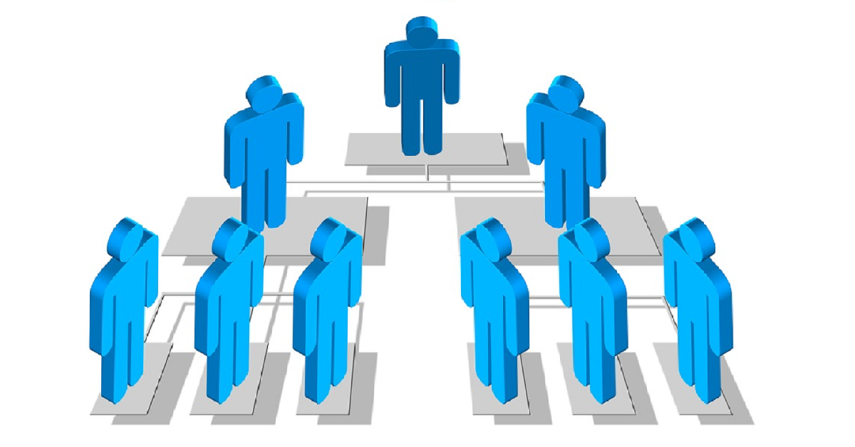
Advantages, Limitations & Applications
Advantages:
Provides nested cluster structure
Visualizes cluster relationships
No predefined number of clusters needed
Robust to outliers
Limitations:
Computationally expensive
Sensitive to distance metric and linkage
Difficult to interpret large dendrograms
Applications:
Gene expression analysis
Image segmentation
Customer segmentation
Text classification

Slide 10
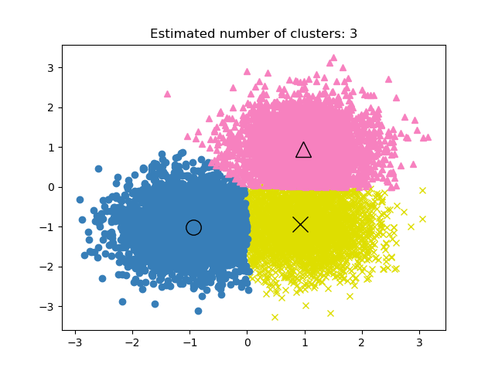
Introduction to Mean Shift Clustering
Non-Parametric Clustering Technique
Unsupervised clustering algorithm
No predefined number of clusters needed
Identifies clusters of varying shapes and sizes
Robust to noise and outliers
Suitable for multimodal distributions

Slide 11
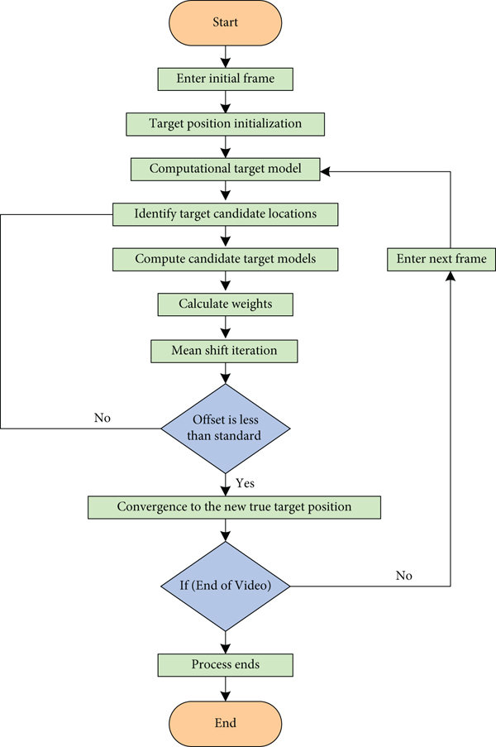
How Mean Shift Clustering Works & Key Concepts
Iterative process: shift points towards density modes
Uses kernel density estimation (KDE)
Bandwidth parameter controls cluster size
Convergence criteria: iteration limit or convergence threshold
Key Concepts:
Kernel function: Gaussian, Epanechnikov, etc.
Bandwidth parameter: controls smoothing
Density modes: local maxima of density estimate
Convergence rate: affects computational efficiency

Slide 12
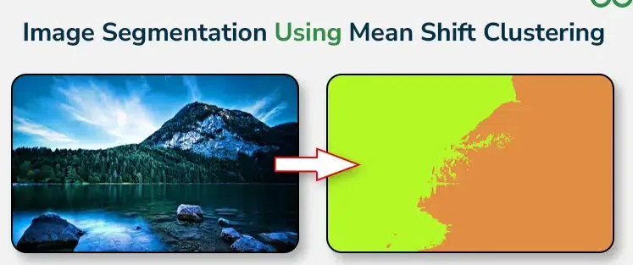
Advantages, Limitations & Applications
Advantages:
Handles varying cluster shapes and sizes
Robust to noise and outliers
No predefined number of clusters needed
Suitable for multimodal distributions
Limitations:
Computationally expensive
Sensitive to bandwidth parameter
Difficult to interpret clusters
Applications:
Image segmentation
Object tracking
Customer segmentation
Gene expression analysis

Slide 13
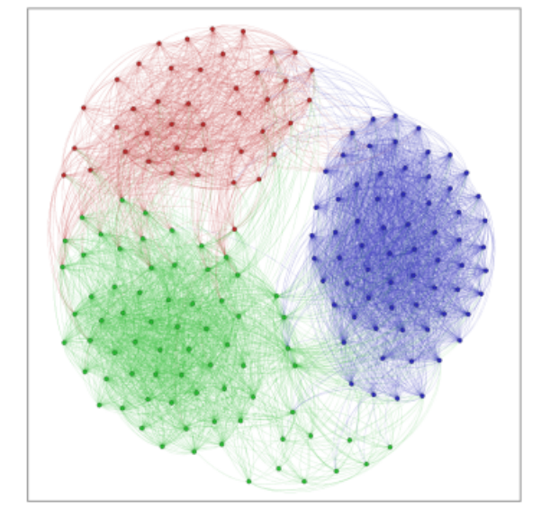
Introduction to Spectral Clustering
Graph-Based Clustering Technique
Unsupervised clustering algorithm
Views data as graph or network
Identifies clusters as connected components
Handles non-linear relationships
Robust to noise and outliers

Slide 14
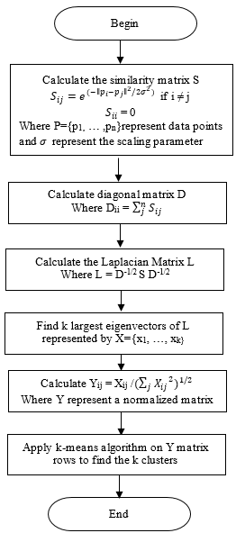
How Spectral Clustering Works & Key Concepts
Constructs affinity matrix (similarity graph)
Computes eigenvectors and eigenvalues
Applies k-means or other clustering method
Handles varying cluster sizes and shapes
Key Concepts:
Affinity matrix: measures similarity between data points
Laplacian matrix: represents graph structure
Eigenvectors: represent cluster assignments
Number of clusters (k): user-defined or estimated

Slide 15
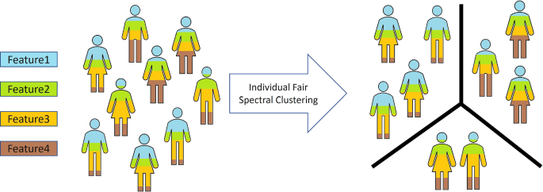
Advantages, Limitations & Applications
Advantages:
Handles non-linear relationships
Robust to noise and outliers
Identifies clusters of varying sizes and shapes
Suitable for high-dimensional data
Limitations:
Computationally expensive
Sensitive to affinity matrix and k
Difficult to interpret clusters
Applications:
Image segmentation
Network analysis
Gene expression analysis
Recommendation systems

Slide 16
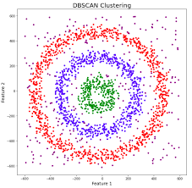
Introduction to DBSCAN Clustering
Density-Based Clustering Algorithm
Unsupervised clustering algorithm
Identifies clusters of varying shapes and sizes
Handles noise and outliers
No predefined number of clusters needed
Robust to density variations

Slide 17
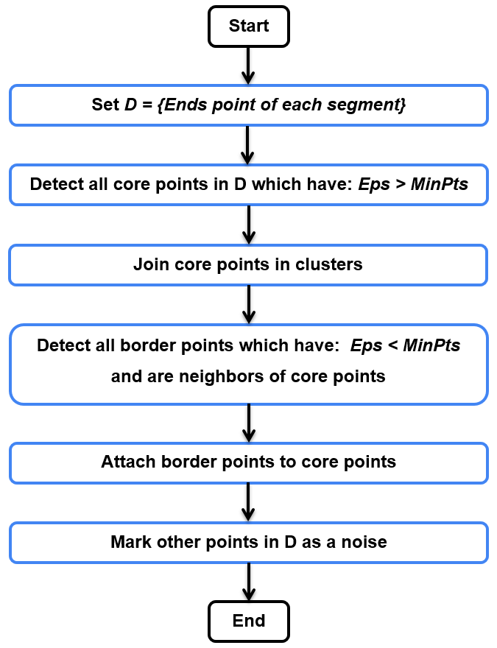
How DBSCAN Clustering Works & Key Concepts
Finds core points (dense regions)
Expands clusters from core points
Handles border points and noise
Uses ε (epsilon) and MinPts parameters
Key Concepts:
ε (epsilon): maximum distance between points
MinPts: minimum points required for dense region
Core point: point with MinPts neighbors within ε
Border point: point near core point but not core point
Noise point: point not part of any cluster

Slide 18
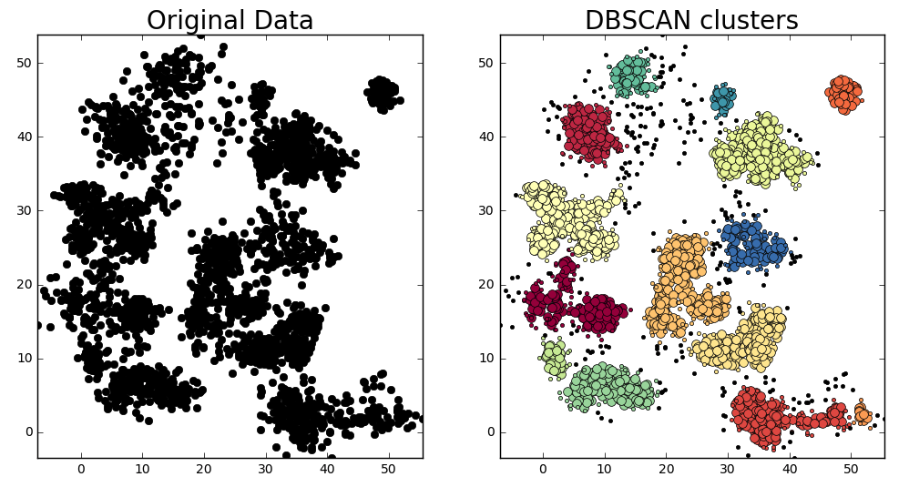
Advantages, Limitations & Applications
Advantages:
Handles varying cluster shapes and sizes
Robust to noise and outliers
No predefined number of clusters needed
Handles high-dimensional data
Limitations:
Sensitive to ε and MinPts parameters
Computationally expensive
Difficult to interpret clusters
Applications:
Spatial data analysis
Image segmentation
Network analysis
Anomaly detection

Slide 19
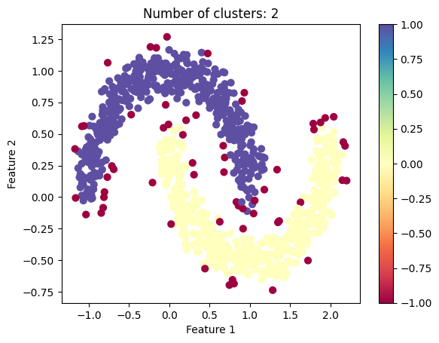
Introduction to HDBSCAN Clustering
Hierarchical Density-Based Clustering Algorithm
Unsupervised clustering algorithm
Identifies clusters of varying shapes and sizes
Handles noise and outliers
No predefined number of clusters needed
Robust to density variations

Slide 20
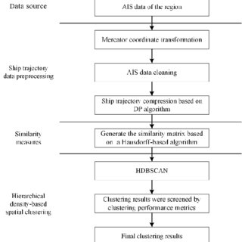
How HDBSCAN Clustering Works & Key Concepts
Builds hierarchical cluster tree (dendrogram)
Uses mutual reachability distance
Identifies clusters at varying granularity
Handles varying density clusters
Key Concepts:
Mutual reachability distance: measures similarity
Minimum cluster size: controls cluster granularity
Cluster stability: measures cluster robustness
Excess of density: identifies cluster boundaries

Slide 21
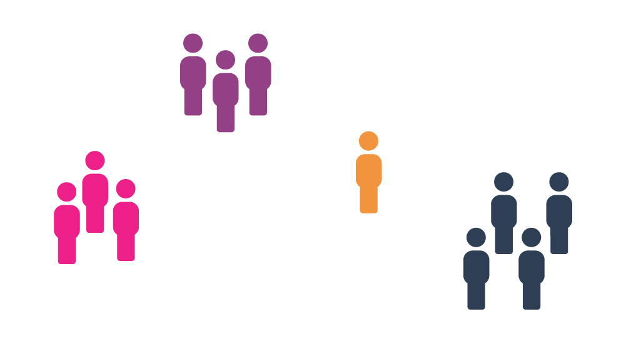
Advantages, Limitations & Applications
Advantages:
Handles varying cluster shapes and sizes
Robust to noise and outliers
No predefined number of clusters needed
Handles high-dimensional data
Limitations:
Computationally expensive
Sensitive to minimum cluster size
Difficult to interpret clusters
Applications:
Gene expression analysis
Image segmentation
Network analysis
Anomaly detection

Slide 22
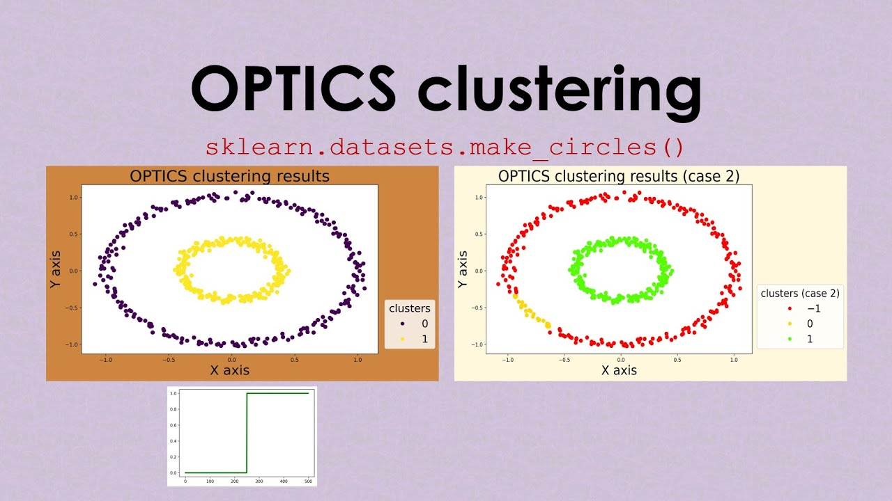
Introduction to OPTICS Clustering
Ordering Points To Identify Clustering Structure
Unsupervised clustering algorithm
Identifies clusters of varying densities
Handles noise and outliers
No predefined number of clusters needed
Robust to density variations

Slide 23
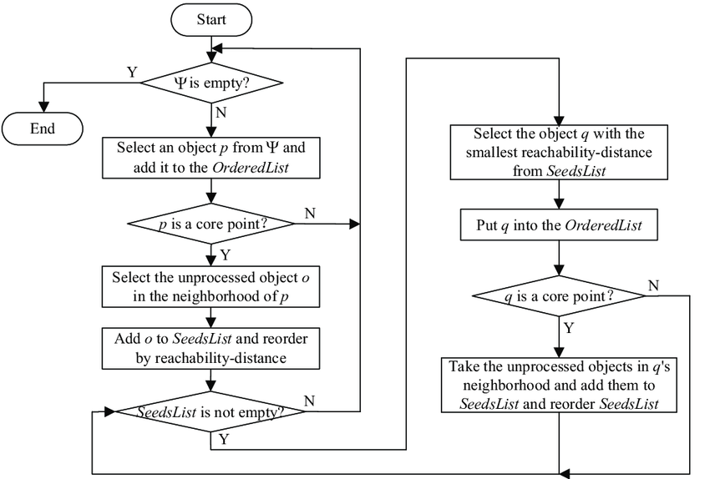
How OPTICS Clustering Works & Key Concepts
Builds reachability graph
Computes reachability distance
Identifies density-based clusters
Handles varying density clusters
Key Concepts:
Reachability distance: measures similarity
Core distance: measures density
Reachability plot: visualizes cluster structure
Density-based clustering

Slide 24
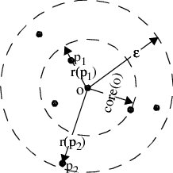
Advantages, Limitations & Applications
Advantages:
Handles varying cluster densities
Robust to noise and outliers
No predefined number of clusters needed
Handles high-dimensional data
Limitations:
Computationally expensive
Sensitive to parameters
Difficult to interpret clusters
Applications:
Gene expression analysis
Image segmentation
Network analysis
Anomaly detection

Slide 25
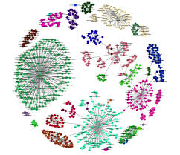
Introduction to BIRCH Clustering
Balanced Iterative Reducing and Clustering using Hierarchies
Unsupervised clustering algorithm
Handles large datasets
Efficient clustering for incremental data
Robust to noise and outliers
Scalable for high-dimensional data

Slide 26
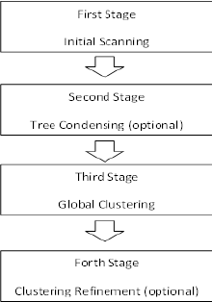
How BIRCH Clustering Works & Key Concepts
Builds CF (Clustering Feature) tree
Stores cluster summaries
Iteratively refines clusters - Handles outliers and noise
Key Concepts:
CF tree: hierarchical representation
CF entries: cluster summaries
Threshold T: controls cluster size
Branching factor B: controls tree width

Slide 27
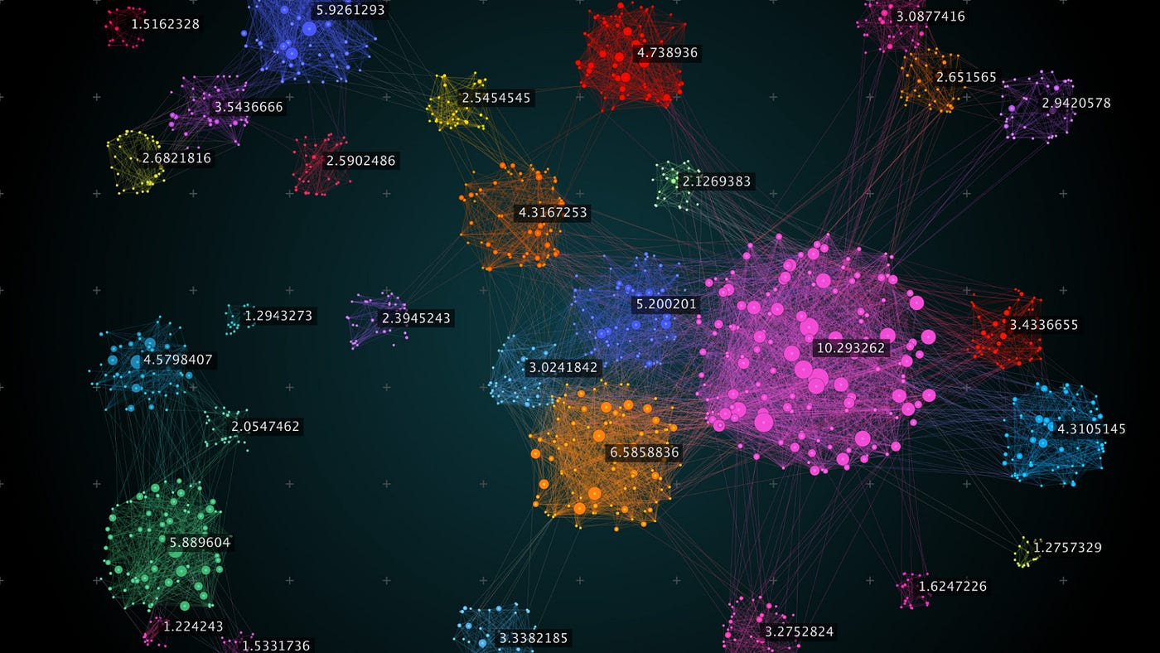
Advantages, Limitations & Applications
Advantages:
Efficient for large datasets
Handles incremental data
Robust to noise and outliers
Scalable for high-dimensional data
Limitations:
Sensitive to parameters (T, B)
Difficult to interpret clusters
Not suitable for varying density clusters
Applications:
Data mining
Image segmentation
Network analysis
Text clustering

