Slide 1
Customer Segmentation using Azure and Spark

Slide 2




Team working on this
Samohitha Data Engineer
Sathish Gandhi ML Engineer
Siddhanth Business Analyst
Krishna Chaitanya Cloud Engineer

Slide 3
Introduction
Customer segmentation divides customers into groups based on common characteristics, aiding targeted marketing and customer satisfaction. Using Azure's cloud infrastructure and Apache Spark's distributed data processing, this project gathers, stores, and analyzes customer data at scale. Spark's clustering algorithms segment customers, allowing businesses to refine marketing strategies, improve customer experiences, and optimize resources.

Slide 4
Objective
The objective of this project is to implement customer segmentation using Azure and Apache Spark, enabling businesses to group customers based on shared traits like behavior and demographics. By leveraging Spark's data processing and Azure's scalable infrastructure, the goal is to improve targeted marketing, enhance customer experiences, and optimize business resources for greater efficiency and profitability.

Slide 5
The Problem
01
Many e-commerce businesses struggle to expand because they encounter difficulties in identifying their target audience or in retaining their existing customer base.
Problem #1 Finding Target Audience.
02
Problem #2 Customer Retention

Slide 6
The Solution
We utilize segmentation analysis, to group users according to their RFM scores and demographic information. This will help us identify the target audience more effectively.
Solution #1 Customer segmentation using RFM score
Solution #2 Segmentation analysis using Demographics
01
02

Slide 7
What is RFM?
RFM is a customer segmentation technique that evaluates customer behavior based on three metrics: Recency, Frequency, and Monetary. It considers how recently a customer made a purchase, how often they buy, and how much they spend. By combining these factors, businesses can identify valuable customer segments, enabling targeted marketing, personalized communication, and optimized resource allocation to boost customer engagement and loyalty.

Slide 8
Importance of RFM Analysis
Benefits for businesses: RFM analysis helps businesses identify high-value customers, tailor marketing strategies, improve customer retention, and optimize resource allocation.
Widely adopted: RFM analysis is widely adopted by major companies across industries for marketing campaigns, customer relationship management, and business decision-making.

Slide 9
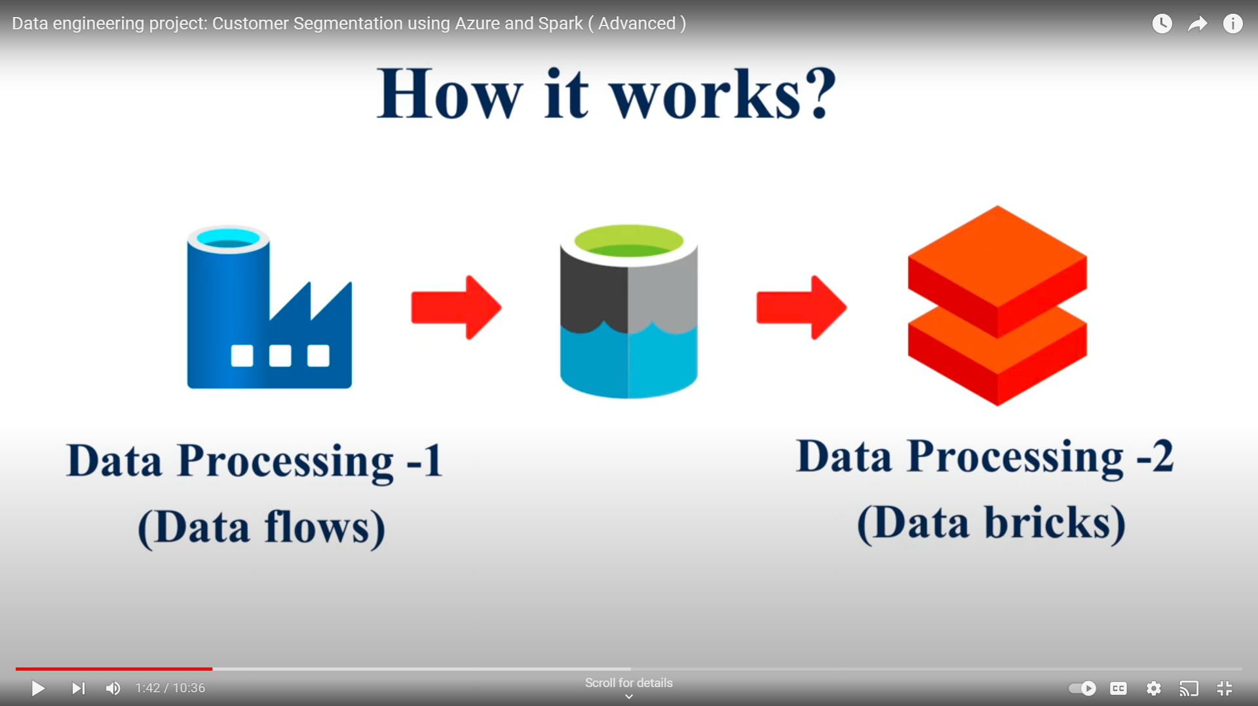
How it works?

Slide 10
Data
There are two methods to obtain the data: one involves accessing the Kaggle dataset, while the other entails utilizing Google Data Analytics.
Kaggle Dataset
Google Analytics

Slide 11
About Dataset
This is a transnational data set which contains all the transactions occurring between 01/12/2010 and 09/12/2011 for a UK-based and registered non-store online retail. The company mainly sells unique all-occasion gifts. Many customers of the company are wholesalers."
https://www.kaggle.com/datasets/carrie1/ecommerce-data

Slide 12
Data Pipeline
We'll gather data from GA Tags and Kaggle, preprocess it in Azure, then use Databricks for modeling and RFM score calculation.
DATA INGESTION
DATA PREPROCESSING
Model Implementaion
Data ingestion through GA tags(Extracting the data)
Data preprocessing in Azure
Calculating RFM score in Databricks and implementing spark

Slide 13
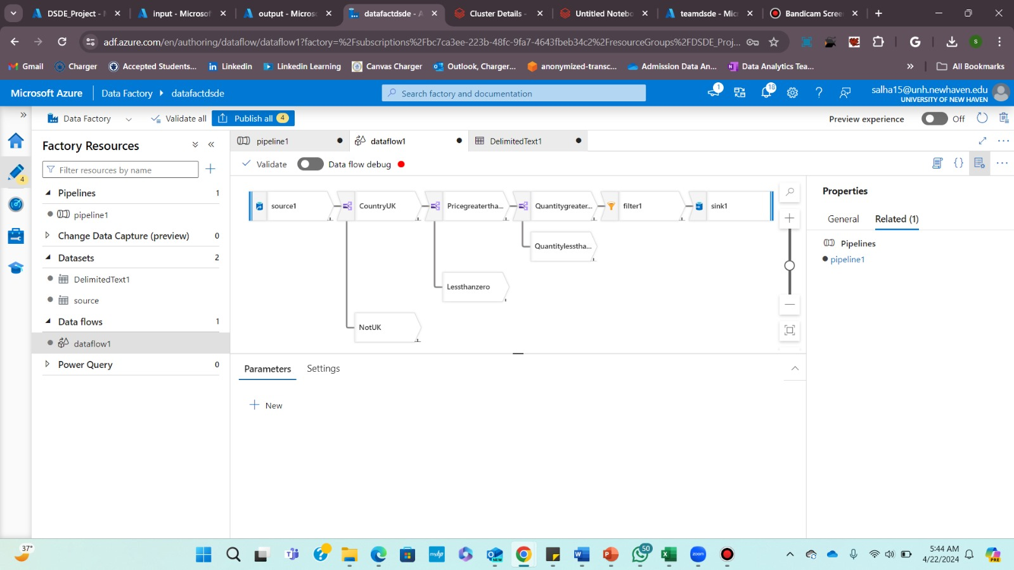

Slide 14
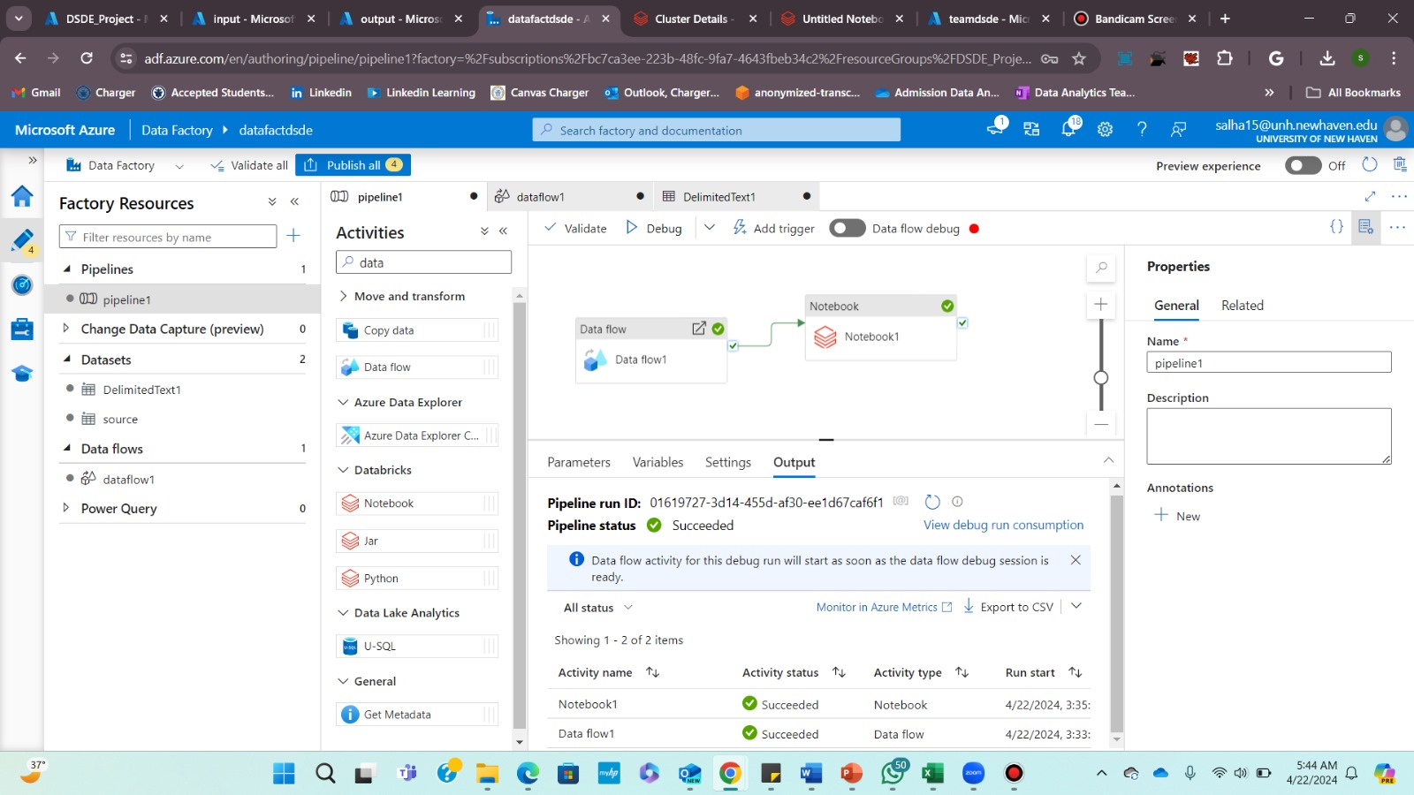

Slide 15
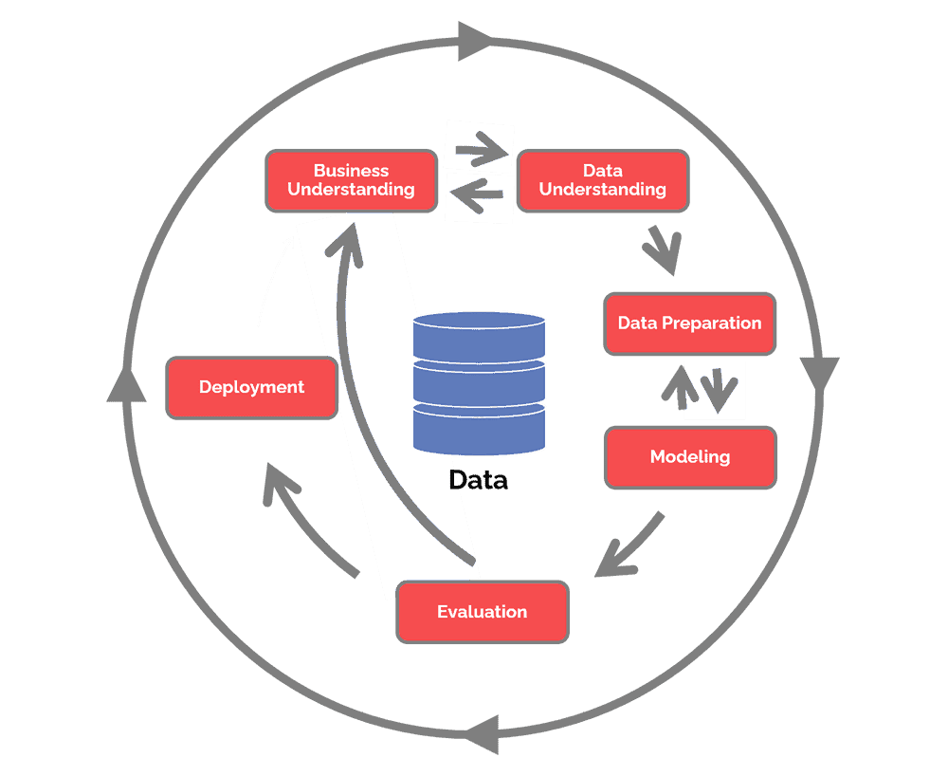
Data Science Pipeline
CRISP- DM methodology
Finding Target Audience
Extracting Data from GA, Kaggle Data Set
Using Databricks and Azure

Slide 16
Data Collection and Processing
Source of data: Data for RFM analysis was sourced from Kaggle, a popular platform for datasets.
Tools used: Azure Data Factory and Databricks were utilized for data processing.
Overview of the data processing pipeline: The data processing pipeline involved basic data transformations in Azure Data Factory followed by advanced processing using Spark in Databricks.

Slide 17
Azure Data Factory
Role in basic data processing: Azure Data Factory was used to construct a pipeline for basic data processing and transformations.
Construction of pipeline: The pipeline included steps for data ingestion, cleansing, and transformation using Azure Data Flow.
Key steps in data transformation: Data was filtered, aggregated, and prepared for further analysis in Databricks.

Slide 18
Databricks Integration
Utilization of Spark code: Spark code was implemented in Databricks for advanced data processing tasks.
Filtering null values: Null values were filtered out from the dataset to ensure data quality.
Calculating RFM scores: RFM scores were calculated using Spark code to evaluate the recency, frequency, and monetary value of customer transactions.

Slide 19
RFM Score Calculation
Explanation of RFM score components: Recency, Frequency, and Monetary (RFM) scores are calculated based on the customer's recent purchase, frequency of purchases, and monetary value of transactions.
How RFM scores are calculated: Each customer is assigned an RFM score based on their transaction history, with higher scores indicating higher value or engagement.

Slide 20
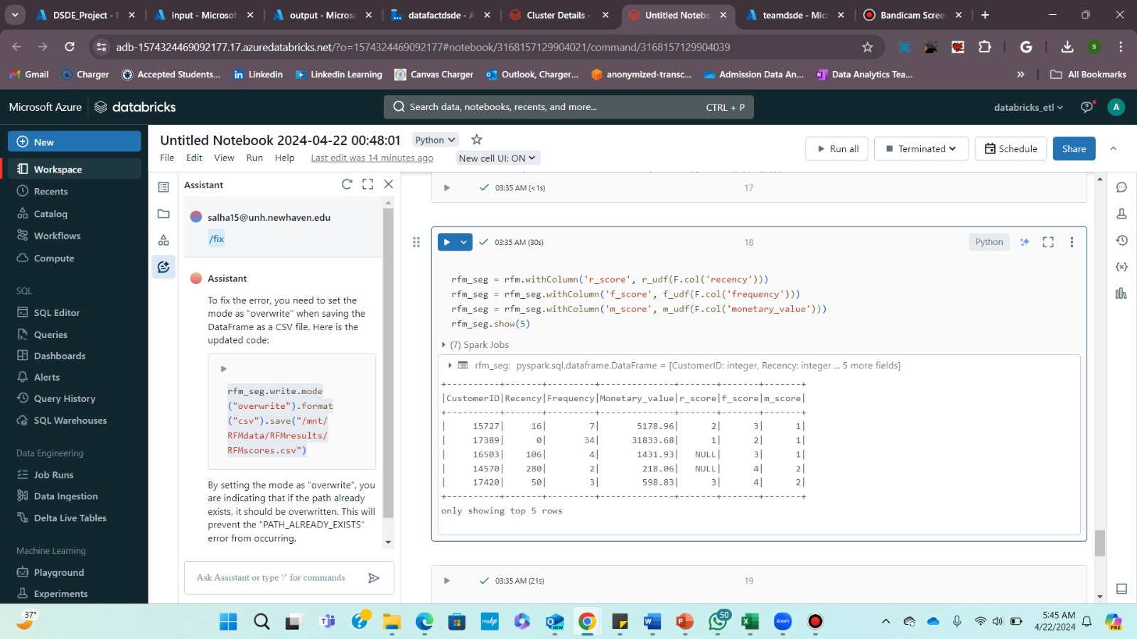

Slide 21
Customer Segmentation and Insights
Application of RFM scores: RFM scores are used to segment customers into different groups based on their buying behavior.
Interpretation of RFM scores: Businesses can gain insights into customer behavior and preferences, enabling targeted marketing campaigns and personalized customer experiences.
Business insights and strategies: RFM analysis helps businesses identify high-value customers, re-engage dormant customers, and optimize marketing strategies for better ROI.

Slide 22
Conclusion
Customer segmentation using Azure and Spark enables effective understanding and targeting of customer base.
RFM analysis identifies high-value customer segments, facilitating tailored marketing strategies and improved customer experiences.
Utilizing Azure's cloud infrastructure and Apache Spark's data processing capabilities optimizes resources, enhancing profitability and growth opportunities.

Slide 23
GitHub Repository Link
GitHub - SathishGandhi-PR/UNH-DSCI-6007-03-DSDE-Term-Project-Team-08-Smart-Segmentation

Slide 24
Thank You!
Appreciation: Thanks for your time and attention.
Contact: Feel free to reach out for more information.
Next steps: Consider implementing RFM analysis in your business.
Closing: Looking forward to future collaboration.

