Slide 1
Employee Data Analysis using Excel
STUDENT NAME:
REGISTER NO:
DEPARTMENT:
COLLEGE
SATHISH.H
312206832
B.Com(Bank Management )
A.M.Jain College

Slide 2
PROJECT TITLE
Employee Performance Analysis using Excel

Slide 3


AGENDA
Problem Statement
Project Overview
End Users
Our Solution and Proposition
Dataset Description
Modelling Approach
Results and Discussion
Conclusion
3/21/2024 Annual Review

Slide 4

PROBLEM STATEMENT
A problem statement is a formal business report written by either a business leader or consultant to define and describe an issue an organisation is facing. Its goal is to propose a detailed method to solve the problem and recommend how those responsible can prevent it from reoccurring in the future.

Slide 5

PROJECT OVERVIEW
Data analytics converts raw data into actionable insights. It includes a range of tools, technologies, and processes used to find trends and solve problems by using data. Data analytics can shape business processes, improve decision-making, and foster business growth.

Slide 6
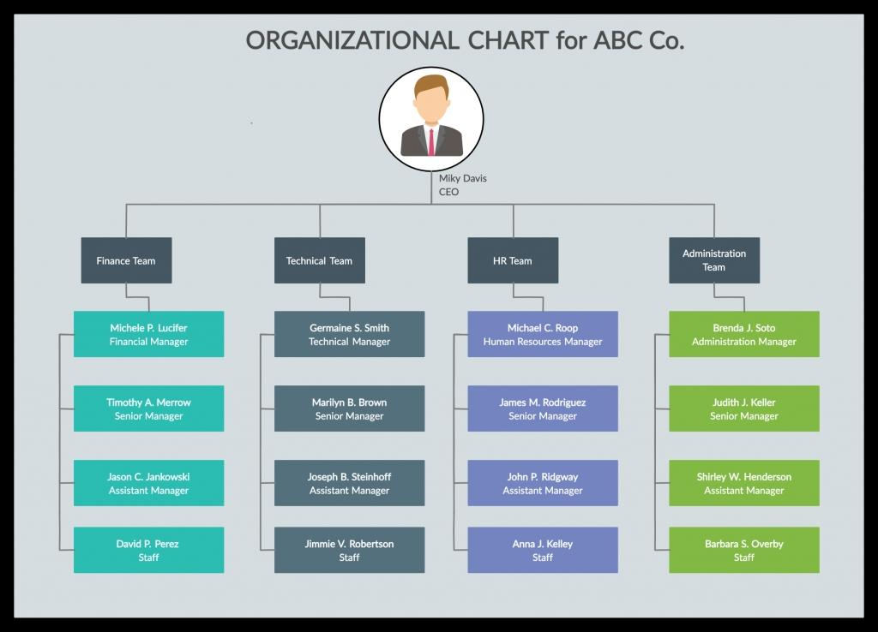

WHO ARE THE END USERS?

Slide 7

OUR SOLUTION AND ITS VALUE PROPOSITION
1.Conditional Formatting-Missing.2.Filter remove.3.Formula -Performance.4.Pivot tablet.5.Graph-data visualization.

Slide 8
Dataset Description
Employee=Kaggle26 Features9 FeaturesEmp id-numName text (First name & Last name)Emp type Performance level Gender-male & Female Employee rating -num

Slide 9

THE "WOW" IN OUR SOLUTION
=SUM(C2:C5)
=MIN(E2:E5)
=MAX(E2:E5)
=AVERAGE(C2:C5)
=COUNT(E2:E5)
=POWER(D2/100,2
3/21/2024 Annual Review
9

Slide 10
MODELLING
1.Data collection. 1.Employee Kaggle.2.Go the Dashboard.3.Download.
2.Feature Collection.1.26 Feature identify.2.9 Feature identify.
3.Data Cleaning.1.Missing values identify.2.Missing values Fillter out.
10

Slide 11
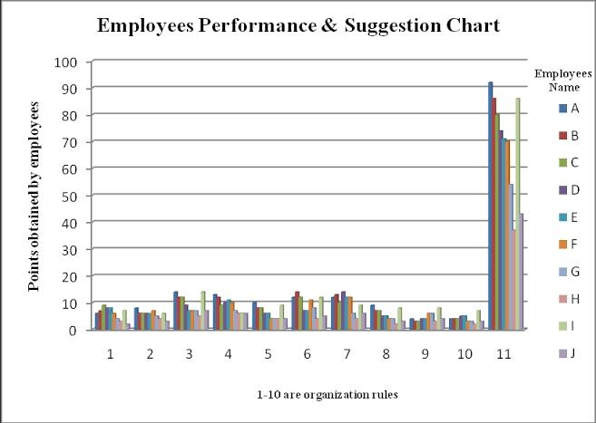
RESULTS
11

Slide 12
conclusion
select a cell in a data range > select the Analyze Data button on the Home tab. Analyze Data in Excel will analyze your data, and return interesting visuals about it in a task pane.

