Slide 1
Lending Club Case Study
Exploratory Data Analysis
Sathish Kumar Ramasamy
Sudheer Balabadruni

Slide 2
Table of Contents
Problem Statement
Univariate Analysis
Segmented Univariate Analysis
Bivariate Analysis
Conclusion

Slide 3
Problem Statement
The company is the largest online loan marketplace lending borrowers loans for personal, business and medical needs.
Lending loans to risky applicants is what contributes to the largest financial loss(credit loss) for the company
The company wants to understand the driving factors(variables) behind loan default so that credit loss can be reduced

Slide 4
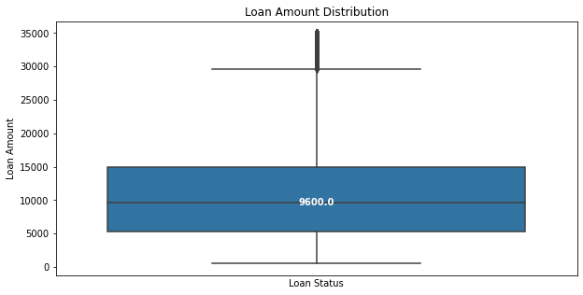
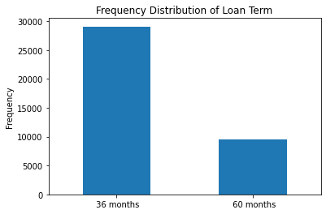
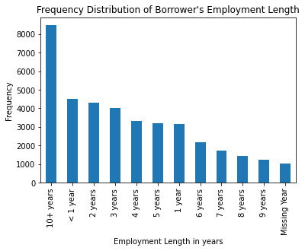
Univariate Analysis – Loan Amount, Term, Employment Length
Observations
75% of the loan amount requested is within 15000
About 75% of the loan is requested/granted for the term of 36 months
Majority of the loan applicants have employment length of 10+ years

Slide 5
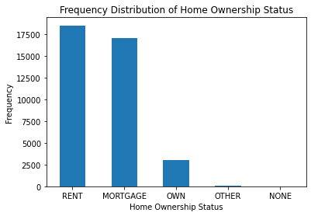
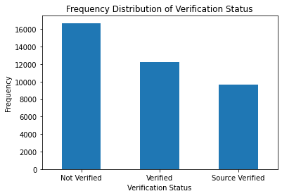
Univariate Analysis – Home Ownership, Verification Status, Purpose
Observations
About 48% and 44% of the loan applicants have respectively RENT and MORTGAGE as their home ownership
About 43% of the loan applicants income were not verified

Slide 6
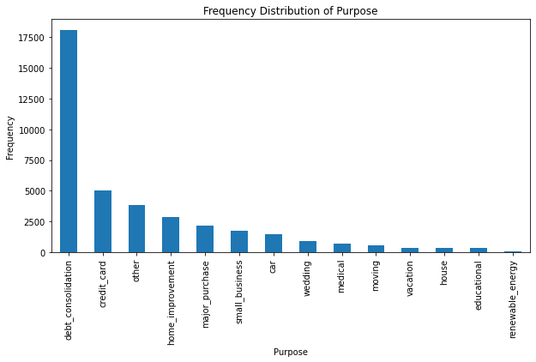
Univariate Analysis – Purpose
Observations
About 46% of the loan applicants have specified purpose of loan as debt consolidation

Slide 7
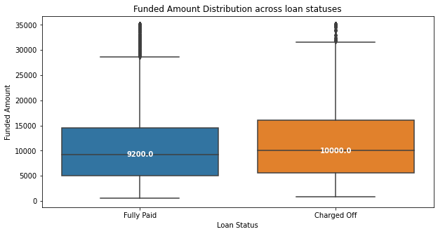
Segmented Univariate Analysis – Funded Amount
Observations
Applicants granted with higher funded amount tend to default more than those who got lesser funded amount

Slide 8
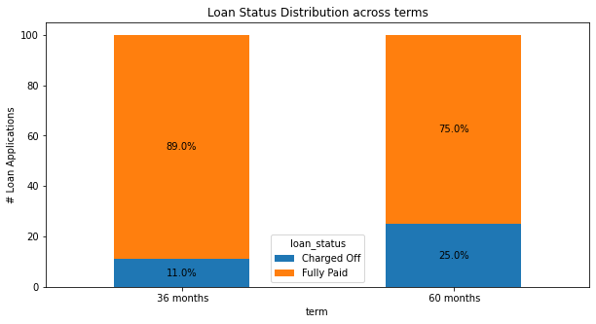
Segmented Univariate Analysis – Loan Term
Observations
Applicants who opted for higher term (60 months) tend to default more than those who opted for 36 months term. This is substantial considering the univariate analysis of term where 75% of the loan was requested/granted for 36months.

Slide 9
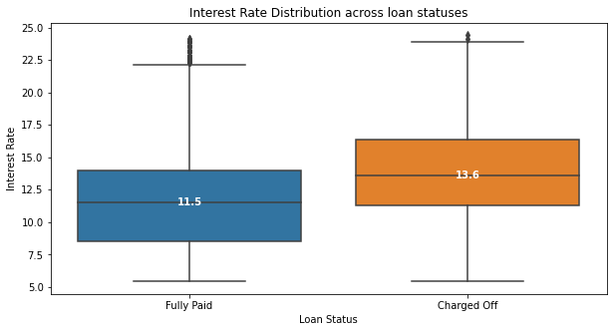
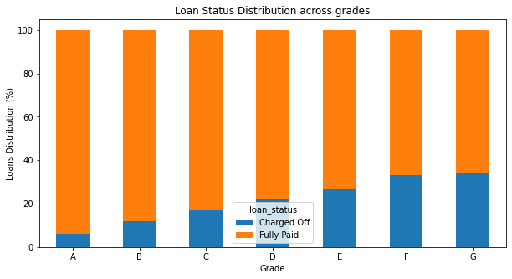
Segmented Univariate Analysis – Interest Rate
Observations
Applicants who got loan for higher interest rate tend to default more than those who got it for lower interest rates
Same behavior is observed for grades and sub grades where alphanumerically higher order grades and subgrades has more default rate. Business wises, grades and sub grades are correlated to interest rate. Hence, this observation is justified

Slide 10
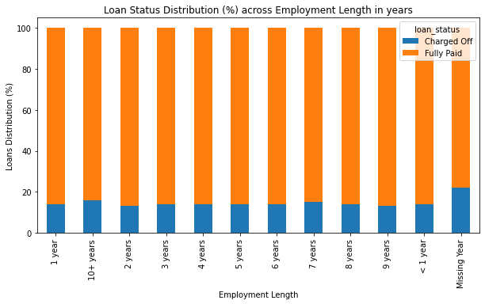
Segmented Univariate Analysis – Employment Length
Observations
Applicants with Employment Length of 10+ years tend to default more than other durations
Applicants whose Employment Length is missing has higher factor of default rate(22%) than all others. This is substantial considering the univariate analysis of employment length where 10+years dominate the distribution

Slide 11
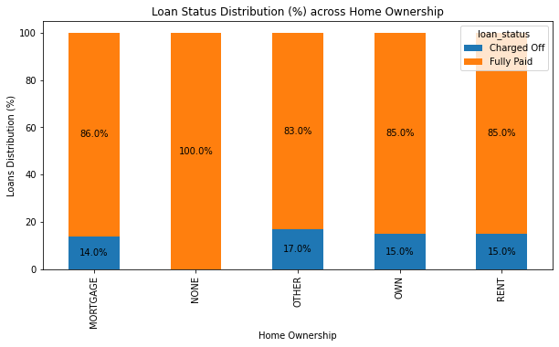
Segmented Univariate Analysis – Home Ownership
Observations
Applicants with home ownership as “OTHER” tend to default more likely than rest of the categories. This is despite the fact that 92% of the applicants has either RENT or MORTAGE as the home ownership.
Interesting to note that there are no defaulters in category “NONE”

Slide 12
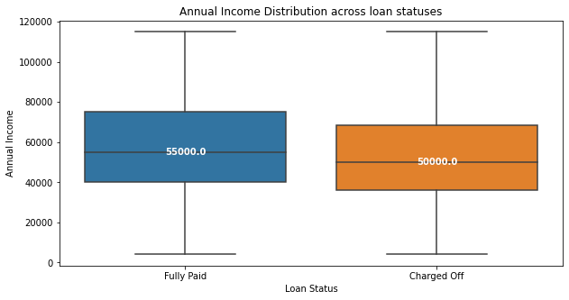
Segmented Univariate Analysis – Annual Income
Observations
Applicants with lesser Annual income tend to default more than those with higher levels of annual income

Slide 13
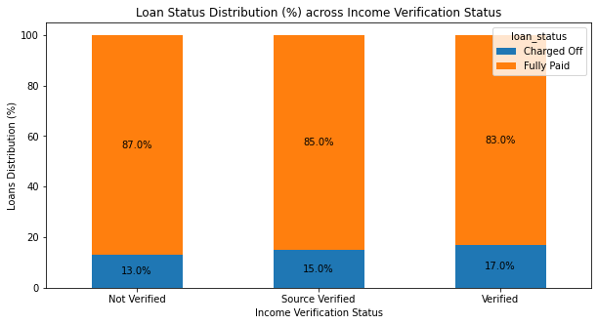
Segmented Univariate Analysis – Income Verification Status
Observations
Surprisingly, Loan Applications whose Income is verified defaults more than others by at least 2%. May be verification process needs to be revisited.
This is substantial considering the fact that 43% of the applicants income were not verified.

Slide 14
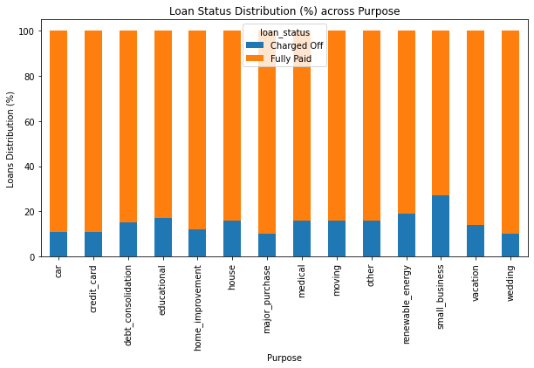
Segmented Univariate Analysis – Purpose
Observations
Applicants whose purpose of loan is “educational” or “small business” tend to default more than other categories by huge difference between 8 % - 17 %.
This is substantial considering the fact that purpose “debt consolidation” dominates the dataset (46% applicants)

Slide 15
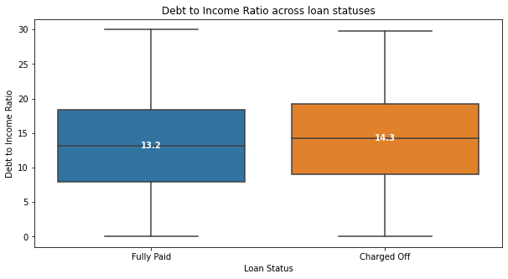
Segmented Univariate Analysis – Debt to Income Ratio
Observations
Applicants with higher debt to income ratio tends to default more than those with lesser debt to income ratio. Although this is not a strong indicator as the difference in mean between them is merely 1

Slide 16
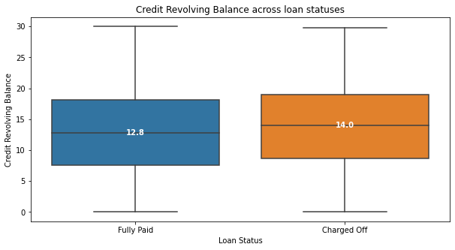
Segmented Univariate Analysis – Revolving Balance
Observations
Applicants with higher credit revolving balance tend to default more than those with lesser credit revolving balance

Slide 17
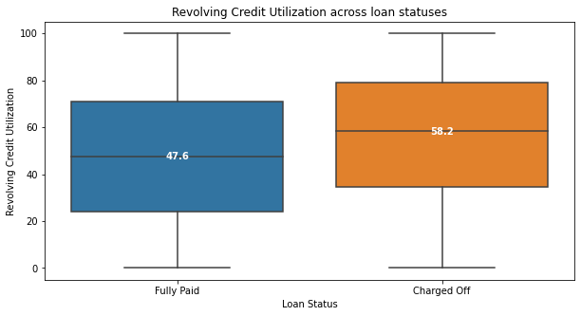
Segmented Univariate Analysis – Revolving Utilization
Observations
Applicants with higher revolving credit utilization tend to default more than those with lesser credit utilization

Slide 18
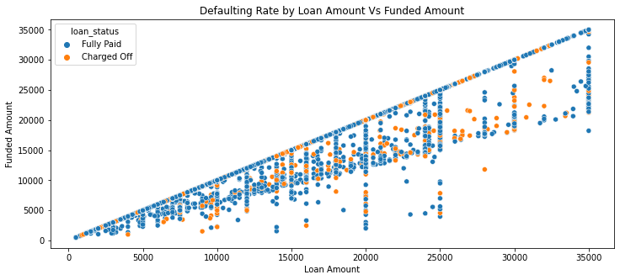
Bivariate Analysis – Loan Amount vs Funded Amount
Observations
There are very less defaulters when funded amount is nearly same as that of requested loan amount (linear relation)

Slide 19
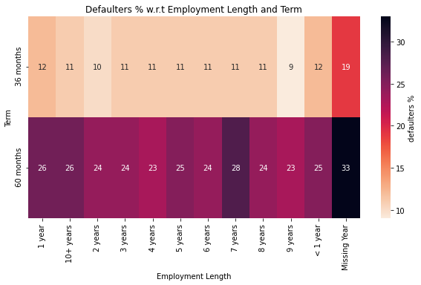
Bivariate Analysis – Term vs Employment Length
Observations
Applicants with employment length of 7 years tend to default more than others when the term is 60 months
Interesting to note that applicants whose employment length is missing also shows similar pattern for 60 months

Slide 20
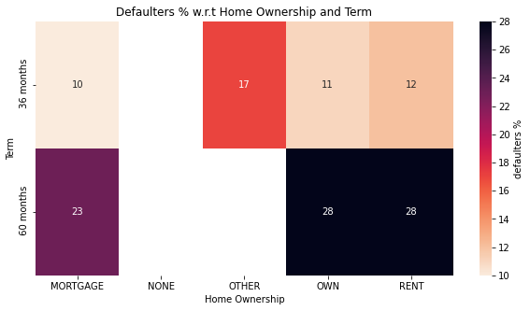
Bivariate Analysis – Term vs Home Ownership
Observations
Applicants with 60 months as term and Home ownership as OWN and RENT tend to default more likely than other combinations

Slide 21
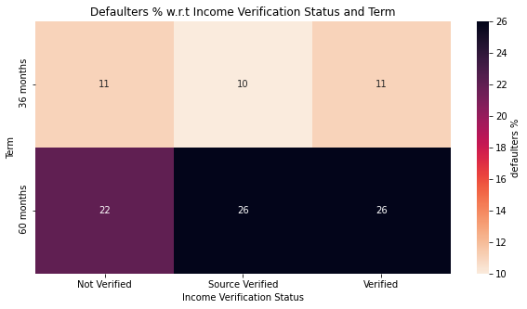
Bivariate Analysis – Term vs Verification Status
Observations
Applicants with 60 months term and verification status as “Source Verified” and “Verified” tend to default more than other combinations

Slide 22
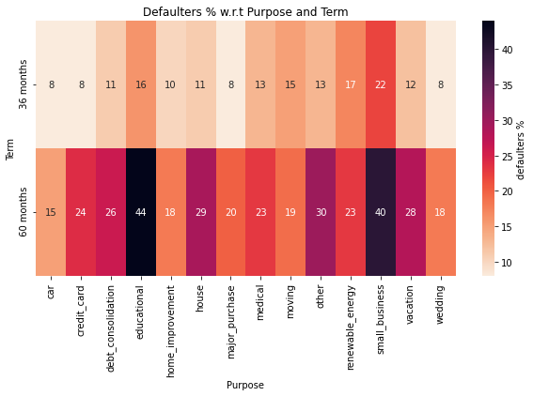
Bivariate Analysis – Term vs Purpose
Observations
Applicants with 60 months term and purpose as “educational” and “small business” tend to default more than other combinations

Slide 23
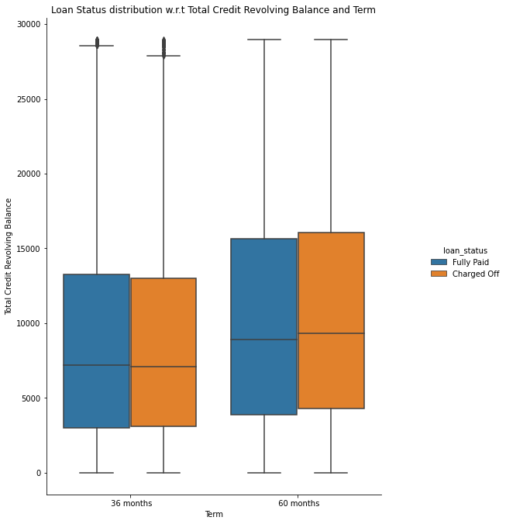
Bivariate Analysis – Term vs Revolving Balance
Observations
Applicants with higher credit revolving balance tend to default likely only for 60 months term

Slide 24
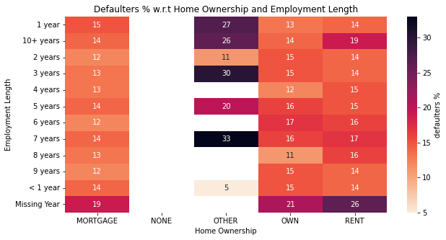
Bivariate Analysis – Employment Length vs Home Ownership
Observations
Applicants with home ownership as “OTHER” and employment length as 7 years or 3 years tend to default more than other combinations

Slide 25
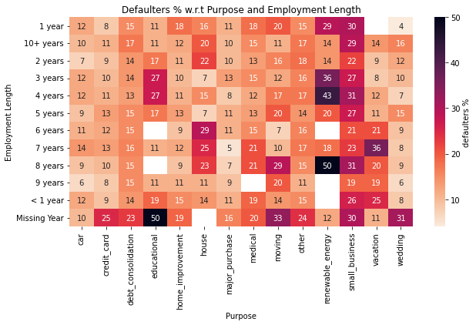
Bivariate Analysis – Employment Length vs Purpose
Observations
Loan Applicants for purpose as renewable energy tend to likely default when their employment length is 4 years or 8 years.
Interestingly, Loan Applicants with no employment length specified tend to default more for educational purpose

Slide 26
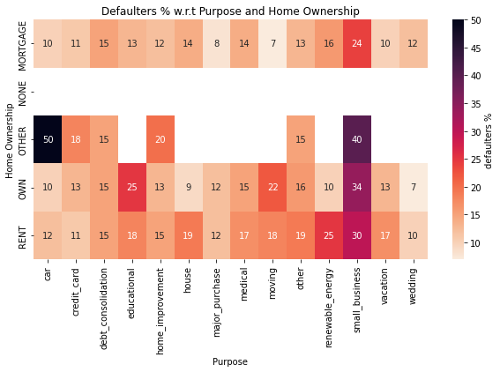
Bivariate Analysis – Home Ownership vs Purpose
Observations
Applicants with the purpose of small business tend to default more likely when home ownership is “RENT”,”OWN” and “OTHER”
Applicants with the purpose of car tend to default with home ownership as “OTHER”

Slide 27
Conclusion
Applicants who opted for higher term (60 months) tend to default more than others.
Applicants who got loan for higher interest rate tend to default more than others.
Applicants with home ownership as “OTHER” tend to default more likely than rest of the categories. Also, there are no defaulters in category “NONE”
Surprisingly, Loan Applications whose Income is verified defaults more than others by at least 2%. May be verification process needs to be revisited.
Applicants whose purpose of loan is “educational” or “small business” tend to default more than other categories by huge difference between 8 % - 17 %.
Applicants whose employment length is missing also shows similar pattern for 60 months
Applicants with 60 months term and verification status as “Source Verified” and “Verified” tend to default more than other combinations
Applicants with no employment length specified tend to default more for educational purpose

