Slide 1



HR_Analytics
View in Power BI
Last data refresh:
6/25/2024 2:43:23 PM UTC
Downloaded at:
6/25/2024 2:44:39 PM UTC

Slide 2
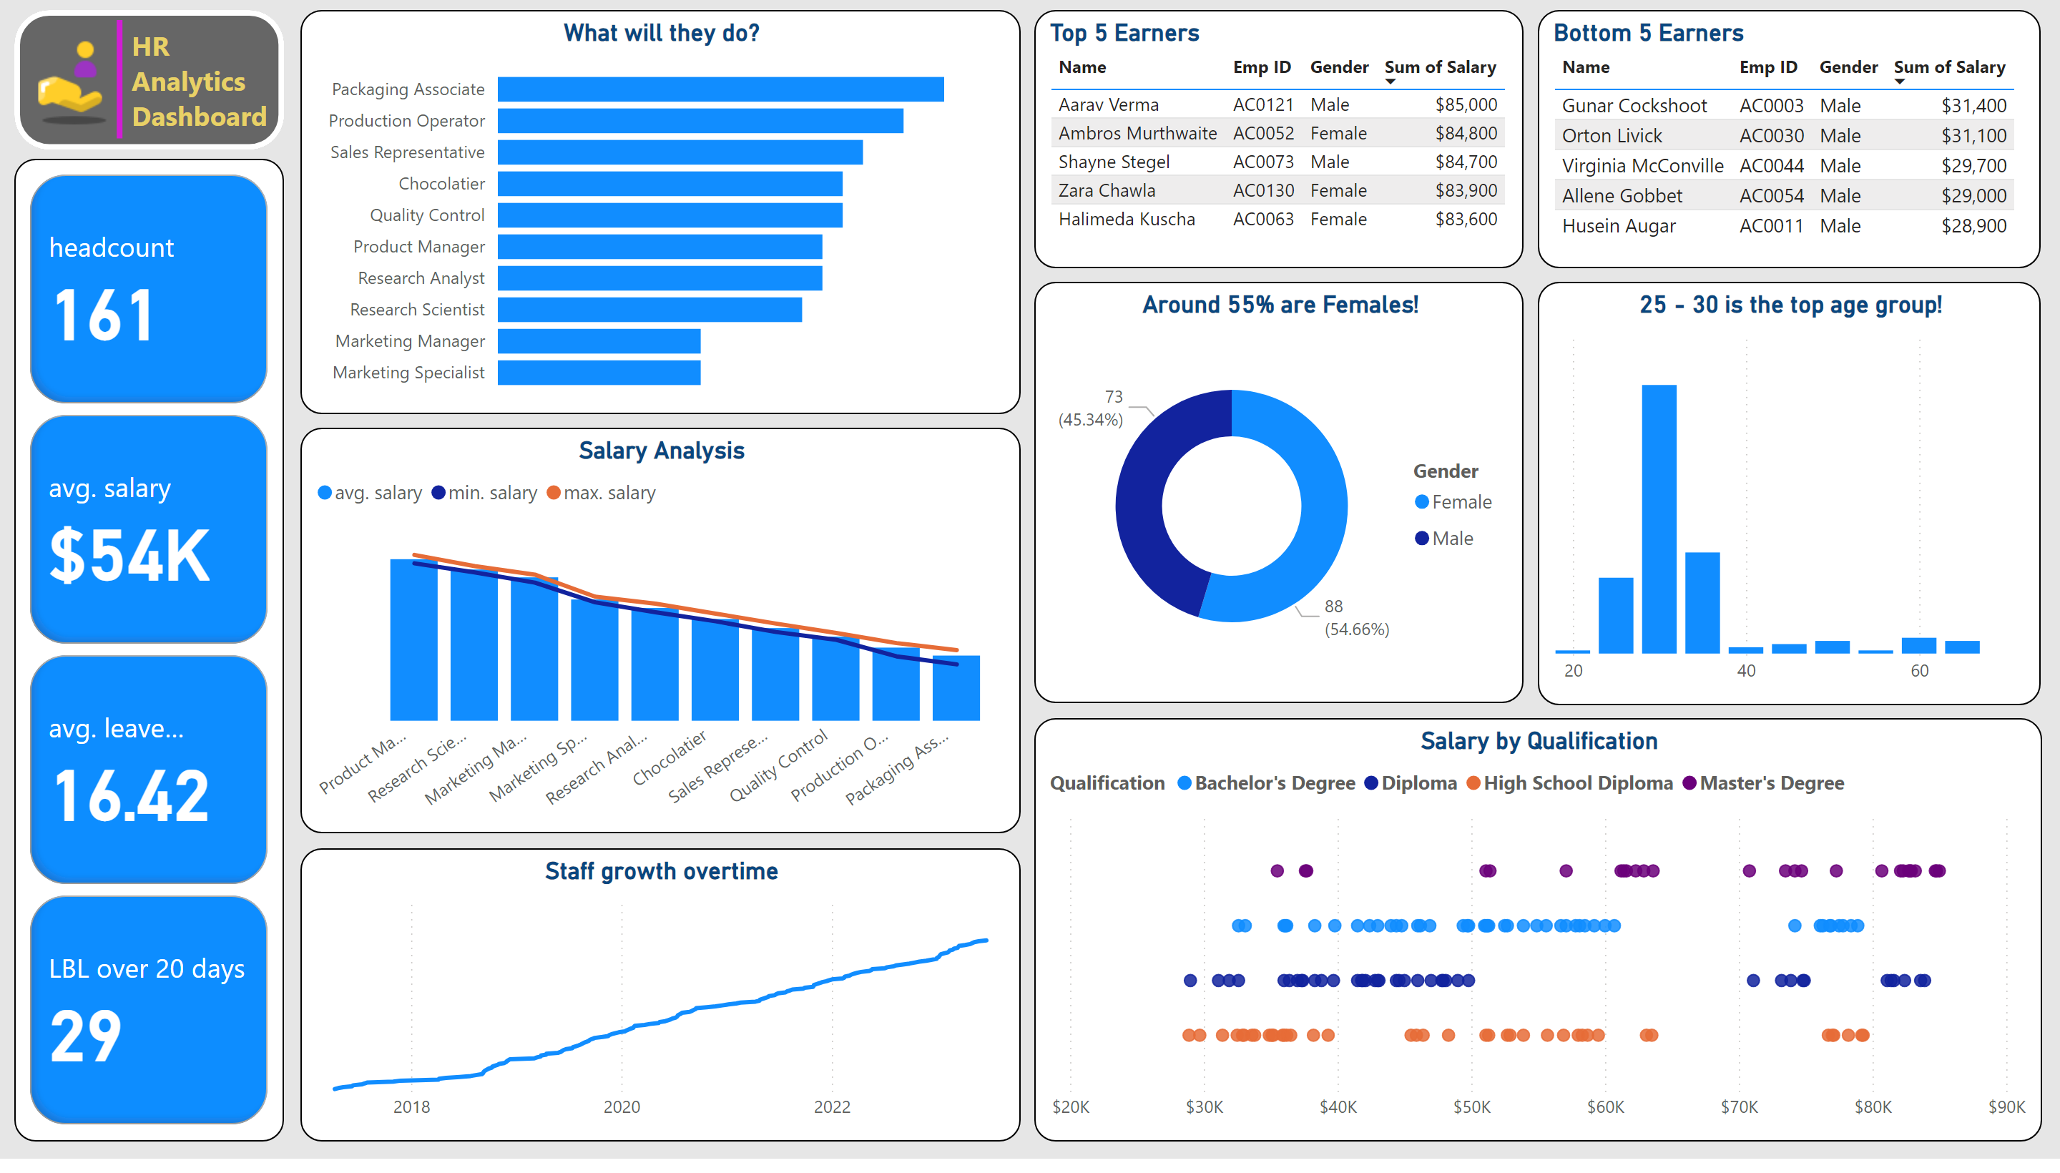
Quick Dashboard
Notes:
cardVisual
No alt text provided
image
No alt text provided
shape
No alt text provided
textbox
No alt text provided
shape
No alt text provided
What will they do?
No alt text provided
Around 55% are Females!
No alt text provided
25 - 30 is the top age group!
No alt text provided
Salary Analysis
No alt text provided
Salary by Qualification
No alt text provided
Staff growth overtime
No alt text provided
Top 5 Earners
No alt text provided
Bottom 5 Earners
No alt text provided

Slide 3
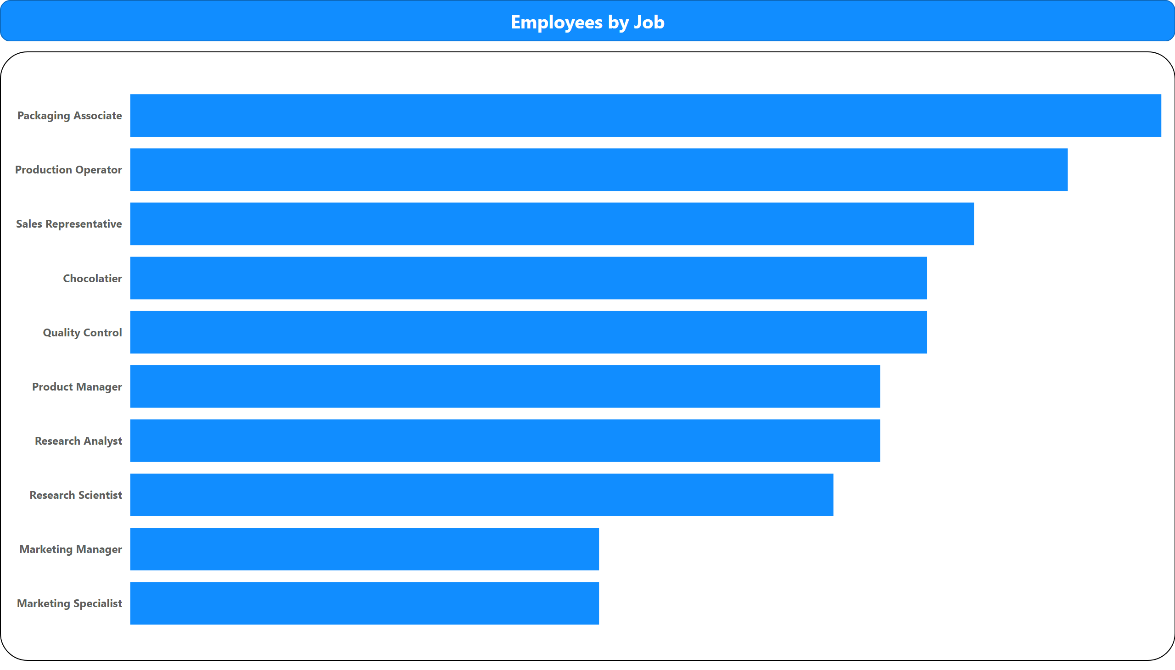
Employees by Job
Notes:
barChart
No alt text provided
shape
No alt text provided

Slide 4
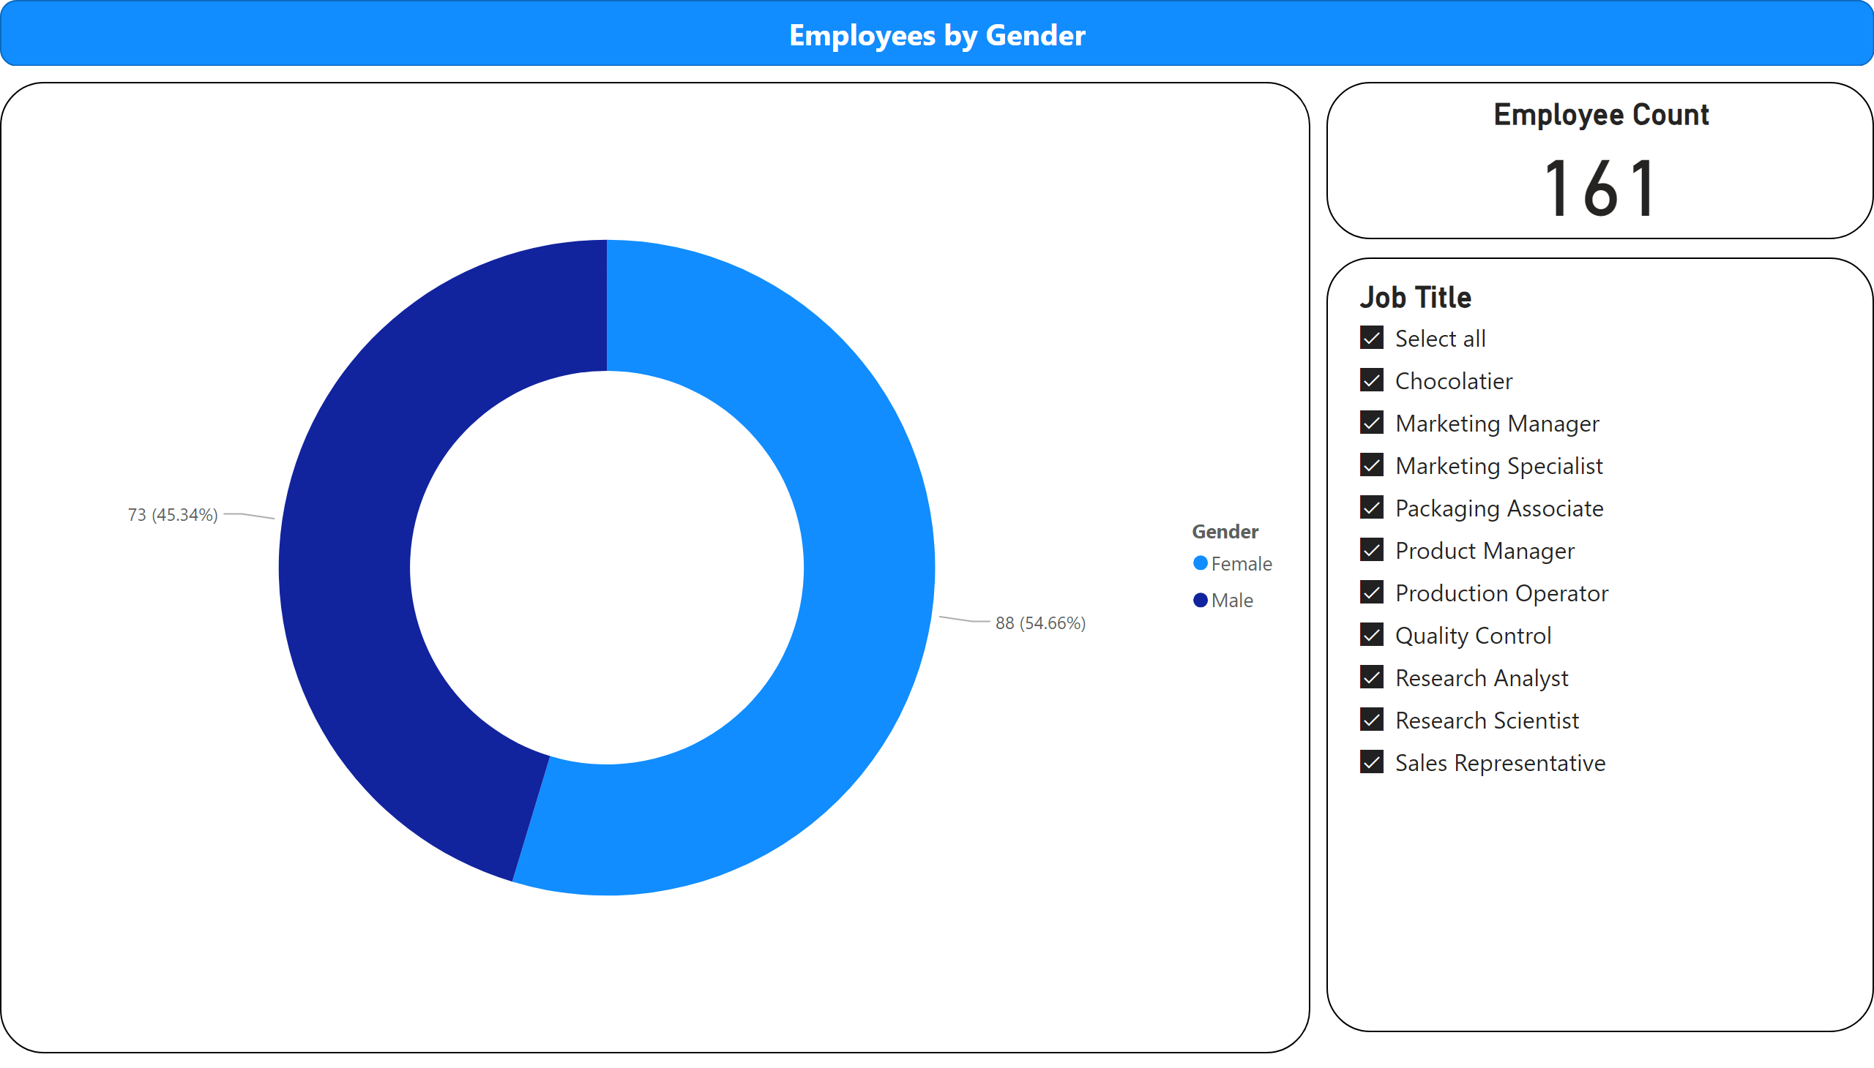
Gender Breakdown
Notes:
Employees by Gender
No alt text provided
slicer
No alt text provided
Employee Count
No alt text provided
shape
No alt text provided

Slide 5
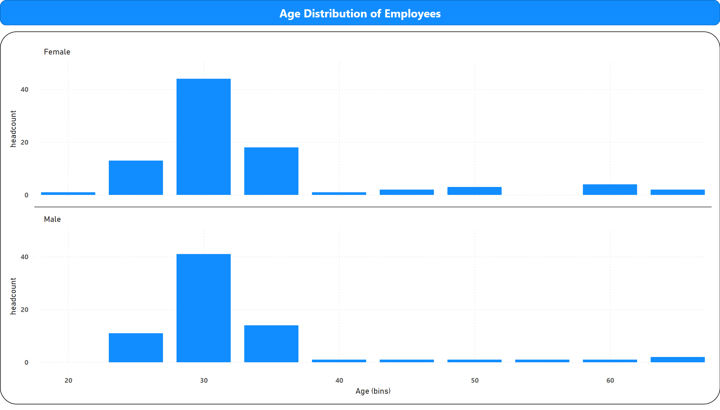
Age Distribution
Notes:
columnChart
No alt text provided
shape
No alt text provided

Slide 6
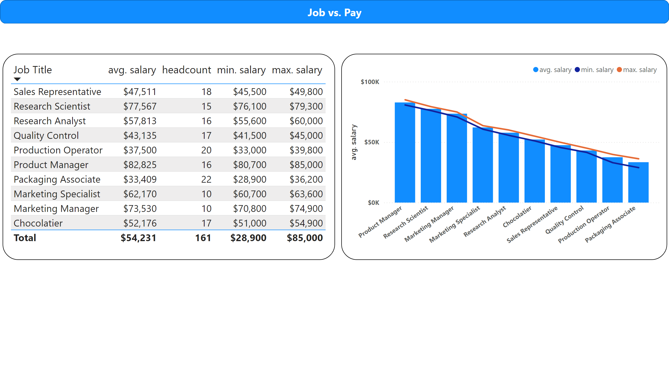
Job / Pay
Notes:
tableEx
No alt text provided
lineClusteredColumnComboChart
No alt text provided
shape
No alt text provided

Slide 7
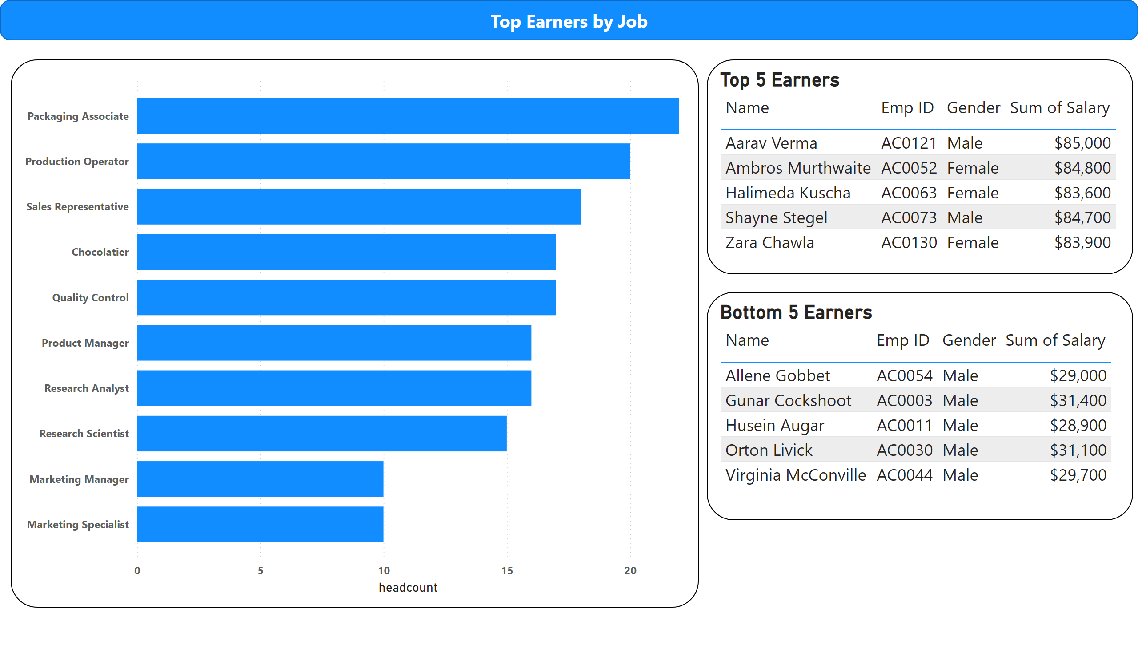
Top Earners / Job
Notes:
barChart
No alt text provided
Top 5 Earners
No alt text provided
Bottom 5 Earners
No alt text provided
shape
No alt text provided

Slide 8
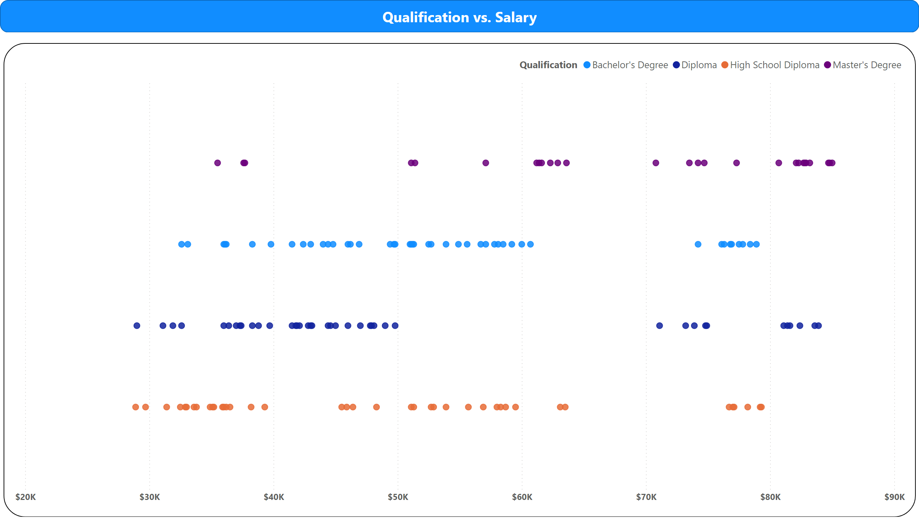
Qualification / Salary
Notes:
scatterChart
No alt text provided
shape
No alt text provided

Slide 9
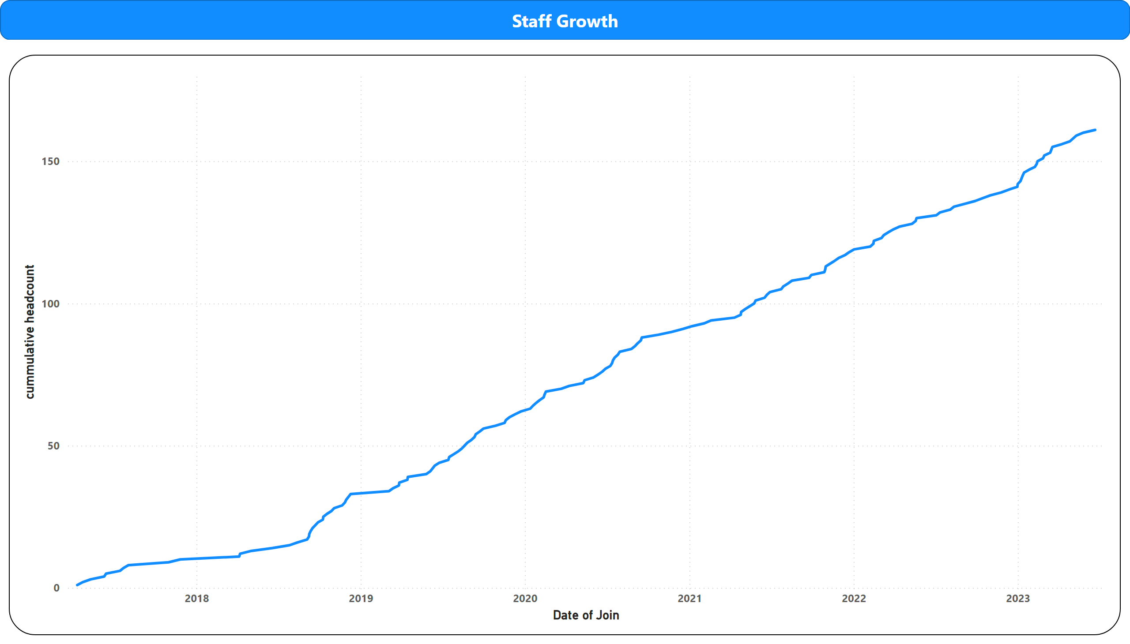
Staff Growth
Notes:
lineChart
No alt text provided
shape
No alt text provided

Slide 10
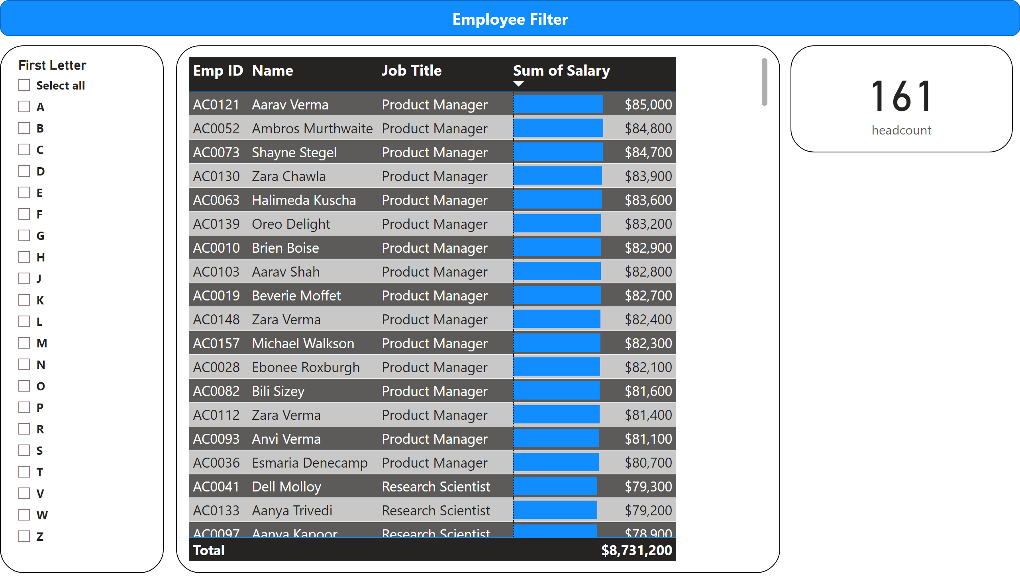
Employee Filter by starting letter
Notes:
slicer
No alt text provided
tableEx
No alt text provided
card
No alt text provided
shape
No alt text provided

Slide 11
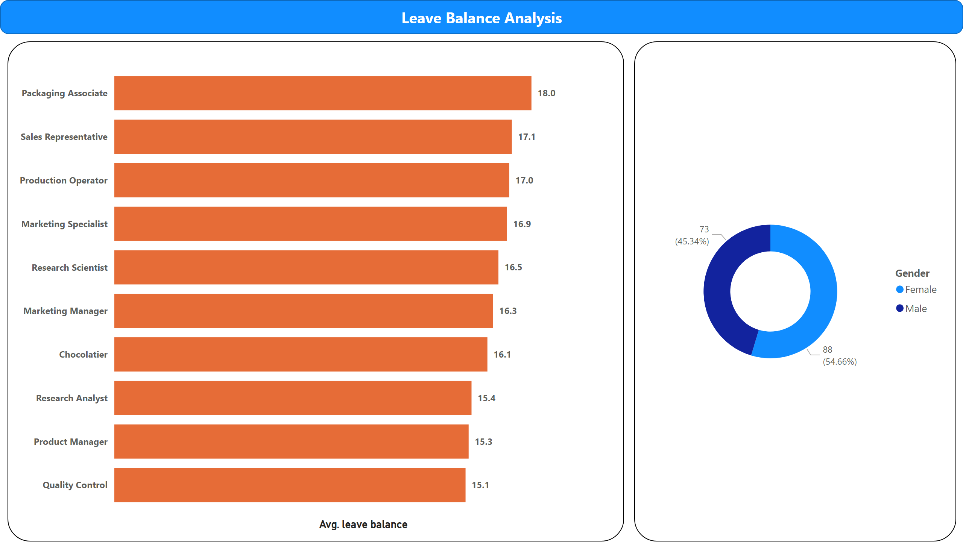
Leave Balance Analysis
Notes:
barChart
No alt text provided
Employees by Gender
No alt text provided
shape
No alt text provided

Slide 12
Thank You

