Slide 1

HR ANALYSIS
prepared by Sathish kanna S

Slide 2
Objective:
The HR Analysis Project aims to provide a comprehensive evaluation of employee data to identify trends and patterns related to employee demographics, job roles, compensation, satisfaction, and attrition. The analysis leverages various attributes to gain insights that can inform HR strategies and improve organizational effectiveness.

Slide 3
Using Excel, Power BI, My SQL, and Python, I merged two HR datasets into a single dataset named "HR Table," which contains 35 columns and 50,000 rows. I then cleaned the data by removing 3 columns, renaming headers, and reordering columns for easier analysis. Finally, I have created some kPI questions and I created an interactive dashboard in Power BI and Excel Sheet to facilitate more effective HR data visualization and analysis.

Slide 4
KPI Questions:
Question: 1 Count number of attrition "Yes" and "No" in each department?
Question: 2 Calculate monthly average income and hike percent by department?
Question: 3 Calculate the monthly average income of educational field ?
Question: 4 Count marital status both male and female ?
Question: 5 Which department has monthly high ratings ?
Question: 6 Count number of department has non - traveler ?
Question: 7 Find the distance from home to work place by department ?
Question: 8 How many peoples has 10 to 35 total working years experience by
each department?
Question: 9 Find how many years working in the same company and in same department ?

Slide 5
Excel:
The dataset was merged using the VLOOKUP function.
It contains 35 columns and 50,000 rows.
Unwanted columns were removed, and the remaining columns were rearranged.
There are No Null values in the dataset.
Pivot tables were created to make the Excel dashboard interactive.
Key Performance Indicator (KPI) questions were formulated to help HR analyze the dataset.
The company has spent 1 crore and 37 lakhs on the total employees.
The dataset shows that 25,059 males and 24,941 females are working in the company.
The company has six different departments.
The company provides monthly salary hikes to employees with good performance.
Using the Excel dashboard, HR will become familiar with employee details.

Slide 6
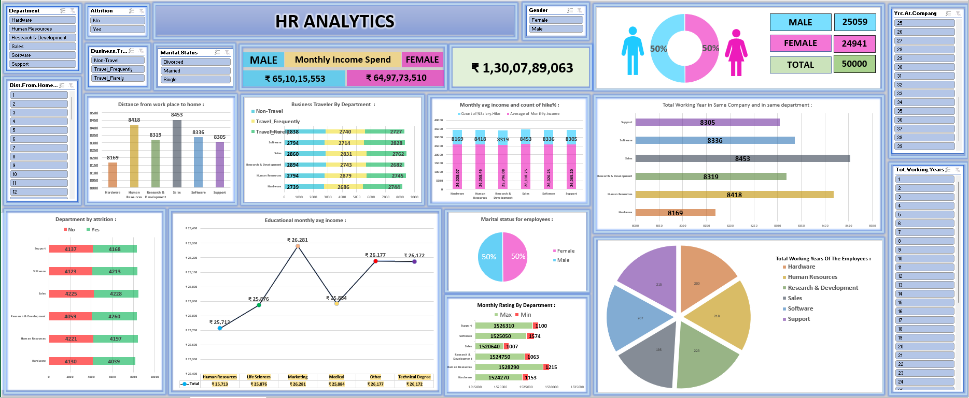

Slide 7
Power BI
The dataset was combined using the Merge Queries function in the Transform Data option.
It contains 35 columns and 50,000 rows.
Unwanted columns were removed, and the remaining columns were rearranged.
There are No Null values in the dataset.
A Power BI dashboard was created to make the data more interactive.
Key Performance Indicator (KPI) questions were formulated to help HR analyze the dataset.
Using the Power BI dashboard, HR will become familiar with employee details.
The dashboard includes visualizations such as stacked column charts, stacked bar charts,
Pie charts, line and clustered column charts, donut charts, cards, and slicers.

Slide 8
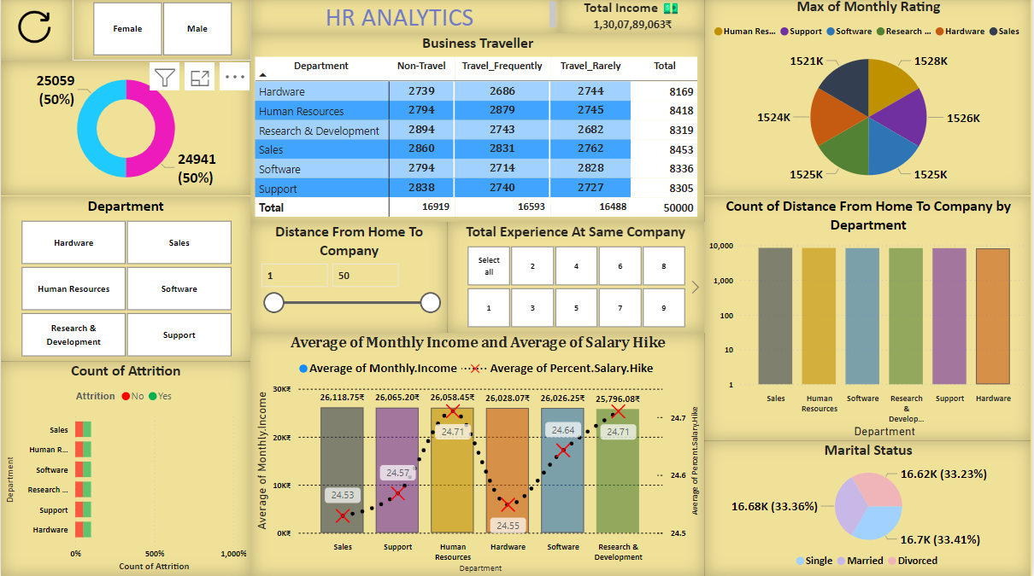

Slide 9
My SQL
The dataset was combined using the Inner Join function.
It contains 35 columns and 50,000 rows.
Unwanted columns were removed by Drop function, and the remaining columns were rearranged.
There are No Null values in the dataset.
Key Performance Indicator (KPI) questions were formulated to help HR analyze the dataset.
Using Structured Query Language (SQL), HR will become familiar with employee details.
This Structured Query Language include function such as Alter, Inner Join, Group By, Order By, Average, Maximum, Minimum, Count .

Slide 10
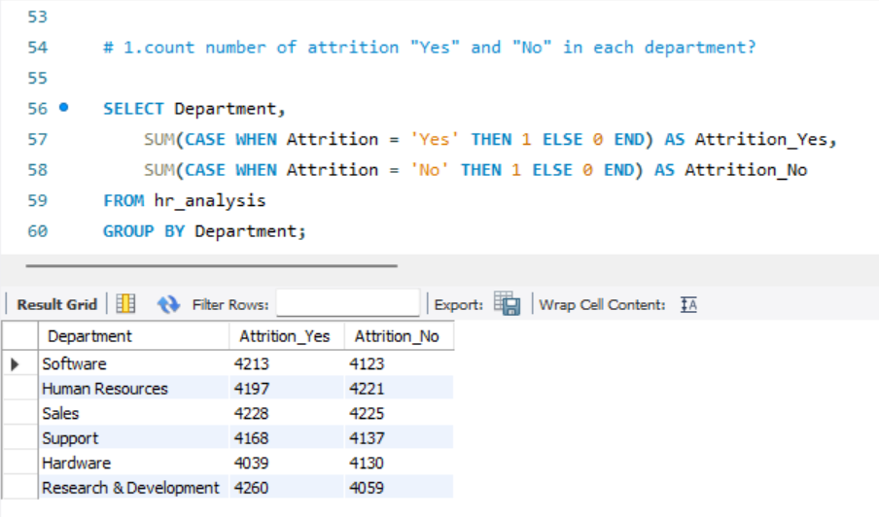
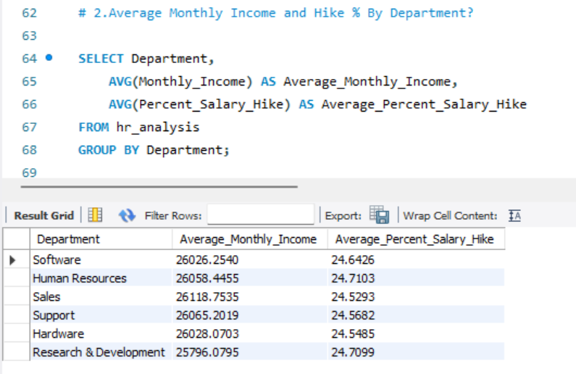
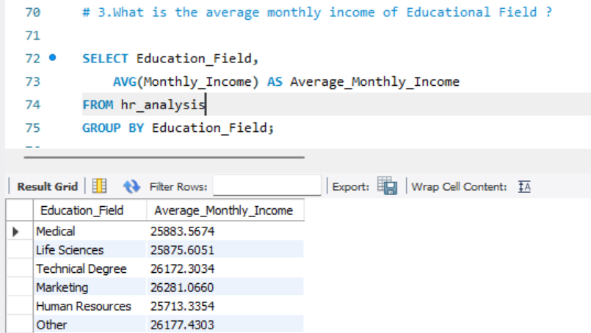
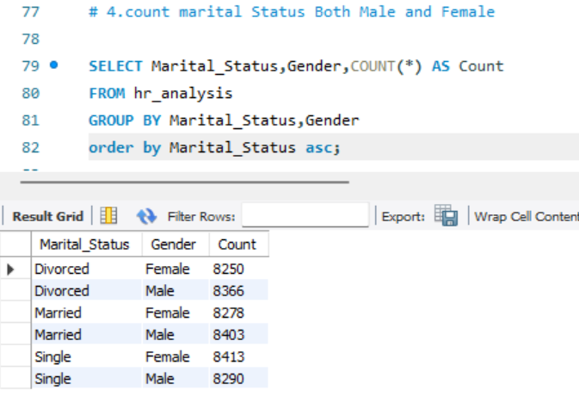

Slide 11
Python
The dataset was combined using the ‘Merge’ function.
It contains 35 columns and 50,000 rows.
Unwanted columns were removed by ‘Dropna’ function, and the remaining columns were rearranged.
The ‘IS.NULL’ function were used to check any null values in the data frame.
The ‘HEAD’ function were used to check first 5 rows in the data frame.
The ‘TAIL’ function were used to check last 5 rows in the data frame.
The ‘INFO’ function were used to check basic information about the data frame.
The ‘DESCRIBE’ function were used to check statistics of the data frame.
The ‘PANDAS’ and ‘SEABORNS’ were used in this data frame.

Slide 12
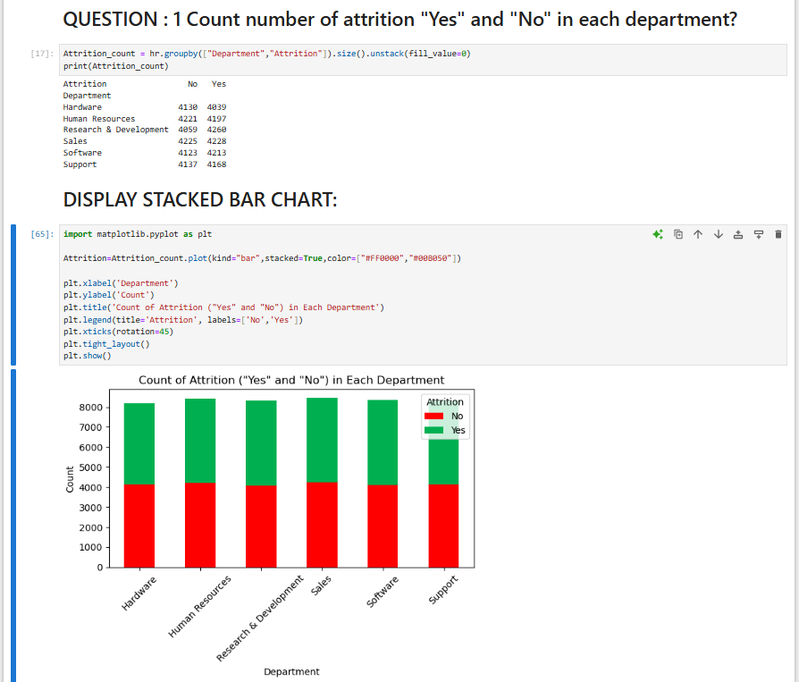
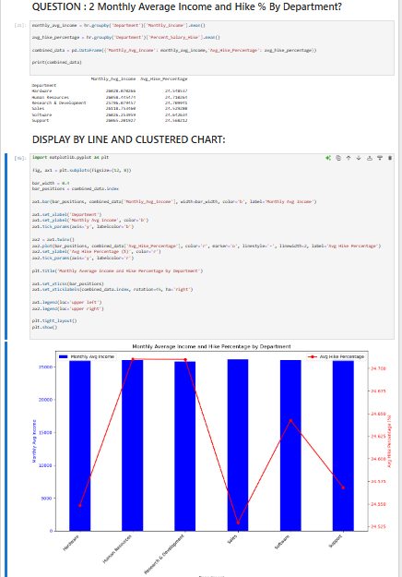
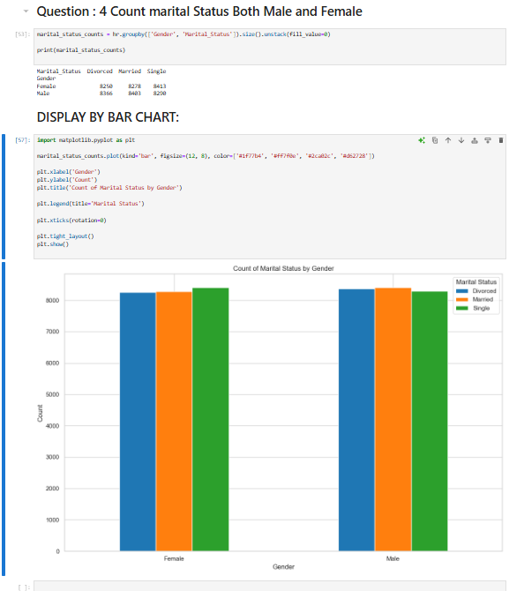
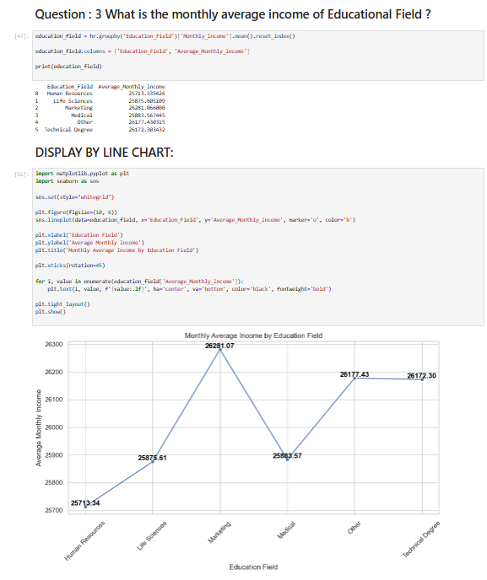

Slide 13
Conclusion:
The project provides actionable insights into employee attrition, compensation structures, job satisfaction, and work conditions. These insights are intended to support HR decision-making, enhance employee retention, and improve overall job satisfaction within the organization.

Slide 14
THANK YOU

