Slide 1















Disney+Hotstar
Presented by Sathish Kumar Ravi
Batch Code : MBT11

Slide 2

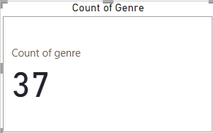
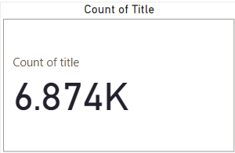

Slide 3
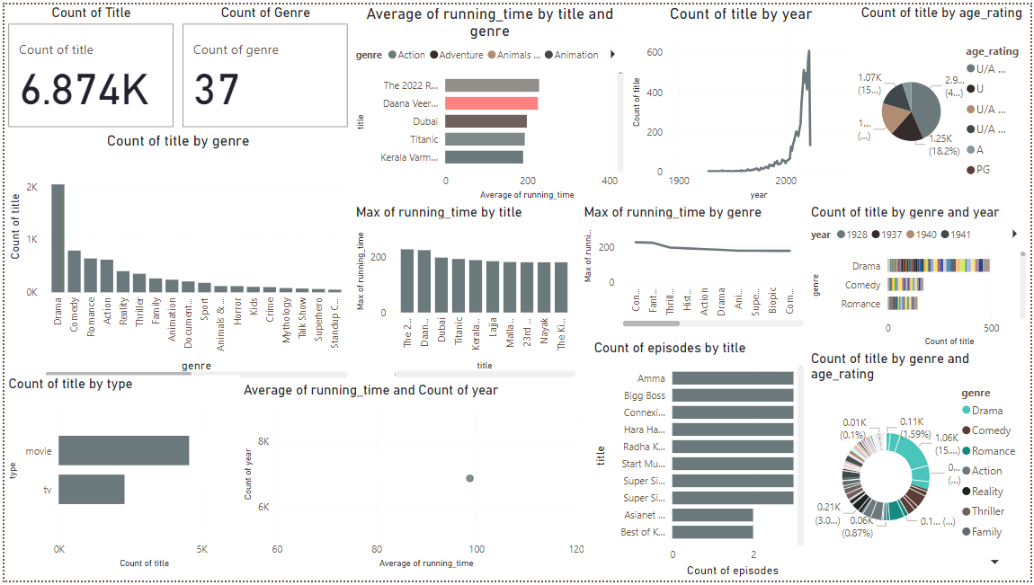
DashBoard

Slide 4
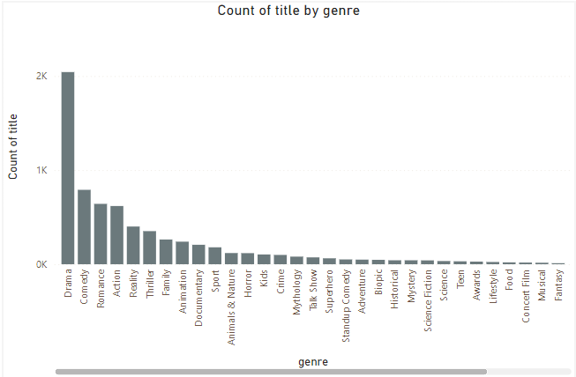
1. Distribution of Movies by Genre :

Slide 5
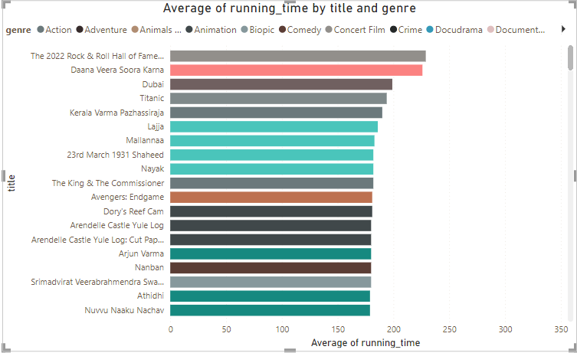
2. Average Running Time by Genre :

Slide 6
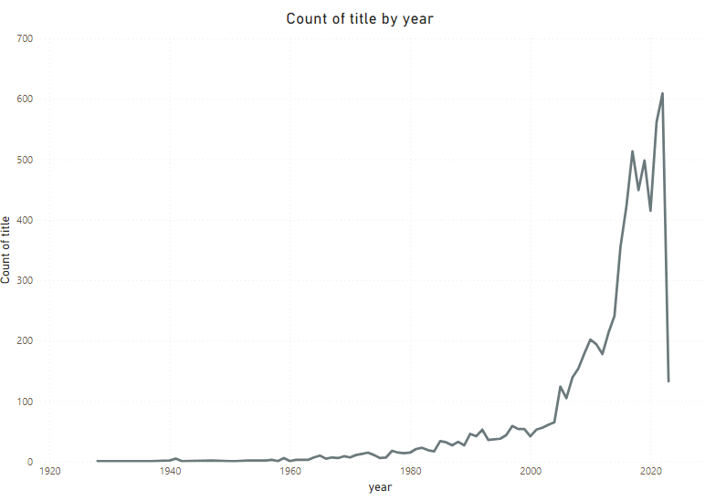
3. Movies Released Each year :

Slide 7
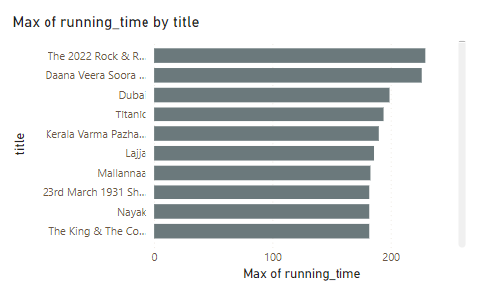
4. Top 10 Longest Movies :

Slide 8
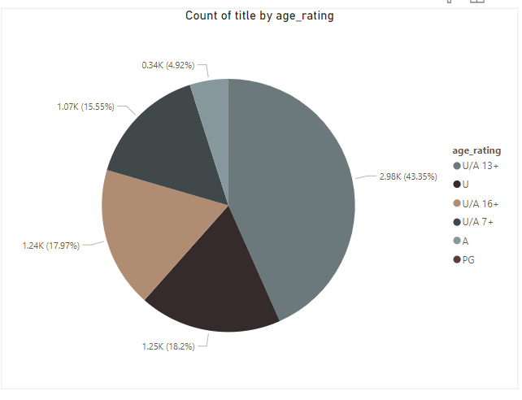
5. Movies by Age Rating :

Slide 9
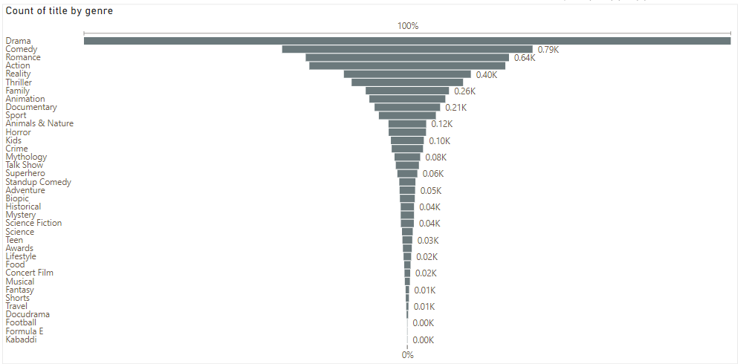
6. Count of Movies by year and Genre :

Slide 10
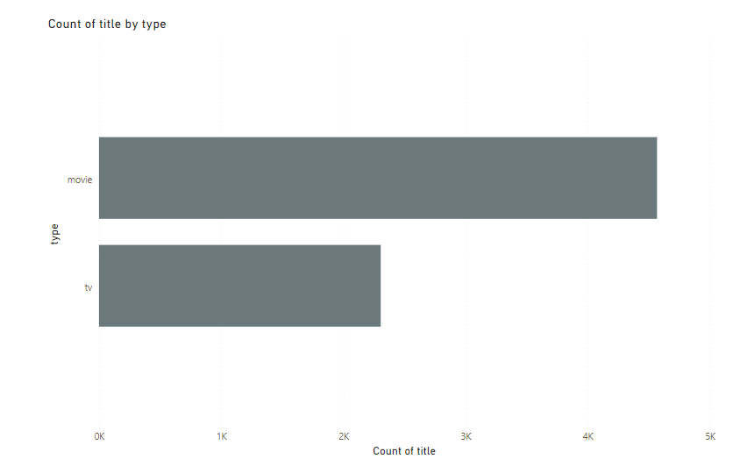
7. Most Common Movie Types :

Slide 11
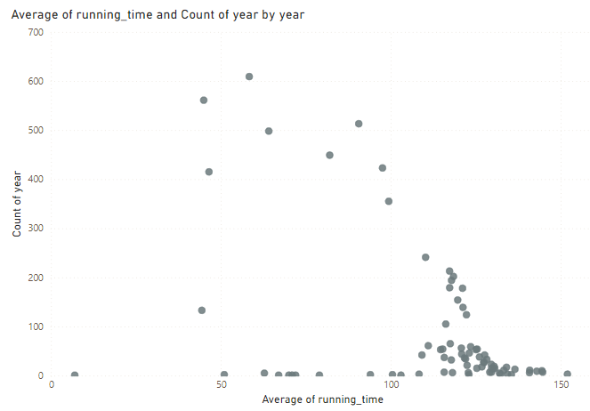
8. Correlation Between Running Time and Year :

Slide 12
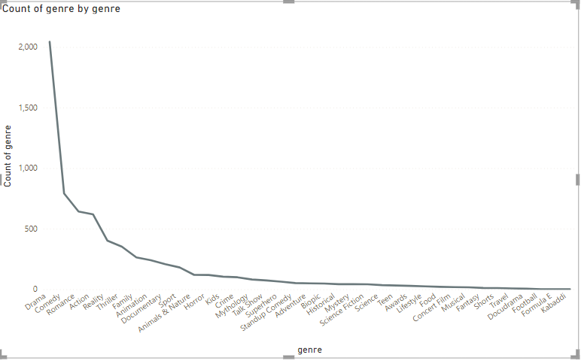
9. Genre Popularity Over Time :

Slide 13
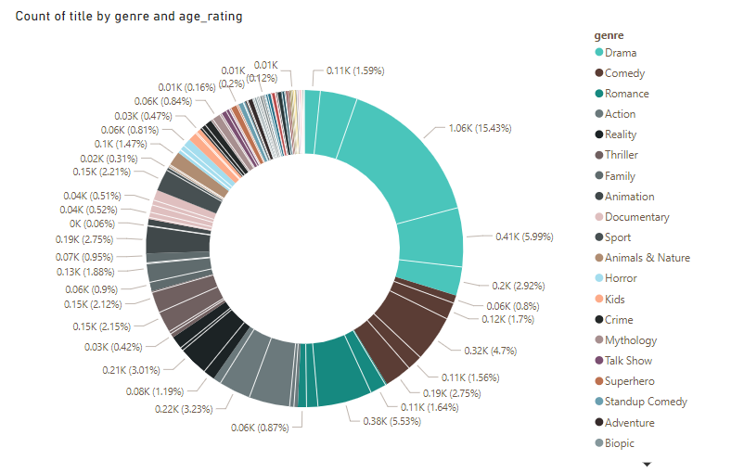
10. Movies by Genre and Age Rating :

Slide 14
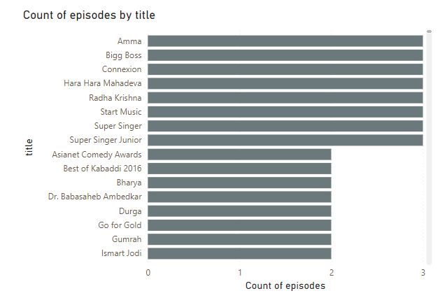
11 . Movies With Maximum Episodes :

Slide 15
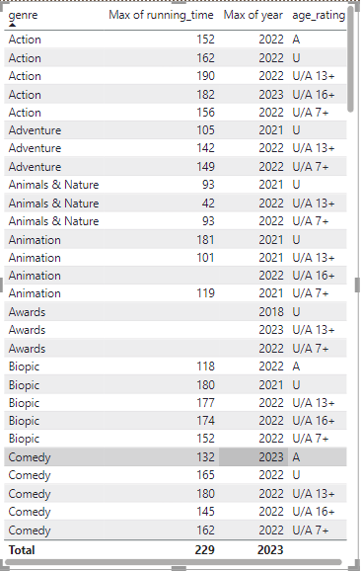
12. Analysis of Specific Genres :

Slide 16
Thank you very much!
Sathishkumaravi29@gmail.com

