Slide 1

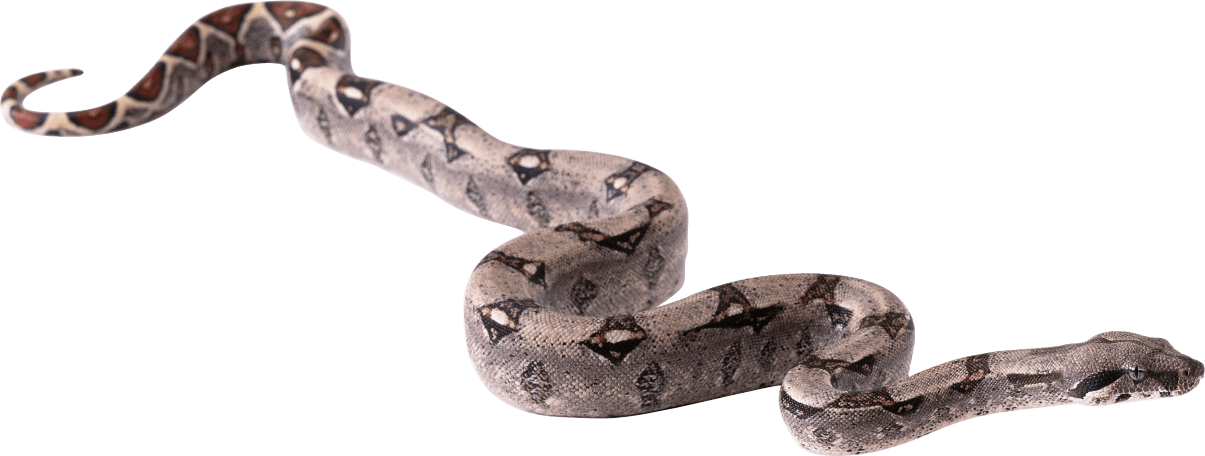



INFOBIN
A P E R S O N A L DATABASE

Slide 2
Data and Personal Data
Data was is and will be the most confidential thing to Protect.
This Universe of Network will hold most of our personal information.
Collected from our social media logins.
Therefore ,there is a need to store or remember our login details.
But ,Actually everyone could not.
-::MOTO::-
To create a personal database ,such that the Internet user store all his/her login information in his own “DATABASE”.

Slide 3
OUTPUT

Slide 4
DATABASE: MySQL
PYTHON MODULES:
->Tkinter
->MySQL
->PyWhatKit
->DateTime
->MessageBOX
->Data Encryption and Decryption
KNOWLEDGE

Slide 5
CONCLUSION
It can “PROTECT” your data from second user who is accessible to your database.
You will have a simple User Interface to use this application.
WE INVOLVED
Vijay Thota
SaiPavan Pabba
Sathish Mogulagani

