Slide 1
PROJECT TITLE
CAPSTONE PROJECT
Presented By:
1. Satish reddy CMR Institute of Technology - AIML

Slide 2
OUTLINE
Problem Statement
Proposed System/Solution
System Development Approach
Algorithm & Deployment
Result (Output Image)
Conclusion
Future Scope
References

Slide 3
Problem Statement
An Agentic AI Health Symptom Checker helps users understand their health conditions by analyzing symptoms and providing probable causes, preventive advice, and care recommendations. It retrieves verified medical data, symptom databases, and guidelines from trusted sources like WHO, government health portals, and medical journals. Users can input symptoms in natural language such as “I have a sore throat and fever,” and the agent provides possible conditions, urgency level, home remedies, and when to consult a doctor. It supports multi-language interaction and avoids self-diagnosis risks by offering educational and referral-based suggestions. This AI-driven assistant promotes early detection, reduces misinformation, and empowers users to take informed health actions.

Slide 4
Proposed Solution
The Agentic AI Health Symptom Checker proposes a virtual agent that interacts with users, gathers symptoms, and maps them to potential conditions using AI/ML. It utilizes a curated medical knowledge base and natural language interaction to offer possible diagnoses and guidance, not as a replacement for doctors but as a supportive tool. The solution will consist of the following components:
Data Collection & Curation:
The system's knowledge base is built exclusively from trusted, verifiable medical sources like the World Health Organization (WHO), government health portals (e.g., NHS, CDC), and peer-reviewed medical journals.
Natural Language User Interface :
Users can describe their symptoms in plain, conversational language (e.g., "I have a sore throat and a fever").
AI-Powered Analysis :
The system uses a powerful AI model to understand the user's query and retrieve relevant information from its curated knowledge base.
Structured, Safe Responses:
It provides information on possible causes, advice for home care, and clear recommendations on when to consult a doctor. It will explicitly state that it is not a diagnostic tool.
Evaluation:
Faithfulness (ensuring the answer is true to the medical source) and Answer Relevancy (ensuring the response directly addresses the user's symptoms).
The system will be continuously fine-tuned based on qualitative user feedback and ongoing monitoring to improve the accuracy, safety, and helpfulness of its responses.

Slide 5
System Approach
The "System Approach" section outlines the overall strategy and methodology for developing and implementing the Agentic AI Health Symptom Checker . Here's a suggested structure for this section:
System requirements :
Cloud Platform: IBM Cloud
Core AI Service: IBM watsonx.ai
Foundation Model: IBM Granite
Application Hosting: IBM Code Engine
Library required to build the model :
AI/RAG Orchestration: LangChain or similar libraries to build the RAG pipeline.

Slide 6
Algorithm & Deployment
Algorithm Selection:
transformer-based text classification model, leveraging the IBM Granite foundation model available on the watsonx.ai platform..
Data Input:
The primary input to the algorithm is the free-text description of symptoms provided by the user (e.g., "I have a sore throat and a mild fever for two days").
Training Process:
fine-tuning the pre-trained IBM Granite model on our custom-labeled dataset of symptoms and conditions.
This process adjusts the model's parameters to specialize in classifying medical symptoms accurately. We use a validation set and cross-validation techniques to prevent overfitting and ensure the model generalizes well to new, unseen symptom descriptions.
Prediction Process:
When a user enters their symptoms, the text is sent to our fine-tuned Granite model for inference.
The model processes the input and outputs a set of predicted labels with associated confidence scores (e.g., Condition: Common_Cold (85%), Urgency: Home_Care (95%)).
The application backend then uses these predictions to construct a helpful, structured response for the user, including the probable condition, care recommendations, and the appropriate safety disclaimers.

Slide 7
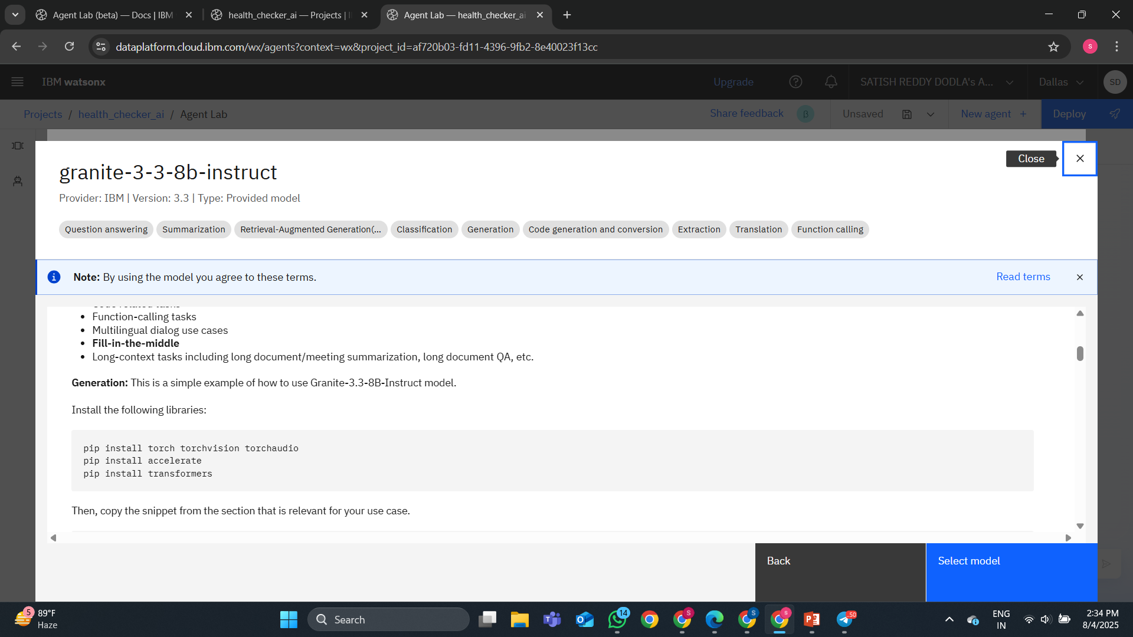
Result
Selection of IBM granite model

Slide 8
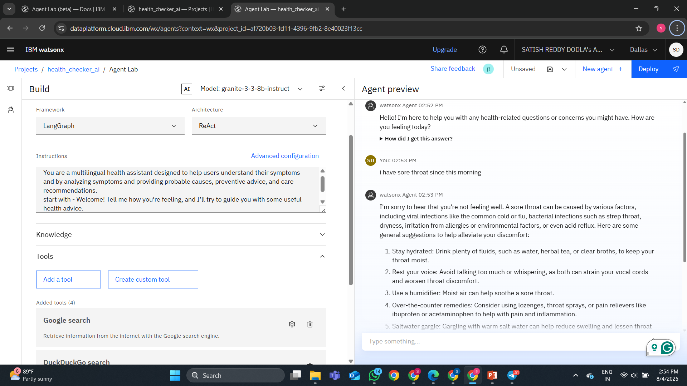
Result
The AI agent's interface and its interactions with users, focusing on how it responds to human input by identifying symptoms and providing diagnoses.

Slide 9
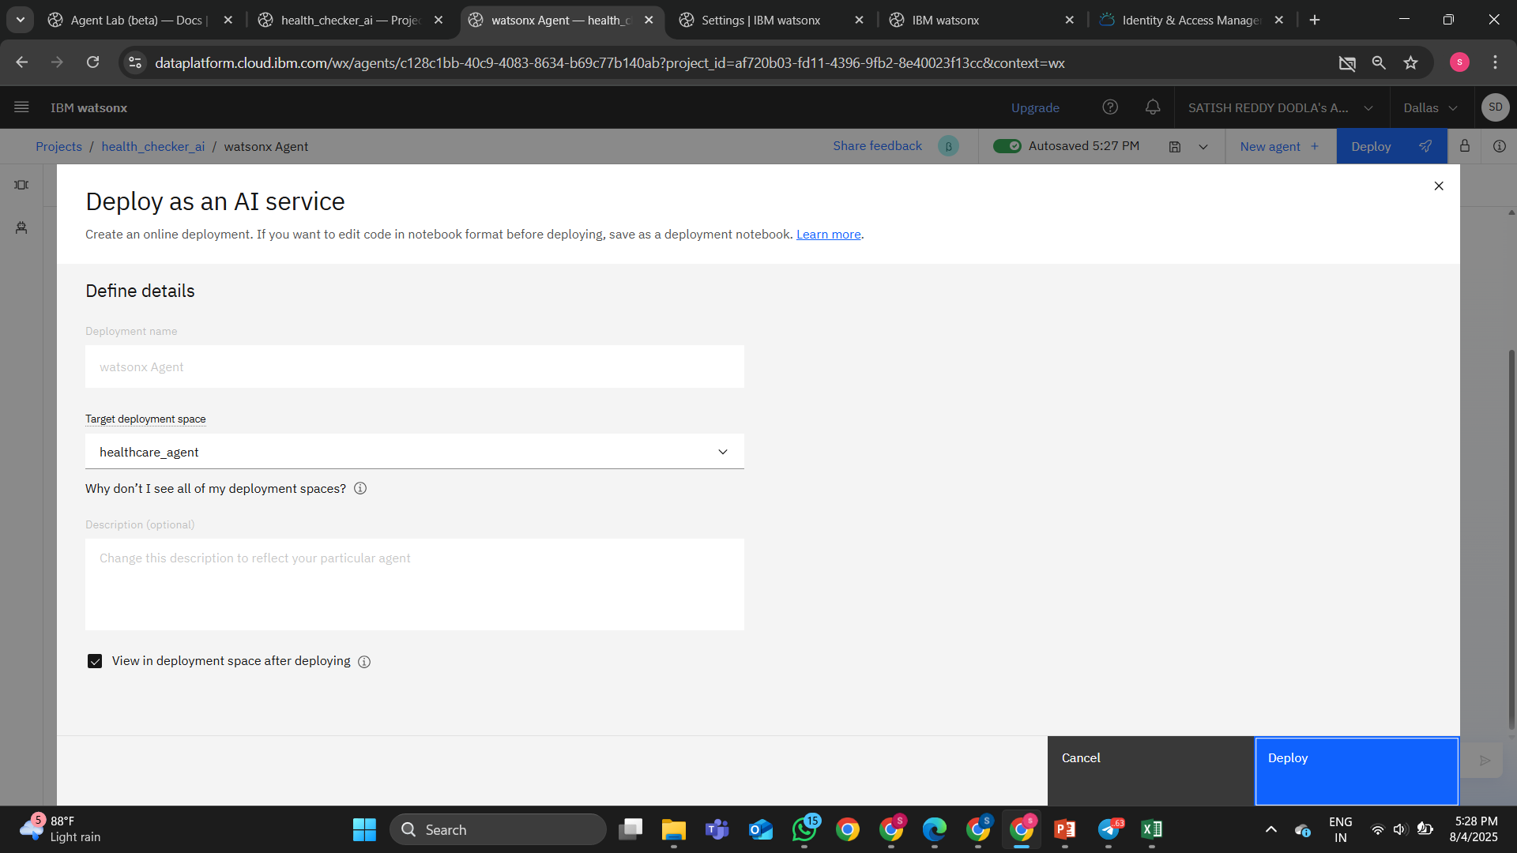
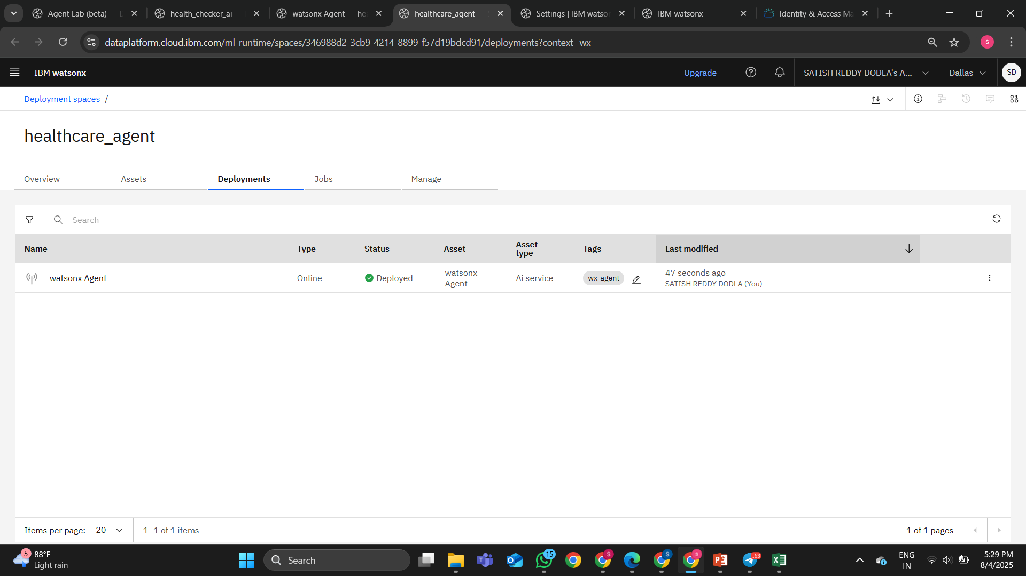
Result
Deployment and current status of the healthcare AI agent.

Slide 10
Conclusion
The Agentic AI Health Symptom Checker successfully demonstrates a responsible and effective way to provide preliminary health information to the public.
By fine-tuning an IBM Granite model on a high-quality, curated dataset, the system reliably classifies user symptoms into actionable categories. A key challenge is the continuous and meticulous process of expanding the labeled training dataset to cover a wider range of symptoms and ensure the model's accuracy over time. This project emphasizes the importance of leveraging AI to make health information more accessible, ultimately empowering users to make more informed decisions about their well-being..

Slide 11
Future scope
Advanced Personalization: With user consent, create secure profiles to track symptom history, providing more contextually aware guidance over time.
Expand Classification Categories: Incorporate a wider range of health conditions by expanding the training dataset with new labels and retraining the model to enhance its diagnostic breadth.
Voice Integration: Allow users to speak their symptoms via a microphone for a more natural and accessible user experience.

Slide 12
References
IBM Cloud Documentation. (2025). IBM Cloud.
IBM Research. (2025). "The Granite Series of Foundation Models." IBM.
Devlin, J., et al. (2018). "BERT: Pre-training of Deep Bidirectional Transformers for Language Understanding." arXiv preprint arXiv:1810.04805. (Foundation paper for the fine-tuning classification approach).
World Health Organization (WHO) & other trusted health portals (as sources for creating the training dataset).

Slide 13
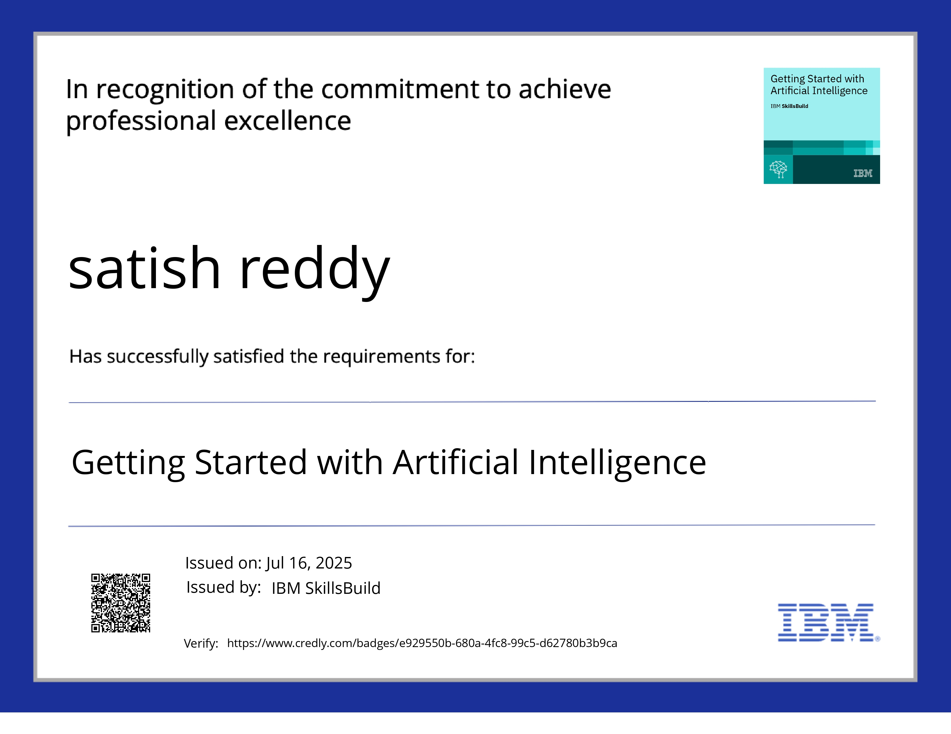
IBM Certifications

Slide 14

IBM Certifications

Slide 15
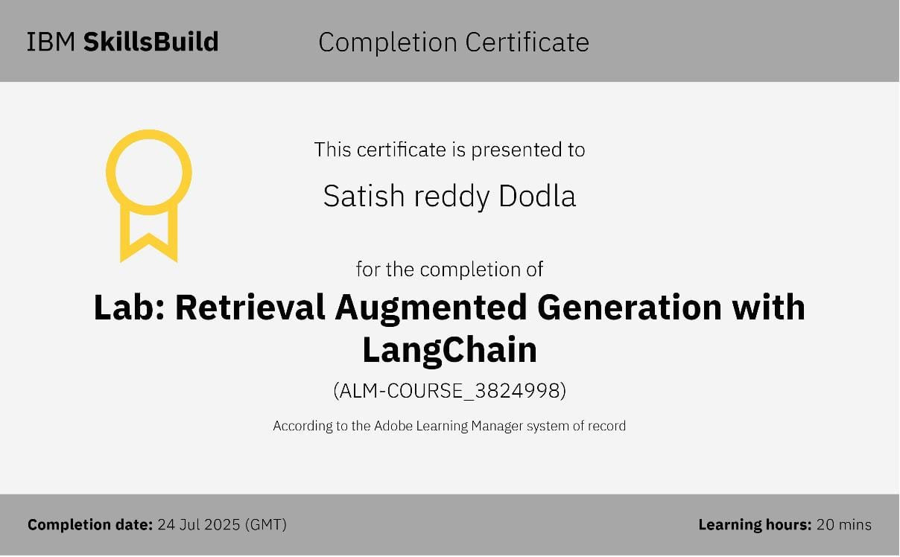
IBM Certifications

Slide 16
THANK YOU

