Slide 1

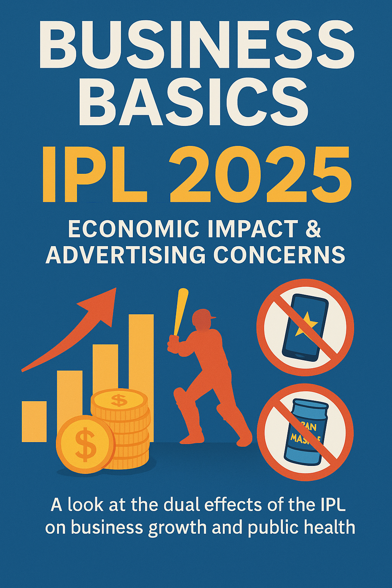

Slide 2
Problem Statement
IPL 2025 fuels massive economic growth but faces backlash for over 50% of its ads promoting fantasy gaming and pan masala. "Business Basics" aims to analyze this dual impact—highlighting both the financial gains and the social/health concerns tied to its advertising practices.

