Slide 1
Real World Analytics
ASSESSMENT 2
Using Aggregation functions for data analysis
Presented by
Sathiyanarayanan Senthil Kumar

Slide 2
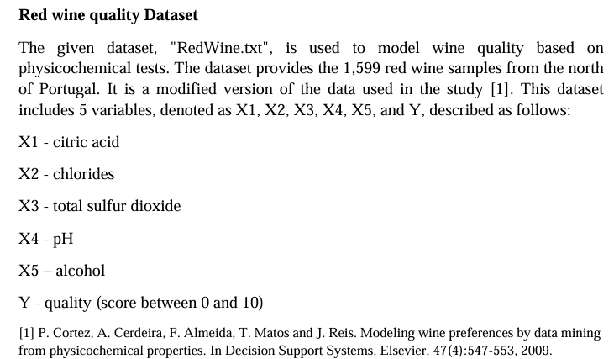
Task requirement
To analyse the given RedWine dataset and predict the wine quality using the following steps.
Visualize the dataset
Transform the data
Build model and compare the results
Use the best model for prediction
Background on RedWine dataset

Slide 3
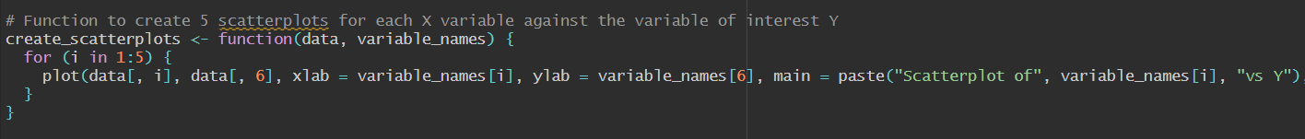
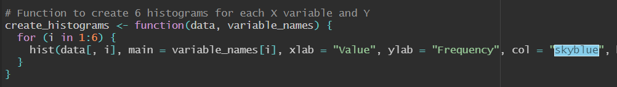

Dataset Visualization using ggplot2:
1. Scatterplots:
2. Histogram:
3. Calling:

Slide 4
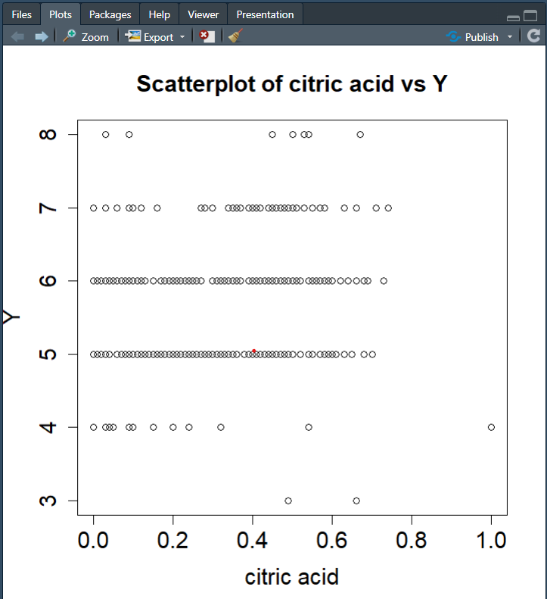
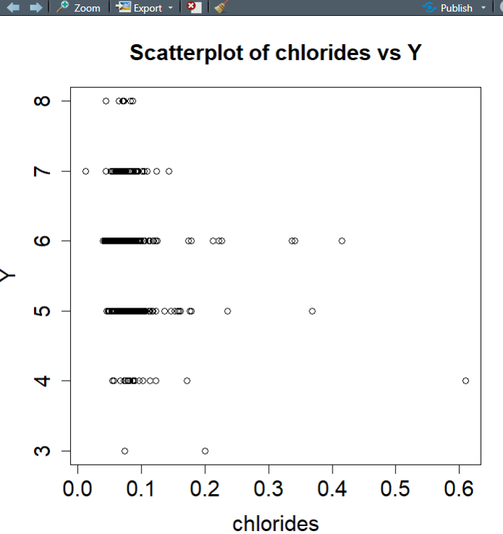
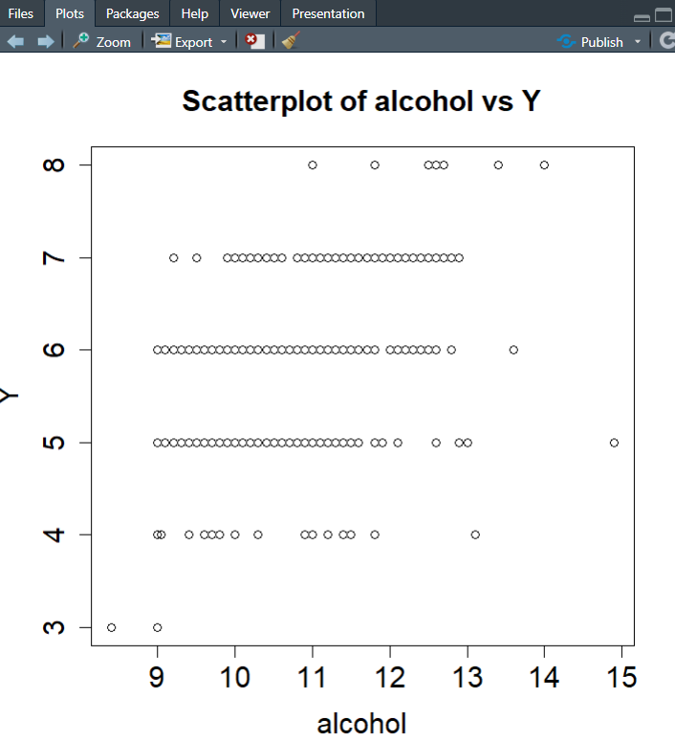
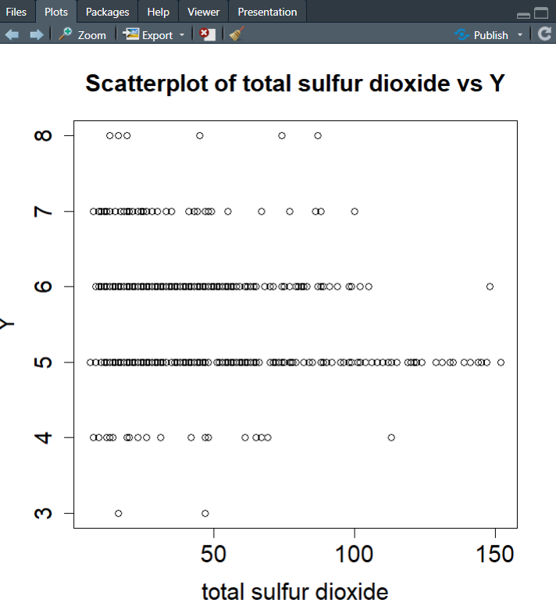
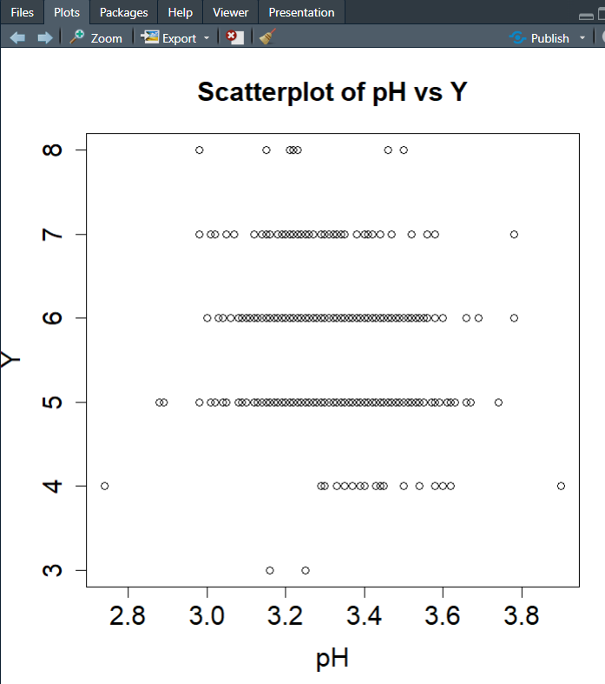
Scatterplots
Insights:
Slightly increase in rank with increase in alcohol
Scattered overall – Can’t conclude as of now

Slide 5
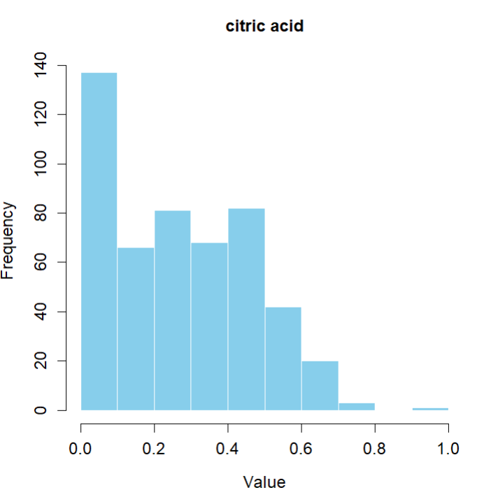
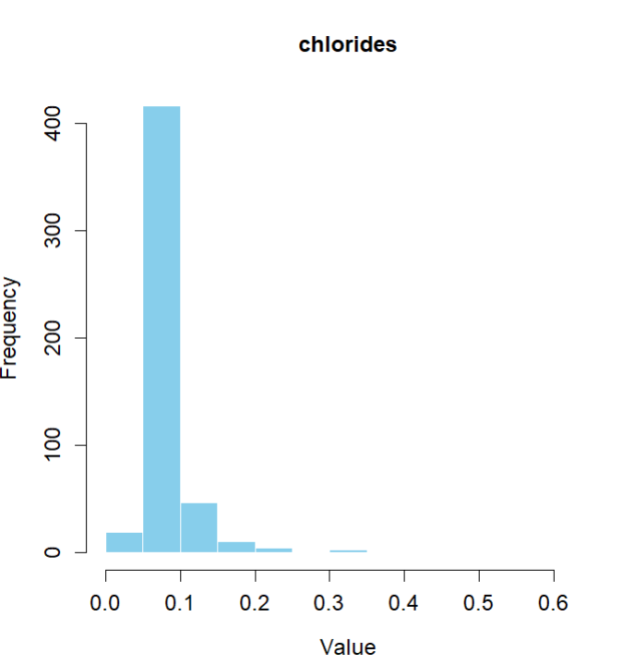
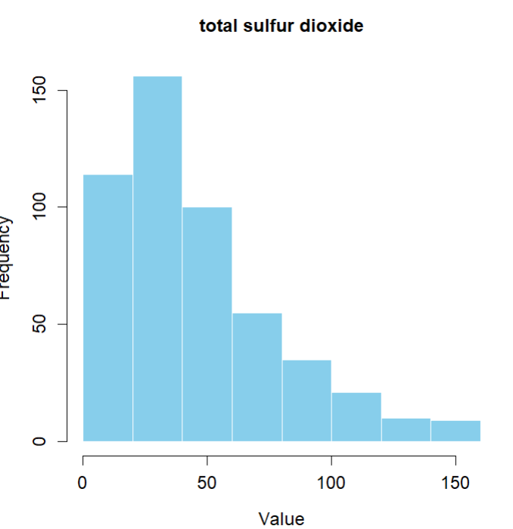
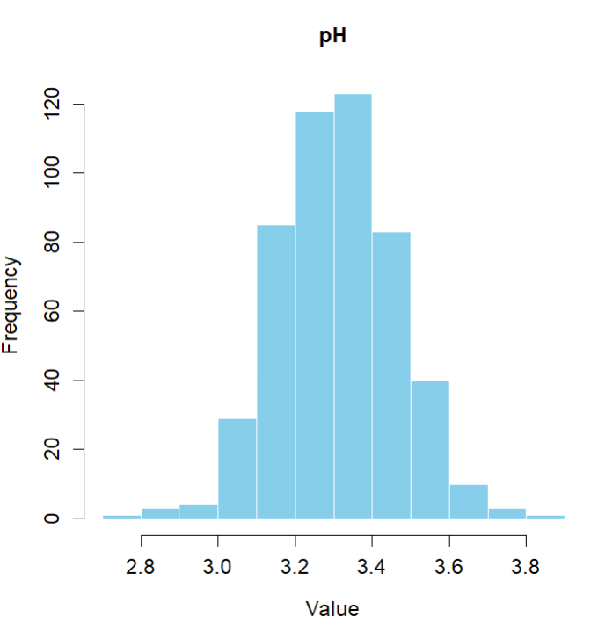
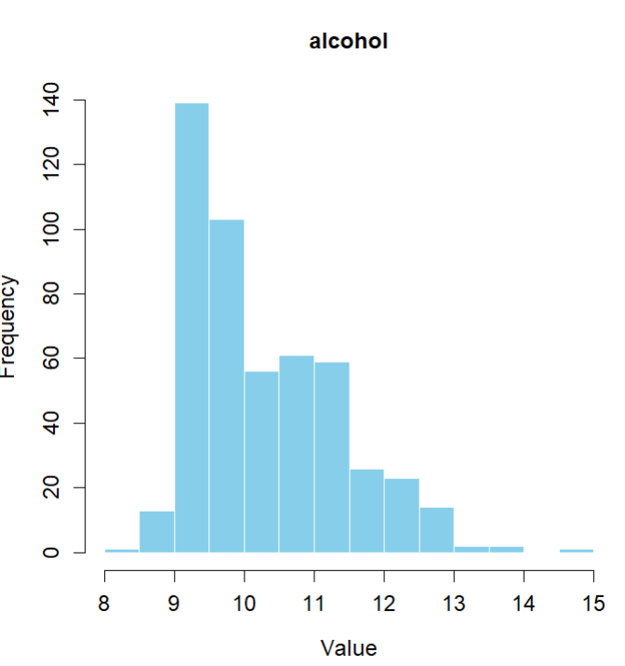
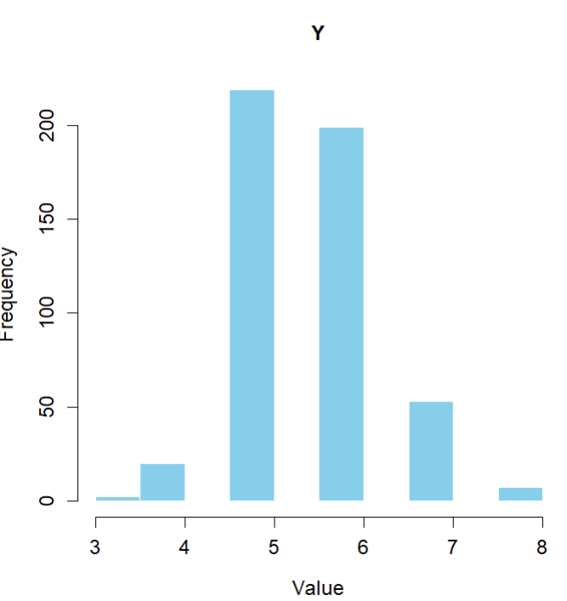
Histograms
Insights:
Citric acid – Positive skewed
Chlorides – strongly positive skewed
Total sulfur dioxide – positive skewed
pH – Almost normal
Alcohol – positive
Y – Slightly positive

Slide 6
Data Transformation
Selected variables for analysis:
Citric acid
Total Sulfur dioxide
pH
Alcohol
(Did not select chlorides because it shows very similar properties for all qualities)
2. Variable of interest:
Y

Slide 7
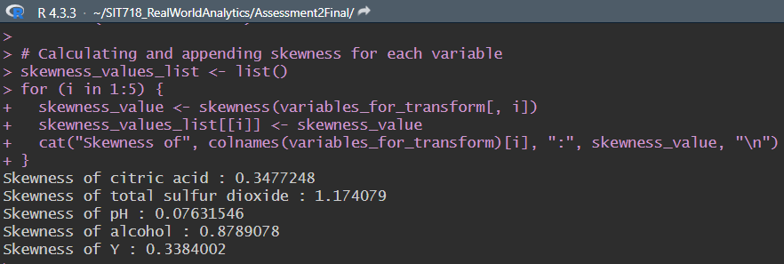
3. Transformation selection:
The test used here for transformation selection is skewness test. This is applied to each columns and the result is displayed in the console. (From ‘e1071’ package)
The skewness values are stored in a variable.

Slide 8
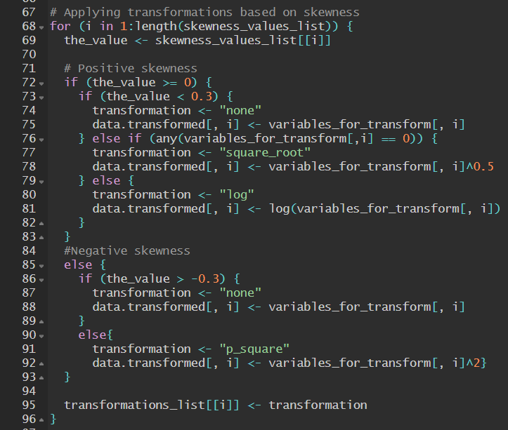
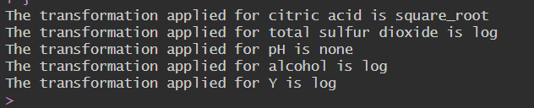
I have coded in a way that,
If the skewness value is less than -0.3, P-square method will be applied.
If the skewness value is between -0.3 to +0.3 then no transformation will be applied.
If the skewness value is greater that 0.3 and if the column has no 0 values, square root transformation is applied else log transformation is applied.
The applied transformations are stored in a variable and displayed on the console.

Slide 9
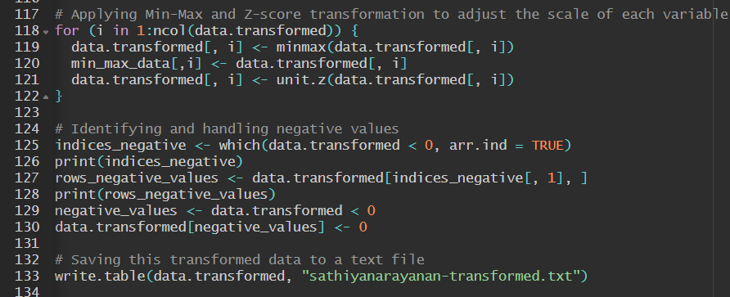
Standardization/ Normalization:
I have used both Min-Max and Z-Score methods to standardize the data. So that it gives reliable result during prediction. I have also handled exceptions(if any) then stored the data to a text file

Slide 10
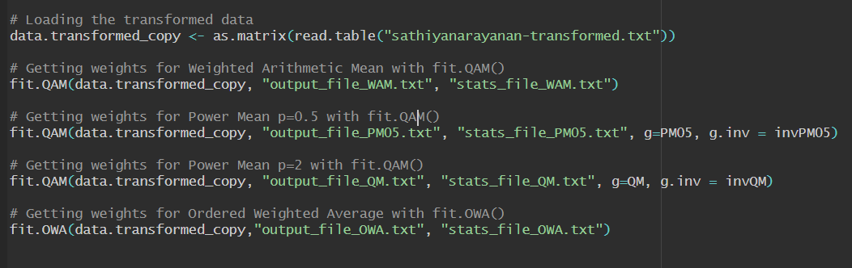
Building Models and investigating
1. Models used in the analysis:
Weighted Arithmetic Mean (WAM)
Weighted Power means (with P=0.5)
Weighted Power means (with P=2)
Ordered Weighted Averaging function (OWA)

Slide 11
Results Comparison:
Method | RSME | Av. abs error | Pearson correlation | Spearman correlation
WAM | 0.142572088136884 | 0.105241075065402 | 0.426953343710159 | 0.416965060991153
PM05 | 0.141645130330746 | 0.105090905314141 | 0.427418766819561 | 0.416478953209706
QPM | 0.143332938734546 | 0.106443460413349 | 0.42078441561194 | 0.418103008092356
OWA | 0.152995122378843 | 0.12092297278576 | 0.188975390564676 | 0.189789928280242
Insights:
Characteristics of a good model,
RSME - Should be the low
Av. abs error - Should be the low
Pearson correlation - Should be close to 1
Spearman correlation - Should be close to 1

Slide 12
Weights Comparison:
Method | Citric acid | Total Sulful dioxide | pH | Alcohol
WAM | 0.204653931802187 | 0.0222789961748349 | 0.0588720047935909 | 0.714195067229387
PM05 | 0.190592200339633 | 0.0342826796284578 | 0.06926264519584 | 0.70586247483607
QPM | 0.258350660099185 | 0 | 0.0597653570237026 | 0.681883982877112
OWA | 0 | 0.543267215759843 | 0.448479759593218 | 0.00825302464693887
Importance of each variable:
In general, Alcohol content plays a major role in determining the quality of the wine (About 70% in average).
Next, the citric acid content determines the quality (About 20%).
Both Sulfur dioxide and pH combined only plays a very minimal role in quality (Less than 10%).

Slide 13
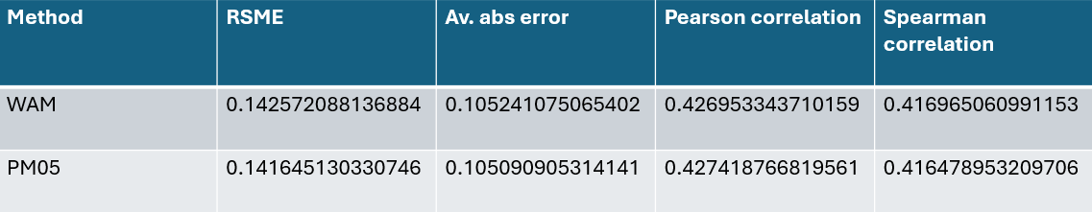
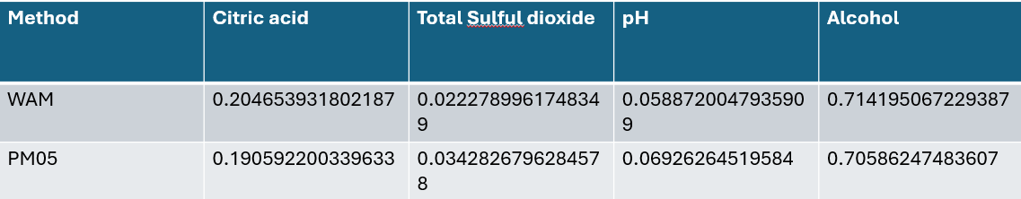
Best Fitting model and chosen model:
Based on the values of Errors, correlations and weights, Weighted Arithmetic mean model and Weighted Power Means models perform very similarly. In that, PM05 has a slight advantage having the least errors and more dispersed weights. So, for this data set (training), PM05 is the best. But, keeping over-fitting in mind, I choose the simplest (more general) model Weighted Arithmetic Mean (WAM).

Slide 14
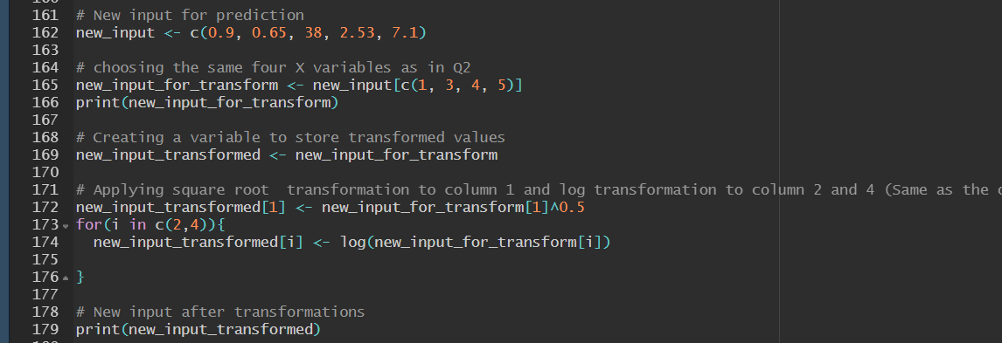
Using WAM for prediction:
Applying the same transformations on the new input:
Citric acid – Square root
Sulfur dioxide – log
pH – none
Alcohol - log

Slide 15

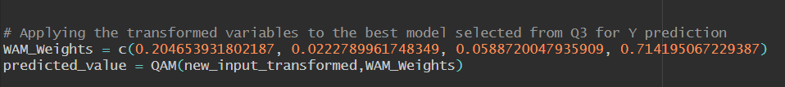
2. Standardizing the new input same as before:
Both Min-Max and Z-Score is applied
3. Applying weights and predicting the value using WAM:

Slide 16
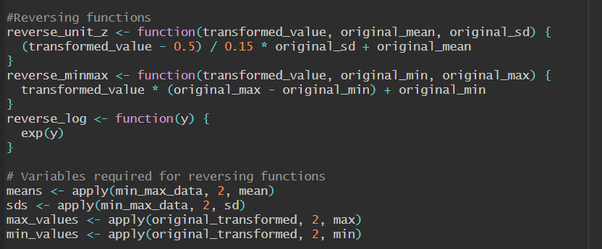
5. Reversing the standardizations and transformations
First, Z-Score is reversed (As it is applied the last)
Next, Min-Max is revered.
Finally, the variable of interest Y is reversed using exp(y)

Slide 17
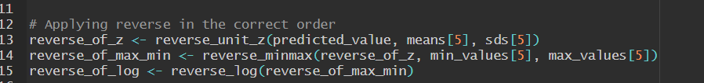
6. Applying the reverse:
Reverse of Z-Score, Min-Max and log are applied in order and the final result is stored in a variable

Slide 18
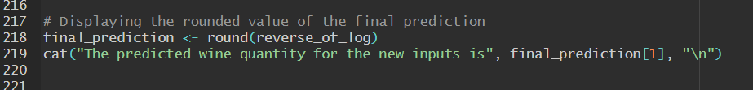
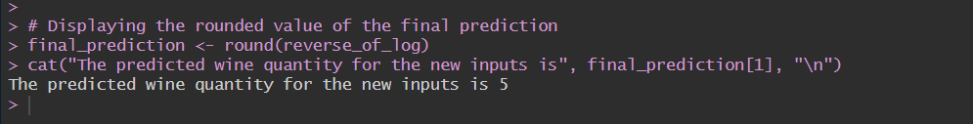
Predicted Result:
The stored result is rounded off to an integer and it is displayed on the screen.
The quality of wine predicted for the new input is 5.

Slide 19
My overall Insights:
The quality of wine predicted by my model is 5 and I believe it is reasonable because the weights of Alcohol and Citric acid plays major role in wine quality according to the analysis discussed earlier.
So, comparing the scatterplots of citric acid and alcohol, the predicted value agrees with the overall distribution.
New input, (citric acid, total sulful dioxide, pH, Alcohol) = (0.9, 38, 2.53, 7.1)

Slide 20
Best condition for higher quality wine:
I believe, that we would get a higher wine quality by increasing Alcohol and citric acid content (As they determine the quality about 90 % according to my analysis).
Implications:
Flexibility in Aggregation
Simple Interpretation
Robustness to Outliers
Limitations:
Sensitivity to Weight Choice
Assumption of Linearity

Slide 21
Presentation link
https://youtu.be/Dkj9l0OlYvM

Slide 22
Thank You!

