Slide 1
IT COMPANY DATA ANALYSIS
Comprehensive Employee & Salary
Dashboard Analysis using Power BI

Slide 2
Introduction
This project focuses on analyzing IT company employee data using Power BI. It aims to visualize and interpret employee demographics, salary distribution, departmental performance, and company-wide trends using dynamic dashboards.

Slide 3
What is Power BI ?
Power BI is a powerful business analytics tool developed by Microsoft. It enables users to visualize data, share insights, and make data-driven decisions. With Power BI, organizations can connect to multiple data sources, transform raw data into meaningful insights, and build interactive dashboards for strategic decision-making.

Slide 4
Dataset Overview
The dataset contains 5500 employee records and 15 columns.
Key columns include: - Employee_ID - Name - Department - Role - Monthly_Salary - Projects_Completed - Gender - Education_Level - Location - Years_of_Experience

Slide 5
Dashboard Visual Components
The Power BI dashboard contains multiple interactive visuals including:
Pie Chart – Employee distribution by Role.
Bar Chart – Projects Completed by Location.
Clustered Bar – Years of Experience by Gender.
Line Chart – Gender count by Joining Month.
Heat Map – Average Age by Company.
Stacked Bar – Department and Education-level-wise Salary.

Slide 6
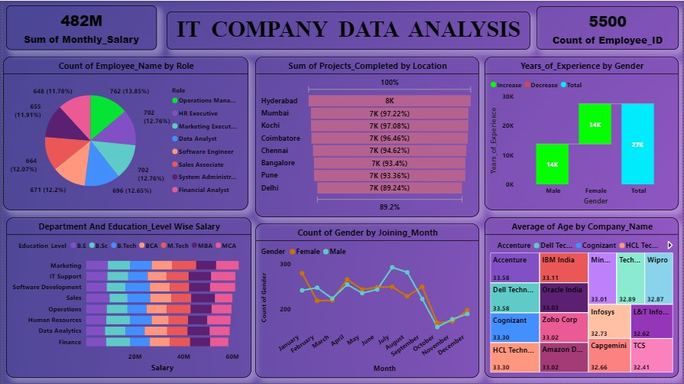
Power BI Dashboard

Slide 7
Key Insights
Key Insights from Dashboard: - Total Employees: 5,500 - Total Salary Distributed: 482M - Highest project completion in Hyderabad - Balanced gender distribution - Most employees aged between 30-35 - Average salary varies by department and education level.

Slide 8
Conclusion
The IT Company Data Analysis Power BI Dashboard provides a holistic view of employee distribution, salaries, and performance. It helps management make informed decisions regarding hiring, salary planning, and project allocation.

