Slide 1
NASA International Space Apps Challenge
Project Title
Novel mechanism for precise docking and In-space assembly using track based solution
Challenge Team Name
Let’s Connect XPLR-4
Team Members
Atmakuri V B S Sathkeerth I.V.S Prathyush
Hari Krishna Bandi Satya Ganesh Sannidhi

Slide 2
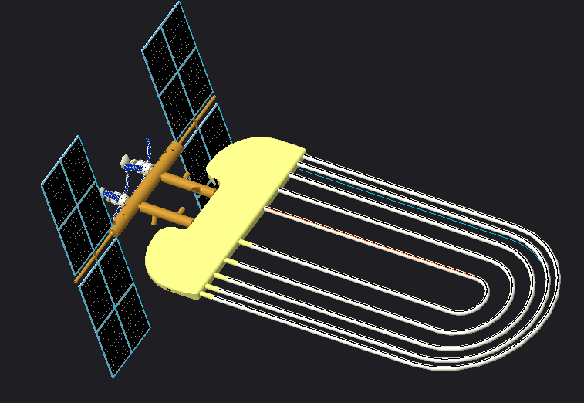
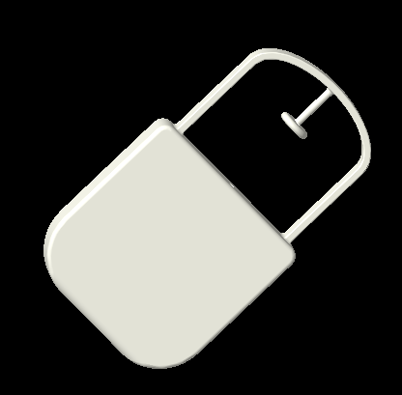
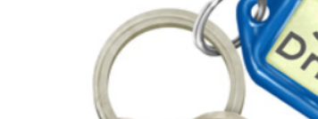
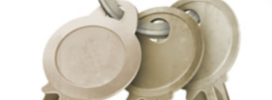
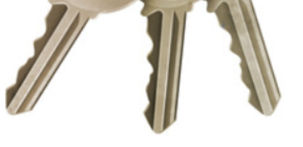
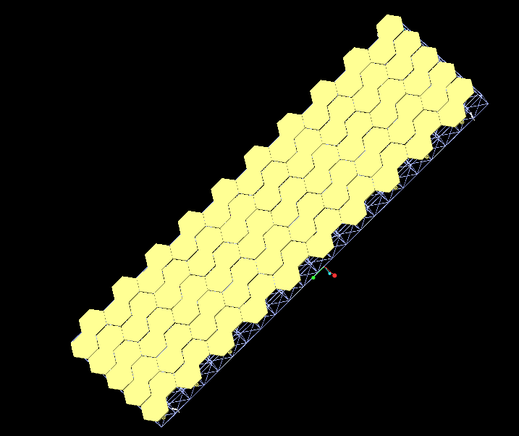
In-Space Assembly
Our inspiration for in-space assembly is a keychain.
space _station
You can hold any part on this space station and assemble
connector
main_part
Every part in inspace assembly should be initially assembled with connector(on earth)
A part of telescope
Telescope lens (gold color) are assembled on truss(on earth).

Slide 3
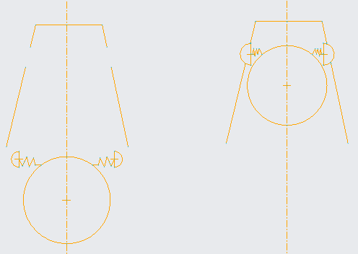
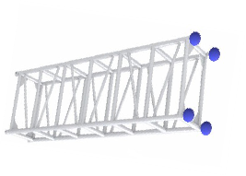
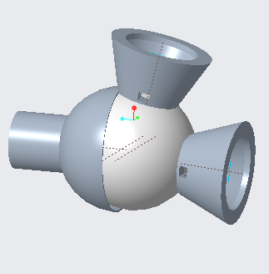
In Space Assembly - Mechanism for Connecting and Locking
This part shows the locking mechanism. The female part is represented using the projection of a frustrum (modified spherical joint) and the circle is the male part of the connection (a sphere with hemispherical structures joined via springs). As the male part moves further up the female part, the hemispherical structures get compressed further and once the these structures reach the cavities present in the female part the springs expand along with the hemispheres hence filling up the cavity which results in the male getting locked.
The ends of the truss marked as blue spheres consists of a modified spherical joint mechanism. The cup / frustrum like projections help in the precise connection once an approximate positioning of the other trusses or parts that are going to be assembled to this, has been achieved. Also, the motor gives the advantage of making connections at desired angles.

Slide 4
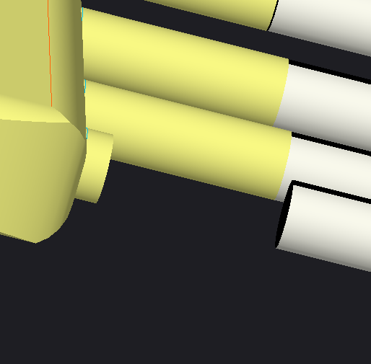
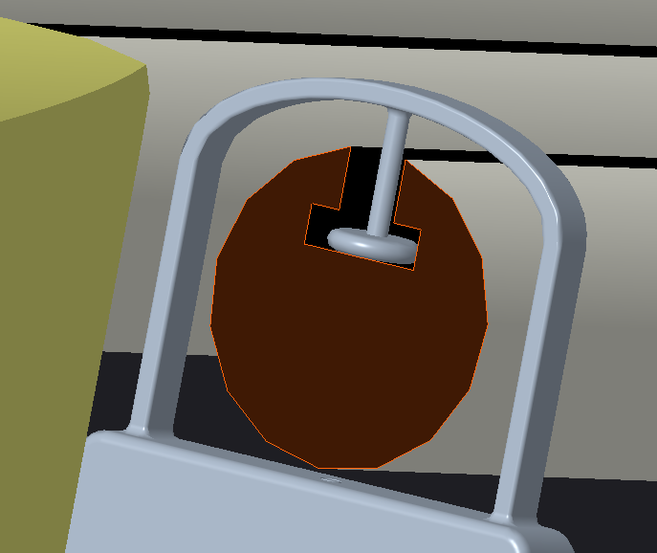
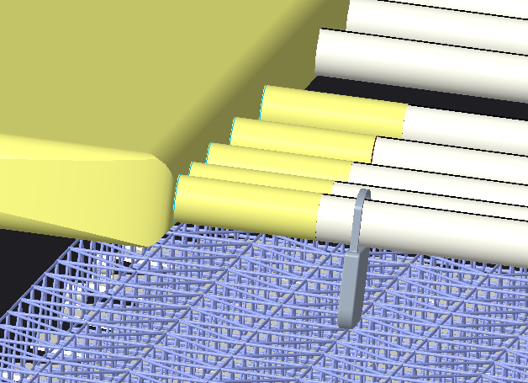
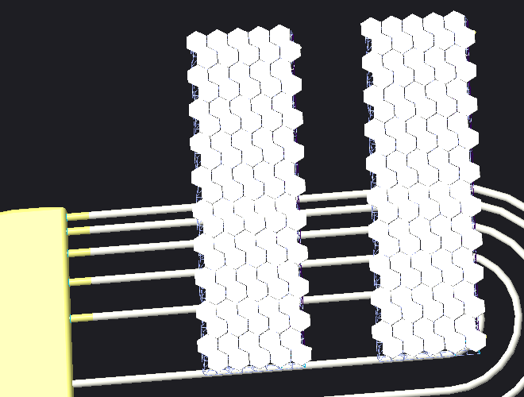
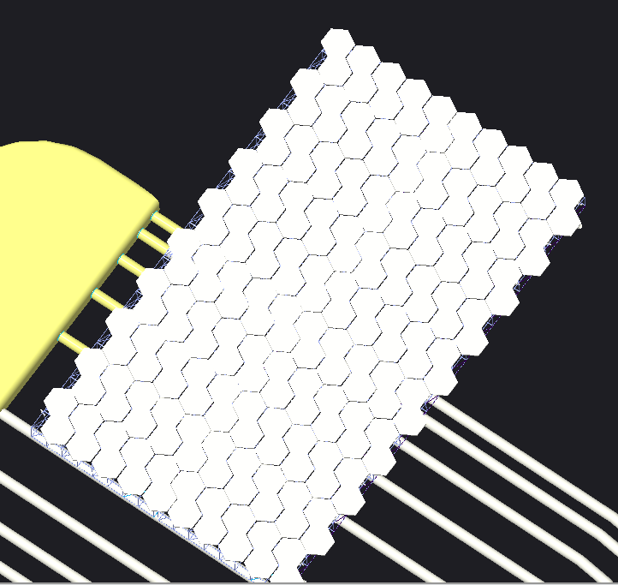
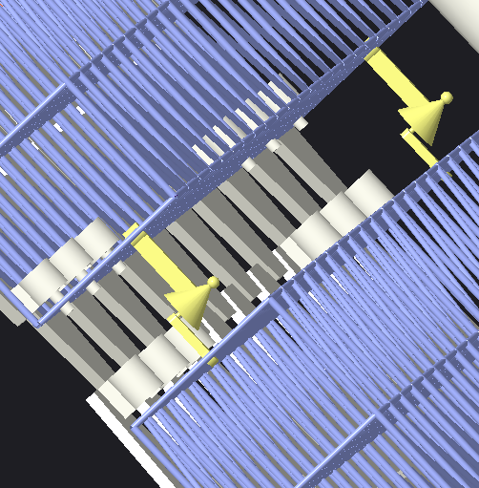
Rough alignment
Repeating the same task with another part to roughly align both parts.
Opening of a track on space station when a part reaches it.
Aligning the part to the track using a robotic arm.
Closing of track once the part aligned with it.
Perfect alignment
After folding the connections and connecting using ref.7 method
Perfectly aligned using ref.1 method
After connecting two telescope parts

Slide 5
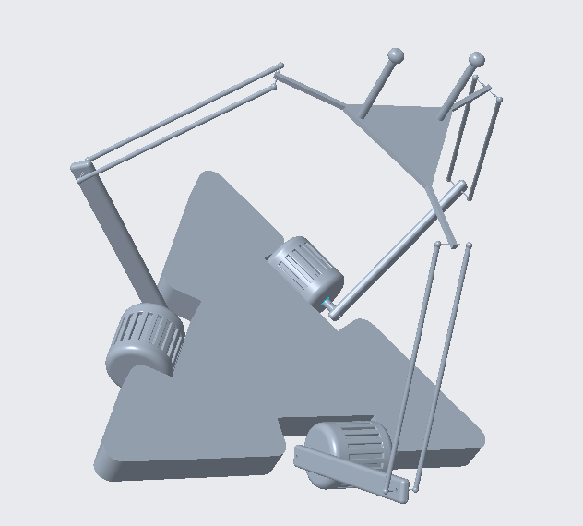
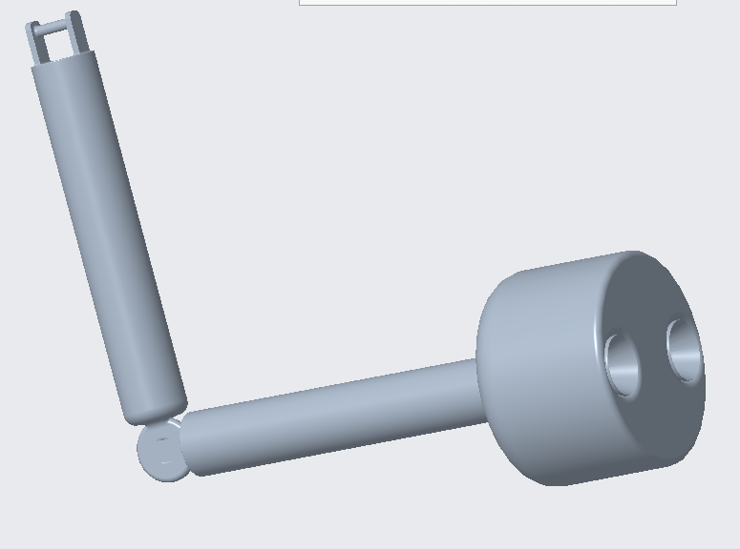
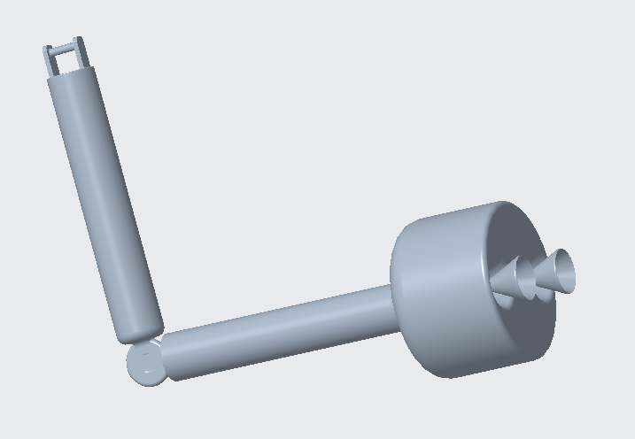
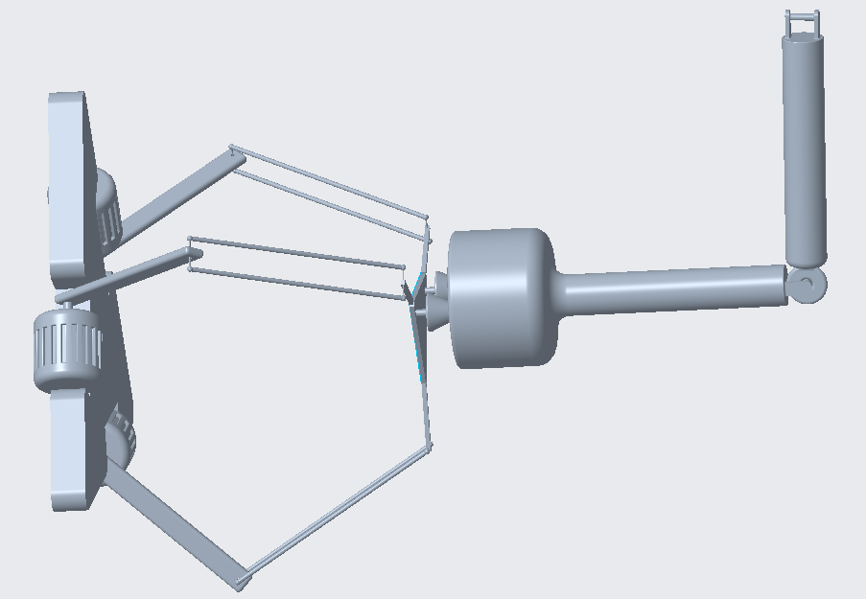
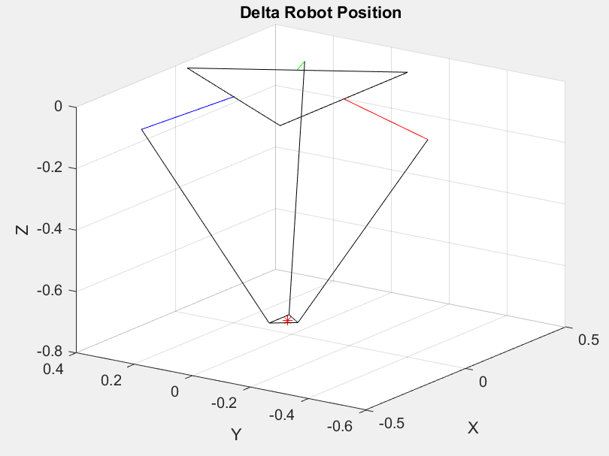
Novel mechanism for Docking
(1)
(2)
(3)
Design of modified delta robot
Design of robotic arm when Cone structures are rested
Design of robotic arm when cone structures are popped up
Design of the docking of these two above structures
(4)

Slide 6
The above plot depicts the simulation of Delta robot in MATLAB.
In the design of our mechanism, the AprilTags have been incorporated for the localisation of manipulators.
Manipulators are optimised with Complementary Metal-Oxide Semiconductor (CMOS) image sensors do detect the AprilTag and align accordingly. Also the orientation of the docking objects can be tracked simultaneously by entailing Accelerometer, Gyroscope and Magnetometer.
The degree of freedom has been split into half 3 each for passive and active modules of docking system.
As mentioned above the docking is facilitated by the track based system with key mechanism, which makes this system more efficient.
All the respective design files and code files are shared on the project page.

Slide 7
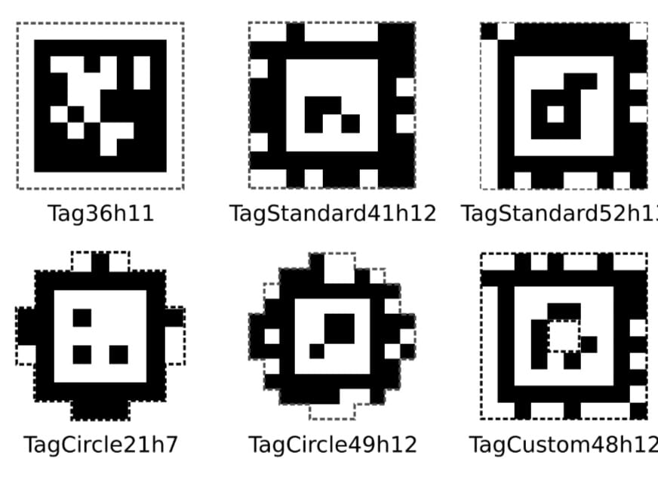
April Tags
A Robust and Flexible(artificial) visual fiducial system by Edwin Olson et.al.
This is new artificial visual system which uses 2D barcode style “tags”, allowing full 6 DOF localization of features from single image.
We design some customized April Tags by using GitHub repo provided by University of Michigan.
On right u can see some pregenerated tag families.
Using this april tags technique we will control movement for alignment of manipulators used in our design.

