Slide 1
OPTIMIZING THE MARKER EFFICIENCY
GROUP 01
01

Slide 2
Group Members
S/17/802 – G D M P Amarasooriya
S/18/803 – A T R Akalanka
S/18/805 – B D Colombage
S/18/806 – C Danusiyan
S/18/807 – P M R S Fernando
S/18/808 – P R N Fernando
S/18/809 – G Sathushana
S/18/811 – M A E Hasheli
02

Slide 3
Outline of the presentation
01.
02.
03.
04.
05.
07.
Introduction
Problem Statement
Our Approach
06.
Final Model
Model Evaluation
Conclusion
Time Frame
03

Slide 4
01
Introduction
04

Slide 5
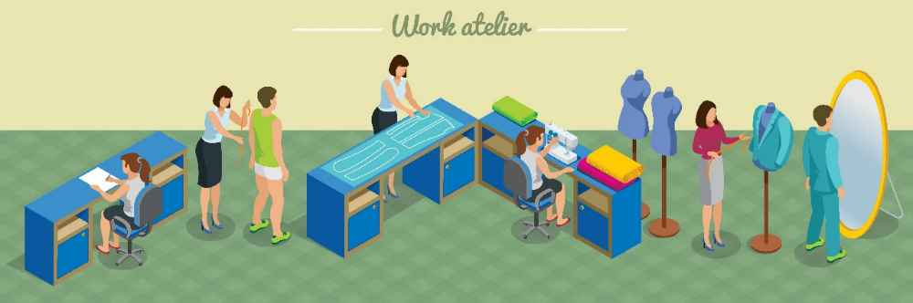
Brandix (Pvt) Ltd
A leading apparel manufacturing firm in Sri Lanka.
Main products : Casualwear , Intimate wear , Sleep and loungewear , Active wear
Main customers : Victoria’s Secret , Calvin Klein , Mark’s & Spencer
Subsidiaries : Moose clothing company
05

Slide 6
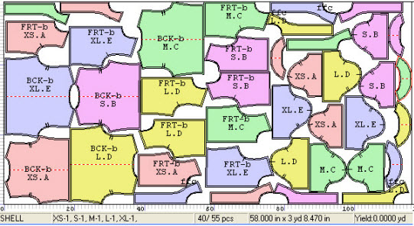
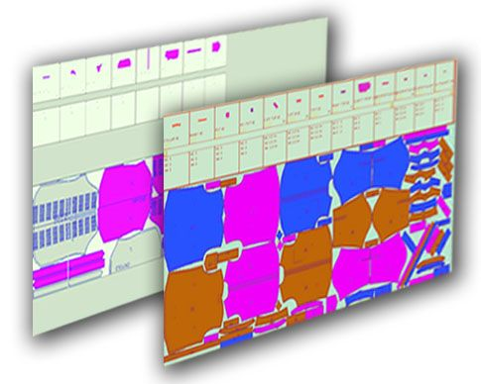
What is a Marker
Picture of organized arrangement of all pattern pieces for a particular style & sizes
Considering single spread of fabric layer
Fabric wastage should be minimized
06

Slide 7
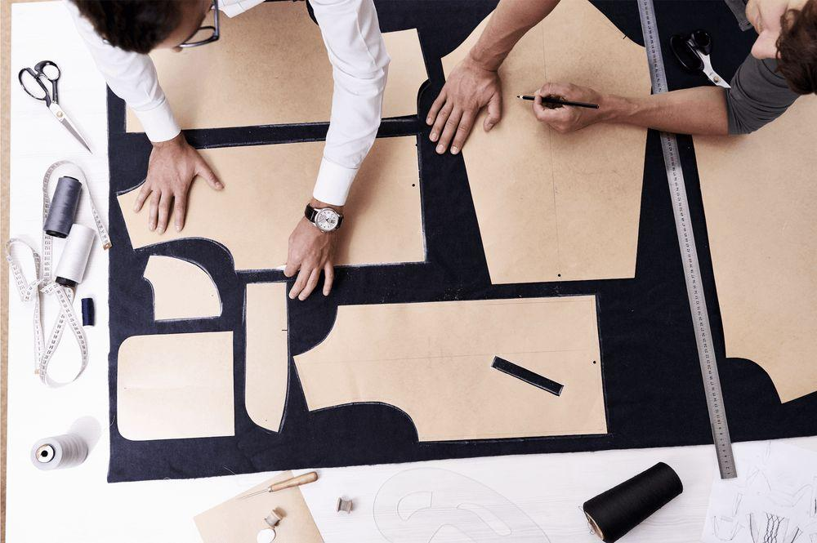
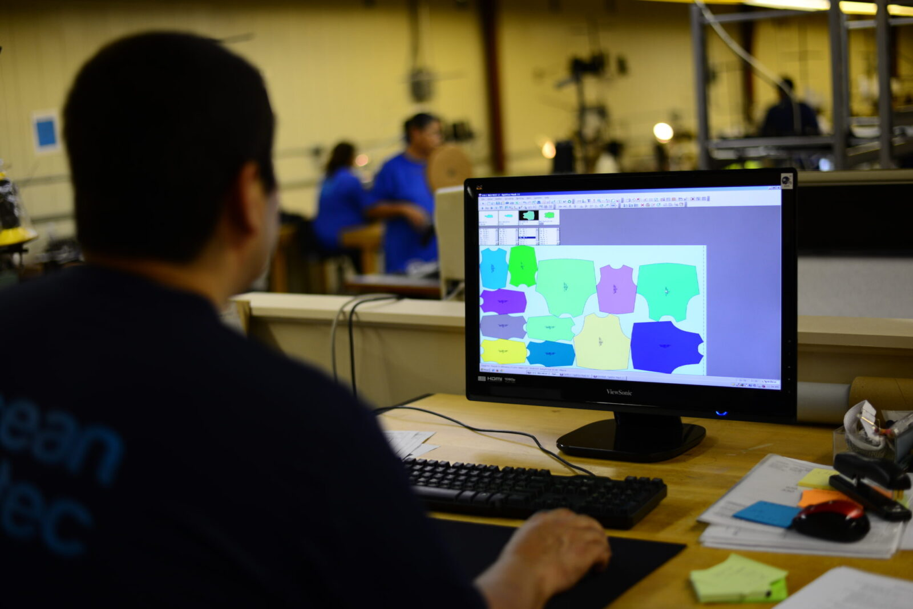
Marker Making
Determine the most efficient layout of pattern pieces
Style
Fabric
Distribution of sizes
Objective : Maximize the utilization of fabrics
Production cost - Fabric wastage
07

Slide 8
Main Steps of Marker Making
Design the garment and draw the pattern card
Do the fabric inspection
Decide the size ratio for a marker and number of markers
Make the marker / markers
08

Slide 9
Marker Efficiency
Marker efficiency = Area of all patterns on the marker X 100%
Area of marker
YY = Area of all patterns on the marker
Number of garments
Marker efficiency depends on ;
Marker planner
Size of garments
Style of garments
Marker length and width
Fabric characteristics
Marker making methods
09

Slide 10
02
Problem Statement
10

Slide 11
Problem
Expected Solution
Current fabric utilization is around 80%
Not efficient enough
Higher fabric costs
Optimize lay planning , Number of Markers , Marker length
Improve Marker shapes
Optimize YY
11

Slide 12
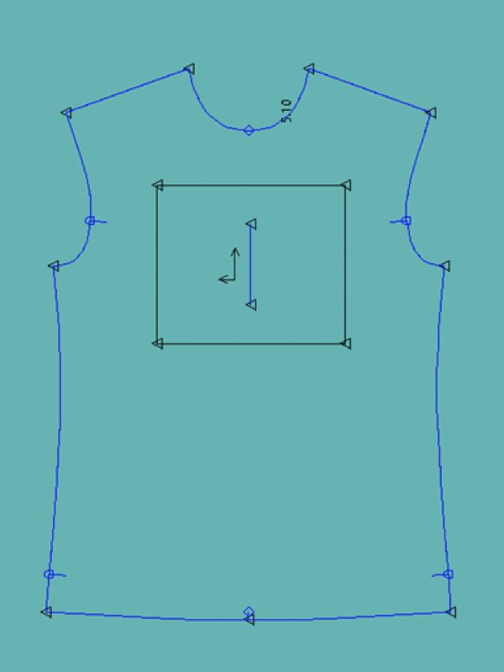
Dimentions to Improve Marker Efficiency
Find the optimal combination of size ratios
Smooth the sharp edges of pattern shapes
12

Slide 13
03
Our Approach
13

Slide 14
Effect of the ratio on marker efficiency
Evaluate the efficiency of manual markers and computerized markers
For various size ratios
Same pattern
Constant width (Assumption)
14

Slide 15
Visual representation (Example)
Size ratio (S : M : L) | Marker Area (square inches) | Pattern Area (square inches) | Marker Efficiency(%)
1 : 1: 1 | 1875.32 | 1575.39 | 84
2 : 1: 1 | 2422.469 | 2013.07 | 83.09
1 : 2: 1 | 2487.78 | 2089.74 | 84
1 : 2: 2 | 3196.54 | 2704.1925 | 84.60
2 : 2: 1 | 3096.075 | 2528.92 | 81.68
2 : 1: 2 | 3124.088 | 2627.658 | 84.10
15

Slide 16
16

Slide 17
04
Final Model
17

Slide 18
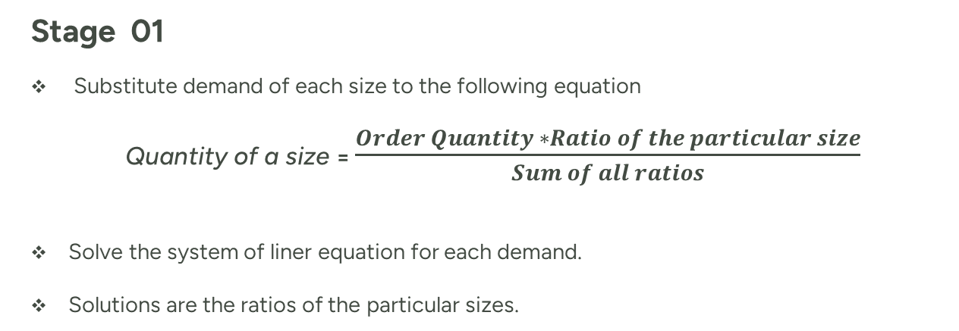
Main Steps to solve the model
Stage 01
Substitute demand of each size to the following equation
Quantity of a size = $\frac{Order Quantity ∗Ratio of the particular size}{Sum of all ratios}$
Solve the system of liner equation for each demand.
Solutions are the ratios of the particular sizes.
18

Slide 19
Stage 02
Mathematical model
Minimum Z = Number of Layers
Constraints
1. Number of Layers * Ratio >= Total demand
2. Number of Layers >= 0
3. Number of Layers should be an integer
19

Slide 20
05
Model Evaluation
20

Slide 21

System of Linear Equations :
For XS
Quantity of the size = 12
Order Quantity (Demand) = 240
Ratio of the size = x
Equation :
$12=\frac{240 ∗x}{x+y+z+u+v+w}$
228*x – 12*y – 12*z -12*w – 12*v – 12*u = 0
Size (variable) | XS (x) | S (y) | M (z) | L (u) | XL (v) | XXL (w)
Demand | 12 | 36 | 72 | 72 | 36 | 12
21

Slide 22
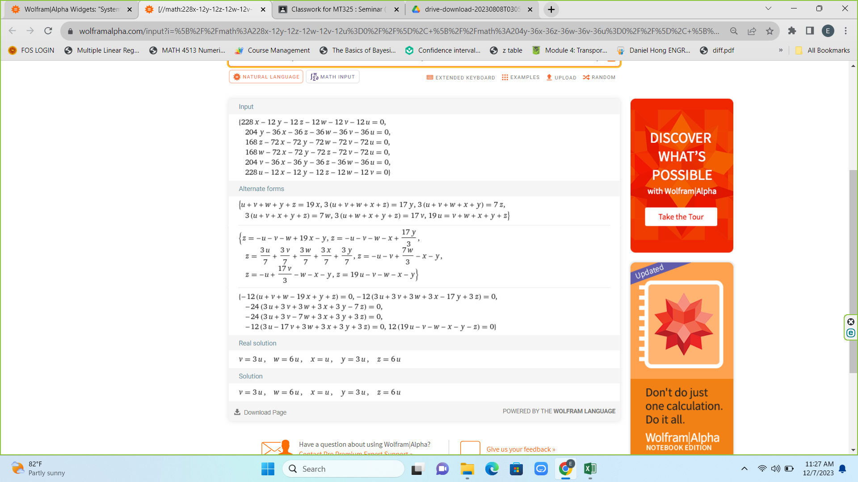
22

Slide 23
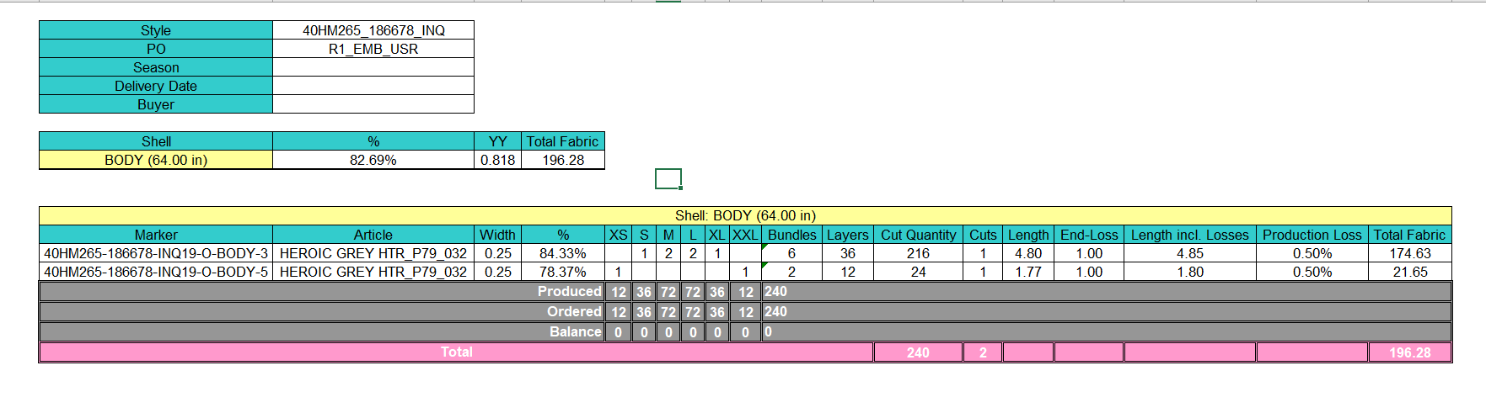
Design 1
23

Slide 24
24

Slide 25
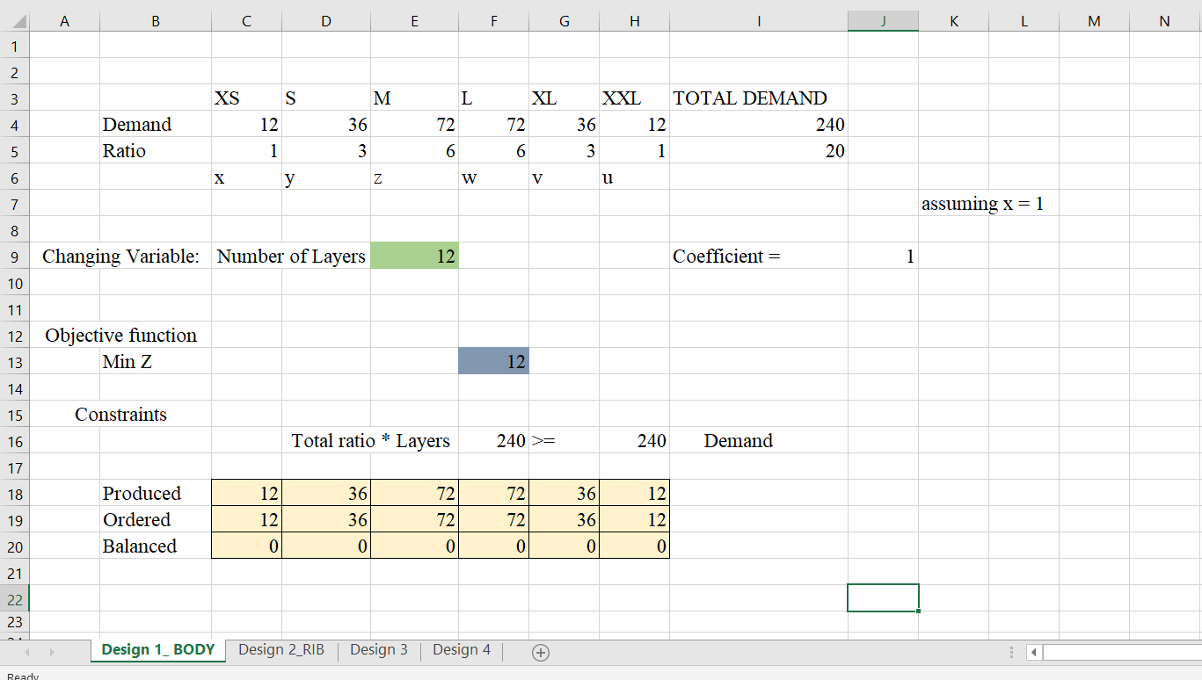
25

Slide 26
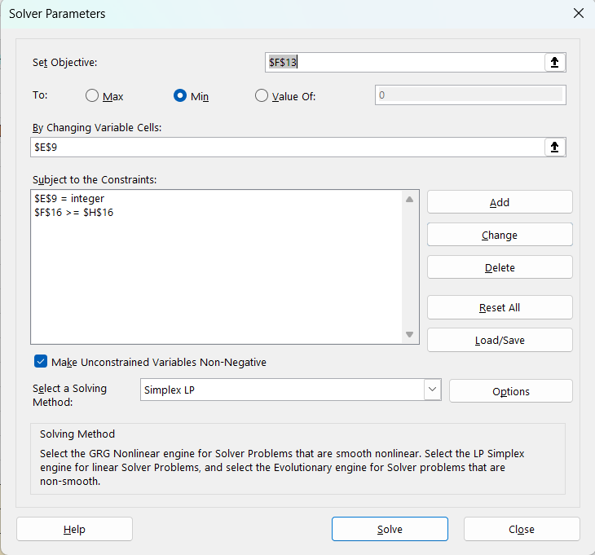
26

Slide 27
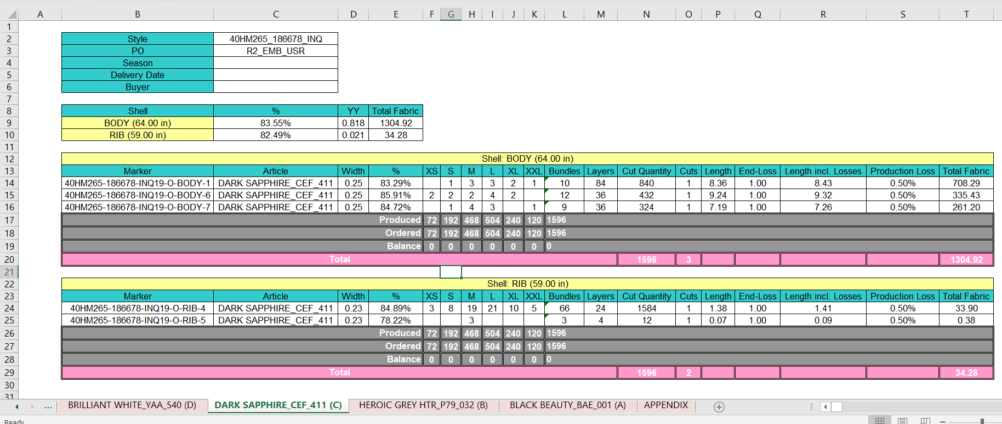
Design 2
27

Slide 28
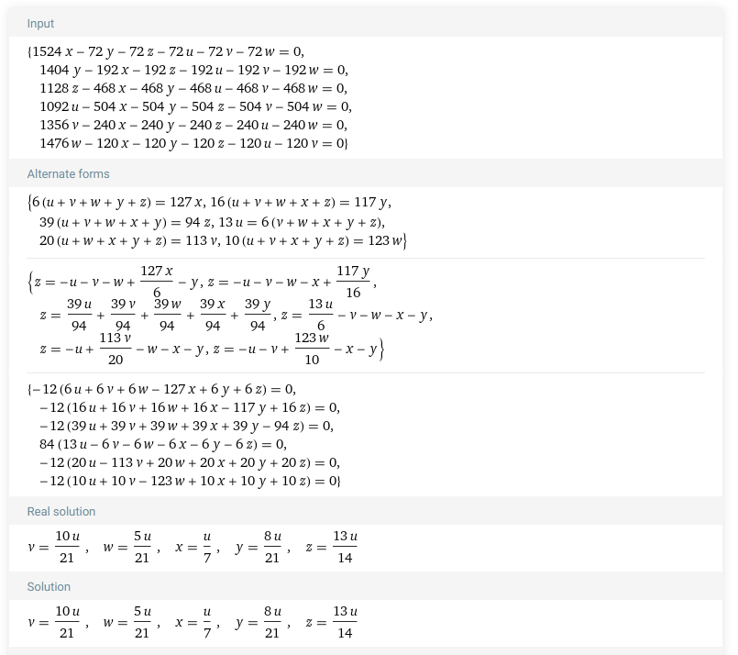
28

Slide 29
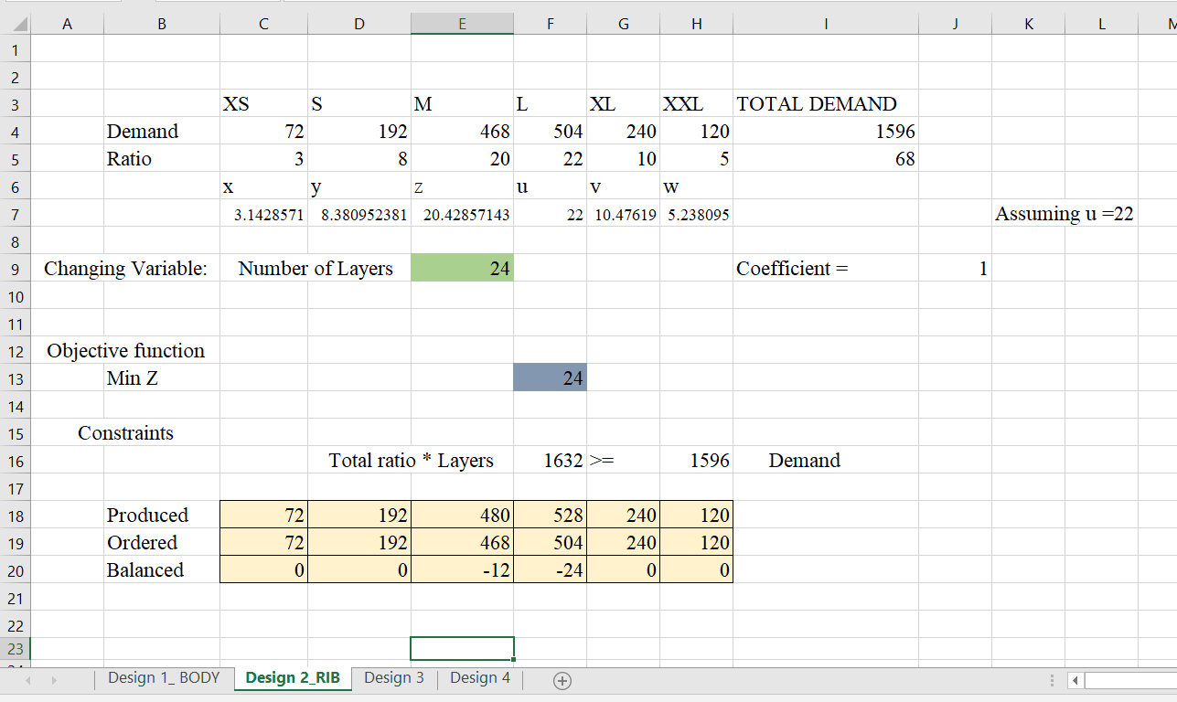
30

Slide 30
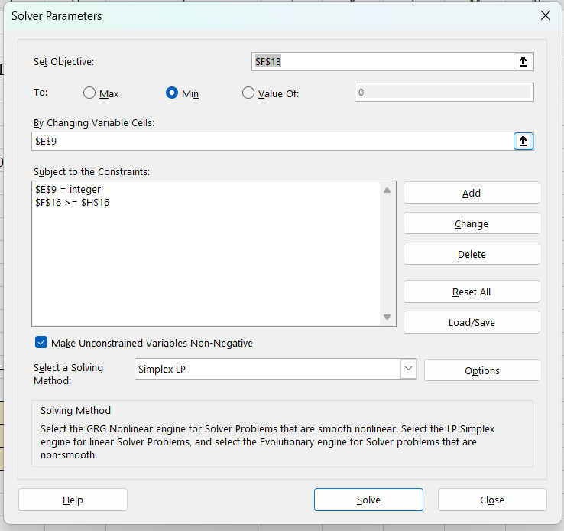
29

Slide 31
Assumption and Limitation
Assumption
No overlapping of garment pattern pieces.
When solving the system of linear equations, the variable which others depend on is greater than or equal 1.
y = 5u / 3 ; u ≥ 1
Limitation:
We should apply set of values to variable u and find the best value which satisfies the demand in best way.
We should find a better way to solve the system of linear equations.
Model is to be generalized.
26
31

Slide 32
06
Conclusion
32

Slide 33
Main objective : Minimize the total fabric wastage.
Less fabric consumption means low fabric wastage.
Satisfy the demand using minimum number of fabric layers.
Ratio and the number of layers are correlated with each other.
By the developed mode we can get a near optimal solution.
33

Slide 34
07
Time Frame
34

Slide 35
Activity | May |  |  |  | June |  |  |  | July |  |  |  | August |  |  |  | September |  |  |  | October |  |  |  | November |  |  |  | December
 | 1 | 2 | 3 | 4 | 1 | 2 | 3 | 4 | 1 | 2 | 3 | 4 | 1 | 2 | 3 | 4 | 1 | 2 | 3 | 4 | 1 | 2 | 3 | 4 | 1 | 2 | 3 | 4 | 1 | 2 | 3
Project Initiation
Field visit
Analyse case studies
Selcting case study
Current system analysis
Design & development of the proposed model
Mid review presentation
Full development & pilot study of the model
Performance evaluation
Project review
Final reporting & handover
35

Slide 36
References
External Supervisor : Mr. Dinesh Gunathilake – Brandix Fast Fashion Walisara
https://ejaet.com/PDF/4-10/EJAET-4-10-765-772.pdf
https://textilelearner.net/techniques-or-methods-of-marker-making/
https://hoshima-int.com/what-is-cutting-room-in-apparel-industry.html
https://www.textileschool.com/193/garment-production-process/#:~:text=Apparel%20manufacturing%20process%20involves%20Product,Dyeing%20and%20Washing%2C%20QC%20etc.
How to Calculate Size Wise Cut Quantity from the Size Ratio in an Order? (onlineclothingstudy.com)
FinalModel.xlsx, RatioCalculation.xlsx
https://www.wolframalpha.com/examples/mathematics/algebra
36

Slide 37
THANK YOU !
37

